Slide 1
Online Newspaper CMS
Date: 27/12/2012

Slide 2
Contents
Introduction
Project Management
Requirement Specifications
Design Description
Test Documentation
Summary
Demo and Q&A

Slide 3
Introduction
The People
Background
Literature Review
Our Proposal
Products

Slide 4
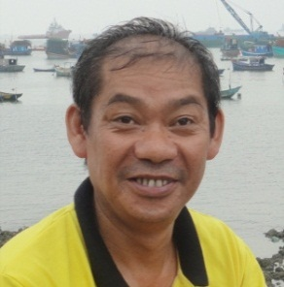
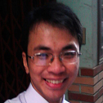
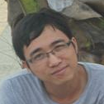
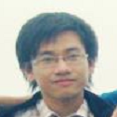
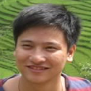
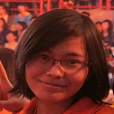
People
Dungha
Supervisor
thangpa
Project Manager
dinhpc
Technical Leader
kienn
Architecture designer
chaunm
GUI designer
quynhnt
Quality assurance and tester

Slide 5
Background
2
300 Hundreds of website with more than 30 millions readers
3
Many of newspaper offices system are old fashioned and not meet the current needs
4
The need of expansion and upgrading system.
1
The boom of Vietnamese online newspaper
Reference: http://www.caobang.gov.vn

Slide 6
Literature Review
Site | Characteristics:
 | - Simple Interface - Only in English - Recommend using with IE
 | - Confusing Interface - User’s privilege is not clear - Some services is not automatic
 | - Limited Features
6

Slide 7
Our Proposals
Specialized for Vietnamese user
User friendly
Full-featured business
Run on many browsers.

Slide 8
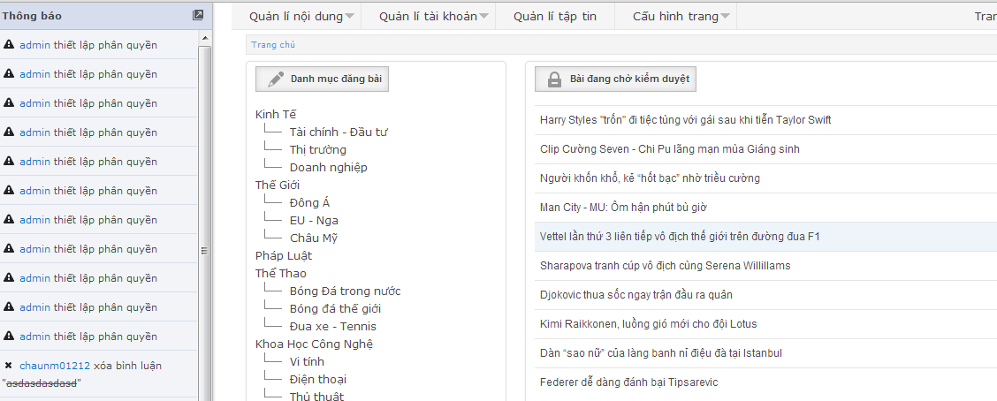
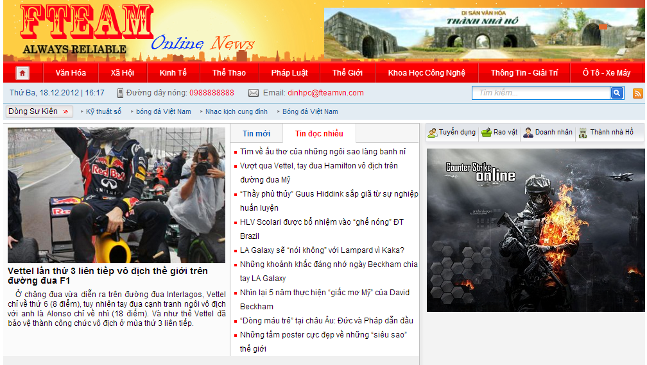
Products
Font-end
Back-end

Slide 9
Software Project Management
Software process model
Project plan
Master Plan
Tools and Techniques
Risks Management
Develop environment
Working time and workplace

Slide 10
Software process model
Waterfall Model

Slide 11
Project Plan
Initiating 8 days since 20/8
Planning 20 days since 29/8
Implement and Development 58 days since 17/9
Testing 35 days since 29/10

Slide 12
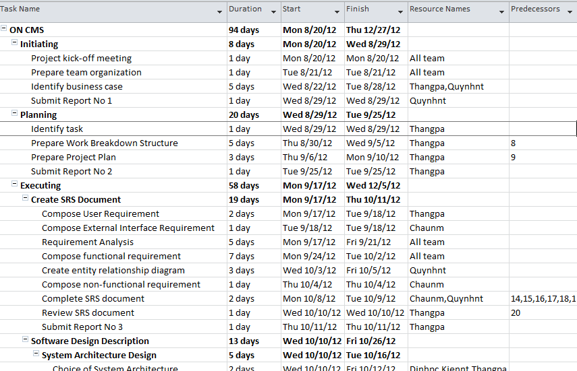
Master Plan

Slide 13
Working time and Workplace
Working time: 6 hours/day
6 days /week
Work place: 2 month work together in an office, 2 month work at home and organize meeting twice a week

Slide 14
Develop environment
Private computer: Windows 7 core 2GHz Ram 2Gb
Linux server:
Processor : Intel® Xeon® Processor E3-1220v2 (Quad-Core 3.1GHz)
Cache : 8MB L3 Cache
Memory : 4GB (1x4GB) ECC DDR3 LP
Hard Drive : Option 4 x 3.5\" Simple Swap SATA
RAID Controller : SR C100
Network Interface : Integrated Dual Gigabit Ethernet

Slide 15
Tools and Techniques
PHP 5.2.6
2.10.3
Zend 1.11.12

Slide 16
Risks Management
People
Hardware
Software
Sick, emergency stuff
Conflict between members
Host not ensure availability
Demand expensive equipment
Virus
Workplace
Experience in management
Crash

Slide 17
Risks Management
Name | Solution
Sick, emergency stuff | Working over time in holiday or weekend.
Conflict between members | Set up meeting so that develop team can discuss and give the final decision.
Lack of experience in management | Take advices from expert and supervisor.
Not have common Workplace | Use online office or online meeting software
Host not ensure availability | Using back-up host
Demand expensive equipment | Using virtual System
Virus | Set-up antivirus software before initiating
Crash | Remove unnecessary software might cause conflict

Slide 18
Success Criteria
Time Management
Human Management
Master of technics
Meet all requirement

Slide 19
Specification Requirements
Business Model
Function Requirement
Non-Function Requirement

Slide 20
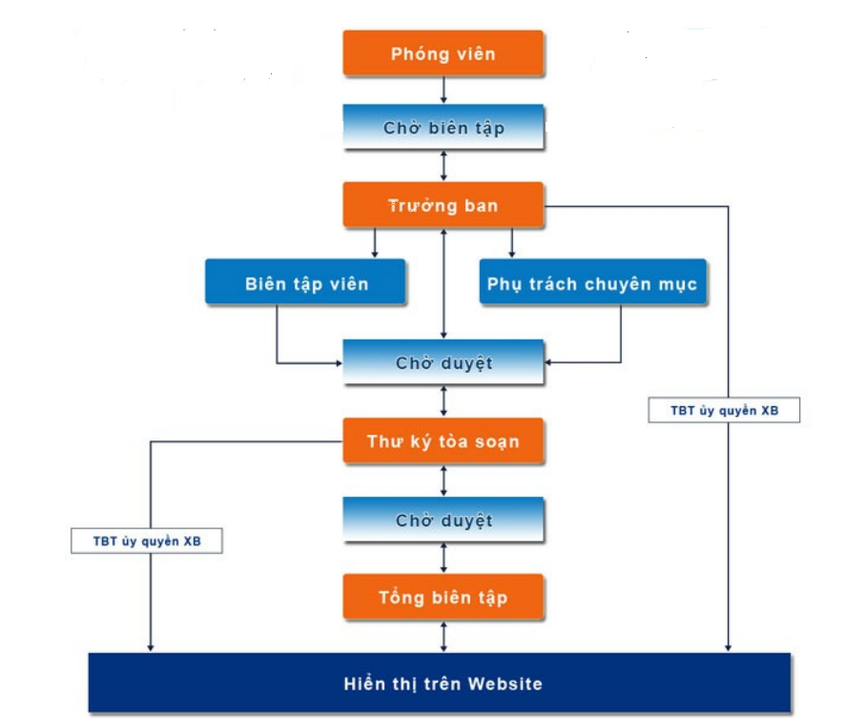
Business Model

Slide 21
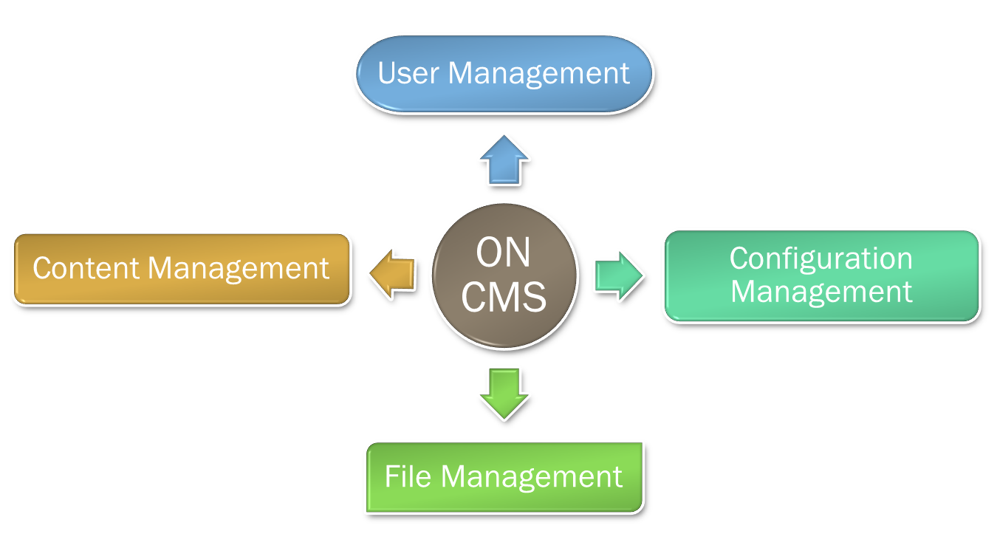
Main Functions

Slide 22
Function Requirement
No | Type of user
1 | Reporter | Create, edit, delete an article Search Comment Royalty View File management Private message
2 | Editor | Organize, Publishing article Article Statistic View Category Management Event Management
3 | Chief Editor/Admin | Menu Management Block Management Advertising Maintenance Mode Setting and Configuration

Slide 23
Non-function Requirement
Usability
Availability
Reliability
Security
Performance
Maintainability

Slide 24
Design Description
Component Diagram
Database
UML Class Diagram
Multi-Server

Slide 25
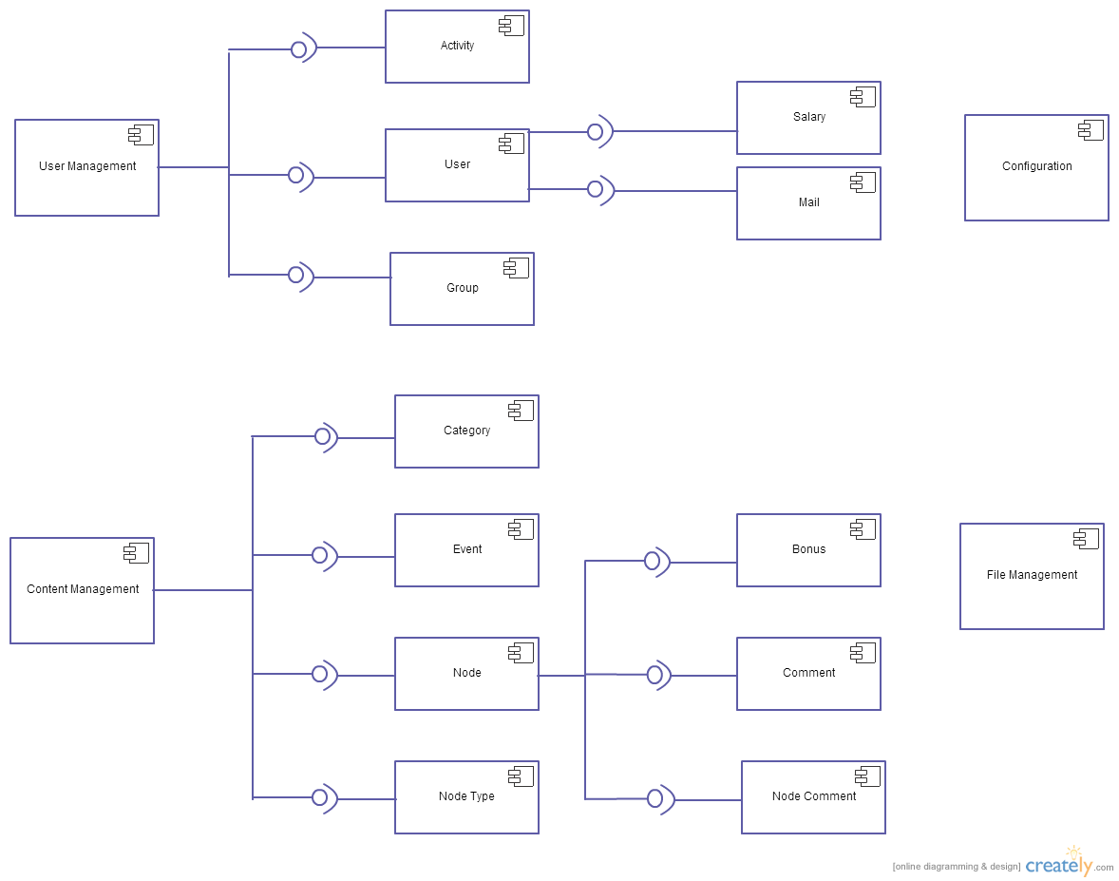
Component diagram

Slide 26
Software Model
Zend MVC

Slide 27
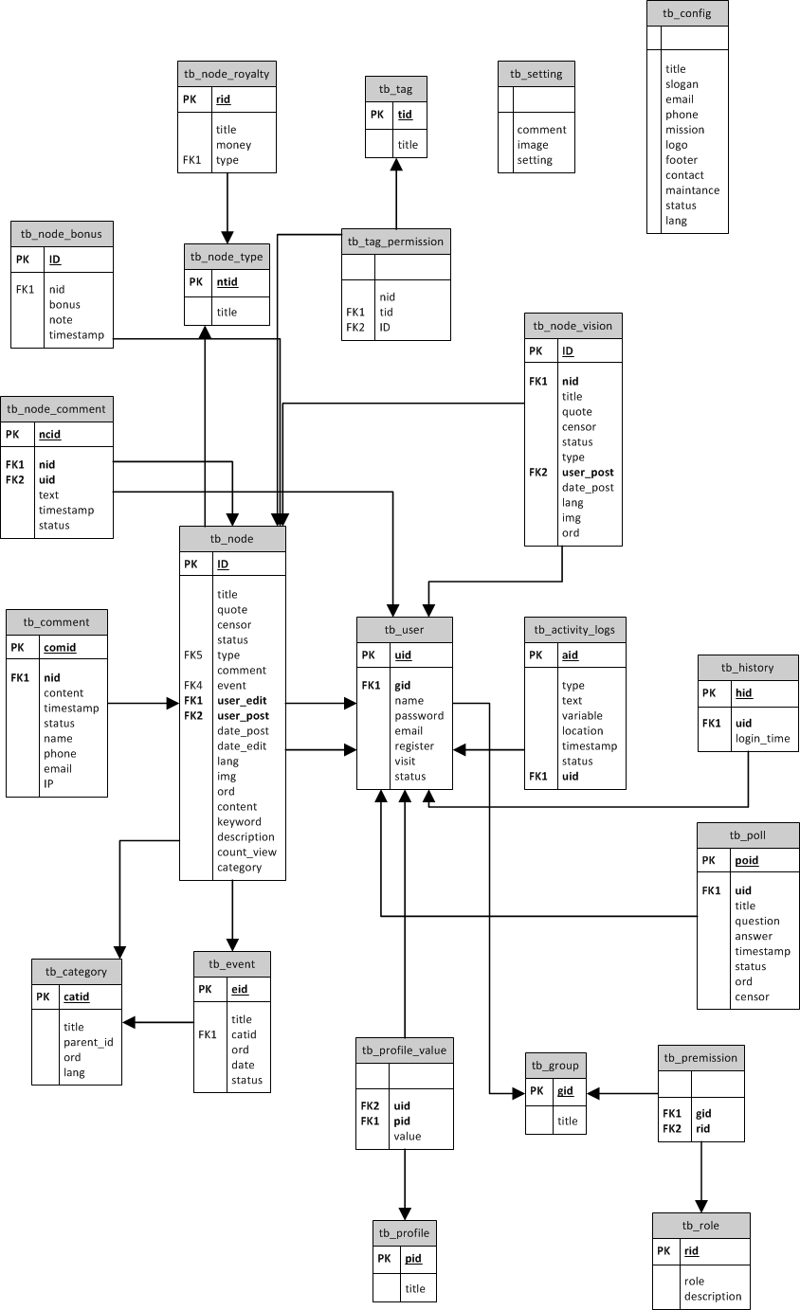
Database Design

Slide 28
UML Content Class Diagram

Slide 29
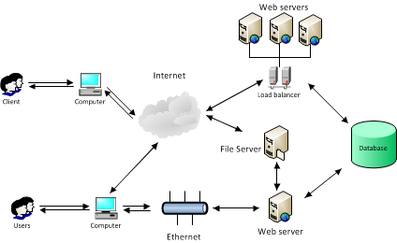
Multi-Server

Slide 30
Test document
Test Model
Bug list
Result

Slide 31
Model

Slide 32
Bug list
32

Slide 33
Test Result
Failed
0
Not Tested
0
Passed
312
Tested
312 cases

Slide 34
Result
• Successful Back-end Features
- User Management
- Content Management
- Files Management
- Configuration Management
• Successful Front-end Features
- User Interface works good with almost screen resolution

Slide 35
Lesson Learned
Project Management Skill
Software Requirement
Teamwork Skill
New technology (multi-server)

Slide 36
Summary
Capstone Project: completed
Product:
Back-end http://fteam.hhs.vn/oncms
Font-end http://home.hhs.vn
Future:
More features.
Mobile app.
More optimality.

Slide 37
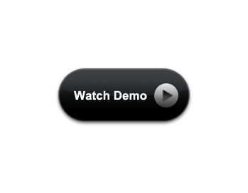
Product

Slide 39
The End
Thank You For Listening

