Slide 1

Product Counting System on Conveyor Belt
Capstone Project – PCSCB Team

Slide 2
Contents
Introduction
Requirements
Design
Identification
Test
Conclusion
Demo
Q&A

Slide 3
1. Introduction
Idea
Scope
Project Management Plan
Member’s role
Communication
Resource Needed

Slide 4
1.1 Idea
Low cost
Easy to use
Easy to deploy
High accuracy

Slide 5
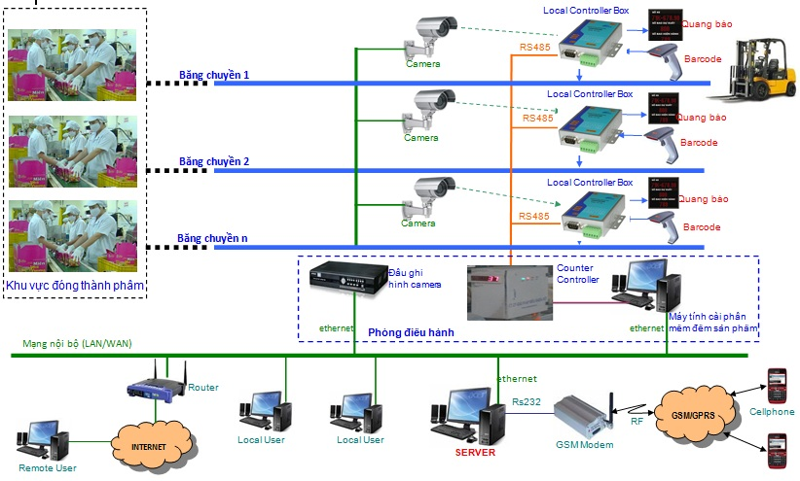
Camera + Barcode

Slide 6
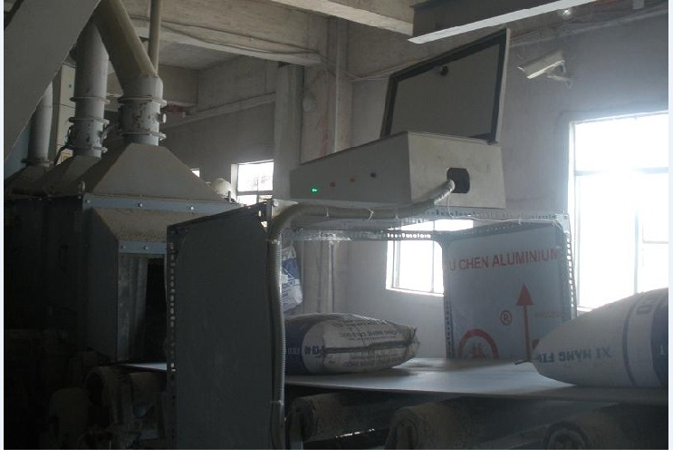
Ultrasonic sensor + Camera

Slide 7
1.2 Scope
Use ultrasonic sensor
Apply Neural Network (NN) as main approach

Slide 8
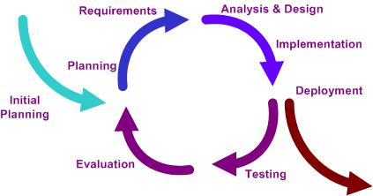
1.3 Project Management Plan
Iterative model

Slide 9
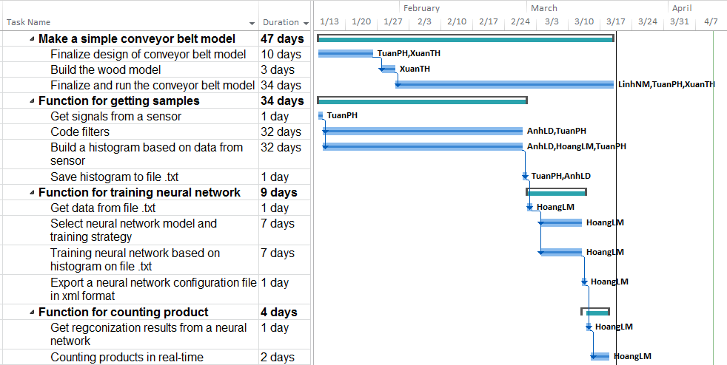
1.3 Project Management Plan

Slide 10






1.4 Member’s role
Supervisor
PM/Dev
Tech Lead
Test/
Design
Dev/
Test
Dev/
Test

Slide 11
1.5 Communication
Work offline five days per week at lab room.
Others: Email, Phone, Skype.

Slide 12








1.6 Resource needed

Slide 13
2. REQUIREMENTS
Functional requirements
Non-functional requirements

Slide 14
2.1 Functional requirements
3 functions: Collecting data sample, Training, Counting
6 Cases:

Slide 15
2.2 Non-functional requirements
System response: < 0.5 s
High accuracy: 100% with constraints of project
Easy to deploy
Easy to use
Low cost, easy to maintain

Slide 16
3. design
Proposed system architecture
Mechanic design
Circuit design

Slide 17
3.1 Propose system architecture
Physical architecture

Slide 18
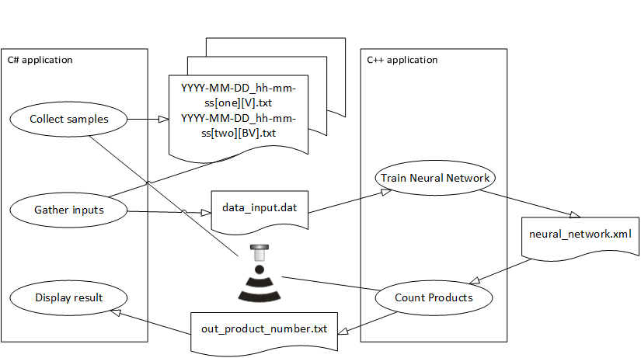
3.1 Propose system architecture
PC application & relation

Slide 19
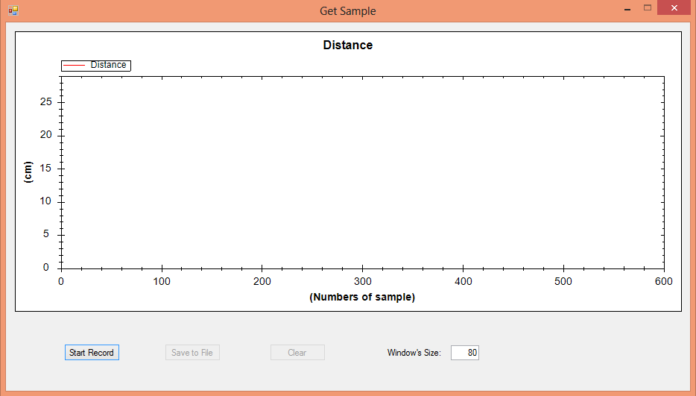
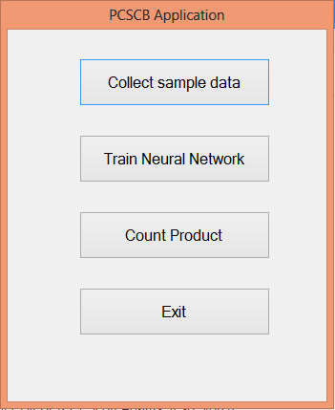
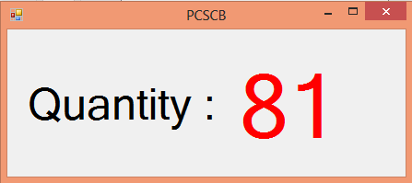
GUI Design

Slide 20

3.2 Mechanic Design
  Software Designer

Slide 21
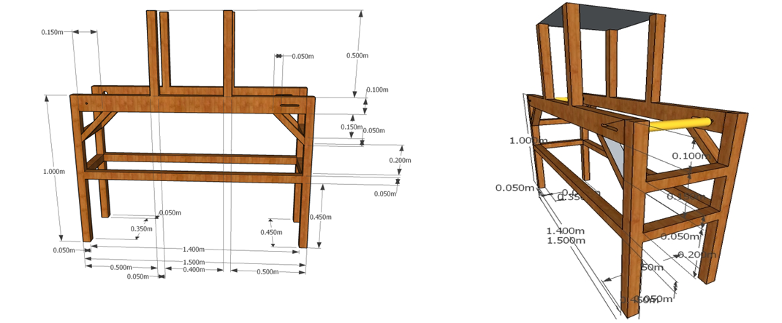
3.2 Mechanic Design
    Conveyor Belt Prototype Design

Slide 22
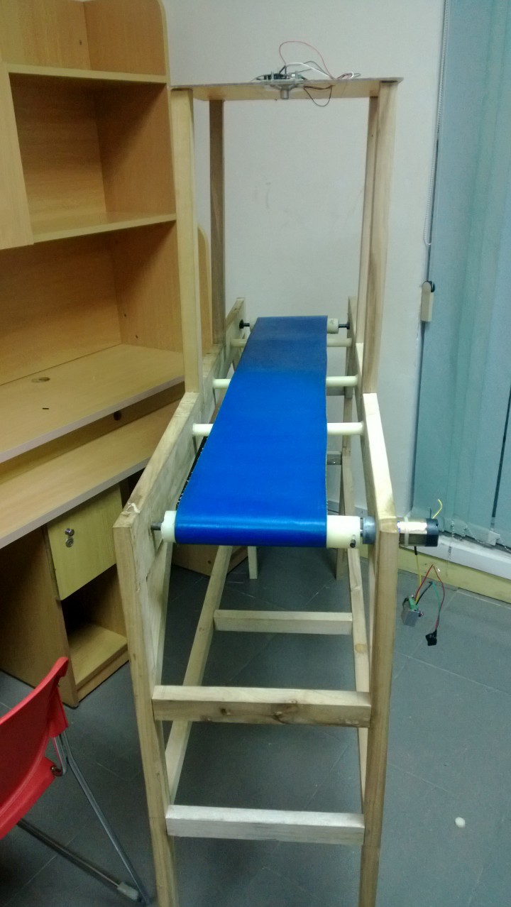
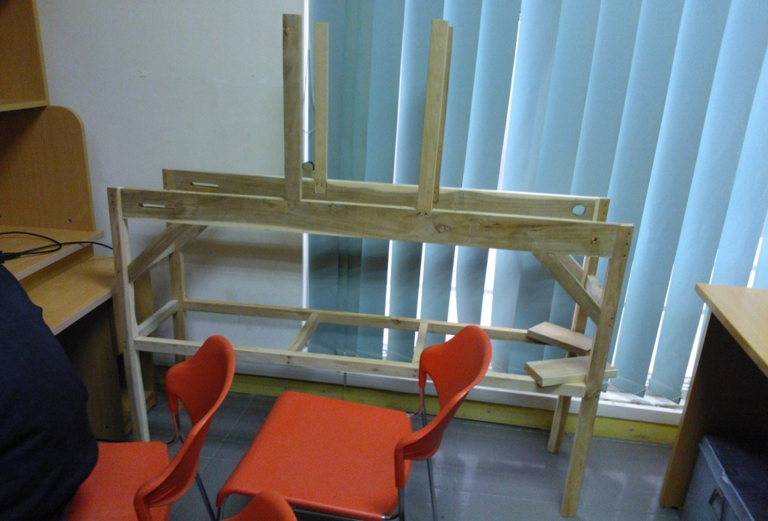
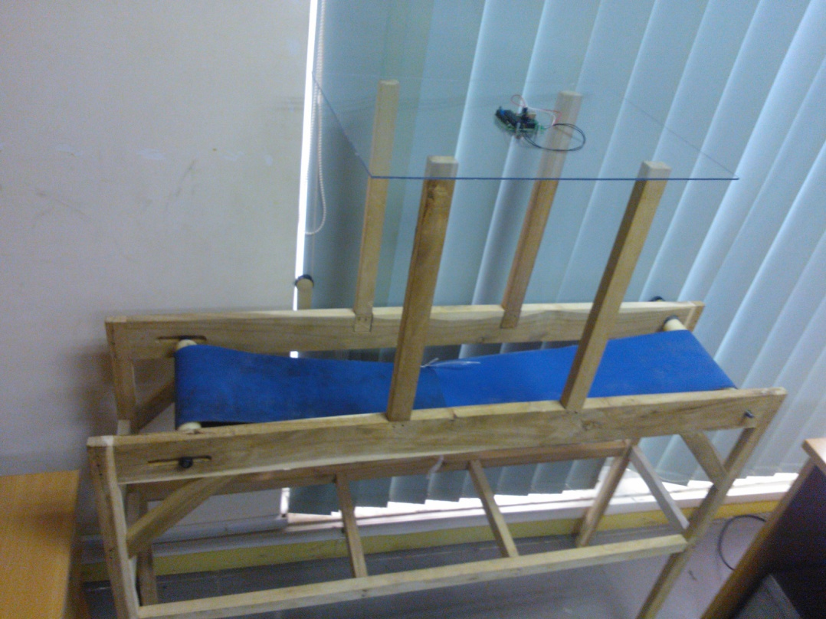
3.2 Mechanic Design
  Real

Slide 23
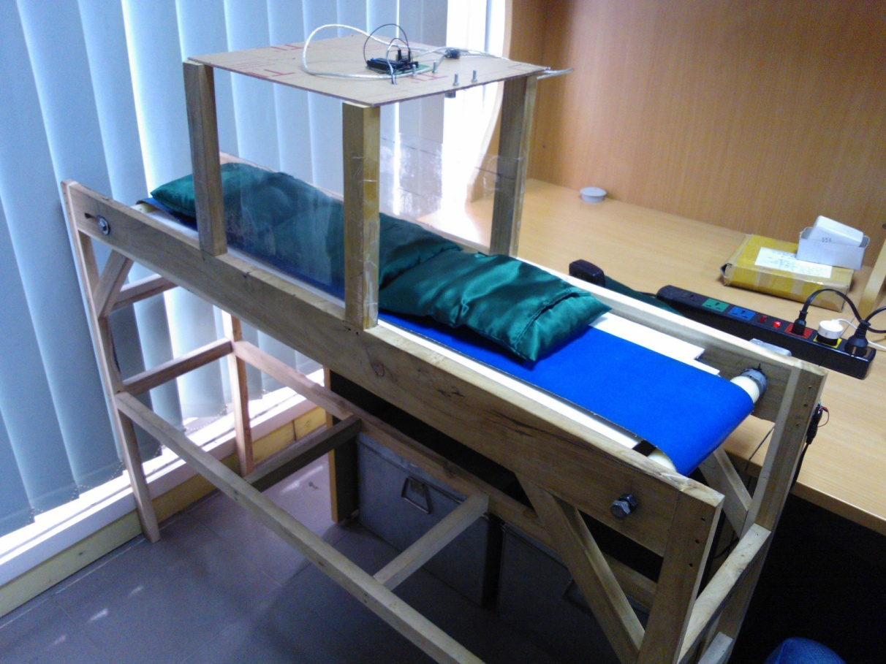
3.2 Mechanic Design
Finally

Slide 24
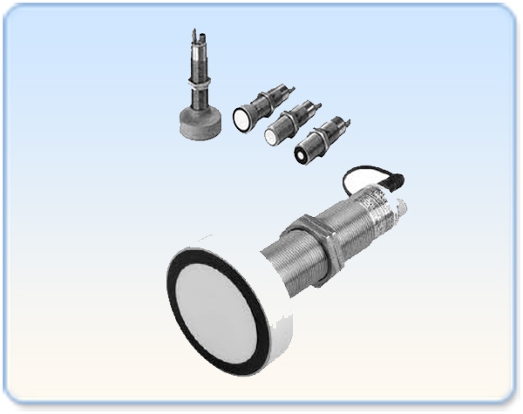
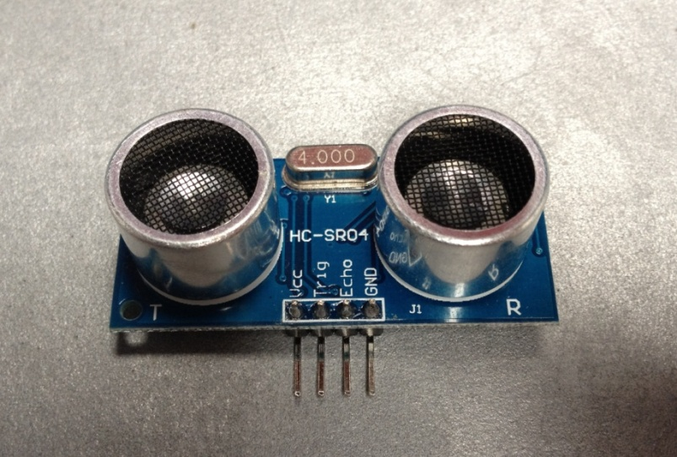
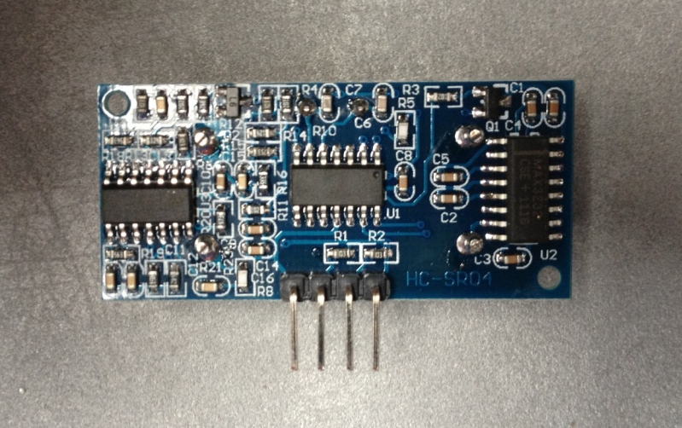
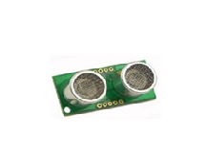
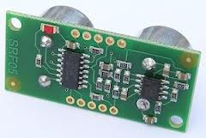
3.3 Circuit Design
Components
Omron E4PA-LS600-M1-N
HC-SR04 ultrasonic sensor
SRF05 ultrasonic sensor

Slide 25
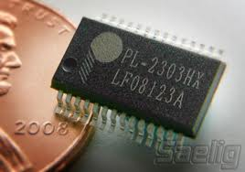
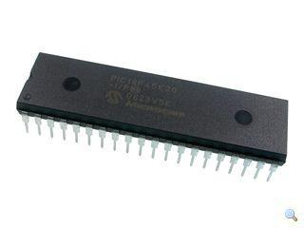
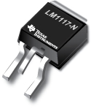
3.3 Circuit Design
PL2303HX
PIC-18F4620
LM1117MP

Slide 26
3.3 Circuit Design
Designer Software

Slide 27
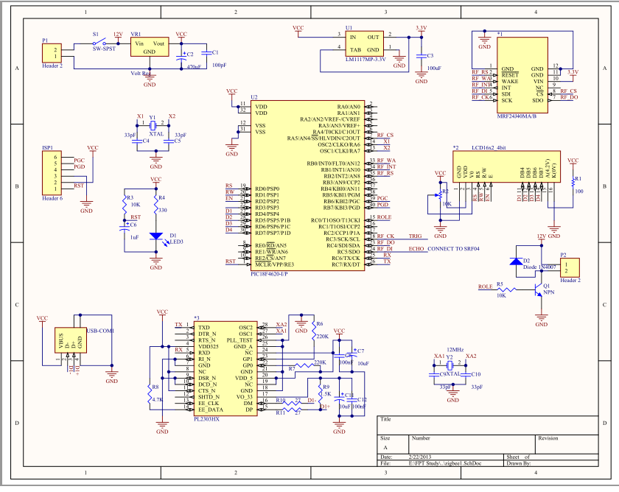
3.3 Circuit Design
Schematic

Slide 28
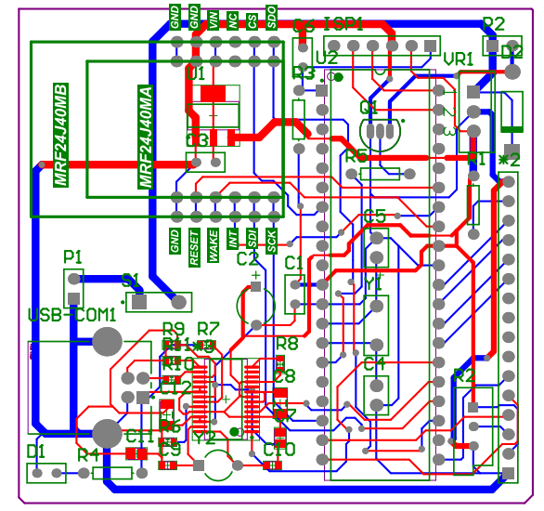
3.3 Circuit Design
PCB (Printed Circuit Board)

Slide 29
4. Identification
Pre-processing of signal
Introduction to NN
Features
Training the NN
Versions of training data

Slide 30
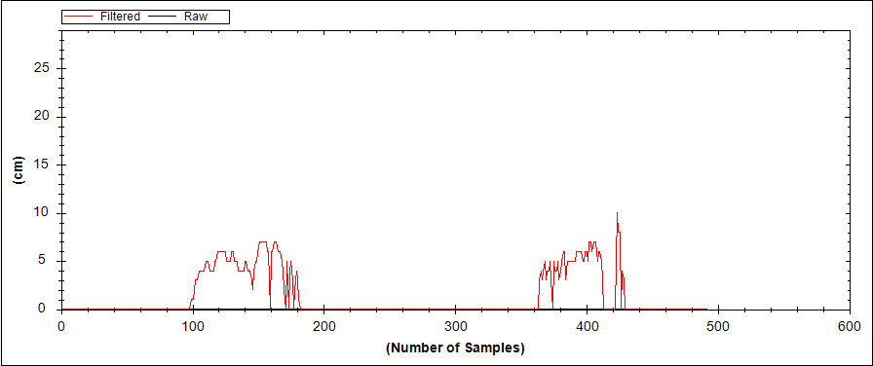
4.1 Pre-processing of signal
Raw data

Slide 31
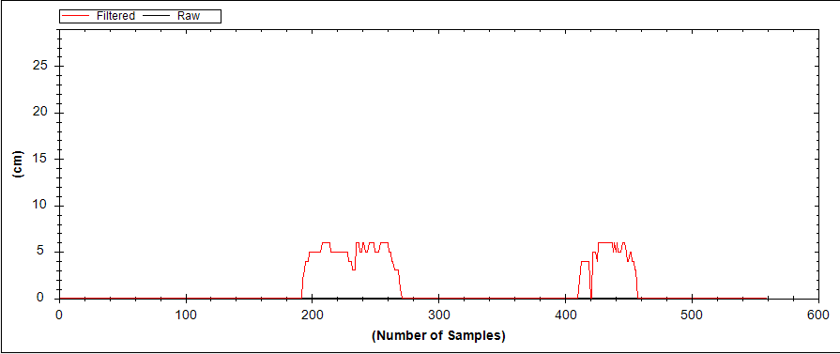
4.1 pre-processing of signal
Median filter

Slide 32
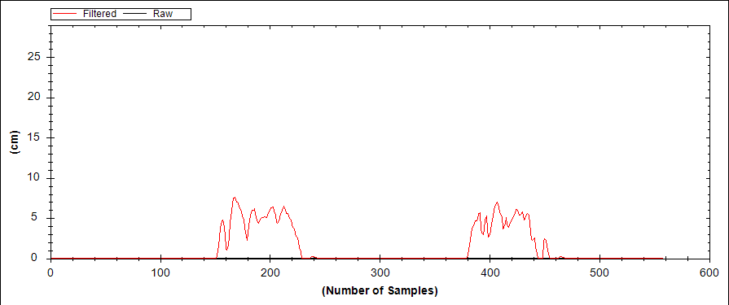
4.1 Pre-processing of signal
Double exponential smoothing
  F_{t} = a* A_{t-1} + (1- a) * (F_{t-1} + T_{t-1})
  T_{t} = b* (A_{t-1}-F_{t-1}) + (1- b) * T_{t-1}
  AF_{t} = F_{t} + T_{t}
  With F_{t}: Unadjusted forecast (before trend)
  T_{t}: Estimated trend
  AF_{t}: Trend-adjusted forecast
  a, b: weight between 0 and 1

Slide 33
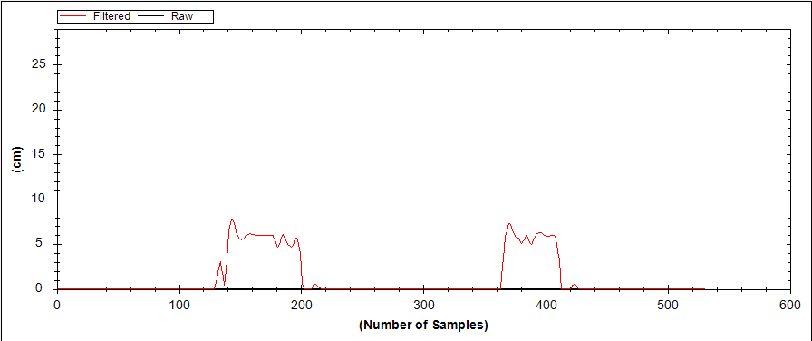
4.1 Pre-Processing of signal
Final results

Slide 34
4.2 Introduction to NN
What is Neural Network
How to train neural network

Slide 35
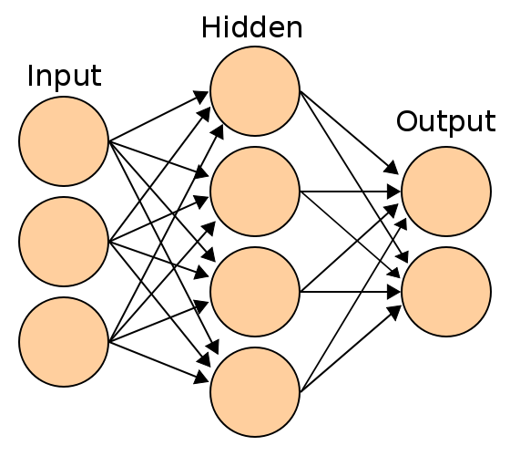
4.2.1 What is Neural Network
A layered network consists of nodes or neurons with training weights.

Slide 36
4.2.2 How to train NN
Flash Demo
http://inquiry.ucsd.edu/flash/simpleNNBP.html

Slide 37
4.3 Features
Core Pattern
Histogram
Measurements

Slide 38
4.3.1 Core Pattern
The “valley” between two consecutive products is the decisive pattern in recognition process

Slide 39
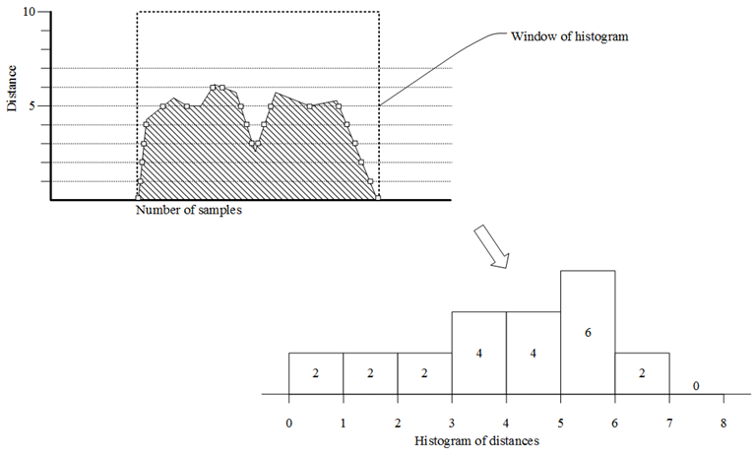
4.3.2 Histogram

Slide 40
4.3.3 Measurements

Slide 41
4.4 Training the Neural Network
Training Cases
Analyze and Construct Training Data

Slide 42
4.4.1 Training Cases
One product
Two products

Slide 43
4.4.2 Analyze and Construct Training Data
Raw data graph
Cut into smaller windows

Slide 44
4.4.2 Analyze and Construct Training Data
View of a single window
Get measurements

Slide 45
4.4.2 Analyze and Construct Training Data
Extracted histograms from windows
Get histograms

Slide 46
4.4.2 Analyze and Construct Training Data
Raw data in the representation of histograms
Pattern revealed!

Slide 47
4.5 Versions of Training Data
Version 1: Only Histograms
Version 2: High Resolution Histograms
Version 3: Trimmed Histogram with Measurements

Slide 48
4.5.1 Version 1: Only Histograms
The training inputs only consist of a histogram with size of 130 and 8 fields.
Pick 3 histograms that represent the graph of a product at it left most, middle and right most position.
The purpose is to test the ability to recognize between whether the conveyor belt has product or not.

Slide 49
4.5.1 Version 1: Only Histograms
43 | 44 | 45 | 46 | 47 | 48 | 49 | 50 | Class
4 | 3 | 8 | 12 | 5 | 3 | 76 | 19 | 1
4 | 3 | 8 | 12 | 5 | 3 | 68 | 27 | 1
4 | 3 | 8 | 12 | 5 | 3 | 71 | 24 | 1
7 | 18 | 7 | 5 | 4 | 4 | 85 | 0 | 1
7 | 18 | 7 | 5 | 4 | 4 | 65 | 20 | 1
43 | 44 | 45 | 46 | 47 | 48 | 49 | 50 | Class
0 | 0 | 0 | 0 | 0 | 0 | 75 | 55 | 0
0 | 0 | 0 | 0 | 0 | 0 | 77 | 53 | 0
0 | 0 | 0 | 0 | 0 | 0 | 76 | 54 | 0
0 | 0 | 0 | 0 | 0 | 0 | 80 | 50 | 0
0 | 0 | 0 | 0 | 0 | 0 | 79 | 51 | 0

Slide 50
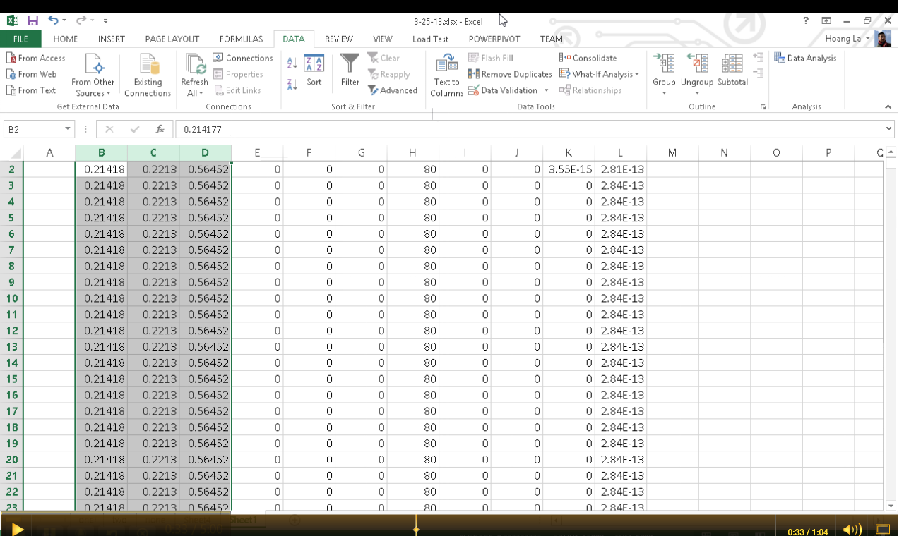
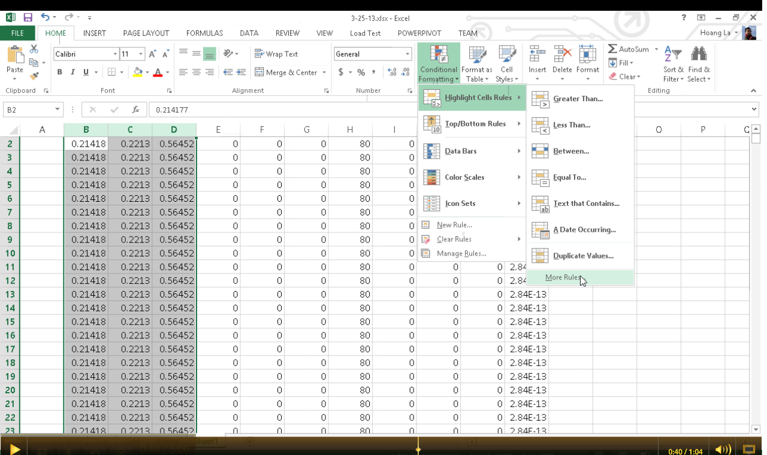
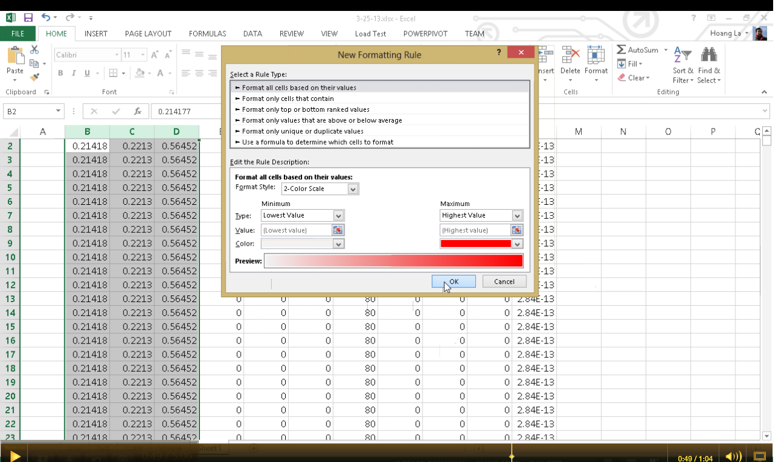
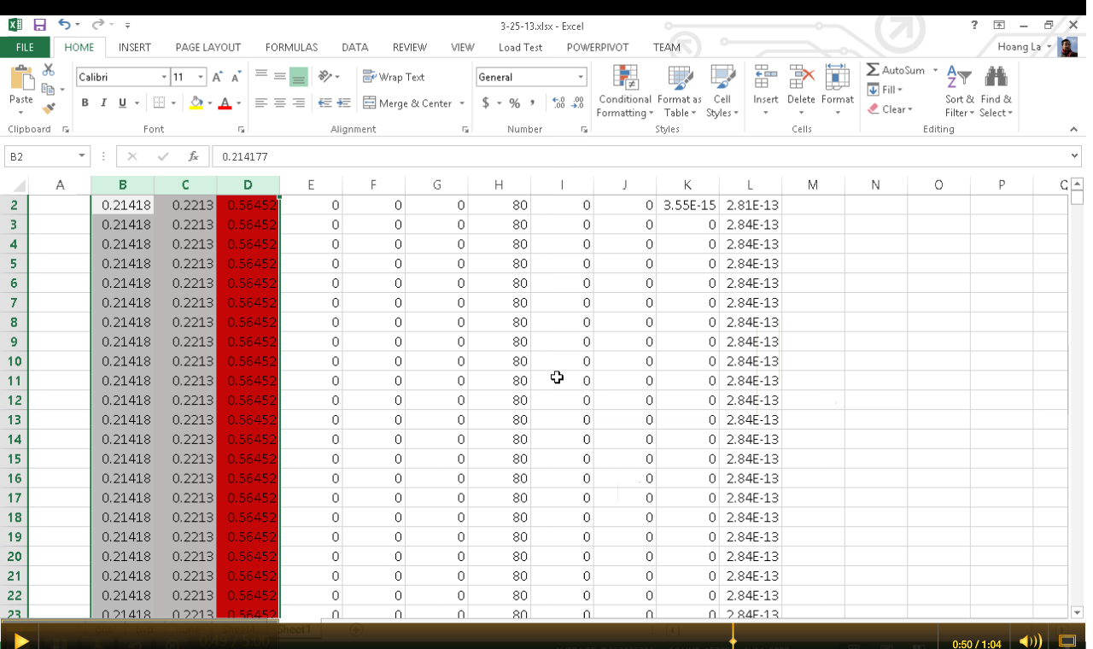

4.5.1 Version 1: Only Histograms
How to visualize Neural Network outputs

Slide 51
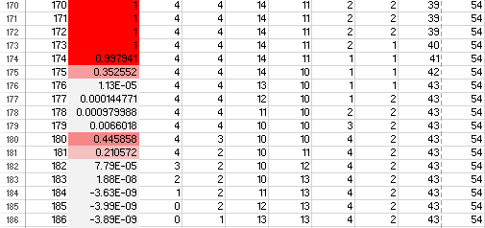
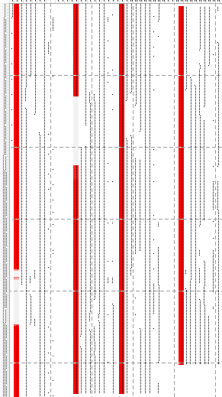
4.5.1 Version 1: Only Histograms
Statistic training results:
  Training samples: 90
  Classification accuracy: 1
  Error rate: 0
Real data test:
  Only 2 cases of none product was detected
  No distinct recognition at all!!!

Slide 52
4.5.2 Version 2: High Resolution Histograms
Increase the resolution of histogram to 0.5 cm.
Pick a set of histograms which shifts from left most to right most position
Increase the number of recognition class to three (one, two or none product)

Slide 53
4.5.2 Version 2: High Resolution Histograms
43 | 43.5 | 44 | 44.5 | 45 | 45.5 | 46 | 46.5 | 47 | 47.5 | 48 | 48.5 | 49 | 49.5 | 50 | One | Two | None
0 | 0 | 4 | 5 | 3 | 1 | 1 | 2 | 1 | 2 | 1 | 1 | 0 | 1 | 68 | 0 | 0 | 1
0 | 0 | 0 | 6 | 2 | 6 | 1 | 0 | 1 | 1 | 1 | 2 | 2 | 5 | 63 | 0 | 0 | 1
0 | 0 | 1 | 6 | 6 | 1 | 1 | 0 | 1 | 1 | 1 | 2 | 2 | 5 | 63 | 0 | 0 | 1
0 | 0 | 0 | 6 | 4 | 5 | 3 | 2 | 1 | 1 | 1 | 2 | 2 | 5 | 58 | 1 | 0 | 0
0 | 0 | 0 | 0 | 5 | 10 | 3 | 2 | 1 | 1 | 0 | 1 | 1 | 1 | 65 | 1 | 0 | 0
0 | 0 | 0 | 0 | 5 | 10 | 3 | 2 | 0 | 1 | 2 | 1 | 2 | 5 | 59 | 1 | 0 | 0
9 | 7 | 7 | 10 | 15 | 13 | 5 | 2 | 1 | 1 | 1 | 1 | 1 | 1 | 16 | 0 | 1 | 0
9 | 7 | 7 | 10 | 15 | 13 | 5 | 2 | 2 | 1 | 1 | 1 | 1 | 1 | 15 | 0 | 1 | 0
9 | 7 | 7 | 10 | 15 | 13 | 5 | 2 | 2 | 2 | 1 | 1 | 1 | 1 | 14 | 0 | 1 | 0

Slide 54
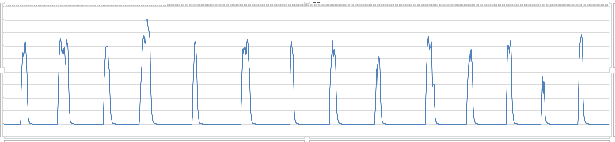
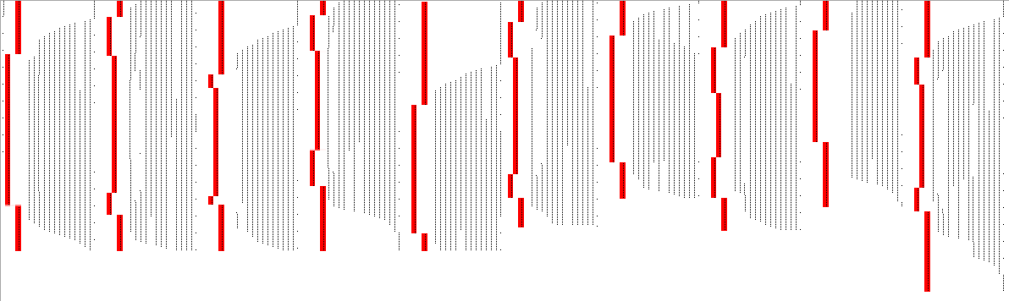
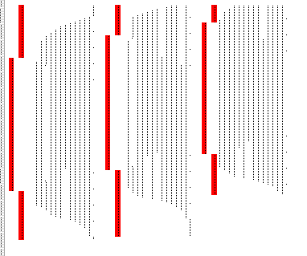
4.5.2 Version 2: High Resolution Histograms
One
Two
One
Two
One
Two
One
Two
One
Two
One
Two
One
WRONG!

Slide 55
4.5.2 Version 2: High Resolution Histograms
Statistic training results:
  Training samples: 1892
  Classification accuracy: 0.979592
  Error rate: 0.0204082
Real data test:
  Only 2 / 13 cases are wrong
  84% accuracy on real data test

Slide 56
4.5.3 Version 3: Trimmed Histogram with Measurements
Do a little statistic analysis on the training data
Statistics | 43 | 43.5 | 44 | 44.5 | 45 | 45.5 | 46 | 46.5 | 47 | 47.5 | 48 | 48.5 | 49 | 49.5 | 50
Standard Deviation | 1.560886 | 3.303085 | 4.744917 | 4.317798 | 2.61962 | 1.561252 | 1.326804 | 1.09453 | 2.114539 | 0.99212 | 0.783453 | 1.045937 | 1.416573 | 2.436769 | 21.10286
Average | 0.348741 | 1.594243 | 2.715195 | 2.341544 | 1.569333 | 1.071132 | 0.846942 | 0.846942 | 1.071132 | 0.747301 | 0.672571 | 0.822032 | 1.145862 | 2.042624 | 72.16441
Min | 0 | 0 | 0 | 0 | 0 | 0 | 0 | 0 | 0 | 0 | 0 | 0 | 0 | 0 | 10
Max | 10 | 16 | 17 | 21 | 11 | 5 | 6 | 4 | 11 | 4 | 2 | 4 | 5 | 7 | 90

Slide 57
4.5.3 Version 3: Trimmed Histogram with Measurements
Reduce the distance between the sensor and the conveyor belt surface(from 50cm to 30cm)
Increase histograms resolution back to 1cm
Choose 4 the most noticeable distances
Sum the two top distances in the chosen four.
Combine with measurements

Slide 58
4.5.3 Version 3: Trimmed Histogram with Measurements
22 | 23 | 24 | 29 | 22 + 23 | Product length | Slopes length | Area
0 | 0 | 0 | 80 | 0 | 0 | 2.44E-12 | 7.05E-12
0 | 0 | 0 | 80 | 0 | 0 | 1.49E-12 | 4.61E-12
0 | 0 | 0 | 80 | 0 | 0 | 0.39 | 0.39
0 | 0 | 0 | 79 | 0 | 1 | 0.6279 | 1.0179
0 | 5 | 2 | 60 | 5 | 20 | 12.4813 | 77.8831
1 | 5 | 2 | 59 | 6 | 21 | 12.6887 | 84.5587
2 | 5 | 2 | 58 | 7 | 22 | 12.8153 | 91.3608

Slide 59
4.5.3 Version 3: Trimmed Histogram with Measurements
Statistic training results:
  Training samples: 2097
  Classification accuracy: 0.986667
  Error rate: 0.0133333
Real data test cases:
  V for 1 vertical product, H for 1 horizontal product
  5xV, 5xH, 5xVV, 5xHH, 5xVH, 5xHV

Slide 60
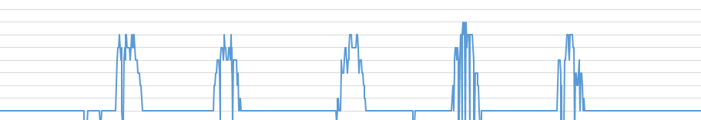
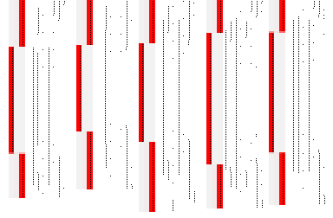
4.5.3 Version 3: Trimmed Histogram with Measurements
5 cases of
one vertical product are all recognized correctly!

Slide 61
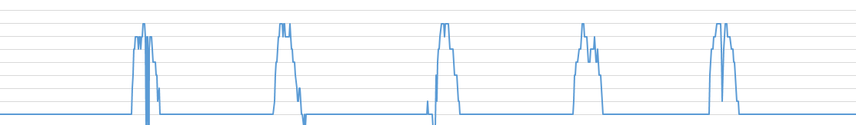
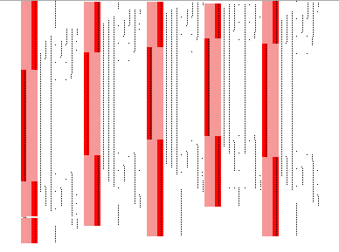
4.5.3 Version 3: Trimmed Histogram with Measurements
5 cases of
one horizontal product are all recognized correctly!

Slide 62
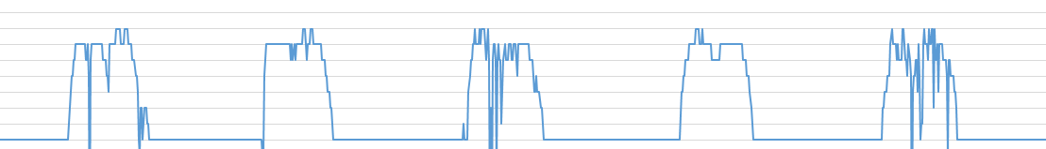
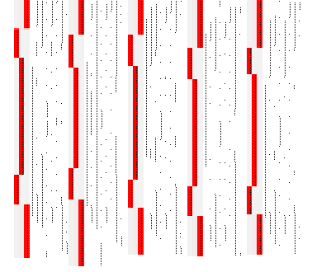
4.5.3 Version 3: Trimmed Histogram with Measurements
5 cases of
two vertical product
are all recognized correctly!

Slide 63
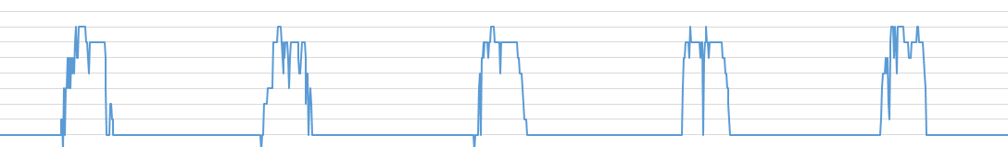

4.5.3 Version 3: Trimmed Histogram with Measurements
5 cases of
two horizontal product
are all recognized correctly!

Slide 64
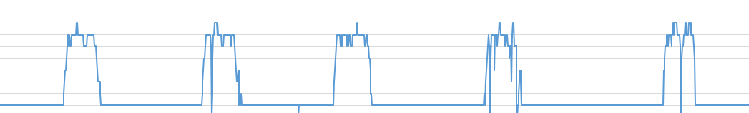
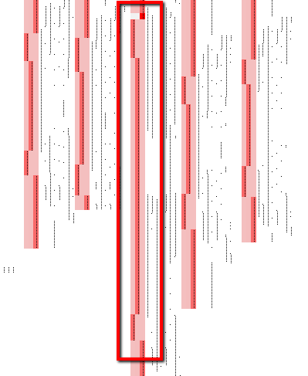
4.5.3 Version 3: Trimmed Histogram with Measurements
5 cases of
one vertical and one horizontal products
are all recognized correctly.
But there is one anomaly!

Slide 65
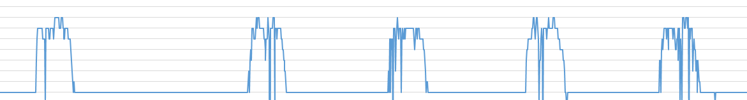

4.5.3 Version 3: Trimmed Histogram with Measurements
5 cases of
one horizontal and one vertical products
are all recognized correctly!

Slide 66
4.5.3 Version 3: Trimmed Histogram with Measurements
Real data test result:
99% accuracy

Slide 67
5. Test
Test strategy
Testing results

Slide 68
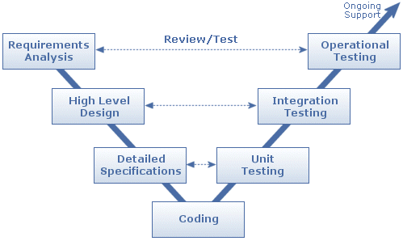
5.1 Test Strategy

Slide 69
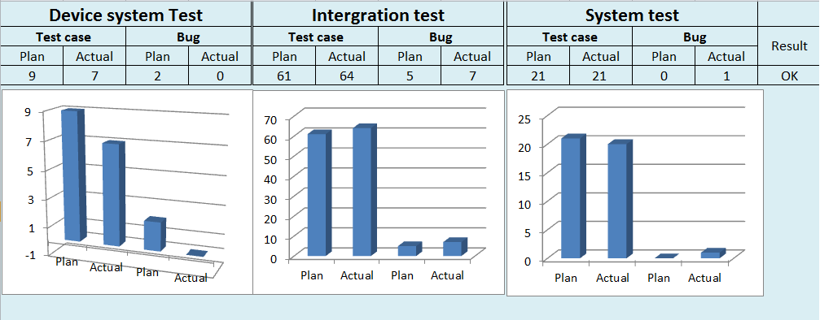
5.2 Testing Result

Slide 70


5.2 Testing Result

Slide 71
6. Conclusion
Difficulties, Limitation, Strategy & Solution
Perspective
Lesson Learnt

Slide 72


Difficulties
Lack of knowledge.
Differences between theory and reality.
Member’s skill are not the same so assigning works for each one.
Mechanic.
Limitation
Non-Technical problem
Technical problem
PCSCB limitations
Solution for different conveyor belt’s speed problem.
Solution for poor sensor’s performance.
Strategies and Solution

Slide 73

6.2 Perspective

Slide 74

6.3 Lesson Learnt
Learn how to approach the new technology
Learn how to make team working effect and improve communication skills.

Slide 75
7. DEMO

Slide 76
8. Q&A

Slide 77
Thanks for listening

