Slide 1
Capstone Project
Time and Attendance System

Slide 2
Time and Attendance System
Project Code: FUTAS
Project Supervisor: Phạm Thanh Tùng
Team Members:
Tạ Minh Việt
Nguyễn Quang Huy
Trương Ngọc Sơn Tùng
Đoàn Việt Anh
Vũ Ngọc Anh

Slide 3
Contents
1
1
Introduction
2
Project Management Plan
3
System Requirement Specification
4
System Detail Design
5
Testing

Slide 4
Introduction
Initial ideas
Nowadays, with the development of economic, the salary of employees is rising. But the employees ’s worked hours are difficult to collect
Overpayment may be made and there can be a lot of money wasted. This is time to build a time and attendance system to calculate accurate employees ‘s performance and reduce the work involved in preparing hours for payroll

Slide 5
Benefit of system expect
Increase productivity
2
1
3
Enhance consciousness
Save money and time
FUTAS
5
4
Accurate
Fair

Slide 6
Project Management Plan
Tool and environment

Slide 7
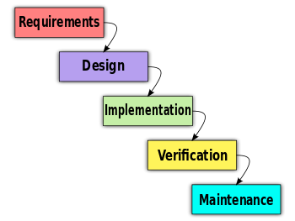
Process Model
Waterfall process model

Slide 8
Project Plan

Slide 9
Risk Management
Risk type | Risk description | Solution
Human | Team member get sick or attendance fail Conflict between idea of members | Other team member have to support work part of that member Team building
Hardware | Borrow just only 1 reader | Use carefully Create virtual reader
Technology | Developer is not C# & .Net professional | Study C# & .Net from instructor
Process | Can not meet deadline | Check milestone

Slide 10
System Requirement Specification
System Requirement
Functional Requirement
Non-functional Requirement.

Slide 11
Main Function
Employee
Payroll
Core Management
Shift
Time Keeping
Group
Export
View Information

Slide 12
Module Function
Edit
Cancel
Form
Delete
Save
Add

Slide 13
Use Case Diagram

Slide 14
Non-functional Requirement
Performance
The system must be nimble enough to allow for easy changes
The response time for install system should be less than 24 hours
Reliability
If the system broken, 24 hours is available to get the system back up again
Information entered yesterday in the system should be there today
Security
The system must be secured and the information will be kept safe
Admin is only person should permitted to view and edit information in the database of the system

Slide 15
Non-functional Requirement
Availability
Database servers will operate 24 hours a day, 7 days a week
System Management
Database backup should be done often and be extremely secure .The downtime will be between 2.00 am to 4.00 am

Slide 16
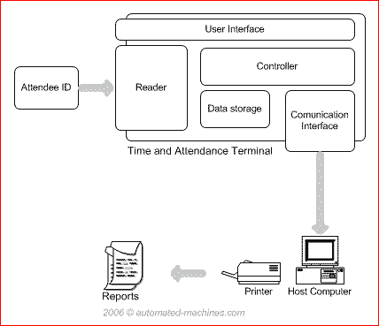
System Detail Design
System Overview

Slide 17
Client-Server Model

Slide 18
Class Diagram

Slide 19
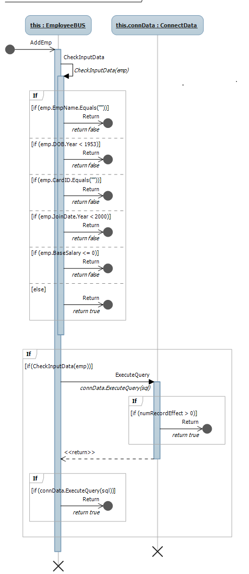
Sequence Diagram
Add new

Slide 20
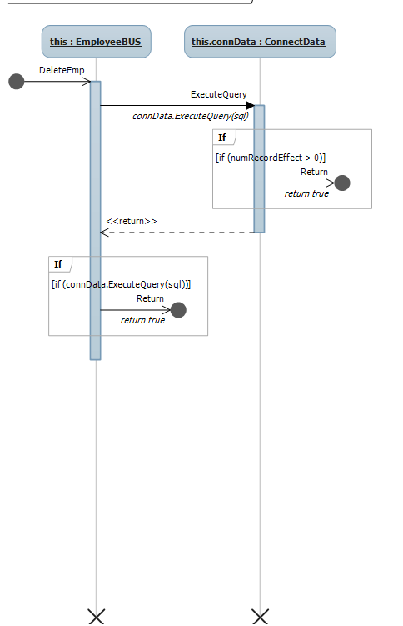
Sequence Diagram
Delete

Slide 21
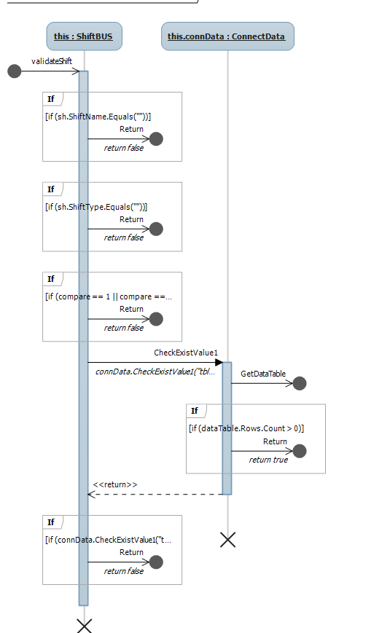
Sequence Diagram
Validate input

Slide 22
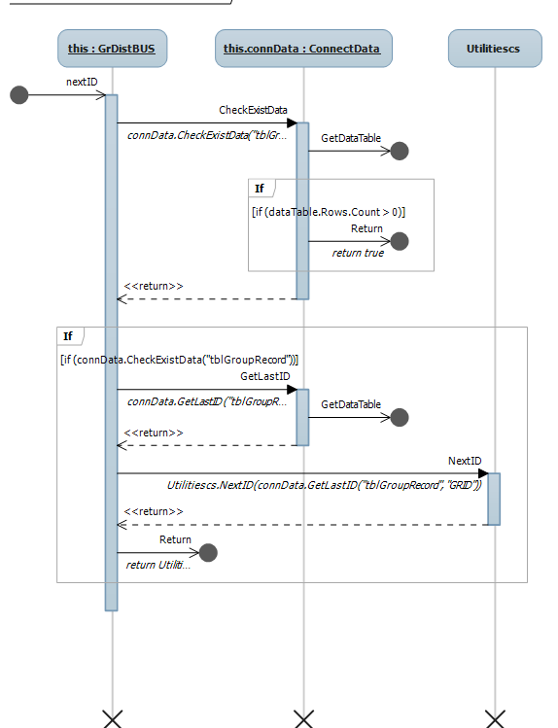
Sequence Diagram
Next ID

Slide 23
Entity Relationship Diagram

Slide 24
Database Design

Slide 25
User Interface

Slide 26
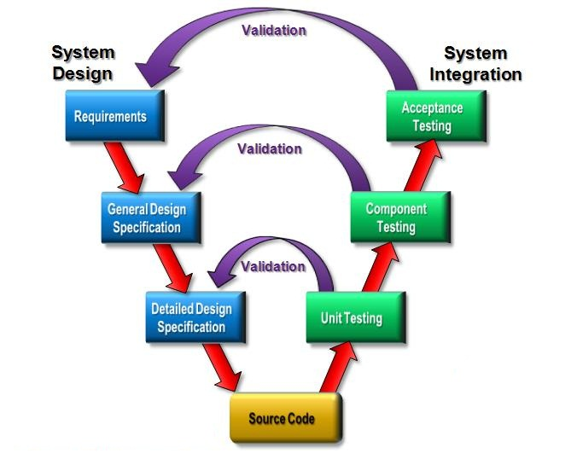
Testing
Test Model

Slide 27
Test Report

Slide 28
Q&A

