Slide 1

Studio Management
Capstone Project
Supervisor
Mr. Trần Đình Trí
SM-Group
Vũ Tiến Duy- 00614
Đặng Việt Dũng- 00519
Nguyễn Quốc Việt- 00244
Nguyễn Đắc Trung- 00823
Hoàng Duy Phương- 00500

Slide 2
Contents
Introduction
Project Management
Software Requirement
Architecture
Testing
Demo

Slide 3
Introduction
Project Name: Studio Management
Project Code: V-Studio
Project Group Name: SM Group
Product Type: Web Application
Timeline: From Jan 1st 2013 to Apr 25th 2013

Slide 4
Introduction
The Idea
Build a web application about Wedding Studio.
Provide photo services to Customer.
Admin, Manager, Staff can manage studio system clearly.
Applied Practice.

Slide 5
Problem
Customer request
Manager received request and contact customer
Manager created order and assign job for employee
Employee perform work
Employee performance produces results for customer

Slide 6
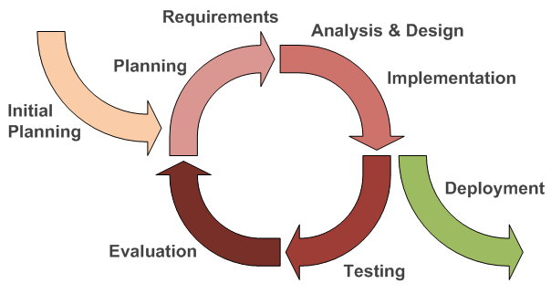
Project Management
Software Process Model
Iterative process model

Slide 7
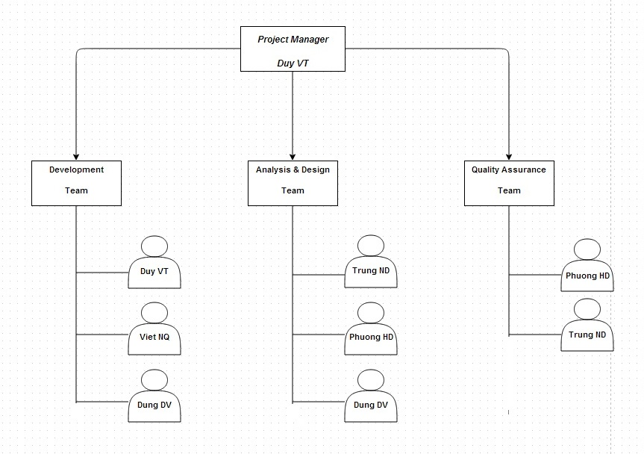
Project Management
Organization Structure

Slide 8
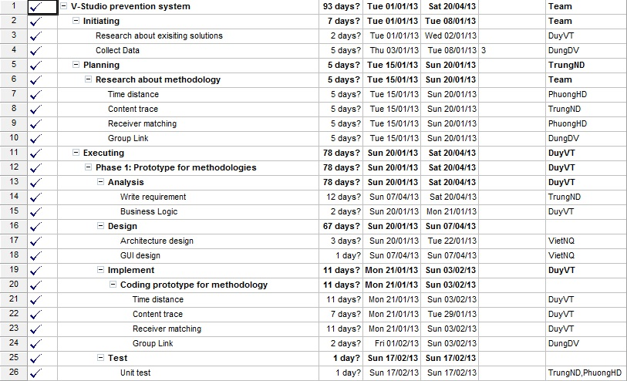
Project Management

Slide 9
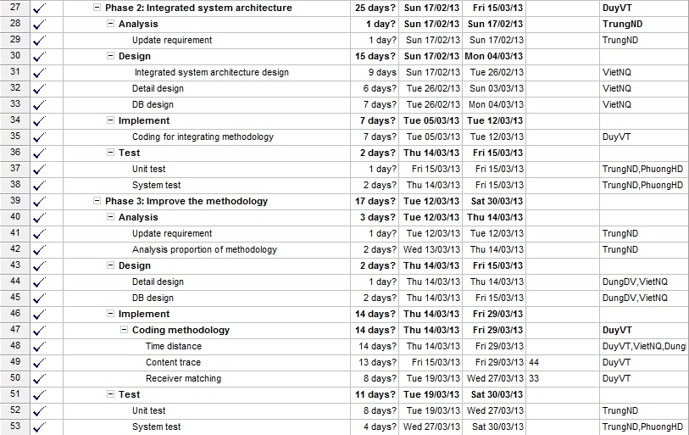
Project Management

Slide 10
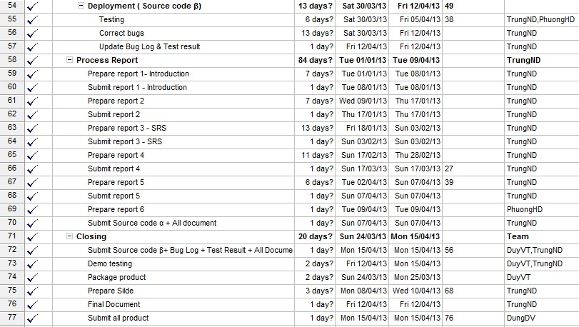
Project Management

Slide 11
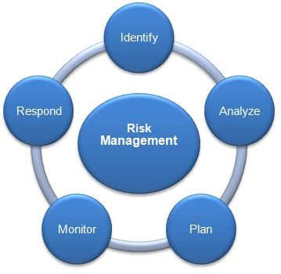
Project Management
Risk Management
Human Resource
PM skill not good
Team members haven’t experience
Time and Communication
Member is ill at critical times.
Technical
Database system cannot process many transactions
Hard to connect team member due to the difference place
Bad attitude of team member
Design difficulty: interface is not attractive, interactive with user

Slide 12
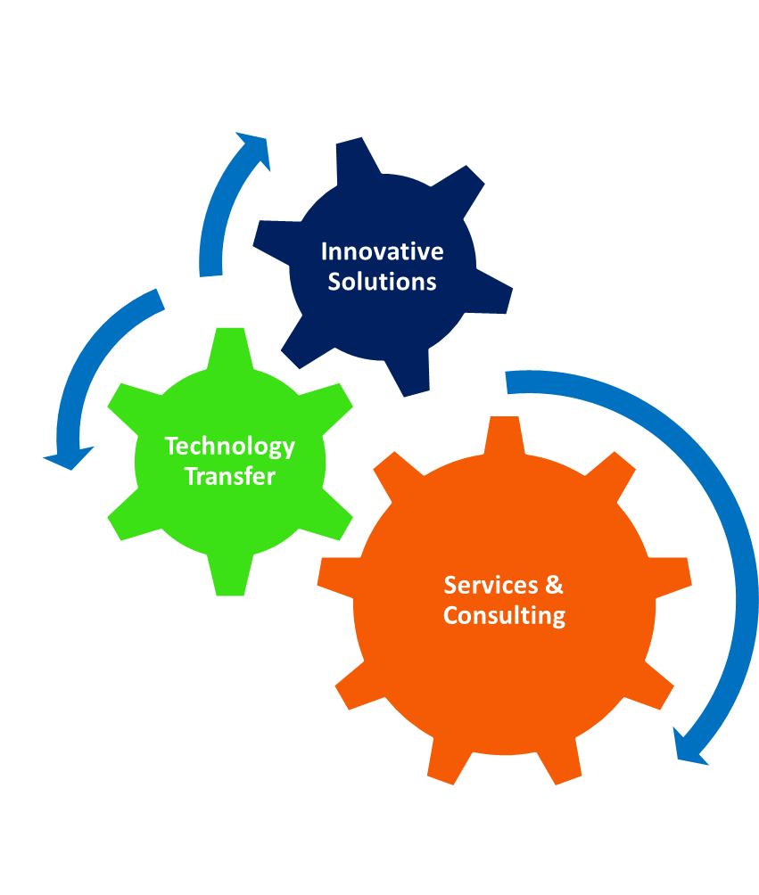
Business Model
Innovative Solutions
Build and maintain relationships online to keep your customers coming back.
Technology Transfer
Studio web application.
Services & Consulting
Provide photo services: Wedding, Fashion, Picnic, Make-up.
Customer Care Services is ensuring the timely delivery of products.

Slide 13
Software Requirement
Admin
Manage topic
Manager
Manage account
Staff
View request
Customer
View Service
View service’s status.
Edit, add, delete services
Manage user accounts
Manage order
Report financial
Request order
Create account
Manage account
Manage account
Manage job
Support

Slide 14
Software Requirement
Non-function Requirement
A simple website so that customer can easily choose products
A friendly environment for customers who want to learn and exchange knowledge and experiences about photography.
Customers can contact with supporters and company continuously.

Slide 15
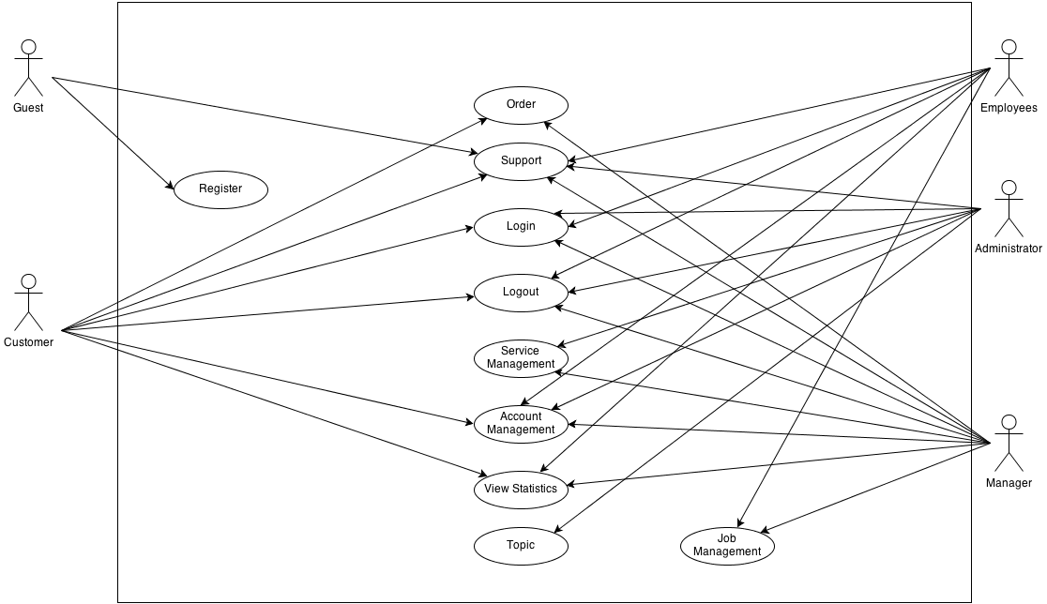
Software Architectural Design
Use Case Overview
Notes:
Gen lại ERD

Slide 16
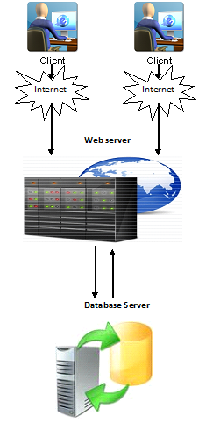
Software Architectural Design
    System Architecture

Slide 17
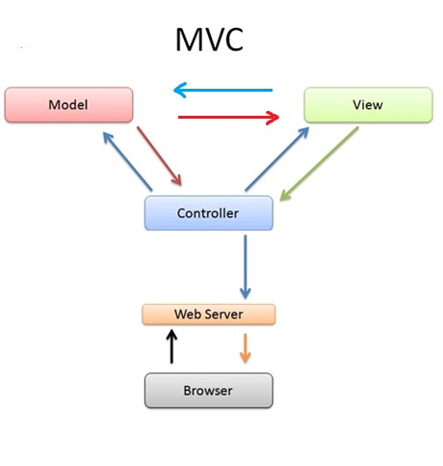
Software Architectural Design
Software Model
MVC

Slide 18
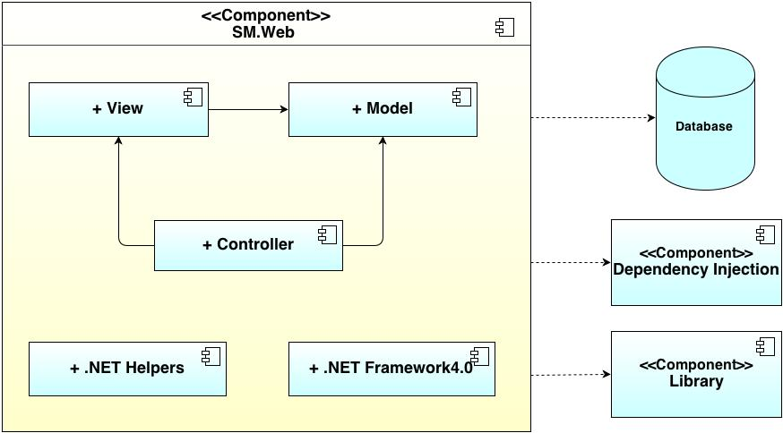
Software Architectural Design
Component Diagram

Slide 19


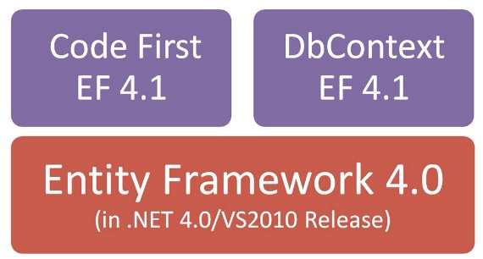
Software Architectural Design
Technology

Slide 20

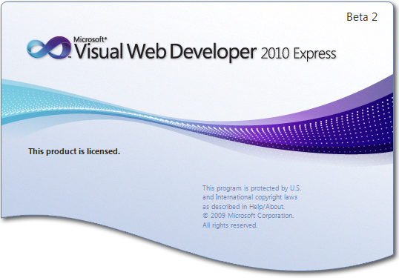
Software Architectural Design
Tool

Slide 21
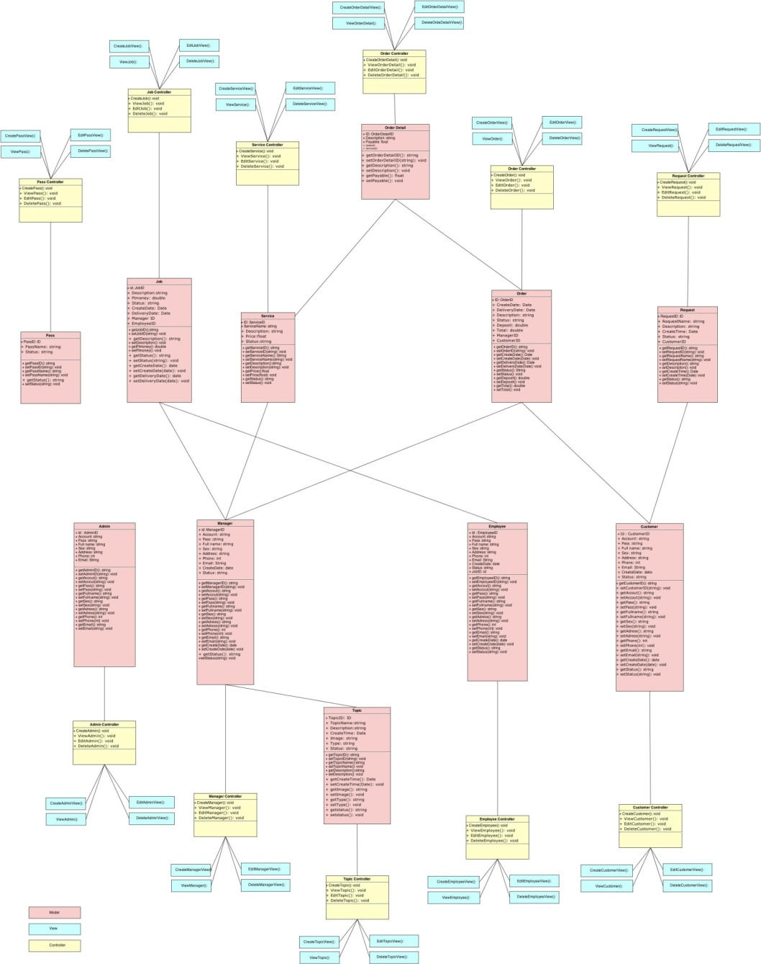
Class diagram

Slide 22
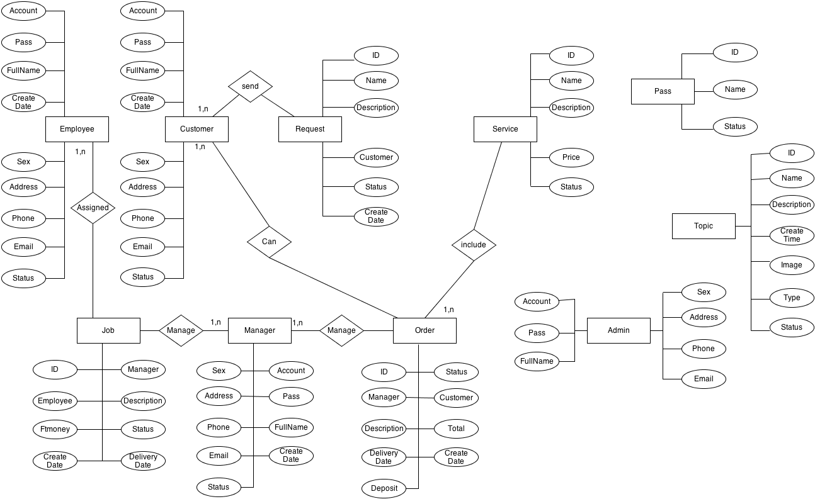
Software Architectural Design
ERD
Notes:
Gen lại ERD

Slide 23
Testing
Testing Strategy
Developing
Testing
Requirements
Acceptance
System design
System
Architecture design
Integration
Module design
Unit
Coding

Slide 24
Testing
Test Process
Create TC template
Write TC (based on SRS)
Review TC
Test Execution
Test Plan

Slide 25
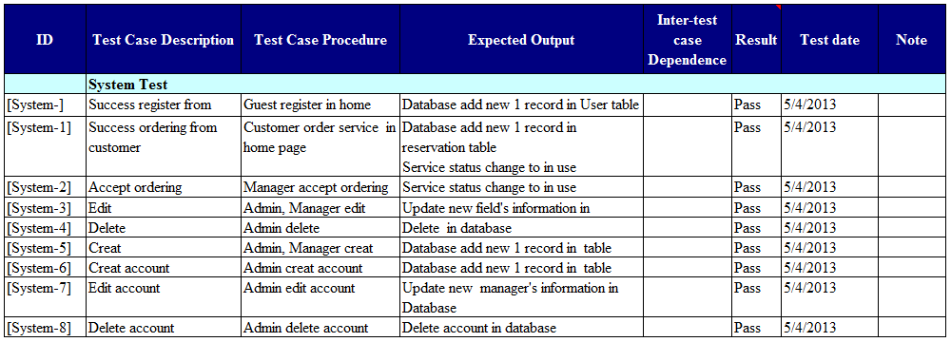
Testing
System Test
Unit Test: reference report

Slide 26
Testing
Test Report
Module code | Pass | Fail | Untested | N/A | Number of test cases
Total | 380 | 6 | 2 | 0 | 388
Guest | 42 | 0 | 0 | 0 | 42
Customer | 56 | 0 | 0 | 0 | 56
Staff | 54 | 0 | 0 | 0 | 54
Manager | 93 | 6 | 2 | 0 | 101
Admin | 126 | 0 | 0 | 0 | 126
System Test | 9 | 0 | 0 | 0 | 9

Slide 27

Result
Lesson learnt
Improve technical skill
Soft Skills
Risk and issues management

Slide 28
Demo

Slide 29
Thank You !

