Slide 1
DEAL
AGGREGATOR
Supervisor: Trần Đình Trí
Students: Nguyễn Mạnh Huy
Nguyễn Thanh Thủy
Nguyễn Quốc Tuấn
Đinh Văn Thể
Đỗ Duy Việt

Slide 2
Contents
Introduction
Project Management
Requirement Specifications
Design
Test
Summary
Demo - Q&A
Notes:
Phần trình bày gồm 7 phần

Slide 3
Introduction
Name | Role
Trần Đình Trí | Supervisor
Nguyễn Mạnh Huy | Team leader
Nguyễn Thanh Thủy | Test leader
Nguyễn Quốc Tuấn | Developer
Đinh Văn Thể | Developer
Đỗ Duy Việt | QA & Tester
Notes:
Vai trò của từng thành viên

Slide 4
Introduction
Idea:
  Order purchasing model-based websites become popular
  They sell better price products (deal)
  When you want to search any product, you have to access many sites.
  Out of date deals
Notes:
Ý tưởng xuất phát từ
Mô hình mua hàng theo nhóm trở nên phổ biến
Người dùng có thể mua được những món hàng với giá tốt hơn ngoài thị trường
Nhưng bù lại họ phải mất thời gian mở từng trang một để tìm được sản phẩm ưng ý
Chưa kể, nhiều deal đã hết hạn

Slide 5
Introduction
Problem:
  A website collect all deals from another websites.
  User can search and sort by categories, price, source or keywords.
  Can access by PC/Laptop or mobile devices.
  Manage all information which is collected.
Notes:
Từ ý tưởng đó em xây dựng lên bài toán:
1 website tổng hợp tất cả deal từ các website khác
Người dùng có thể tìm kiếm và sắp xếp theo danh mục, giá, nguồn và các từ khóa
Người dùng dễ dàng truy cập trên nhiều phương tiện, thiết bị
Người quản lý có thể quản lý tất cả thông tin được collect

Slide 6

Introduction
Website 1
Website 2
Deal Aggregator
…
Website n
Business Model
Notes:
Như vậy, thay vì phải tìm từng website 1, từng trang 1, người dùng chỉ việc truy cập 1 địa chỉ duy nhất

Slide 7
Introduction
Website 1
Deal
Deal
Aggregator
Website n
City
Category
Website 2
Database
Notes:
Xử lý của hệ thống như sau:
- Người quản lý, hoặc một job schedule gọi đến đường dẫn

Slide 8
System Requirement Specifications
Functional Requirements
Non-Functional Requirements
Visitor
Admin
Collection

Slide 9
Use-case

Slide 10
Functional Requirements
Visitor
Browse deals
Search deals
View detail
Report deal
Like deal
Share deal
Comment

Slide 11
Functional Requirements
Admin
Login
View Dashboard
Category Management
Deal Management
Source Management
Report Management
Backup & Restore

Slide 12
Functional Requirements
Automatic
Collect
Test
Re-collect
Manual

Slide 13
Non-Functional Requirements
Usability: easy to use
Maintainability: coding convention
Portability: deploy on many servers
Performance: not too slow

Slide 14
Software Design
System Architectural Design

Slide 15
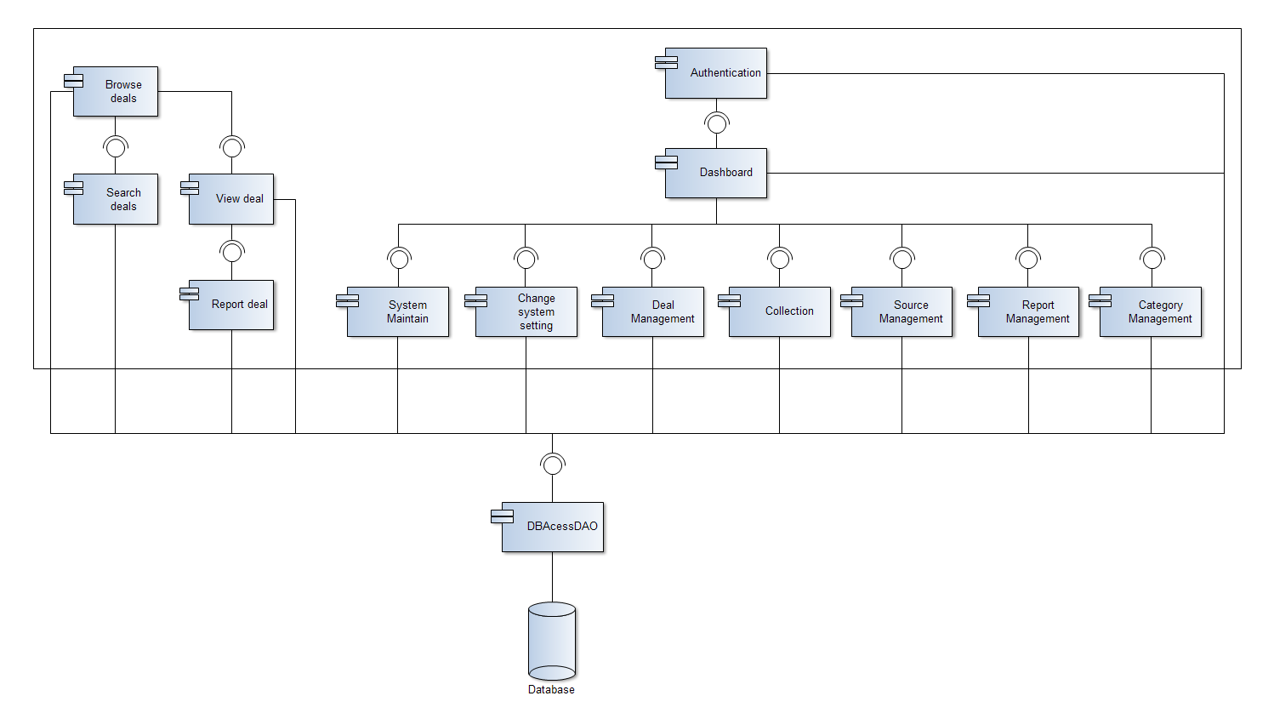
Software Design
Component Diagram

Slide 16
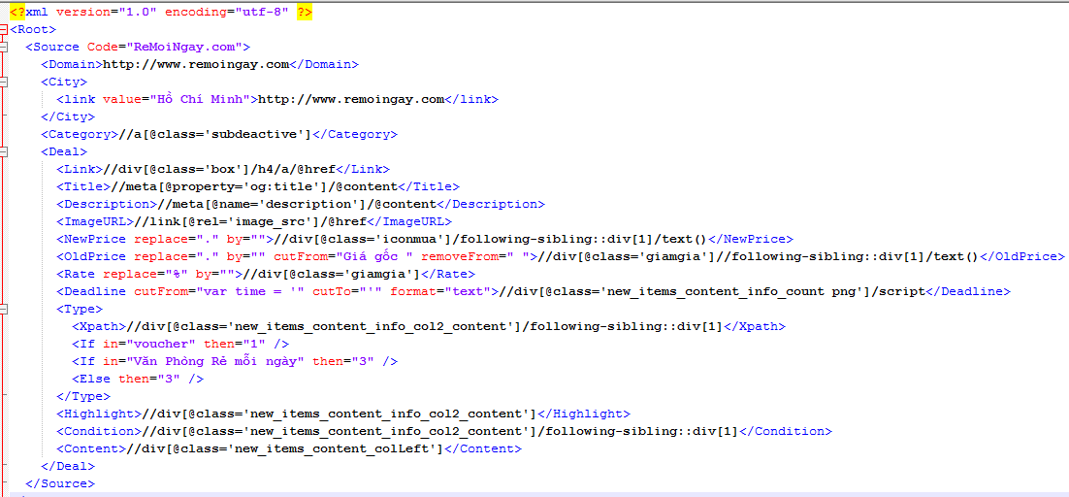
Software Design
Collection script

Slide 17
Software Design Description
Collect
Insert new deal
Ignore existed deals
Test
Get 1 deal information
Display result
Recollect
Insert new deal
Update existed deals

Slide 18
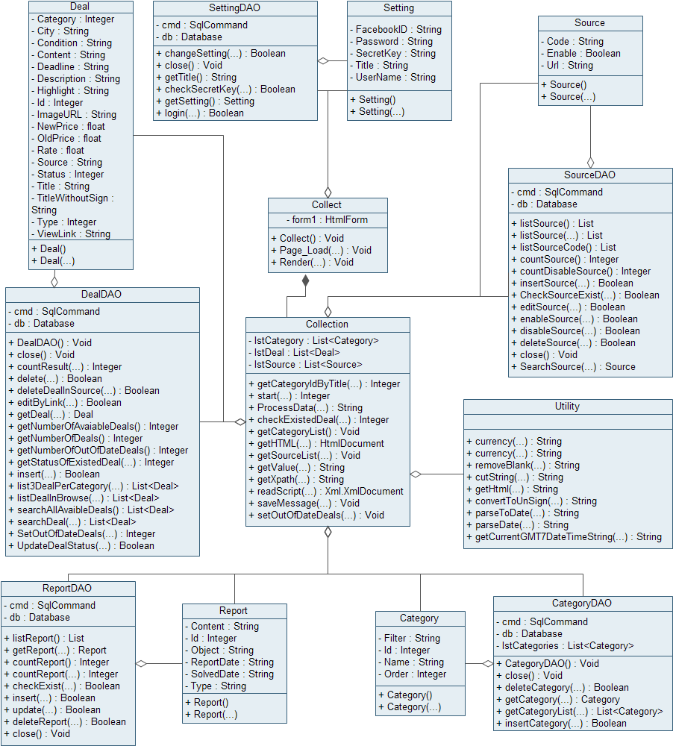
Software Design
Collection Class Diagram

Slide 19
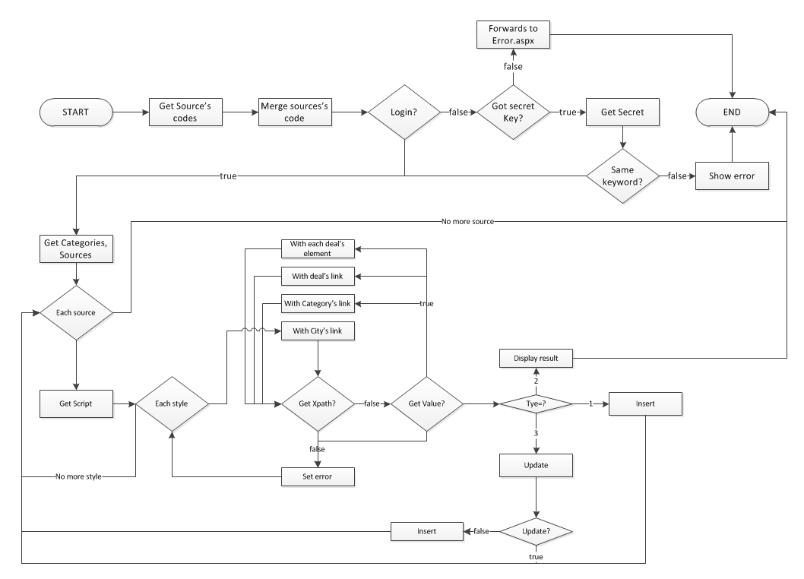
Software Design Description
Collection Flow-Chart

Slide 20
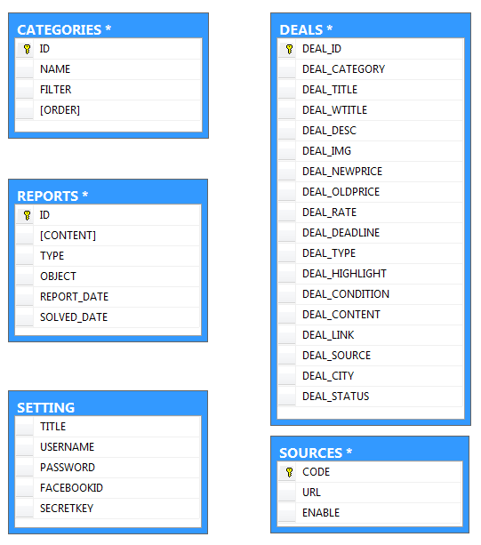
Software Design
Database Design

Slide 21
Project Management
Environment:
Development Hardware
  Pentium Dual Core 2.0 Ghz
  2GB Memory
  50GB hard-disk
Server Hardware
  Azure Cloud service
Framework: .Net Framework 4.5
DBMS: SQL Server 2012
Operation System: Windows 7

Slide 22
Project Management
Web service: IIS7+
Source Control: Tortoise SVN
API: Facebook API & HTML Agility Pack library
IDE: Visual Studio for Web 2012 Express Edition
Document:
  Microsoft Office 2010
  Edraw Max 6.7
Photo editor: Photoshop CS4

Slide 23
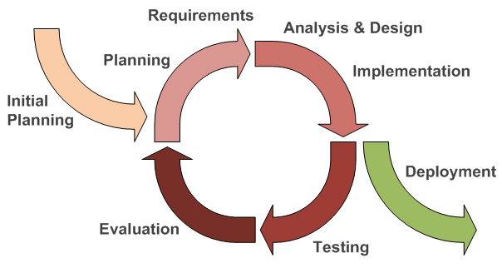
Project Management
Process: Iterative and Incremental

Slide 24



Meeting
Phase 1 | Phase 2 & 3
With Supervisor: 1 time/week With Group: 2 times/week | With Supervisor: 1 time/week With Group: 5 times/week
Logged in Meeting Minute

Slide 25
Defect management
Use Defect list
Contains:
  Screen
  Build version
  Description
  Corrective action
  Cause Analysis
  Status, Assigned to

Slide 26
Risk Management
Absent for reason
Absent without reason
Late
Cannot use SVN
Delay task
Careless mistake delete file but not backup
Task management is unreasonable
Change requirement
Cannot contact

Slide 27
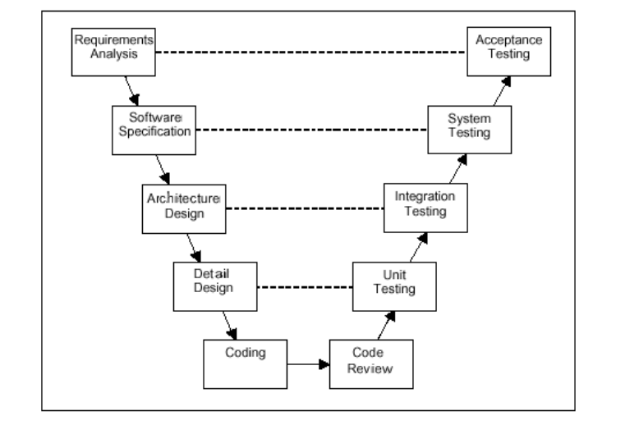
Software Testing
V-Model Process

Slide 28
Software Testing
Component | Class | Status | Date | Done By
Browse deals | DA2013.Browse | OK | 3/27/2013 | TheDV
 | DA2013.Default | OK | 3/27/2013 | TheDV
Search deals | DA2013.Search | OK | 3/27/2013 | TheDV
View deal | DA2013.View | OK | 3/27/2013 | TheDV
Admin | DA2013.AdminCP.Site | OK | 3/27/2013 | TuanNQ
Authentication | DA2013.AdminCP.Login | OK | 3/27/2013 | TuanNQ
ChangeSetting | DA2013.AdminCP.Manage | OK | 3/27/2013 | TuanNQ
Report Management | DA2013.AdminCP.ReportManagement | OK | 3/27/2013 | TuanNQ
Source Management | DA2013.AdminCP.SourceManagement | OK | 3/27/2013 | TuanNQ
Dashboard | DA2013.AdminCP.Dashboard | OK | 3/27/2013 | TuanNQ
Deal Management | DA2013.AdminCP.DealManagement | OK | 3/27/2013 | TuanNQ
Maintain | DA2013.AdminCP.MaintainManagement | OK | 3/27/2013 | TuanNQ
Collection | DA2013.Includes.Collection | OK | 3/27/2013 | HuyNM
 | DA2013.Includes.Utility | OK | 3/20/2013 | HuyNM
Unit-Test Case Result

Slide 29
Software Testing
Component | Class | Status | Date | Done By
DBAcess | DA2013.Category | OK | 3/20/2013 | HuyNM
 | DA2013.CategoryDAO | OK | 3/20/2013 | HuyNM
 | DA2013.Collect | OK | 3/27/2013 | HuyNM
 | DA2013.Database | OK | 3/20/2013 | HuyNM
 | DA2013.Deal | OK | 3/20/2013 | HuyNM
 | DA2013.DealDAO | OK | 3/20/2013 | HuyNM
 | DA2013.Maintain | OK | 3/25/2013 | HuyNM
 | DA2013.Report | OK | 3/20/2013 | HuyNM
 | DA2013.ReportDAO | OK | 3/20/2013 | HuyNM
 | DA2013.Setting | OK | 3/20/2013 | HuyNM
 | DA2013.SettingDAO | OK | 3/20/2013 | HuyNM
 | DA2013.Source | OK | 3/20/2013 | HuyNM
 | DA2013.SourceDAO | OK | 3/20/2013 | HuyNM
Mobile | DA2013.m.Browse | OK | 3/27/2013 | HuyNM
 | DA2013.m.Default | OK | 3/27/2013 | HuyNM
 | DA2013.m.Detail | OK | 3/27/2013 | HuyNM
 | DA2013.m.M | OK | 3/27/2013 | HuyNM
 | DA2013.m.Search | OK | 3/27/2013 | HuyNM
Unit-Test Case Result

Slide 30
Software Testing
Function | Screen | Viewpoint | Total | Normal | Abnormal | Boundary | Pass | Fail | N/A | Not tested | Status | Defect No
Uer | Browse | GUI | 51 | 45 | 6 | 0 | 51 | 0 | 0 | 0 | OK | 13,14,15,16,17,18
 |  |  |  |  |  |  |  |  |  |  | OK | 32
 |  |  |  |  |  |  |  |  |  |  | OK
 |  | Perform | 29 | 29 | 0 | 0 | 29 | 0 | 0 | 0 | OK | 33,35,36,37
 |  |  |  |  |  |  |  |  |  |  | OK | 53
 |  |  |  |  |  |  |  |  |  |  | OK
 | Index | GUI | 30 | 24 | 6 | 0 | 30 | 0 | 0 | 0 | OK | 13,14,15,16
 |  |  |  |  |  |  |  |  |  |  | OK
 |  | Perform | 17 | 13 | 4 | 0 | 17 | 0 | 0 | 0 | OK | 33,35,36,37
 |  |  |  |  |  |  |  |  |  |  | OK | 53
 |  |  |  |  |  |  |  |  |  |  | OK
 | Search | GUI | 60 | 54 | 6 | 0 | 60 | 0 | 0 | 0 | OK | 13,14,15,16,17
 |  |  |  |  |  |  |  |  |  |  | OK | 32
 |  |  |  |  |  |  |  |  |  |  | OK
 |  | Perform | 59 | 51 | 8 | 0 | 59 | 0 | 0 | 0 | OK | 33,35,36,37
 |  |  |  |  |  |  |  |  |  |  | OK | 53
 |  |  |  |  |  |  |  |  |  |  | OK
 | View | GUI | 54 | 48 | 6 | 0 | 54 | 0 | 0 | 0 | OK | 12,13,14,16
 |  |  |  |  |  |  |  |  |  |  | OK | 12,13,14,16,26,27,38
 |  |  |  |  |  |  |  |  |  |  | OK | 65
 |  |  |  |  |  |  |  |  |  |  | OK
 |  | Perform | 29 | 25 | 4 | 0 | 29 | 0 | 0 | 0 | OK | 33,35,36,37
 |  |  |  |  |  |  |  |  |  |  | OK | 53
 |  |  |  |  |  |  |  |  |  |  | OK
Mobile | Browse | GUI | 44 | 36 | 8 | 0 | 44 | 0 | 0 | 0 | OK | 39,40,41,47
 |  |  |  |  |  |  |  |  |  |  | OK
 |  | Perform | 12 | 12 | 0 | 0 | 12 | 0 | 0 | 0 | OK | 43,44,45,46
 |  |  |  |  |  |  |  |  |  |  | OK
 | Search | GUI | 44 | 36 | 8 | 0 | 44 | 0 | 0 | 0 | OK | 39,40,41,47
 |  |  |  |  |  |  |  |  |  |  | OK
 |  | Perform | 32 | 28 | 4 | 0 | 32 | 0 | 0 | 0 | OK | 43,44,45,46
 |  |  |  |  |  |  |  |  |  |  | OK
 | View | GUI | 24 | 16 | 8 | 0 | 24 | 0 | 0 | 0 | OK | 42,48
 |  |  |  |  |  |  |  |  |  |  | OK
 |  | Perform | 8 | 8 | 0 | 0 | 8 | 0 | 0 | 0 | OK
System Test Result

Slide 31
Software Testing
Function | Screen | Viewpoint | Total | Normal | Abnormal | Boundary | Pass | Fail | N/A | Not tested | Status | Defect No
Login | Login | GUI Perform | 19 | 9 | 8 | 2 | 17 | 2 | 0 | 0 | OK | 49
 |  |  |  |  |  |  |  |  |  |  | OK | 71,72
Admin | General | GUI | 24 | 18 | 6 | 0 | 22 | 2 | 0 | 0 | OK | 50
 |  |  |  |  |  |  |  |  |  |  | OK | 50,67
 |  | Perform | 17 | 13 | 2 | 2 | 16 | 1 | 0 | 0 | OK | 20,61,68
 |  |  |  |  |  |  |  |  |  |  | OK | 68
 | Dash board | GUI | 24 | 18 | 6 | 0 | 24 | 0 | 0 | 0 | OK | 51,58
 |  |  |  |  |  |  |  |  |  |  | OK
 |  | Perform | 8 | 8 | 0 | 0 | 8 | 0 | 0 | 0 | OK
 | Setting | GUI | 24 | 18 | 6 | 0 | 24 | 0 | 0 | 0 | OK | 29
 |  |  |  |  |  |  |  |  |  |  | OK
 |  | Perform | 8 | 8 | 0 | 0 | 7 | 1 | 0 | 0 | OK | 56,62
 |  |  |  |  |  |  |  |  |  |  | OK | 62
 | Deal | GUI | 24 | 18 | 6 | 0 | 24 | 0 | 0 | 0 | OK | 19
 |  |  |  |  |  |  |  |  |  |  | OK | 52
 |  |  |  |  |  |  |  |  |  |  | OK
 |  | Perform | 30 | 30 | 0 | 0 | 30 | 0 | 0 | 0 | OK | 21,23
 |  |  |  |  |  |  |  |  |  |  | OK | 21,23,59
 |  |  |  |  |  |  |  |  |  |  | OK
 | Source | GUI | 24 | 18 | 6 | 0 | 24 | 0 | 0 | 0 | OK | 52
 |  |  |  |  |  |  |  |  |  |  | OK
 |  | Perform | 30 | 30 | 0 | 0 | 30 | 0 | 0 | 0 | OK
 | Category | GUI | 24 | 18 | 6 | 0 | 0 | 0 | 0 | 24 | OK
 |  | Perform | 30 | 30 | 0 | 0 | 0 | 0 | 0 | 30 | OK
 | Report | GUI | 24 | 18 | 6 | 0 | 22 | 2 | 0 | 0 | OK | 60,66
 |  |  |  |  |  |  |  |  |  |  | OK | 60,66
 |  | Perform | 30 | 30 | 0 | 0 | 30 | 0 | 0 | 0 | OK | 25,30,31,57
 |  |  |  |  |  |  |  |  |  |  | OK
 | Maintain | GUI | 24 | 18 | 6 | 0 | 24 | 0 | 0 | 0 | OK
 |  | Perform | 30 | 30 | 0 | 0 | 28 | 2 | 0 | 0 | OK | 69,70
System Test Result

Slide 32

Q&A

Slide 33
Thank you

