Slide 1
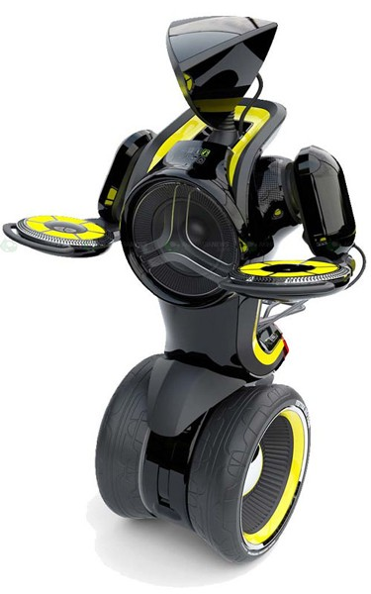
MINI-WAY
Two-wheeled self-balancing robot

Slide 2
Content
MINI-WAY
1
Introduction
2
Project Management
3
Requirement
4
Hardware Design
5
Algorithms & Implement
6
Testing & Results
7
Conclusion

Slide 3
Content
Introduction
Idea
Advantages
Existing products
Scope

Slide 4
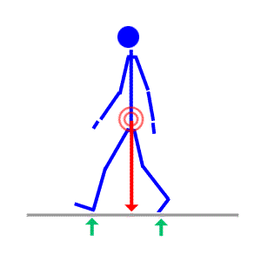
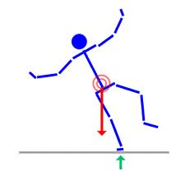
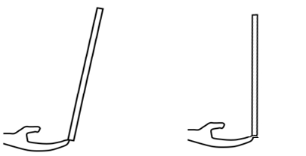
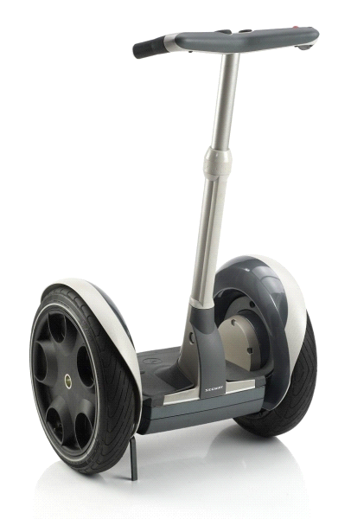
Idea
Introduction
Human’ balance
Balance a stick
Balance
Fall
Balance a stick
Two-wheeled self-balancing robot
Segway automatic electric vehicle

Slide 5
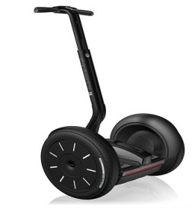
Advantages
Introduction
Narrow traffic
Environment-friendly
Strange Style
Text
Easy to use
Commodity transferring
Medium Price

Slide 6
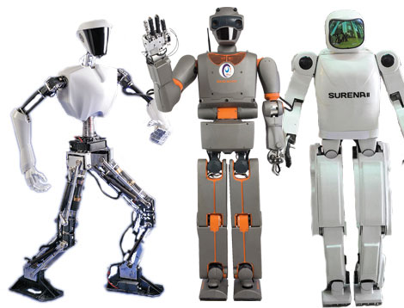
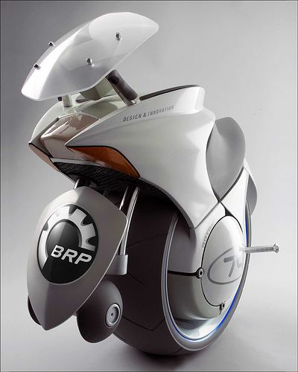
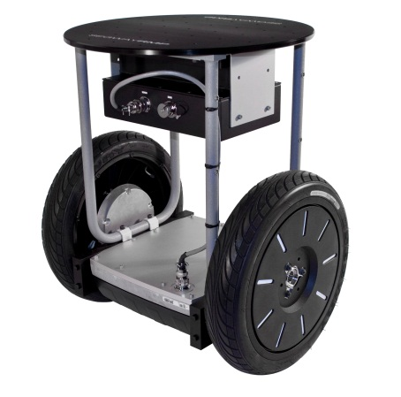
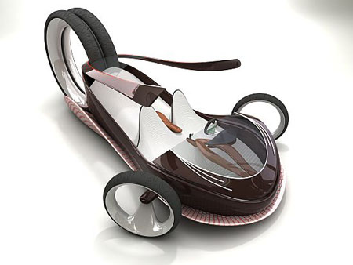
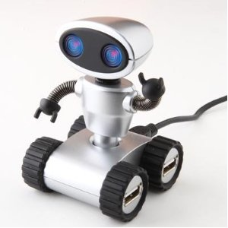
Advantages(cont.)
Introduction
Platform for the develop humanoid robot
Complement movement technology solution

Slide 7
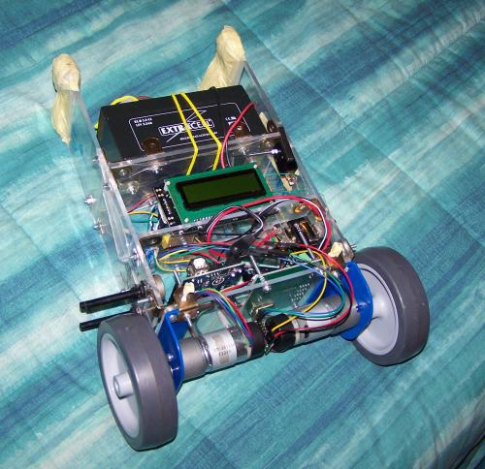
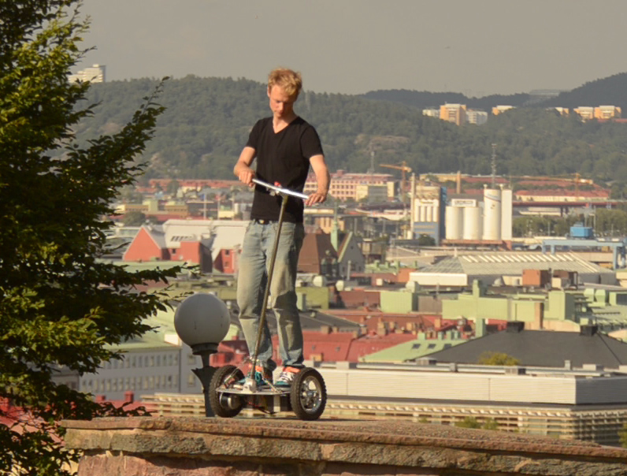
Existing products
Introduction
Nicola’s robot
CPU: Arduino diecimila
Actuators: 2 * EMG30
Sensors: IMU sensor
Cost to build: $350
DIY Segway
Controller: AtMega168
Sensors :
ADXRS614
ADXL203
Cost to build: ~$400

Slide 8
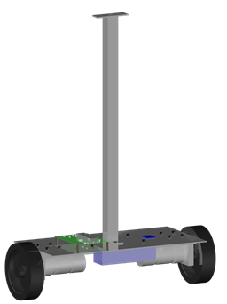
Scope
Introduction
Create small scale model similar to Segway:
High: 50cm
Overall Footprint :15cm x 30cm
Budget: $150
Schedule: 4 months
MINI-WAY clay model

Slide 9
Content
Project Management
Project Information
Project Team
Project Model
Plan
Risk
Communication

Slide 10
Project Information
Project Management
Project Name: MINI-WAY
Project code: MINI-WAY
Production type: Two-wheeled self-balancing robot
Timeline: From December 2012 to April 2013

Slide 11
Project Team
Project Management
HungPD
Supervisor
HieuNN
PM/Dev
TruongNM
Des/Dev
LamVV
Dev/Test
QuyTK
T&QA

Slide 12
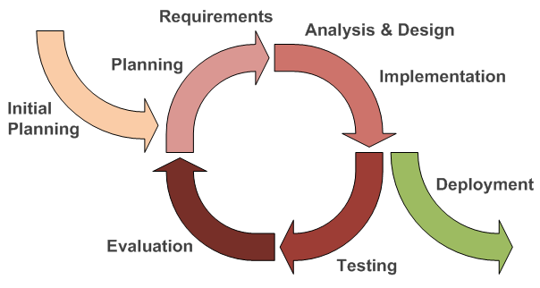
Project Model
Project Management
Iterative and Incremental Development

Slide 13
Plan
Project Management
Initiation & Planning
Execution
Technical Analysis
Monitoring & Closing
Monitoring
Project Introduce
SRS
Closing
Create Plan
Design
Implementation
Testing
Result
Deployment
16 days
83 days
14 days
Miniway_Project Plan

Slide 14
Risk
Project Management
Difficulty in:
Design hardware
Control time to purchase devices, printed circuit
Implement theory

Slide 15
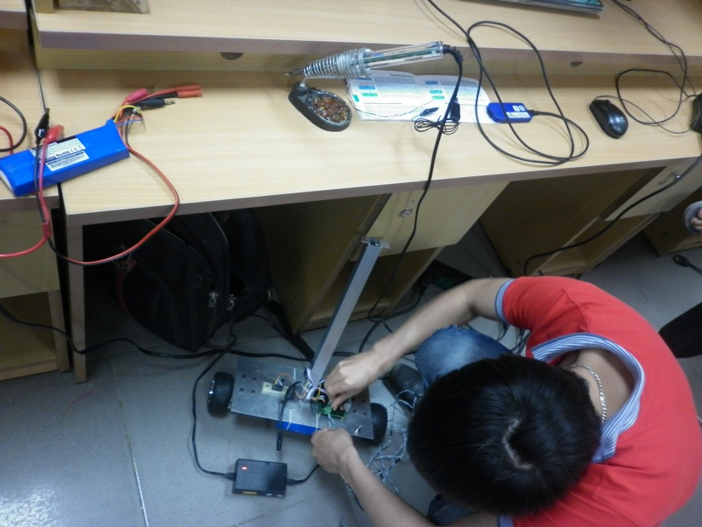
Communication
Project Management
Work offline five days per week at lab room.
Other : Email, Phone, yahoo, Facebook

Slide 16
Content
Requirement
Function Requirement
Non-functional Requirement
Mechanical Design

Slide 17
Function Requirement
Requirement
Function name | Auto balancing
Description: | The robot maintains balance position by moving forward or backward.
Normal Course of Events: | Place the robot on a flat surface and hold it in balance position Switch power ON Let the robot move arround freely
Special Requirements: | The robot must not venture more than 70 centimeters from starting point. Vertical position must not exceed 30 degree
Function name | Rebalance
Description: | The robot need to recover itself from external disturbance
Normal Course of Events: | The robot is powered on and maintaining balace position Use hand to alternate it anglular postion Let the robot rebalace
Special Requirements: | The robot must not regain balace postion while not moving more than 1.5 meter from starting point. In case of unable recovery, the robot should perform auto shutdown or temporary disable its electric motor

Slide 18
Non-functional Requirement
Requirement
Performance
Power-on setup time is less than two second.
Drift no more than 5 degrees from set-point while standing.
Serviceability
All component could be disassemble and reassemble by hand tool, no special equipment required.
Accumulated operating time before major repair: 1 week.
Reliability
Onboard firmware should be able to run at least 2 hours continuously without the need of manual or auto reset.
Cost
Total build cost is less than 300$.
Safety
Electronics and mechanical part is well secured.
All connector and electrical join is insulated.

Slide 19
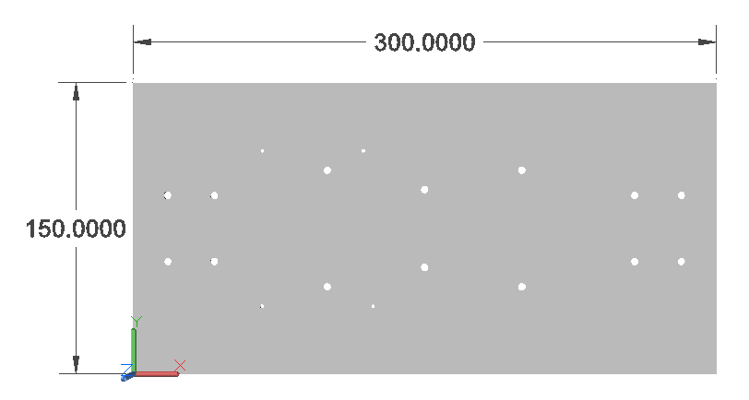
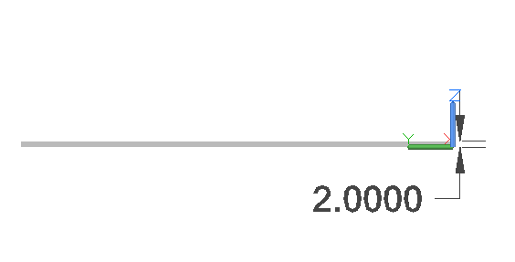
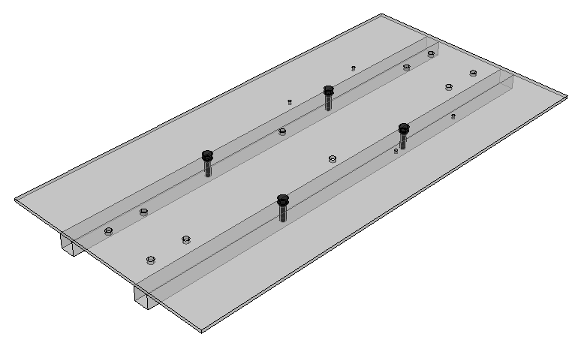
Mechanical Design
Requirement

Slide 20
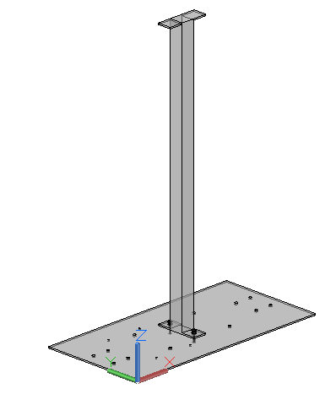
Mechanical Design(cont.)
Requirement

Slide 21
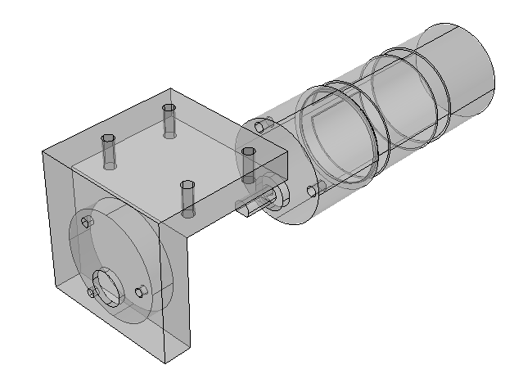
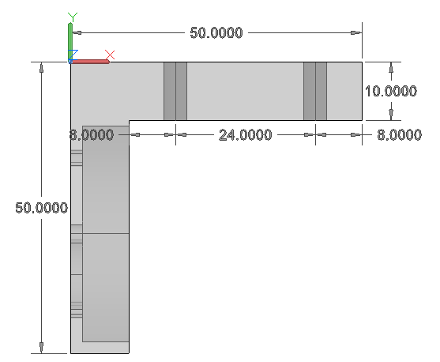
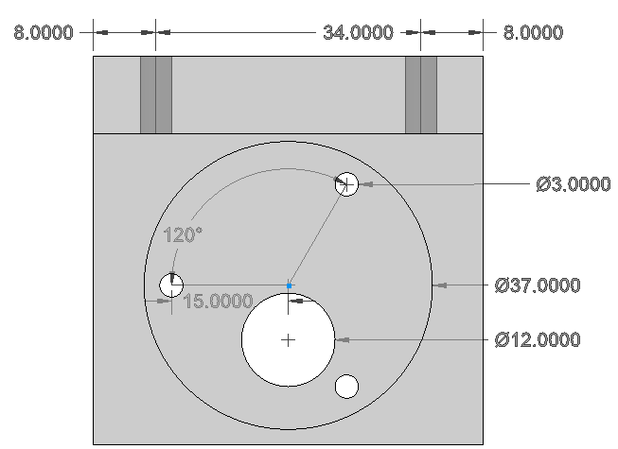
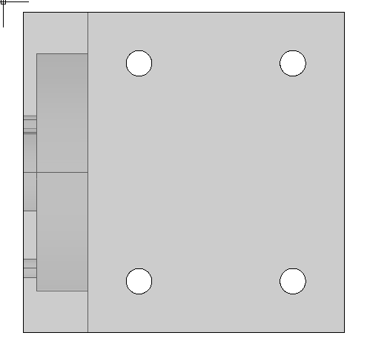
Mechanical Design(cont.)
Requirement

Slide 22
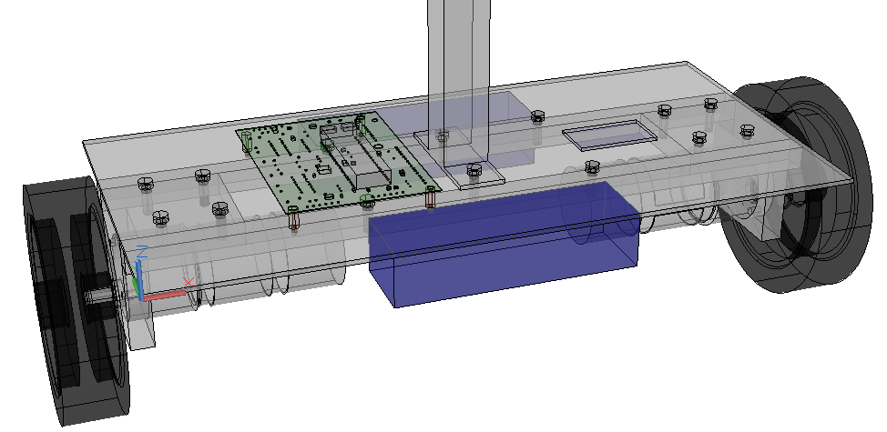
Mechanical Design(cont.)
Requirement

Slide 23
Content
Hardware Design
System Architecture
Block Diagram
Tools
Devices
Controller Broad Design
Printed Circuit
Final board

Slide 24
System Architecture
Hardware Design

Slide 25
Block Diagram
Hardware Design

Slide 26
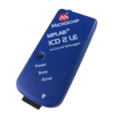
Tools
Hardware Design

Slide 27
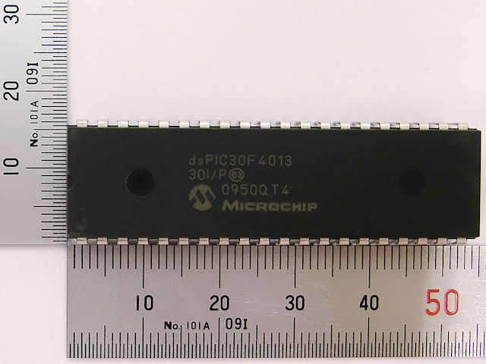
Devices
Hardware Design
Microcontroller
Fast 16-bit microprocessor
48 Kbytes on-chip Flash
1 x I2C module
2 x UART modules
4 x PWM output
Low power consumption
dsPIC30F4013 30I/P

Slide 28
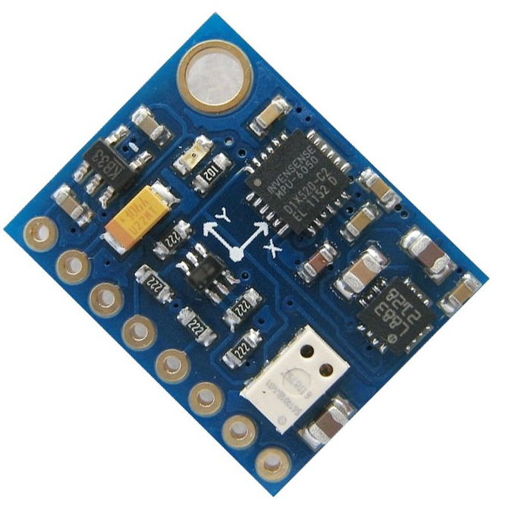
Devices(cont.)
Hardware Design
IMU Sensor
Triple Axis Accelerometer
Triple Axis Gyroscope
IIC Communication
Operate at 3.3/5v
Easy to configure
GY-86 (MPU6050-HMC5883l-MS5611)

Slide 29
Devices(cont.)
Hardware Design
Bluetooth module
Long range, high sensitivity
Bluetooth 2.0 compatible
UART Interface
Easy to configure with AT command
HC-06 Bluetooth module

Slide 30
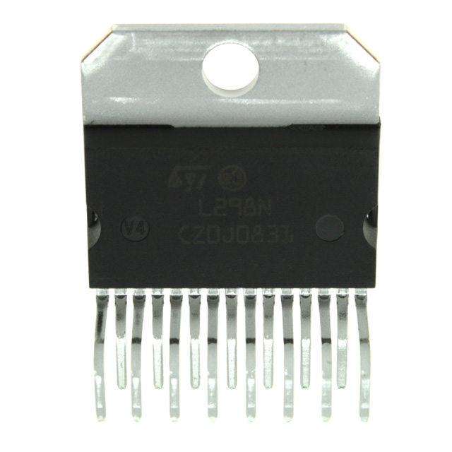
Devices(cont.)
Hardware Design
Motor controller
Operating supply voltage of up to 46V
Total DC current of up to 4A
Accept standard TTL logic levels
Over-temperature protection
L298N dual H-Bridge motor driver

Slide 31
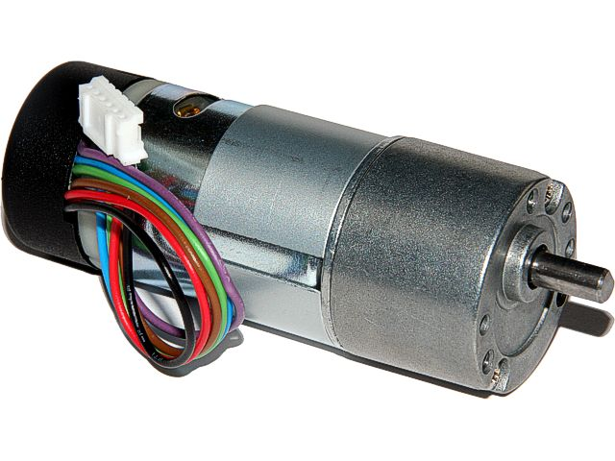
Devices(cont.)
Hardware Design
Motor
Operate at 12 Volt
Compact
Built-in encoder
12 volt brushed DC motor with planetary gearbox

Slide 32
Devices(cont.)
Hardware Design
Battery
High capacity
High discharge rate
Small and light
Turnigy 2200mAh 3S 20C Lipo Pack

Slide 33
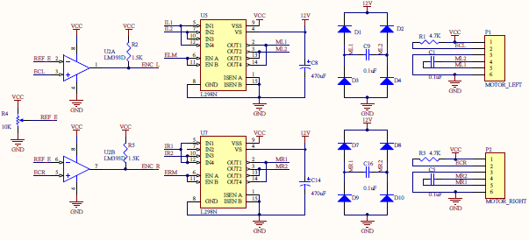
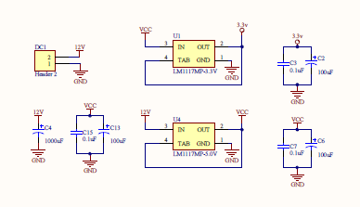
Controller Broad Design
Hardware Design
Dual motor driver
Microcontroller and headers
Power supply

Slide 34
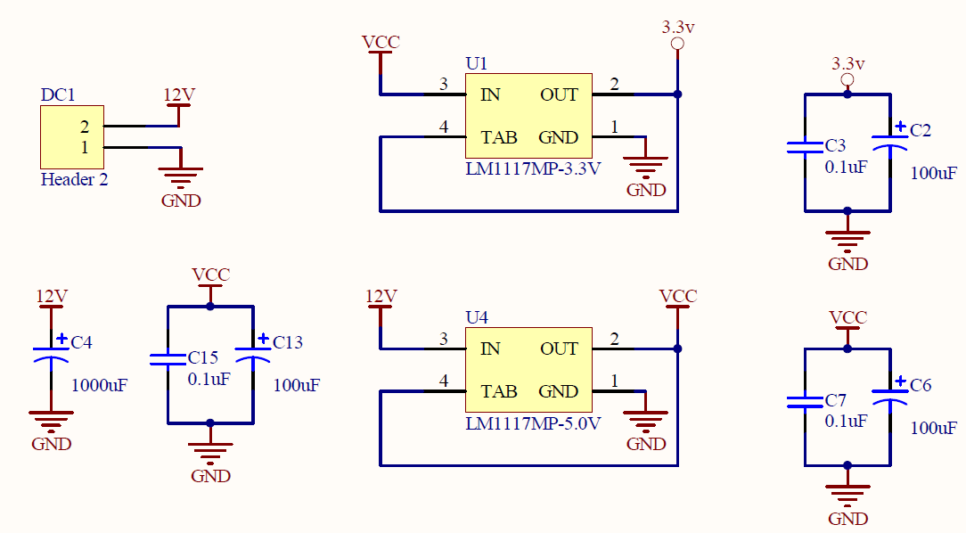
Controller Broad Design(cont.)
Hardware Design

Slide 35
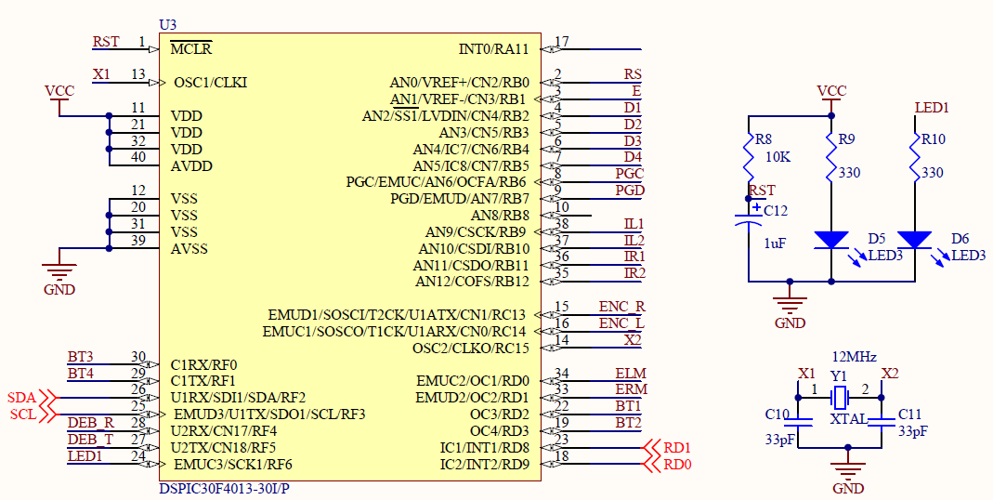
Controller Broad Design(cont.)
Hardware Design

Slide 36
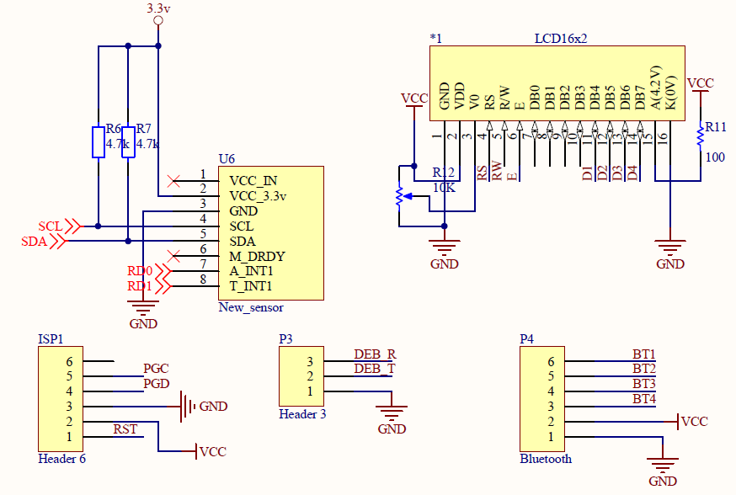
Controller Broad Design(cont.)
Hardware Design

Slide 37
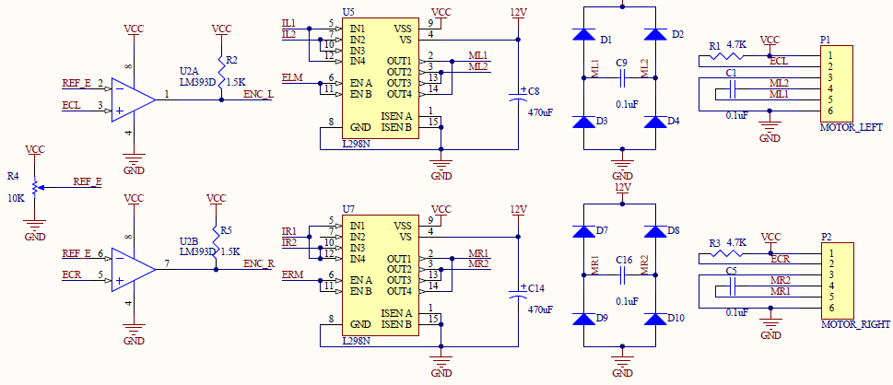
Controller Broad Design(cont.)
Hardware Design

Slide 38
Printed Circuit
Hardware Design

Slide 39
Final board
Hardware Design

Slide 40
Content
Algorithms & Implement
Algorithms
Implement
Experiment

Slide 41
PID Algorithm
Algorithms
PID – Proportional Integral Derivative
Equation:
Where
$$u\left(t\right)= K_{p}∗e\left(t\right)+K_{i}∗\int{e\left(t\right)dt}+K_{d}∗\frac{d}{dt}e(t)$$
Symbol | Description
$$SP$$ | Set-point: the balance position of the robot
$$PV$$ | Process variable: the position of the robot
$$u$$ | Output
$$K_{p}$$ | Proportional term
$$K_{i}$$ | Integral term
$$K_{d}$$ | Derivative term
$$e$$ | Error = SP - PV
$$t$$ | Time

Slide 42
PID Controller
Algorithms
PID controller for balancing robot:

Slide 43
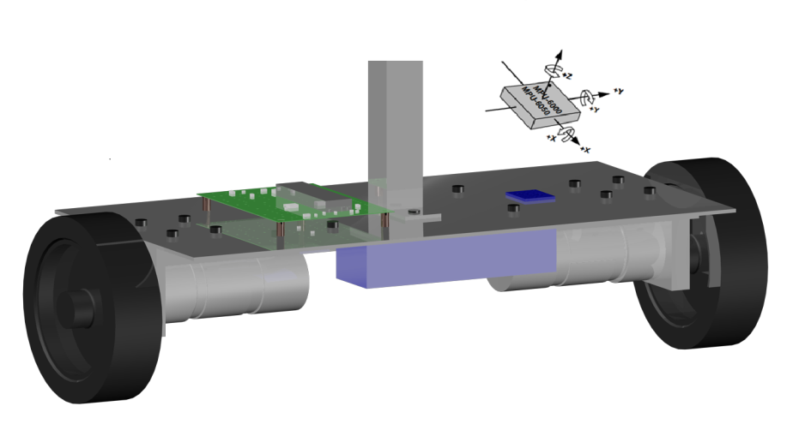
Tilt Angle Calculation
Algorithms
Angle: 𝜃 = $\int{θ′dt}$ (code: 𝜃 = 𝜃 + 𝜃 * Sample period)
𝜃 = (180/Pi) * Arctan[ Rx/SQRT(Ry² + Rz²) ]

Slide 44
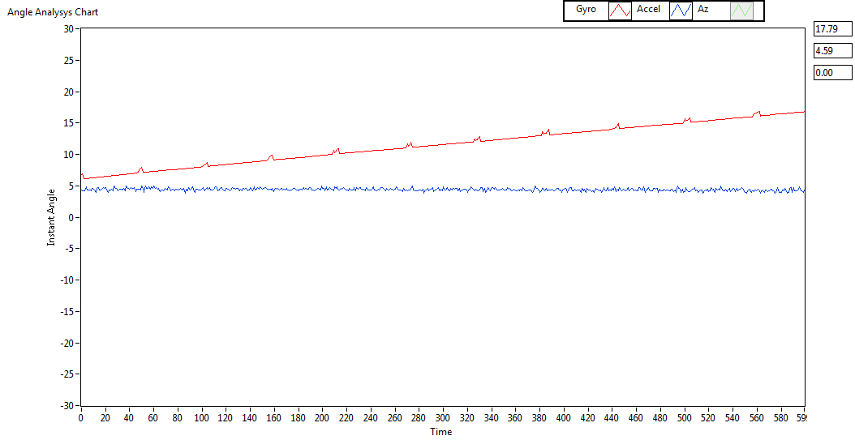
Algorithms
Gyro Angle Drift

Slide 45
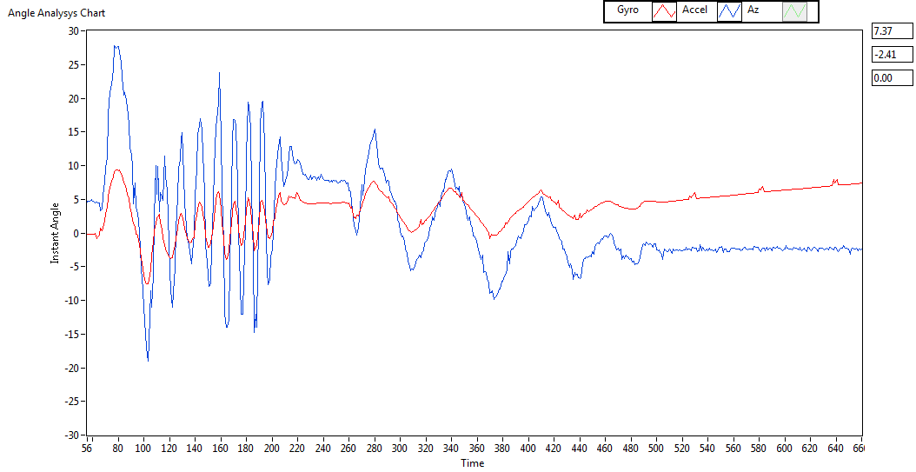
Accelerometer Angle fluctuate
Algorithms

Slide 46
Filter
Algorithms
Complementary Filter

Slide 47
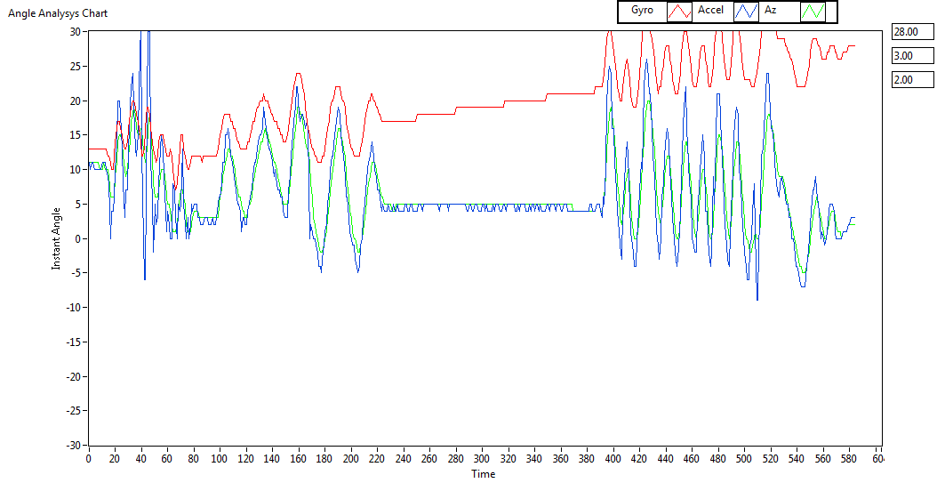
Complementary Filter
Algorithms

Slide 48
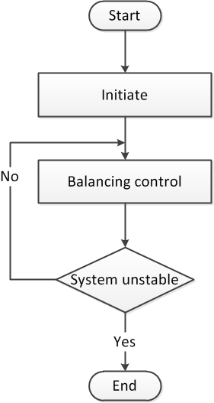
Firmware
Implement
System Flowchart:

Slide 49
Firmware
Implement
Initiate Process:

Slide 50
Firmware
Implement
Balancing Process:

Slide 51
Firmware
Implement
Complimentary Filter Process:

Slide 52
Firmware
Implement
PID Calculator Process:

Slide 53
Firmware
Implement
Motor Controller Process:

Slide 54
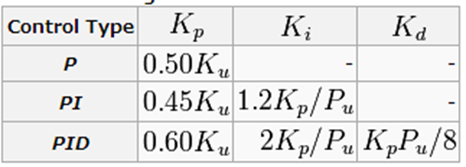
PID Tuning
Experiments
Step 1: Tuning only Proportional term (Ki = 0, Kd = 0).
Step 2: Using Ziegler-Nichols method equations:
Where
Step 3: Correction Kp, Ki, Kd.
Symbol | Description
$$K_{u}$$ | Ultimate gain of Kp
$$P_{u}$$ | Oscillation period

Slide 55
PID tuning
Experiments
Tuning with $K_{p}=9000$

Slide 56
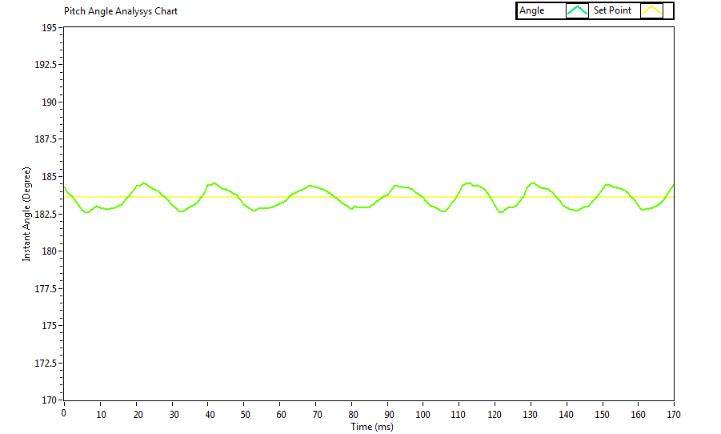
PID tuning
Experiments
Tuning with $K_{p}=25000$

Slide 57
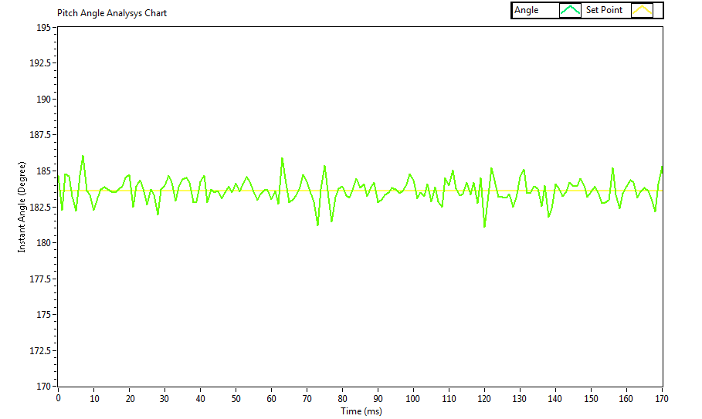
PID Controller
Experiments
With $K_{p}=11250, K_{i}=67500.$

Slide 58
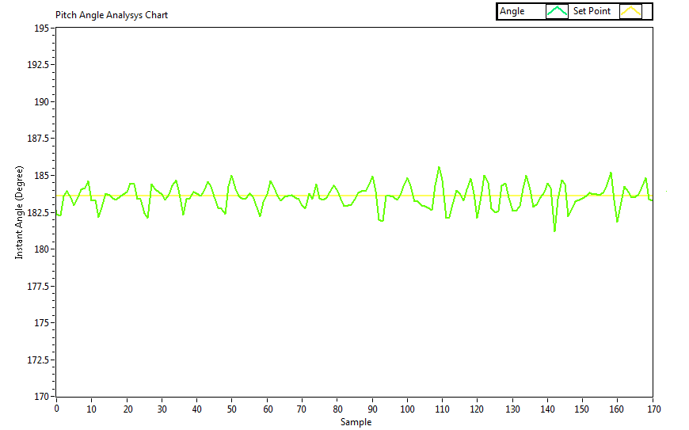
PID Controller
Experiments
With $K_{p}=15000, K_{i}=150000, K_{d}=375.$

Slide 59
PID Controller
Experiments
With $K_{p}=15000, K_{i}=300000, K_{d}=37.5$

Slide 60
Testing & Results
Content
Test Plan
Test Item Example
Test report
Test result

Slide 61
Testing & Results
Test Plan
Device testing
Unit test
Function test
System test

Slide 62
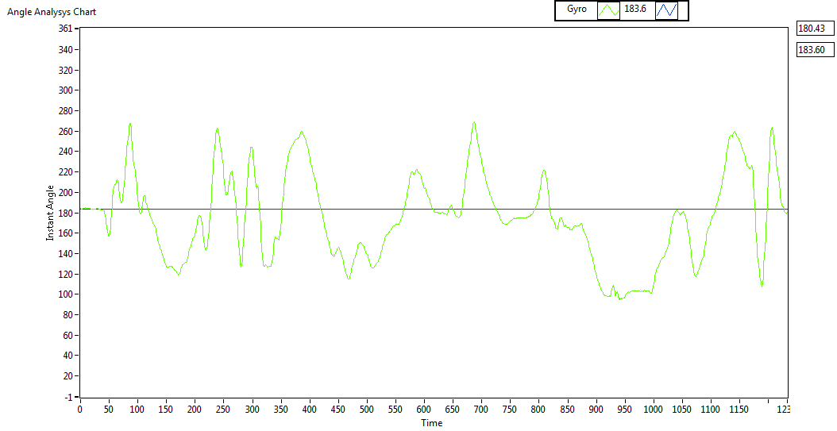
Testing & Results
Test Item Example

Slide 63
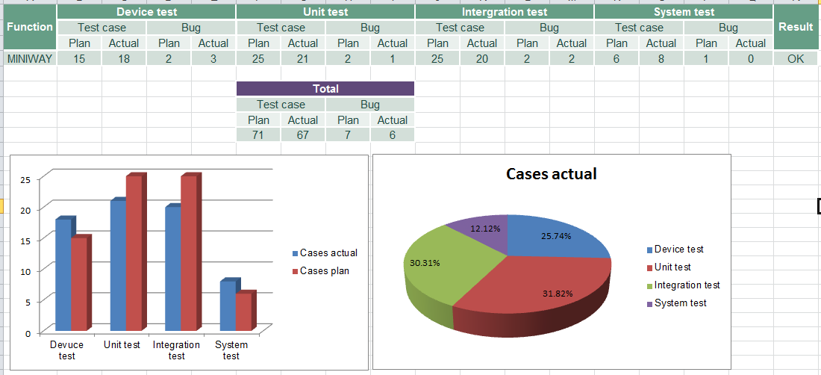
Testing & Results
Test Report

Slide 64
Testing & Results
Test Result
Test result:
 | Device test | Unit test | Integration test | System test | Total
Pass | 18 | 21 | 20 | 8 | 100%
Fail | 0 | 0 | 0 | 0 | 0%
Untested | 0 | 0 | 0 | 0 | 0%
Total | 18 | 21 | 20 | 8 | 100%
Bug result:
 | Device test | Unit test | Integration test | System test | Total
Fixed | 3 | 1 | 1 | 0 | 83.33%
Fail | 0 | 0 | 1 | 0 | 16.67%
Total | 3 | 1 | 2 | 0 | 100%

Slide 65
Conclusion
Content
Limitation
Perspective
Demo

Slide 66
Conclusion
Limitation
For now, MINI-WAY robot can just auto balancing only on a flat surface.
The robot is still a small model for two wheel balancing robot. The robot can just carry small thing that is not too heavy.

Slide 67
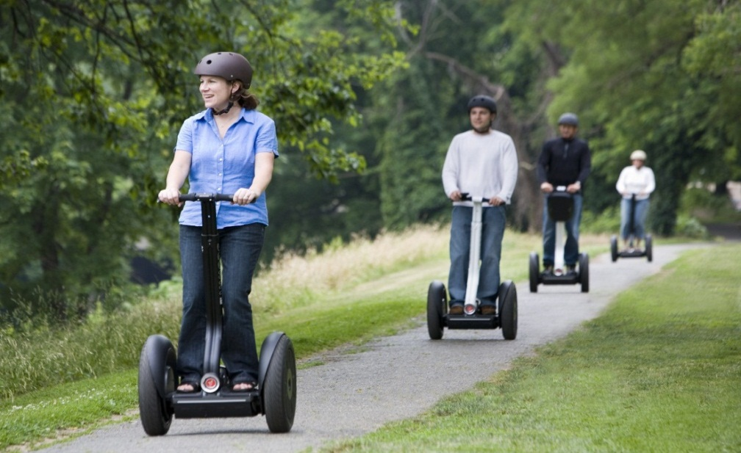
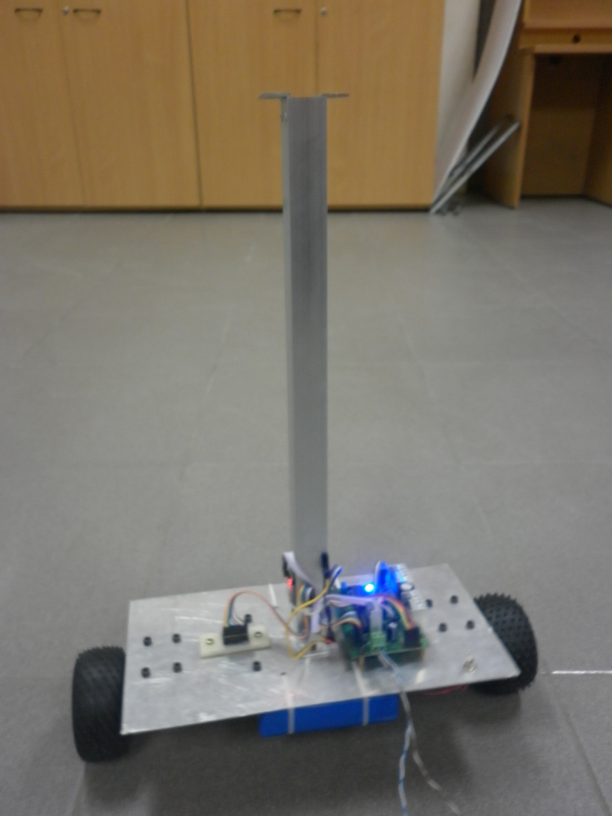
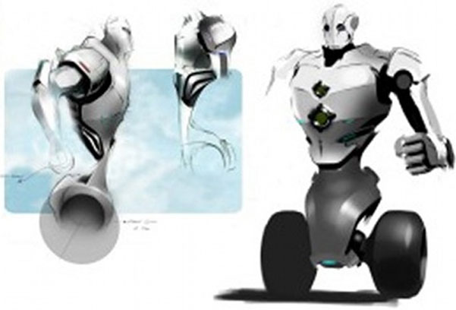
Conclusion
Perspective

Slide 68
Conclusion
Demo
Demo

Slide 69
Thank You !

