Slide 1
Detecting botnet command and control domain names
Student: Vu Cong Thanh
Supervisor: Le Hong Phuong
Supporter: Nguyen Minh Duc

Slide 2
Table of contents
Introduction
Solutions
  Textual Analysis
  Graph relationship
Development
  Demo
Conclusion
Q&A

Slide 3
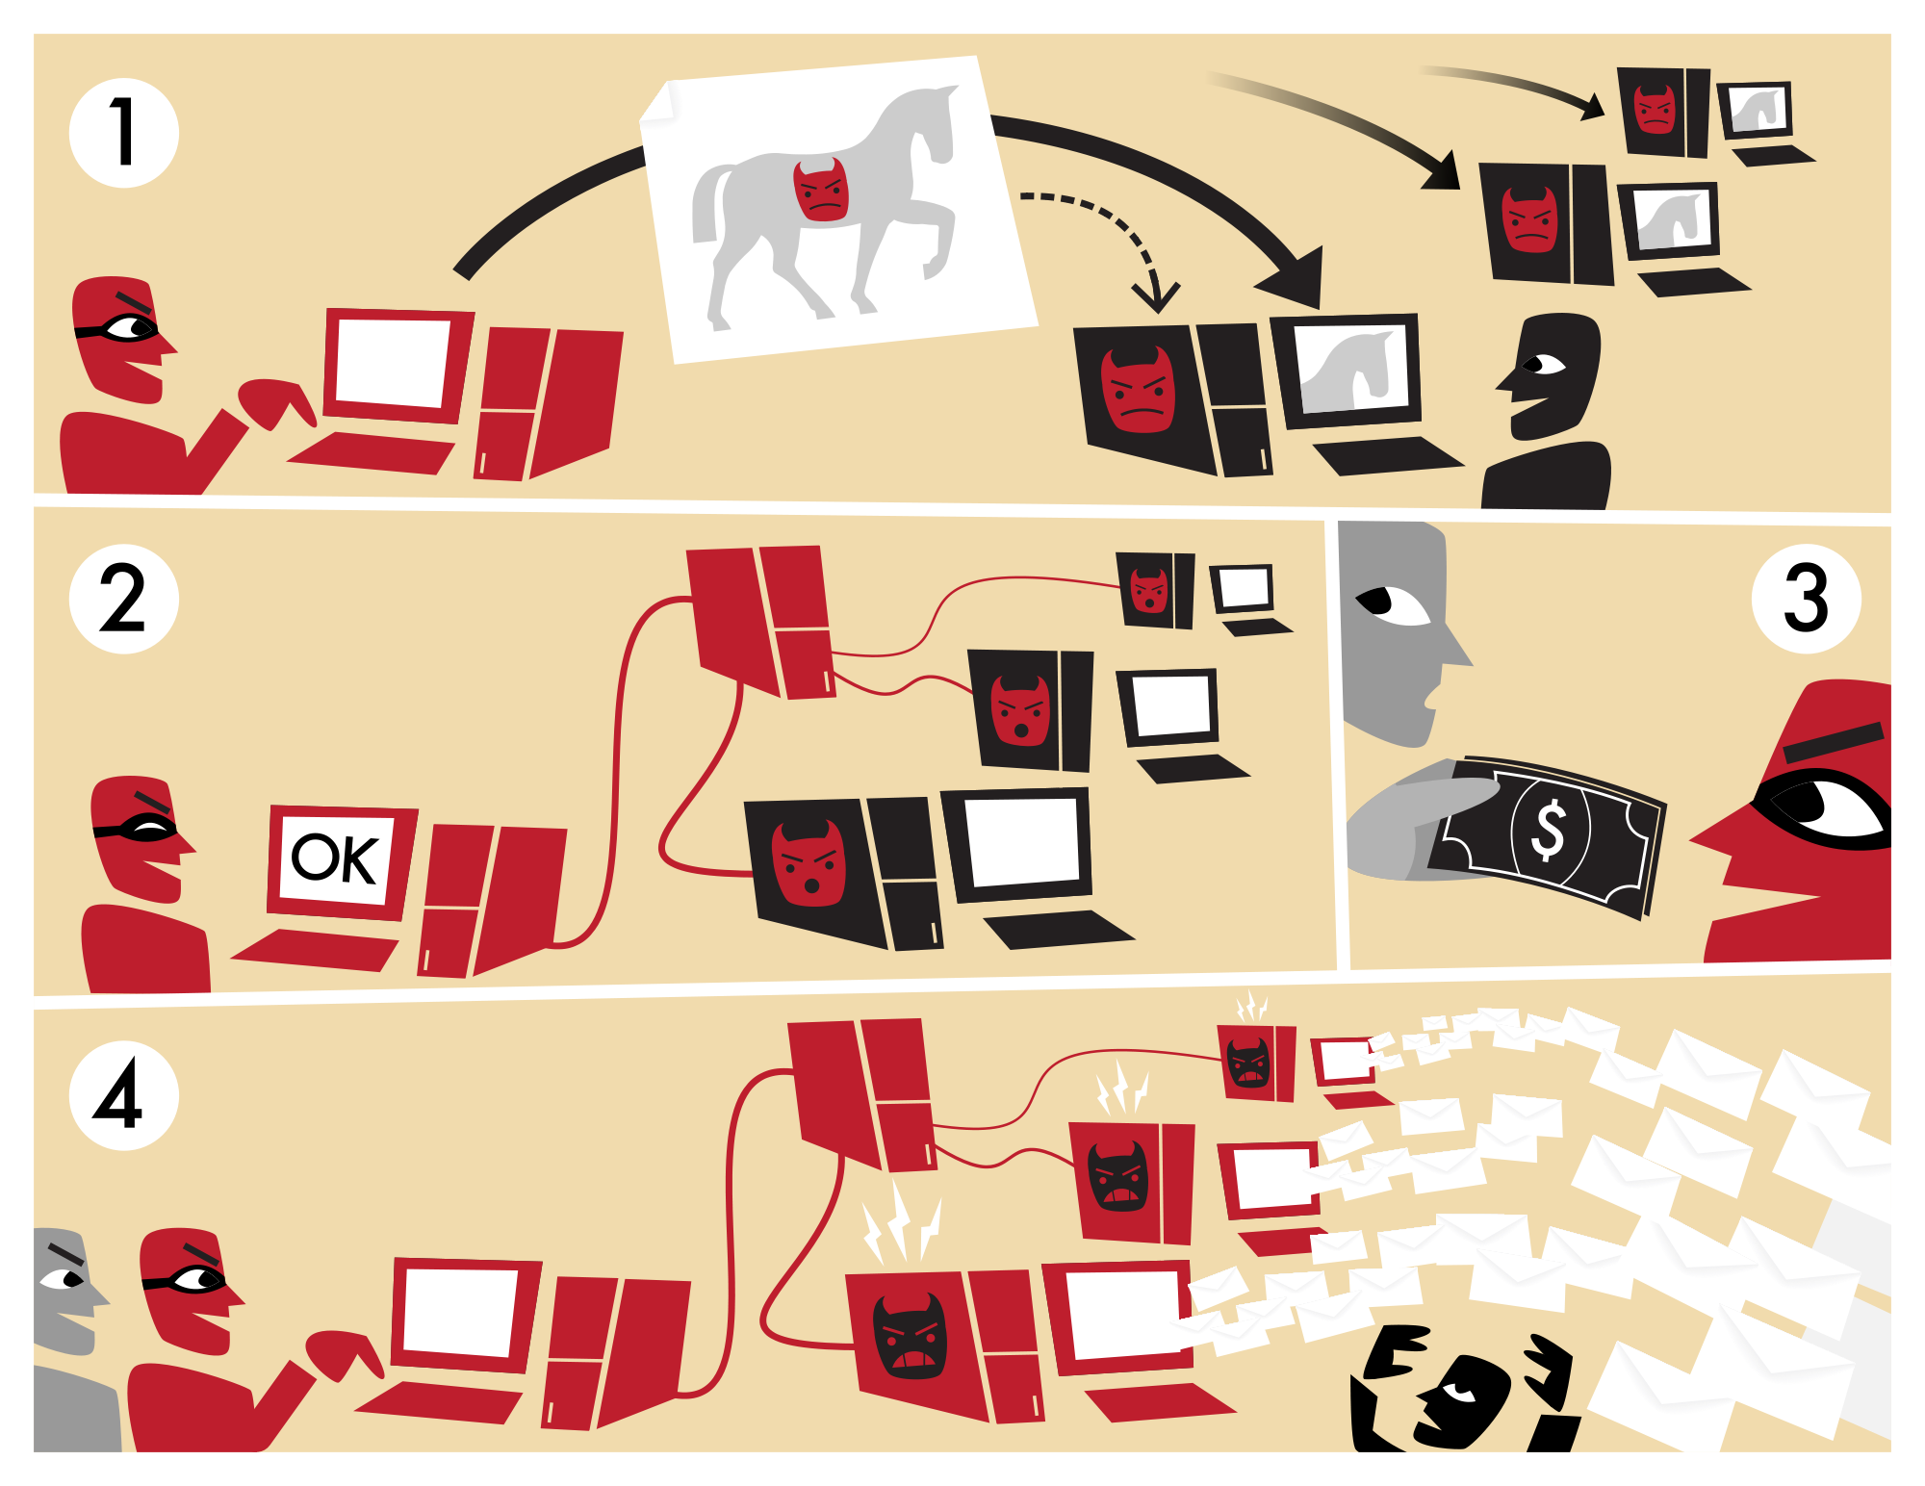




Detecting botnet C&C domain name
Botnet – the rise of modern virus
Botnet connection protocol
Botnet use DGA to generate domains
Current detection systems are blind
F
I
R
E
W
A
L
L
In-Blacklist.com
Look-safe.net

Slide 4
Detecting botnet C&C domain name
Can we detect malicious domain name at the time it registers and before it performs an attack?

Slide 5
Solution – Textual Analysis
Dataset
  Legitimate set:
    Collected from top 500 domains of each popular country
    Top 1.000.000 domains of Alexa
  Malicious set:
    DNS – BH Project (malwaredomains.com, 2015)
    Bambenek Consulting Cybersecurities Services (Bambenek, 2015)

Slide 6
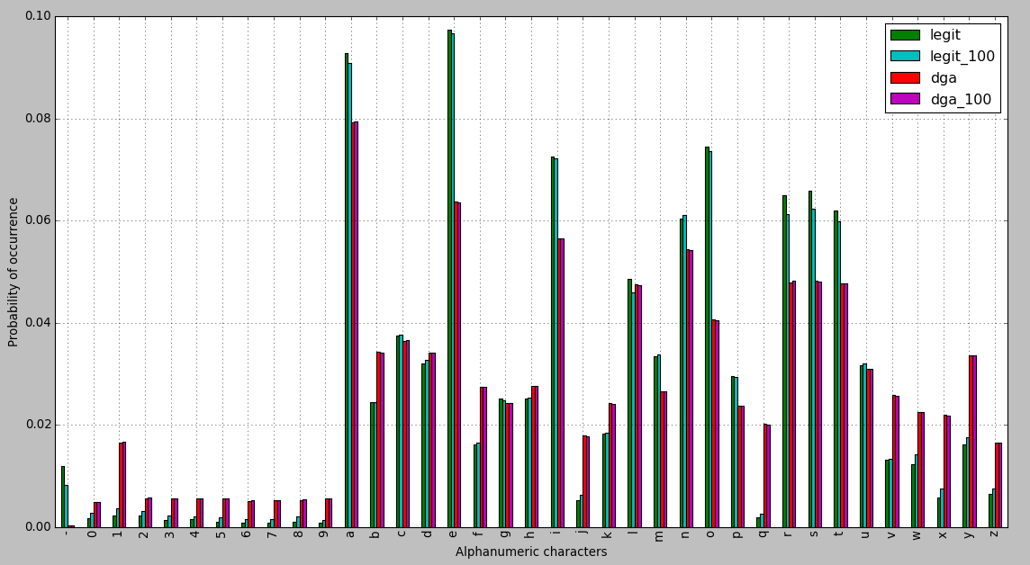
Solution – Textual Analysis
Algorithm Overview

Slide 7
Solution – Textual Analysis
Feature extraction
  Base feature (length, has digits, has minus, is sub-domain…)
  Entropy
  N-grams
Measure of divergence
  Kullback – Leibler divergence
  Jaccard Index measure
  Multiplying matrix

Slide 8
Solution – Textual Analysis
Validation
  Experiment 1: Using base features and entropy
  Experiment 2: Using base features, entropy and apply K-L measure, Jaccard Index
  Experiment 3: Using base features, entropy and apply multiple matrix

Slide 9
Solution – Graph Relationship
The main idea
Database schema
Case study

Slide 10
Development
Project deploy at http://bat.0x1115.org
Main functions:
  Check domain name
  Visualize domain
  Evaluate result
  Feedback
Demo

Slide 11
Conclusion
Summary
  Textual Analysis method have predicted correct about 93.13% domain in testing set.
    The model with best score is Random Forest Classifier
    The most characteristic features of this method is entropy and n-gram distribution
  Graph relationship can detect hidden threat, but has some disadvantages:
    Do not have diverse sources to crawl
    Problem with share host or public IP
    Problem with hidden IP like CloudFlare
    The important evidence, registrar information is hide easily.

Slide 12
Conclusion
Future work
  Deploy REST API system
  Analyze textual of domain name oriented by country and languages
  Use user evaluation to improve results

Slide 13
Question & Answer

Slide 14
Thank you!

