Slide 1


Future Lock Security
Future Lock Security
Group Member | Nguyễn Văn Tuyền – SE02119
 | Vũ Ngọc Linh – 01138
 | Vũ Văn An – SE02207
Supervisor | Hoàng Xuân Sơn
Project Code | Future Lock Security

Slide 2


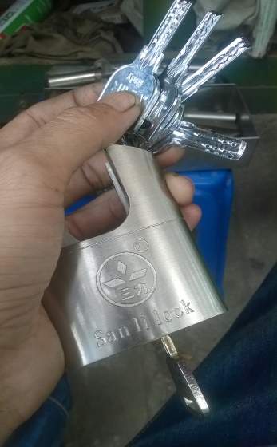
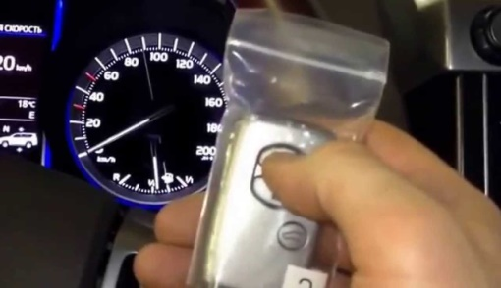
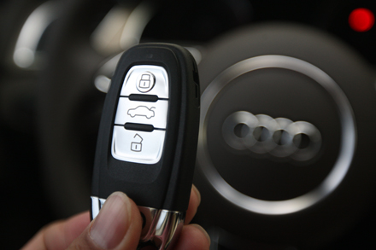
Project Introduction
Future Lock Security
Idea of capstone project:

Slide 3
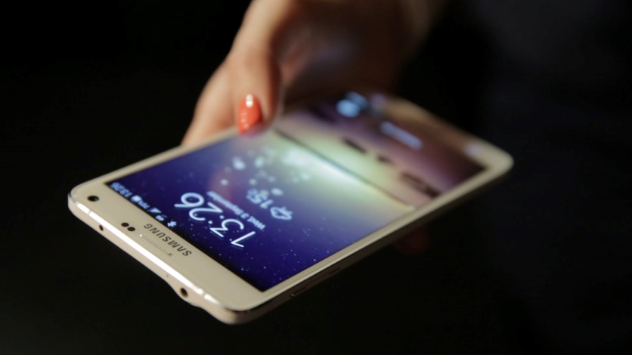
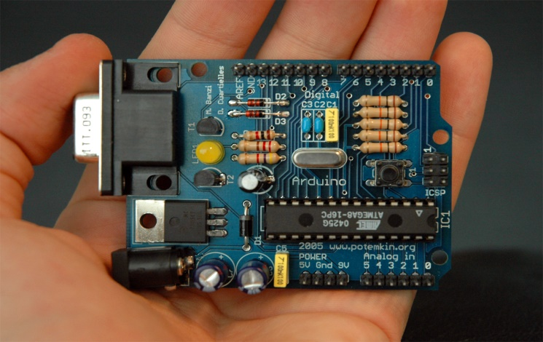
Project Introduction
Future Lock Security
* Scope

Slide 4
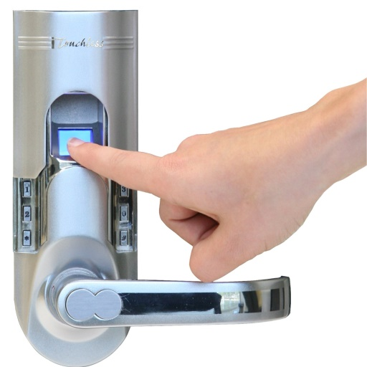
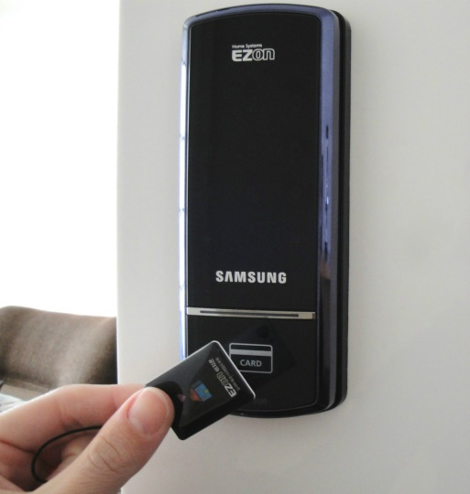
Project Introduction
Future Lock Security
* Existing products

Slide 5
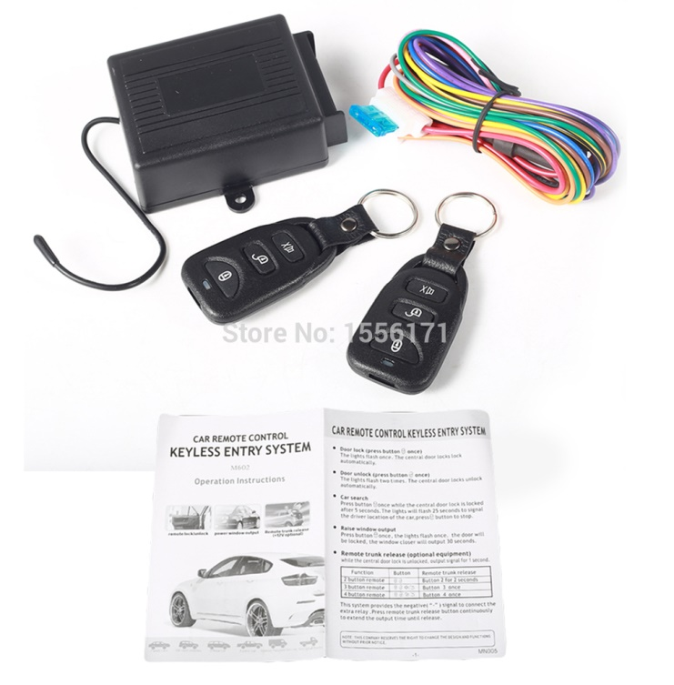
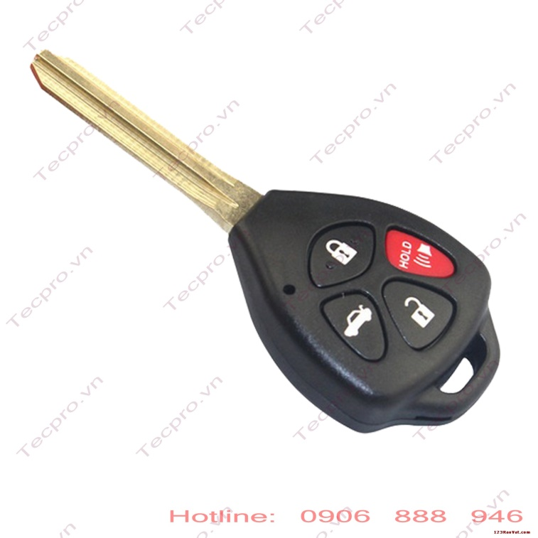
Project Introduction
Future Lock Security
* Existing products

Slide 6
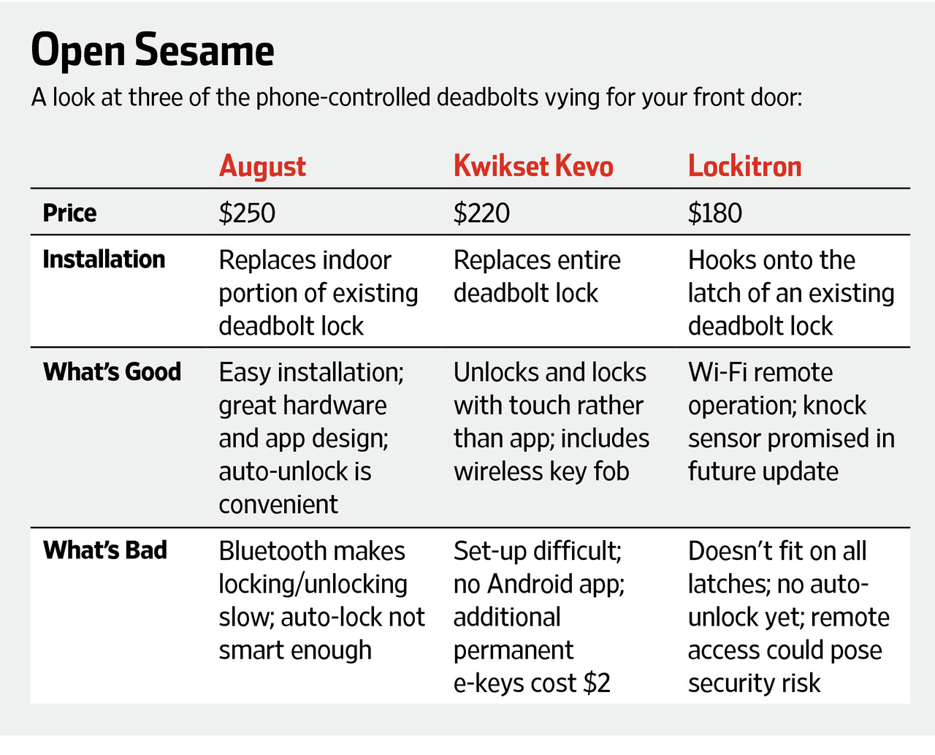
Project Introduction
Future Lock Security

Slide 7
Future Lock Security
Software project management
Problem Definition:
Name of this CapStone Project.
Problem Abstract.
Project Overview.
_ The Proposed System.
_ Boundaries of the System.
_ Development Environment.

Slide 8
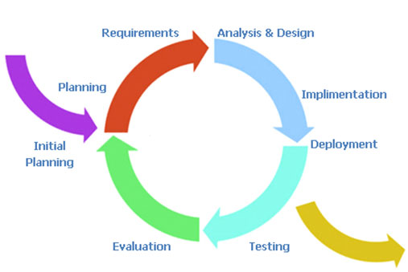
Future Lock Security
Software project management
Project organization:
The Iterative and Incremental Model:

Slide 9
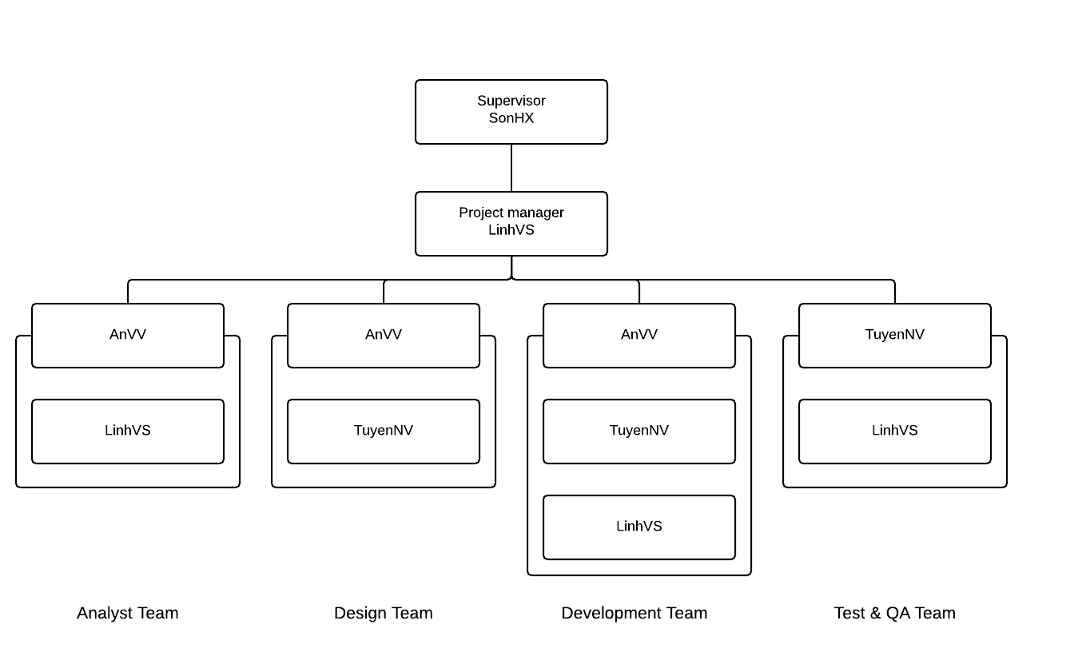
Future Lock Security
Software project management
Project organization:
Roles and Responsibilities:

Slide 10
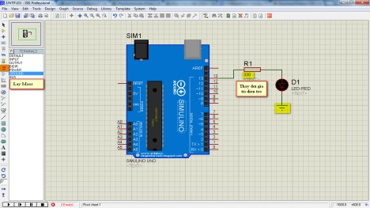


Future Lock Security
Software project management
Project organization:
Tools and Techniques:
Proteus.
Arduino IDE.
Android Studio.

Slide 11
Software requirements specification
Future Lock Security
User Requirement Specification
_ User requirement.
_ Lock system requirement.
_ Android application requirement

Slide 12
Software requirements specification
Future Lock Security
System Requirement
Interface requirement
_ User interfaces.
_ Hardware interfaces.
_ Application interface.
_ Communications Protocol.

Slide 13
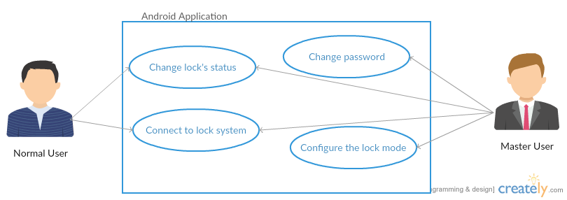
Software requirements specification
Future Lock Security
System Requirement
Functional Requirements.
_ Overall.
_ Use Case Diagram and Specification.

Slide 14
Software requirements specification
Future Lock Security
No | Use Case Name | Summary
A1 | Change lock’s status | User tap on the status icon to change the status of the lock
A2 | Connect to the lock system | User select the lock system from bluetooth list (can change to auto connect) and enter the password
A3 | Change password | Master User can change the current password to the new one
A4 | Configure the lock mode | Master User can change the parameters in the lock mode (auto mode, smart mode,….)

Slide 15
Software requirements specification
Future Lock Security
Infrastructure and Tools:
_ Hardware:
No | Item | Why do we use it?
1 | Arduino Uno | Popular and approach to new products. 3
2 | HC-05 | New module communicate using Bluetooth.
3

Slide 16
Software requirements specification
Future Lock Security
Non-functional Specification
Reliability
Performance Requirements
_ Availability
_ Response time
_ Usability
_ Hardware/Software Requirements

Slide 17
Software DESign specification
Future Lock Security
Design overview
- System Architecture
- Component Diagram
- Sequence Diagram
- Hardware Interface Design
- Theories and Algorithms

Slide 18
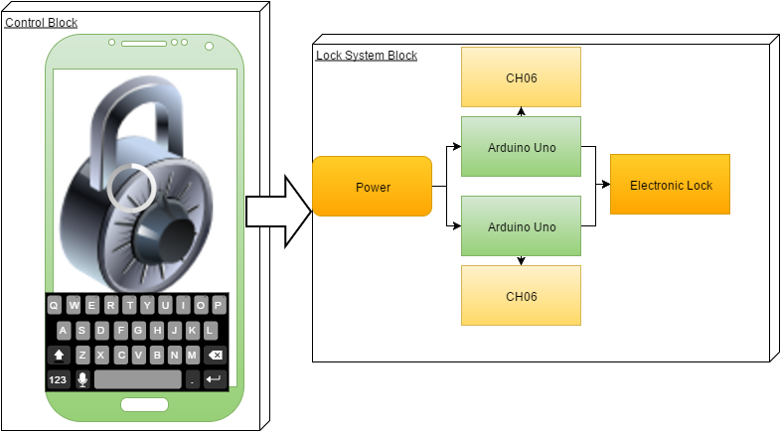
Software DESign specification
Future Lock Security
System Architectural Design
- Choice of System Architecture

Slide 19
Software DESign specification
Future Lock Security
System Architectural Design
- Description of the System Interface.
- Power: This component is used so supply energy power for circuit.
- Arduino Uno: : Communicate with the android application via HC05, handling the data, control the electric lock via digital port.
- HC05: Transfer data from android application to Arduino via bluetooth.
- Electronic Lock: This component is control by Arduino Uno.

Slide 20
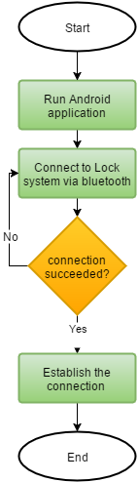
Software design specification
Future Lock Security
System Flowchart
Connect to HC-05 module

Slide 21
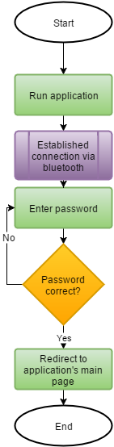
Software design specification
Future Lock Security
System Flowchart
Access to the lock system

Slide 22
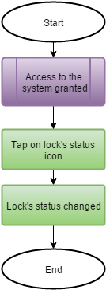
Software design specification
Future Lock Security
System Flowchart
Change lock’s status

Slide 23
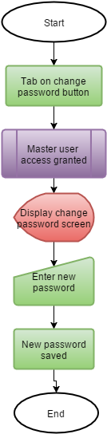
Software design specification
Future Lock Security
System Flowchart
Change password

Slide 24
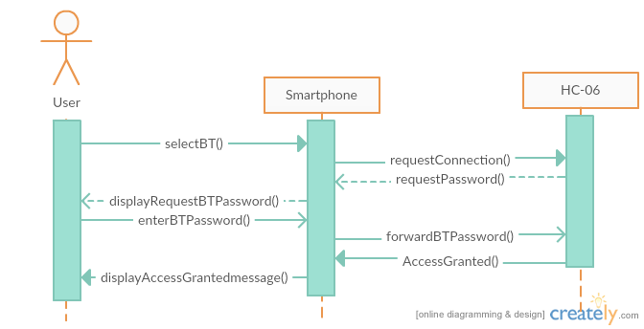
Software design specification
Future Lock Security
Sequence Diagram
Connect to HC-05 module

Slide 25
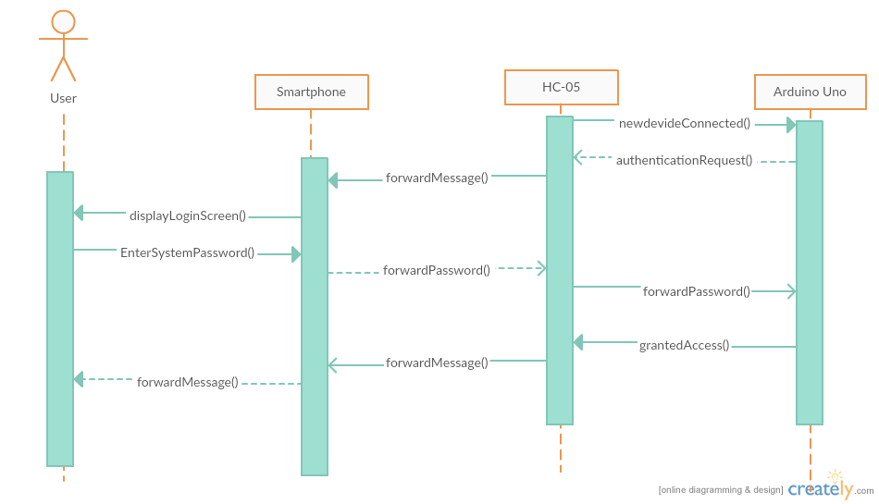
Software design specification
Future Lock Security
Access to the lock system

Slide 26
Project Introduction
Future Lock Security
Change lock’s status

Slide 27
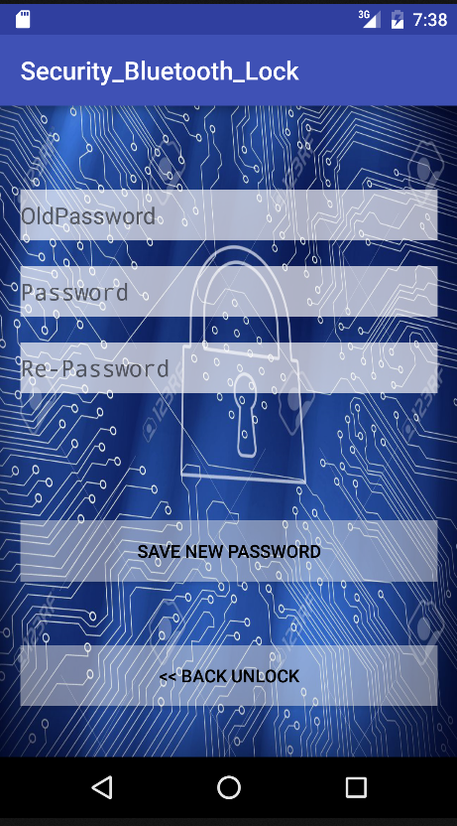
Software design specification
Future Lock Security
User Interface Design/
Hardware Interface Design
User Interface Design
_ Android’s User Interface Design

Slide 28
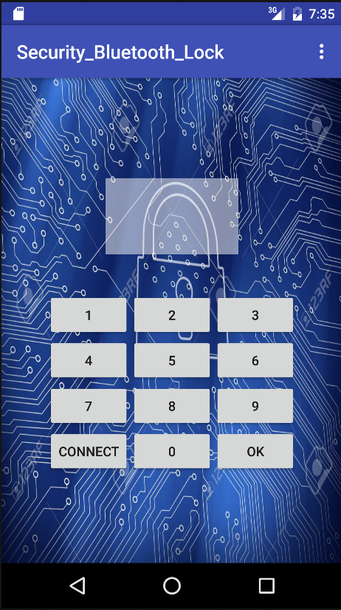
Software design specification
Future Lock Security
User Interface Design/
Hardware Interface Design
User Interface Design
_ Android’s User Interface Design

Slide 29
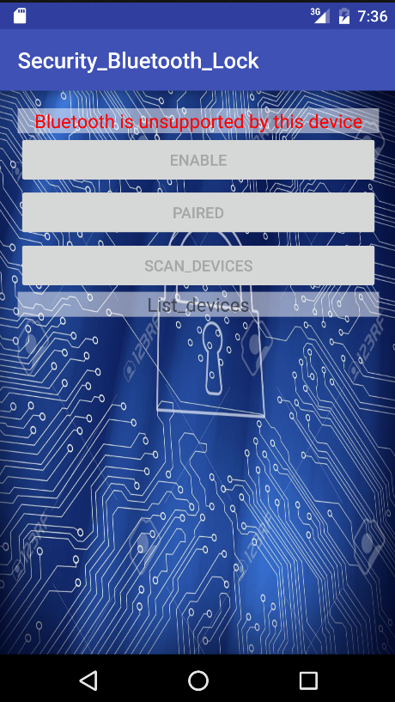
Software design specification
Future Lock Security
User Interface Design/
Hardware Interface Design
User Interface Design
_ Android’s User Interface Design

Slide 30
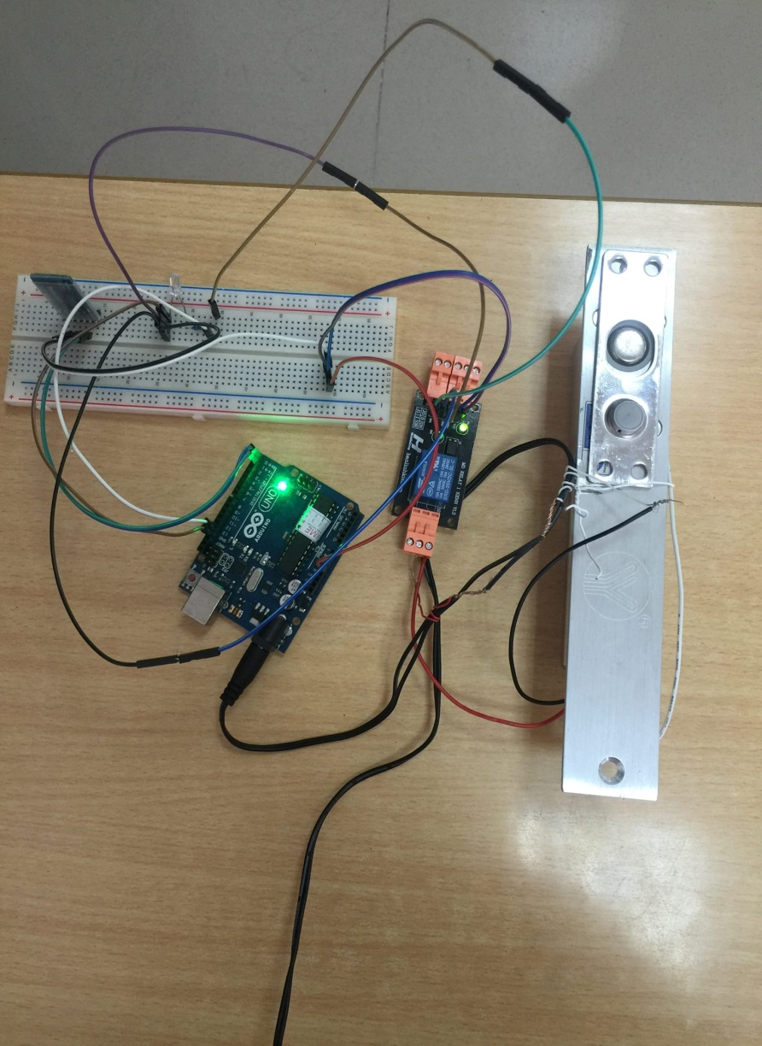
Software design specification
Future Lock Security
User Interface Design/
Hardware Interface Design
_ Physical design illustration

Slide 31
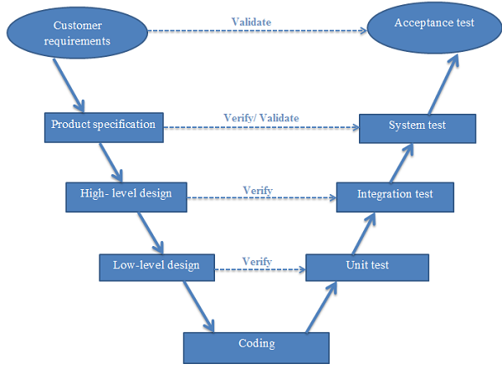
System implementation & test
Future Lock Security
  * Introduction
* Test Overview

Slide 32
System implementation & test
Future Lock Security
  _ Introduction
  _ Test Overview
  _ Test Strategy
  _ Test Plan
  _ Scope of Testing
  _ Requirements for Testing
  _ Test Strategies

Slide 33
System implementation & test
Future Lock Security
  * Introduction
* Test Overview

Slide 34
USER’S GUIDE
Future Lock Security
USER’S GUIDE
Purpose
Function’s Description
Detailed Guidelines
CONCLUSION

Slide 35
USER’S GUIDE
Future Lock Security
CONCLUSION:
_ Development.
_ Advantage and Disadvantage
_ Advantage
_ Disadvantage
_ Skill learned

Slide 36


