Slide 1
CAPSTONE PROject student identity tracking & assistance
Supervisor: Mr. Phan Trường Lâm
Ext Supervisor: Mr. Lưu Xuân Trường
Mr. Quách Ngọc Xuân
Group Member:
Nguyễn Quý Dương – SE02934
Phạm Huy Hoàng – SE2658
Trương Ngọc Anh – SE02984
Nguyễn Mạnh Đạt – SE02656

Slide 2
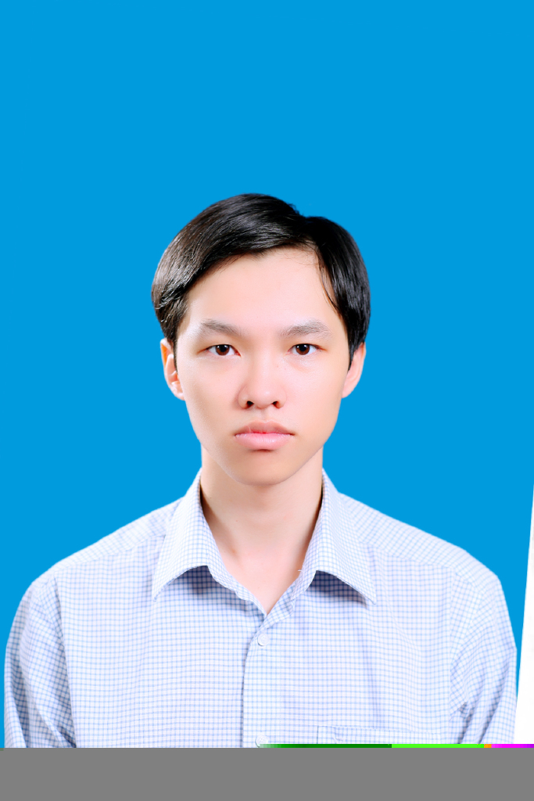
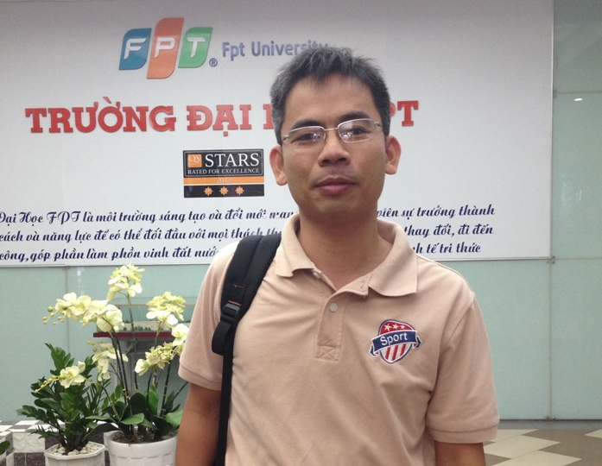
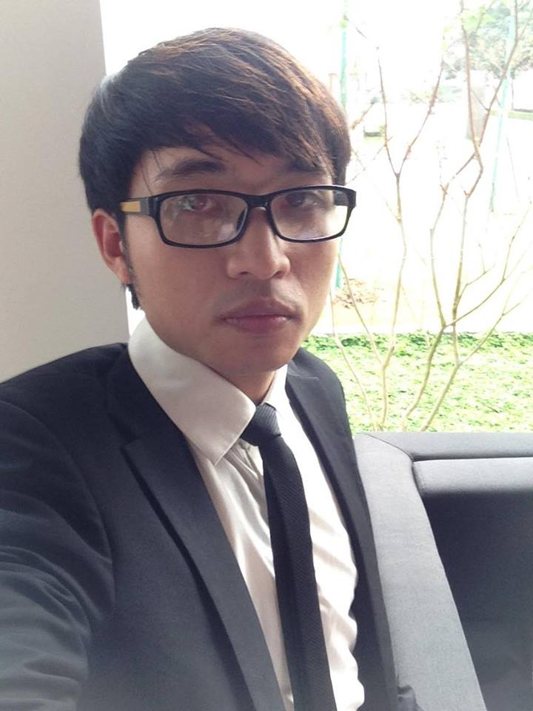
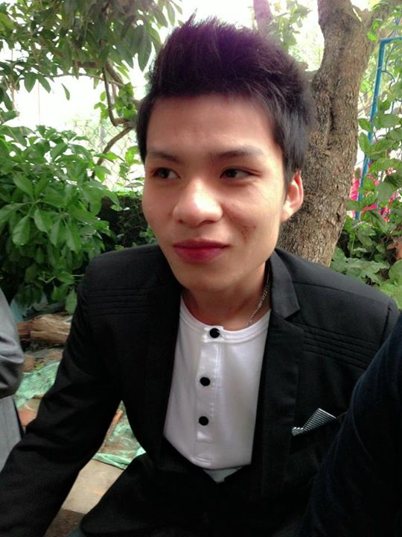
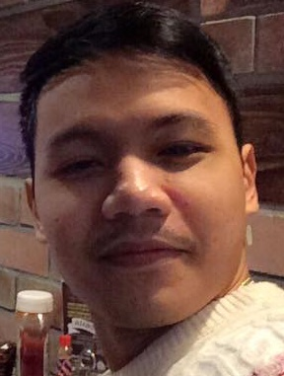
SITA Team
Nguyễn Quý Dương
Leader
Mr. Phan Trường Lâm
Supervisor
Phạm Huy Hoàng
Member
Trương Ngọc Anh
Member
Nguyễn Mạnh Đạt
Member

Slide 3
Project information:
Project name: System Identity Tracking Assistance
Project code: SITA
Project type: Web Application
Timeline: 7th September 2015 to 23th December 2015

Slide 4
Contents:
Introduction
Software Project Management Plan
Software Requirement Specification
Software Design Description
Software Test Documentation
Demo

Slide 5
Part I: Introduction

Slide 6
Background:
Part I: Introduction
Two of the most popular online-learning website in Vietnam.
topica.edu.vn
hocmai.vn
Mentor support online system
No
No

Slide 7
Problem:
Part I: Introduction
Almost online learning websites lacks of utilities to make the interaction between mentors and students.
Students are limited by time and how to communicate with mentors.

Slide 8
Idea
Part I: Introduction
Build an online interaction system between students and mentors.
Report the duration each mentor had been spent on mentoring his/her student.

Slide 9
Existing Solutions
Part I: Introduction
Code Mentor:
Founded : in 2013, Codementor now has 3,000 pre-vetted experts on its platform,
who have worked with more than 60,000 developers.
Website: www.codementor.io

Slide 10
Part II: Software project management plan

Slide 11
Organization:
Part 2:Software project management plan
LâmPT
(PM)
SRS Analysis
Coding
Testing
Design
All member
All member
All member
All member

Slide 12
Software Development process model
Part 2:Software project management plan

Slide 13
Technologies

Slide 14
Tools:
Part 2:Software project management plan
Operating System: Windows 7,8,10
Development tool: PHPStorm, Nodejs
Database: MySql, MongoDB
Browser: Chrome 47, Firefox 37, IE 11
Other: Microsoft Office 2013, Microsoft Project 2013,
Microsoft Visio 2013, Astah Professional,

Slide 15
Teamwork:
Part 2:Software project management plan
Meeting : once per week
Group working time: 5 days/week
Location: University, Home
Communication:
Schedule :

Slide 16
Detailed Plan
Part 2:Software project management plan

Slide 17
Risks & Issues
ID | Description | Solutions
1 | Difficulties of the Analyze software requirements to create software requirements specification document
2 | Learn about new technologies take a long time | Training with experience persons, who knowledge about technologies
3 | Underestimate project scope, tasks’ difficulty level and risks’ effectiveness. | Estimate project scope with instructor and experience persons.
4

Slide 18
Part III: Software Requirement Specification

Slide 19
Functional requirements
Part 3:Software requirement specification
Functional Requirements
Non-Functional Requirements
Entity Relationship Diagram

Slide 20
Functional requirements
Part 3:Software requirement specification
Authorization levels
Chat between users
Historical Data
Reporting Requirements

Slide 21
Non-functional requirements
Part 3:Software requirement specification
Non-Functional:
Scalability
Maintainability

Slide 22
Entity relationship diagram
Part 3:Software requirement specification

Slide 23
Part IV: Software Design Description

Slide 24
List:
Part 4:Software design description
System Architecture Design
Component Diagram
Class Diagram
Sequence Diagram
Database Diagram

Slide 25
System Architecture design
Part 4:Software design description

Slide 26
System Architecture design why choose three layer architecture?
Part 4:Software design description
Because:
Reusability
Maintainability

Slide 27
Component Diagram
Part 4:Software design description

Slide 28
Address component Class diagram
Part 4:Software design description

Slide 29
Admin component Class diagram
Part 4:Software design description

Slide 30
Authorize component Class diagram
Part 4:Software design description

Slide 31
Expert component Class diagram
Part 4:Software design description

Slide 32
Home component Class diagram
Part 4:Software design description

Slide 33
Subject component Class diagram
Part 4:Software design description

Slide 34
User component Class diagram
Part 4:Software design description

Slide 35
Sequence diagram add subject
Part 4:Software design description

Slide 36
Sequence diagram Edit subject
Part 4:Software design description

Slide 37
Sequence diagram feedback subject
Part 4:Software design description

Slide 38
Sequence diagram list subject
Part 4:Software design description

Slide 39
Sequence diagram Sign up
Part 4:Software design description

Slide 40
Sequence diagram chat
Part 4:Software design description

Slide 41
Sequence diagram chat
Part 4:Software design description

Slide 42
Sequence diagram Lock User
Part 4:Software design description

Slide 43
Database Design
Part 4:Software design description

Slide 44
Part V: Software Test Documentation

Slide 45
List Test:
Part 5:Software test documentation
Test Model
Test Process
Test Cases
Checklists

Slide 46
Test Model: V-Model
Part 5:Software test documentation
Validation
Requirement
Acceptance Testing
Validation
General Design Specification
Component Testing
Validation
Detailed Design Specification
Unit Test
Source Code

Slide 47
Test process:
Part 5:Software test documentation
Test Plan & Control
Test Analysis & Design
Test Implementation & Execution
Evaluating Exit Criteria & Reporting
Test Closure Activities

Slide 48
A integration test case sample
Part 5:Software test documentation

Slide 49
Report test phase 1
Part 5:Software test documentation
ID | Test Case Pre-condition | Test Case Procedure | Expected Output | Function | Result
DP-02 | - Go to mentor.funix.edu.vn | 1.On the header, click "FUNIX" logo | 1.The home page is refreshed | Display Page | Pass
DP-04 | - Go to mentor.funix.edu.vn | 1.On the header, point to "Học cùng chuyên gia" option 2.On the list view, point to "Kỳ 1" option | 2."Chứng chỉ công dân số" button is displayed | Display Page | Pass
SI-01 | - Go to funix.com | 1. Click "Đăng nhập " button | 1. There are 2 textfield you need fill-in: - Username - Password 2. Button Sign In 3. There is 1 Link"Bạn chưa có tài khoản ?" | Signin | Pass
S-03 | - Go to mentor.funix.edu.vn | 1.On home page,input "java" on "GIÚP ĐỠ" textbox 2.Click "GIÚP ĐỠ" button | 2.JavaScript course be found 2.Mentor list can support JavaScript be displayed | Search Mentor | Pass
S-13 | - Go to mentor.funix.edu.vn -> click "Học cùng chuyên gia" button - Login account: Email: datnmse@gmail.com Mật khẩu: 123456 | 1.Input "Kì VII" on textbox "Tìm Kiếm" 2.Click suggest "Kì VII" 3.Click "Tìm Kiếm" button | 2. "Kì VII" is inputed 3.Subjects list of "Kì VII" are displayed include: - Subject name - Profile picture - Description | Search Category | Pass

Slide 50
Report test phase 2
Part 5:Software test documentation
ID | Test Case Pre-condition | Test Case Procedure | Expected Output | Function | Result
C-02 | - Go to mentor.funix.edu.vn - Login as member - CallCenter is online | 1.On the homepage, click "Trợ giúp" button 2.Click "CallCenter" 3.Input content on textarea 4.Press "Enter" key | 3.Content is inputed succesfully 4.Content is sent to CallCenter succesfully | Chat | Pass
C-11 | - Go to mentor.funix.edu.vn - Login as callcenter Mật khẩu: 123456 | 1.CallCenter receives messages from member 2.Click sender line | 1.Sender name is display on "Người gửi" 2.Chatbox is displayed | Chat | Pass
C-18 | - Go to mentor.funix.edu.vn - Login as member - Is chatting with callcenter and mentor | 1.On feedback frame, click [x] button | 1.Feedback frame is remove | Chat | Pass
AM-17 | - Login admin account: Email: duongnqse02934@fpt.edu.vn Mật khẩu: 123456 - Account "anhtnse@gmail.com" is mentor acount - Go to mentor.funix.edu.vn ->click "profile picture" -> click "Admin" button -> click"Người dùng" button -> set unLock account "anhtnse@gmail.com" | 1.At "Khóa tài khỏan" column of account "anhtnse@gmail.com", click "Lock" button 2.Login account: - Email: anhtnse@gmail.com - Mật khẩu: ngocanh2502 | 1.Alert "Cập nhật thành công" is displayed 2.Account could not be logged | Lock User | Pass

Slide 51
Report test phase 3
Part 5:Software test documentation
ID | Test Case Pre-condition | Test Case Procedure | Expected Output | Function | Result
AM-50 | - Login admin account: Email: duongnqse02934@fpt.edu.vn Mật khẩu: 123456 - Go to mentor.funix.edu.vn ->click "profile picture" -> click "Admin" button | 1.Click"Mentor" button 2.Click " Thêm mentor" button 2.Input: - Người dùng: datnm - Mô tả mentor: - Tên môn học: Mobile Programming - Sau khi lưu dữ liệu: select "Tiếp tục nhập" 3.Click "Lưu" button | 3.Mentor was added succesfully 3.Mentor adding form is still displayed | Add Mentor | Pass
CC-02 | - Go to funix.com - Login as callcenter | 1.On the home page, click profile picture 2.Click "CallCenter" button 3.Click "Lịch sử" button 4.Click any conversation | 3.Conversations list are displayed 4.Conversations content are displayed | CallCenter Management | Pass
C-26 | - Go to mentor.funix.edu.vn - Login account as mentor - Prepared a file that capacity less than 10mb have format: image | 1.On the conversation, member sent a image in pre-condition 2. Click on image was received | 2.The image is enlarged | Chat | Pass
C-22 | - Go to mentor.funix.edu.vn - Login as member - Is chatting with Callcenter | 1.On chatbox, click [x] button 2.On feedback frame, click [x] button | 1.Feedback frame "Bạn cảm thấy hài lòng với callcenter này chứ?" is displayed include: - Kém/Trung Bình/Tốt/Rất tốt ratio button - Textarea 2.Chatbox is still displayed | Chat | Pass

Slide 52
Report test phase 4
Part 5:Software test documentation
No | Module code | Pass | Fail | Untested | N/A | Number of test cases
1 | Display Page | 43 |  |  |  | 43
2 | SignIn | 20 |  |  |  | 20
3 | SignOut | 2 |  |  |  | 2
4 | SignUp | 27 |  |  |  | 27
5 | List User | 4 |  |  |  | 4
6 | Set Role | 9 |  |  |  | 9
7 | Lock User | 6 |  |  |  | 6
8 | Active User | 2 |  |  |  | 2
9 | Add Subject | 6 |  |  |  | 6
10 | Edit Subject | 3 |  |  |  | 3
11 | List Subject | 4 |  |  |  | 4
12 | Add Category | 4 |  |  |  | 4
13 | Edit Category | 3 |  |  |  | 3
14 | Edit Interface | 3 |  |  |  | 3

Slide 53
Report test phase 5
Part 5:Software test documentation
15 | Edit Mentor | 1 |  |  |  | 1
16 | List Mentor | 2 |  |  |  | 2
17 | Search Mentor | 4 |  |  |  | 4
18 | Search Category | 10 |  |  |  | 10
19 | CallCenter Management | 2 |  | 2 |  | 4
20 | Update Profile | 16 |  |  |  | 16
21 | Register Mentor | 20 |  |  |  | 20
22 | Chat | 32 | 1 |  |  | 33
23 | Search Subject | 2 |  |  |  | 2
24 | List Category | 3 |  |  |  | 3
25 | Add Mentor | 5 |  |  |  | 5
 | Sub total | 233 | 1 | 2 |  | 236
 | Test coverage |  | 99.15 | %
 | Test successful coverage |  | 98.73 | %

Slide 54
Checklists checklist about validation
Part 5:Software test documentation
 | Is the general screen background the correct color? | Yes | No | N/A
 | Are the field prompts the correct color? | x
 | Are the field backgrounds the correct color? | x
 | Is all the screen prompts specified in the correct screen font? | x
 | Is the text in all fields specified in the correct screen font? | x
 | Is all the field prompts aligned perfectly on the screen? | x
 | Are all the field edits boxes aligned perfectly on the screen? | x
 | Are all group boxes aligned correctly on the screen? | x
 | Are all characters or alphanumeric fields left justified? | x
 | Is all the error message text spelt correctly on this screen? | x

Slide 55
Checklists checklist about validation
Part 5:Software test documentation
 | Is all users input captured in UPPER case or lower case consistently? | Yes | No | N/a
 | Does a failure of validation on every field cause a sensible user error message? | x
 | Is the user required to fix entries, which have failed validation tests? |  | x
 | Have any fields got multiple validation rules and if so are all rules being applied? | x
 | If the user enters an invalid value and clicks on the OK button is the invalid entry identified and highlighted correctly with an error message? | x
 | Is validation consistently applied at screen level unless specifically required at field level? |  | x
 | For all numeric fields check whether negative numbers can and should be able to be entered. | x
 | For all numeric fields check the minimum and maximum values and also some mid-range values allowable? | x
 | For all character/alphanumeric fields check the field to ensure that there is a character limit specified and that this limit is exactly correct for the specified database size? | x
 | Do all mandatory fields require user input? | x

Slide 56
PART VI: DEMO

