Slide 1
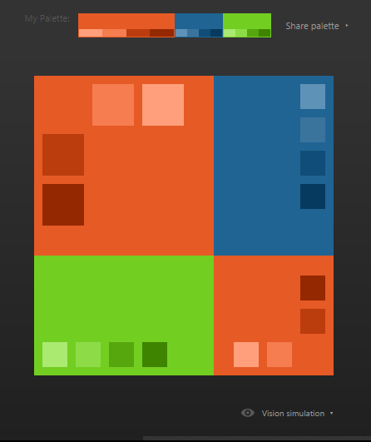
Eventzone
Only one zone for all Activities. Promote, manage, and host successful events

Slide 2
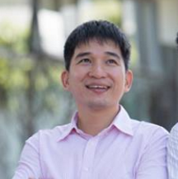
Instructor
Tran Binh Duong

Slide 3
Member
Phan Thanh Vũ
Nguyễn Văn Cường
Project Leader
Technical Leader
Dương Thị Lan Anh
Nguyễn Sen Hà
Team Member
Testing Leader
Nguyễn Thị Chương
Nguyễn Ngọc Dương
Team Member
Designer Leader

Slide 4
Table of Content
概要
1. Overview
プロジェクト管理
2. Project Management
要求仕様
3. Requirements Specification
ソフトウェア設計
4. Software Design
テステ
5. Testing
サマリー
6. Summary
デモ
7. Demo – Q&A

Slide 5
1. Overview - 概要
Idea
Why choose this idea?
Why Events
  What is an Event?
  Is the Event Industry Growing?
  Event Industry in Vietnam
  Event Marketing Trend
  Why Live Streaming
Literating System
Proposal System
アイデア
なぜこのアイデアを選択しますか。
なぜエベント？
  エベントは何ですか？
  イベント産業が増えていますか？
  ベトナムでイベント産業
  イベントマーケティングの傾向
  なぜ生放送する？
在のウェブサイト
提案

Slide 6
1. Overview - 概要
1.1 Idea -アイデア
Difficulties when trying to participate in different events
  Difficulties in real life to participate: distance, works,..
  Various sources to search but they all have SAME INFORMATION
  Not supporting live from events for people from other places to watch
Want to learn something about events before participating in
  Idea of a search, review and provide information for events online.

Slide 7
1. Overview - 概要
1.2 Why choose this idea? - なぜこのアイデアを選択しますか。
Why build a search, review and provide information website
New trends of technology world
  In Vietnam: Foody, Lozi (food), Molo (Movie), Vinalo (Location)
  In Others Countries: Yelp (Places), TripAdvisor (Tourism), Pitchfork (Music)
Content built by user -> Great communcation among them

Slide 8
1. Overview - 概要
1.3 Why Events - なぜエベント？
Why Events?
What is an Event?
An event can be defined as any public gathering of people for a purpose. The events industry can be divided into three main sectors, based along content lines:
  Sport
  Meetings/Conference/Expos (Business)
  Cultural /Arts/Music
Events are staged both for profit and non-profit, by business, government or community. Events can be held for commercial, celebratory, entertainment or specific reasons and or causes.

Slide 9
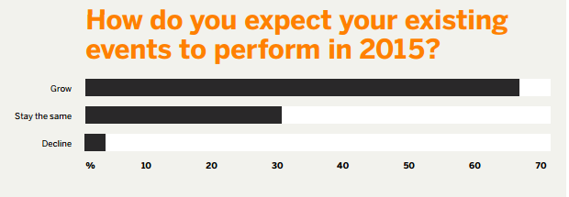
1. Overview - 概要
1.3 Why Events - なぜエベント？
Why Events?
Is the event industry growing?

Slide 10
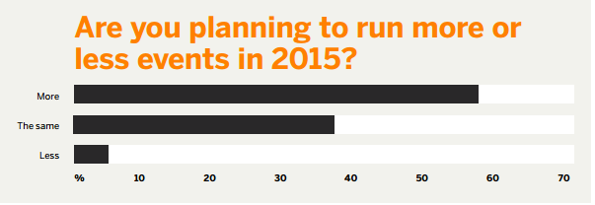
1. Overview - 概要
1.3 Why Events - なぜエベント？
Why Events?
Is the event industry growing?

Slide 11
1. Overview - 概要
1.3 Why Events - なぜエベント？
Why Events?
Event Industry in Vietnam
  Average annual spending more businesses $ 15 billion in various events such as customer conference, introduced showroom (Data source of market research FTA)
  is growing rapidly with an estimated 30% of new companies are appearing on the market, there are now more than 20 professional events organizing companies and hundreds of advertising business companies

Slide 12
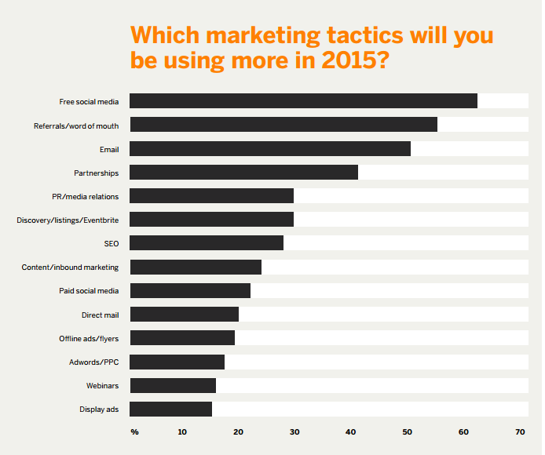
1. Overview - 概要
1.3 Why Events - なぜエベント？
Why Events?
Event Marketing Trend

Slide 13
1. Overview - 概要
1.3 Why Events - なぜエベント？
Why Events?
Why live streaming?
  Timeliness
  Cost efficient
  More audience engaged
  Simple
  Reach target audience

Slide 14
1. Overview - 概要
1.3 Why Events - なぜエベント？
Why Events?
Literating System
  Sukienhay.com
  Talktv.vn
  Eventbrite.com
  Livestream.com

Slide 15
1. Overview - 概要
1.3 Why Events - なぜエベント？
Why Events?
Proposal system
 | sukienhay.com | talktv.vn | eventbrite.com | livestream.com | EventZone
Create Event | X |  | X | X | X
Edit Event | X |  | X | X | X
Invite Others | X |  | X
View Blog | X
Search by Location | X |  | X |  | X
Manage Tickets | X |  | X
Like | X | X | X | X | X
Share | X | X | X | X | X
Comment | X | X | X | X | X
Follow Events | X |  | X |  | X
Follow Category |  |  |  |  | X
Report Violated | X |  | X | X | X
Appeal |  |  | X |  | X
Live Streaming |  | X |  | X | X
Analytic Event |  |  | X | X | X

Slide 16
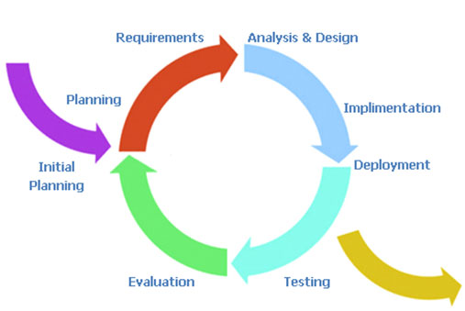
2. PROJECT MANAGEMENT PLAN - プロジェクト管理
Software Process Model
ソフトウェ アプロセス モデル
Project Organization
Project Schedule
Project Resource
Risk Management
Configuration Management
Quality Management
Communication Management
Human Resource
Software and Tools

Slide 17
2. PROJECT MANAGEMENT PLAN - プロジェクト管理
Software Process Model
Project Organization
プロジェクト組織
Project Schedule
Project Resource
Risk Management
Configuration Management
Quality Management
Communication Management
Human Resource
Software and Tools

Slide 18
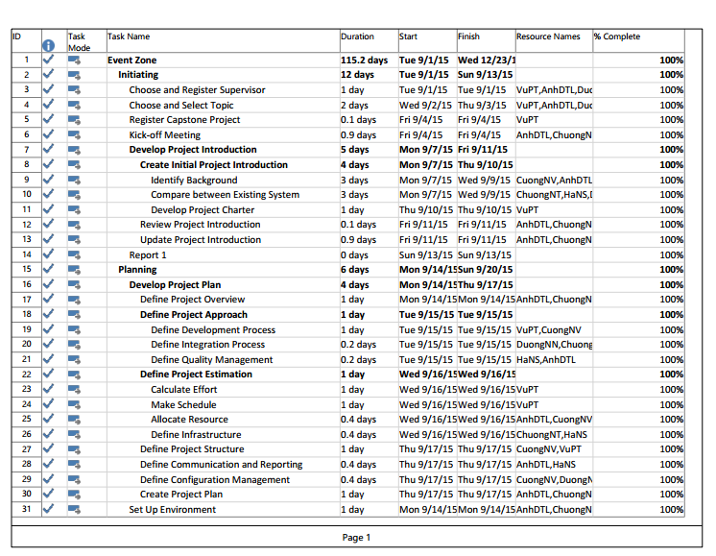
2. PROJECT MANAGEMENT PLAN - プロジェクト管理
Software Process Model
Project Organization
Project Schedule
プロジェクトのリソース
Project Resource
Risk Management
Configuration Management
Quality Management
Communication Management
Human Resource
Software and Tools

Slide 19
2. PROJECT MANAGEMENT PLAN - プロジェクト管理
Software Process Model
Project Organization
Project Schedule
Project Resource
プロジェクトのリソース
Risk Management
Configuration Management
Quality Management
Communication Management
Name | W1 Sep | W2 Sep | W3 Sep | W4 Sep | W1 Oct | W2 Oct | W3 Oct | W4 Oct | W1 Nov | W2 Nov | W3 Nov | W4 Nov | W5 Nov | W1 Dec | W2 Dec | W3 Dec | W4 Dec | Average
VuPT | 77 | 38 | 100 | 100 | 100 | 100 | 100 | 100 | 100 | 42 | 96 | 100 | 98 | 79 | 100 | 100 | 77 | 89
AnhDTL | 75 | 77 | 88 | 96 | 96 | 96 | 96 | 96 | 96 | 58 | 77 | 96 | 77 | 96 | 96 | 96 | 58 | 87
DuongNN | 75 | 77 | 81 | 96 | 96 | 85 | 96 | 96 | 96 | 96 | 96 | 96 | 96 | 77 | 96 | 96 | 58 | 89
HaNS | 75 | 77 | 96 | 96 | 96 | 94 | 96 | 96 | 77 | 96 | 96 | 96 | 77 | 96 | 96 | 50 | 58 | 86
CuongNV | 75 | 77 | 92 | 100 | 100 | 100 | 100 | 100 | 100 | 100 | 62 | 62 | 98 | 98 | 100 | 100 | 54 | 89
ChuongNT | 75 | 77 | 81 | 96 | 96 | 96 | 96 | 96 | 65 | 96 | 96 | 96 | 96 | 96 | 96 | 65 | 58 | 87
Human Resource
工数
Software and Tools

Slide 20
2. PROJECT MANAGEMENT PLAN - プロジェクト管理
Software Process Model
Project Organization
Project Schedule
Project Resource
プロジェクトのリソース
Risk Management
Configuration Management
Quality Management
Communication Management
Item | Description | Version
Development Environment
Operating System | Windows | 8/8.1/10
Browser | Chrome | Latest Version
DBMS | SQL Server | 2012
Development Tool | Visual Studio | 2013 Ultimate
 | Sublime | 2.0.2
Design Tool | Astah Professional | 7.0
 | Lucidchart.com
Management Tool
Source Code Management | GitHub | 2.5.3
Document Management | Google Drive
Project Management Tool | Microsoft Project | 2013
Document Tool | Microsoft Word | 2013
Human Resource
Software and Tools
ツールと インフラストラクチャ

Slide 21
2. PROJECT MANAGEMENT PLAN - プロジェクト管理
Software Process Model
Project Organization
Project Schedule
Project Resource
Risk Management
リスク管理
Configuration Management
Quality Management
Communication Management
ID | Description | Type | Root Cause | Avoidance Plan | Contingency Plan | Probability | Impact | Status
R1 | Overestimate or underestimate time of project | ● Schedule Risk | ● Lack of experience of estimating each phase of the project | ● Create detail plan for each project’s phase. ● Breakdown project to some milestone releases. Main function development is high priority ● Get the team more involved in planning and estimating. Get early feed-back and address slips directly with stakeholders ● Consult supervisor’s advice | ● Implement task in parallel or overlapping them ● Overtime to push progress faster | Medium | High | Solved
Human Resource
Software and Tools

Slide 22
2. PROJECT MANAGEMENT PLAN - プロジェクト管理
Location | Main folder | Sub-folder | Purpose
Google Drive | Member’s Workspace | VuPT | Team member’s document working area
 |  | AnhDTL | Team member’s document working area
 |  | DuongNT | Team member’s document working area
 |  | HaNS | Team member’s document working area
 |  | CuongNV | Team member’s document working area
 |  | ChuongNT | Team member’s document working area
 | References |  | Store Reference materials needed in project
 | Week [number] |  | Store submitted reports and documents each week
 | Test Workspace |  | Storing testing related documents
Github | Finals | Report 1 | Store final deliverables of phase 1 and related Meeting Minutes and Progress Reports
 |  | Report 2 | Store final deliverables of phase 2 and related Meeting Minutes and Progress Reports
 |  | Report 3 | Store final deliverables of phase 3 and related Meeting Minutes and Progress Reports
 |  | Report 4 | Store final deliverables of phase 4 and related Meeting Minutes and Progress Reports
 |  | Report 5 | Store final deliverables of phase 5 and related Meeting Minutes and Progress Reports
 |  | Report 6 | Store final deliverables of phase 6 and related Meeting Minutes and Progress Reports
 | Reference | Store Reference materials needed in project
 | Work in Progress | Working Space | Each Team Members has a folder to store working task
 |  | Documents | Documents which aren’t released to final
 |  | Coding | Codes aren’t finished
Software Process Model
Project Organization
Project Schedule
Project Resource
Risk Management
Configuration Management
コンフィグレーション管理
Quality Management
Communication Management
Human Resource
Software and Tools

Slide 23
2. PROJECT MANAGEMENT PLAN - プロジェクト管理
Software Process Model
Project Organization
Project Schedule
Project Resource
Risk Management
Configuration Management
Quality Management
品質管理
Communication Management
Item | Strategy | Expected Result
Requirement missing | List up all of requirement into SRS document | 10–20% reduction in defect injection rate and about 2% improvement in productivity
Careless mistake in Design Document Format/Template wrong | After designing, all team will review Document Format and content based on last meeting reports | Improvement in quality as overall defect removal efficiency will improve; some benefits in productivity as defects will be detected early
Data is not reliable | Search data from reliable sources -> Filter information | Avoid confusing data.
Duty neglecting | Check task list per 2 days | Focus on what I am doing
Inconsistency | Define naming convention for document, coding convention for coding | Easy to manage and combine.
Human Resource
Software and Tools

Slide 24
2. PROJECT MANAGEMENT PLAN - プロジェクト管理
Communication Type | Objective | Methods | Frequency | Participant | Deliverable
Kick-off meeting | ● Discuss and agree on project objective and scope | ● Face-to-face | ● Once at the start of the project | ● Supervisor ● Project team | ● Meeting minutes
Project Team Meeting | ● Assign task ● Solve remained problems | ● Face-to-face | ● Monday each week, more if necessary | ● Project team | ● Project schedule ● Updated Work Breakdown Structure
Project Requirements Meeting | ● Define requirements | ● Face-to-face | ● At least once per week until the requirements and use cases are defined clearly | ● Project team | ● Software requirements specifications
Detailed Document Review Meeting | ● Review document for updating and correcting errors | ● Face-to-face | ● At least once per week until the document is finished | ● Project team | ● Reviewed document
Design Meeting | ● Define database design and user interface design | ● Face-to-face | ● At least once per week until the design is finished | ● Project team | ● Database design ● User interface prototype
Bug Report | ● Report if finding any bugs while executing test | ● Facebook ● Google Driver Test Case Report | ● If necessary | ● Project team | ● Bug’s list
Project Team Weekly Report | ● Report the progress of the project | ● Email | ● Every Sunday | ● Team leader ● Supervisor | ● Progress report
Meeting with Supervisor | ● Report the progress of the project ● Q&A if necessary | ● Face-to-face | ● Once per week based on all participant’s schedule | ● Project team ● Supervisor | ● Meeting minutes
Unexpected Issues | ● Find solutions for raised issues | ● Face-to-face ● Online | ● If necessary | ● Project team ● Supervisor
Software Process Model
Project Organization
Project Schedule
Project Resource
Risk Management
Configuration Management
Quality Management
Communication Management
コミュニケーション 管理
Human Resource
Software and Tools

Slide 25
3. Software Requirements Specification - 要求仕様
システムのユーザ - System Users
3.2
機能要求 - Functional Requirements
3.3
非機能要求 - Non-Functional Requirements
3.1

Slide 26



3.1. システムのユーザ - System Users
ユーザー
User
モデレータ Moderator
管理者
Administrator
2役者があります - There are 3 main actors

Slide 27
3.2. 機能要求 - Functional Requirements
User Module
アカウントの管理 - Account management module (Sign In, Sign Out, Sign Up, View Profile, Edit Profile)
コモン·モジュール - Common module (Search, Create event, Edit Event, Create Live Streaming Link, Add Video, Add Image, Appeal)
プラクティス·マネージメント - Social Module (Like, Dislike, Follow & Unfollow Event, Follow & Unfollow Category, Share, Report, View Video of Events, View Image of Events)
User : 2 types registered and unregistered

Slide 28
3.3. 非機能要求 - Non-Functional Requirements
Moderator Module
Manage Events
Manage Report / Appeal
Manage Users
View Statistic
Admin Module
  Manage Moderators: (Set / Unset) Moderators

Slide 29
3.3. 非機能要求 - Non-Functional Requirements
ユーザーインターフェース - User Interfaces
    友好的で簡単な界面 - Friendly and simply interface
    色が上品で、派手ではありません - The color is elegant, not flashy
    言語は英語です - Language is English
    データセキュリティ機能と高いパフォーマンスを確認しなければなりません - Ensure data security capabilities, high performance
    開発の可能 - Scalability system

Slide 30


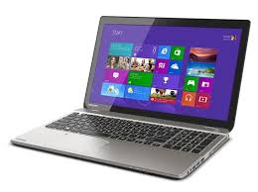
3.3. 非機能要求 - Non-Functional Requirements
ソフトウェア要求
Software Requirements
ハードウェア要求
Hardware Requirements
ラップトップは インターネット接続があります。
PC, Laptop with internet connection.

Slide 31
4. Software Design - ソフトウェア デザイン
4.1
Technology & Reason
4.2
Architecture Representation
4.3
Package View
4.4
Screen Design
4.5
Class Diagram
4.6
Activity Diagram
4.7
ERD

Slide 32
4.1. テクノロジー と 理由 - Technology & Reason
主なテクノロジー - Core Technology:
      MVC .NET
      SQL Server 2012
サブテクノロジー - Sub Technology:
      Bootstrap
      SignalR
      Quartz
理由 - Reason:
      EZシステムと一致する
    Consistent with FAP system
      MVCモデルに基づいて設計
      Designed according to the MVC Model

Slide 33
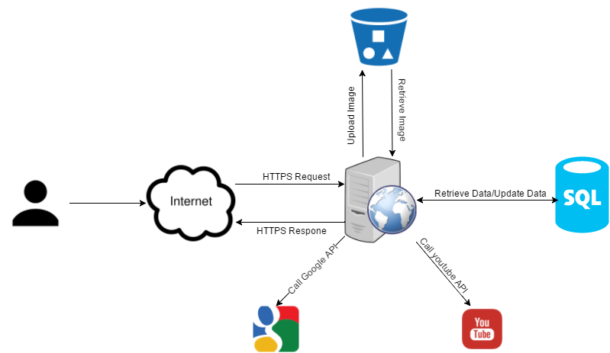
4.2. アーキテクチャ表現 - Architecture Representation
EZシステム全体のアーキテクチャ - EZ system overall architecture

Slide 34
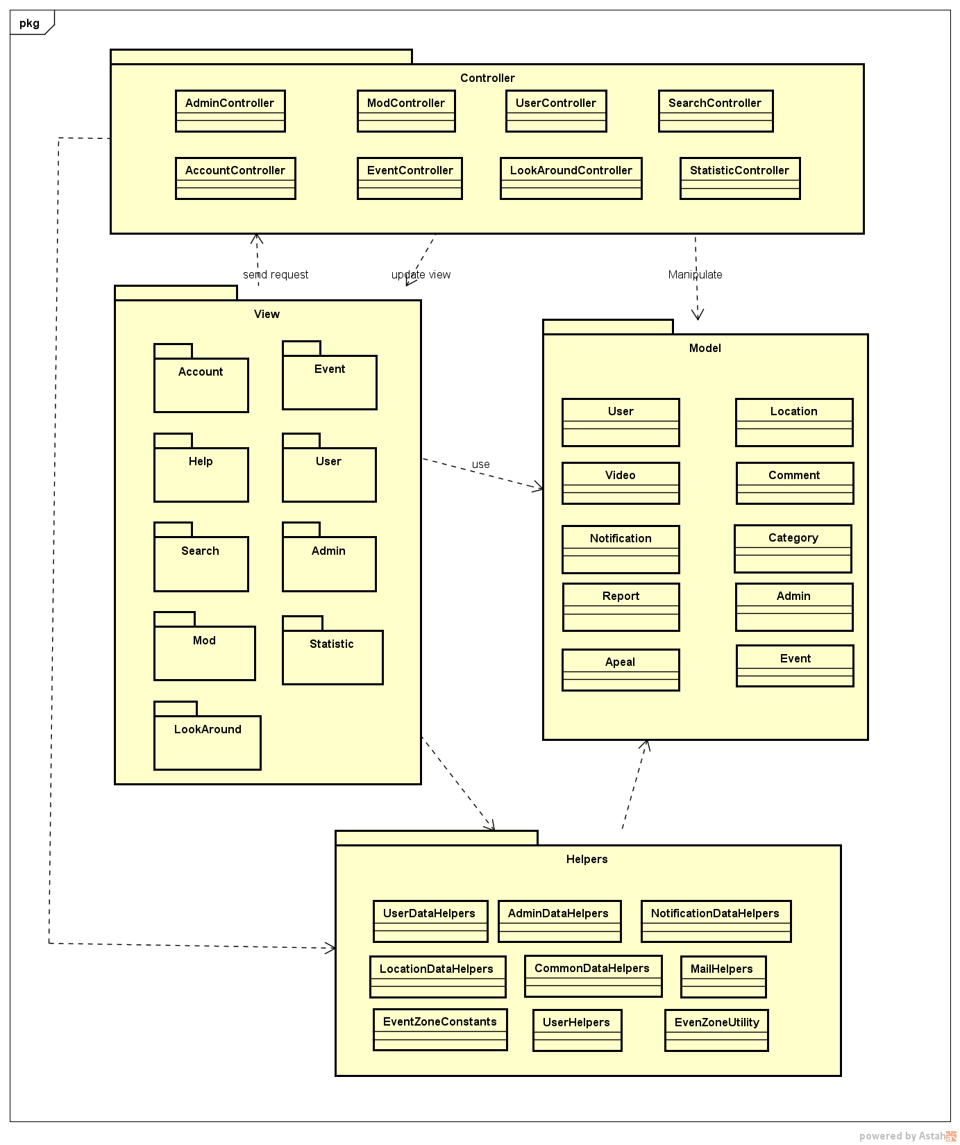
4.3. パッケージ ビュー - Package View
パッケージ ビュー
Package View

Slide 35
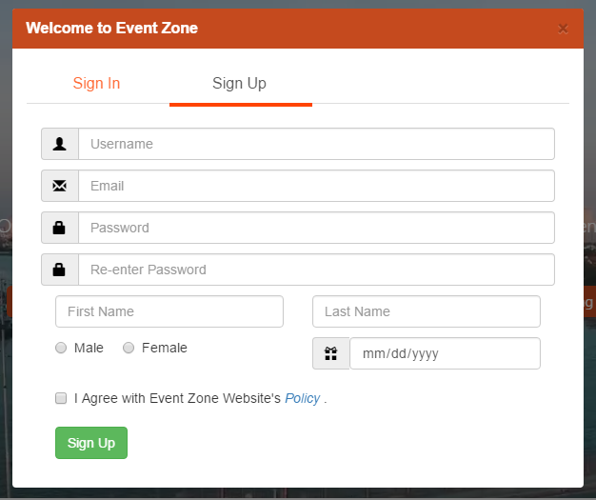
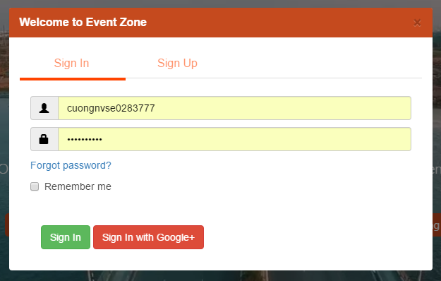
4.4. Screen Design - 画面設計
Some sample images of Screen Design
Sign In
Sign Up

Slide 36
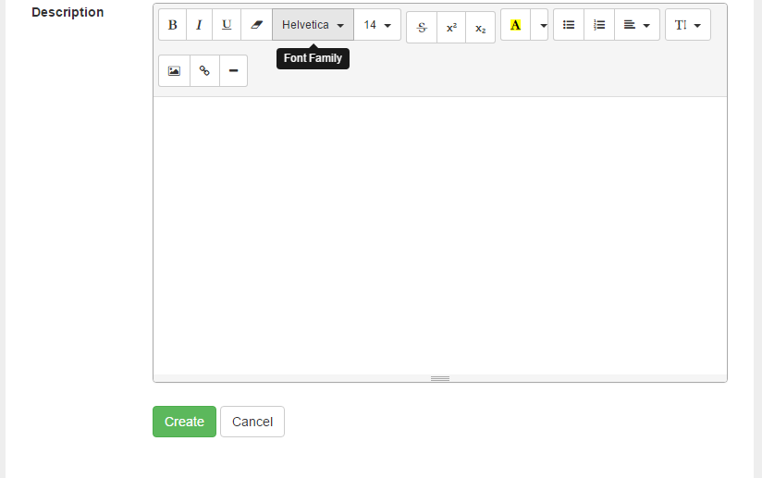
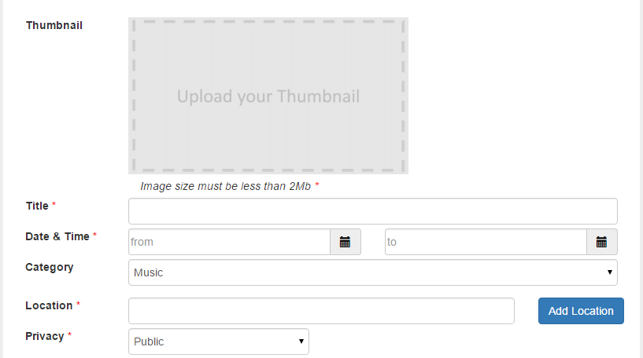
4.4. Screen Design - 画面設計
Create an event Screen
Basic info
Event’s Description

Slide 37
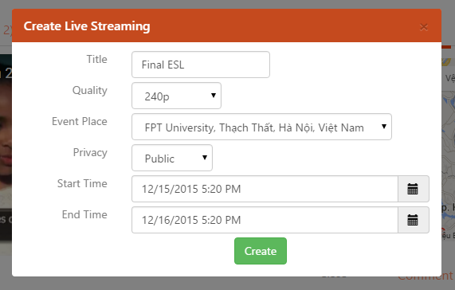
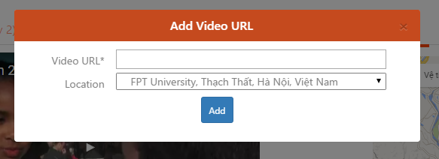
4.4. Screen Design - 画面設計
Add a video or a live streaming link
Add a video link
Add a Live Streaming link

Slide 38
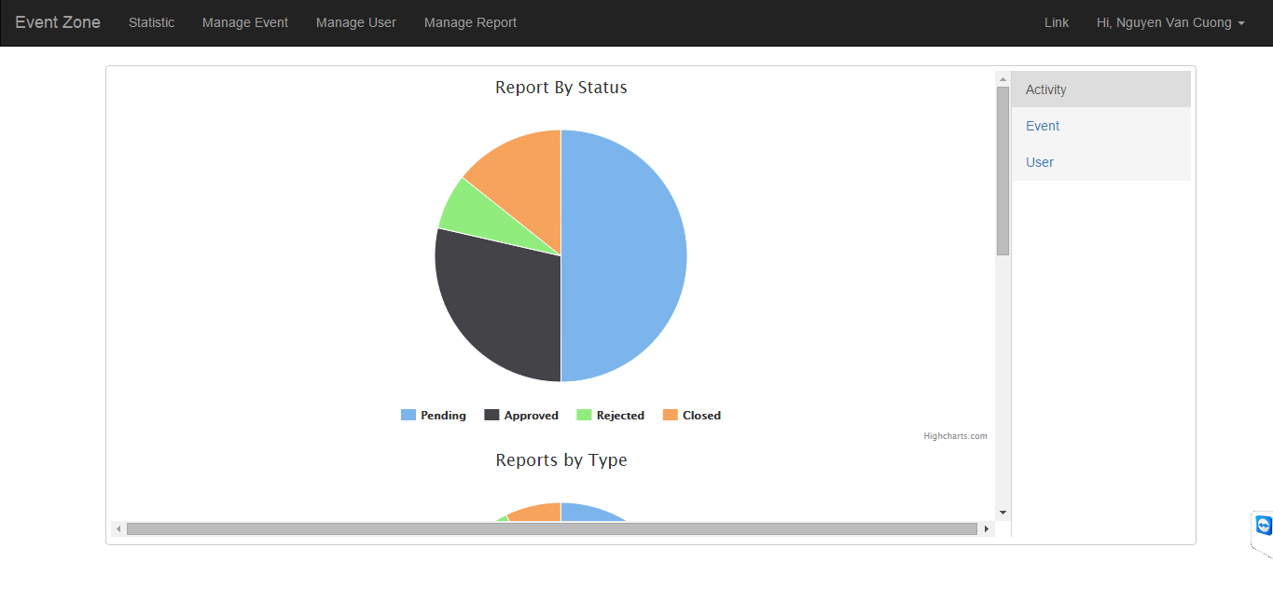
4.4. Screen Design - 画面設計
Admin’s Management Screen
Statistic

Slide 39
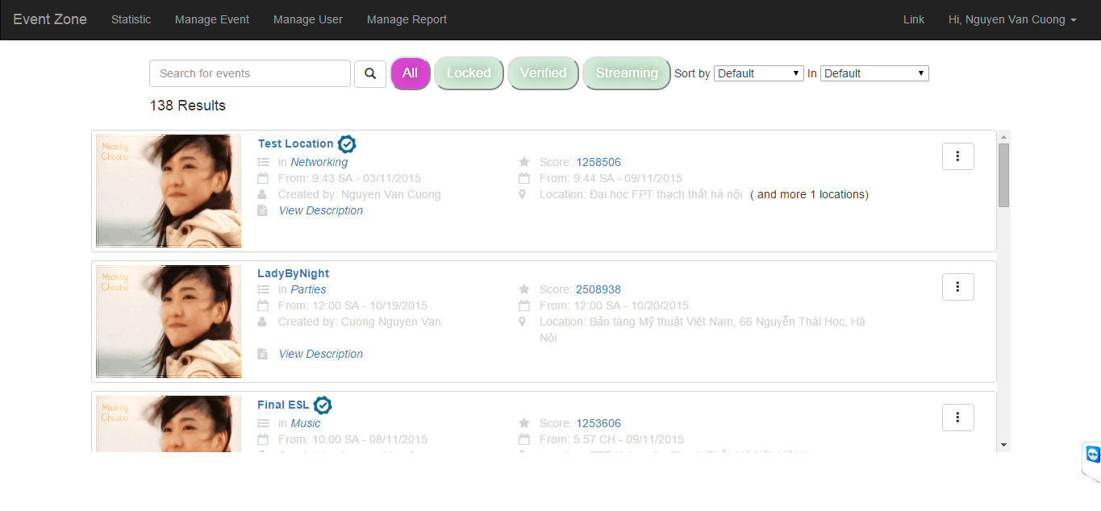
4.4. Screen Design - 画面設計
Admin’s Management Screen
Manage Event

Slide 40
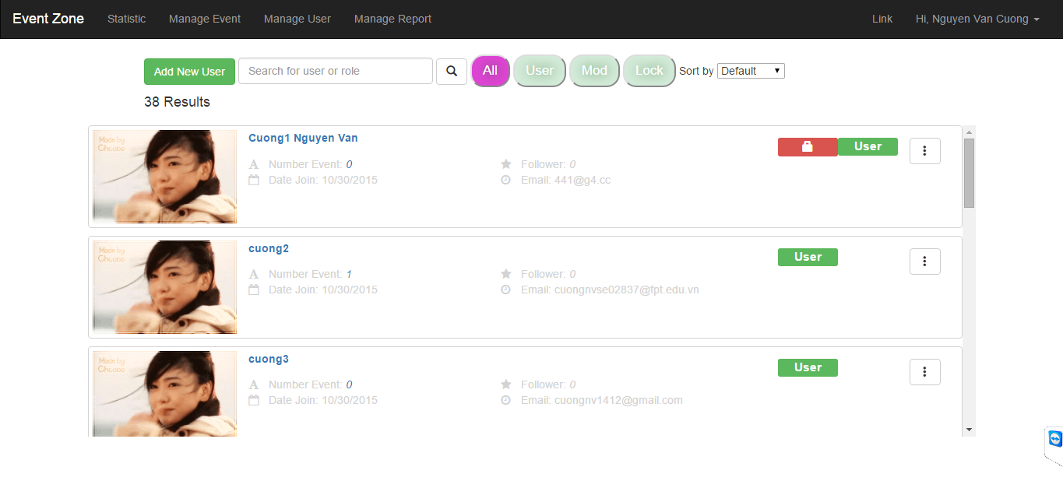
4.4. Screen Design - 画面設計
Admin’s Management Screen
Manage User

Slide 41
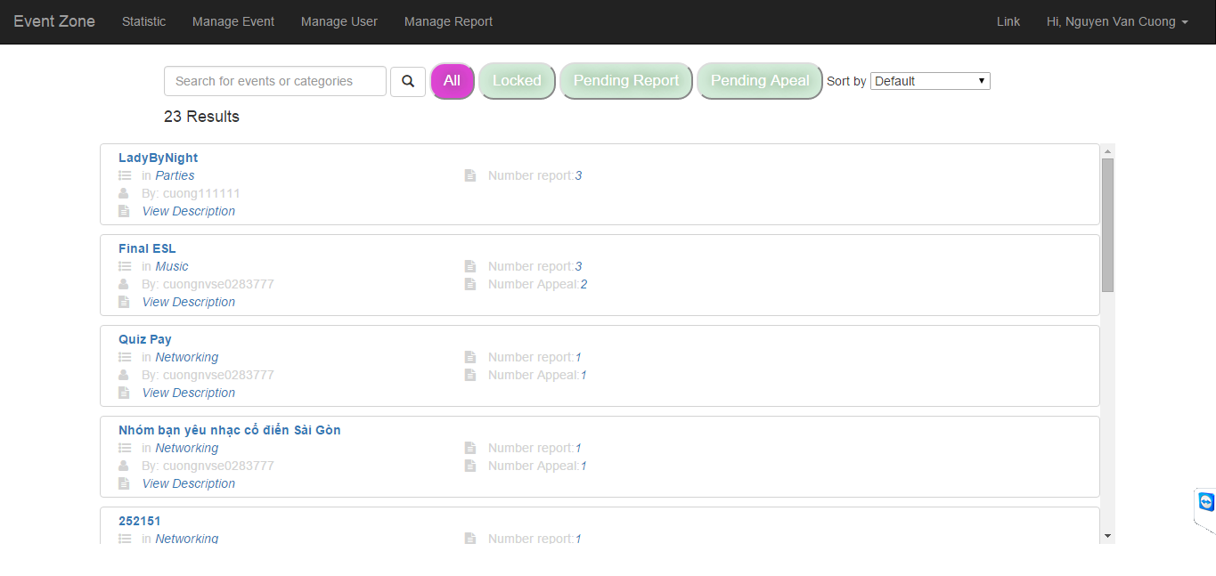
4.4. Screen Design - 画面設計
Admin’s Management Screen
Manage Report

Slide 42
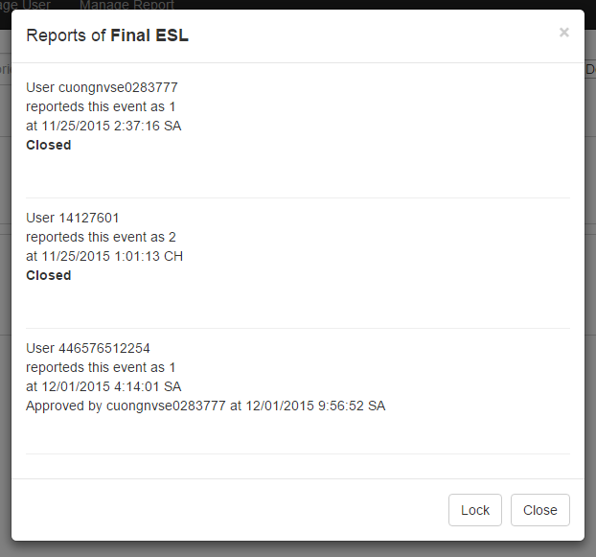
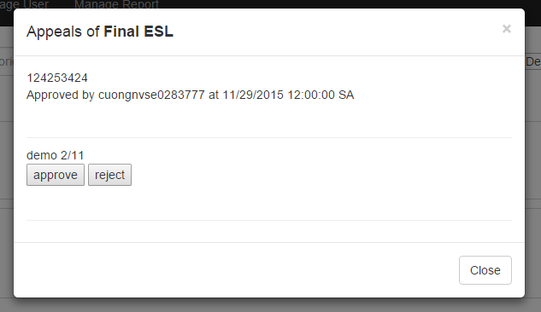
4.4. Screen Design - 画面設計
Admin’s Management Screen
Handle a report
Handle a report

Slide 43
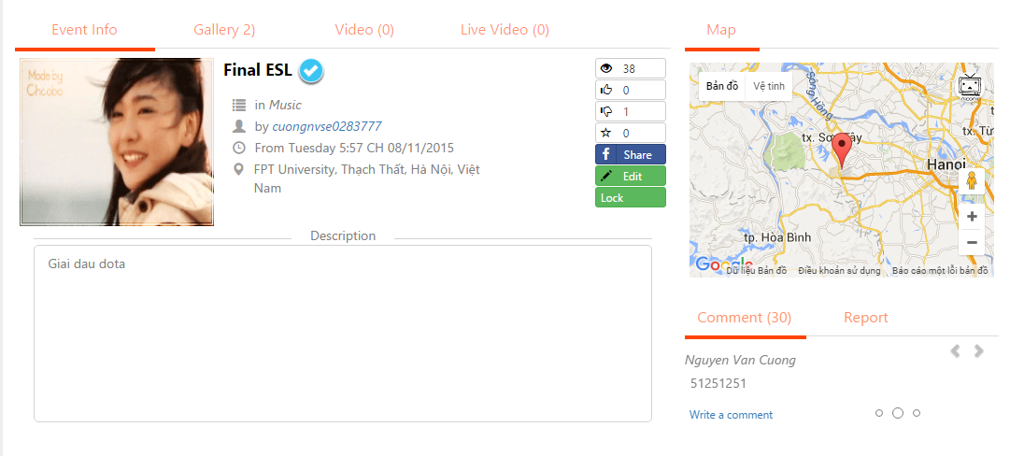
4.4. Screen Design - 画面設計
Unregisted User Screen Design
View an event (including Basic info, Description, Gallery, Video, Map, Comment & Report)

Slide 44
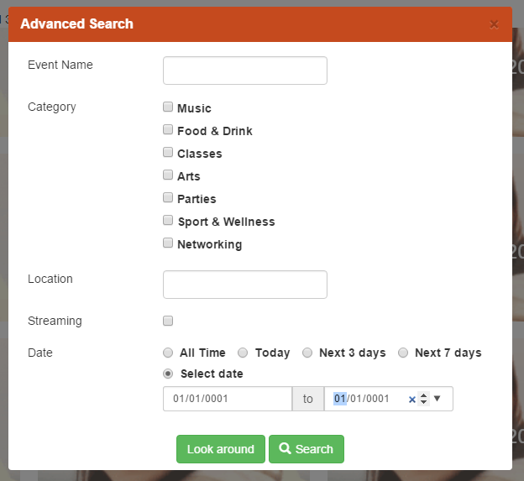
4.4. Screen Design - 画面設計
Unregisted User Screen Design
Advanced Search

Slide 45
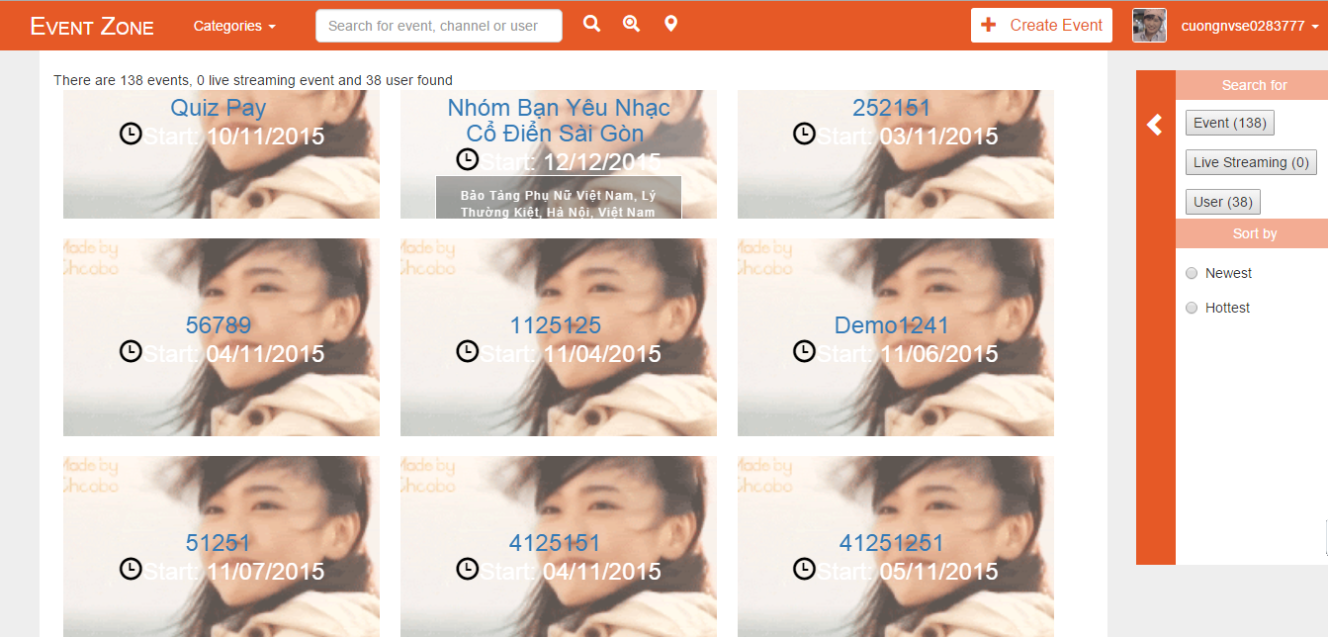
4.4. Screen Design - 画面設計
Unregisted User Screen Design
Search Result

Slide 46
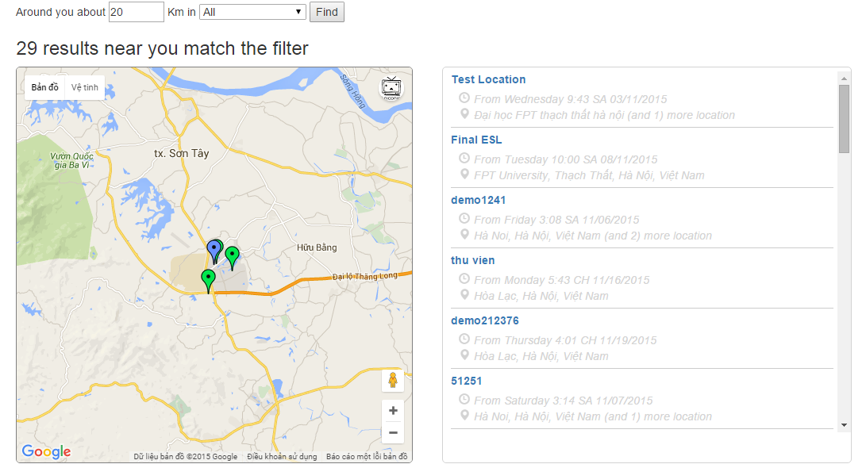
4.4. Screen Design - 画面設計
Unregisted User Screen Design
Look Around!

Slide 47
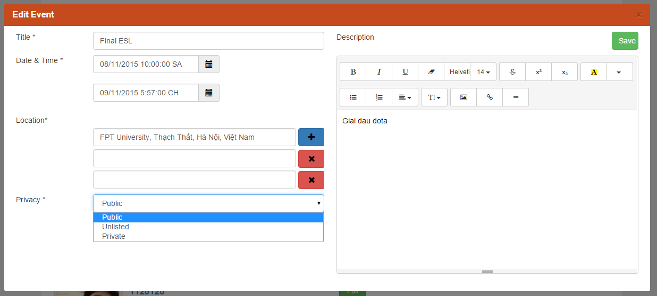
4.4. Screen Design - 画面設計
Registed User Screen Design
Quản lý profile của mình
Quản lý Event mình tạo (xem report về số lượng)
Khiếu nại với Admin về tính hợp pháp để đăng tải
Edit an Event & set privacy

Slide 48
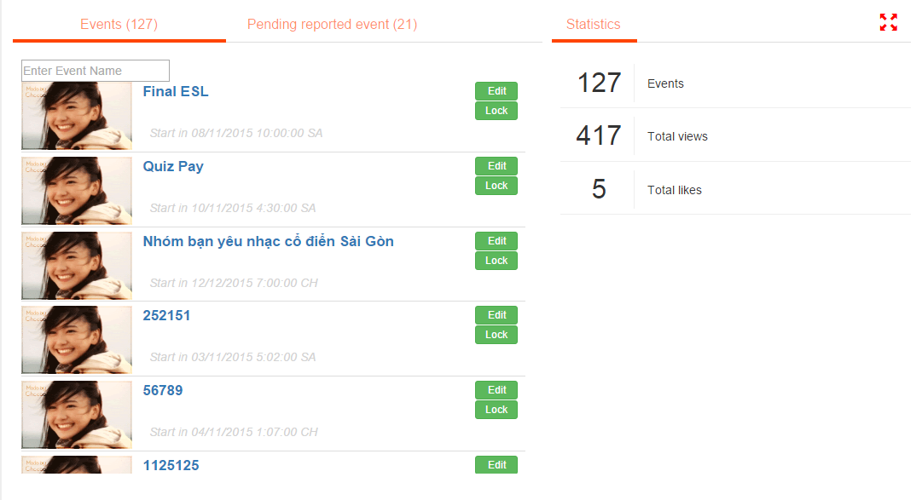
4.4. Screen Design - 画面設計
Registed User Screen Design
Quản lý Event mình tạo (xem report về số lượng)
Khiếu nại với Admin về tính hợp pháp để đăng tải
Manage their own events

Slide 49
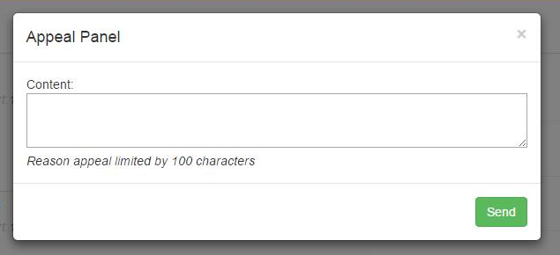
4.4. Screen Design - 画面設計
Registed User Screen Design
Khiếu nại với Admin về tính hợp pháp để đăng tải
Appeal about their event’s policy

Slide 50
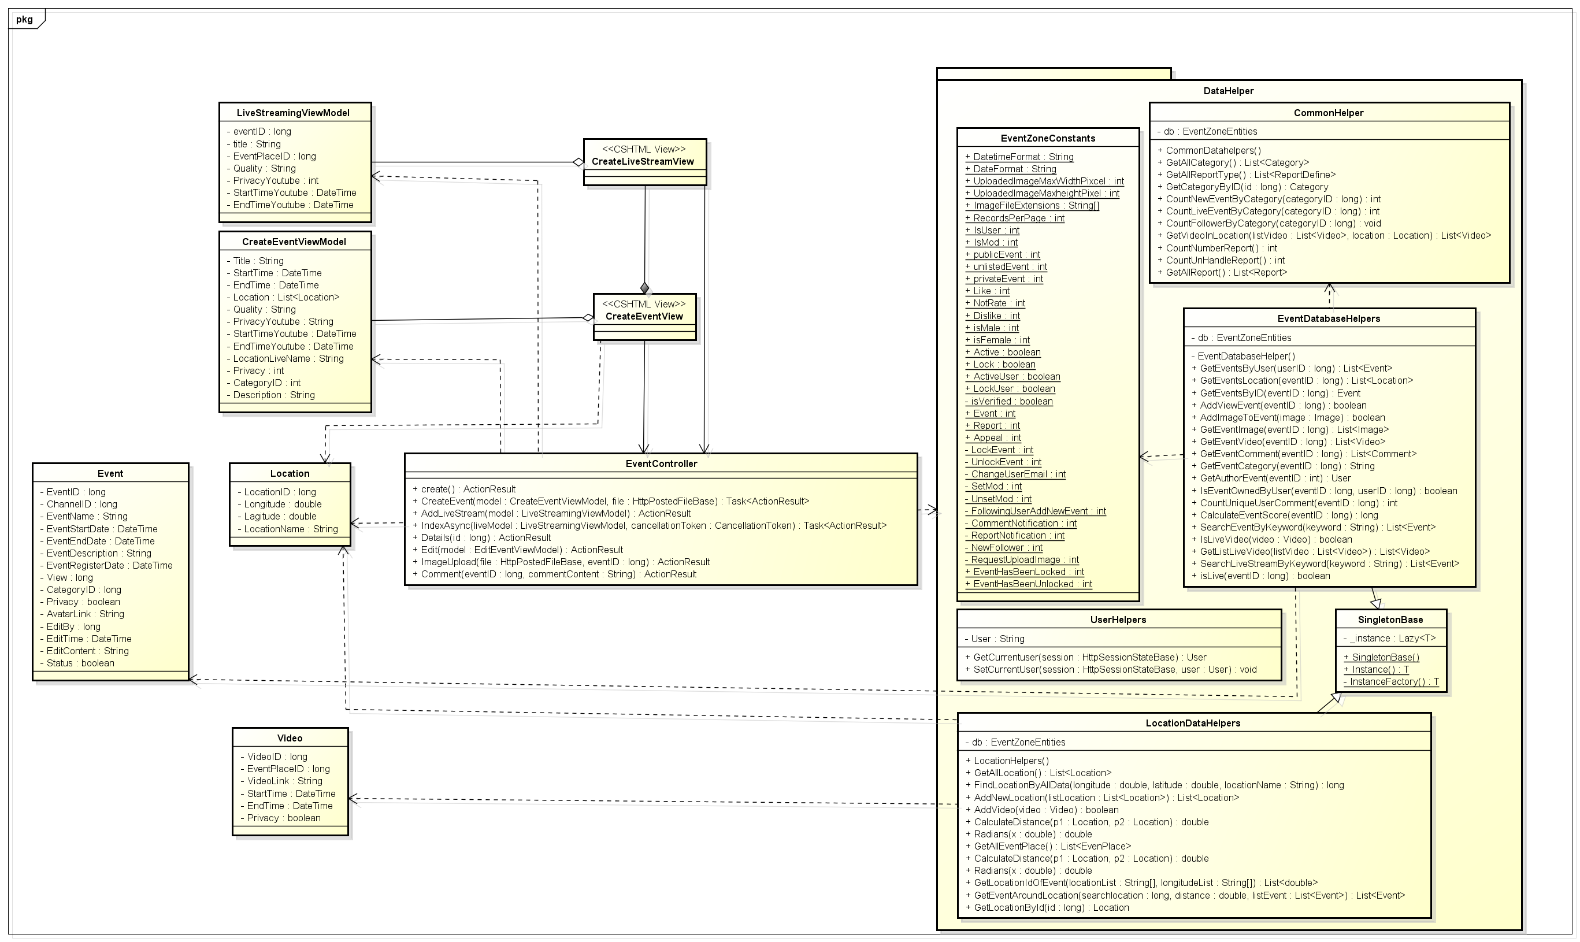
4.5. Class Diagram・クラス図
Khiếu nại với Admin về tính hợp pháp để đăng tải
Application Logical View ・アプリケーションの論理ビュー

Slide 51
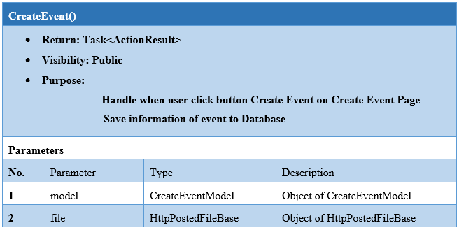
4.5. Class Diagram・クラス図
Khiếu nại với Admin về tính hợp pháp để đăng tải
Class detailed design - クラス詳細設計

Slide 52
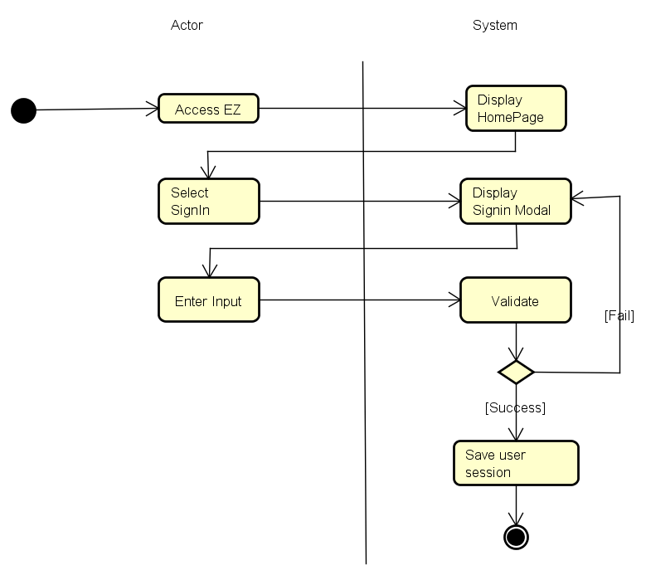
4.6. Activity Flow Diagram・アクティビティフロー図
Khiếu nại với Admin về tính hợp pháp để đăng tải

Slide 53
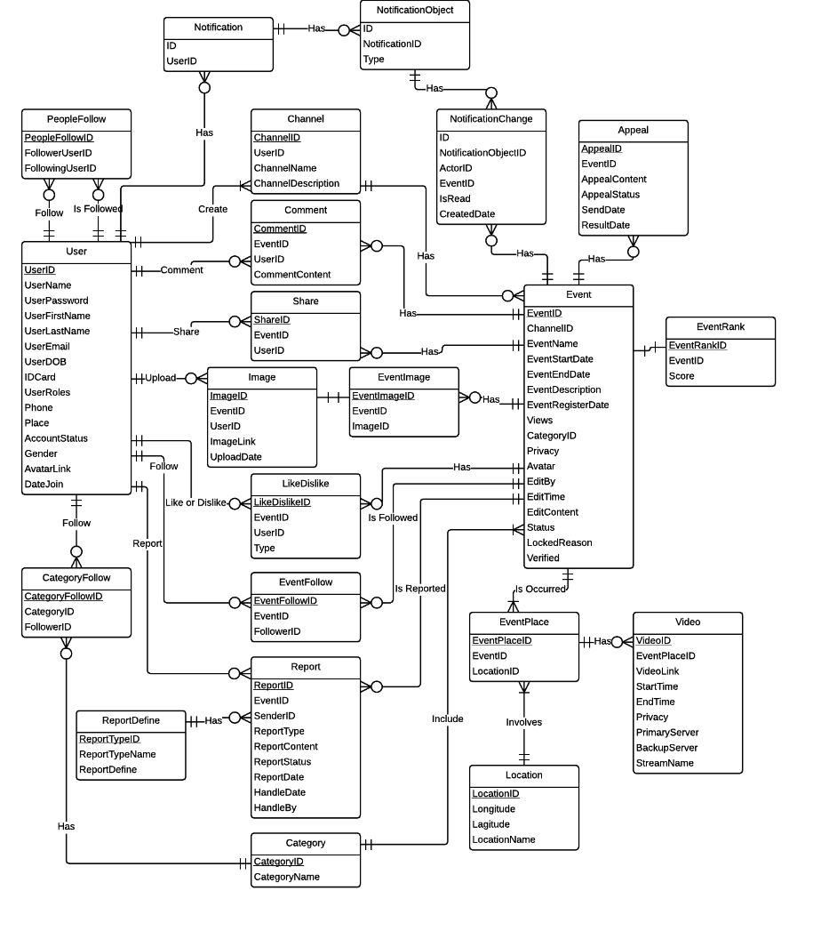
4.7. Database Design・データ設計
Khiếu nại với Admin về tính hợp pháp để đăng tải
Main application ERD - アプリケーションのERD

Slide 54
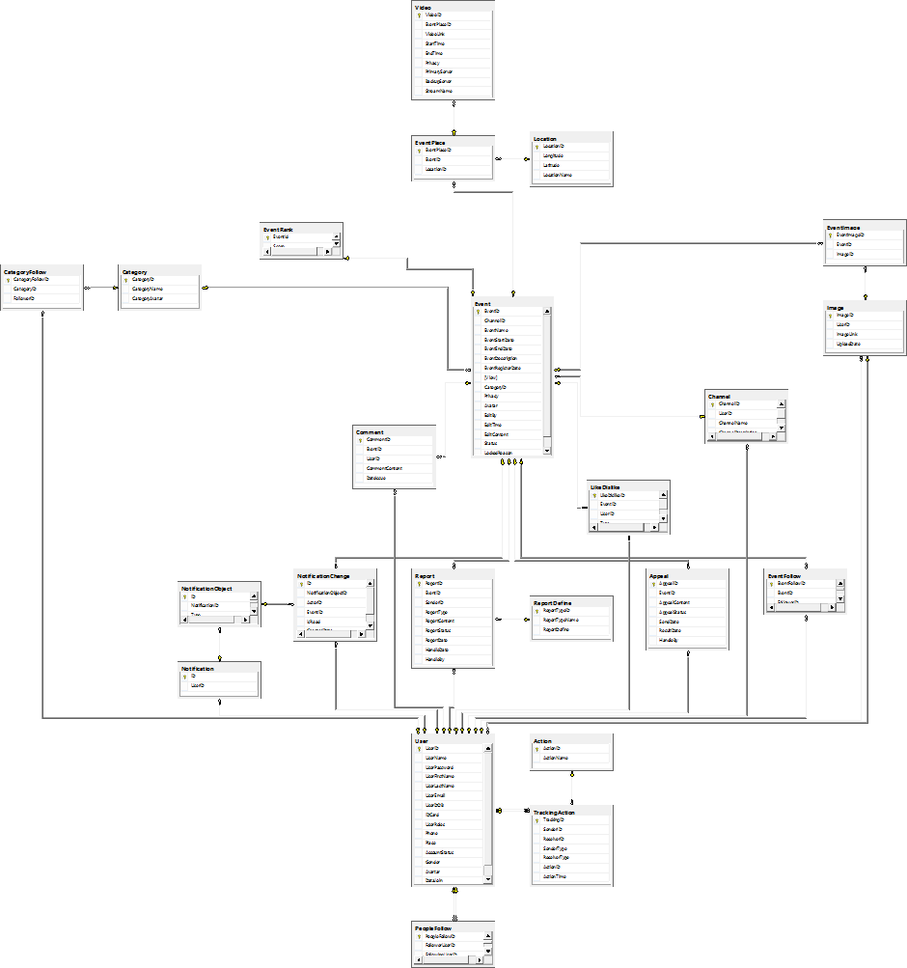
4.7. Database Design・データ設計
Khiếu nại với Admin về tính hợp pháp để đăng tải
Main application table diagram - アプリケーションのテーブル図

Slide 55
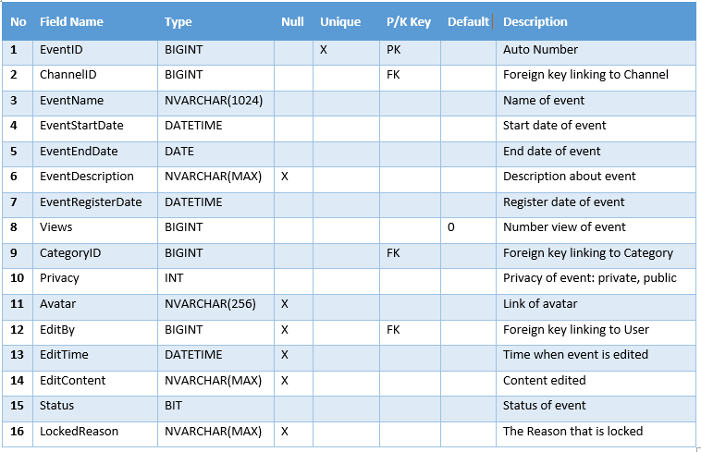
4.7. Database Design・データ設計
Khiếu nại với Admin về tính hợp pháp để đăng tải
Sample: Event table - サンプル： テーブル

Slide 56
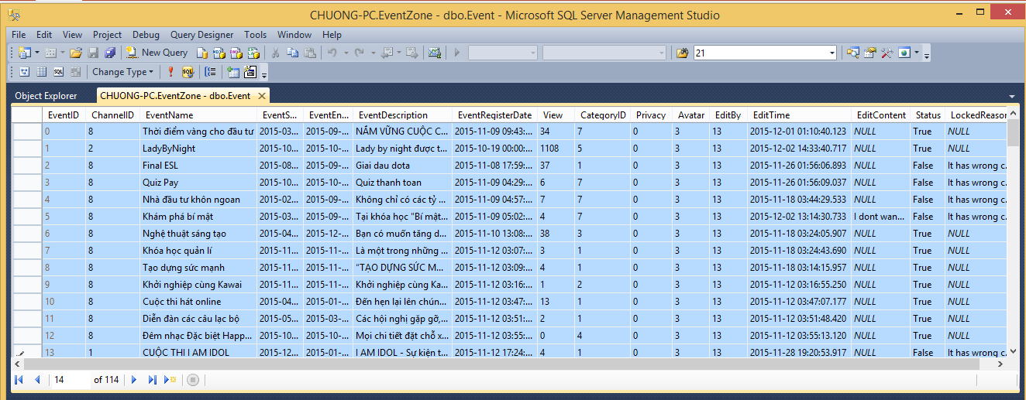
4.7. Database Design・データ設計
Khiếu nại với Admin về tính hợp pháp để đăng tải
Database sample・データベース サンプル

Slide 57
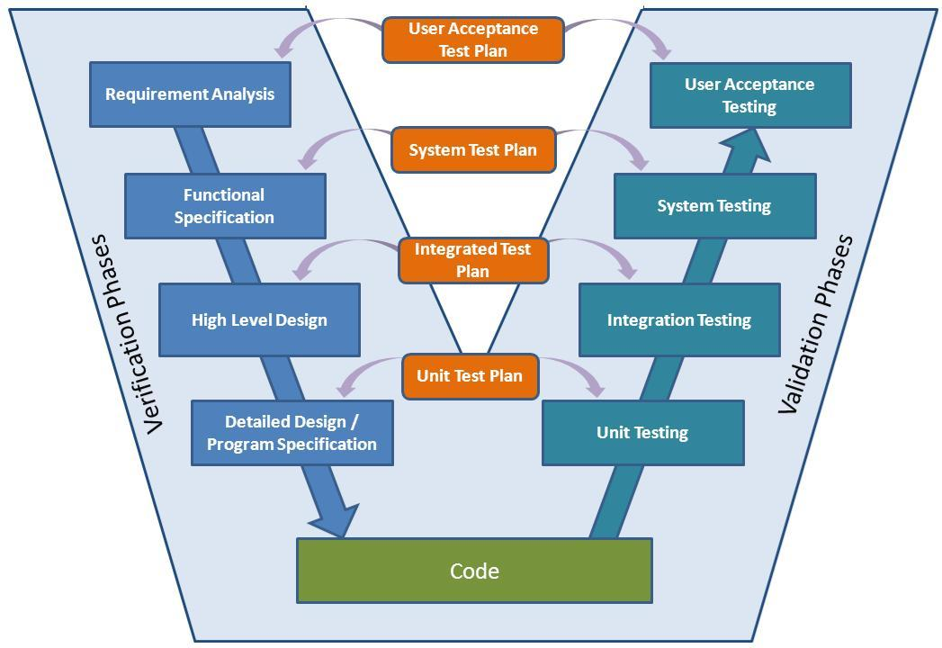
5. Testing - テスティング
5.1. Test Model
テストモデル

Slide 58
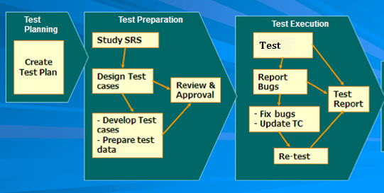
5.2. Test Process
テストのプロセス

Slide 59


5.3. Test Tools
テストツール
NUnit 3.0 is a plugin used in C#, it makes writing unit test more easier.
HostedRedmine: Log bug. (www.hostedredmine.com).

Slide 60
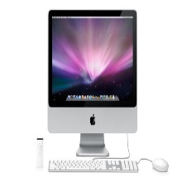



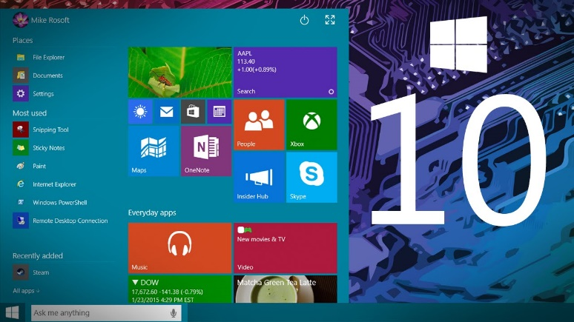
5.4. Test Environment
テスト環境
Device:
Laptop, Desktop
Operating System:
Windows 7, 8.1, 10

Slide 61
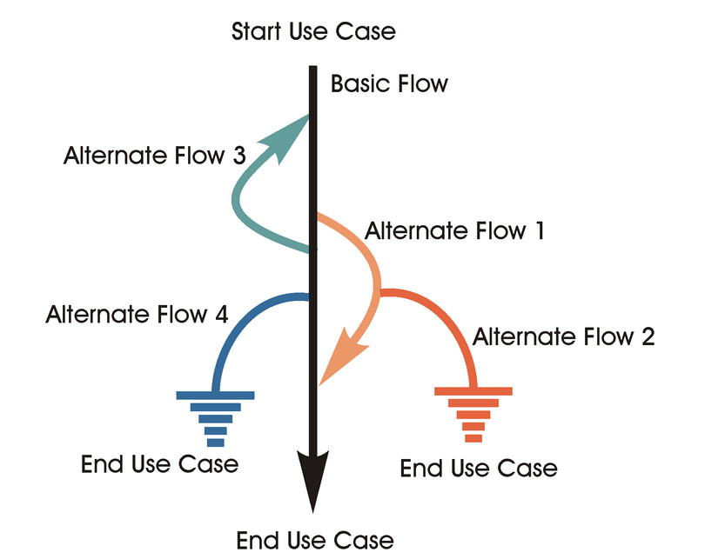
5.5. Test case guideline

Slide 62
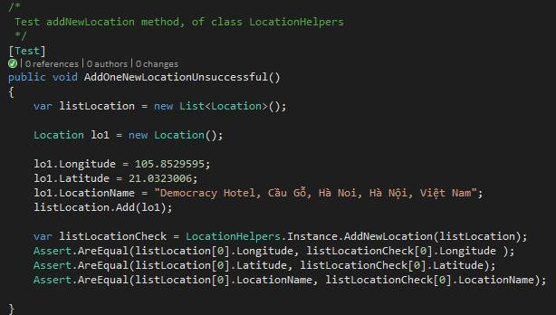
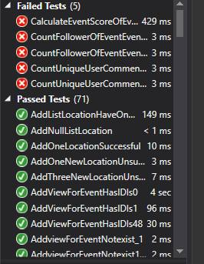
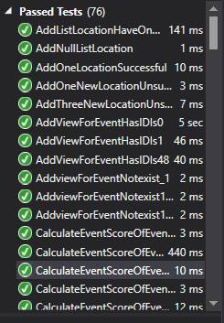
Unit test for addNewLocation function of DatabaseHelper.cs
5.6. Test Type
テスト範囲
Unit Test
Integration Test
System Test
Acceptance Test
Test result after first run
After fixing code, all unit was passed
Integration test and System test

Slide 63
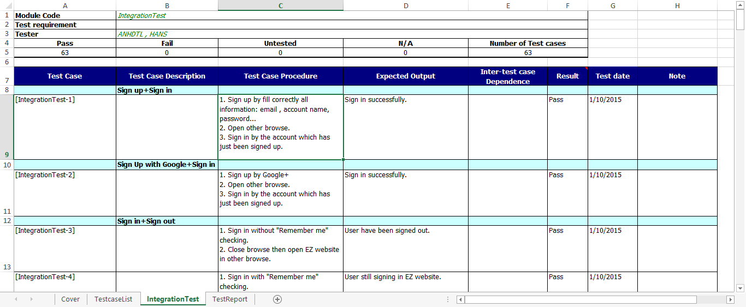
5.6. Test Type
テスト範囲
Unit Test
Integration Test
System Test
Acceptance Test
Sample of test case

Slide 64
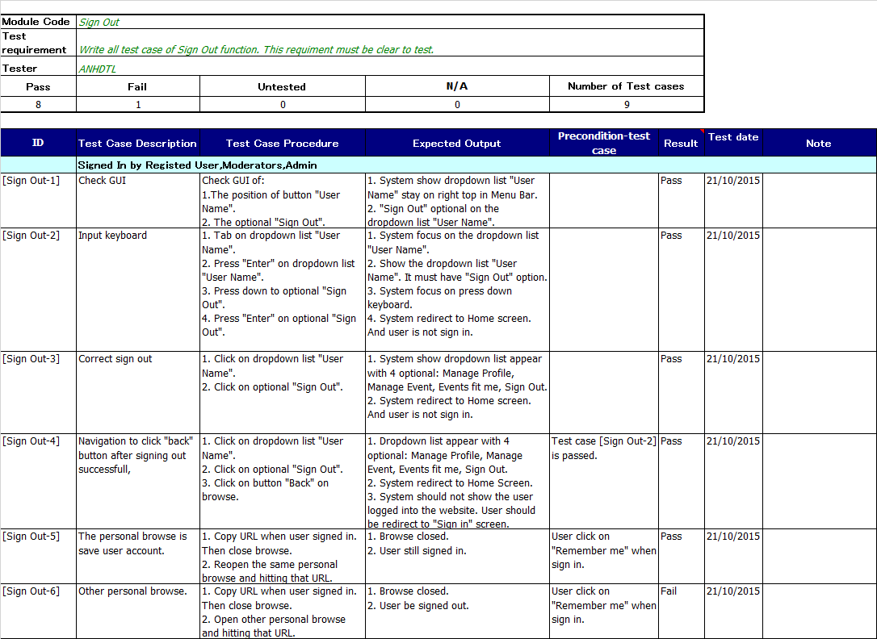
5.6. Test Type
テスト範囲
Unit Test
Integration Test
System Test
Acceptance Test
Sample of test case

Slide 65
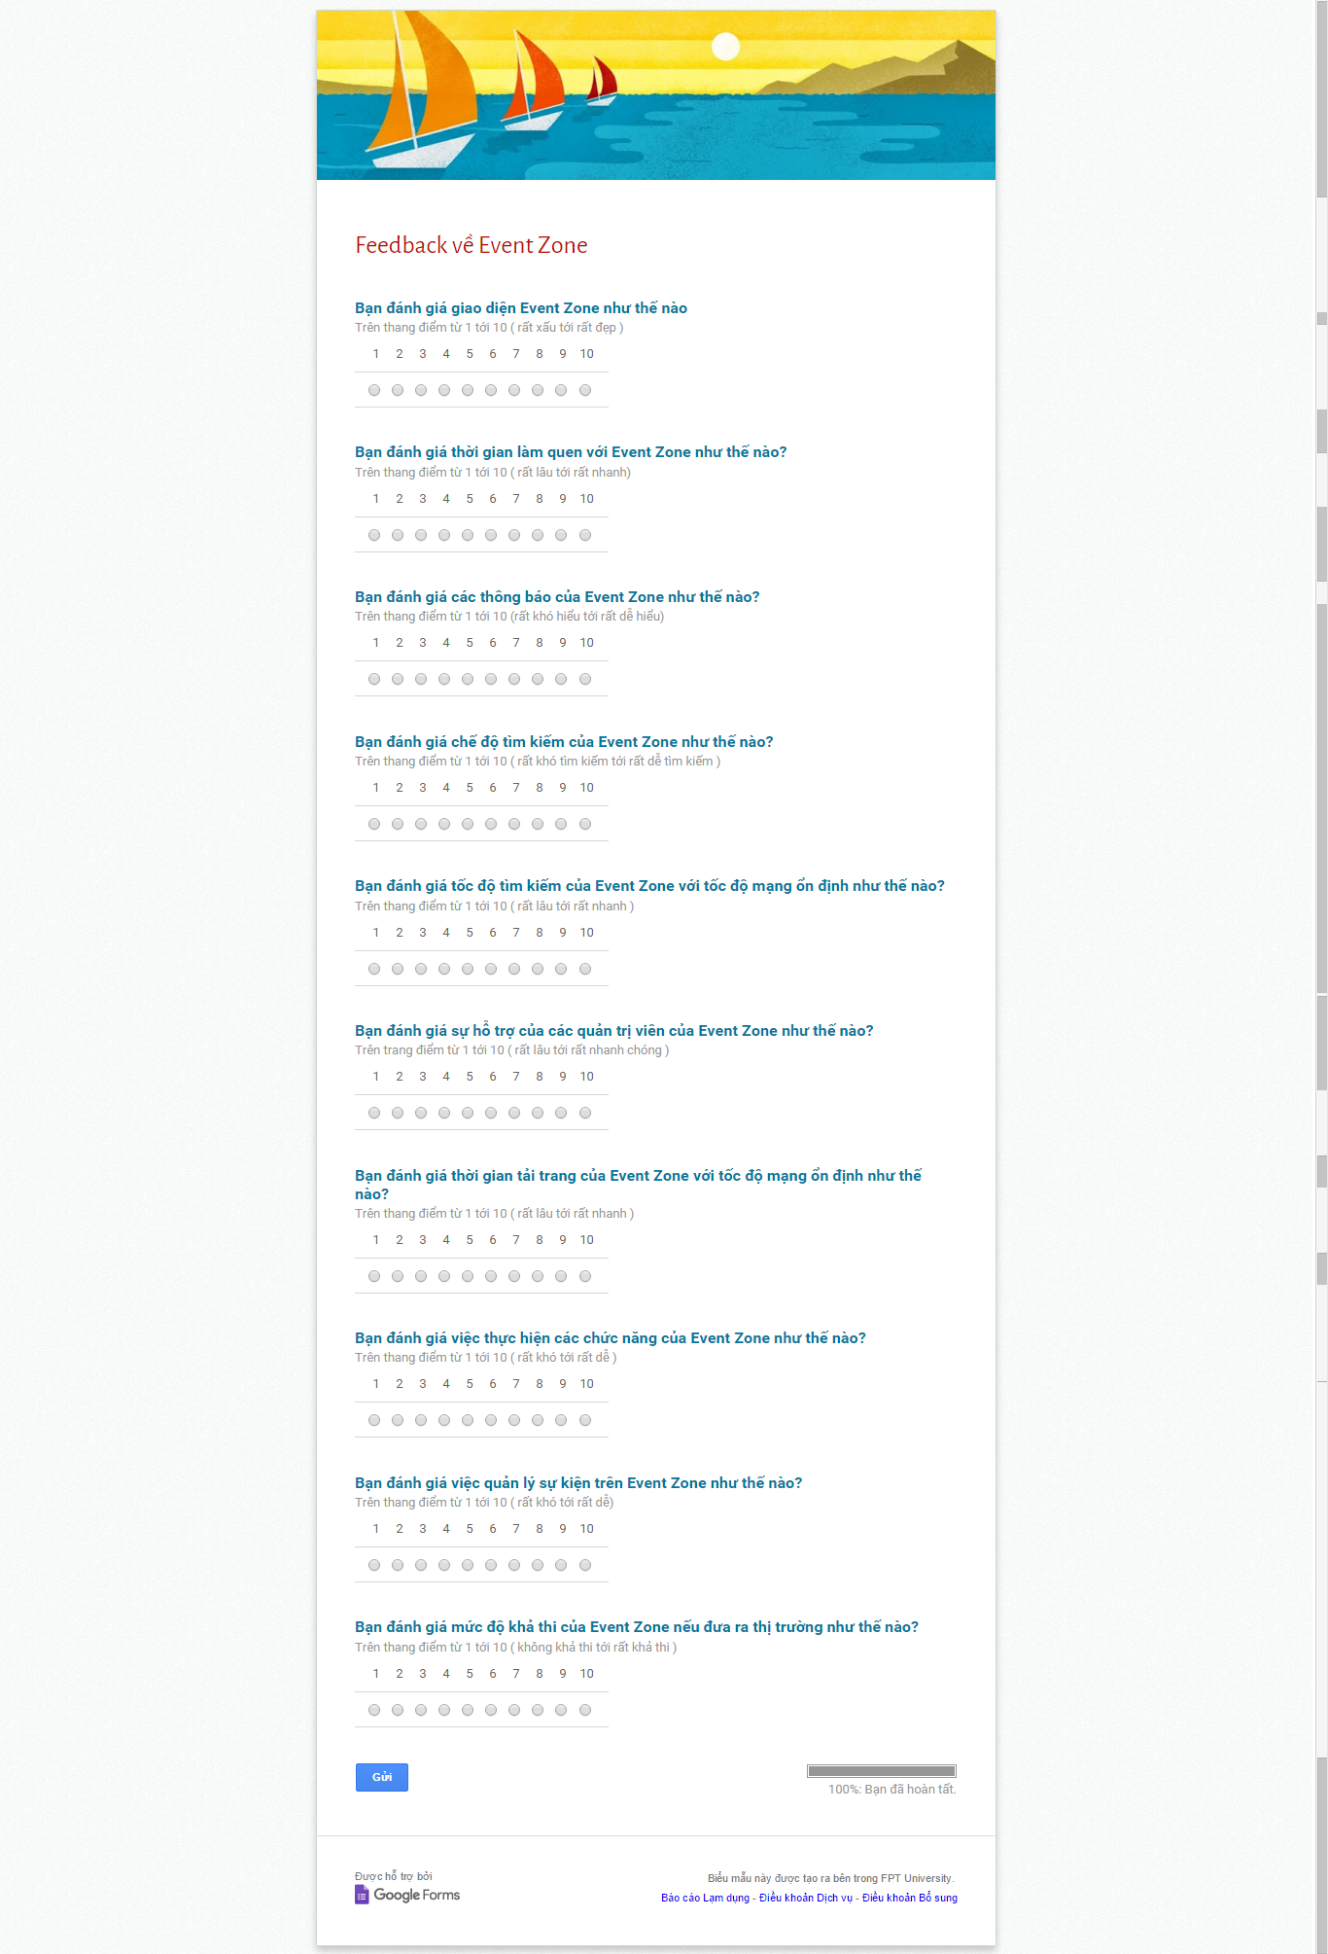
5.6. Test Type
テスト範囲
Unit Test
Integration Test
System Test
Acceptance Test

Slide 66
5.7. Process Logging Bug (Based on FSoft)
バグをログするプロセス
1. Tester detect bug → log bug in hostedredmind.com with status assigned and assign coder fix.
2. Coder fix bug → change bug status on hostedredmind.com to resolve and assign tester to check again.
3. Tester check bug again
  If bug is fixed, change bug status on hostedredmind.com to resolve.
  If bug haven’t been fixed yet, change bug status on hostedredmind.com to assign again coder fix.

Slide 67
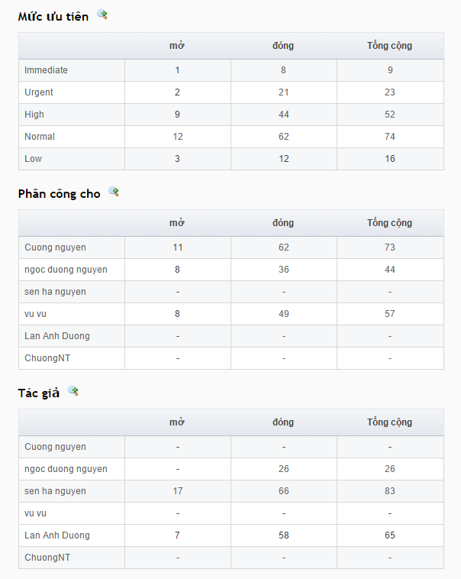
5.8. Bug List Report
テスト実行報告

Slide 68
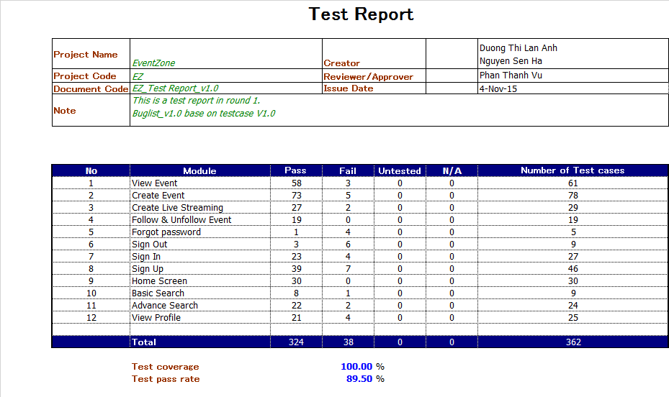
5.8. Bug List Report
テスト実行報告
Test Case report round 1

Slide 69
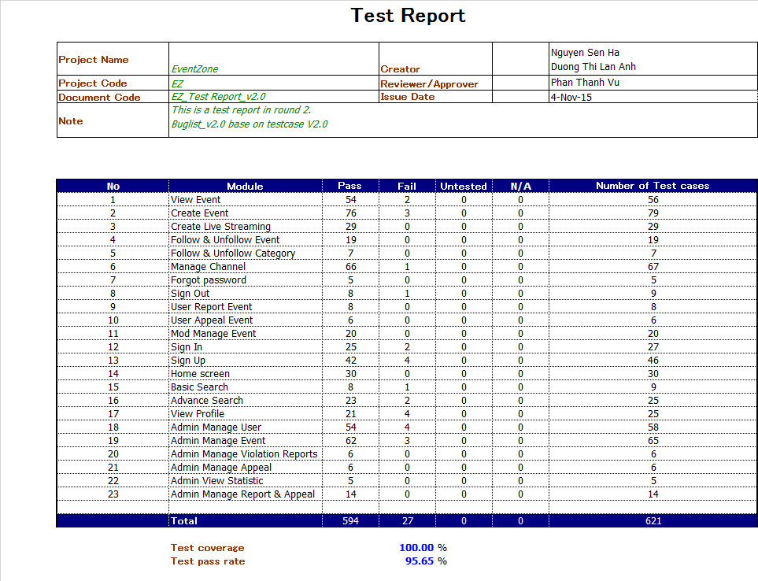
5.8. Bug List Report
テスト実行報告
Test Case report round 2

Slide 70
6. Summary - サマリー
Future Development - 拡張機能
  Publish online and maintain
  Crowd funding
  Managing Tickets
  Mobile Apps
  Event Zone Video Server
Lesson Learned - 学んだこと
  Technique: C# MVC 5, using Bootstrap create user interface without other interfaces framework, jquery
  Teamwork: Improve Teamwork, work under pressures
  Process: Testing skills, document writing skills
  Management: Improve Organization and planning skills

