Slide 1
Blood Bank
Supervisor: Lương Trung Kiên
Leader: Phạm Đình Tùng – SE02589
Member: Ngô Thanh Giang – SE02443
Phạm Tiến Lập – SE02683
Nguyễn Sơn Hải – SE02879
Phạm Quang Hưng – 01767

Slide 2
Outline of Content
1. Introduction
2. Project Management
3. Software Requirement Specification
4. System Design Description
5. Testing and Evaluation
6. Maintain and Future development
7. Demo and Q&A

Slide 3
1. Introduction
1.1 Current Situation
1.2 Existing Application
1.3 Idea
1.4 Proposal

Slide 4
1.1 Current Situation
Demand on donated blood is a very important problem
We need more apps about searching blood and blood bank
According to the statistics:
1200-1500 units of blood needed each day
At the beginning of 2/2015 in inventories sometimes left with only 4 units of blood A and falls into crisis
23/06/2015, the blood bank of the Hematology Institute - Central Blood Transfusion only about 5,000 units of blood

Slide 5
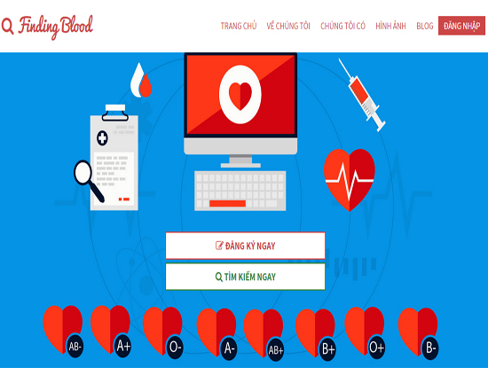
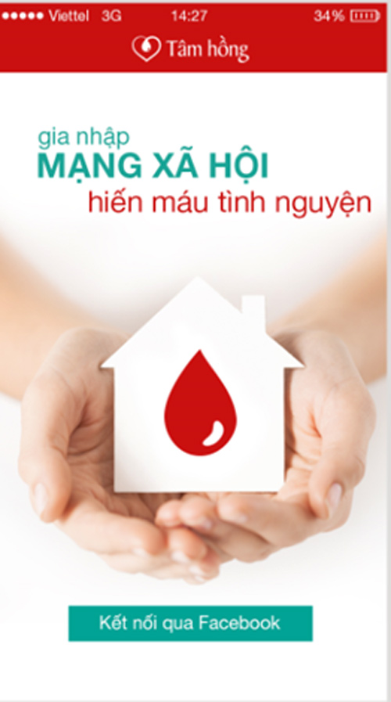
1.2 Existing Application
Finding Blood
Tam Hong

Slide 6
1.3 Idea
Build a application with:
    Create a community to help people that needed blood can easily find a group with same type of blood to cover danger situation.
    To avoid selling blood illegal
    Create a developing community

Slide 7
1.4 Proposal
    You can join in blood donations without wasting time for register.
    The users can find out information easily about the people who have same blood group and contact them when necessary.
    Support for searching by the blood type.
    Support for providing statistics.
    Team's member can communicate through message systems or through mobile phone.
    Allow administrator create and manage news easily.
    Free for all users.

Slide 8
2. Project Management
2.1 Software Process Model
2.2 Project Organization
2.3 Project Schedule
2.4 Tools & Technique
2.5 Risks management
2.6 Communication management

Slide 9
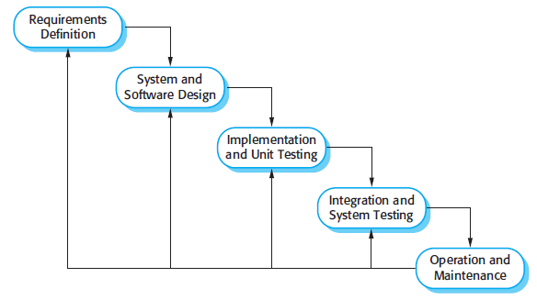
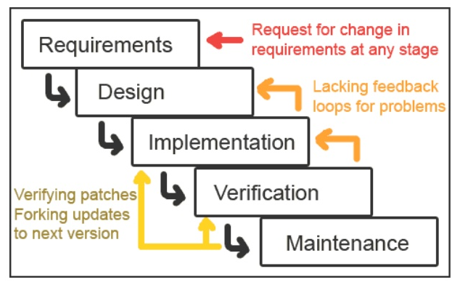
2.1 Software Process Model
Waterfall Model
Interative Waterfall Model

Slide 10
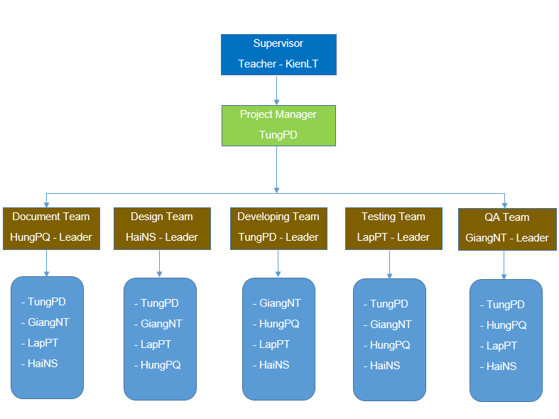
2.2 Project Organization

Slide 11
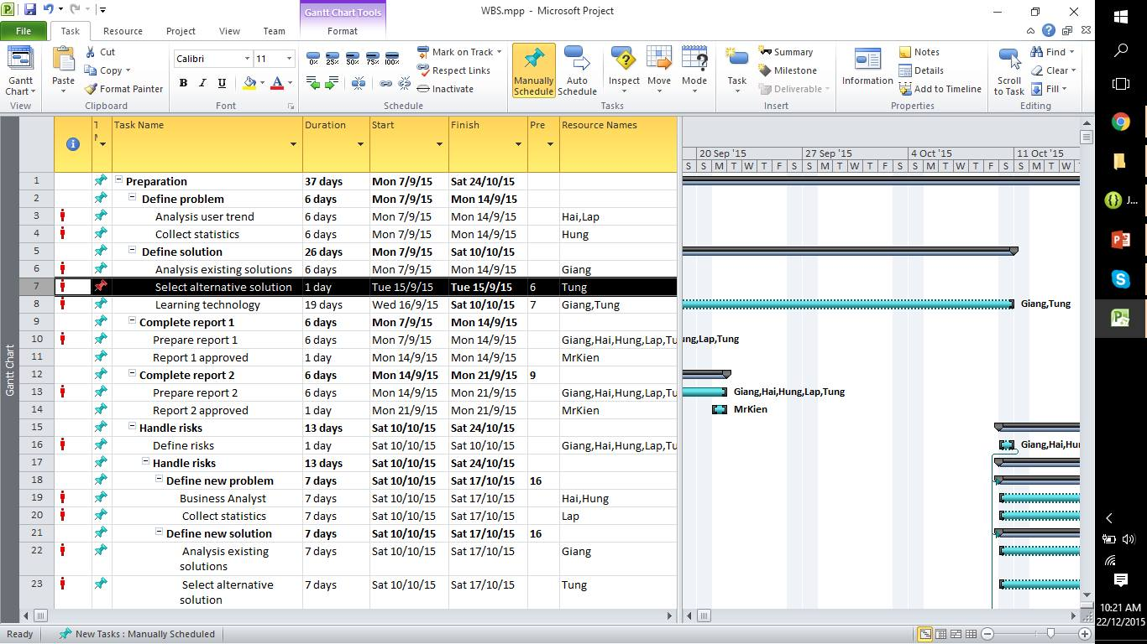
2.3 Project Schedule

Slide 12









2.4 Tools & Technique
Tools
    Tools for project management
    Tools for developing
TortoiseGit
Word 2013
Excel 2013
Project 2013
Visio 2013
Power Point 2013
Visual studio 2015
Eclipse
SQL Server 2008 R2

Slide 13
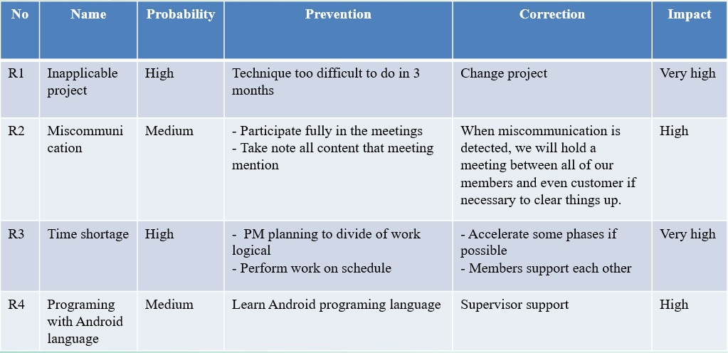
2.5 Risks management

Slide 14





2.6 Communication management
Time: 3 hours/day, 2 days/week.
Location: library
Communication
Meeting minutes

Slide 15
3. Software Requirement Specification
3.2
Functional Requirements
Non-Functional Requirements
3.1
System Users
3.3

Slide 16




3.1 System Users
There are 4 actors:
Guest
Personal User
Organization User
Administrator

Slide 17
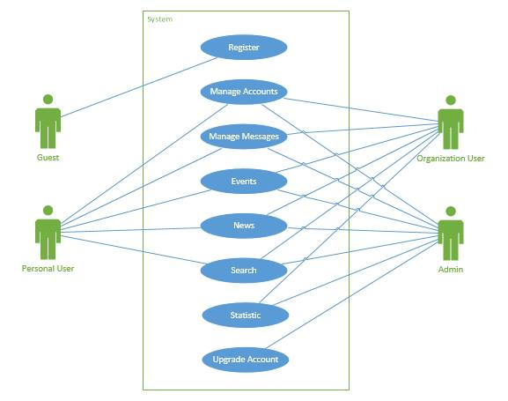
3.2 Functional Requirements
Module
Register
Manage Accounts
Manage Messages
Events
News
Search
Statistic
Upgrade Account

Slide 18
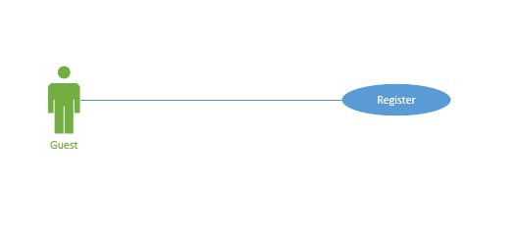
3.2 Functional Requirements
Guest
    Register Personal User

Slide 19
3.2 Functional Requirements
Personal User
    Login
    Logout
    Change password
    Forgot password
    Change avatar
    View profile
    View events
    Join Event
    Unjoin Event
    View news
    View member profile
    Edit profile
    New message
    Read message
    Send message
    Search blood type
    Search events
    Search news
    Search username

Slide 20
3.2 Functional Requirements
Organization User
- Organization User can do like Personal User, and:
    Create events
    Edit events
    Create News
    Edit News
    Statistic location
    Statistic events

Slide 21
3.2 Functional Requirements
Admin
- Administrator can do like Personal User and Organization User, and:
    Upgrade account

Slide 22
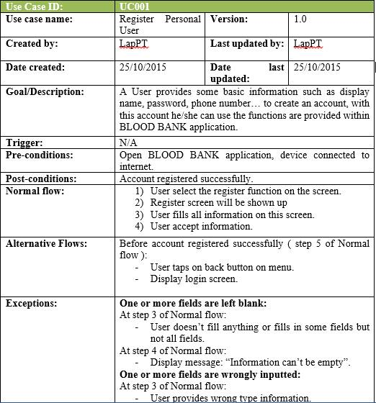
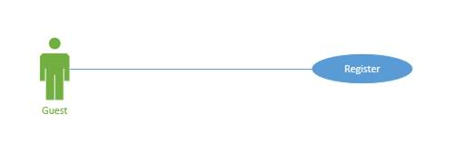
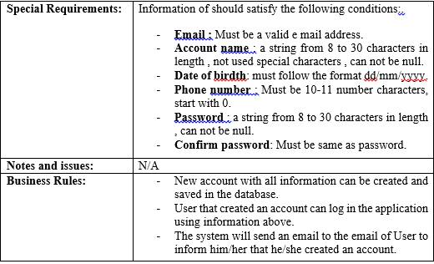
Usecase specification

Slide 23
3.3 Non-functional Requirements
User Interfaces
    Friendly and simply interface
    The color is elegant, not flashy
    Language is English
    Scalability system

Slide 24

3.3 Non-functional Requirements
Software Requirements
Android

Slide 25
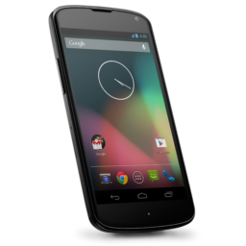

3.3 Non-functional Requirements
Hardware Requirements
Smartphone with internet connection.

Slide 26
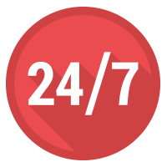



3.3 Non-functional Requirements
Availability
Security
Maintainability
Portability

Slide 27
4. Software Design Description
4.1 System Architecture Design
4.2 Component Diagram
4.3 Class Diagram
4.4 Class Explanation
4.5 Sequence Diagram
4.6 Entity Relationship Diagram
4.7 Table Database
4.8 Interface

Slide 28
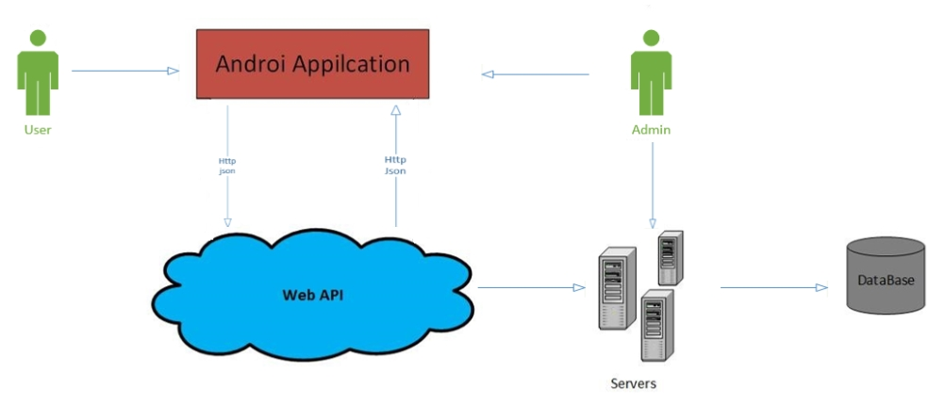
4.1 System Architecture Design

Slide 29
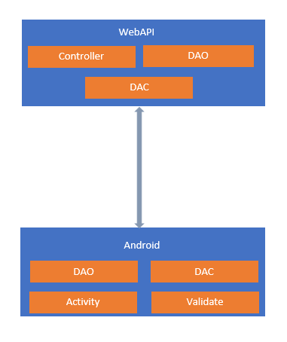
4.2 Component Diagram

Slide 30
4.3 Class Diagram
Class diagram server

Slide 31
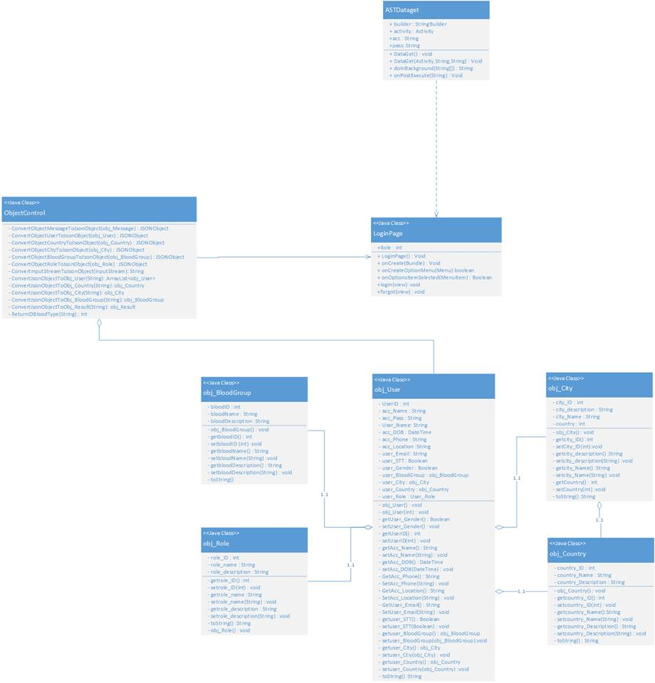
4.3 Class Diagram
Class diagram client

Slide 32
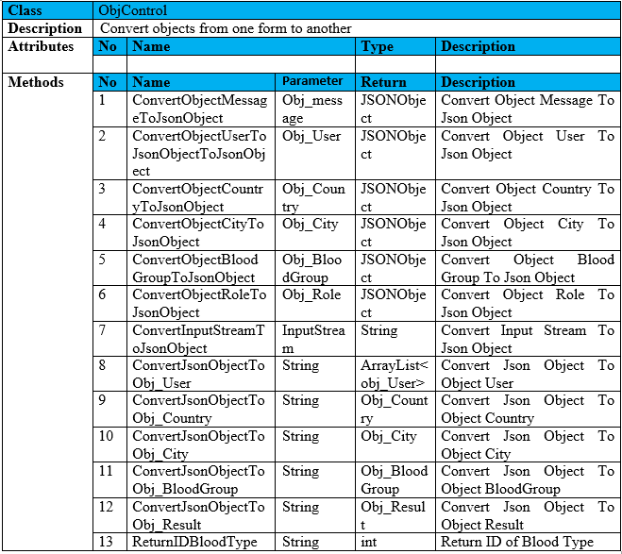
4.4 Class Explanation

Slide 33
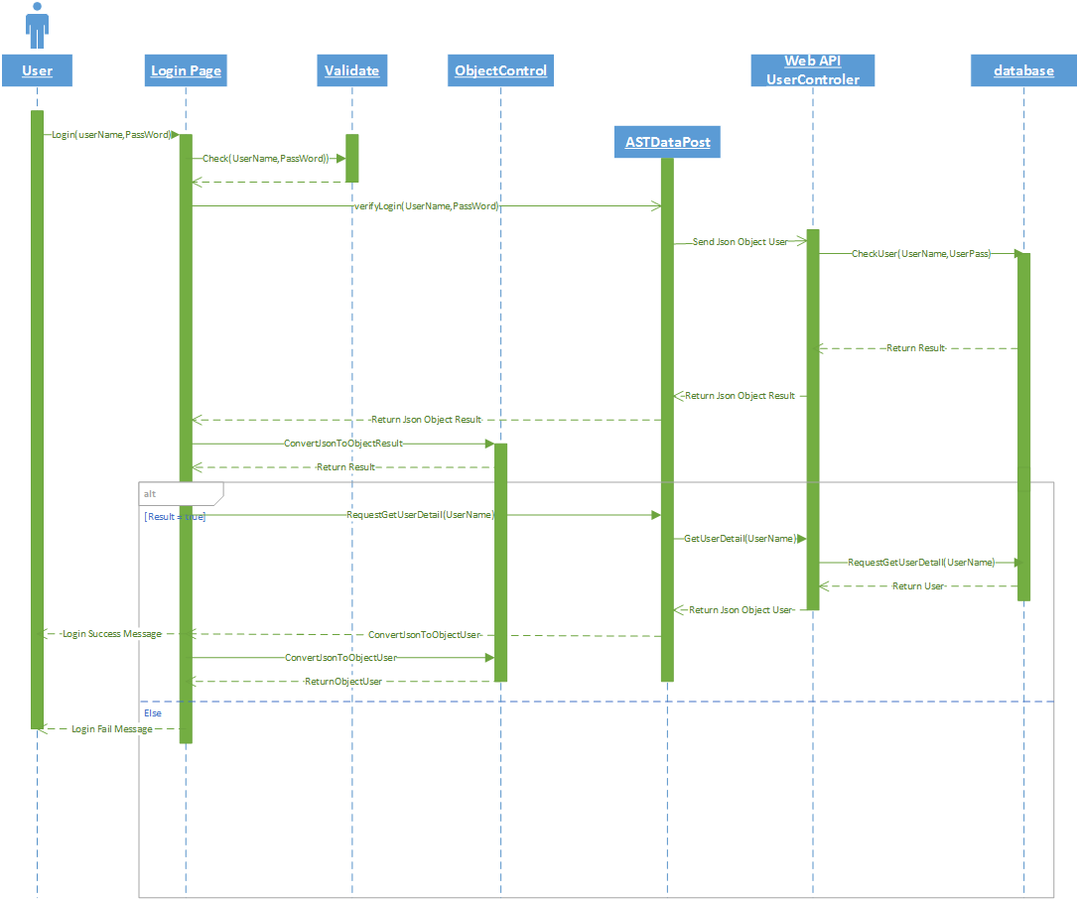
4.5 Sequence Diagram

Slide 34
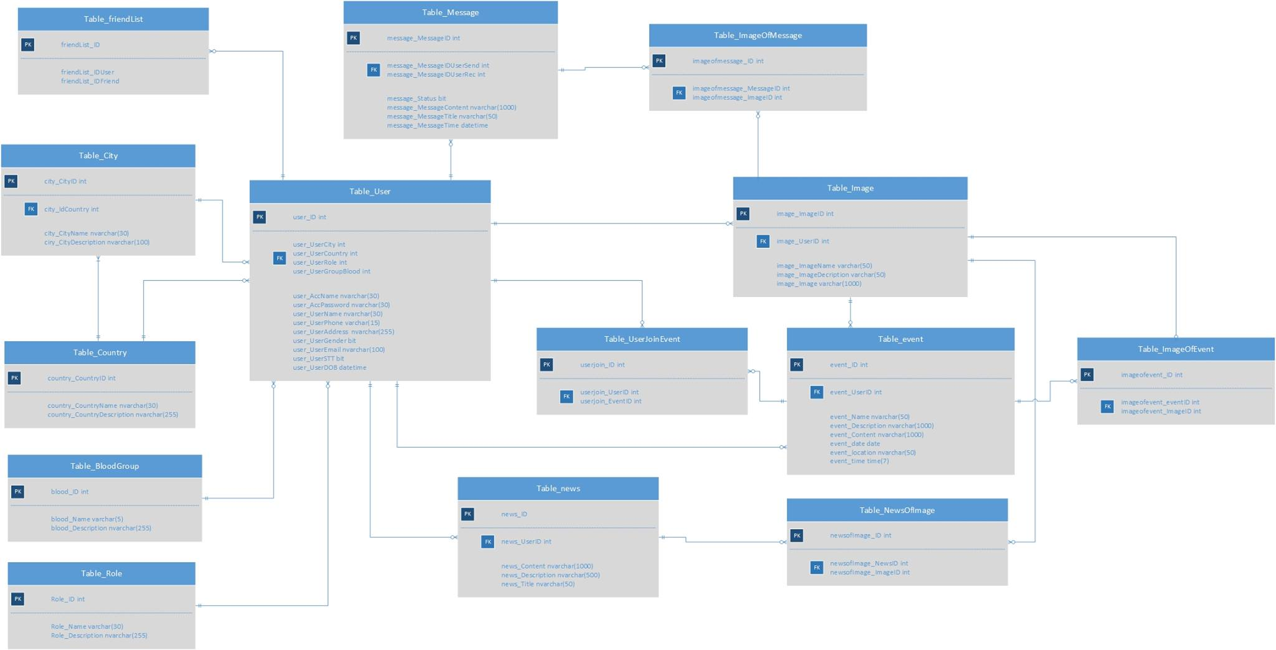
4.6 Entity Relationship Diagram

Slide 35
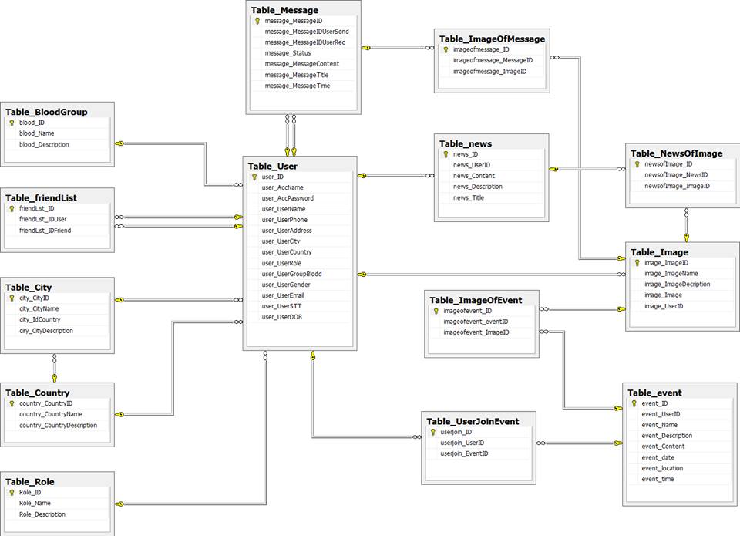
4.7 Table Database

Slide 36
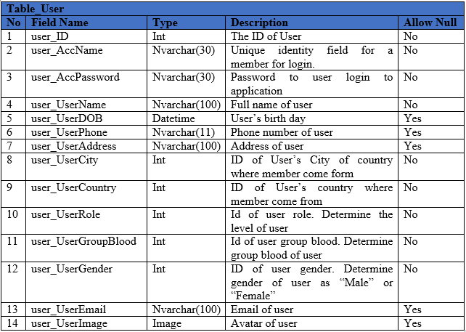
Table Data Dictionary

Slide 37
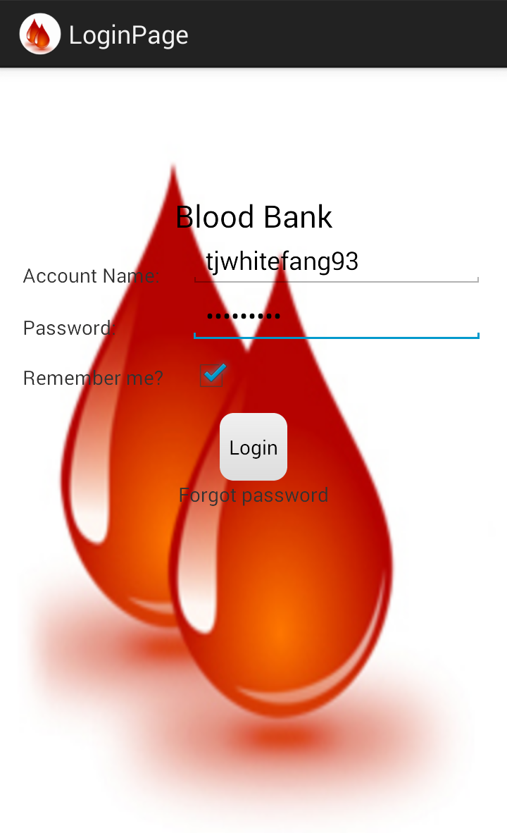
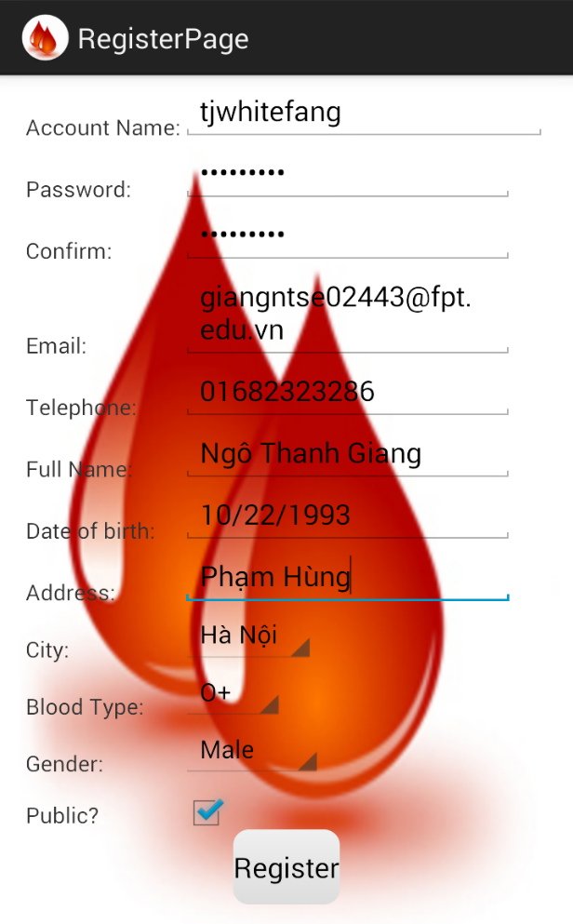
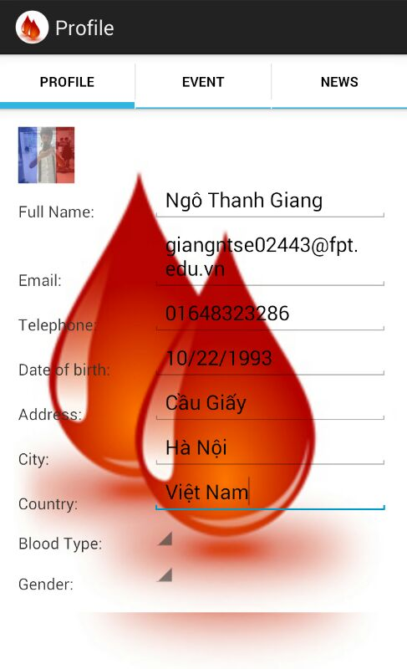
4.8 Interface

Slide 38
5. Testing and Evaluation
5.1 Test Strategy
5.2 Test Model
5.3 Test Plan
5.4 Test Process
5.5 Test Cases
5.6 Test Report
5.7 Checklists
5.8 Evaluation

Slide 39
5.1 Test Strategy
We divide into two kind of testing
  Static testing
    Review requirement (Cross check document)
    Review coding convention
  Dynamic testing
    Unit testing (Developer performing)
    Integration testing (Tester performing)
    System testing (Tester performing)
    Acceptance testing (Some FPT university’s student performing)

Slide 40
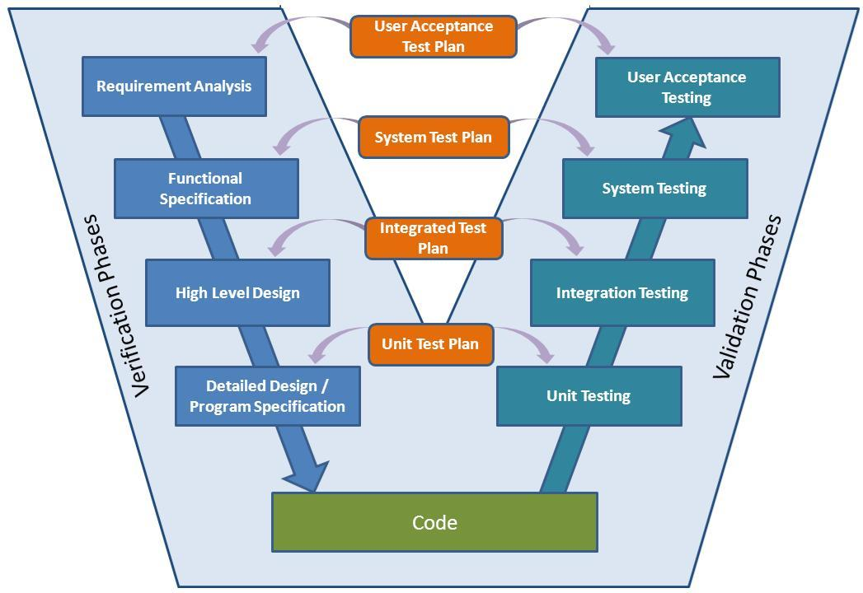
5.2 Test Model
V-Model

Slide 41
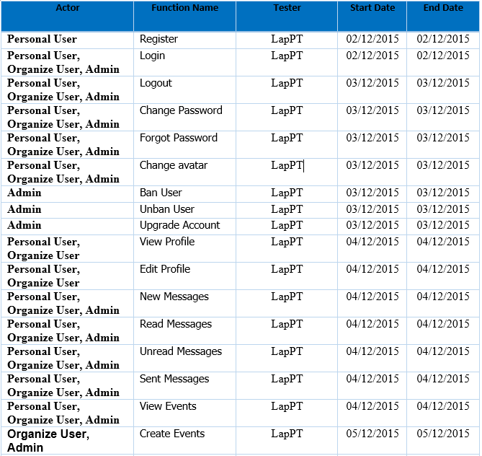
5.3 Test Plan

Slide 42
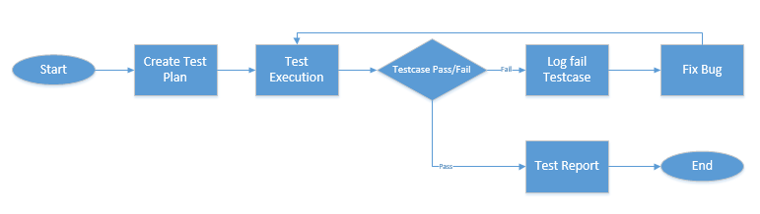
5.4 Test Process

Slide 43
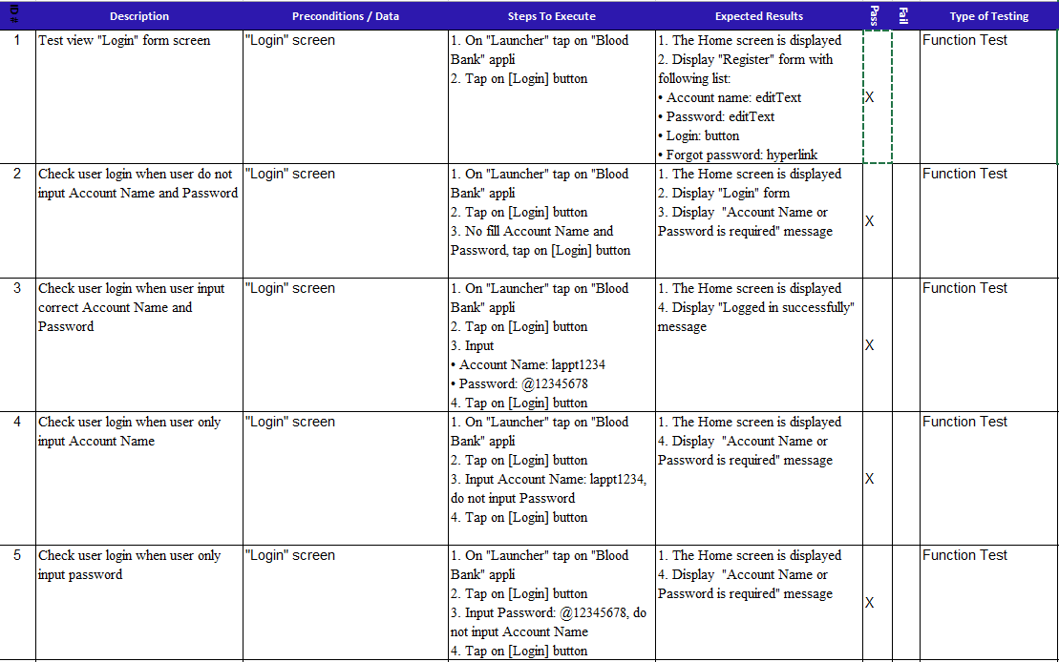
5.5 Test Cases
Test cases sample

Slide 44
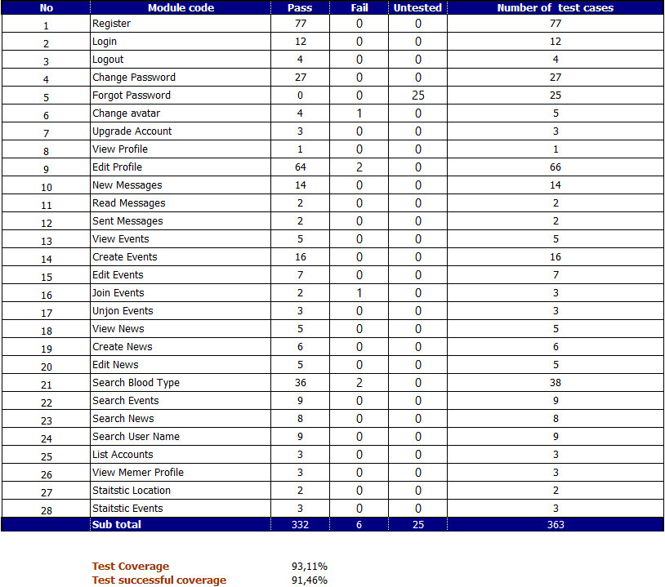
5.6 Test Report

Slide 45
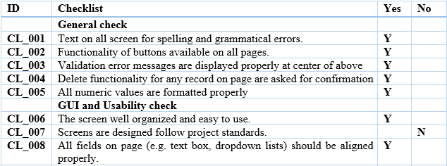
5.7 Checklists
Checklists sample

Slide 46
5.8 Evaluation
We tried my best, but it still has some functions that are not complete, and we will complete these functions in the future.

Slide 47
6. Maintain and Future Development
Maintain
Fix GUI
Update and fix code
Future Development
Develop more interactivity between users (share, follow,…)
Adding support for other language
Integrate Google location
Support for searching by blood constituents

Slide 48
7. Demo and Q & A
Demo
Q & A

Slide 49
THANKS FOR YOUR LISTENING

