Slide 1
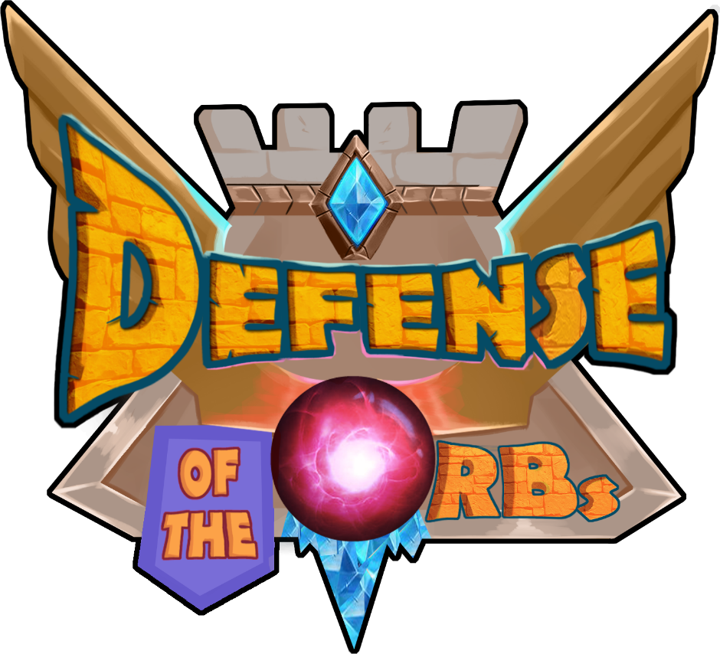
Defense of The Orbs
A computer game developed using Unity Technology

Slide 2
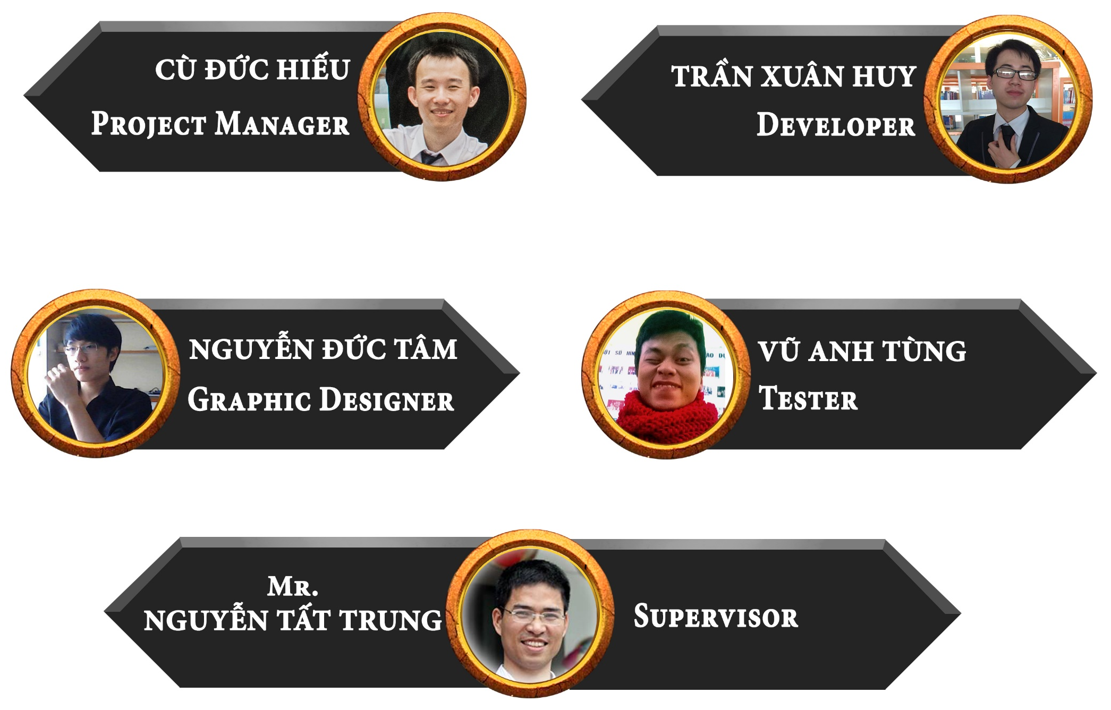
Project Team

Slide 3
Contents
1
Introduction
2
Project Management Plan
3
Requirement Specification
4
Software Design
5
Software Testing
6
Lesson Learned
7
Demo – Q&A

Slide 4
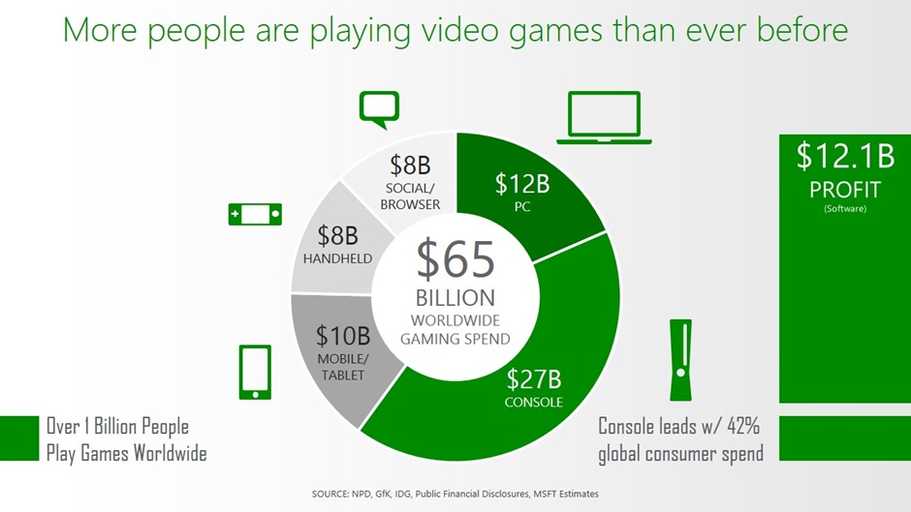
Background
November 29th, 2014

Slide 5
What is Game?
The ASTD/i4cp study defines games as, “systems in which players engage in various ways toward a common goal or win state. Games often include a storyline, rules, interactivity, and feedback that result in a quantifiable outcome.” (2014).

Slide 6
Game Categories
Declarative Knowledge
Conceptual Knowledge
Procedural Knowledge
Decision Making
Communication / Soft Skills

Slide 7
Game Types
Real Time Strategy (RTS)
First Person Shooter (FPS)
Role Playing Game (RPG)
Multiplayer Online Battle Arena (MOBA)

Slide 8





Idea
Private
Communities
Hold
Hold
Hold
Hold
Party
Travel
Karaoke
Our Idea
Teambuilding Activities

Slide 9
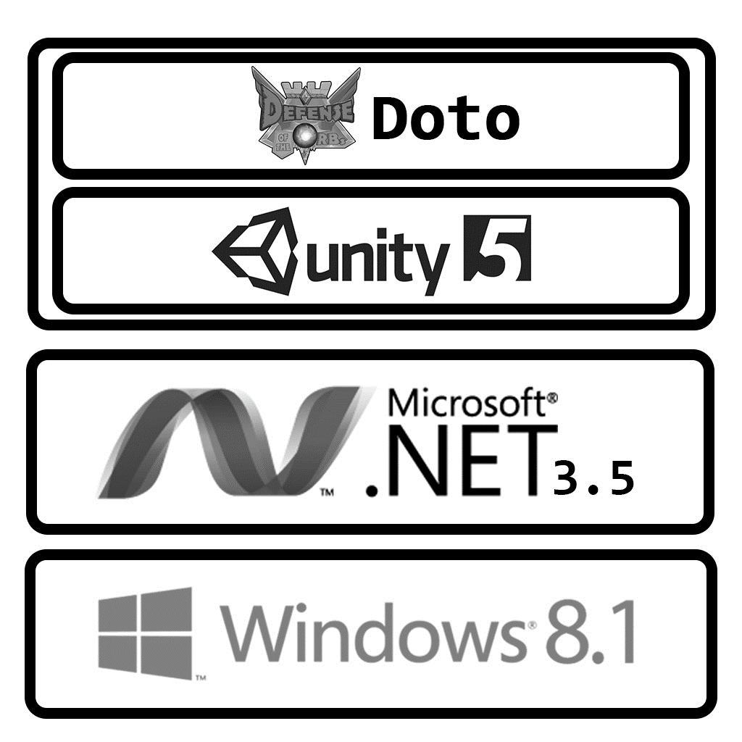

Proposal of System
PC/Laptop
(Client)
PC/Laptop
(Client)
PC/Laptop
(Client)
PC/Laptop
(Host)
PC/Laptop
(Client)
PC/Laptop
(Client)

Slide 10
Overview
Product Name: Defense of The Orbs.
Product Type: Computer game.
Game operates on
Hardware: Personal Computer (PC) or Laptop.
Software: Microsoft Windows 8.1 Professional x64.
Perspective: 3-dimensions.
Game Category: Communication/Soft Skills.
Game Type: Real Time Strategy.

Slide 11
Objectives
Support Multi-player
Support Playing over Local Network
Support Instant Messaging

Slide 12
Out of Scope
3D Modeling
Creating sound effects
Composing game music

Slide 13
Contents
1
Introduction
2
Project Management
3
Requirement Specification
4
Software Design
5
Software Testing
6
Lesson Learned
7
Demo – Q&A

Slide 14
Project Structure
Project Team
FPT University
Project Manager
Supervisor
Design Team
Dev Team
Test Team
Designer
Dev
Tester
Designer
Dev
Tester

Slide 15
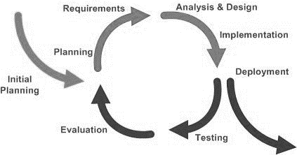
Software Process Model

Slide 16
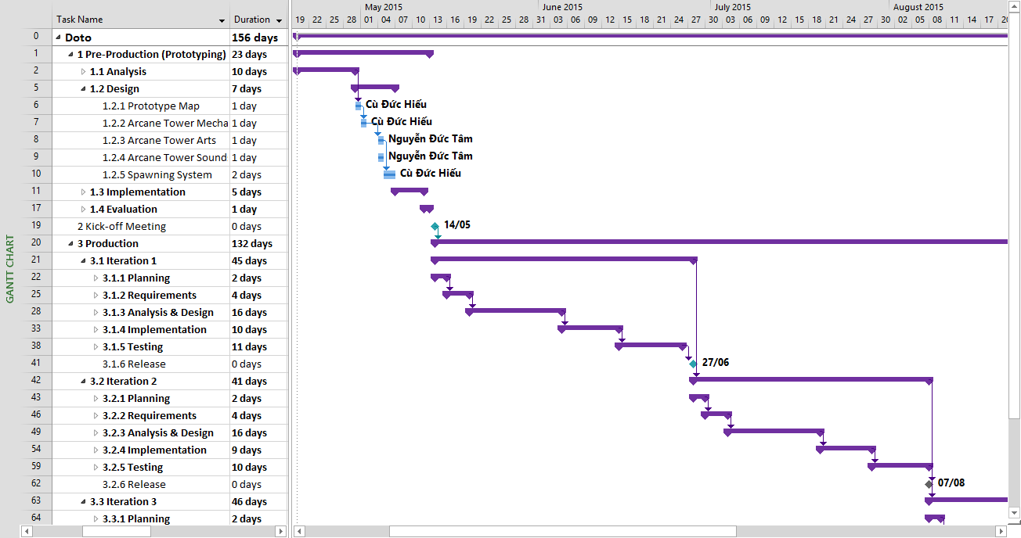
Project Planning

Slide 17








Tools
Redmine 1.4
Microsoft Office 2013
Microsoft Visual Studio 2013
Unity Editor 5
Adobe Photoshop CS6
Autodesk 3Ds max 2015
Visual Paradigm for UML 8 SP2
SourceTree 1.6.2

Slide 18


Technologies
Unity 5
.NET Framework 3.5

Slide 19
Risk Management
No. | Description | Avoidance Plan | Contingency Plan | Status
1 | Unfamiliar technology. | Organize training activities before project starts. | Use iterative development and incremental delivery method. | Closed
2 | Hardware & software failure. | Prepare backup hardware & software | Use online hosting version control system and always keep a baseline of the project on another one. | Closed
3 | Stakeholders conflict over proposed changes. | Clearly define scope at the beginning. | In all circumstances, project manager makes the final decision. | Closed
4 | Team members with negative attitudes towards the project. | Work with the resource to eliminate the negative attitudes. | Use online hosting version control system to mitigate the sabotage. | Closed

Slide 20
Contents
1
Introduction
2
Project Management Plan
3
Requirement Specification
4
Software Design
5
Software Testing
6
Lesson Learned
7
Demo – Q&A

Slide 21
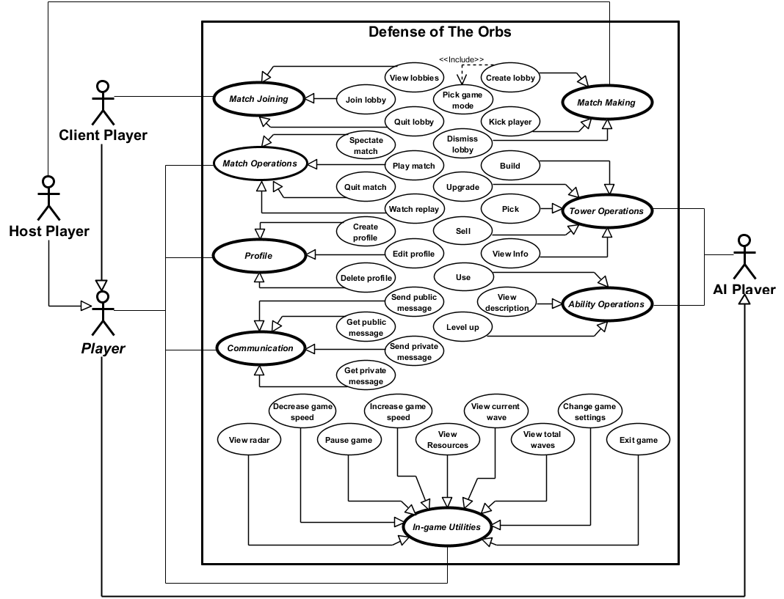
Use Case Diagram
43
AI Player
Player
Host Player
Client Player
Use Cases
35
Concrete Use Cases
Use Cases
8
Abstract Use Cases
Use Cases

Slide 22
Functional Requirements
Unit Movement
Path Finding
Unit Animation
Tower Selection
Tower Attack
Predictive Aiming
Lobbed Projectile
Dealing Damage
Network Playing
Game Mode
Tower Upgrade
Tower Selling

Slide 23
Non-Functional Requirements
Performance
Optimize 3D Model
Optimize 2D Texture
Limit the use of Lightning & Shadow
Maintainability
Use component-based approach
Usability
Use user-centred approach

Slide 24
Contents
1
Introduction
2
Project Management Plan
3
Requirement Specification
4
Software Design
5
Software Testing
6
Lesson Learned
7
Demo – Q&A

Slide 25
Game Structure
Defense of The Orbs
Main Menu Scene
Tower Selection Scene
Gameplay Scene
UIC Agent
UIC Agent
M Agent
M Agent
UC Agent
UIC Agent
PC Agent
CCC Agent
Multi-player Agent
Pooler Agent
Jsoner Agent
Debugger Agent

Slide 26
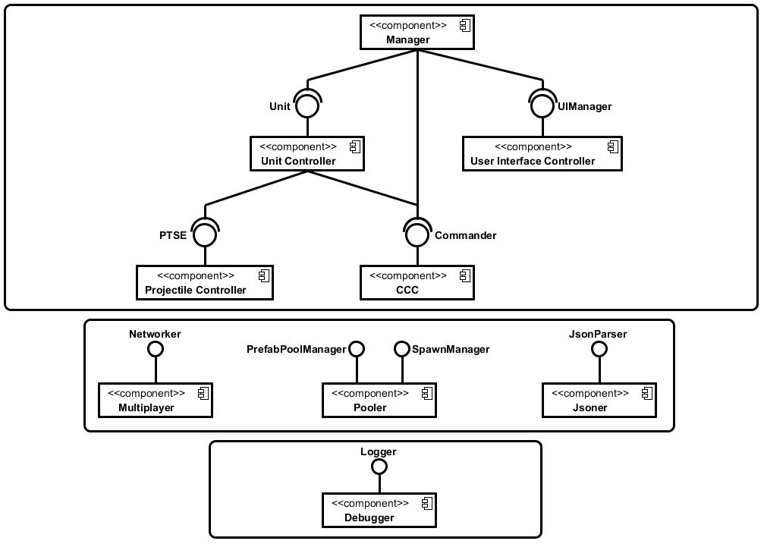
Component Diagram

Slide 27
Agent Specifications
Pooler Agent
Performance
Handling exhausted pool
Handling overloaded pool
PC Agent
UC Agent
CCC Agent

Slide 28
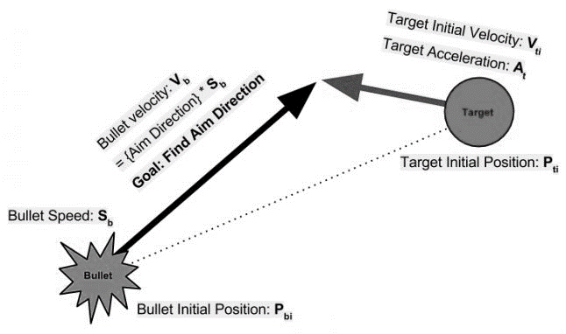
Agent Specifications
Pooler Agent
Predictive Aiming
PC Agent
UC Agent
CCC Agent
V_{b} = V_{t} + [ (P_{ti} - P_{bi}) / t ]

Slide 29
Agent Specifications
Pooler Agent
Ballistic Trajectory
PC Agent
UC Agent
CCC Agent
V_{b} = V_{t} - 0.5 * A_{b} * t + [ ( P_{ti} – P_{bi} ) / t ]

Slide 30
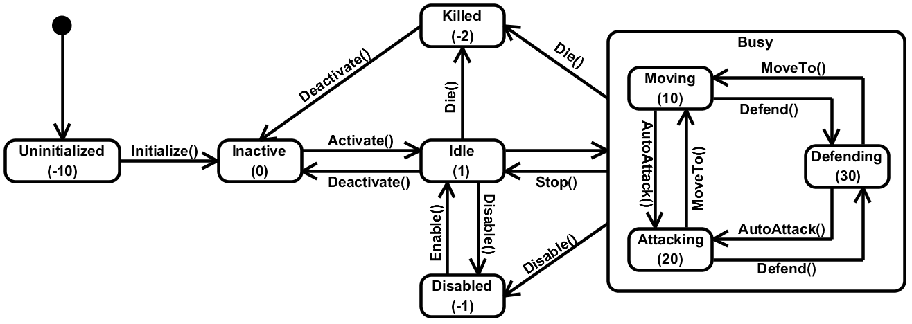
Agent Specifications
Pooler Agent
Unit States
PC Agent
UC Agent
CCC Agent

Slide 31
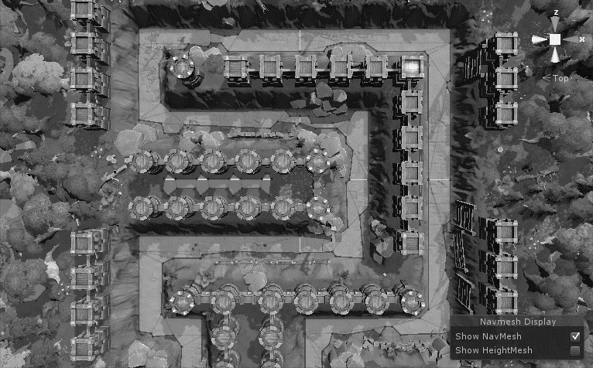
Agent Specifications
Pooler Agent
Unit Movement
PC Agent
UC Agent
CCC Agent

Slide 32
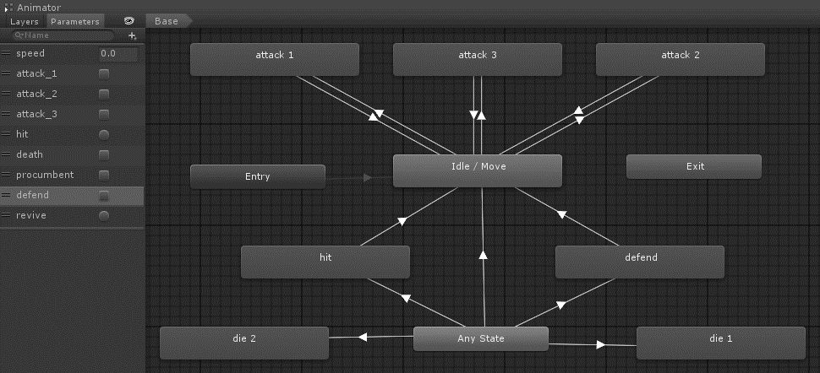
Agent Specifications
Pooler Agent
Unit Animation
PC Agent
UC Agent
CCC Agent

Slide 33

Agent Specifications
Pooler Agent
Network Synchronization
PC Agent
UC Agent
CCC Agent

Slide 34
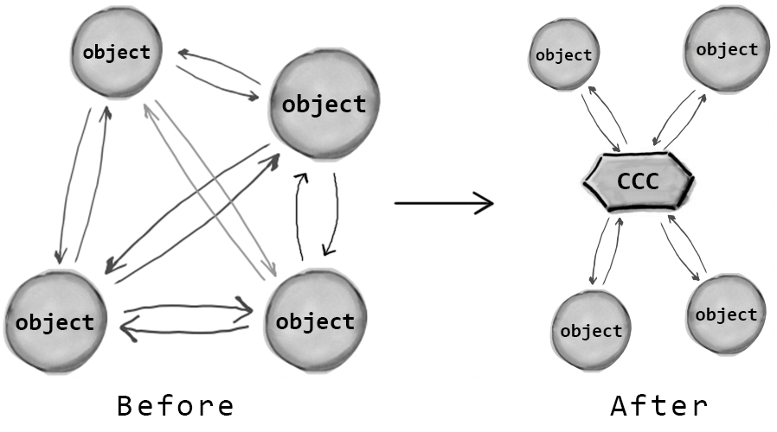
Agent Specifications
Pooler Agent
Communication Centralization
PC Agent
UC Agent
CCC Agent

Slide 35
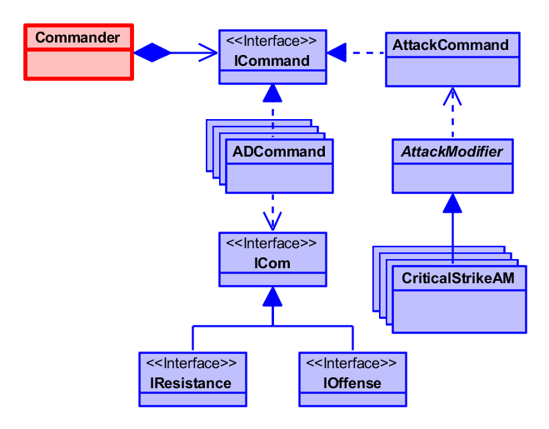
Agent Specifications
Pooler Agent
Decoupling
PC Agent
UC Agent
CCC Agent

Slide 36
Contents
1
Introduction
2
Project Management Plan
3
Requirement Specification
4
Software Design
5
Software Testing
6
Lesson Learned
7
Demo – Q&A

Slide 37
Testing Life-Cycle
Identify Requirements
Test Planning
Bug Fixing
Acceptance Testing
Test Excuting
Design Test Case
Regression Testing
Test Result Report

Slide 38
Test Types
GUI Testing
Function Testing
Performance Testing
Acceptance Testing

Slide 39

Test Tools
Redmine 1.4
Frap 3.5.99

Slide 40
Test Environment
Software:
Windows 8.1 Professional x64
.NET Framework 3.5
Hardware:
CPU: Intel® Core™ i3
GPU: AMD Radeon HD 7400M Series
Resolution: 1366x768
RAM: 8.00GB

Slide 41
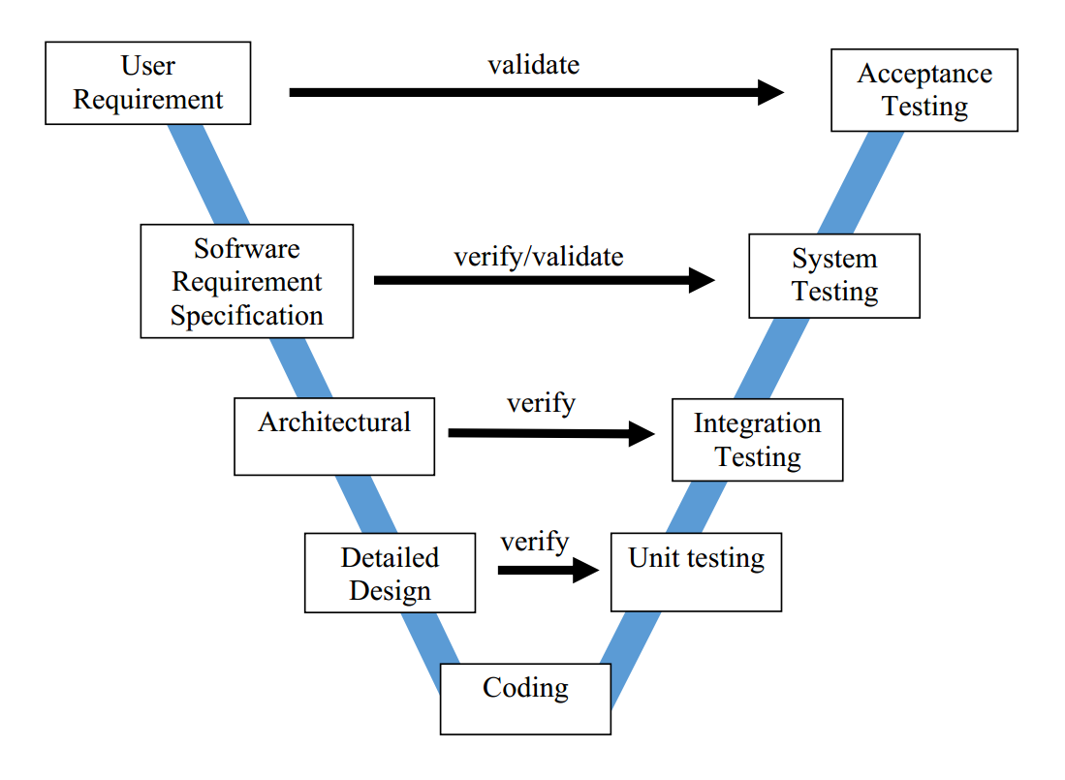
Testing Model

Slide 42
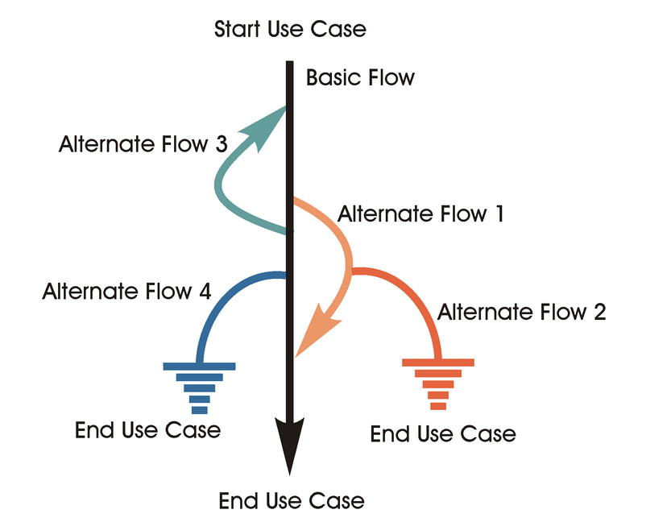
Test Case Guideline

Slide 43
Contents
1
Introduction
2
Project Management Plan
3
Requirement Specification
4
Software Design
5
Software Testing
6
Lesson Learned
7
Demo – Q&A

Slide 44



Lesson Learned
Working in group:
Resolve conflicts
Communication
Management skills:
Organize
Negotiate
Make plan
Architectural Design:
GoF Design Patterns
OO Principles
PAC architecture
Component-based approach

Slide 45
Contents
1
Introduction
2
Project Management Plan
3
Requirement Specification
4
Software Design
5
Software Testing
6
Lesson Learned
7
Demo – Q&A

Slide 46

Demo

Slide 47

Q&A

