Slide 1
FOOTBALL PITCHES BOOKING

Slide 2
About us
Supervisor:
Phan Trường Lâm
Group:
1. Phan Ngọc Trầm
2. Lê Xuân Thành
3. Nguyễn Hoàng Huy
4. Nguyễn Trí Quãng
5. Đinh Tiến Huy
2

Slide 3
Contents
»
Problems
»
Solutions
»
Football Pitches Booking
»
Demonstration
»
Questions & Answers
3

Slide 4


Problems
» What do users need?
Guest
Stadium Owner
4

Slide 5

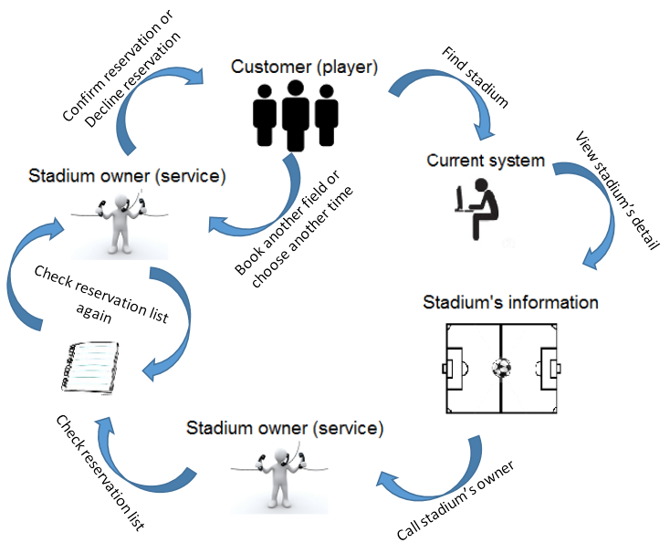



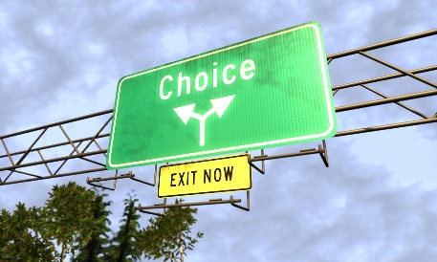
Current system
Complicated process
Wasting time
Ineffective management
Existing system: tuyensonsport.vn, datsan.com.vn, webbongda.net,...
Limited choices
5

Slide 6


Solutions
» New system with improvements:
More choices
Simple process
Saving time
Easy to manage
Chances to promote
6

Slide 7
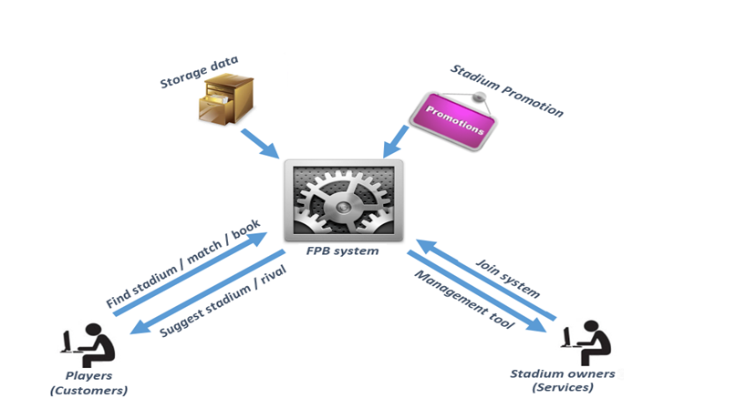
Football Pitches Booking
B2B2C business model
7

Slide 8






Tools & Technologies
8

Slide 9
User roles
Website Master
Stadium Owner
Guest
9

Slide 10
Core flow
Find a field
Book a field
Take a field
10

Slide 11
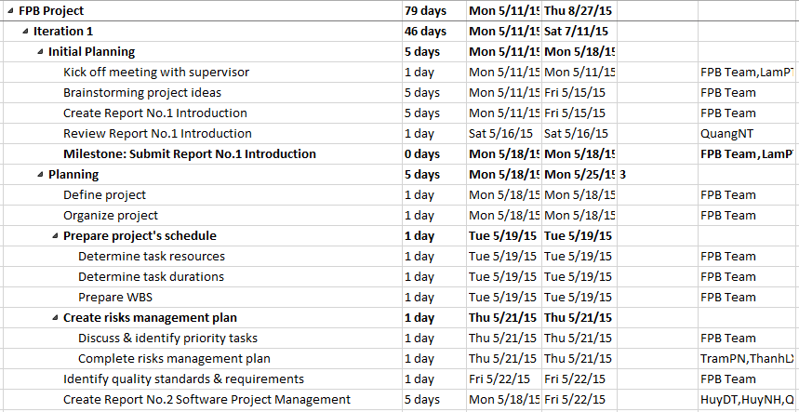
Project Management Plan
11

Slide 12
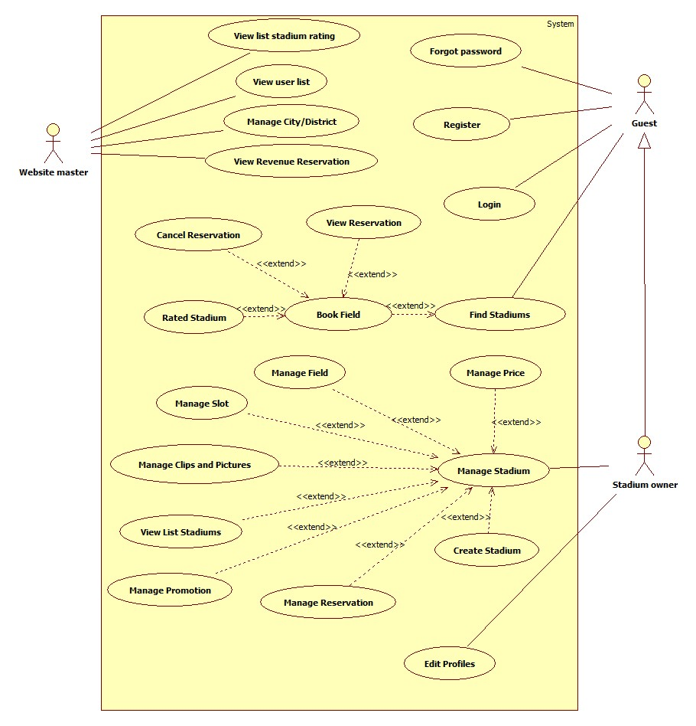
System Requirements Specifications
    Functional Requirements
12

Slide 13
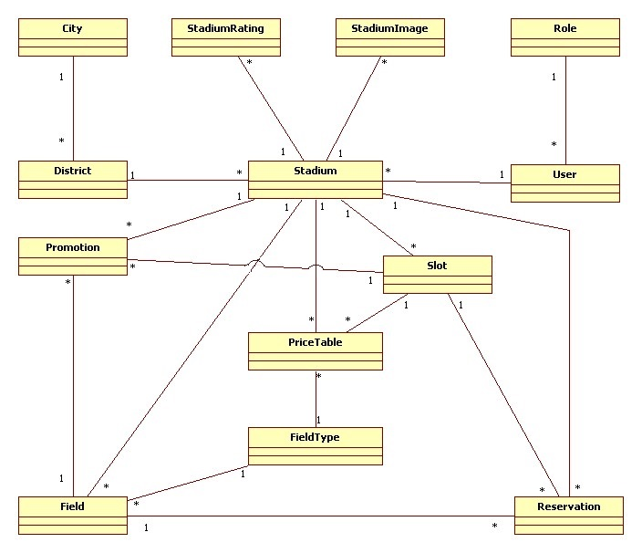
System Requirements Specifications
    Entity Relationship Diagram
13

Slide 14
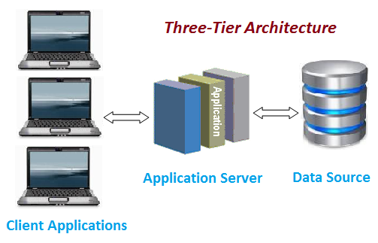
System Design Specifications
  System Architectural Design
14

Slide 15
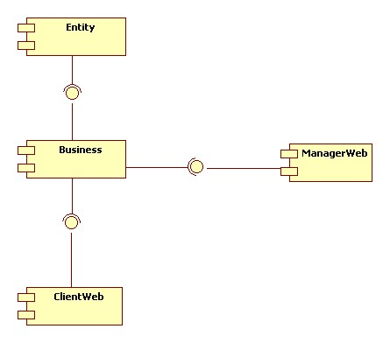
System Design Specifications
  Component Diagram
15

Slide 16
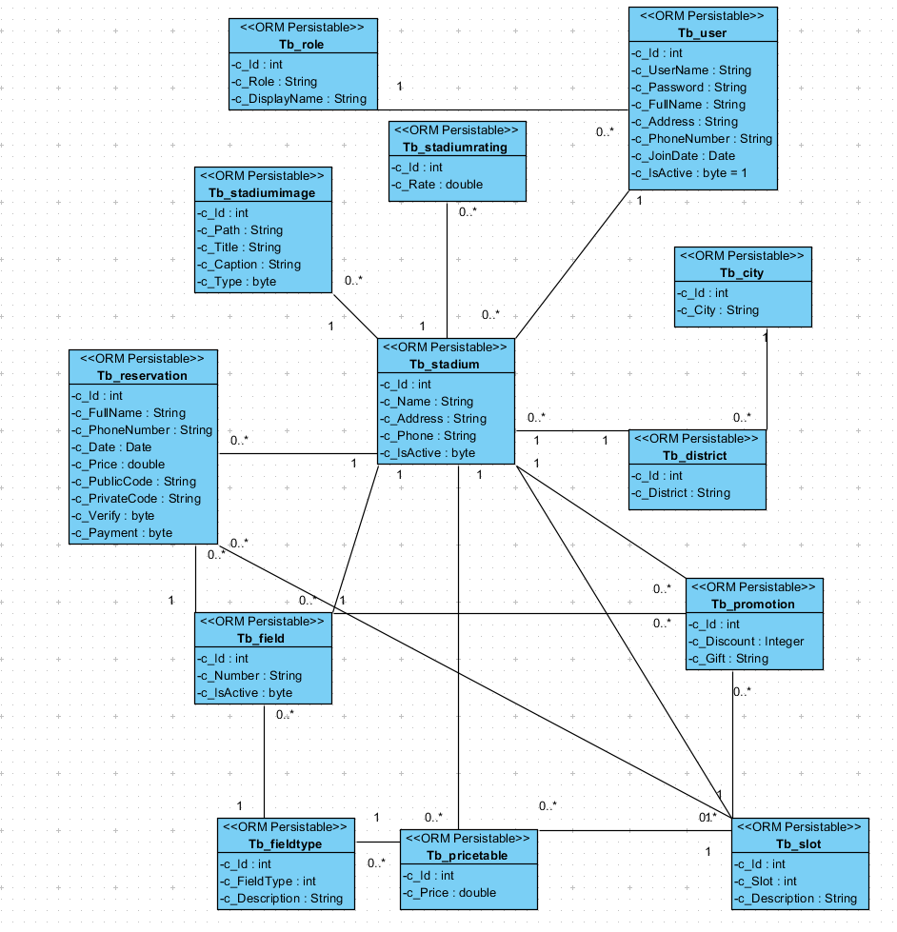
  Class Diagram
16

Slide 17
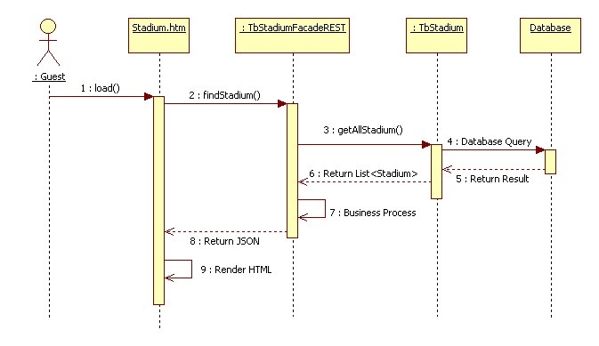
System Design Specifications
  Sequence Diagram
Find stadiums
17

Slide 18
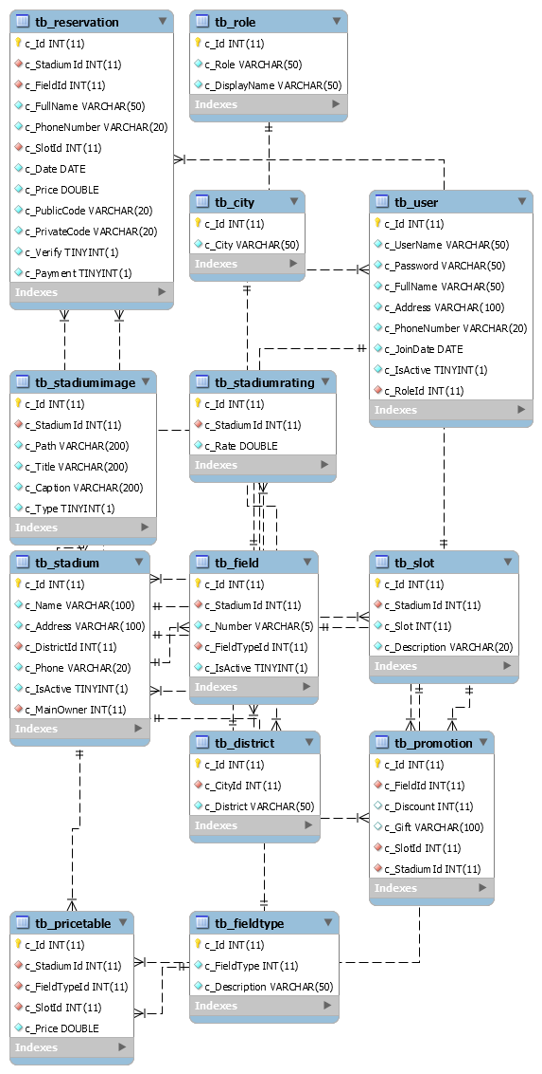
  Database Design
18

Slide 19
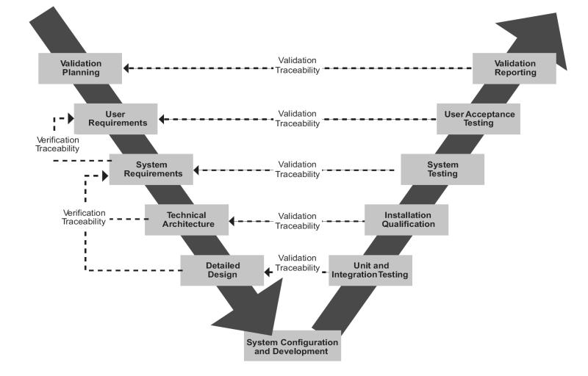
System Implementation & Test
    Testing model
19

Slide 20


System Implementation & Test
    Testing Tools and Environment
20

Slide 21
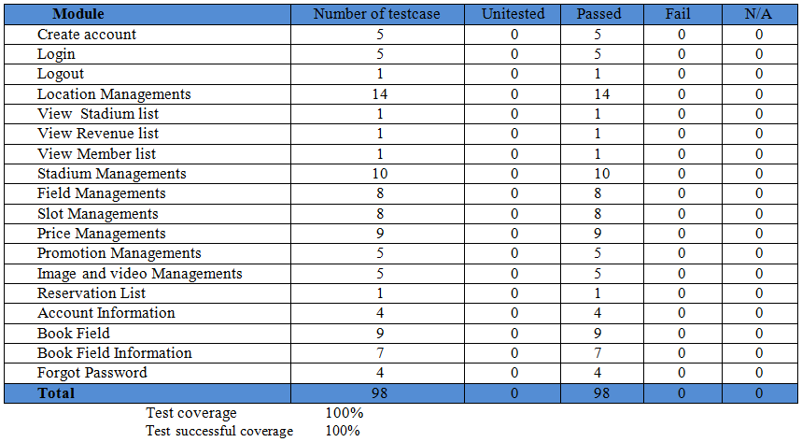
System Implementation & Test
    Testing Report
    Test level: system and integration test.
21

Slide 22

Demonstration
22

Slide 23

Questions & Answers
Thanks for your listening!
23

