Slide 1
Chatting secure on Android
Capstone Project

Slide 2
CONTENTS
Introduction
Project Management Plan
Requirement Specification
Software Design Specification
Testing & Evaluation
Demo & QA

Slide 3
Introduction
Team member
Problems
Exist system
Our Purpose

Slide 4
Introduction
Team member
LanTV - Supervisor
DucDV – Project manager
NgocNV - Developer
MinhTN - Developer
ThucNV - Tester

Slide 5
Introduction
Problem

Slide 6
Introduction
Existing system
Encryption algorithm is fixed and maybe decrypted on the future
Encrypt data will be decrypt by producer
Text Secure

Slide 7
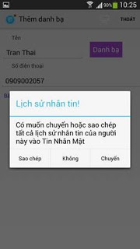
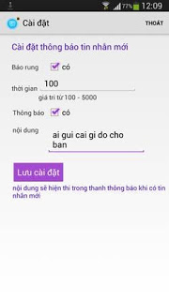
Introduction
Existing system
Low level of security
Data is not encrypted when transfer
Pay money to get full feature
TinNhanMat

Slide 8
Introduction
Our purpose
Running on Android operating system.
Easy to use.
Extremely high security.
Free.

Slide 9
Project Management
Problem definition
Project planning
Project organization
Tracking, Reporting and Controlling
Risk management
Communicate management

Slide 10
Problem definition
Proposed System
Working method

Slide 11
Problem definition
Proposed System
System provided functions as normal SMS app
User can decide secret key and encryption method for each conversation
Android application
Every data must be encrypted before save to database

Slide 12
Working methods
Problem definition
Project rule
Building workflow

Slide 13
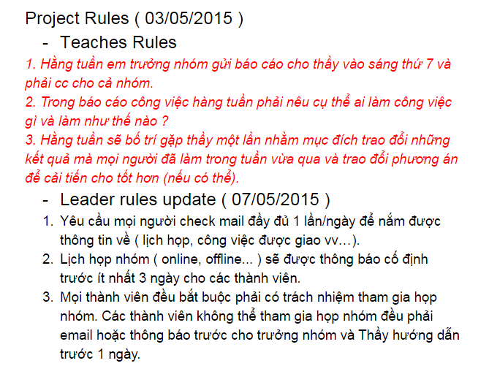
Project rule
Problem definition
Working methods

Slide 14
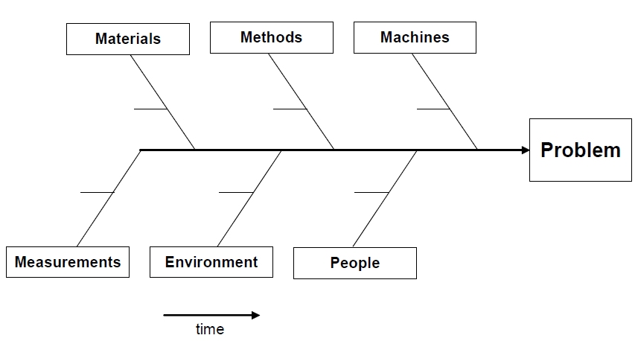
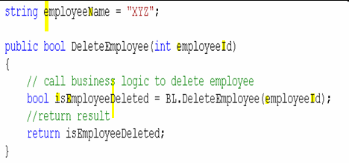
Building workflow
Problem definition
Working methods
Coding convention
Fishbone

Slide 15
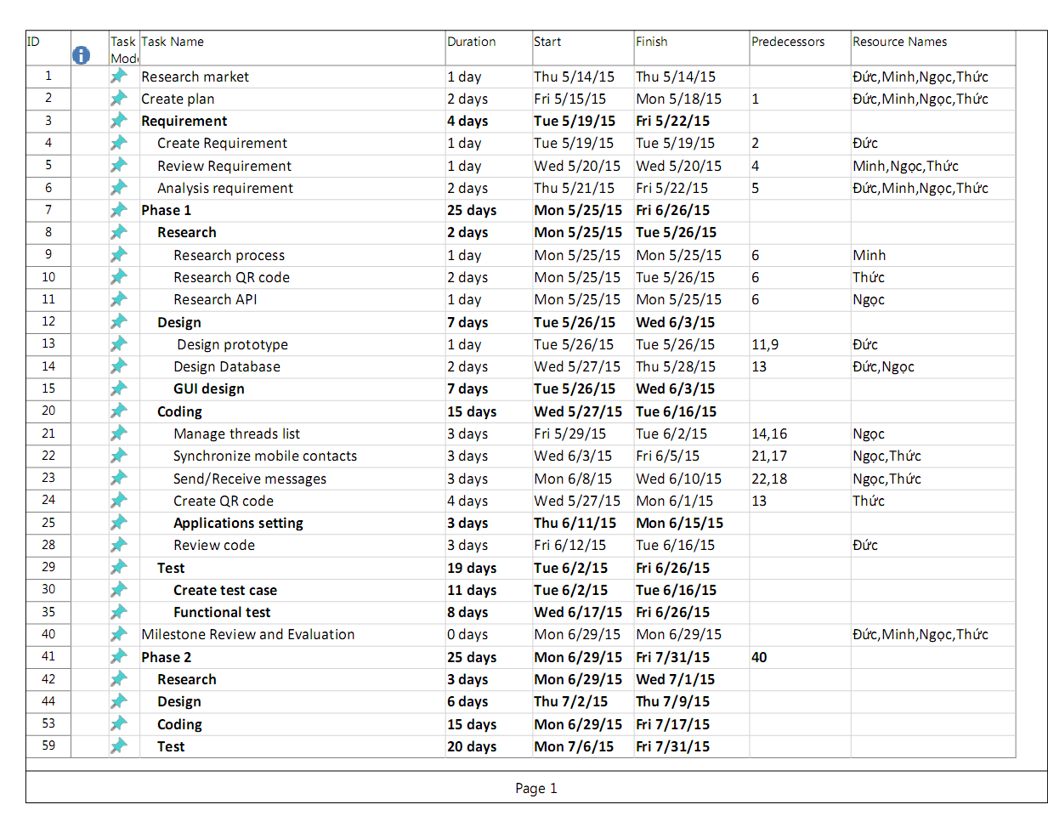
Project planning
Task sheet

Slide 16
Project organization
Software Process Model
Role and Responsibilities

Slide 17
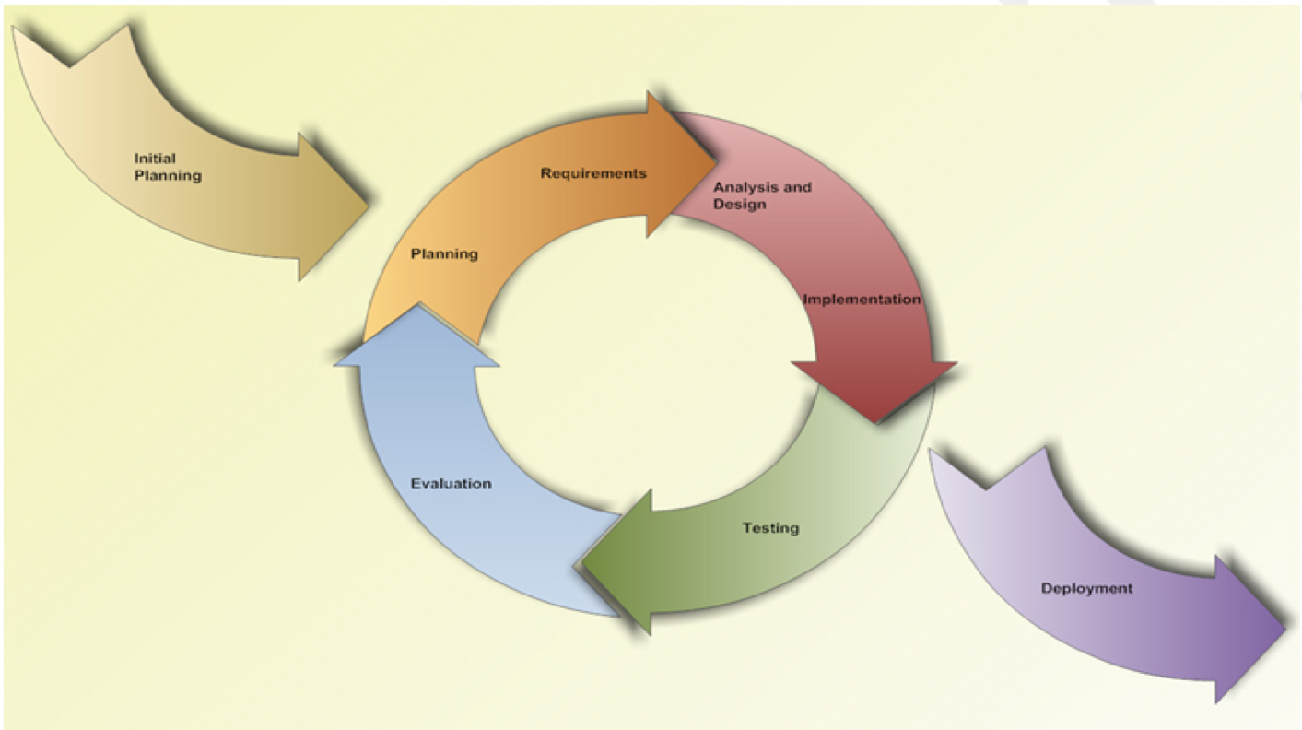
Software Process Model
Project organization

Slide 18
Role and Responsibilities
Project organization
Supervisor
Mr. Trương Vĩnh Lân
Project manager
Đỗ Việt Đức
Business analysis
Đỗ Việt Đức (Leader)
Nguyễn Văn Ngọc (Support)
Design
Trần Nhật Minh (Leader)
Nguyễn Văn Ngọc (Support)
Coding
Nguyễn Văn Ngọc (Leader)
Trần Nhật Minh Nguyễn Văn Thức (Support)
Đỗ Việt Đức (Review)
Testing
Nguyễn Văn Thức (Leader)
Đỗ Việt Đức (Support)

Slide 19
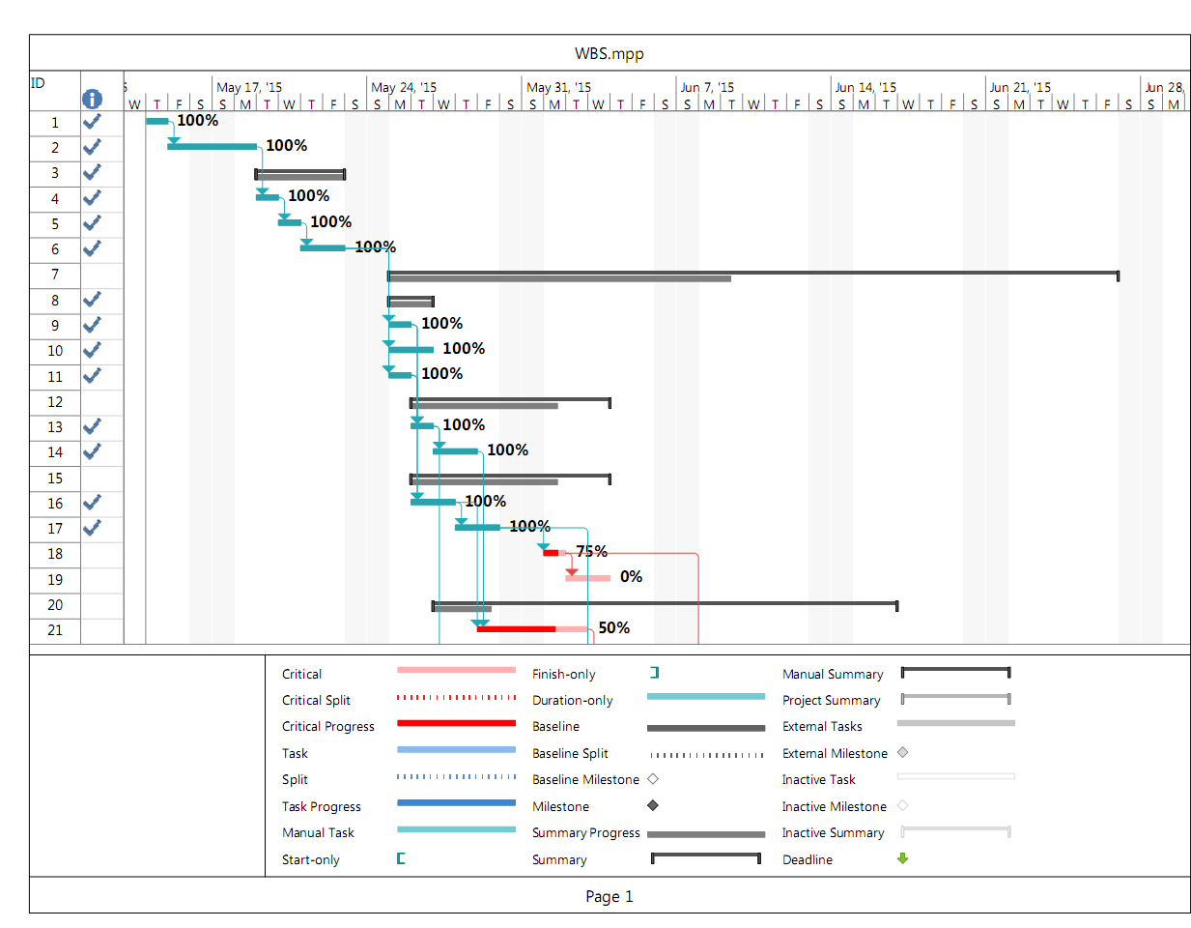
Tracking, Reporting and Controlling

Slide 20
Risk management
No | Risk name | Risk Description | Probability | Effect | Strategy
# | People risk
1 | Lack of skill | Team member are lack of coding skill, technical knowledge skill… | HIGH | SERIOUS | Provide a short training course before applying new technique.
2 | Lack of people | Team member are sick, accident…They cannot complete task under deadline. | HIGH | SERIOUS | Additional resources to support. Working over time
3 | Conflict between team member | Team member are dissent, argument… make working ineffective | HIGH | SERIOUS | 1. Setup an open-talk to find the root cause and resolve problem. 2. Organize team building more often
4 | Special person | Team member are lazy, don’t spend enough time to working | HIGH | SERIOUS | 1. Warning and reminding member. 2. Report to supervisor to find solution.
# | Technical Risk
5 | New technologies | Encounter technique problem in Android development | HIGH | TOLERABLE | 1. Discuss to supervisor 2. Discuss forums on internet
6 | Lack of device | Impossible to test all Android device | HIGH | TOLERABLE | Try to provide device as much as possible

Slide 21
Communicate management
Time: 5 hours/day, 5 days/week
Location: Hòa Lạc campus, Home.
Meeting supervisor: once a week
Team building: once a month

Slide 22
Requirement Specification
User Requirement Specification
Functional Requirements
Non-functional Requirements

Slide 23
User Requirement Specification
Client:
User
Mobile device : Android 4.0 or later
Server:
SMS provider

Slide 24
Functional Requirements

Slide 25
Non-functional Requirements
Availability
Usability
Security
Compatibility
Performance
Maintainability
Portability

Slide 26
System design description
System Architectural Design
Component Diagram
Class Diagram
Class Diagram Explanation
Sequence Diagram
Database design

Slide 27
System Architectural Design

Slide 28
Component Diagram

Slide 29
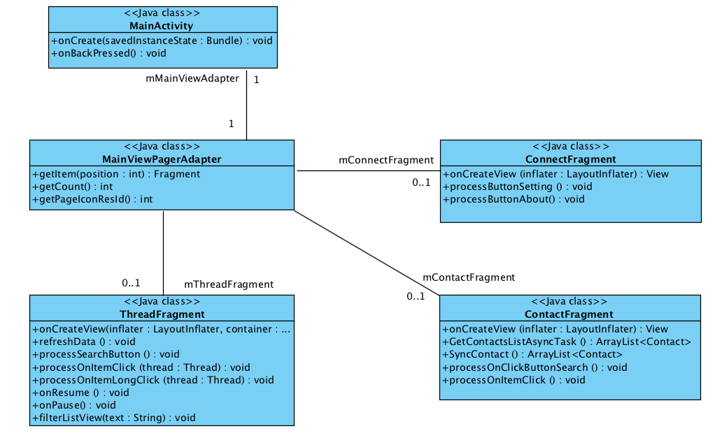
Class Diagram

Slide 30
Class Diagram Explanation
Attribute | Type | Visibility | Description
name of attribute | Type of attribute | víibility | description
Name: Method name()
Purpose: the purpose of this method
Parameters and return:
No | Parameter | Type | In/Out | Description
1 | N/A | N/A | N/A | N/A

Slide 31
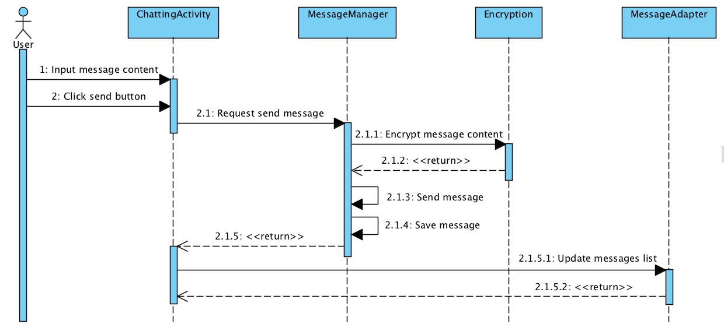
Sequence Diagram

Slide 32
Database design

Slide 33
Security
Shift Encode
Vigenere Encode
AES Encode
RC4 Encode
AES Encode

Slide 34
Shift Encode
Algorithm definition
Plain text
H | e | l | l | o | W | o | r | l | d
Key
a | b | c | d | a | b | c | d | a | b
Cipher text
u | l | g | t | n | h | k | f | e | c
Complexity

Slide 35
Vigenere Encode
Algorithm definition
“Move each character in plain text to other character by alternative method use Vigenere square”
Key
Plain
a | b | c | d | … | x | y | z
b | c | d | … | x | y | z | a
c | d | … | x | y | z | a | b
d | … | x | y | z | a | b | c
… | x | y | z | a | b | c | d
x | y | z | a | b | c | d | …
y | z | a | b | c | d | … | x
z | a | b | c | d | … | x | y
Cipher text = [Plain, key]
Plain: x x x
Key: b c d
Cipher: y z a
Complexity

Slide 36
AES Encode
Algorithm definition
AES - Advanced Encryption Standard
Established by the U.S. National Institute of Standards and Technology (NIST) in 2001
Complexity

Slide 37
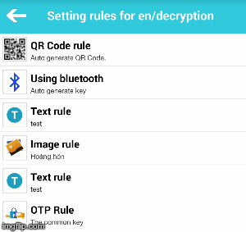
You decide how the application encode your message content
5 types of new rule
Up to 10 rules
Change the rule’s position easily
Encode follow the order that you set

Slide 38
Security
Delete message after 2-30 seconds automatically
Delete chatting thread from another phone
Application passcode

Slide 39
Testing & Evaluation

Slide 40
Test Model

Slide 41
Test Execute
Formal testing
Test type | Duration
Execute acceptance test | 1 day
System and integration testing cycle 1 | 7 days
Regression testing | 2 days
System and integration testing cycle 2 | 3 days
Acceptance test | 2 days
Regression testing and release testing | 2 days

Slide 42
Test process
Test process
Make Plan
Design test case
Execute
Make Plan
Analyze & Design
Preparation test
Execute
Check
Evaluation

Slide 43
Test report
Build # | Sub Module | Pass | Fail | Untest | N/A | Number Of test cases | Number of run on all devices
1.0 | Test UI | 67 | 0 | 0 |  | 67 | 4
1.0 | Function test | 48 | 0 | 0 |  | 48 | 4
 | Total |  |  |  |  | 115

Slide 44
Demo & QA
Available on
PriSMS - Tin nhắn bảo mật
PriSMS – Private your SMS

Slide 45
Conclusions

Slide 46
Thanks for listening

