Slide 1

Aloha
SUPERVISOR TRAN BINH DUONG
指導教員
TEAM MEMBER Nguyen Hoang Nam
チームメンバー Nguyen Van Sang
Dao Duy Thang
http://aloha.org

Slide 2
Content-目次
1
Project introduction-はじめに
2
Project background-プロジェクトの背景
Project management-プロジェクト管理
Existing systems-存在していたシステム
3
Idea- アイデア
Requirements specification-要求仕様
4
Proposal system-提案システム
Software design-ソフトウェアの設計
5
Testing-テスト
6
Lesson learned-学んだこと
7
Demo - Q&A-デモと質疑応答
Aloha

Slide 3
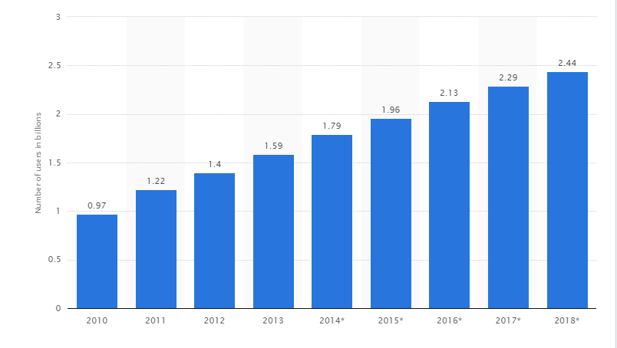
Project backgroundプロジェクトの背景
Number of social network users worldwide from 2010 to 2018 in billions)
Source: http://www.statista.com/statistics/278414/number-of-worldwide-social-network-users/
http://www.slideshare.net/lehoangha304/facebook-market?related=1
http://www.statista.com/statistics/316481/us-beliefs-online-dating/
Aloha

Slide 4
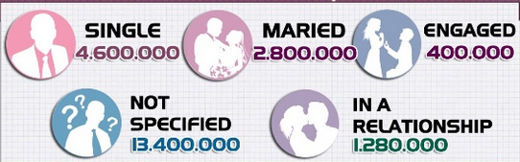
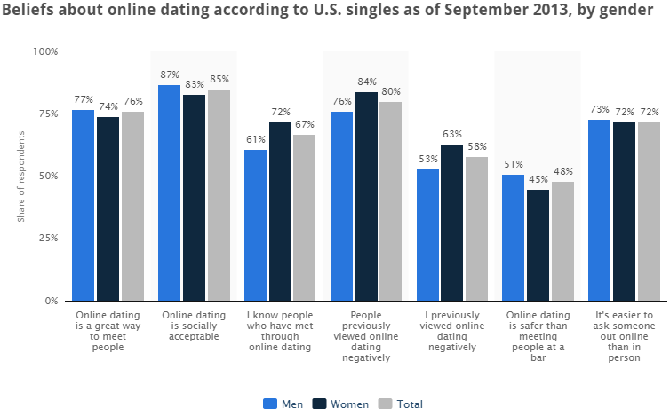
Project backgroundプロジェクトの背景
Relationship status of Facebooks user in Vietnam
Beliefs about dating online dating according to U.S singles
Aloha

Slide 5

Existing system
存在していたシステム
Badoo is the fastest growing places to chat with new people. Now, Badoo has nearly 250 million user
Aloha

Slide 6
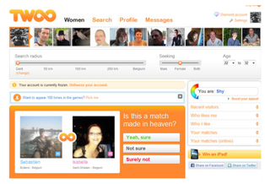
Existing system
存在していたシステム
Now, Twoo has more than 160 million users
Aloha

Slide 7

Our idea-アイデア
Aloha

Slide 8
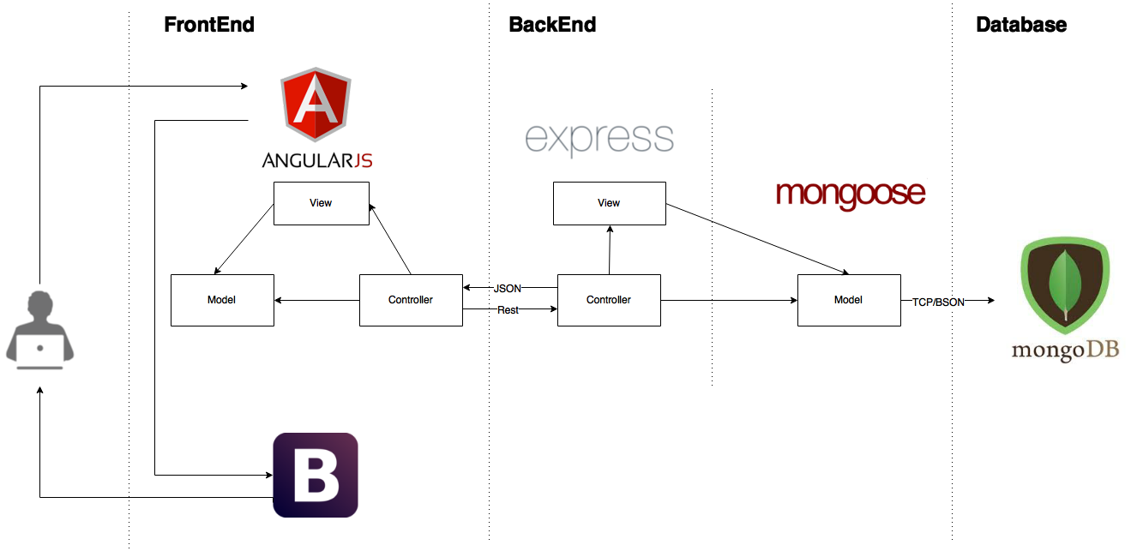
Proposal system
提案システム
Aloha

Slide 9
Main objective
主な目標
To help people connect with each other
Auto data synchronization
Simple user interface, easy to use
Aloha
Aloha

Slide 10
Content-目次
1
Project introduction-はじめに
2
Project management-プロジェクト管理
Software process model
3
Requirements specification-要求仕様
Project planning
4
Environment, tools and technology
Software design-ソフトウェアの設計
5
Project risk management
Testing-テスト
Team communication
6
Lesson learned-学んだこと
7
Demo - Q&A-デモと質疑応答
Aloha

Slide 11
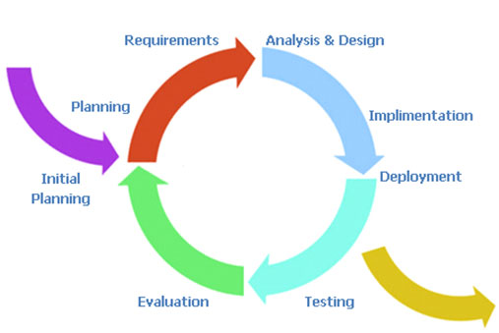
Software process model
ソフトウェアのプロセスモデル
Aloha

Slide 12
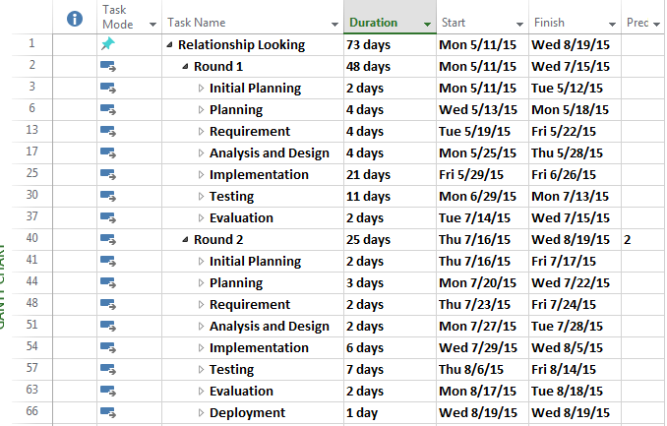
Project schedule
プロジェクトのスケジュール
Aloha

Slide 13
Development tools
開発ツール
HARDWARE
Develop: Personal computers
Deploy: Local server, Aloha’s server
Test: Personal computers
SOFTWARE
File management: Trello
Source control: Bitbucket
Development kit: Sublime text
Design: Astah community 6.4.2, Mockflow, Microsoft Project 2013,
Microsoft Office Word 2013, Microsoft Office Excel 2013,
Microsoft Office Power Point 2013
Running & test: Google Chrome
Bug tracker: Mocha, Karma
Aloha

Slide 14






Technology- 技術
Aloha

Slide 15
Project risk management
リスクマネジメント
No | Risk Description | Root Cause | Avoidance Plan | Contigency Plan | Prob-ability | Impact | Status
1 | Over estimate or under estimate time of project | -Wrong estimate about time of each phases. | - Create detail plan for each project’s phase. - Breakdown project to some mile-stone releases. Main function development is high priority - Get the team more involved in planning and estimating. Get early feed-back and address slips directly with stakeholders. - Consult supervisor’s advice | - Implement task in paral-lel or overlapping them - Overtime to push pro-gress faster | High | High
2 | Run over budget | -Spend too much | - Saving - Reasonable spending | - Make a contributions | Low | Medium
3 | Member do not have enough knowledge to follow project | -Member does not have skill about technologies | - Training - Encourage member learn from others | - Working in group | Medium | Medium
Aloha

Slide 16

Team communication
チームのコミュニケーション
Time: 20 hours/week
Location: Room, university library.
Meeting supervisor: once a week.
Communication: Skype, Gmail, Face-to-face, Mobile phone, Facebook
Aloha

Slide 17
Content-目次
1
Project introduction-はじめに
2
Project management-プロジェクト管理
3
Requirements specification-要求仕様
4
Software design-ソフトウェアの設計
5
Testing-テスト
6
Lesson learned-学んだこと
7
Demo - Q&A-デモと質疑応答
Aloha

Slide 18
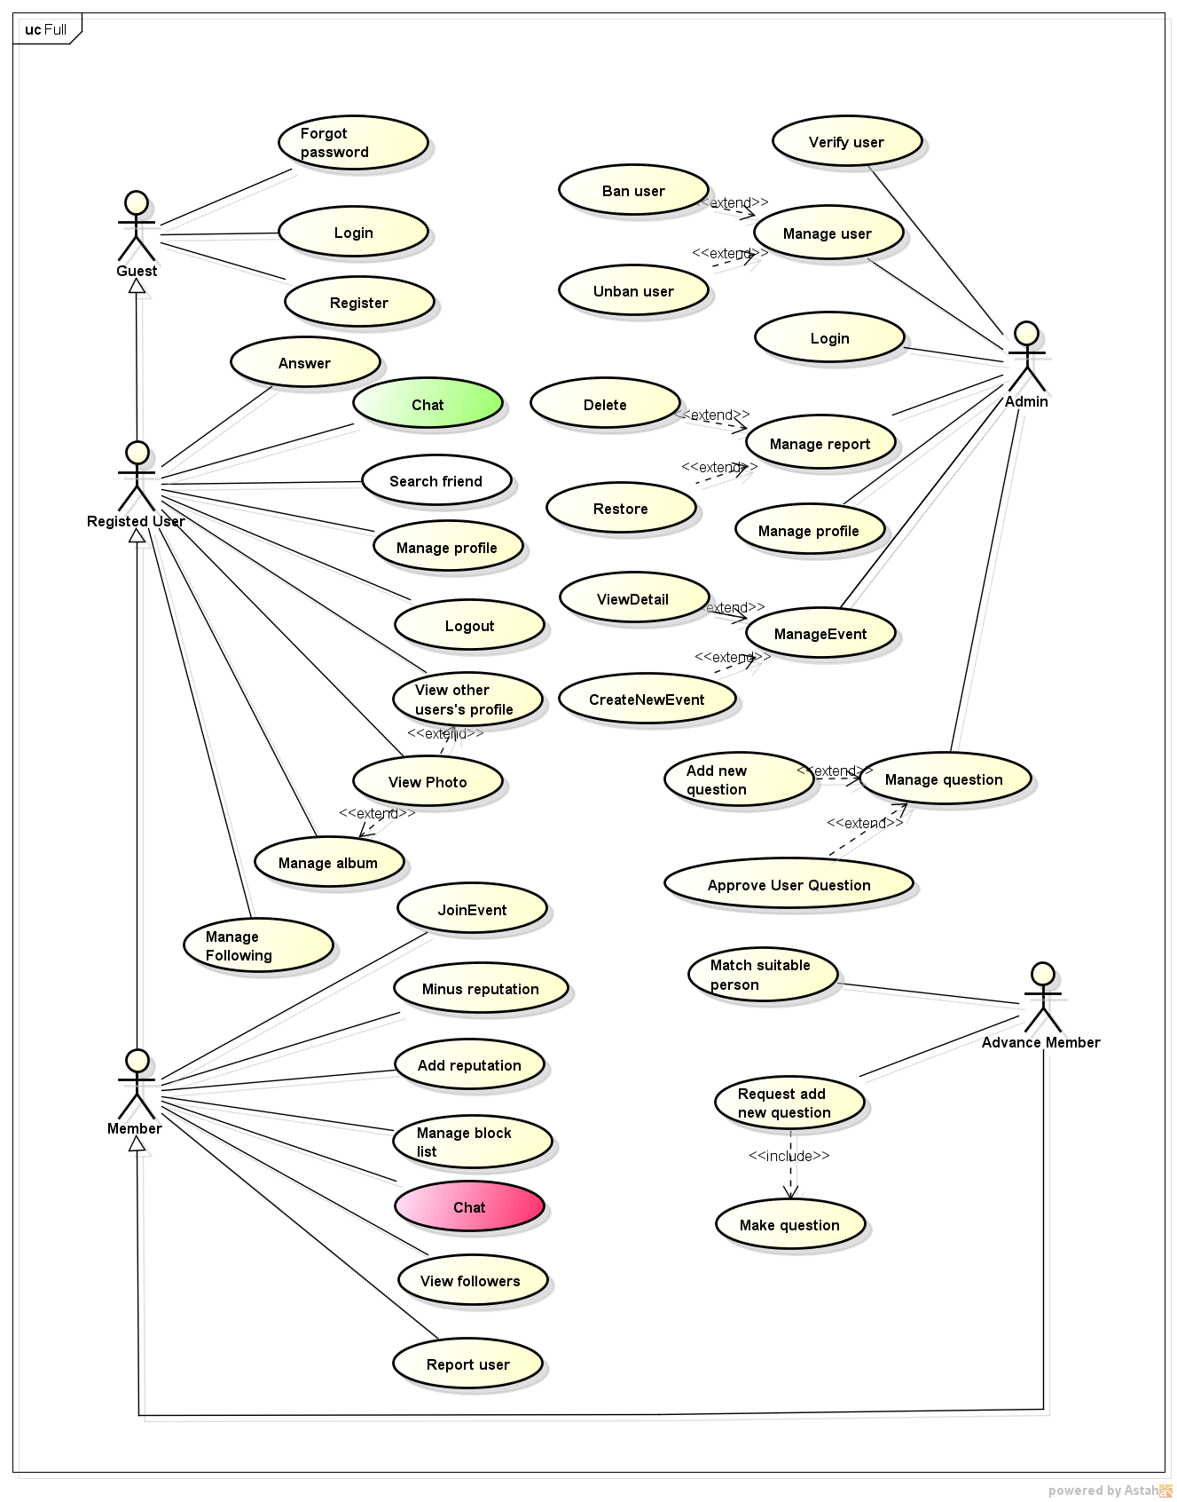
Use case diagram
ユースケース
39
use cases
Guest
Registered user
Member
Advanced member
Admin

Slide 19
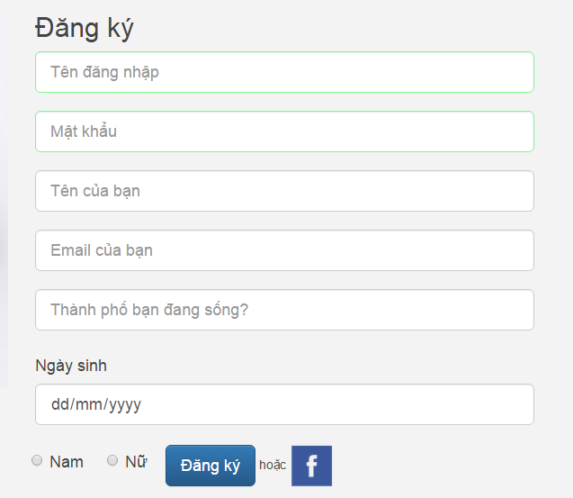
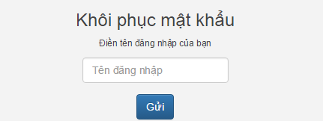
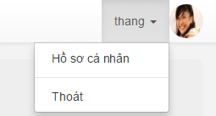
Authentication-認証
1
Register
2
Login
3
Logout
4
Reset password

Slide 20
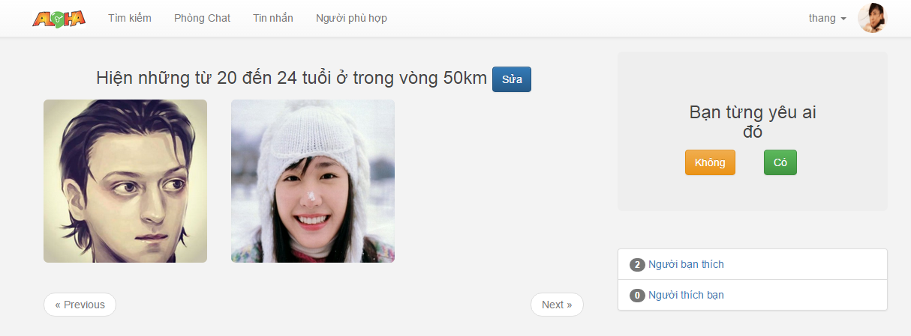
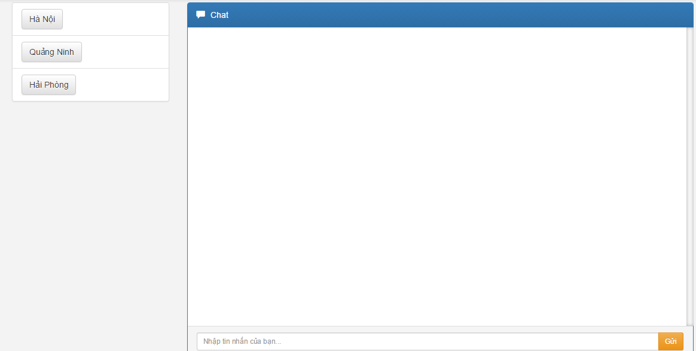
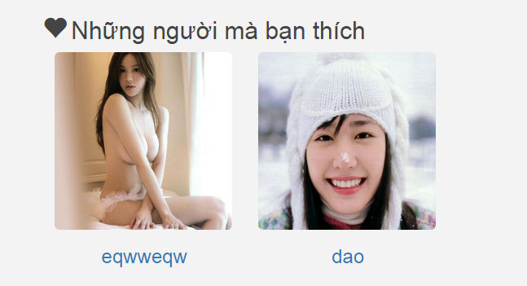
Web: User-ユーザー
1
View Aloha
2
People who you like
3
People who like you
4
Chat room

Slide 21
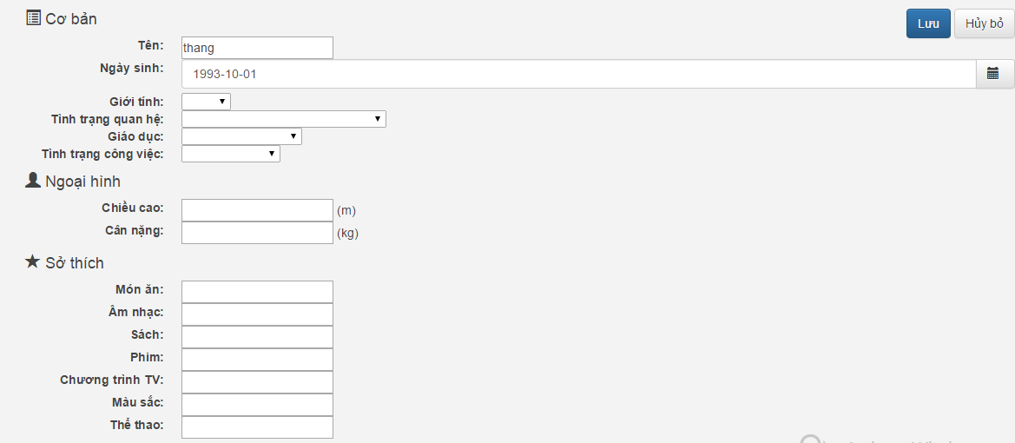
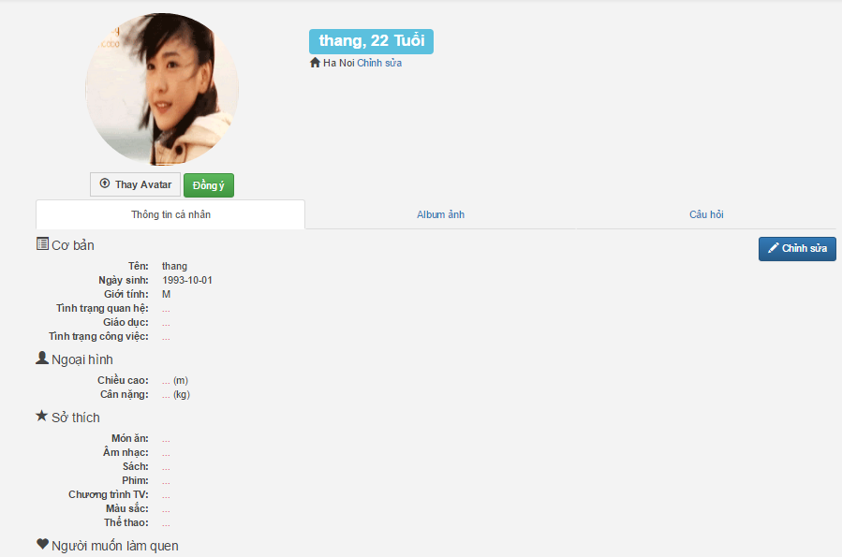
Web: User-ユーザー
1
2
User profile
Update profile

Slide 22
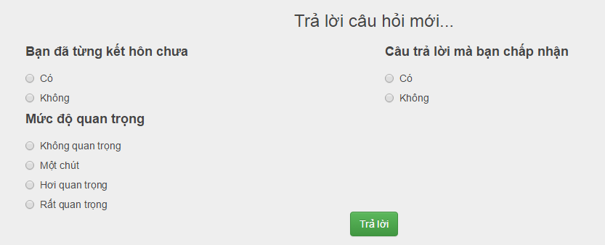

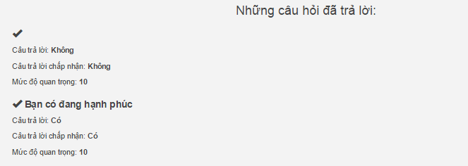
Web: User-ユーザー
1
View album
2
View answer

Slide 23
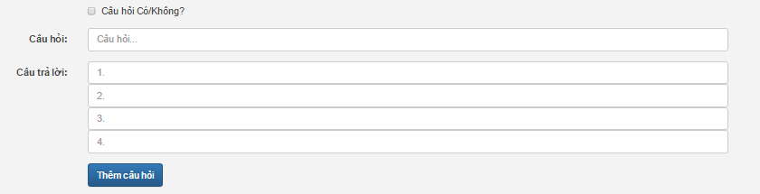
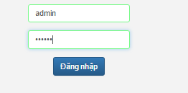
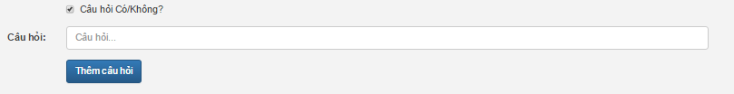
Web: Admin-管理者
1
2
Login
Add question

Slide 24
Non-function requirements
非機能仕様
Usability | Security | Maintainability | Performance
Supports Vietnamese. | Require authentication for any access. | Follow coding convention. Comment before each function. | Database indexing. Database in 3NF.
The user interface should be elegant, simple, easy to use. | Password is encrypted by crypto, hash password | Follow Object-Oriented-Programming paradigm. | Review code to reduce unnecessary code.
 |  | Follow layered architecture, modular software and component-based development.

Slide 25
Content-目次
1
Project introduction-はじめに
2
Overall system architecture
Project management-プロジェクト管理
3
Decomposition
Requirement specification-要求仕様
Database design
4
Activity diagram
Software design-ソフトウェアの設計
5
Class diagram
Testing-テスト
Sequence diagram
6
Lesson learned-学んだこと
Algorithm
7
Demo - Q&A-デモと質疑応答
Aloha

Slide 26
Overall system architecture
システムアーキテクチャ全体

Slide 27
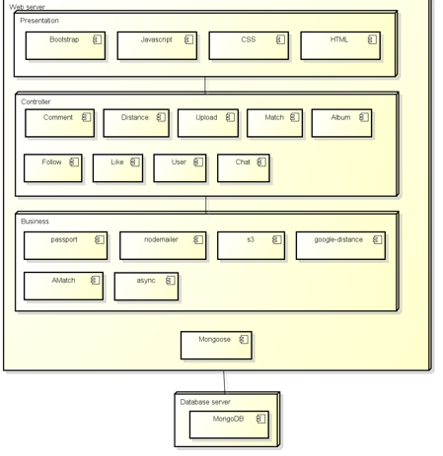
Decomposition-分解

Slide 28
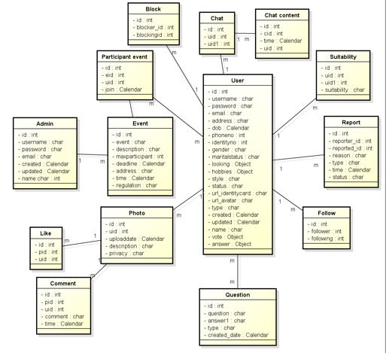
Database design
データベースの設計

Slide 29
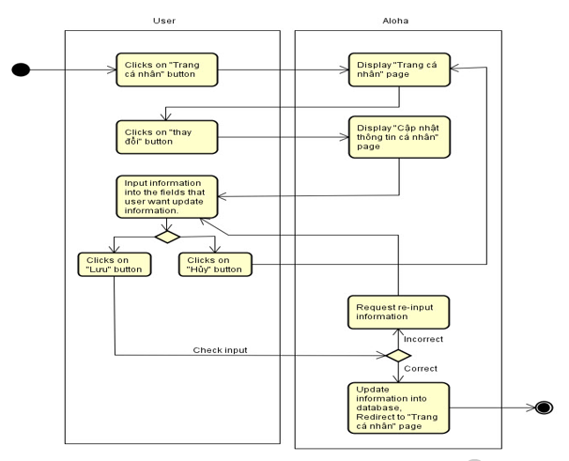
Activity diagram
アクティビティダイアグラム

Slide 30
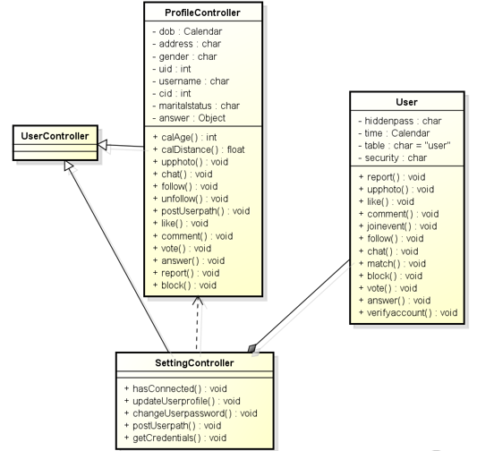
Class diagram
クラスダイアグラム

Slide 31
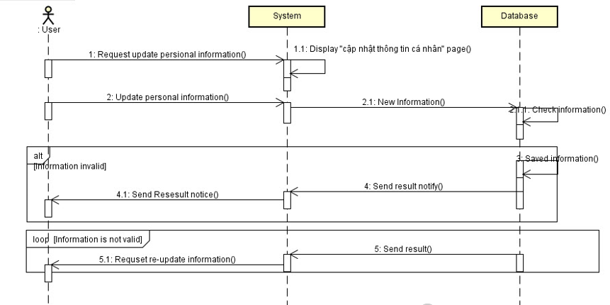
Sequence diagram
シーケンスダイアグラム

Slide 32
Algorithm-アルゴリズム
Amatch Algorithm
What is AMatch?
Each user want to find someone have some common to make friend, find a mate or just or share something like idol, music, movie. How to meet someone like that?
AMatch Algorithm allow we make a function that making sure that user can meet great people have so much in common with each user.
Aloha

Slide 33
Algorithm-アルゴリズム
Amatch Algorithm
How AMatch work?
Our goal is to help people connect with each other, help them to find people who share hobby, personality, style ... By answering the questions, user can find someone matching criteria. There will be 3 easy parts for every question:
1. User’ answer
2. Answer that user accept
3. Importance
Aloha

Slide 34
Algorithm-アルゴリズム
Amatch Algorithm
AMatch calculating
Importance | Point
Very | 50
Normal | 10
A little | 1
Aloha

Slide 35
Algorithm-アルゴリズム
Amatch Algorithm
Example
Stephan and Jessica also answer 2 questions:
Q1. How long do you want your next relationship to last?
1. One night
2. A few months to a year
3. Several years
4. The rest of my life
Q2. Do you believe in God?
1. Yes
2. No
Aloha

Slide 36
Algorithm-アルゴリズム
Amatch Algorithm
Example
Stephan answer
Q1:
1. Stephan’s own answer: Several years
2. Answer Stephan accept: A few months to a year/ Several years
3. Importance: Very important
Q2:
1. Stephan’s own answer: No
2. Answer Stephan accept: No
3. Importance: Normal
Aloha

Slide 37
Algorithm-アルゴリズム
Amatch Algorithm
Example
Jessica answer
Q1:
1. Jessica’s own answer: One night
2. Answer Stephan accept: One night
3. Importance: A little
Q2:
1. Stephan’s own answer: No
2. Answer Stephan accept: No
3. Importance: Normal
Aloha

Slide 38
Algorithm-アルゴリズム
Amatch Algorithm
Example
Stephan satisfaction with Jessica’s responses
 | Question 1 | Question 2
Answer Stephan accept | A few months to a year/ Several years | No
Importance | Very | Normal
Point | 50 | 10
Jessica answer | One night | No
Match? | No | Yes
Point | 0/50 | 10/10
Score = sum(numerator)/sum(denominator)=(0+10)/(50+10)~~16,67%
Aloha

Slide 39
Algorithm-アルゴリズム
Amatch Algorithm
Example
Jessica satisfaction with Stephan’s responses
 | Question 1 | Question 2
Answer Jessica accept | One night | No
Importance | A little | Normal
Point | 1 | 10
Jessica answer | A few months to a year | No
Match? | No | Yes
Point | 0/1 | 10/10
Score = (0+10)/(1+10)~~90.1%
Stephan and Jessica match sqrt(90.1%*16.67%)=38.67%
Aloha

Slide 40
Content
1
Project introduction-はじめに
2
Project management-プロジェクト管理
3
Testing process
Requirement specification-要求仕様
4
Testing stages
Software design-ソフトウェアの設計
Testing types
5
Testing tools & Environment
Testing-テスト
Testing scenario
6
Lesson learned-学んだこと
Testing result
7
Demo - Q&A-デモと質疑応答
Aloha

Slide 41
Process Modelプロセスモデル
Requirement Analysis
Test Planning
Create Test Case
Test Execution
Bug Fix
Test Results
Test Closure

Slide 42
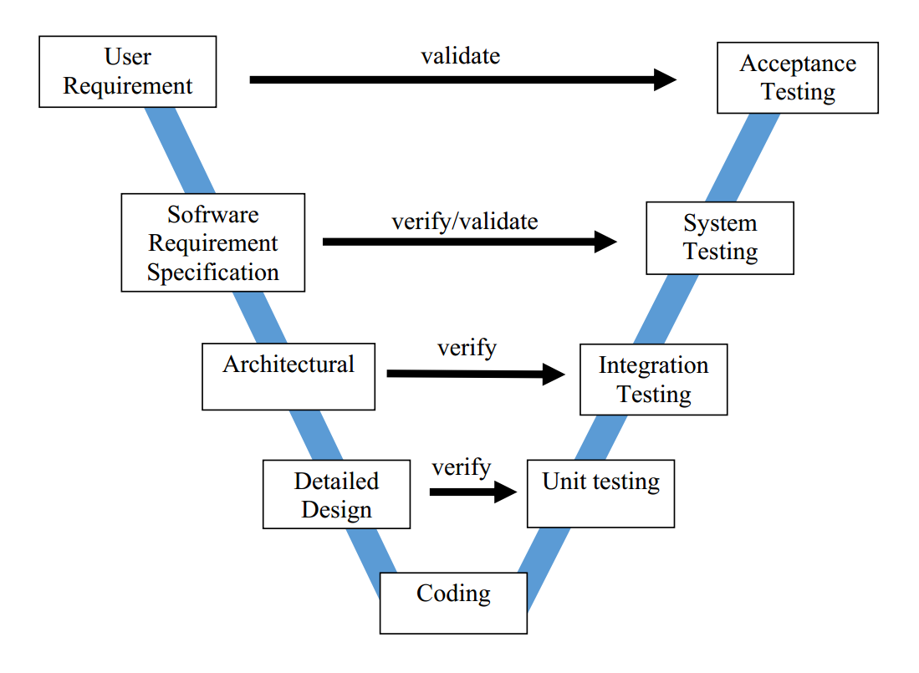
V-Model
V-モデル

Slide 43
Testing types
テストの種類
GUI test
Acceptance test
Function test

Slide 44




Testing tools & Environment
テストのツールや環境
TOOLS
ENVIRONMENT
Diabetes Buddy

Slide 45
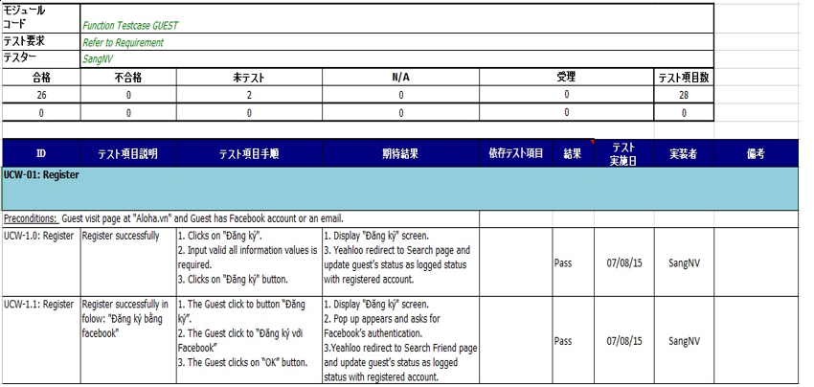
Test case sample
テストケースのサンプル

Slide 46
Testing result
テストの結果
No | Module code | Pass | Fail | Untested | N/A | Number of test cases
 | Test case admin | 6 | 1 | 23 | 0 | 30
2. | Test case GUEST | 26 | 0 | 2 | 0 | 28
3. | Test case Registered User | 27 | 5 | 11 | 10 | 53
4. | Test case Member | 28 | 5 | 14 | 10 | 57
5. | Test case Advance Member | 28 | 6 | 16 | 10 | 60
6. | Common | 40 | 3 | 0 | 15 | 58
7. | Performance | 10 | 0 | 12 | 0 | 22
8. | GUI | 85 | 0 | 6 | 0 | 91
9. | Sub total | 250 | 20 | 84 | 45 | 399

Slide 47
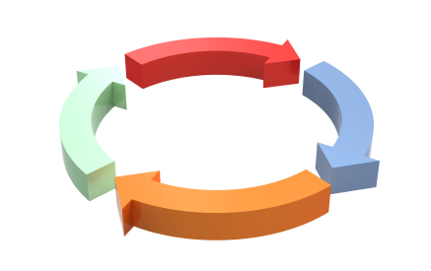
Lesson Learned
学んだこと
Process - 工程
Apply Fsoft process and use Fsoft template document
Management -マネジメント
Improve organization and planning skill

Slide 48
Demo – Q&A
デモと質疑応答
Aloha
Friend-based social network
http://aloha.org

