Slide 1
Coach Route Searching System
http://www.xekhachso.com

Slide 2

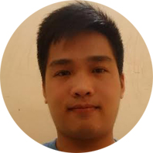
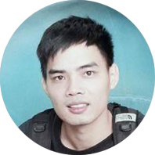

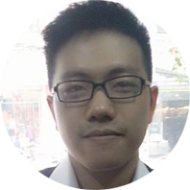
CRSS Team
Mr. Lương Trung Kiên
Supervisor
Lê Văn Quân Bùi Công Tân Phan Hoàng Ba Phạm Quang Thái

Slide 3
Contents
Overview
Project Management
Requirement Specification
Software Design
Testing & Quality Control
Demo - Q & A
Implement
1
2
3
4
5
6
7

Slide 4
Contents
Overview
Project Management
Requirement Specification
Software Design
Testing & Quality Control
Demo - Q & A
Implement
1
1.1 Background
1.2 Our idea
1.3 Similar existing systems
1.4 Expected system
2
3
4
5
6
7

Slide 5
1.1 Background
  Each year, millions of people need to move far away by coaches.
  In Vietnam , Coach companies don’t have websites or channels to introduce their routes, phone numbers, services... to the passengers.

Slide 6
1.2 Our idea
Coach Route Searching System is a website informs that is designed for appropriate on demands in Vietnamese.
Allow users to search exactly, fully information from Coaches, Route to the district level, and price of tickets.
Helps the Coach companies to advertise, enhance all activities and manage information easier.

Slide 7
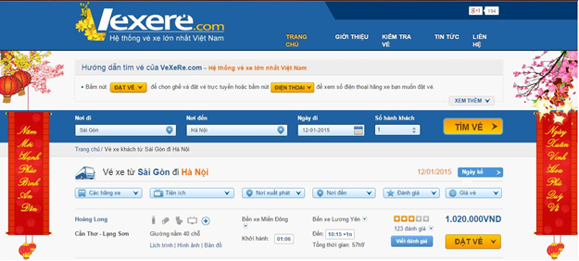
1.3 Similar existing systems
Analyzing system of http://www.vexere.com
.

Slide 8
        1.4 Expected system
                Search coaches
                Support method to catch coaches
        Book ticket online
        Contact by phone number
        Proactive register all information to the website
        Proactive updating information
Search
Book ticket
Manage data

Slide 9
Contents
Overview
Project Management
Requirement Specification
Software Design
Testing & Quality Control
Demo - Q & A
Implement
2.1 System Process Model
2.2 Roles and Responsibilities
2.3 Task Plan
2.4 Tools and Techniques
2.6 Communication Management
2.5 Project risk management
1
2
3
4
5
6
7

Slide 10
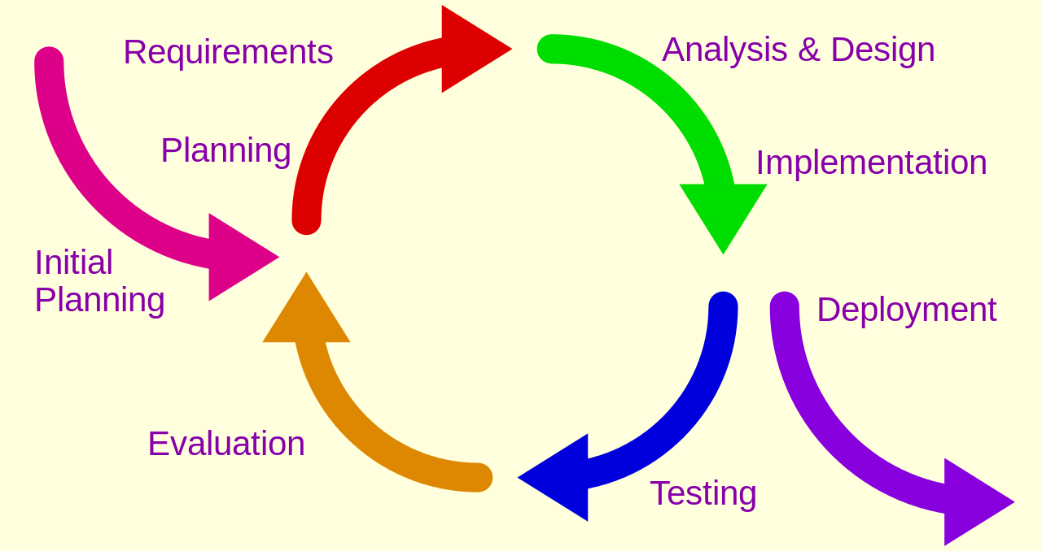
  2.1 System Process Model

Slide 11
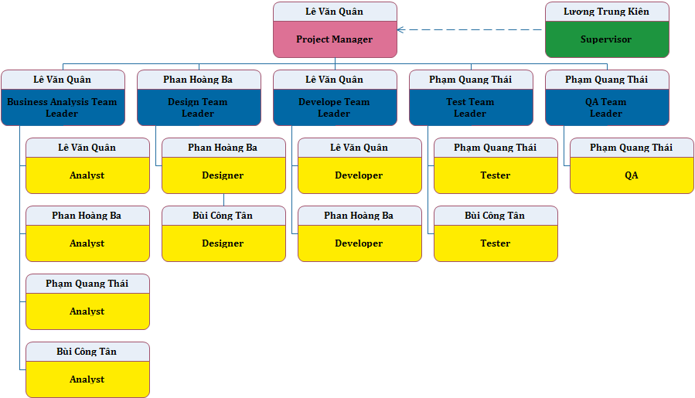
2.2 Roles and Responsibilities

Slide 12
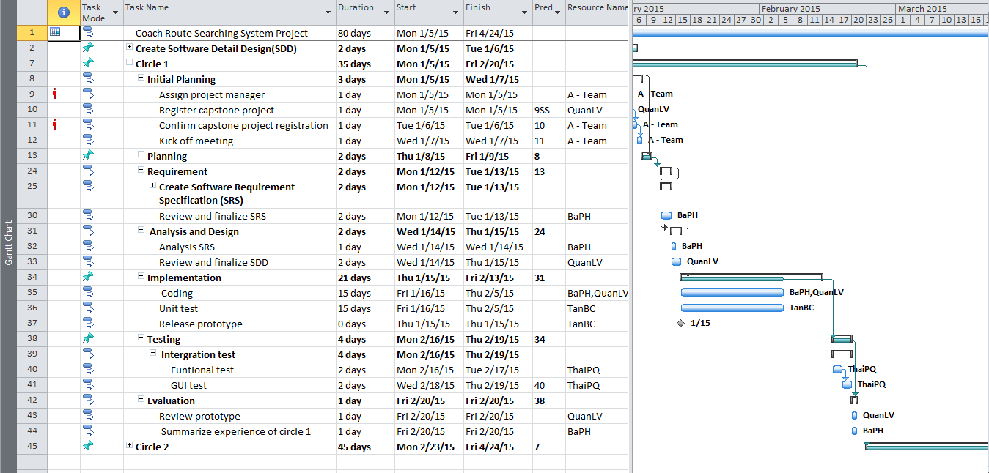
2.3 Task Plan

Slide 13






2.4 Tools and Techniques

Slide 14
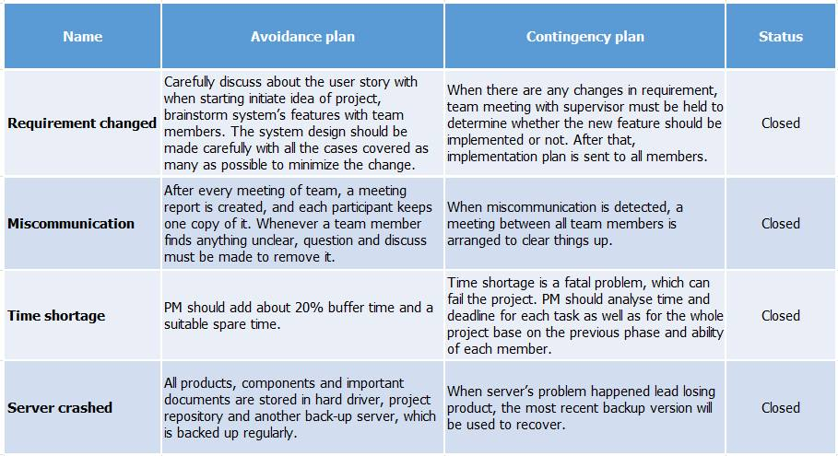
2.5 Project risk management

Slide 15



2.6 Communication Management
Kick-off meeting: 07/01/2015.
Team meeting: 4 days/week, Full time.
Location : Home, University Library.
Meeting with supervisor:
Every Monday and Tuesday afternoon.
Communication : Phone, Email, FaceBook.

Slide 16
Contents
Overview
Project Management
Requirement Specification
Testing & Quality Control
Demo - Q & A
Software Design
Implement
1
3.1 User Requirement Specification
3.2 Functional Requirements
3.3 Non-functional Requirement
3.4 HomePage Screen
3.5 Result Screen
3.6 Contact Screen
3.7 Filtering Result Screen
3.8 Book Screen
2
3
4
5
6
7

Slide 17
  3.1 User Requirement Specification
Administrator: Manage all of information by using website manager.
Coach’s manager: manage their coach.
Passenger: Using website without login. Passenger can search for coach and book ticket.

Slide 18
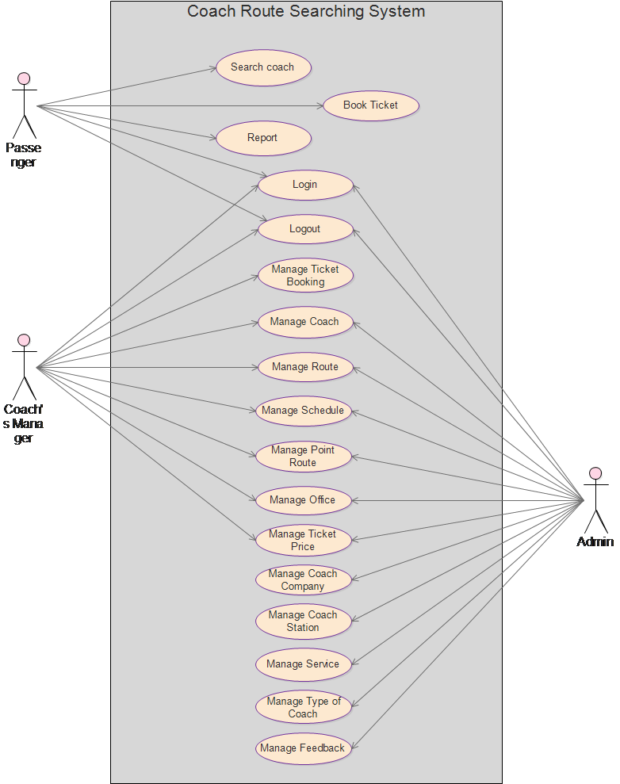
    3.2 Functional Requirements

Slide 19
3.3 Non-functional Requirement
        The user’s interface has to friendly, easy to use on each function.
      Search capabilities fast and exactly.
      User’s password is invisible for the system administration.
      When user password is saved in database, it must be encrypted.
      Must include coding standards and naming conventions documentations.
      Code must be clearly commented, including class, method documentations
Usability
Security
Maintainability

Slide 20
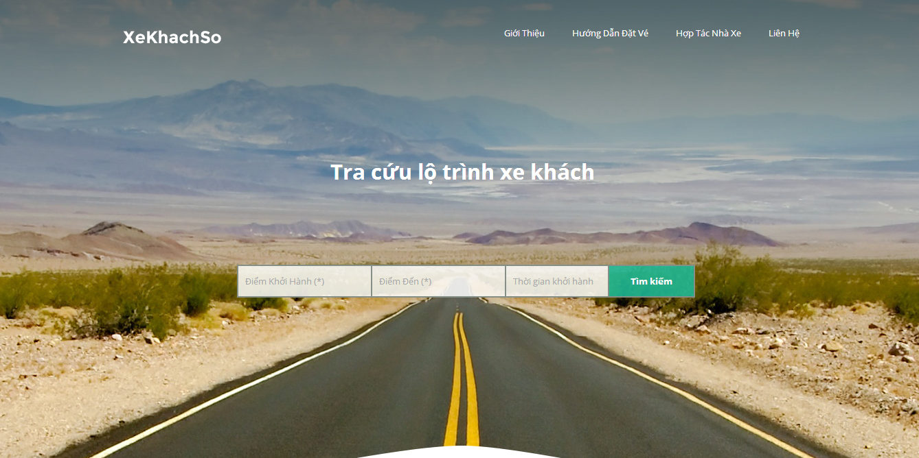
3.4 HomePage Screen

Slide 21
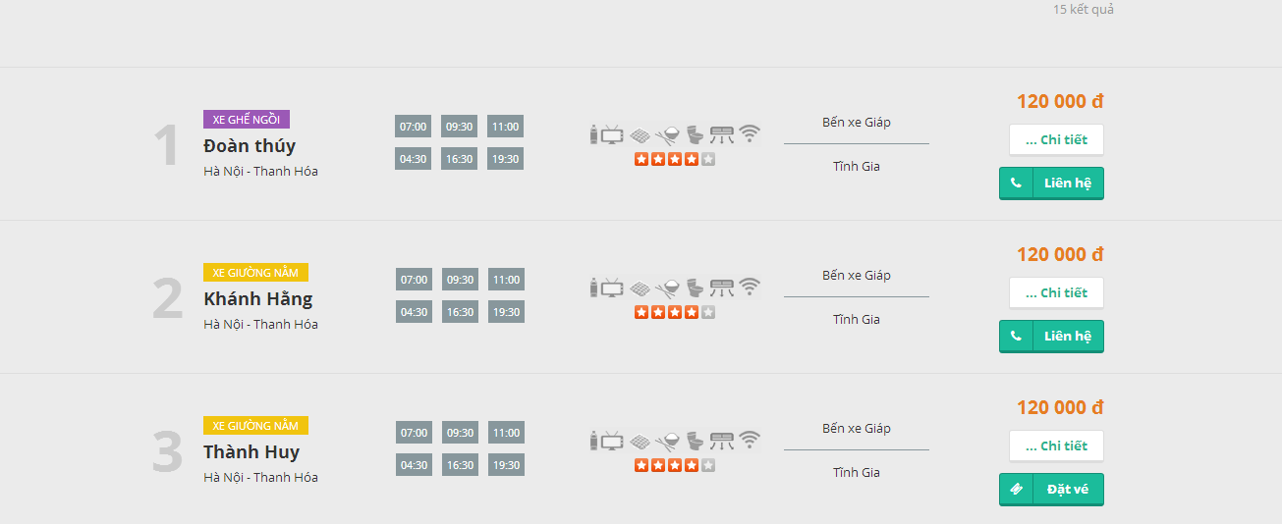
3.5 Result Screen

Slide 22
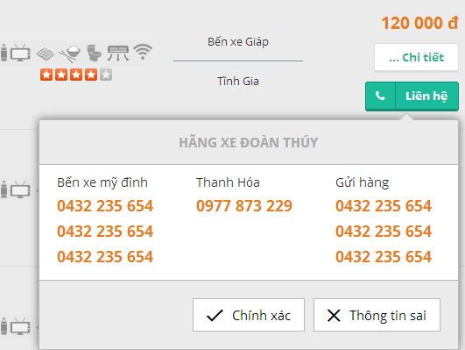
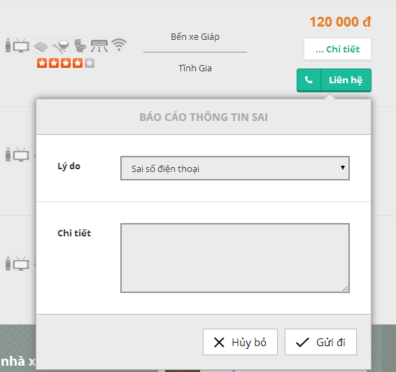
3.6 Contact Screen

Slide 23
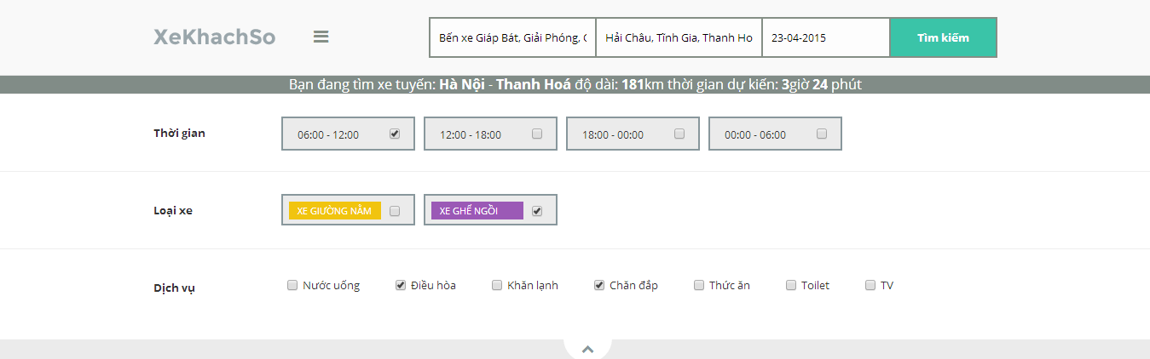
3.7 Filtering Result Screen

Slide 24
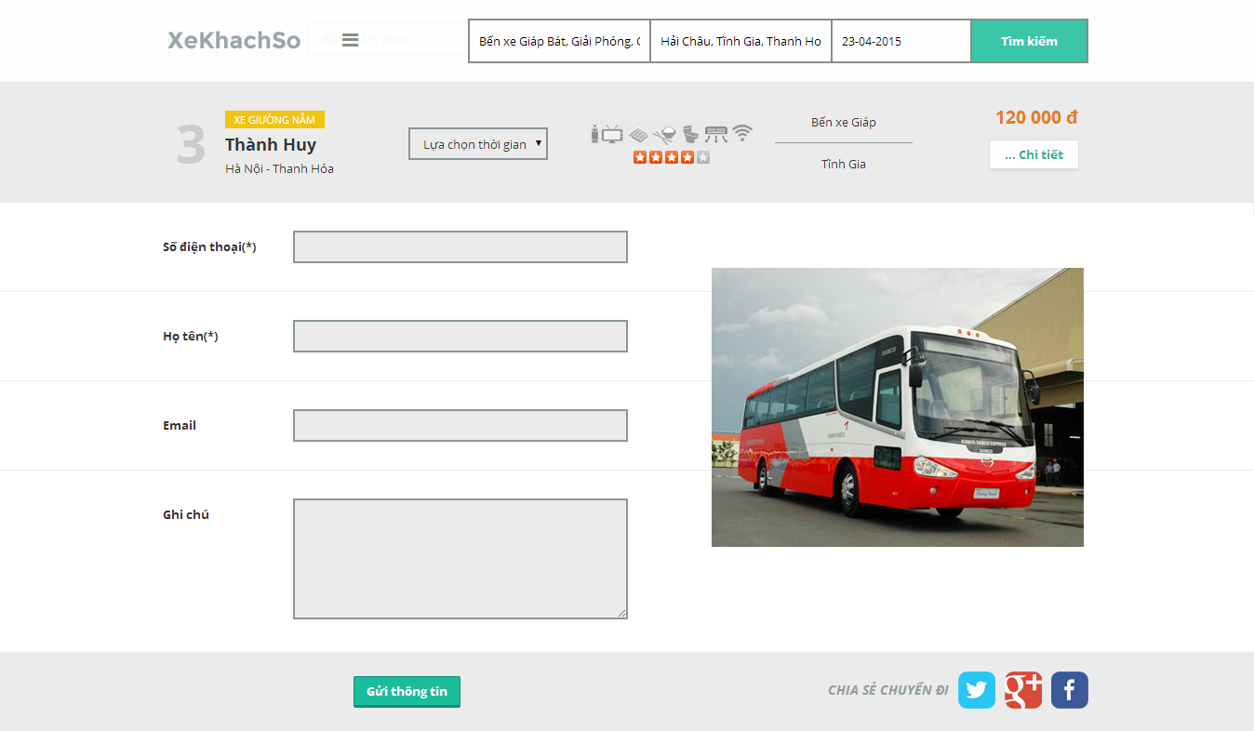
3.8 Book Screen

Slide 25
Contents
Overview
Project Management
Requirement Specification
Software Design
Testing & Quality Control
Demo - Q & A
Implement
1
4.1 System Design
4.2 Architecture Design
4.3 Detailed Description
4.4 Database Design
2
3
4
5
6
7

Slide 26
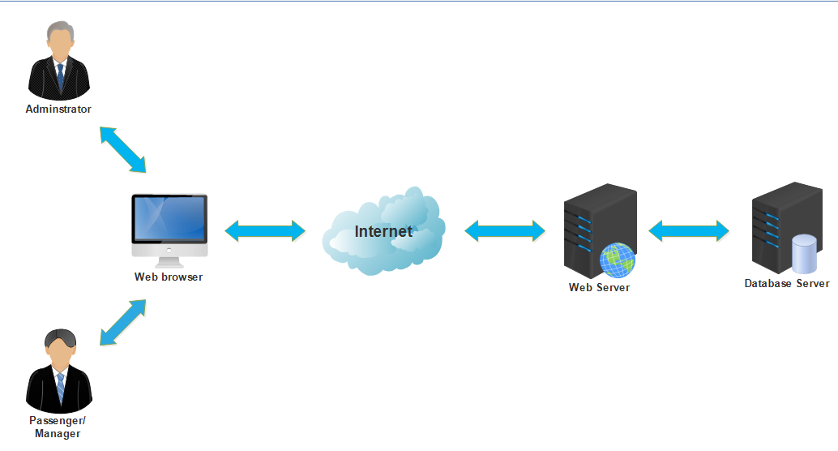
  4.1 System Design

Slide 27
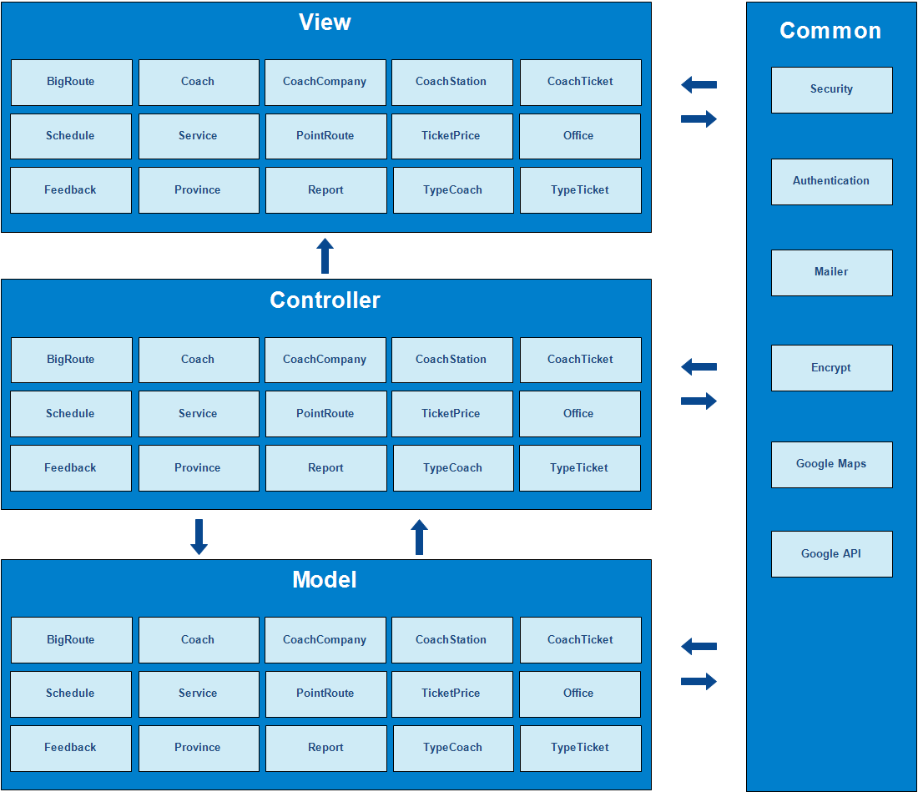
4.2 Architecture Design
MVC Model

Slide 28
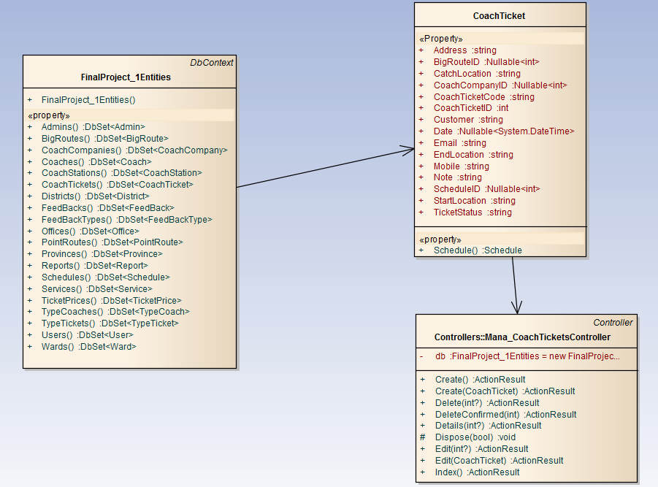
4.3 Detailed Description
Class Diagram

Slide 29
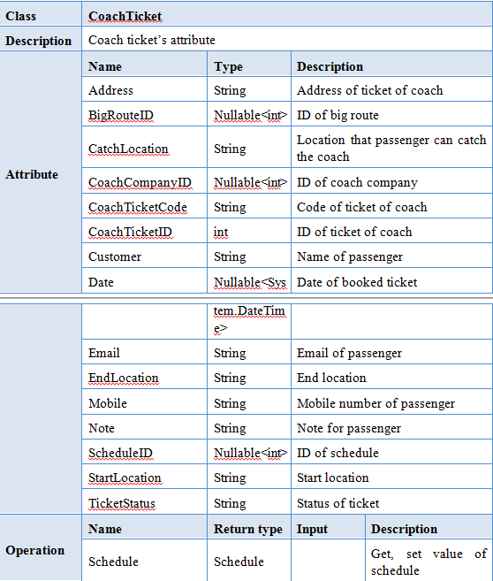
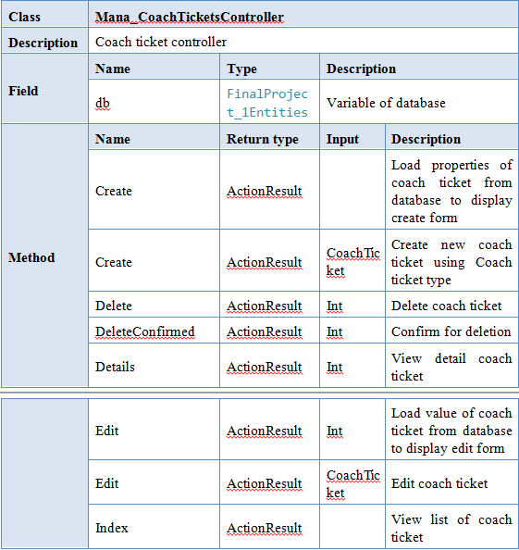
4.3 Detailed Description
Class explanation

Slide 30
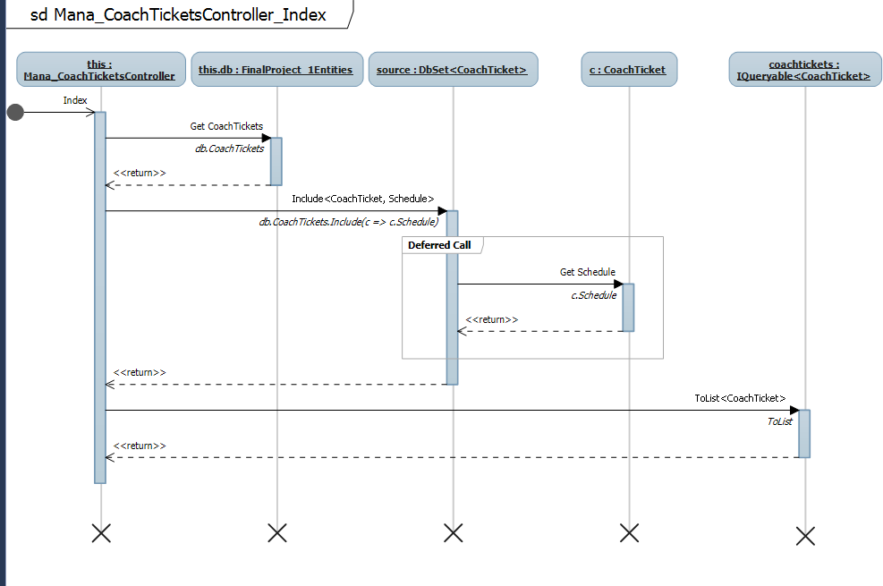
4.3 Detailed Description
Sequence Diagram

Slide 31
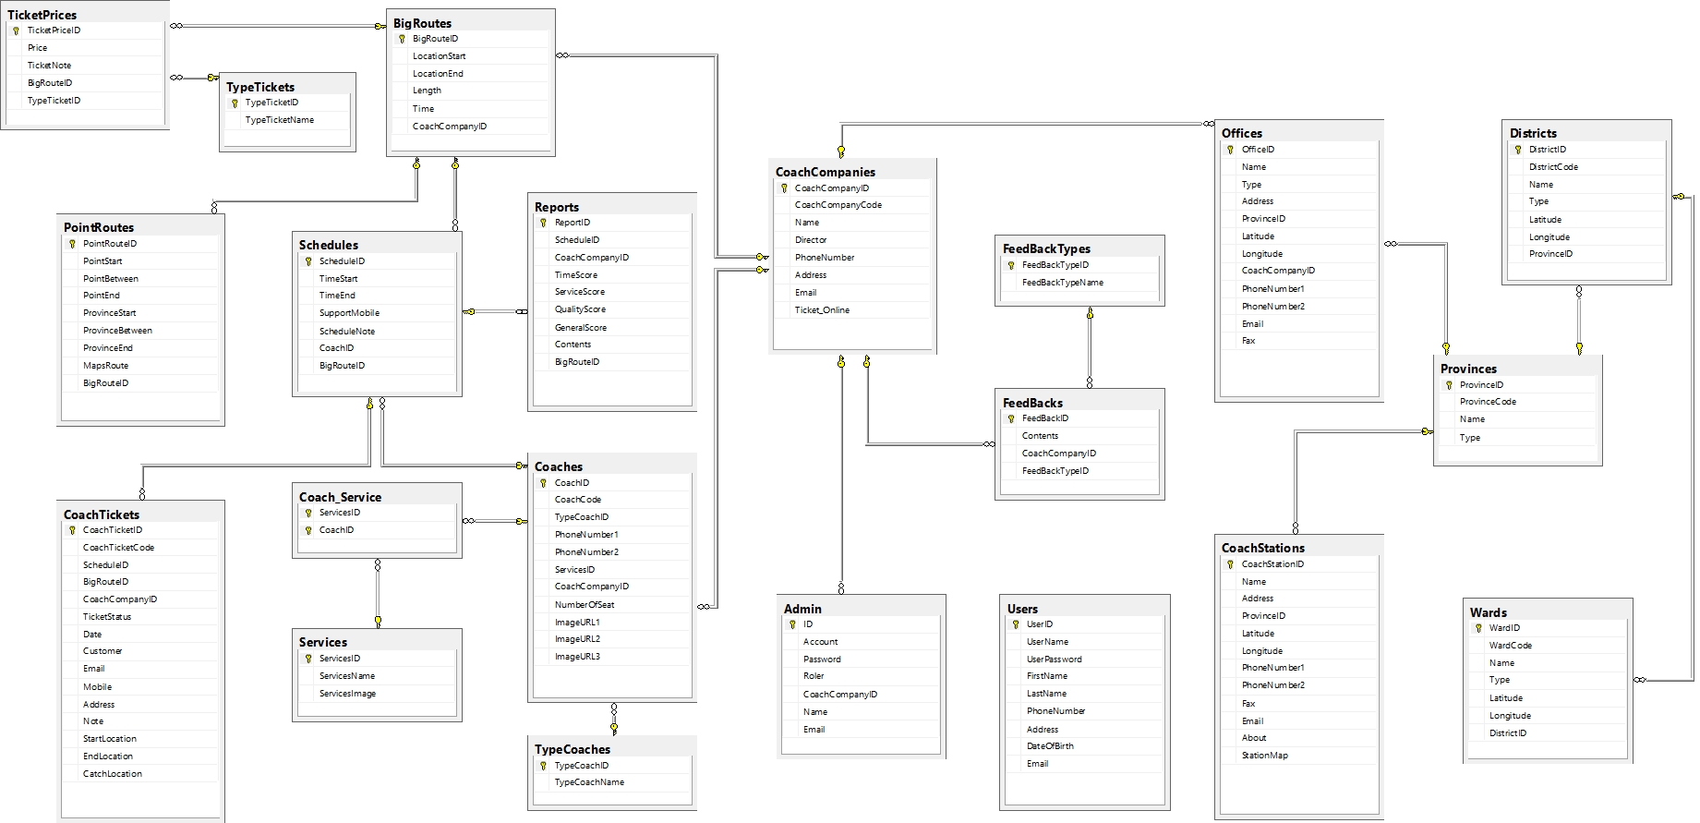
4.4 Database Design

Slide 32
Contents
Overview
Project Management
Requirement Specification
Software Design
Testing & Quality Control
Demo - Q & A
Implement
1
5.1 Development Environment
5.2 Deployment Environment
5.3 Coding Convention
2
3
4
5
6
7

Slide 33



5.1 Development Environment

Slide 34



5.2 Deployment Environment
IE : Version 9 Chrome : Version 27 Fifox : Version 20

Slide 35
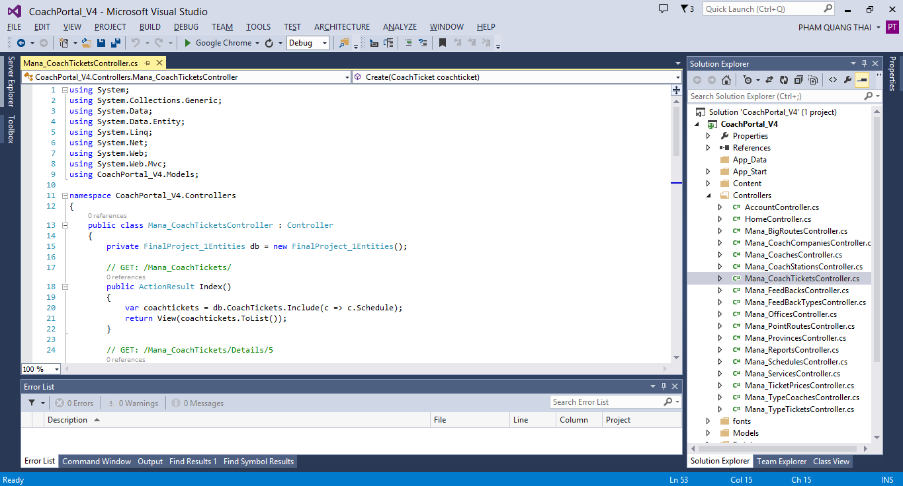
5.3 Coding Convention

Slide 36
Contents
Overview
Project Management
Requirement Specification
Software Design
Testing & Quality Control
Demo - Q & A
Implement
1
6.1 Test Process
6.6 Test case result
6.2 V – Model Test
6.5 Test case sample
6.3 Test type
6.4 Testing tool & Environment
2
3
4
5
6
7

Slide 37
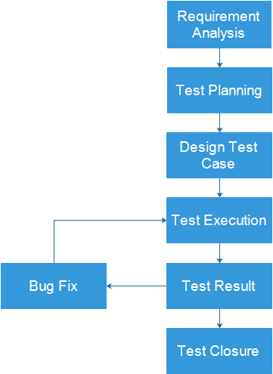
6.1 Test Process

Slide 38
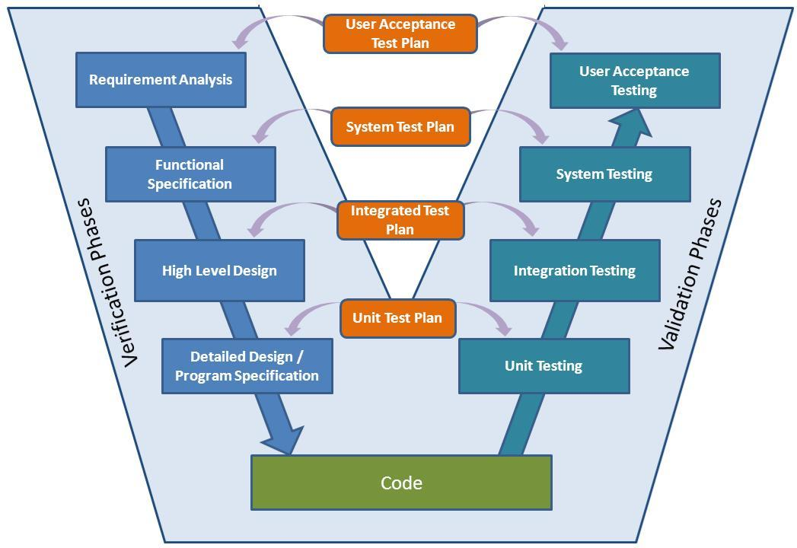
6.2 V – Model Test

Slide 39
6.3 Test type
GUI
Test
Function
Test

Slide 40




6.4 Testing tool & Environment
TOOLS
Color Pick
(http://vidsbee.com/ColorPick/)
Redmine
(https://www.hostedredmine.com/)
ENVIRONMENT
Chrome
Firefox
Internet Explore
Windows 8

Slide 41
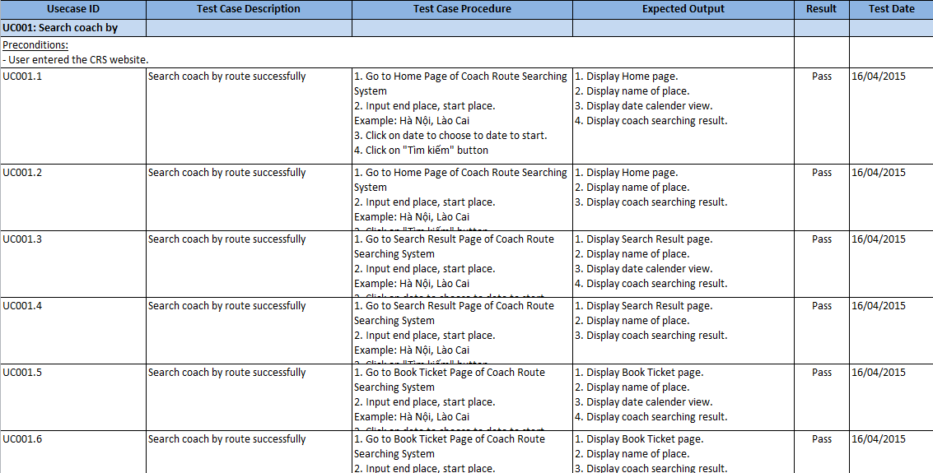
6.5 Test case sample

Slide 42
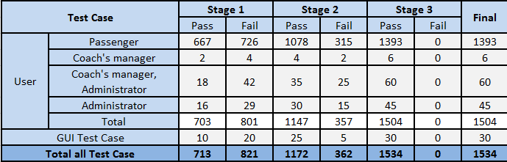
6.6 Test case result

Slide 43
Lesson Learned
Working in group:
Communication
Resolve conflicts
New technologies:
Google Map API
ASP.NET MVC Framework
Html-css
JSON
AJAX
JavaScript
Management skills:
Organize
Negotiate
Planning
Making Decision

Slide 44
Contents
Overview
Project Management
Requirement Specification
Software Design
Testing & Quality Control
Demo - Q & A
Implement
1
2
3
4
5
6
7

Slide 45

The End.
Thank you for your listening !

