Slide 1
ASSET MANAGEMENT SYSTEM
SUPERVISOR:
TEAM MEMBERS:
MR. PHAN TRƯỜNG LÂM
TRƯƠNG HẢI ĐĂNG
NGUYỄN VĂN TƯỜNG
PHAN THANH SƠN
TRỊNH NGỌC TUẤN

Slide 2
PRESENTATION OUTLINE
1
Project introduction
2
Project management
3
Project result
6
4
5
Software requirement specification
Software design
Testing

Slide 3

Project introduction
1. Problem
2. Idea
3. Solution

Slide 4
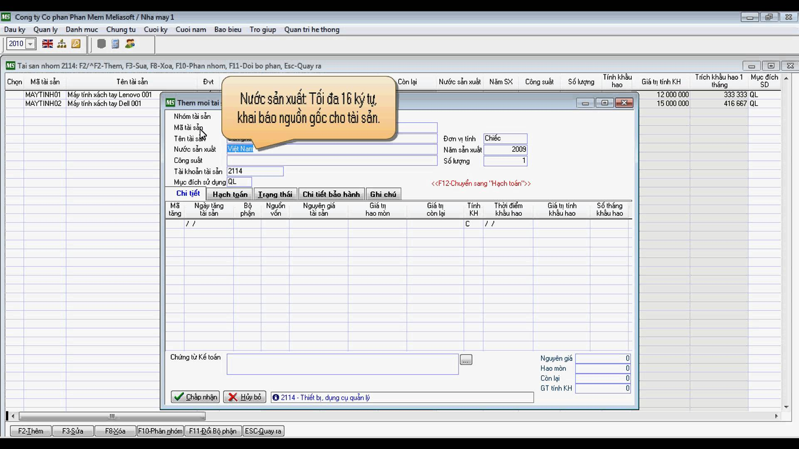
Project introduction
Problem
Manage asset is one of the most important tasks in any company. The difficulties that people who do this task scopes with is the accuracy of asset reports and the time to create them.

Slide 5
Project introduction
Problem
Medium and small enterprises
Excel
similar software
low security
it is not online
not effective
it causes difficulties
time-consuming to use.

Slide 6
Project introduction
Problem
Have high cost
Need many staffs (IT man, System Admin, accountant, ...)
Difficult for moving when the company changes office.
Security risk
Changing policies by government causes some difficulties in changing the software.

Slide 7
AMS system will help companies manage asset easily with very low expenses. They no need to care of security issues, backup and maintenance
Project introduction
Idea
AMS has the following main features:
without buying any hardware and software
no need to hire technician staff to support the system
register an account on AMS website

Slide 8
Project introduction
solution
AMS has the following main features:
Asset Increase: Buy, Basic build, Finance lease, Repair
Asset Decrease: Sell, Transfer, Return finance lease
Calculate Depreciation
User management
Report and Statistics tool

Slide 9

Project management
1. Project model
2. Project life cycle
3. Organization Structure
4. Master Schedule
5. Objects

Slide 10
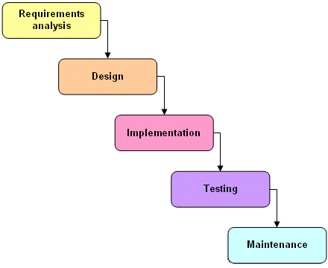
PROJECT MANAGEMENT
Project model
Waterfall model

Slide 11
PROJECT MANAGEMENT
Project life cycle
  Phase 1: Requirement analysis and software definition
  - includes gathering as much as possible requirements:
  + customer
  + other information source like World Wide Web
  - producing a most detail and accurate software definition

Slide 12
PROJECT MANAGEMENT
Project life cycle
Phase 2: System Design
  - Based on customer’s requirements to
  + create logical modules
  + definite their inter relations
  - Using algorithm and diagram to describe implementation of those modules.

Slide 13
PROJECT MANAGEMENT
Project life cycle
Phase 3: Implementation
  - This phase consists of actually constructing the product as per the design specification(s) developed in the previous step.
  - This step is performed by:
  + development team consisting of programmers
  + interface designers
  + other specialists
  - Using tools such as:
  + compilers
  + debuggers
  + interpreters
  + test editors

Slide 14
PROJECT MANAGEMENT
Project life cycle
Phase 4: Testing
  - System implementation and Unit testing: Developing software modules follow detail designs, and doing unit testing for each module.
  - Integration and System testing: Testing output, performance in modules integrating process, and retests all functions of whole system.
  - User acceptance testing: A proper execution of all the preceding stages ensures an application as per the provided requirements and most importantly, it ensures a satisfied client.

Slide 15
PROJECT MANAGEMENT
Project life cycle
Phase 5: System deployment and maintenance
  - After testing completely, the software is handle over client, developing team will respond for maintenance of the system

Slide 16
PROJECT MANAGEMENT
Organization Structure
Project Manager
DangTH
QA Team
SonPT
Test Team
TuanTN
Develop Team
DangTH
SonPT
DangTH
TuanTN
SonPT
Tuong NV
TuanTN
DangTH
SRS Analysis Team
DangTH
Design Team
Tuong NV
Supervisior
Mr. LamPT
Tuong NV
DangTH

Slide 17
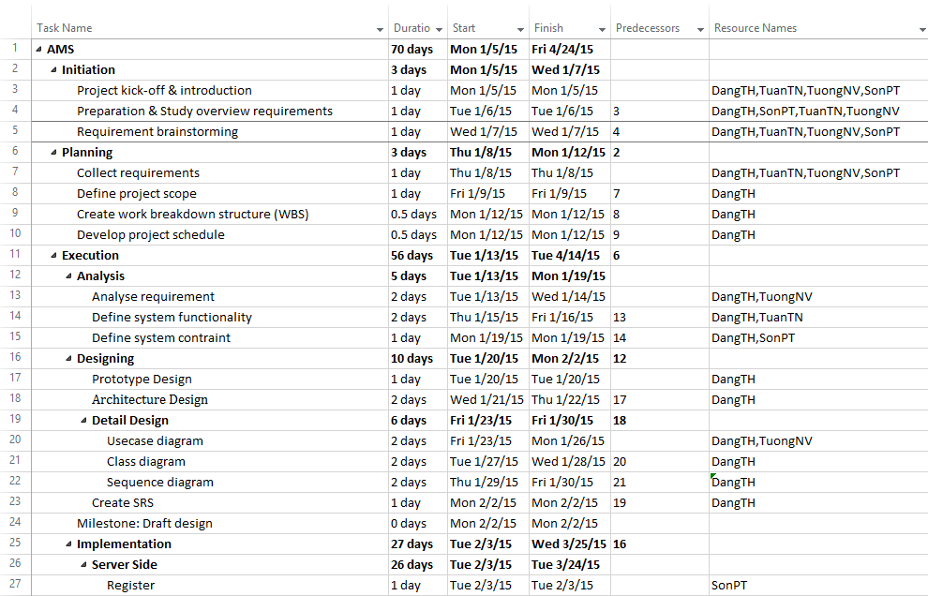
PROJECT MANAGEMENT
Master Schedule

Slide 18
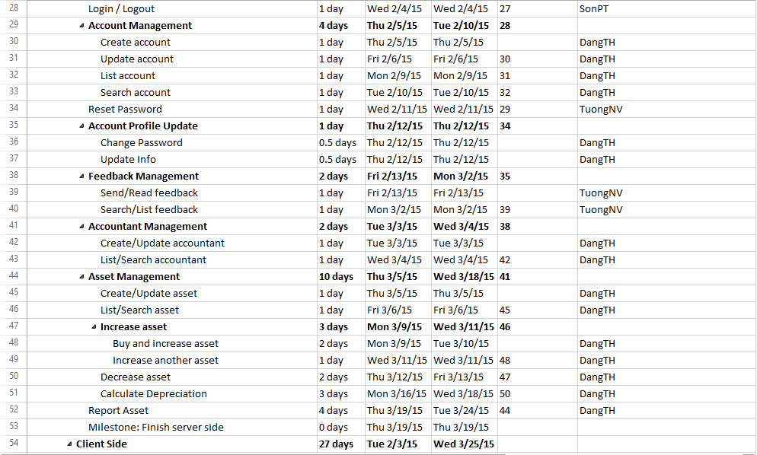
PROJECT MANAGEMENT
Master Schedule

Slide 19
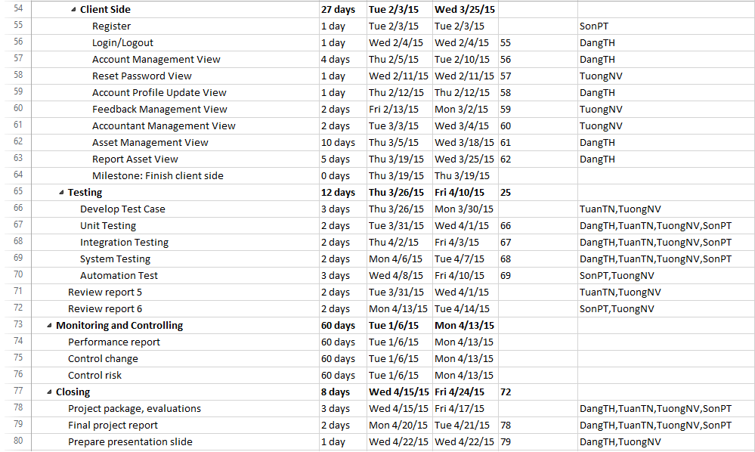
PROJECT MANAGEMENT
Master Schedule

Slide 20
PROJECT MANAGEMENT
Objects
Metrics | Unit | Committed | Actual | Deviation
Start Date | dd-mm-yyyy | 05-01-2015 | 05-01-2015 | 0 days
End Date | dd-mm-yyyy | 22-04-2015 | 24-04-2015 | 2 days
Duration | Elapsed days | 68 days | 70 days | 2 days
Maximum Team Size | Person | 4 | 4 | 0

Slide 21
PROJECT MANAGEMENT
Objects
No | Stage | Deliverable/ Milestone | Delivery Date | Delivery Location
1 | Inception | Deliver Report No.1 | 12-01-2015 | Supervisor
2 | Inception | Project plan | 19-01-2015 | Supervisor
3 | Inception | Deliver Report No.2 | 19-01-2015 | Supervisor
4 | Elaboration | Deliver Report No.3 | 28-01-2015 | Supervisor
5 | Elaboration | Deliver Report No.4 | 11-02-2015 | Supervisor
6 | Construction | Complete Coding | 12-03-2015 | Supervisor
7 | Construction | Deliver Report No.5 | 12-03-2015 | Supervisor
8 | Construction | Deliver Report No.6 | 13-04-2015 | Supervisor
9 | Transition | The last Document and CD source code | 24-04-2015 | FU
10 | Transition | Project completed | 24-04-2015 | FU

Slide 22









PROJECT MANAGEMENT
Objects

Slide 23

SOFTWARE
SPECIFICATION
1. System Overview
2. Functional Requirement
3. Non-Functional Requirement

Slide 24
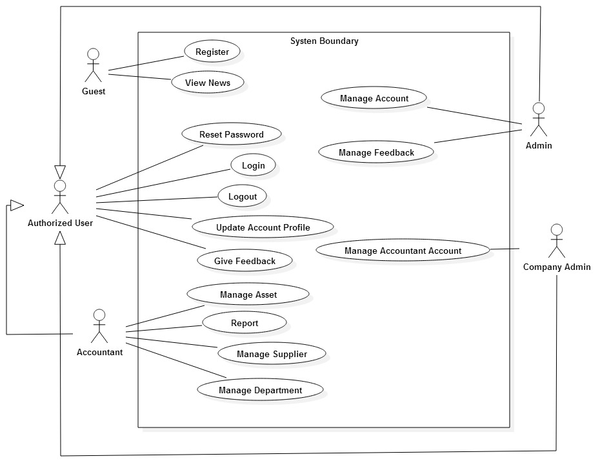
SOFTWARE SPECIFICATION
System Overview

Slide 25
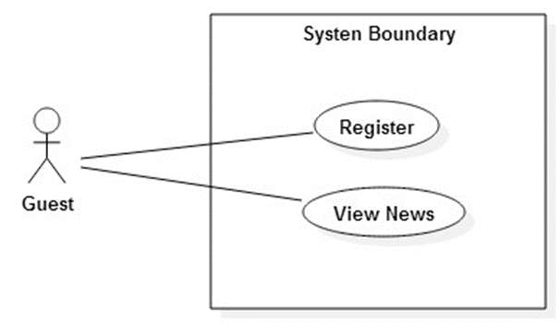
SOFTWARE SPECIFICATION
Functional Requirement

Slide 26
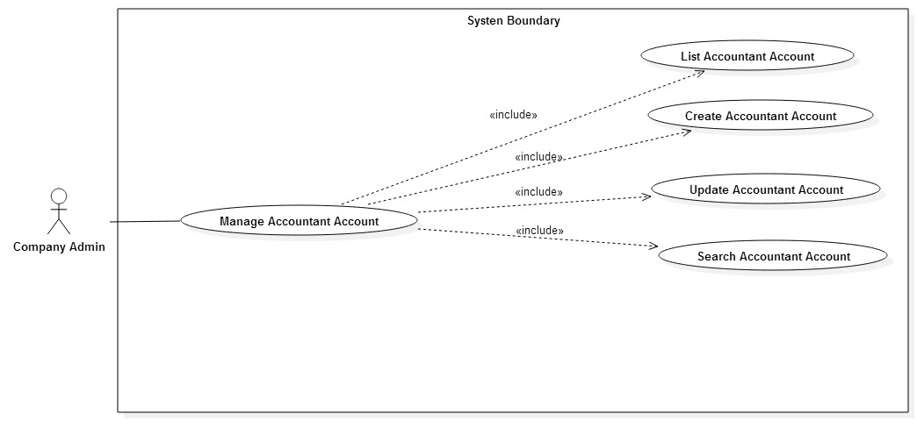
SOFTWARE SPECIFICATION
Functional Requirement

Slide 27
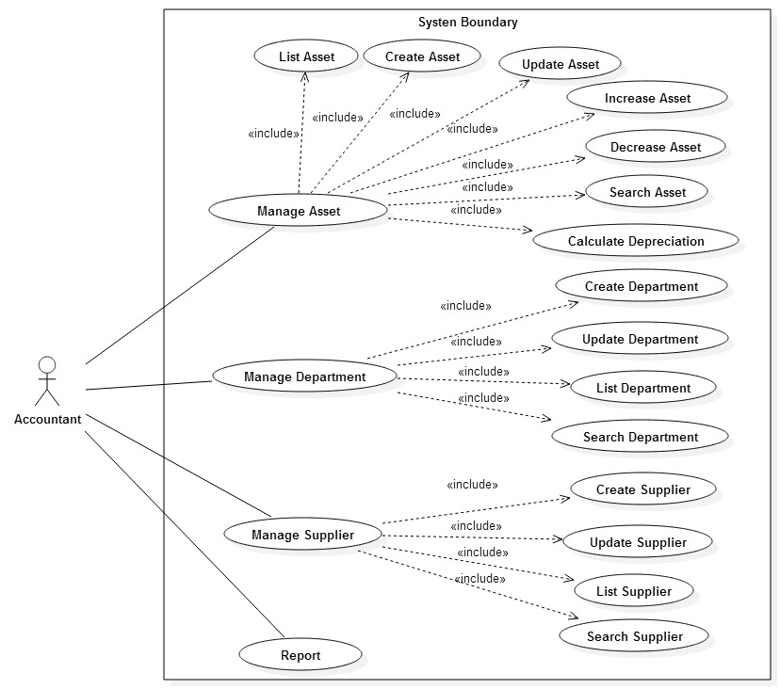
SOFTWARE SPECIFICATION
Functional Requirement

Slide 28
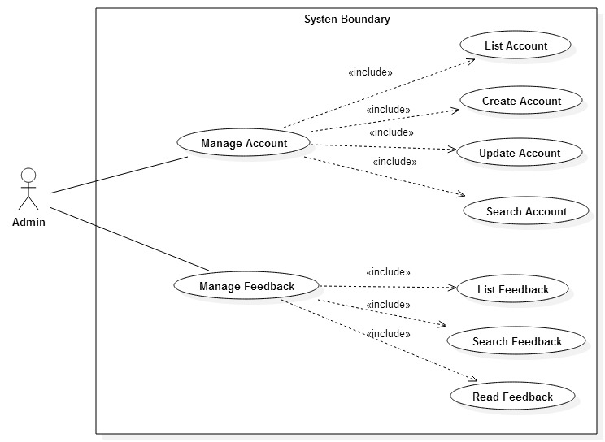
SOFTWARE SPECIFICATION
Functional Requirement

Slide 29
SOFTWARE SPECIFICATION
Nonfunctional Requirement
Reliability:
  The systems with high reliability, can be used like “always on” system
  Business is based on circular 45/2013/TT-BTC
  The website is developed by standard process such as having design, test case …
Availability:
  The expected downtime for maintenance is about 5 minutes each time
  Hosting owner and hosting user have contraint through hosting lendlease.
Security:
  Users must login for using the system
  Data is backed-up once time per month
  Super admin can not meddle to data
Maintainability:
  Each component only perform specific functions so the modification of a component will not affect other components
  The system uses OOAD, component-based technology and observes C# Coding Convention.
Portability:
  The system can be accessed anywhere with a web browser and Internet connection
  It can be run on any browser

Slide 30

SOFTWARE DESIGN
1. Architecture overview
2. Package diagram
3. Database design

Slide 31
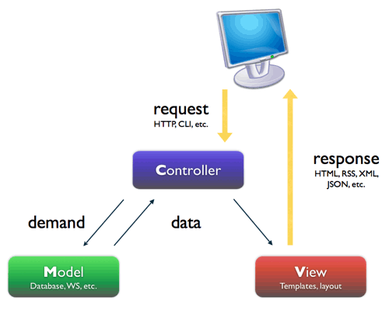
SOFTWARE DESIGN
Architecture overview

Slide 32
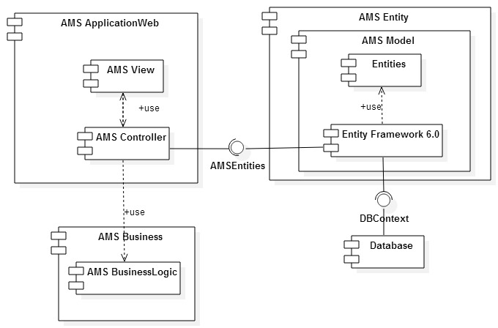
SOFTWARE DESIGN
Package diagram

Slide 33
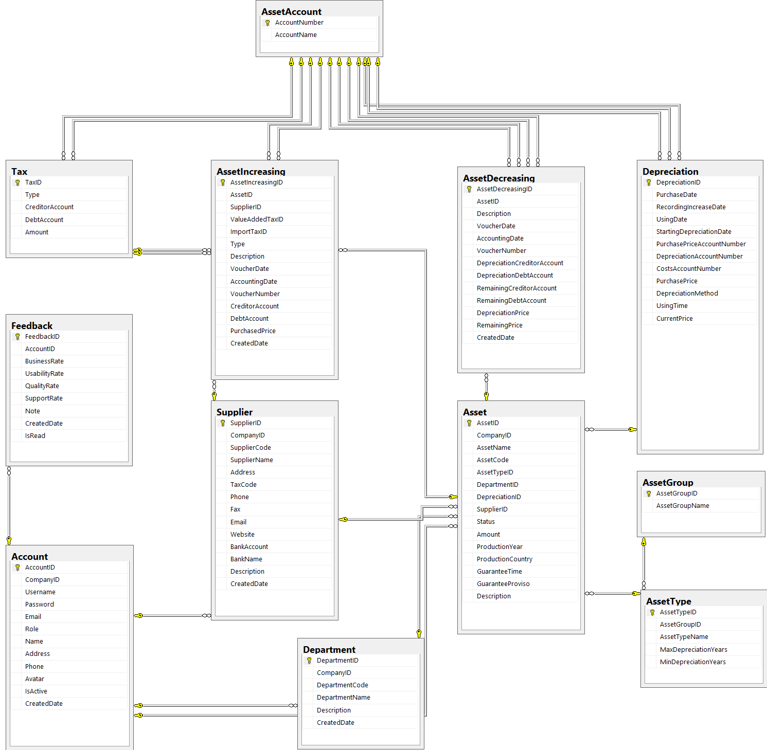
SOFTWARE DESIGN
Database design

Slide 34

TESTING
1. Test model
2. Test Approach
3. Features to be tested
4. Test Schedule
5. Test Result

Slide 35
TESTING
Test model
Customer requirement
validate
Acceptance test
Product specifications
verify/validate
System test
verify
High-level design
Integration test
other V&V activities
Low-level design
verify
Component test
Coding & unit test

Slide 36
TESTING
Test Approach
The testing of the project includes unit, integration, system, and acceptance test levels. It is hoped that there will be as less errors as possible in the product
  Unit testing and Integration test will be done by team member and will be approved by team leader.
  Integration test is done by test team. It is based on requirement in SRS and validation in database, test team will test as black box testing method to check if the input and output display as expected and does that flow work fluently
  System testing will be performed by all member of team. It will check all mainflow of the system to discover error or bugs that can’t be found on unit testing level.
  Base on Circulars 45/2013/TT-BTC, Acceptance testing will be performed by all members of team. The project be checked from the member test to find out if the project in accordance with the expectations.

Slide 37
TESTING
Features to be tested
Function:
  • Is it calculate true follow guide of Circulars 45/2013/TT-BTC
  • Manage account and asset (create, update, …)
Non-Function:
  • Interface
  • Data, processing and concurrent user capacities. Current and future.
  • Useable – Easy to use by target users.

Slide 38
TESTING
Test Schedule
Duration of all testing is from 15 February to 20 April.
Duration of create test plan, test case and checklist are from 12 February to 17 April

Slide 39
TESTING
Test Result

Slide 40

PROJECT RESULT
1. Project judging
2. Project summary
3. Limitation & Expectation

Slide 41
PROJECT RESULT
Project judging
The idea of the AMS is to develop a new website, it can help small and medium sized company in management asset, control accountants. It has main features of existing website such as easy to manage than traditional methods, online data storage and centralized etc… It also provide new method for accountant to calculate Depreciation of asset:
senior manager can have the overview about their Asset in visualization and simplest
Help accountant to manage, calculator all company’s Asset faster, save time and security.
All database history can be saved and allow to access easy.
Available to access any where.

Slide 42
PROJECT RESULT
Project summary
Main objective | Develop a website that helps company can manage asset, calculate depreciation.
Purpose | Help accountant can work more effective, easier and simpler
Items | Plan | Actual
Releases Date | 20/4/2016 | 23/4/2016
Releases version | 1.0 | 1.0
Days | 77 | 80
Test cases |  | 180 test case
Defects |  | 11
Document pages |  | > 200 (include appendix)
Lines of code |  | Approximately 40.000

Slide 43
PROJECT RESULT
Limitation & Expectation
  Limitation:
Support not well : Firefox, IE
Some function not good to use
  Expectation:
Support more in other browser and mobile.
Fix all bug existed in this release.
Staff can manage and check Asset periodic by QR code

Slide 44
Demo

Slide 45
Thank for watching

