Slide 1


Measuring customer satisfaction
of e-service quality at
WELCOME TO OUR THESIS DEFENSE
GROUP 6

Slide 2
Presentation OUTLINE
SECTION 01
Introduction
SECTION 02
Literature review
SECTION 03
Methodology
SECTION 04
Analysis & findings
SECTION 05
Recommendation
SECTION 06
conclusion

Slide 3
01
Introduction

Slide 4

COMPANY BACKGROUND
FOUNDED IN
LOCATION
PRODUCTS
183
Retail shops
August 2007
in
provinces
23

Slide 5
PRACTICAL
PROBLEMS
Focus investment on Advertising
No
investigation
ON
YET
customer insight
trying to attract
new customers
but forgetting
existing customers' insight

Slide 6
THEORETICAL
PROBLEMS
1
There has not been many
researches and studies
on e-service quality
2
There has not been models applied in researches on e-service quality
in Vietnam
in Vietnam market

Slide 7
RESEARCH
QUESTIONS
Which factors influence
on FPT Shop’s customer satisfaction?
Which factors of FPT shop e-services are most important?
1
2
Which factors have the perceived value reach the customer expectation?
3
4
Which factors that FPT should focus on to improve customer satisfaction?

Slide 8
RESEARCH
SCOPE
FPT Shop’s customers
Logged on and used the e-service at website www.fptshop.com.vn
Using function, interacting with website
Using online order process and support service
Experiencing home delivery service.
Location
AGE
Sample size
15 – 44
years old
156
Hanoi

Slide 9
02
Literature review

Slide 10
CUSTOMER
SATISFACTION
\
How well the expectations of a customer
concerning a product or service
provided by your company have been met.
\
Grimsley, 2012

Slide 11
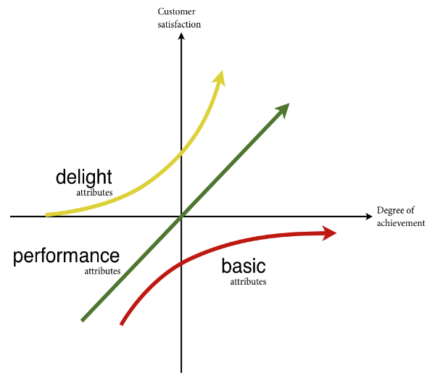
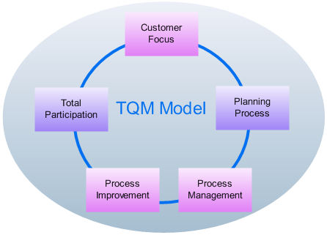
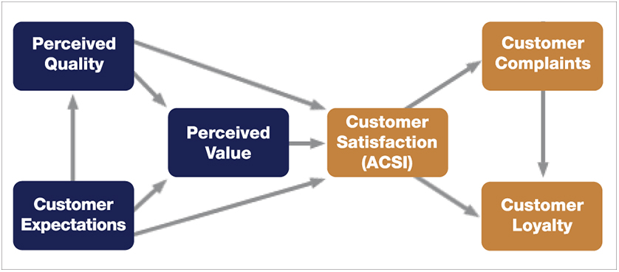
RELATED MODELS
OF
CUSTOMER SATISFACTION
Kano’s model of
customer satisfaction
TQM
Berger et al., 1993
Deming(1986)
Macro Model of Customer Satisfaction
Woodruff & Gardial (1996)

Slide 12

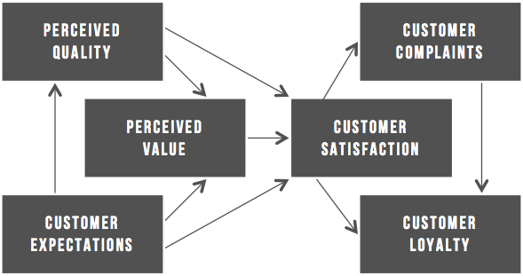
APPROACHES
Complaints & Feedbacks
Expectation & Perceive Value
Macro Model OF Customer Satisfaction
1
2
Basic method
No requirement of skillful researchers
Advantages
Advantages
Specific data, clear information of problem
Evaluating exactly customer satisfaction
Gap of Expectation-Perceive is measurable
Disadvantages
Simple & general responsiveness
The percentage that customers willing to complain is 50%
The responsiveness is not always correct.
Longer time
Disadvantages
Costly

Slide 13
DIMENSIONS
OF
SERVICE QUALITY
SERVQUAL
eTailQ
E-S-QUAL
Parasuraman (1988)
Wolfinbarger (2003)
Parasuraman (2005)
Reliability
Website design
Efficiency
Responsiveness
Fulfillment (Reliability)
42
System availability
ITEMS
Assurance
Customer Service
Fulfillment
P.10 – printed report
Empathy
Privacy (Security)
Privacy
Tangibles

Slide 14
03
Methodology

Slide 15
DATA COLLECTION
METHODS
In-depth interview
Advantages
Qualitative Research
Rich source of data
Lower rating of copycat answering
Transfering the statistical data into the meaningful information
Finding the correlation from the respondents
Focus group
Bulletin board
Case study
QUANTITATIVE Research
Survey

Slide 16
DATA COLLECTION
PROCESS
Interview with customers
Pilot survey
Final survey
Interview with employees
3rd March
10th march
15-18th march
21th march
Evaluating the important level of several e-service factors
42 -> 30 items
Evaluating time
Check technical words, complicated questions and unclear questions
Real quantitative survey target to all the sample
Offline: 103 responses
Online: 53 responses
-> 156 usable responses
Assuming customer expectation
Ask for their opinion about the data analysis results.
QUALITATIVE RESEARCH
Quantitative research
QUALITATIVE RESEARCH

Slide 17
PHASE
01
Interview with customers
3rd March
QUALITATIVE RESEARCH
Ã
Evaluating the important level of
42 e-service items (after literature review)
Ã
Reducing 42 items to 30 items
DEMO survey questionnaire

Slide 18
PHASE
02
Pilot survey
10rd March
Ã
Evaluating time to do survey
Ã
Check grammar, mistake, complicated questions and unclear questions
FINAL survey questionnaire
P.76-79 – printed report

Slide 19
PHASE
03
Final survey
15-18th March
QUANTITATIVE RESEARCH
Ã
Both offline and online channels
Ã
156 usable responses
RAW DATA
ANALYSIS

Slide 20
PHASE
04
Final survey
21th March
QUALITATIVE RESEARCH
EXPECTATION
Ã
Assuming level of expectation
Website quality
3.22
Online order process
3.52
Ã
Discussing about the findings
Home delivery service
3.60
Online customer service
3.34
RECOMMENDATION FOR FUTURE RESEARCH

Slide 21
DATA ANALYSIS
METHODS
SPSS 20
Descriptive STATISTICS
Multiple Regression
Chart
Diagram
Graph
Cronbach’s Alpha
Multiple Regression formula

Slide 22
Multiple Regression
Analysis
0.89
=
Cronbach’s alpha
/
35
VARIABLES
0.87
29
GEN
0.513
WEB8
0.451
DEL1
0.371
WEB
0.319
WEB9
0.396
DEL2
0.292
ORD
0.403
WEB10
0.269
DEL3
0.414
DEL
0.411
WEB11
0.374
DEL4
0.301
CUS
0.393
WEB12
0.353
CUS1
0.569
WEB1
0.354
WEB13
0.469
CUS2
0.598
WEB2
0.437
WEB14
0.208
CUS3
0.523
WEB3
0.377
ORD1
0.177
CUS4
0.508
WEB4
0.475
ORD2
0.035
CUS5
0.489
WEB5
0.474
ORD3
0.167
CUS6
0.491
WEB6
0.408
ORD4
0.474
CUS7
0.539
WEB7
0.371
ORD5
0.421
Corrected Item-Total Correlation

Slide 23
Multiple Regression
Analysis
GEN
=
?
WEB
+
?
ORD
+
?
DEL
+
?
CUS
General satisfaction
Website quality
Order process
Home delivery
Customer service
14 items
5 items
4 items
7 items

Slide 24
04
ANALYSIS & Findings

Slide 25
Descriptive
statistics
156
respondents
Mean
GENERAL SATISFACTION
2.74
WEBSITE QUALITY
3.12
ONLINE ORDER PROCESS
3.23
72.4%
2.70
HOME DELIVERY SERVICE
43.6%
66.7%
ONLINE CUSTOMER SERVICE
2.61
GENDER
INCOME
NUMBER OF BUYINGS
MALE
5-10 million VND
1 time

Slide 26
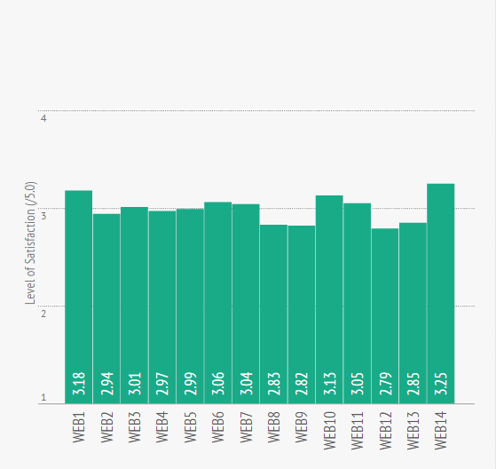
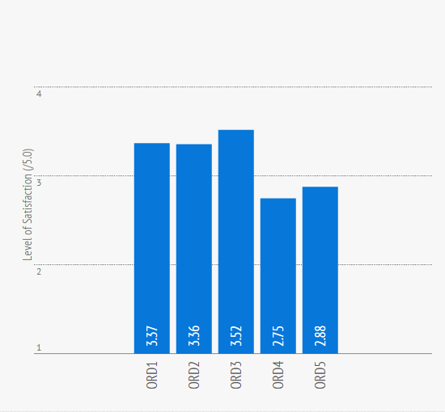
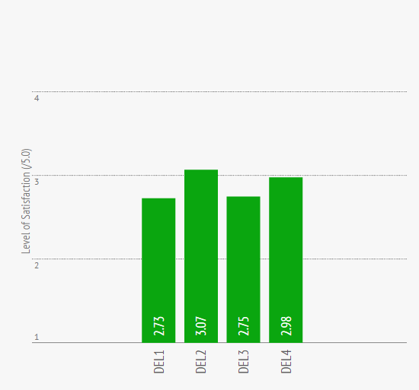
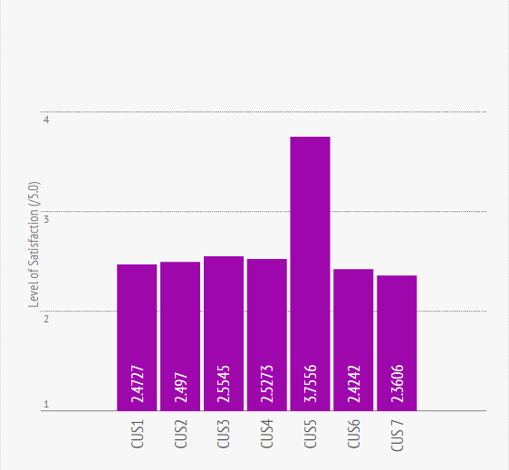
Website quality
Online order process
Friendly supporter
Home delivery service
Online customer service

Slide 27
In customers' view point,
Online customer service
is the most important factor
Finding
01
Website quality
1
Online customer service
Online customer service
2
Home delivery service
Online order process
3
Website quality
Home delivery service
4
Online order process
CUSTOMERS

Slide 28
In customers' view point,
Online customer service
is the most important factor
CONCLUSION
01
The importance of each service in FPT Shop’s viewpoint has not yet matched with customers’ perspective.

Slide 29
Finding
02
Website quality has nearly
achieved customer satisfaction
–
=
PERCEIVED VALUE
EXPECTATION
SATISFACTION
Website quality
3.12
3.22
- 0.10
Online order process
3.23
3.52
- 0.29
Home delivery service
2.70
3.60
- 0.90
Online customer service
2.61
3.34
- 0.73

Slide 30
02
CONCLUSION
Website quality has nearly
achieved customer satisfaction
The quality of e-commerce site FPTShop.com.vn
has reached customer satisfaction,
with perceived value nearly equal to expectation.

Slide 31
Finding
03
4 main items need improvement
General satisfaction
GEN
=
0.16 WEB
+
0.14 ORD
+
0.20 DEL
+
0.21 CUS
Home delivery
Customer service
Home delivery
On time delivery
=
0.18 DEL1
+
0.19 DEL3
+
0.05 DEL4
DEL
Well-packaged product
Customer service
=
+
+
Prompt response
CUS
0.02 CUS1
0.06 CUS2
0.20 CUS3
+
+
+
0.11 CUS6
Friendly supporter
0.08 CUS4
0.15 CUS5
+
0.04 CUS7
Knowledgeable supporter

Slide 32
CONCLUSION
03
4 main items need improvement
Home delivery service
and
Online customer service
affect the most on general satisfaction
Four items need upgrading:
On time delivery
Prompt response
Well-packaged product
Knowledgeable supporter

Slide 33
05
RECOMMENDATIONS

Slide 34






Home delivery
Customer service
On time
delivery
Well-packaged
product
Prompt
response
Knowledgeable
supporter
Upgrade system & Assign more online supporters
Assigning more freelance shipper
Crush-proof foam & FPT Shop Sticker
Open technical training courses

Slide 35
06
CONCLUSION

Slide 36
RESEARCH
LIMITATION
Limited secondary data on
e-service & customer satisfaction
Spend 2 weeks to a month
Lack of previous researches
Time bound
Limited budget
Sample size
Without sponsorship, could not serve respondents gift,
rewards to co-operation
Only limited within people who are living in Hanoi

Slide 37
CONCLUSION
03
research objectives
FURTHER research
Ã
ARE Fulfilled
Ã
Wider AND DEEPER
investigation on
customer insight

Slide 38
THANK YOU!

