Slide 1

Capstone Project
Betonamu No Ryouri
BNR Group Members
Group members | Đặng Minh Quân | 01847 | QuanDM
 | Lê Viết Anh Tuấn | 00778 | TuanLVA
 | Nguyễn Văn Tuấn | 01691 | MyNTP01691
Supervisor | Mr. Phạm Ngọc Hà
Capstone Project Code | BNR

Slide 2
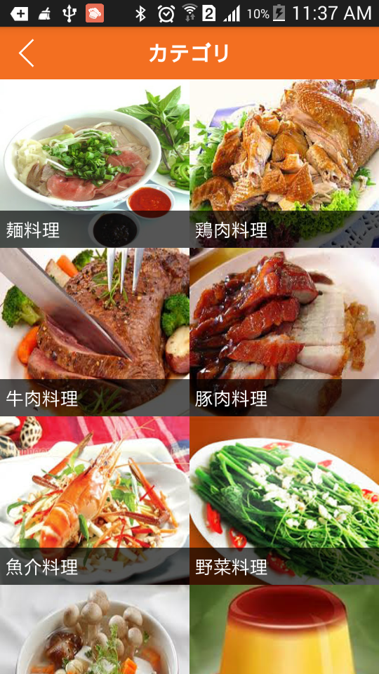
Capstone Project
Betonamu No Ryouri

Slide 3
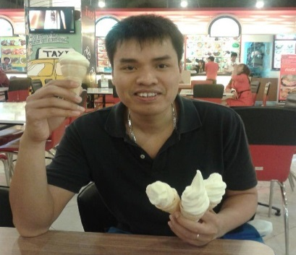
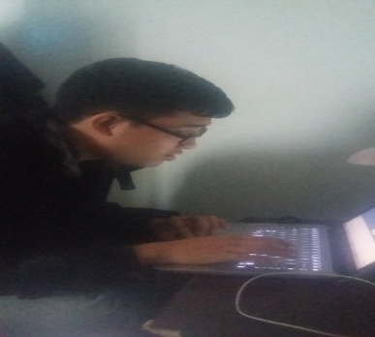
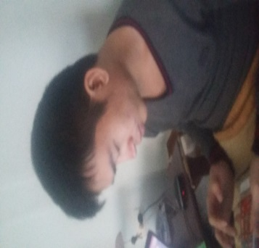

Project Team
Mr.HaPN
Supervisor
QuanDM
Project Manager
TuanLVA
Technique
TuanNV
Test

Slide 4
Outline of Content
1. Introduction. (QuanDM).
2. Project management. (QuanDM).
3. SRS. (QuanDM).
4. SDD. (TuanNV).
5. Testing. (TuanNV).
6. Lesson Learned. (TuanLVA).
7. Demo. (TuanLVA).
8. Q&A. (BNR Team).

Slide 5
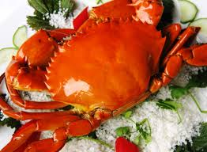

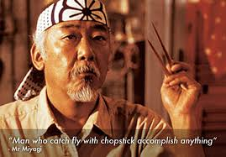
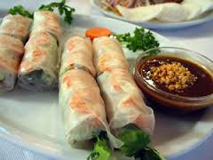
1. Introduction
1.1 What is BNR?
BNR is android application introduce Vietnam cuisine for Japanese person
  Rich data
  Japanese Language
  Easy to Use

Slide 6

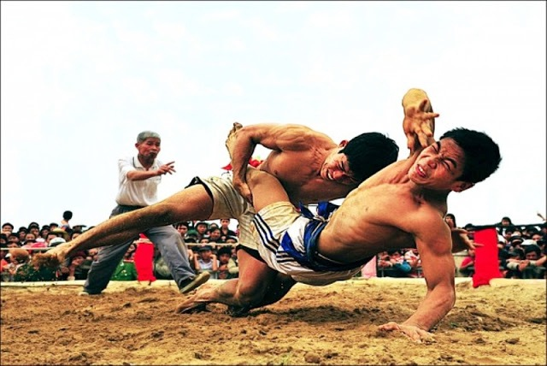
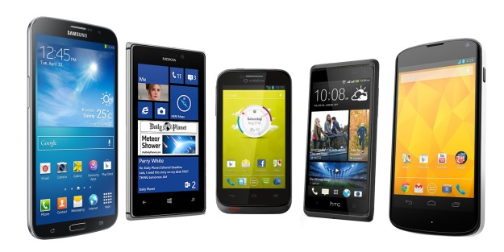

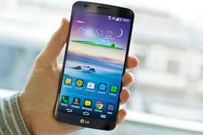
1. Introduction
1.2 Why ?
Notes:
Có rất nhiều thiết bị công nghệ hiện đại hỗ trợ con người trong cuộc song, giúp cho họ làm việc nhàn hơn, nhanh hơn, hoc tap hiệu quả hơn, hấp dẫn người học hơn. Điển hình như: Máy tính, iPad, Tablet…

Slide 7
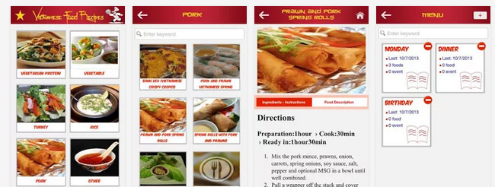
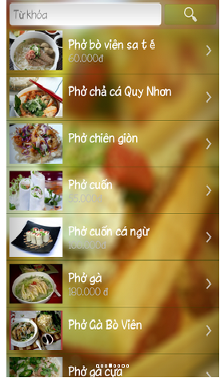
1. Introduction
1.2. Existing System.
Notes:
Hoc tieng nhat online.
Luyen ngu phap.
Trung tam nhật ngữ hồng nhung.
http://web-japan.org/kidsweb/
Kids web japananese.
Phần lớn những trang web này đối tượng của họ là những người học cấp tốc, hoặc trang web học tiếng anh-nhật.

Slide 8
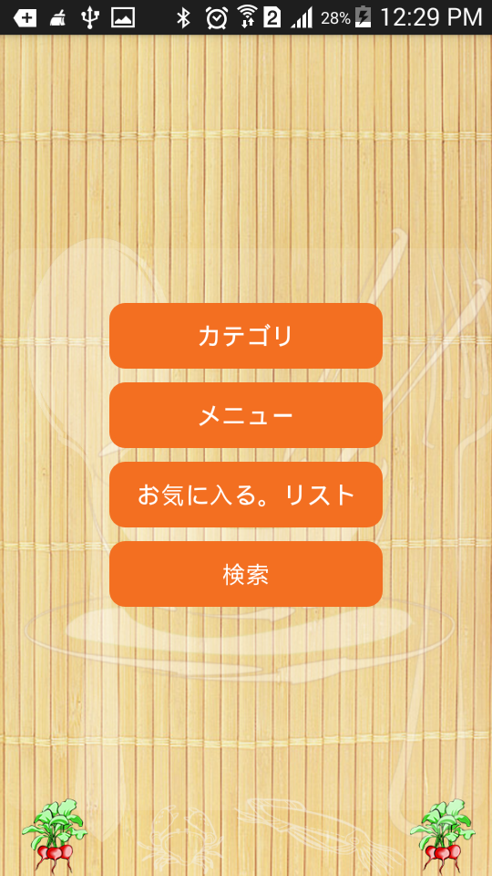
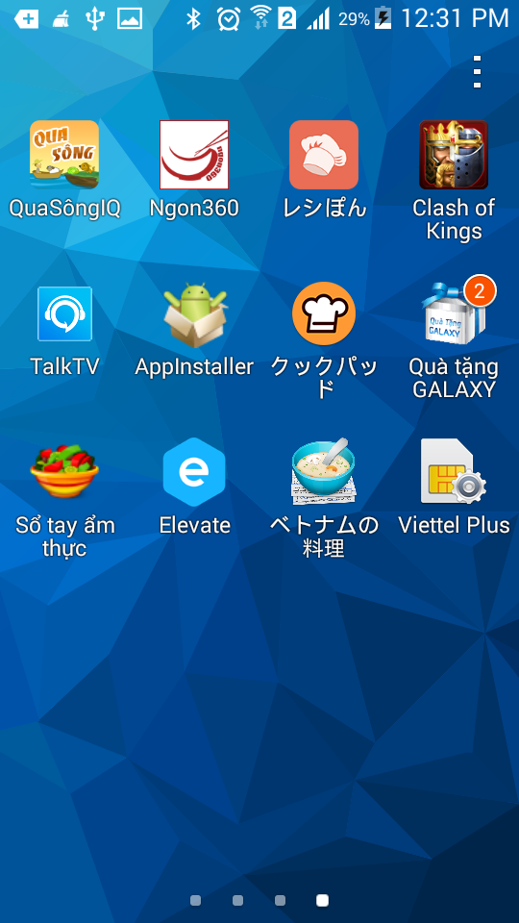
1. Introduction
Summary

Slide 9

2.1. Software process model.
RUP
2. Project management

Slide 10
RUP
RUP is a specific implementation of the Unified Process.
The horizontal axis represents time and shows the dynamic aspect of the process as it is enacted, and it is expressed in terms of cycles, phases, iterations, and milestones.
The vertical axis represents the static aspect of the process: how it is described in terms of activities, artifacts, workers and workflows.

Slide 11
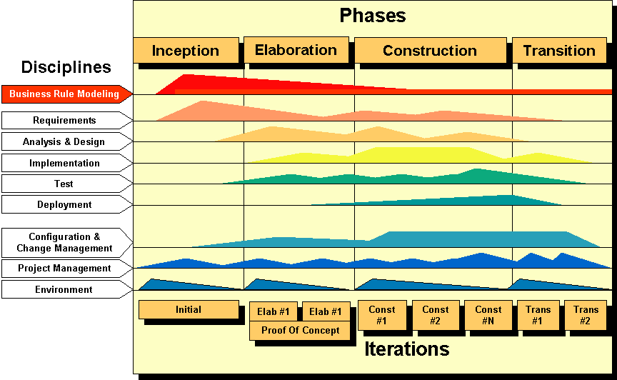


Slide 12








2.2. Team work.
2. Project management
Time: 2 hours/day, 5 days/week.
Location: school, home.
Communication:
Meeting supervisor: 1/week.
Meeting minutes.

Slide 13










2.3. Tools.
2. Project management

Slide 14




2.4. Techniques.
2. Project management

Slide 15
2. Project management
2.5. Organization.
Supervisor
(Mr.HaPN)
Project manager
(QuanDm)
SRS
Analysis
Design
Coding
Testing
All
members
Quandm
TuanNV
Quandm
TuanLVA
TuanLVA
TuanNV

Slide 16
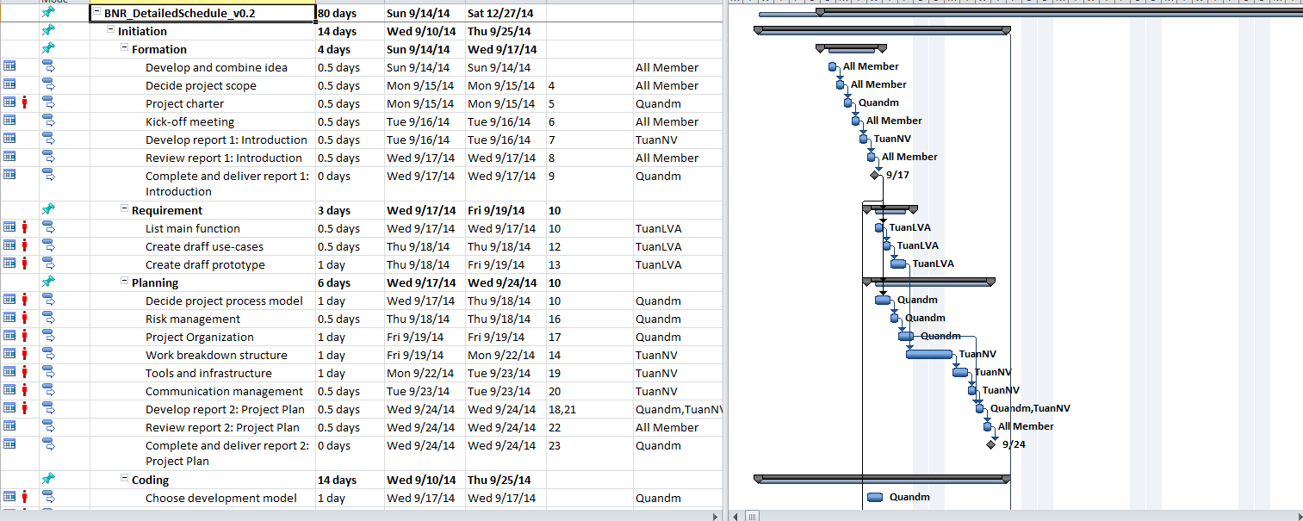
2.6. WBS And Gantt Chart
2. Project management

Slide 17
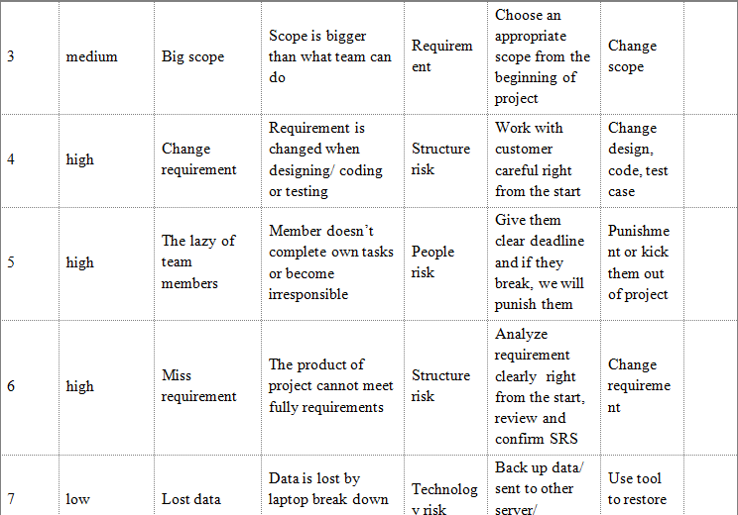
2.8. Risks.
2. Project management

Slide 18

3. Software Requirement Specification (SRS).
3.1. User requirements
There are 1 actors which. system support
User

Slide 19
User
View Information Food And Restaurant
Search and Book Mark Food
Create Menu (add/delete/view)

Slide 20
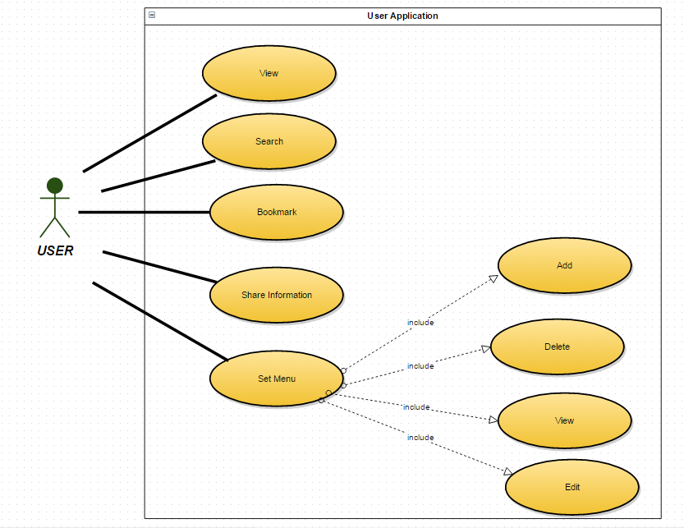
3.2. User (Kids)

Slide 21
3. Software Requirement Specification (SRS).
3.4. System Requirement
3.4.1. User Interfaces
  User interface should be easy to understand, interested image and easy use, friendly.
  The color use to design user interface is elegant, not flashy.
  There is not much item.
  The text is big enough and Vietnamese.
  Screen need adapt any frame rate on Android devices

Slide 22
3. Software Requirement Specification (SRS).
3.4. System Requirement
3.4.1. Software Interface

Slide 23
3. Software Requirement Specification (SRS).
3.4. System Requirement.
3.4.3. Hardware Interfaces.

Slide 24


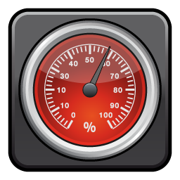
3. Software Requirement Specification (SRS).
3.5. Non-Function Requirement
  Usability
  Reliability
  PerformanceON-FUNCTION REQUIREMENT

Slide 25
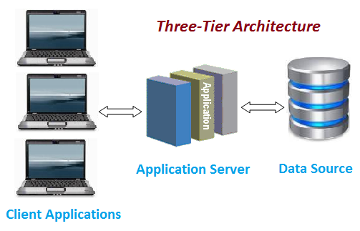
4. System Detail Design
4.1. System Architecture Design

Slide 26
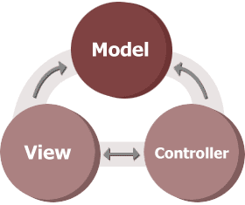
4. System Detail Design
    4.2. Software Architecture Design

Slide 27
4. System Detail Design
A model: notifies its associated views and controllers when there has been a change in its state. Model objects are the parts of the application that implement the logic for the application s data domain, retrieve and store model state in a database.
A view: requests from the model the information that it needs to generate an output representation to the user. It handles the display of data and is created from the model data.
A controller: can send commands to the model to update the model's state. It handles user interaction and can also send commands to its associated view to change the view's presentation of the model.

Slide 28
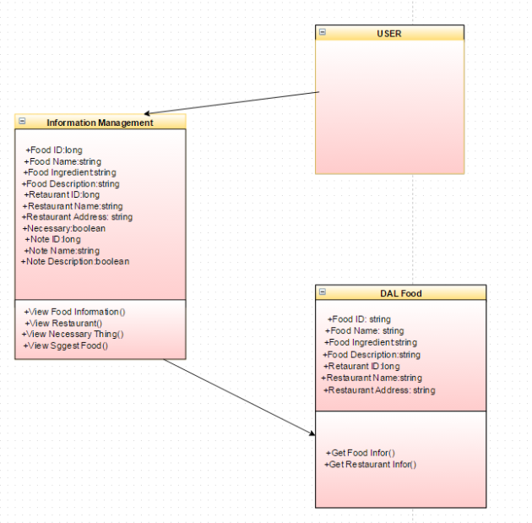
    4.3. Class Diagram

Slide 29
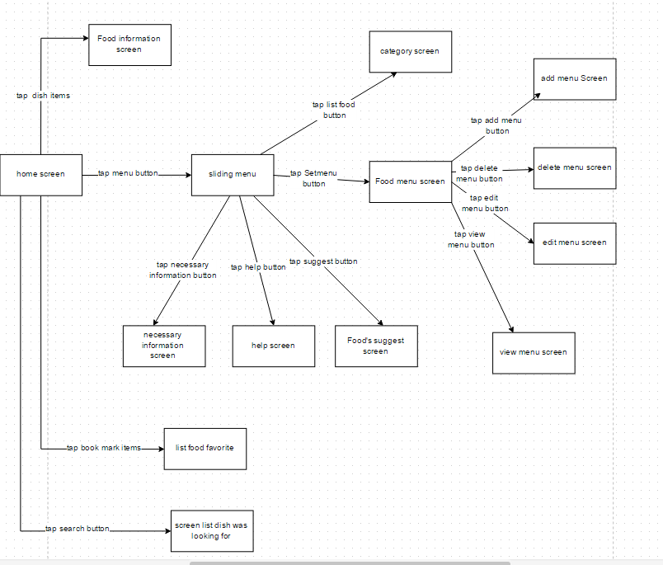
    4.4.Screen Flow

Slide 30
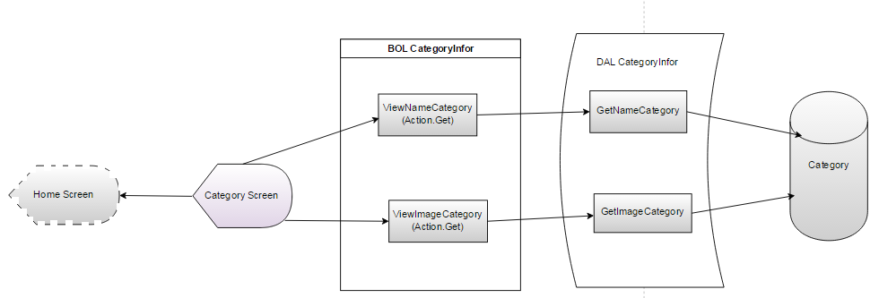
4.5. Object Transition Diagram

Slide 31
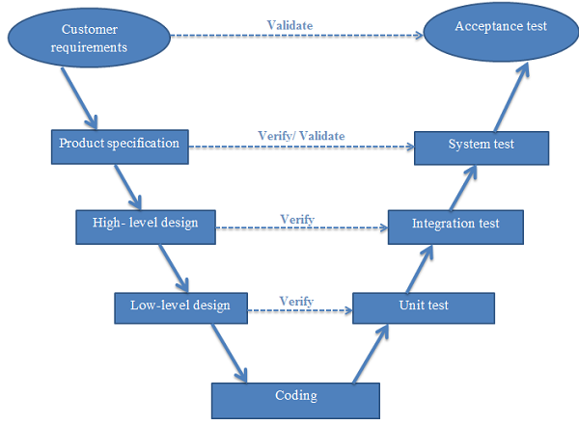
5.1. Test strategy.
5. Testing

Slide 32
5.2. 3-Types of testing.
5. Testing
Unit Testing
Integration Testing
System Testing
Unit testing to test particular functions or code modules.
Testing of combined parts of an application to determine if they function together correctly
Here the features and requirements of the product as described in the requirement document are tested
Notes:
Trong giai đoạn system teesst thi se thụ hien do performance của web site..
Giai đoạn acception test bọn em dự kiesn sẽ thực hiện sau khoảng 1 tuần khi hoàn thiện hoàn toàn hệ thống.

Slide 33
5.3 Test process.
5. Testing
Create Test Plan
Create Test Report
Create Test Case
Execute Test Case
Log & Tracking bugs
Review & Update Test Case
Re-Test
Create Test Plan
Create Test Report
Create Test Case
Execute Test Case
Log & Tracking bugs
Review & Update Test Case
Re-Test

Slide 34
5.4 Features to be tested.
5. Testing
No | Component |  | Feature Name |  | Feature to be tested
 | Interface | Main Application | Screen elements |  | Check the display of elements.
 | Function | Main application | View Food Information Management | View Food Name
 |  |  |  | View Food image
 |  |  |  | View Food Description/ Ingredients
 |  |  | View Restaurant Information Management | View Name Restaurant
 |  |  |  | View Address Restaurant
 |  |  |  | View Phone Restaurant
 |  |  |  | View Map Restaurant
 |  |  | Menu Management | Menu Processing | Add Menu
 |  |  |  |  | Delete Menu
 |  |  |  |  | View Menu
 |  |  |  |  | Update Menu
 |  |  | Share Facebook
 |  |  | Book Mark Favorite Food
 | Performance | MAA | Response time

Slide 35
5. Testing
5.5 Test case.
Module Code | Homepage
Test requirement
Tester | TuanNV
ID | Test Case Description | Test Case Procedure | Expected Output | Inter-test case Dependence | Result1 | Result2 | Test date | Note
 | Search
[Home Screen-5] | Find food in home Screen | 1.Input name of food on search’s text field 2.tap button “search” button | 1.Show the search text field and button 2.List food screen is redirected to. |  | Pass | Pass | 2014/11/27
[Home Screen-7] | Input "Search" tab > 30 character | 1. tap "Search" tab in the menu. 2. Input text field | 2. keyboard block |  | Fail | Pass | 2014/11/27
[Home Screen-9] | Input "Search" tab Special character | 1. tap "Search" tab in the menu. 2. Input tex special characters | 2. keyboard block |  | Fail | Pass | 2014/11/27

Slide 36
5.6 Bug list.
5. Testing
Defect ID | Module | Description | Type | Severity | Priority | Status | Assign to | Root Cause | Create by
1 | Food Menu Page | Click into Back Button Expected result: Go back to home Page | User Interface | Cosmetic | Low | Open | TuanLVA | wrong with requirement | TuanNV
2 | Food Menu Page | Click into Add Button Expected result: Go to Search Page | Business Logic | Cosmetic | Low | Closed | TuanLVA | wrong with requirement | TuanNV
3 | Food Menu Page | Click into Recipe Item Excepted Result: Go to Recipe Details Page | Coding Logic | Cosmetic | Low | Closed | TuanLVA | wrong with requirement | TuanNV
5 | Food Menu Page | Click into Detele Button Expected result: Delete this Recipe from Food Menu | Coding Logic | Cosmetic | Low | Closed | TuanLVA | wrong with requirement | TuanNV

Slide 37
5.7 Test Result
5. Testing
Module Code |  | Pass | Fail | Untested | N/A | Number of Test Cases
Total of Test Case |  | 215 | 0 | 0 | 0 | 242
Unit test |  | 20 | 0 | 0 | 0 | 20
Integration test |  | 39 | 0 | 0 | 0 | 39
MAA’s features | Home Screen | 13 | 0 | 10 | 0 | 23
 | View | 17 | 8 | 9 | 0 | 17
 | Set menu | 15 | 3 | 0 | 0 | 18
 | Search |  | 0 | 0 | 0 | 0
Performance |  | 18 | 0 | 0 | 0 | 18
GUI |  | 36 | 8 | 0 | 0 | 44
Test check list GUI |  | 25 | 3 | 0 | 0 | 28
Test Check list CODE |  | 32 | 3 | 0 | 0 | 35

Slide 38

6. Lesson learn
Learn new coding language.
Working Group
Knowledge about Software development process
Improve Soft Skill

Slide 39
7. Demo
Demo BNR

Slide 40

8. Q&A

Slide 41


