Slide 1
Online Movie Ticket Sale for the cinema
Supervisor | Mr. Phan Trường Lâm
Group Members | 01446 – Trịnh Anh Đức
 | 01153 – Nguyễn Minh Thành
 | SE02311 –Phạm Tuấn Anh
 | SE02425 – Vũ Hoàng Anh
1

Slide 2
OUTLINE OF CONTENT
1- Introduction
2- Project Management
3- Software Requirement Specification
4- Software Design Description
5- Testing
6- Project Result
7- Lessons Learnt
8- Demo
2
9- Q&A

Slide 3
1. Introduction
3

Slide 4
1. Introduction
Objective
Current Situation
Idea and My Project

Slide 5
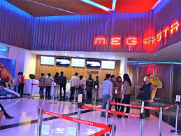
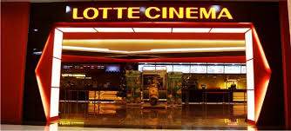
1. Introduction
IDEAs
Currently to get a cinema ticket, the customers have to go to the cinema ticket office and queue to buy a ticket. It takes a lot of times and efforts. .
5

Slide 6
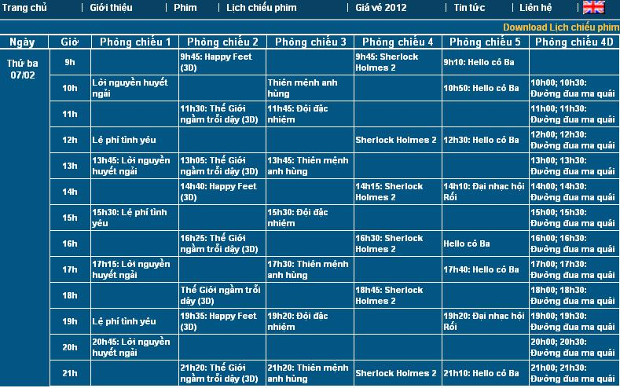
1. Introduction
Ideas
To overcome the above difficulties, the project builds a website to provide information and sell the cinema ticket.

Slide 7
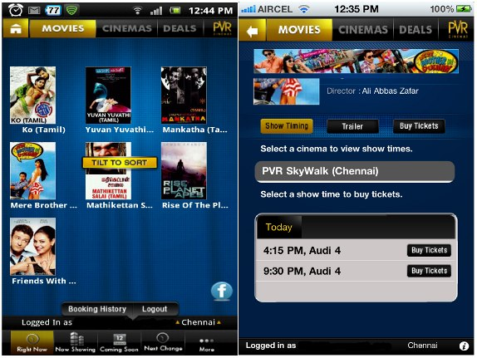
1. Introduction
Ideas
The customers can buy the ticket everywhere at any time. They go to the cinema just some minutes before the film starts without annoying waiting in the buying ticket queue.
7

Slide 8
1. Introduction
Technologies applied
Development Language: PHP
Operating system: Windows 8
Database Management System: MySQL 5.4
Others: Xampp 1.8.3, Microsoft Office 2010
8
Notes:
ASP.NET Hỗ trợ mạnh mẽ bộ thư viện phong phú và đa dạng của .Net Framework, làm việc với XML, Web Service
Tách code riêng, giao diện riêng
Dễ đọc, dễ quản lý và bảo trì
Kiến trúc lập trình giống ứng dụng trên Windows
MVC : Mô hình rất phổ biến và được chia thành các thành phần độc lập nên giúp phát triển ứng dụng nhanh, đơn giản, dễ nâng cấp, bảo trì..

Slide 9
1. Introduction
objectives
Study, train and apply new technologies
Upgrade soft skill : Working in Group, Communication
My Project will apply in reality and support for:
Administrator and Staffs of Cinema Centers: can manage and control information about User, Schedule, Movie, Cinema, Room, Ticket, Seat layout, News easily and quickly
Customer : can view and choose favorite film to booking ticket from anywhere with appropriate seat
9

Slide 10
2. Project Management
10

Slide 11
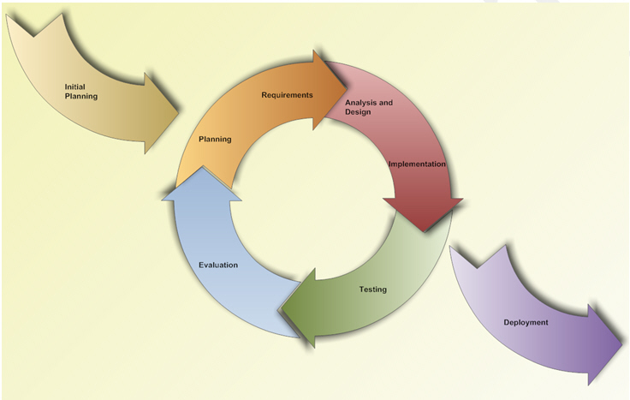
2. Project Management
Process model
We’ll always have a running
version of the program.
Suitable for new developer.
The Iterative model
11

Slide 12
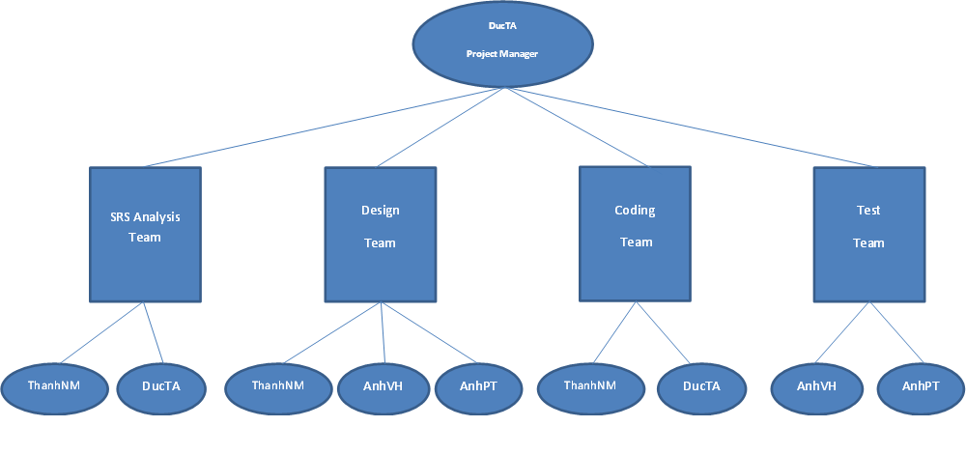
Organisation
2. Project Management
12

Slide 13
2. Project Management
Team Work
Meeting Minute : once a week
Time: 5 days/week.
Location: university, home
Communication
Manage document
13

Slide 14
2. Project Management
Tools :
Operating System: Windows 8
Development tool: Zend Studio 10.0.5
Browser: Chrome 39.0, Firefox 34, IE 10
Database: MySQL 5.4
Virtual System: Xampp 1.8.3
14

Slide 15
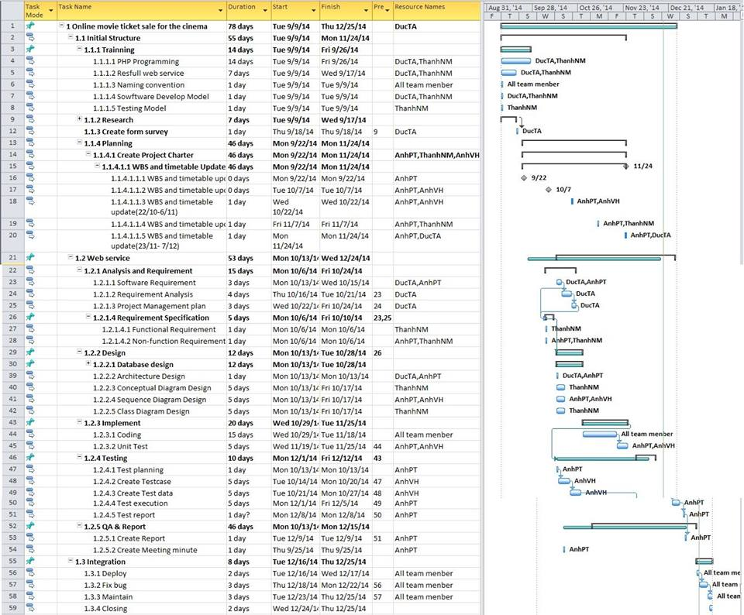
2. Project Management
Detail Plan :
15

Slide 16
2. Project Management
Risk & Issue :
ID | Description | Prevent & Solution
1 | Team members have some problems, they cannot complete tasks before deadline | -Increasing project team’s working effort in “peace period”.
2 | Conflicts between team members. | - Setup an open-talk environment in project team. - “Do not criticize” is set as a rule.
3 | Team members are lack of coding skill, technical knowledge and soft skill | -Provide a short training course before applying new technique.
4 | Underestimate project scope, tasks’ difficulty level and risks’ effectiveness. | - Estimate project scope with instructor and experience persons.
5 | Lost data of project | - Save Data of Project in SVN and Drop box.
16

Slide 17
3.Software Requirement Specification
14

Slide 18
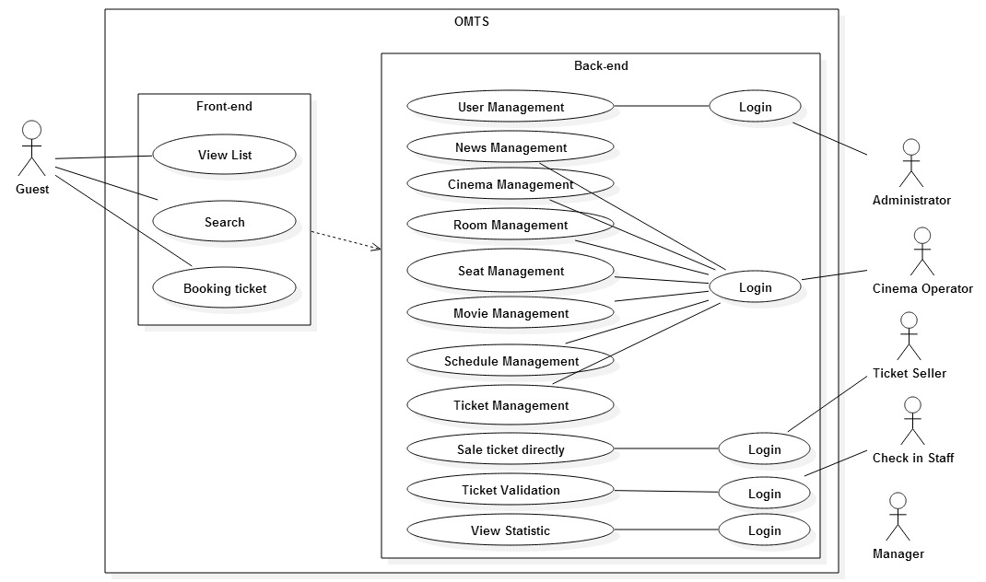
3. Software Requirement Specification
SYSTEM OVERVIEW:
15

Slide 19
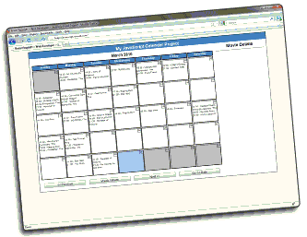
3. Software Requirement Specification
Function requirements:
Booking Tickets On Web
Booking
Select Film
Confirm
Select Schedule
Payment
16

Slide 20
3. Software Requirement Specification
Function requirements:
User | Function | Description
 | Login | This function uses for authentication and authorization
Guest | View | Customer can view the information, the schedule of all movies
 | Search | This function allows customer to search for booking a ticket of movie
 | Book | Customer can purchase the movie ticket by credit card
Administrator | User management | Administrator can create user and set permissions.
Ticket Seller | Sale ticket directly | Check the movie schedule, seat layout to sell movie ticket directly for customers who buy at ticket office
Check-in Staff | Ticket validation | This function allows Checking Staff to validate the customer who booked ticket online
20

Slide 21
3. Software Requirement Specification
Function requirements:
User | Function | Description
Cinema Operator | News management | Post, edit, delete the news
 | Cinema management | Add, edit, delete the cinemas
 | Room management | Manage the rooms of cinema
 | Seat management | Manage the seat layout of a room
 | Movie management | Add, edit, delete the movies
 | Schedule management | Set the movie schedule
 | Ticket management | Set the ticket price for the movie schedule
Manager | View statistic | Manager can view all statistic of transaction to make report
21

Slide 22
3. Software Requirement Specification
NON-Function requirements:
Non – Functional | Description
Reliability | Data backed up daily
Performance | Response times, processing times will be 3 to 5 seconds
Maintainability | Coding Convention.
Portability | GUI is clear, friendly
Availability | Approximately 99%.
18

Slide 23
4.Sofware Design Description

Slide 24
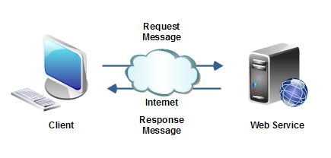
4. Software Design Description
Overall System Architecture
24

Slide 25
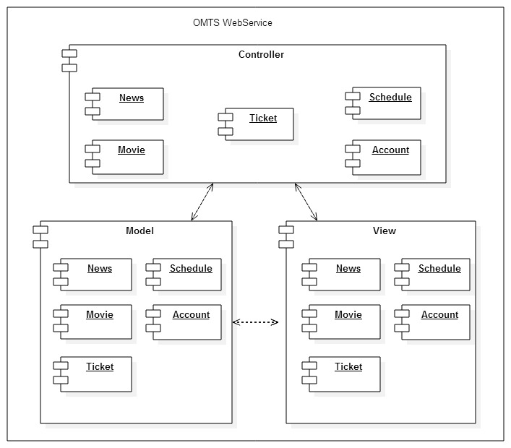
4. Software Design Description
Architectural OVERVIEW
25

Slide 26
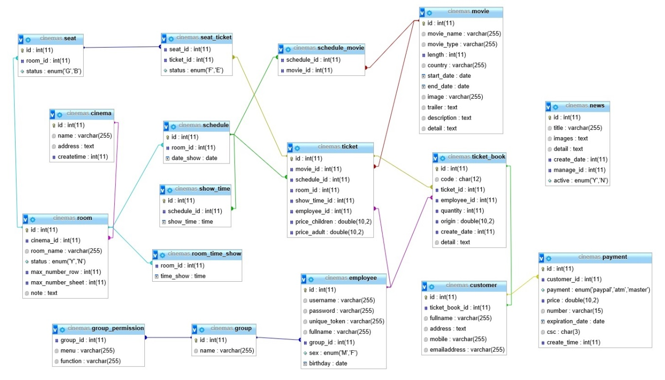
4. Software Design Description
Database design
26

Slide 27
5.Testing
27

Slide 28
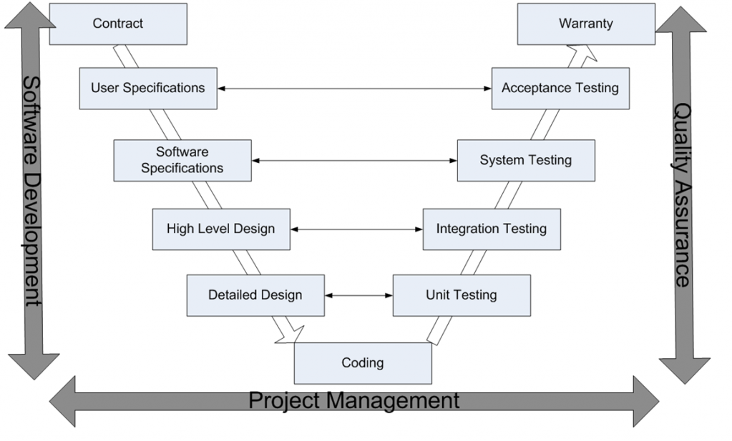
5.Testing
Test Model
28

Slide 29
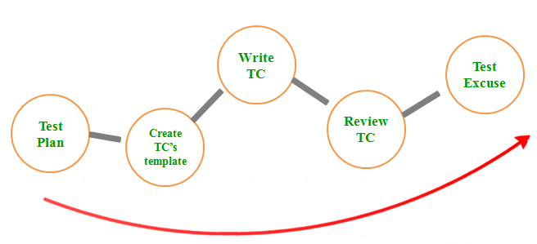
Testing Process
5.Testing
29

Slide 30
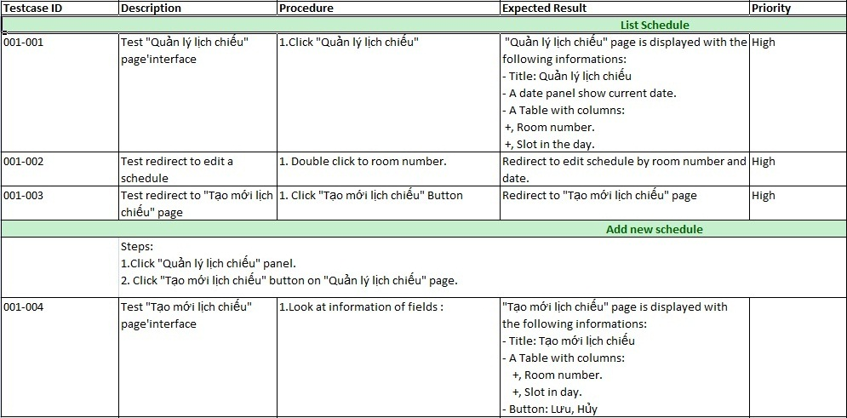
Test case example
5.Testing
30

Slide 31
6.Project Result
31

Slide 32
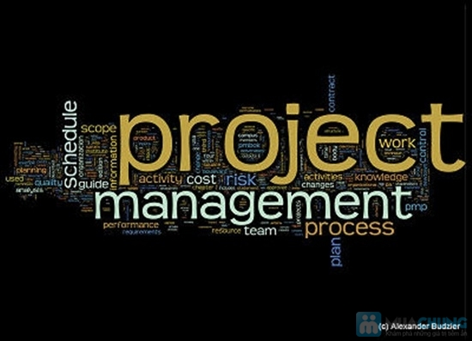
6.Project Result
Project Management Skill
Working in group
Presentation Skill
Technique Skills
32

Slide 33
6.Project Result
Advantage of OMTS system
User can find films schedule easily with a friendly interface, accurately and quickly.
Admin and staffs can manage information about films easily.
33

Slide 34
6.Project Result
Current limitations and
expectation in future
Functions are still lacking and don’t put up OMTS: function Payment and all non-functions.
34

Slide 35
7.Lession Learnt
35

Slide 36
7.Lession Learnt
With member who lacks of coding skills or technical, we provide a short training course.
Store project data in server by tools.
Estimate project scope with instructor and experience persons. Assign task accordance with capabilities of each member.
Allow all team members to understand clearly about what other do, so that they can cover the task when necessary.
Setup an open-talk environment in project team.
36

Slide 37
8.Demo
37

Slide 38
9.Q&A
38

Slide 39
39

