Slide 1
Online Solution for Small Shop
Supervisor: Phan Truong Lam
TEAM MEMBERS:
Le Huy
Bui Duc Manh
Le Thanh Hai
Pham Van Nguyen
Nguyen Dinh Dong

Slide 2
Agenda
Introduction
Project management plan
Software Requirement Specifications
Software Architecture Design
Testing
Summary
Demo
Q&A

Slide 3
Introduction
Project information:
Project name: Online Solution for Small Shop
Project code: O3S
Project type: Website

Slide 4
Roles & Responsibilities
Supervisor: Phan Truong Lam
Project Manager: HuyL
Developer & Designer team:
HuyL
NguyenPV
ManhBD
HaiLT
Test team: NguyenPV, HuyL, ManhBD
Document & QA: DongND, HaiLT

Slide 5
Project management plan
Using Waterfall Model

Slide 6
Task Sheet
Notes:
Trên slide là bản kế hoạch làm việc chi tiết của nhóm, được mô tả kỹ trong WBS.

Slide 7
Metrics | Committed | Actual
Start Date | 8-Sep-2014 | 8-Sep-2014
End Date | 9-Dec-2014 | 9-Dec-2014
Duration | 93 | 93
Team member | 5 | 5
Notes:
Mục tiêu của nhóm là hoàn thành đồ án trong vòng 93 ngày, bắt đầu từ 8/9/2014 tới 19/12/2014 bao gồm cả việc kiểm thử.

Slide 8
RISK
Miscommunication
Time shortage
Design Errors
Requirement changed
Scope changed

Slide 9
Tools and Techniques
Programming languages: C#, HTML, CSS, JavaScript.
Software Architecture: MVC.
Process Model: Waterfall process model.
IDEs: Visual Studio 2013.
DBMS: Microsoft access 2010.
UML Tools: Astah Professional.
Web Server: IIS 8.0.

Slide 10
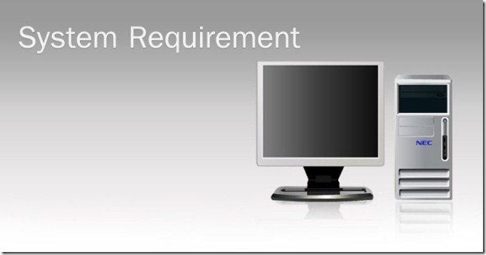
Functional Requirements Non-Functional Requirements Entity-Relationship Diagram

Slide 11
Functional Requirement
Notes:
Use case diagram

Slide 12
Use case diagram for customer

Slide 13
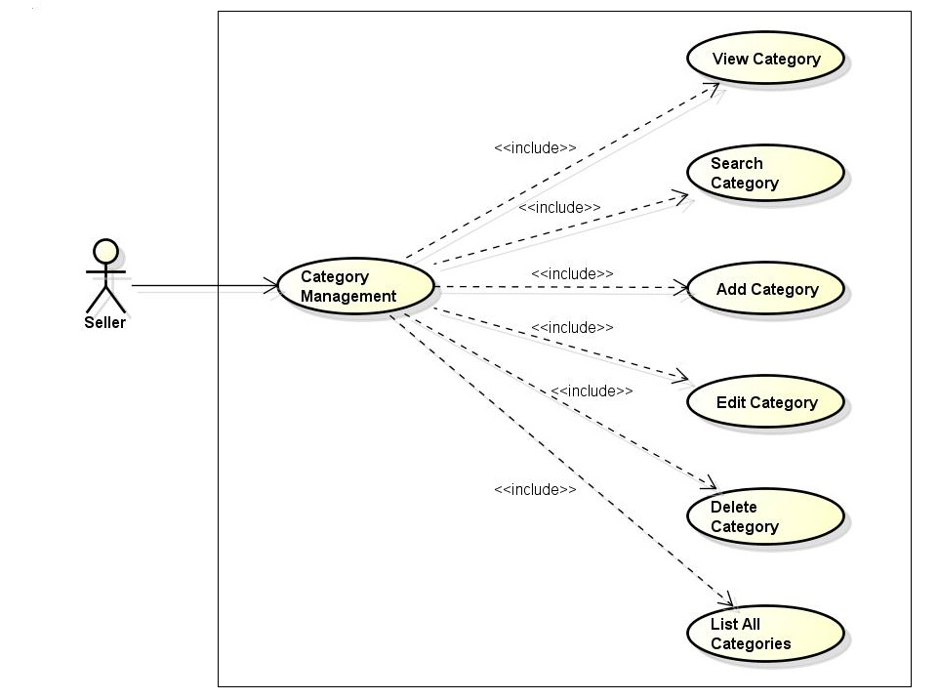
Use case diagram for Category management

Slide 14
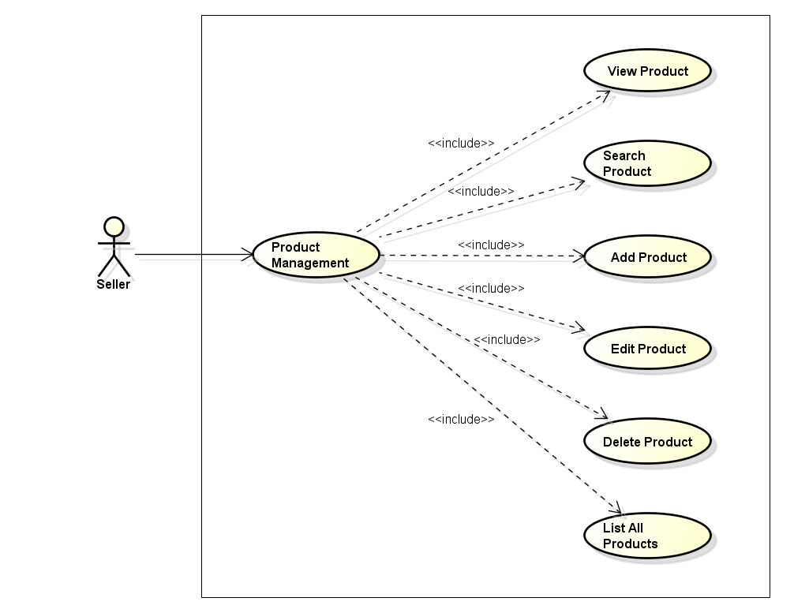
Use case diagram for Product management

Slide 15
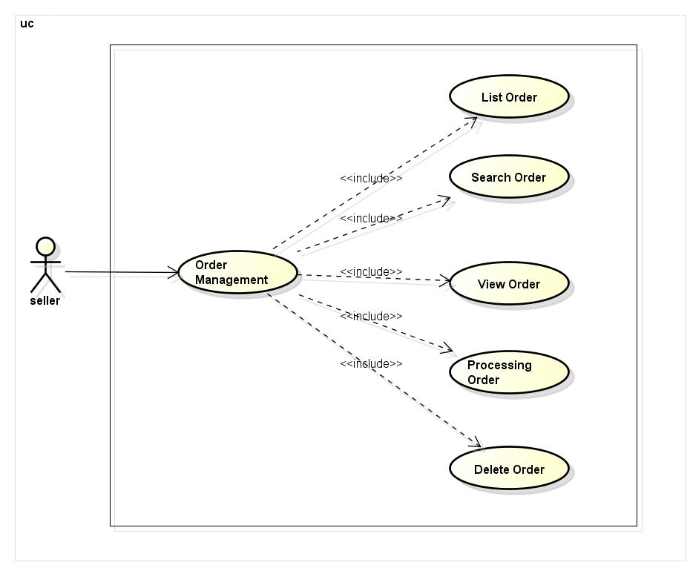
Use case diagram for Order management

Slide 16
Non-Functional Requirement
Reliability
Restrict error in system.
Security
The system should provide methods to prevent common.
Using SSL, MD5 to encrypt transferred sensitive information.
Maintainability
System will be designed high cohesive and loosely coupling to easy change and not affected to other components
Portability
Support multiple screen resolutions (1024x768, 1366x788)

Slide 17
Entity-Relationship Diagram

Slide 18
System Overview

Slide 19
System Architectural Design

Slide 20
Component Diagram

Slide 21
Class Diagram

Slide 22
Sequence Diagram

Slide 23
Database Design

Slide 24
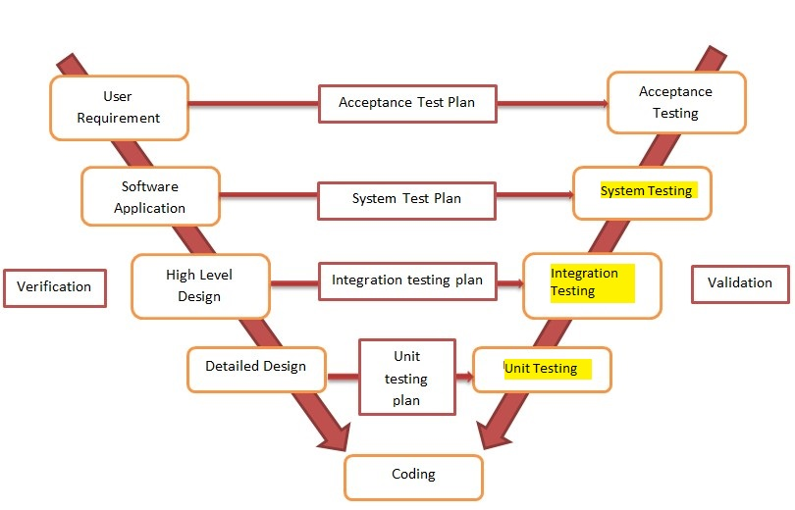
Testing Strategy

Slide 25
Testing Process

Slide 26
Test Stages
Type of test | Stage of test
 | Unit test | Integration test | System test
Function test | X | X | X
Security test |  |  | X

Slide 27
TEST CASE

Slide 28
TEST RESULT
No | Module code | Pass | Fail | Untested | N/A | Number of test cases
1 | Seller Function | 52 | 10 | 0 | 0 | 62
2 | Customer Function | 6 | 2 | 0 | 0 | 8
3 | Security Test | 3 | 0 | 0 | 0 | 3
Total |  |  |  | 0 | 0 | 73

Slide 29
DEMO

Slide 30
Q&A

Slide 31
THANK FOR LISTENING

