Slide 1
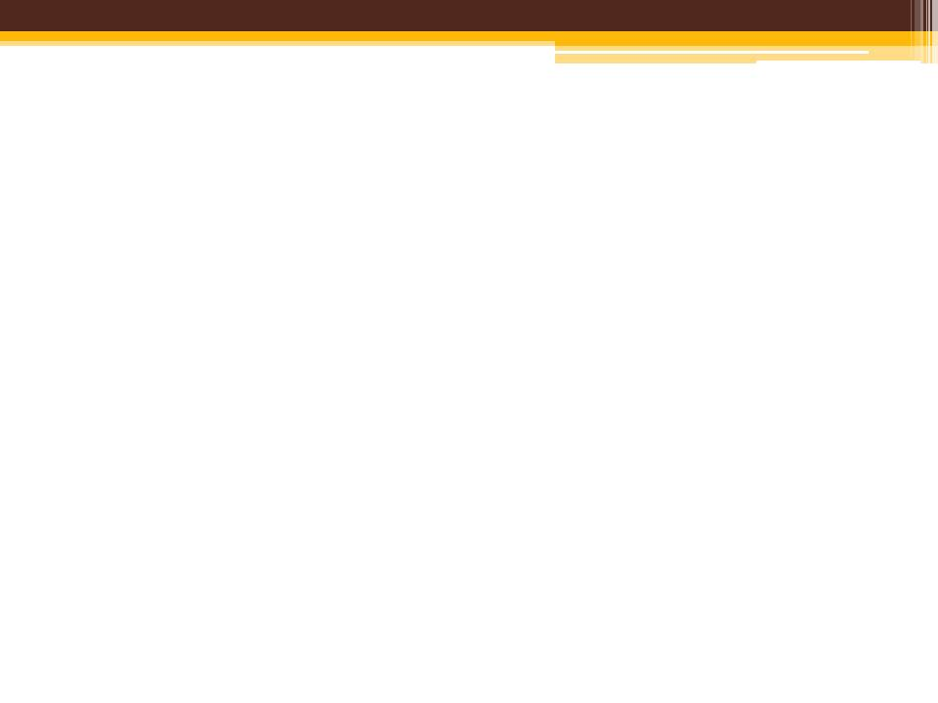




CAPSTONE PROJECT
Transport Information System
Perform by
LIQUID TEAM
Supvisor: Luong Trung Kien

Slide 2


CONTENTS
INTRODUCTION
PROJECT MANAGEMENT PLAN
REQUIREMENT SPECIFICATION
SOFTWARE DESIGN FUNCTION
IMPLEMENTATION
TESTING & EVALUATION
MAINTAIN & FUTURE DEVELOPMENT
DEMO & Q/A

Slide 3


I. INTRODUCTION
Team members
Problem
Exist system
Our purpose

Slide 4

1. Team members
Code: SE02254
Hobbies:
guitar instrument
travelling
movies
music
Code: SE02914
Hobbies:
play game
travel
reading book
Liquid Team
Code: SE02374
Hobbies:
reading books
watching movies
listening to music
travelling
photography
Phạm Vũ Hoàng Giang
Phạm Hữu Cường
Code: SE02183
Hobbies:
play game online
watch movie
Code: SE02239
Hobbies:
reading books
listening to music
travelling
photography
Trần Xuân Bình
Phạm Hoàng Chung
Đinh Ngọc Trung

Slide 5

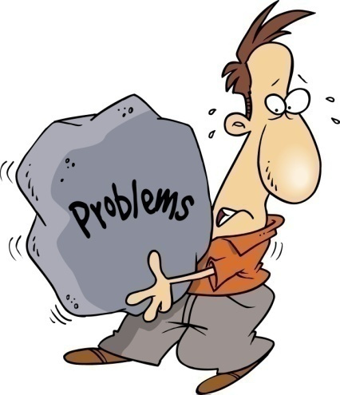
2. Problem
Throughout human history, traveling to different places is always people’s needs
Searching coach transport is a demand of all people
People have difficult to find the right coach transport that they need
Difficult to manager transport vehicle

Slide 6
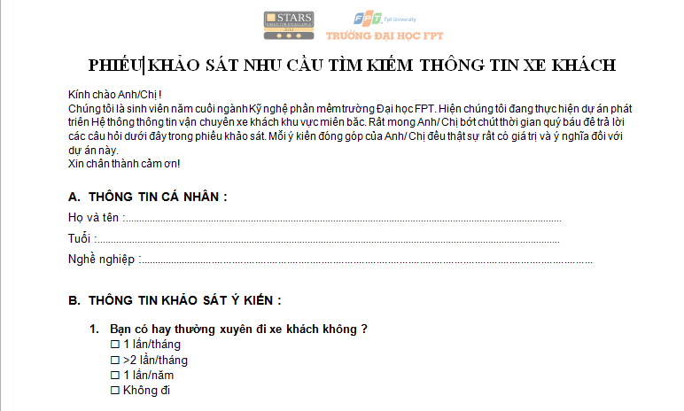
2. Problem
Survey

Slide 7
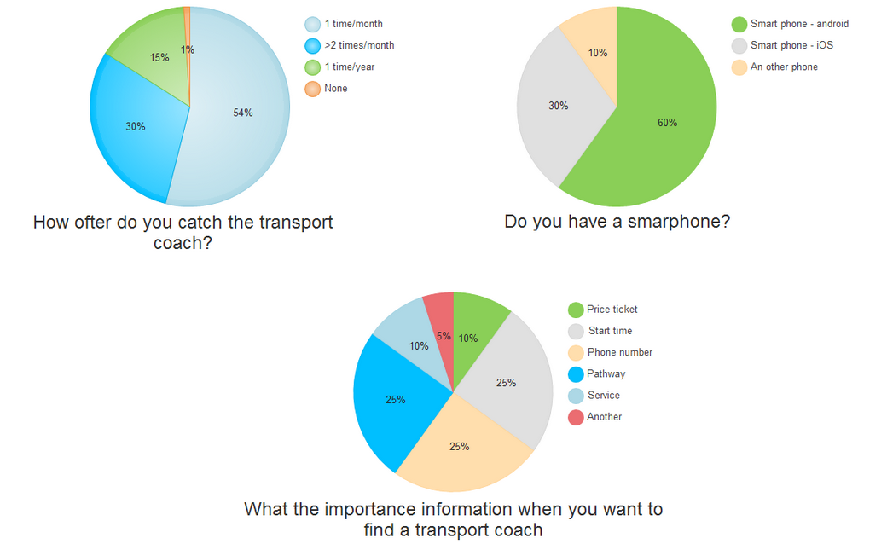
2. Problem
Pie chart

Slide 8
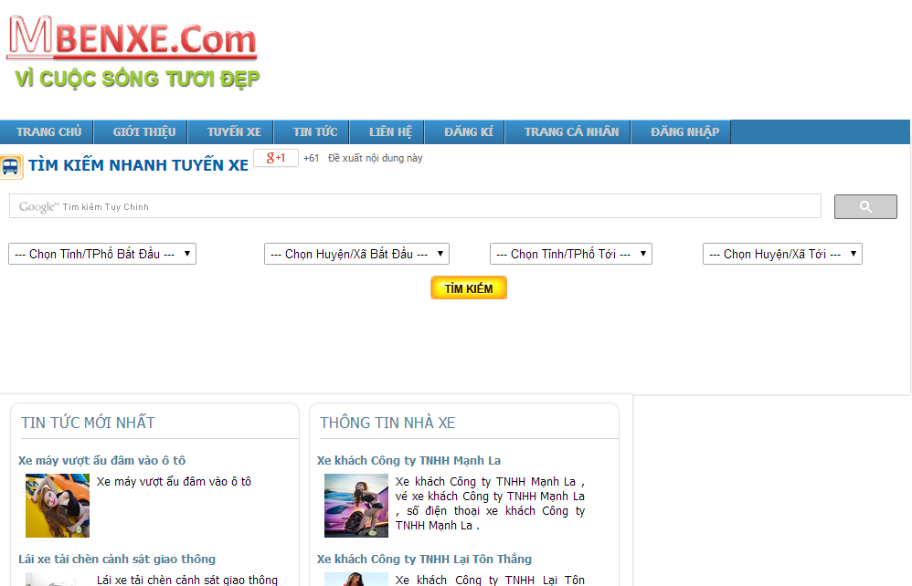

3. Exist system
Only support three bus stations in Ha Noi
The number of bus routes less
Hard to using on mobile

Slide 9

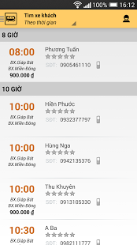
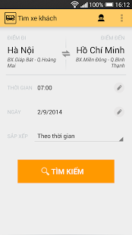
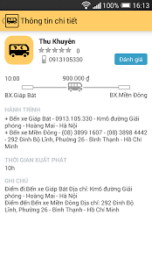
3. Exist system
The number of transport coach is very limited
The search speed is slow
No support for positioning

Slide 10


4. Our purpose
Running on Android operating system
Have both website and application for passenger and transport manager
Searching via GPS and maps, searching with many options
Easy to user
Favorite transport vehicle

Slide 11

II. PROJECT MANAGEMENT PLAN
Software project model
Project schedule
Task management
Project Organization
Equipment and Tool

Slide 12
II. PROJECT MANAGEMENT PLAN
Communication Management
Task management
Risk Management
Quality Management
Communication Management
Meeting minutes

Slide 13
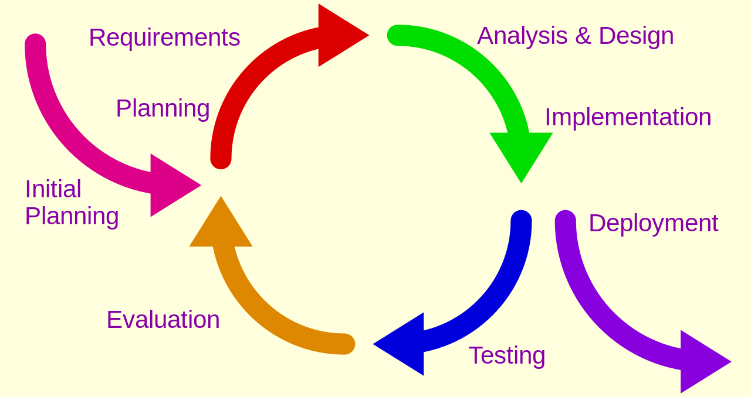
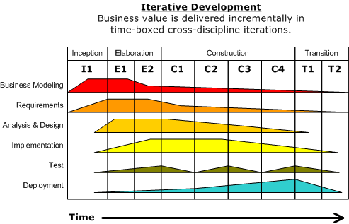
1. Software project model
Iterative development model

Slide 14
2. Project schedule
No | Stage | Delivery Date
1 | Report No.1 | 15-Sep-14 | Introduction
2 | Report No.2 | 22-Sep-14 | Project plan, SRS, Meeting minute form,
3 | Report No.3 | 06-Oct-14 | Use case diagram, use specification, entity relationship diagram.
4 | Report No.4 | 20-Oct-14 | System architectural design, package/component diagram, class diagram, sequence diagram, database design.
5 | Report No.5 | 17-Nov-14 | Test report
6 | Report No.6 | 08-Dec-14 | User manual, Software package, Installation guide
7 | Final report | 19-Dec-14 | Final report

Slide 15
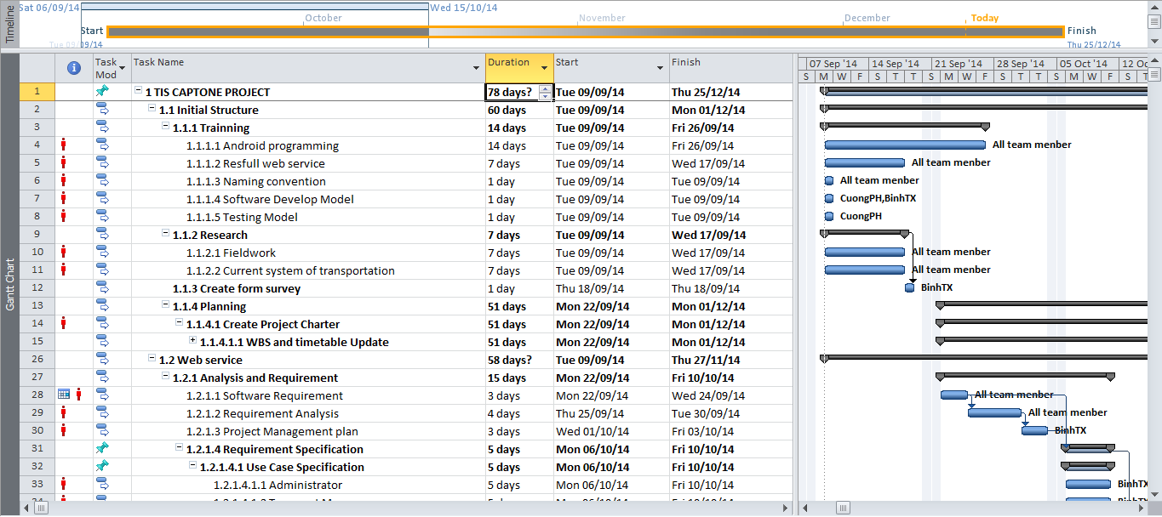

3. Task manager

Slide 16
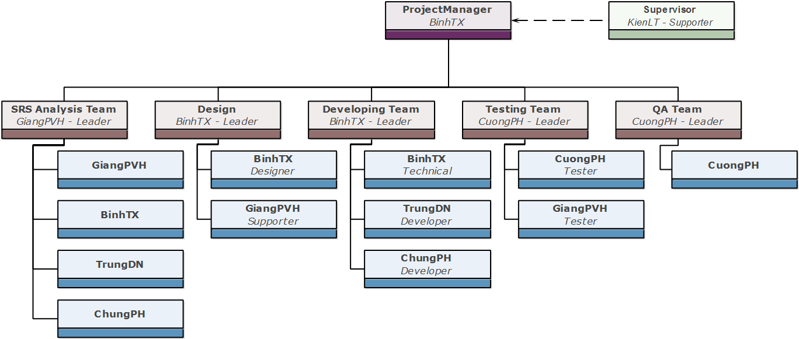
4. Project Organization
Project Organization

Slide 17







5. Equipment & tools
Development tools
Development tools

Slide 18







5. Equipment & tools
Document Tools
Communication Tools
Resource Control Tools

Slide 19


6. Communication management
Project Team Member:
Working together from Monday to Friday every week (From 12.30 p.m. to 5h30 p.m.):
Work 5 days/week and 6 hours/day.
Locations: FPT University, home.
Meetings: daily meetings.
Team members and Supervisor:
Work 1day/week and 90 minutes.
Locations: FPT University

Slide 20
7. Risk management
ID | Description | First Indicator | Prevention Approach | Mitigation Approach | Owner
 | Inadequate planning: Planning document is not practical, far from the real. | Variance between planning and the real is large | - Make the plan as detailed as possible, use milestone, who do the work make the estimate. - Frequently update project plan | When the deadline is delayed, solutions may be overtime or choose using external API instead | ChungPH
 | The team members live far from school | Teamwork’s efficient decrease, Hard to coordinate team members | - Use properly reward and penalty - Respect other team member | If you busy, you have to report it immediately to arrange the time and work | ChungPH
Risk sample

Slide 21
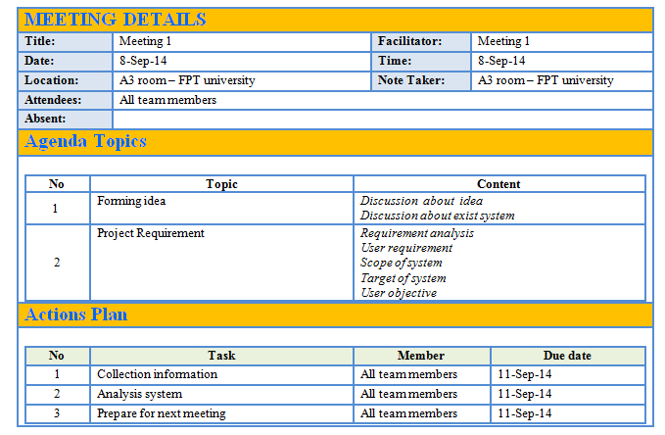
8. Quality management
Sample meeting minute

Slide 22

III. REQUIREMENT SPECIFICATION
User types
Functional Requirement
Use Case Specification
Non-functional Requirement

Slide 23



1. User types
Administrator
Transport manager
Passenger

Slide 24
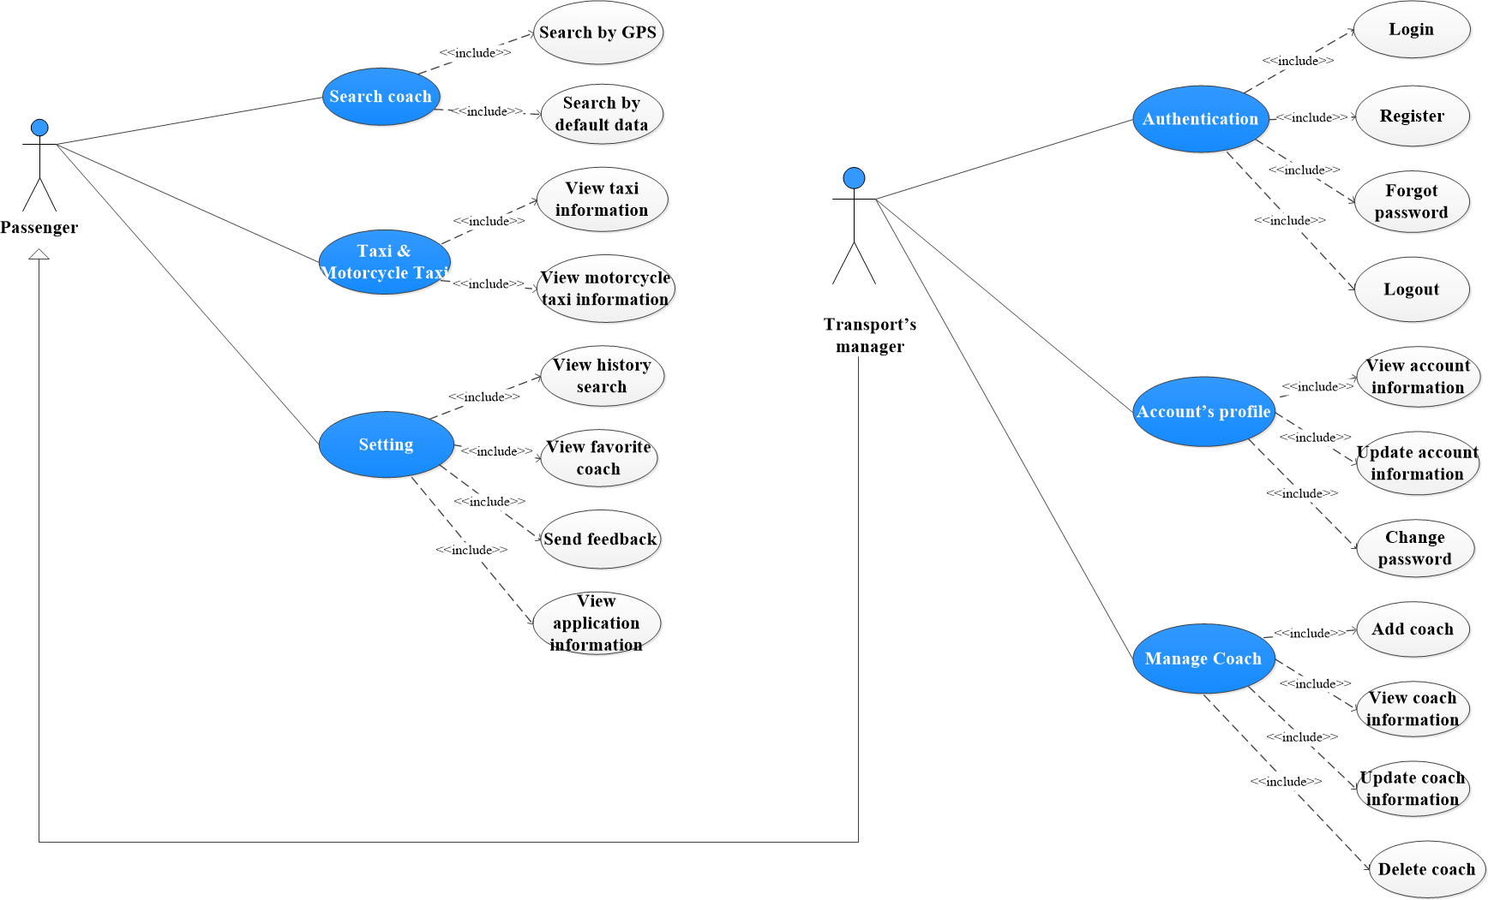
2. Functional requirement
Passenger & Transport manager

Slide 25
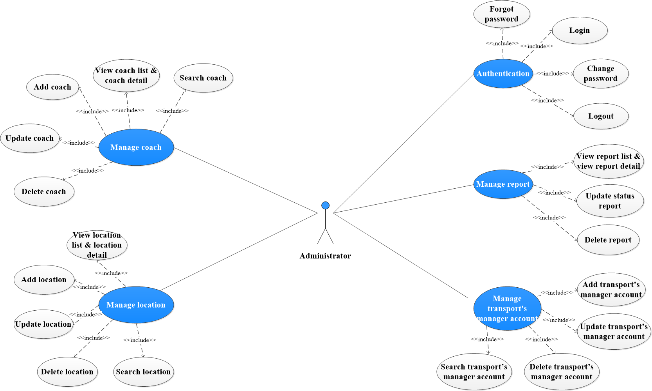
2. Functional requirement
Administrator

Slide 26
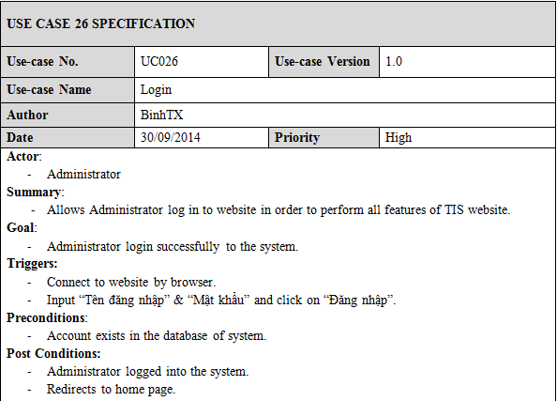
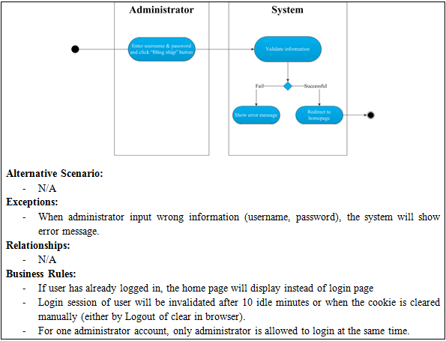
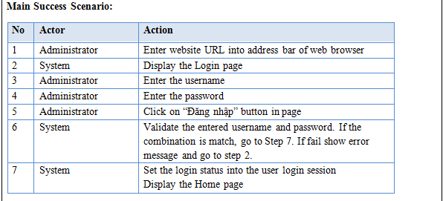
3. User case specification
Use case example

Slide 27
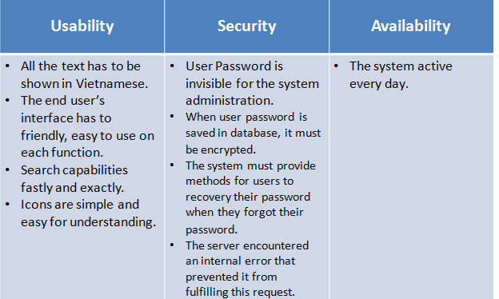
4. Non-functional Requirement

Slide 28
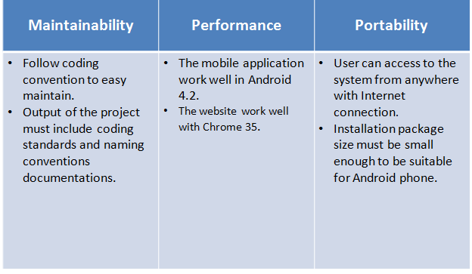
4. Non-functional Requirement

Slide 29

IV. SOFTWARE DESIGN
Architecture Design
Class Diagram
RESTful Web service
Database Design
Google MAP API Web service
Screen Design
Model – Controller – View
Package Diagram
Sequence Diagram

Slide 30
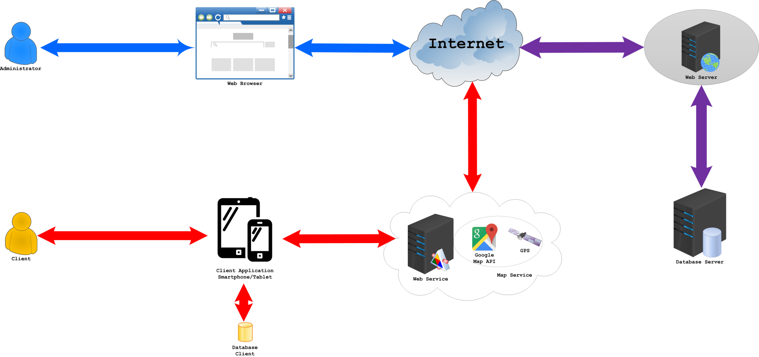
1. Architecture Design
System architectural design

Slide 31
1. Architecture Design
1a. RESTful Web service
1b. Google MAP API Webservice

Slide 32

1. Architecture Design
1c. Model – Controller – View
Why do we choose MVC model?
- Reduce code complexity.
- Code reuse: well factored code lends itself to reuse.
- Decoupled code: fewer dependencies.
Increased flexibility.
Controller: logic or glue
View: presentation and interaction
Model: data representation

Slide 33
2. Package Diagram
Example: Web Administrator package diagram

Slide 34
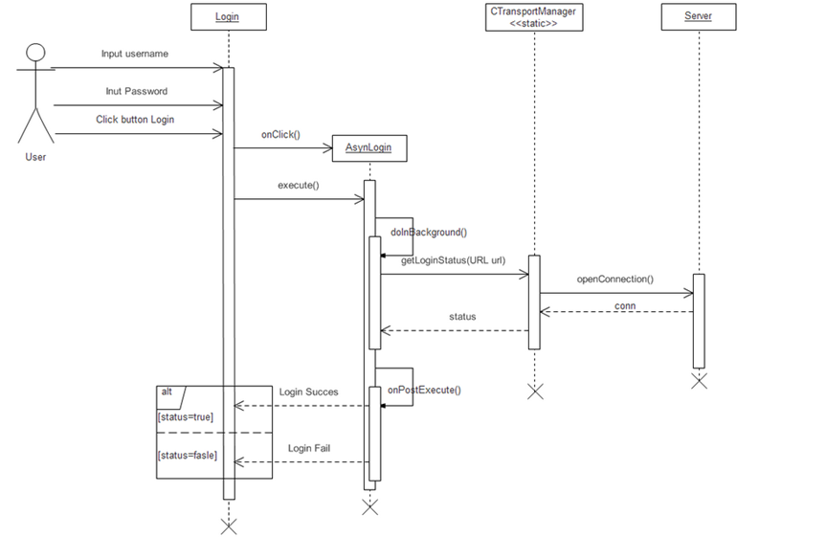
3. Sequence diagram
Example: Login sequence

Slide 35
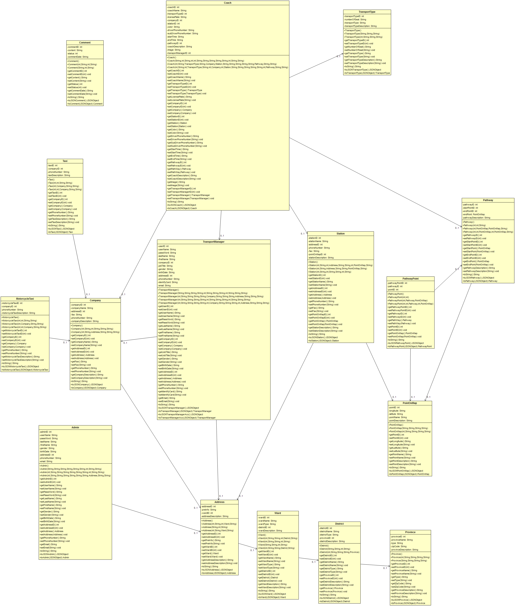
4. Class diagram

Slide 36
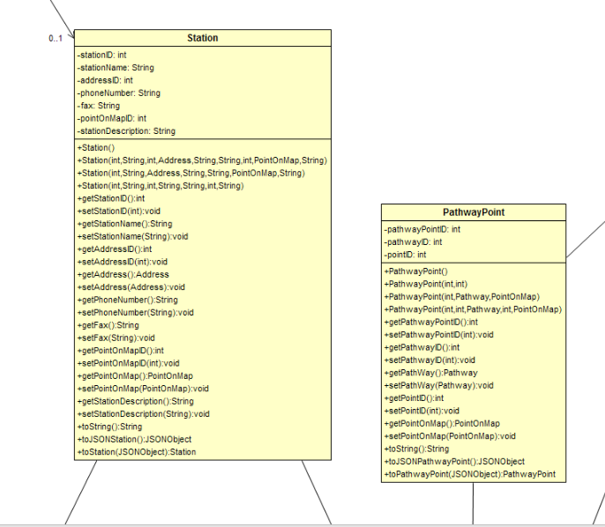
4. Class diagram

Slide 37
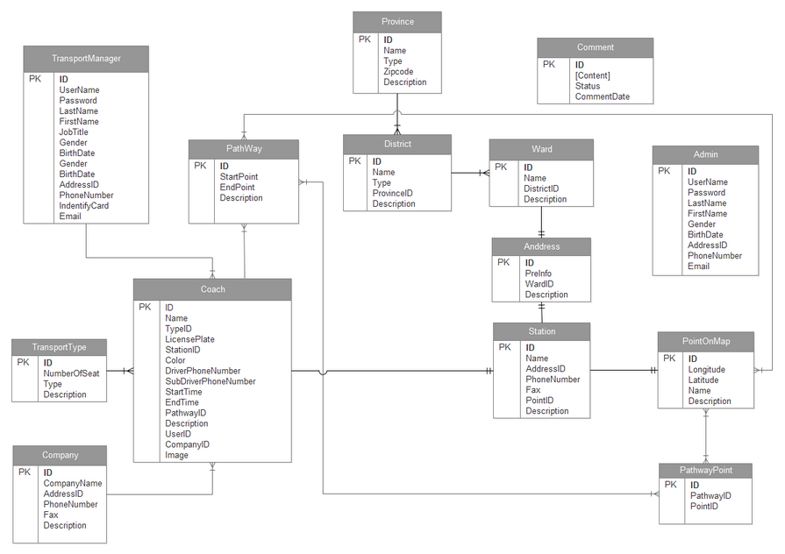
5. Database design

Slide 38
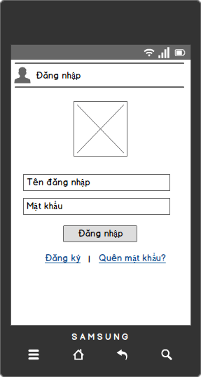
6. Screen design
Example: App login design

Slide 39
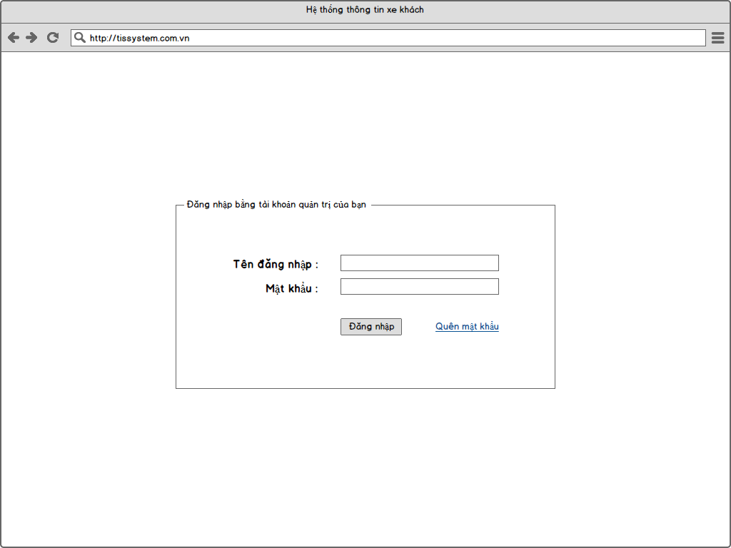
6. Screen design
Example: Web login design

Slide 40



V. Implementation

Slide 41

V. Implementation
Table diagram
PointOnMap
 | Field name | Type | Max Length | Description
1 | ID | int |  | ID of Point
2 | Longitude | nvarchar | 15 | Longitude value
3 | Latitude | nvarchar | 15 | Latitude value
4 | Name | nvarchar | 100 | Name of point
5 | Description | nvarchar | max | More details

Slide 42
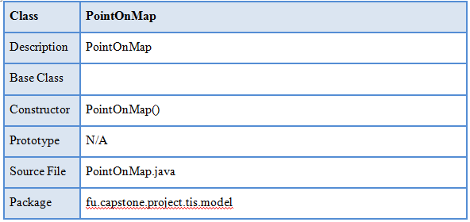
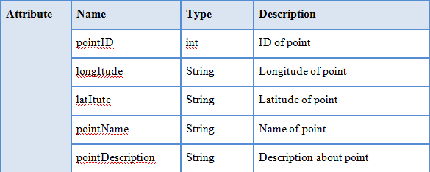
V. Implementation
Class detail

Slide 43
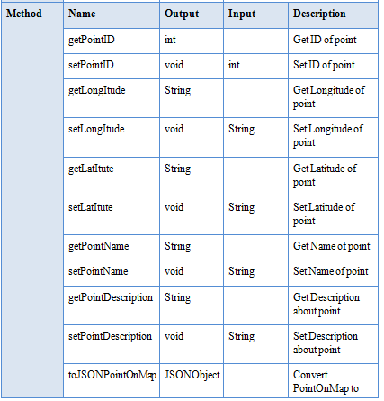

Slide 44
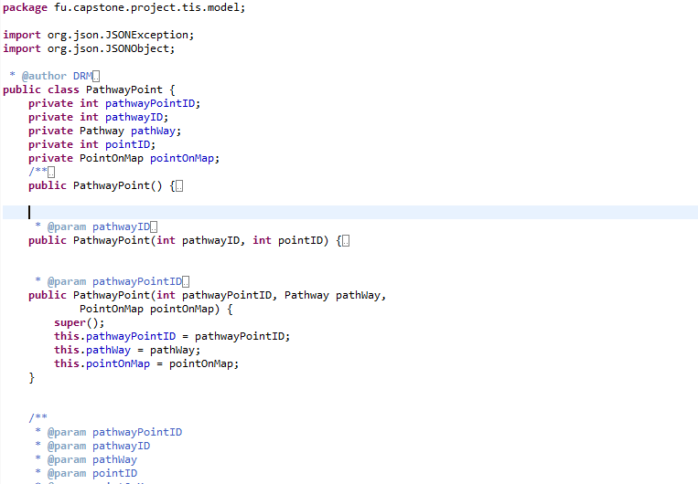
V. Implementation
Class code

Slide 45
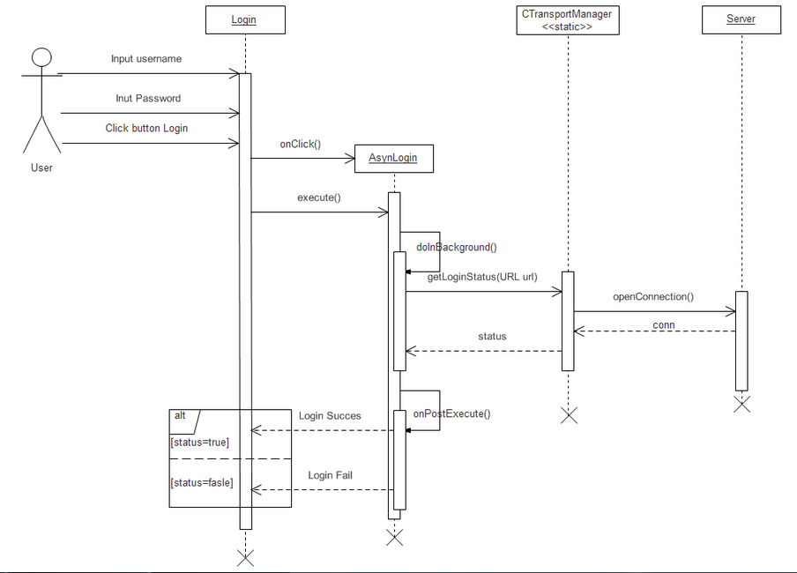
V. Implementation
Sequence diagram

Slide 46
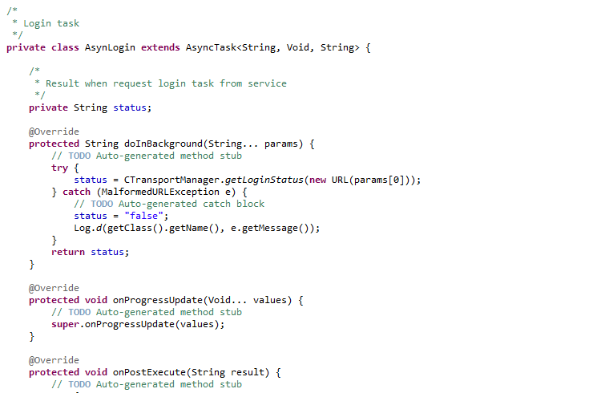

V. Implementation
Code with sequence

Slide 47
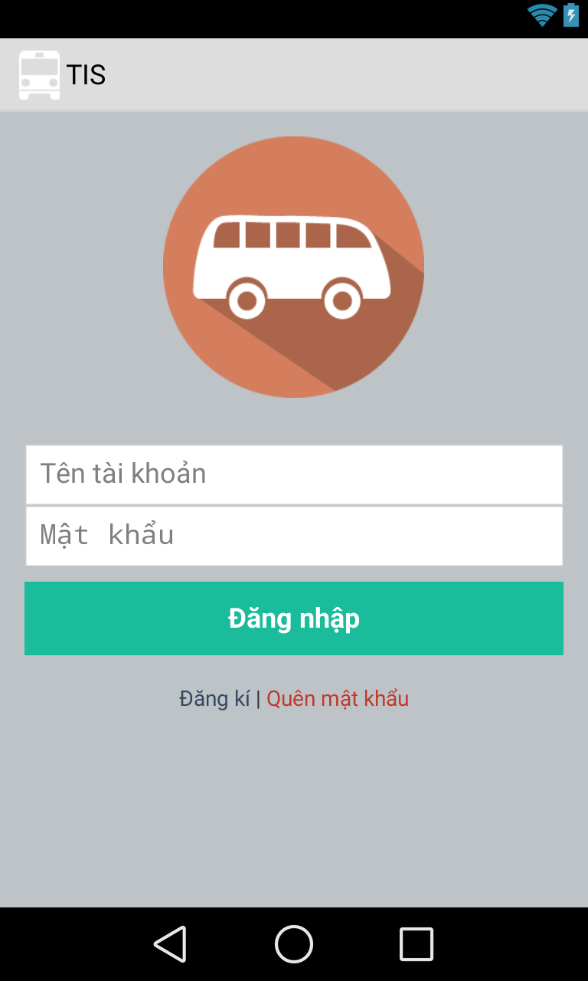
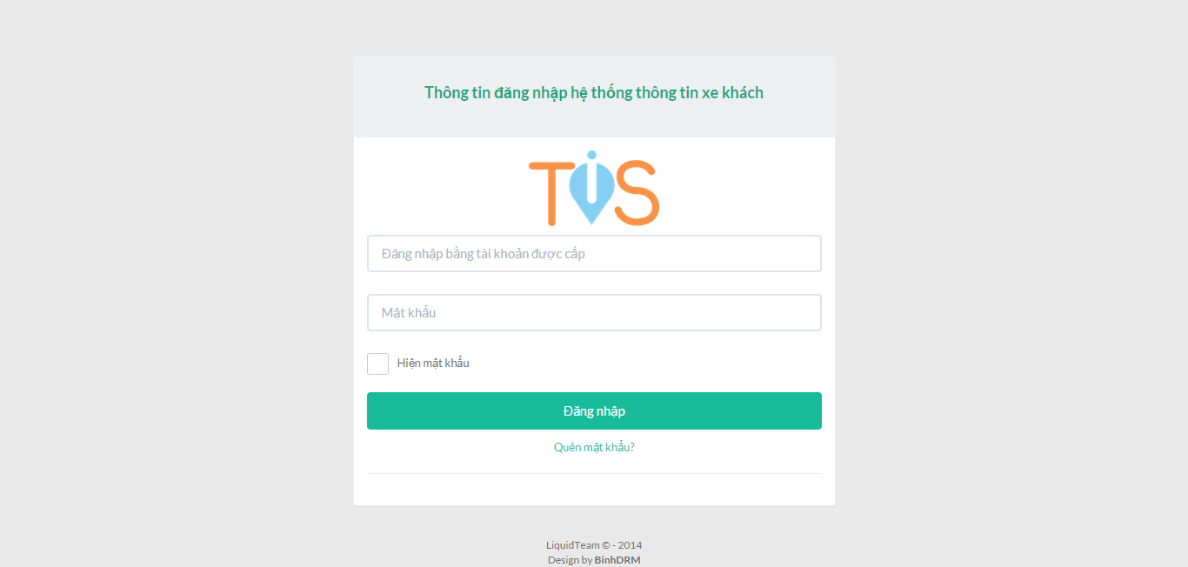
V. Implementation
Example: Screen login TIS mobile application

Slide 48
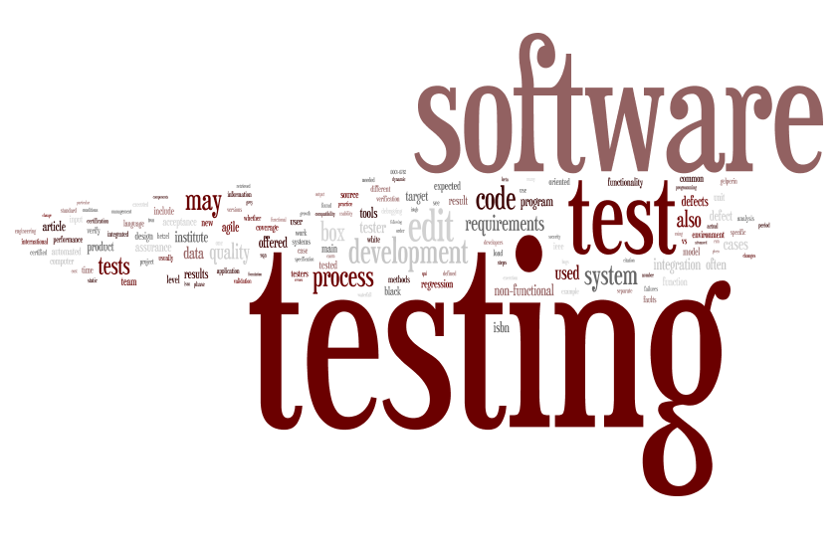

VI. Testing & evaluation
Test model
Test strategy
Test environment & tools
Test process
Test execution

Slide 49
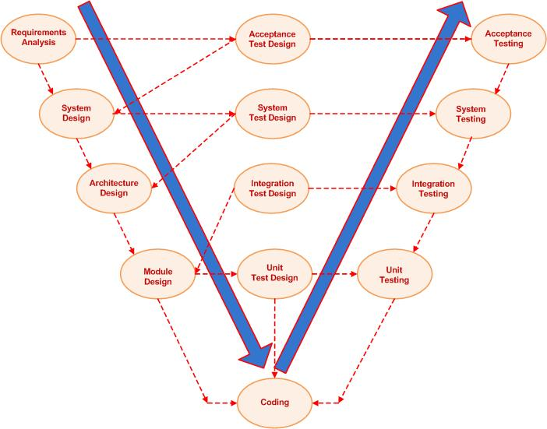
1. Test model

Slide 50
2. Test strategy
Formal test cycle to test TIS(transport information system) project
Formal testing
Test type | Duration
Building acceptance test | 1 day
System and integration testing cycle 1 | 5 days
Regression testing | 2 days
System and integration testing cyclce 2 | 5 days
Performance and acceptance testing | 2 days
Regression test and release testing | 2 days

Slide 51



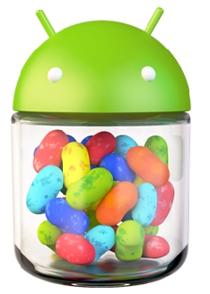



3. Test environment & tools
environment
tool

Slide 52
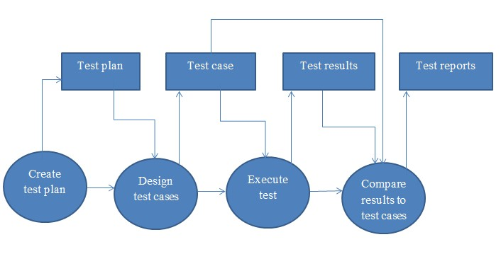
4. Test process

Slide 53
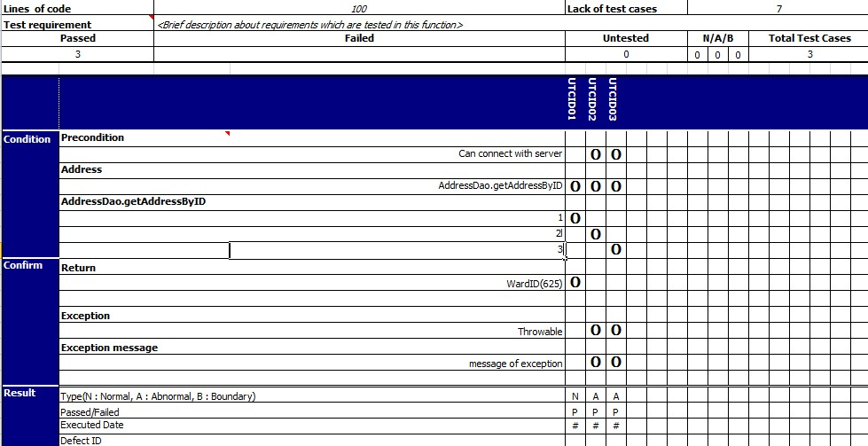
5. Test execution
Sample of Unit Test case

Slide 54
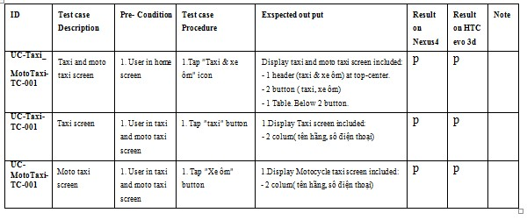
5. Test execution
Sample of testcase

Slide 55
5. Test execution
Sample of testcase

Slide 56
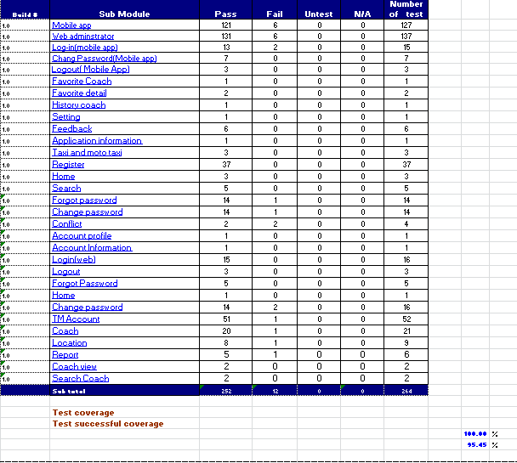
5. Test execution
Test report

Slide 57



VI. MAINTAIN & FUTURE DEVELOPMENT
Maintain
Future development

Slide 58

1. Maintain
 When application has errors, user can use feedback function on application to inform us or send email to liquidteam2607@gmail.com
➢ Review code: coding convention, comment
➢ Re-factor code to increase performance
➢ Debug and fix errors

Slide 59
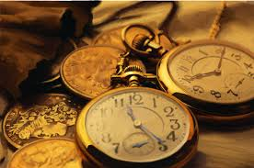


2. Future development
The present, Team collected data coach on the station in Hanoi. Next time, we will collect data coaches of all provinces
Improve the function of convenience, flexibility and easier for users on android application
Develop app on iOS and Winphone
Improve interface of app, friendly and easy to use

Slide 60
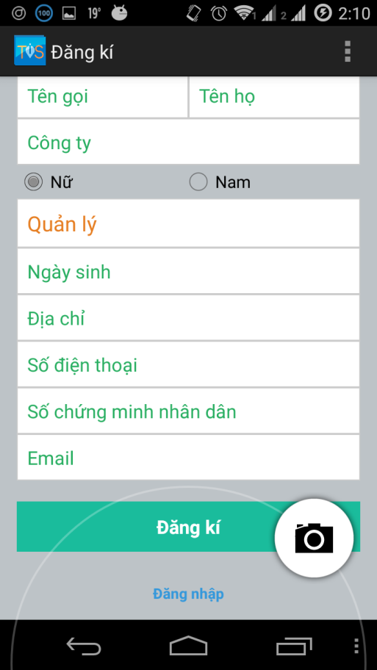
V. Demo & Q/A

Slide 61


THANKS & BEST WISHES
HN, 2014 - LIQUID TEAM

