Slide 1
PowerPoint Template
Capstone Project
Shot and Sell
S&S
www.themegallery.com

Slide 2
Shot and Sell Team
Mr. Trần Đình Trí
Supervisor
Phạm Duy Hưng
Phan Nho Vương
Bùi Trần Thanh Huyền
Hoàng Văn Quang
Nguyễn Tam Vũ

Slide 3
Contents
1
Introduction
2
Project Management Plan
3
System Requirements Specifications
4
System Design Description
5
System Implementation & Test
6
Demo & QA

Slide 4
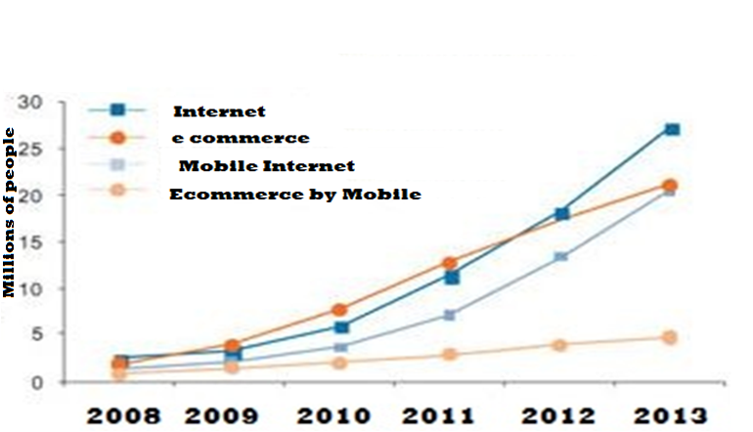
1
Introduction
1.1 Internet and e-commerce in Viet Nam
Internet and e-commerce in Viet Nam Chart
http://socongthuonght.gov.vn/tin-tuc/thuong-mai-111ien-tu-buoc-tien-trong-kinh-doanh-hien-111ai

Slide 5
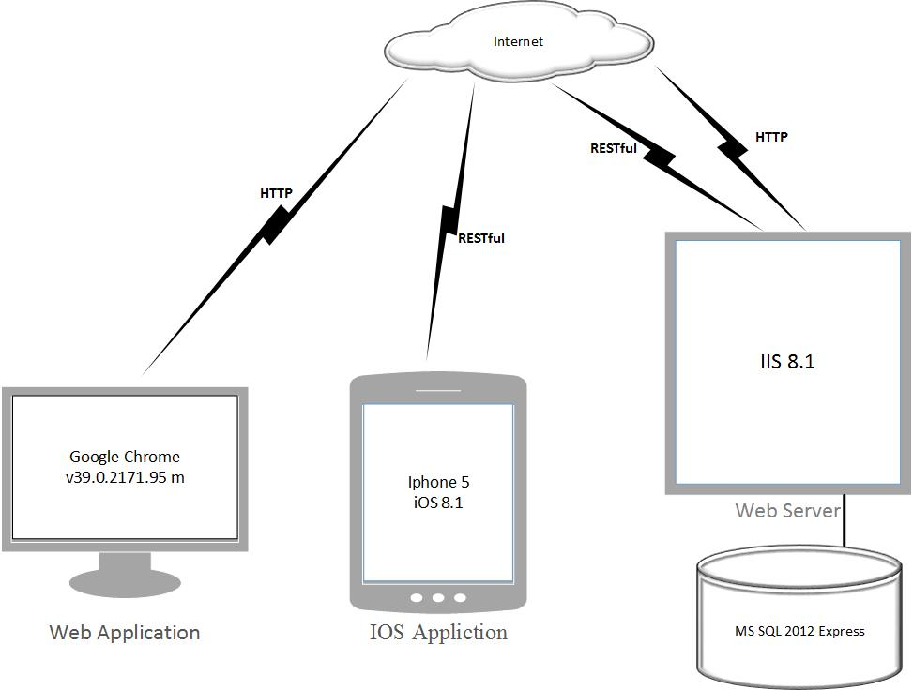
1
Introduction
1.2 Idea and Proposal

Slide 6
1
Introduction
1.3 Reference

Slide 7
1
Introduction
1.4 My product
Page speed
Offer Location on Map
Shot and sell
S&S
Search Easy
Ads Management
Usability

Slide 8
2
Project Management Plan
2.1 Project Organization
Project Organization

Slide 9
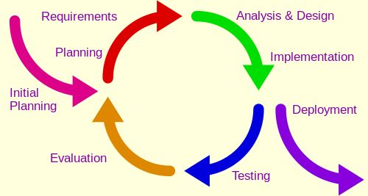
2
Project Management Plan
2.2 Process Model
Iterative Model

Slide 10
2
Project Management Plan
2.2 Process
Process

Slide 11
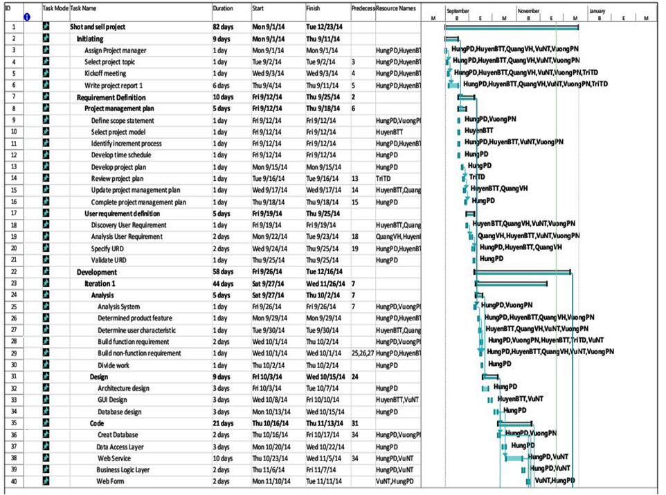
2
Project Management Plan
2.3 Project Plan

Slide 12
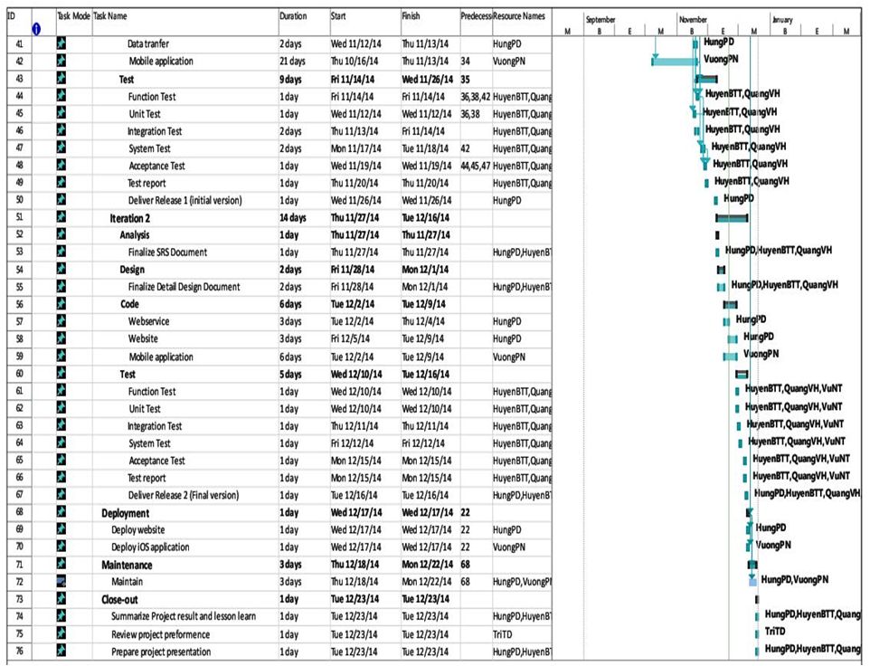
2
Project Management Plan
2.3 Project Plan

Slide 13
2
Project Management Plan
2.4 Communication

Slide 14
2
Project Management Plan
2.5 Tool development
Xcode 6.1

Slide 15
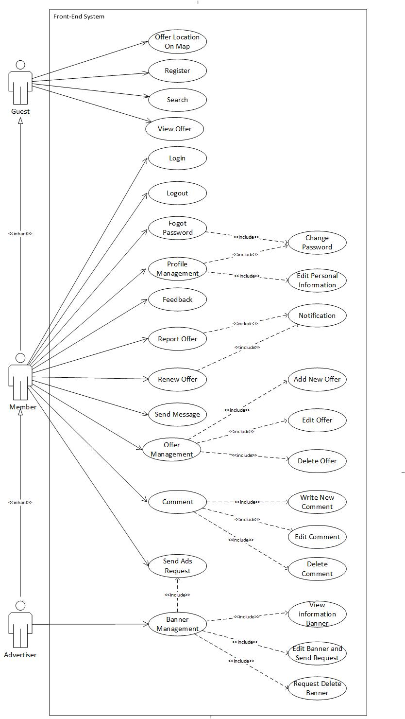
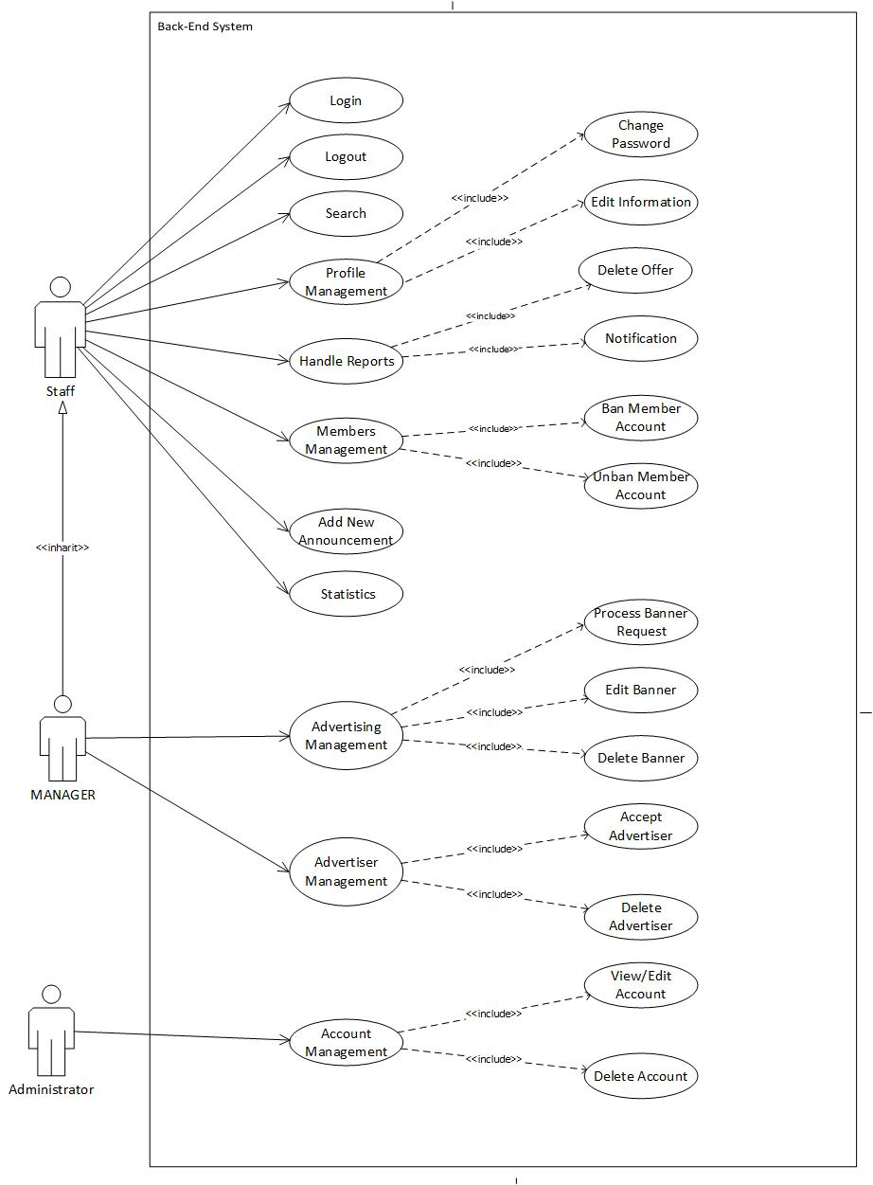
3
System Requirements Specifications
3.1 Use Case

Slide 16
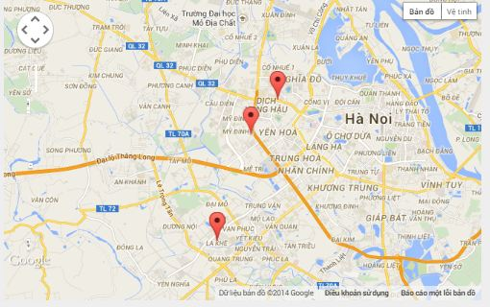
3
System Requirements Specifications
3.2 Function user
Search
Offer location on Map
Guest
View Offer
Register

Slide 17
3
System Requirements Specifications
3.2 Function user
Login
LogOut
Information Personal
Feedback
Add New Offer
Comment
Member
Offer Management
Send Message

Slide 18
3
System Requirements Specifications
3.2 Function user
Member
Advertiser

Slide 19
3
System Requirements Specifications
3.2 Function for manager
Handle Report
Ban/Unban Account
Staff
Statistic
Nontification

Slide 20
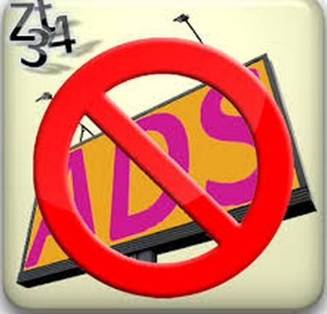
3
System Requirements Specifications
3.3 Function for Manager
Ads management
Advertiser management
Manager
Admin
Account management

Slide 21
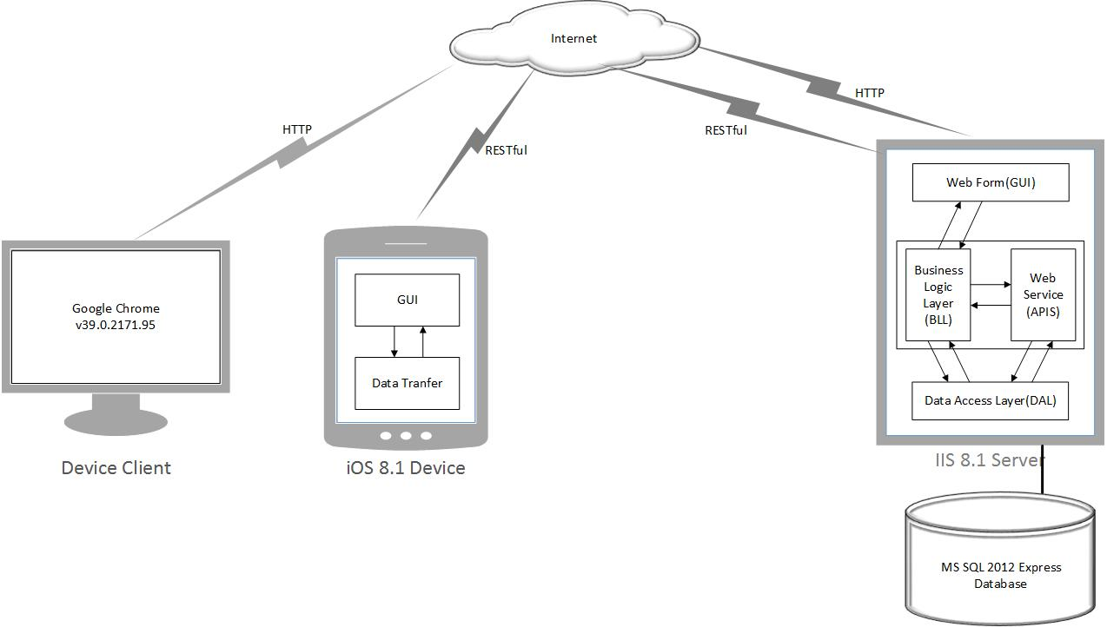
4
System Design Description
4.1 System architectural design
System architectural

Slide 22
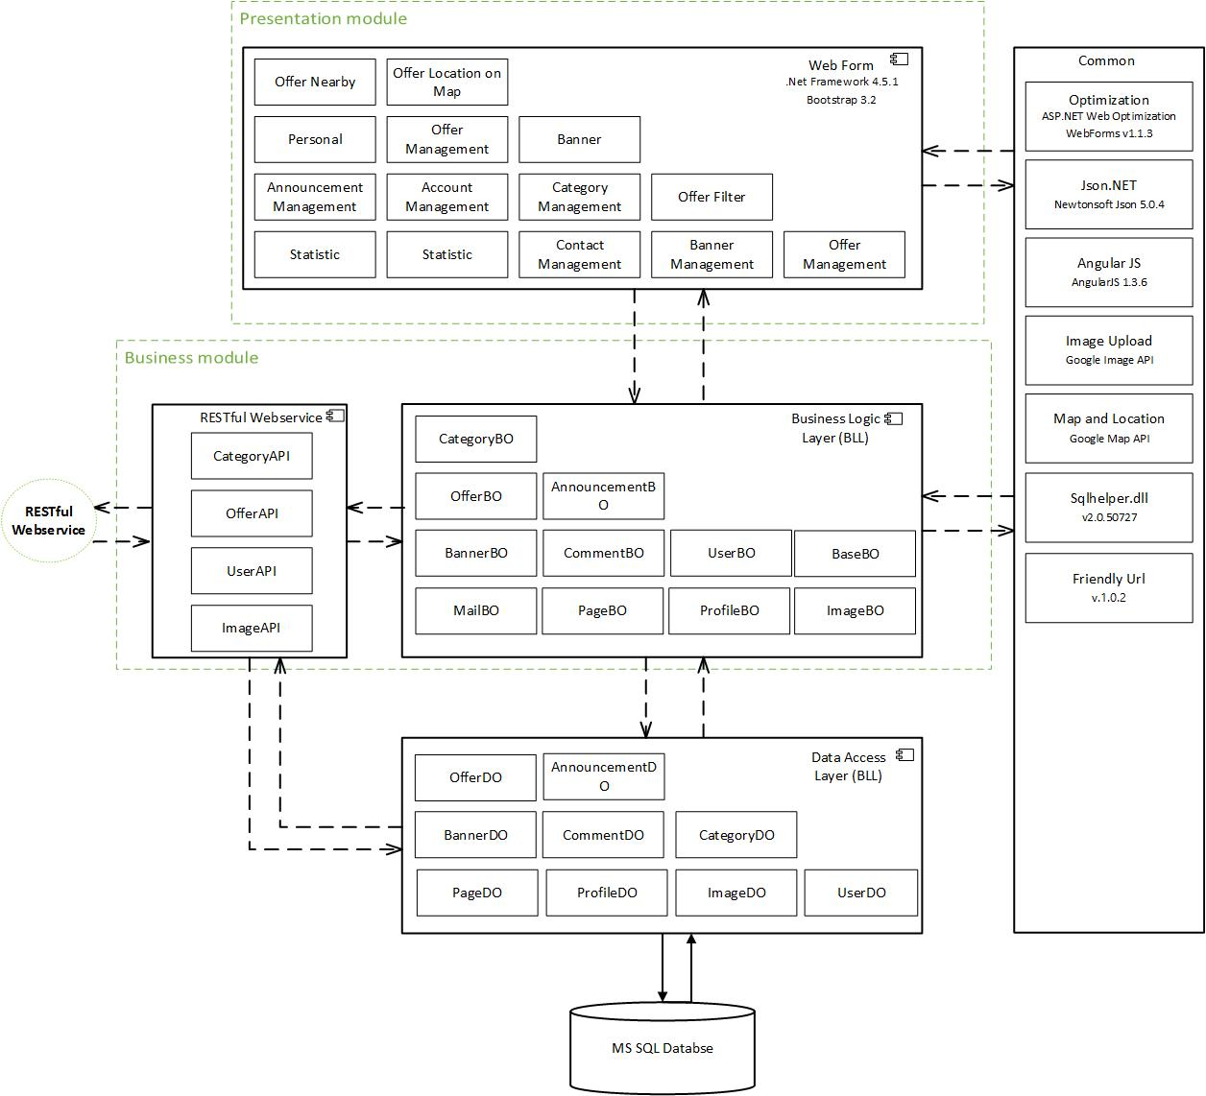
4
System Design Description
4.2 Component diagram
Component Web application

Slide 23
4
System Design Description
4.2 Component diagram
Component Mobile application

Slide 24
4
System Design Description
4.3 Class diagram

Slide 25
Example
Class OfferBo

Slide 26
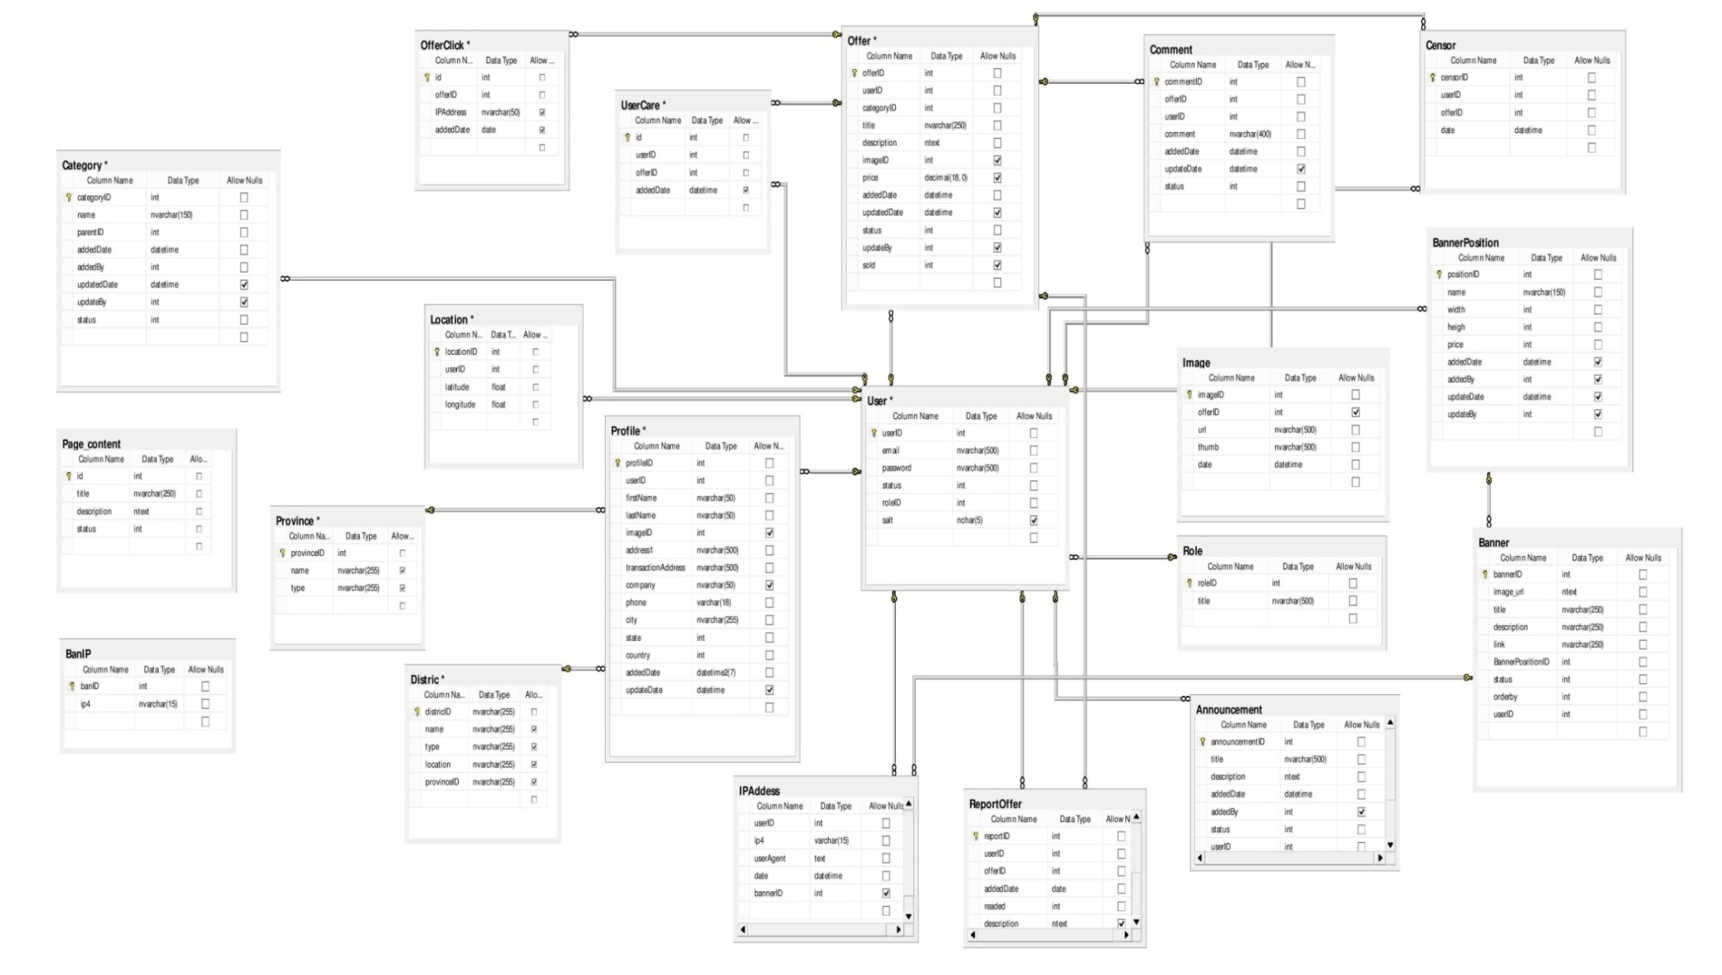
4
System Design Description
4.4 Database Design

Slide 27
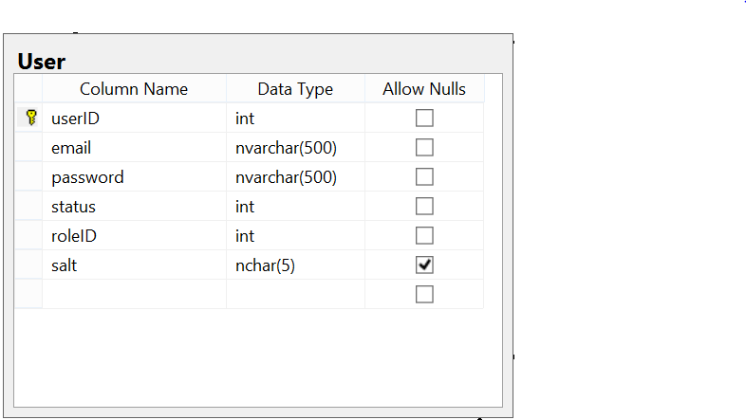
Example
Object

Slide 28
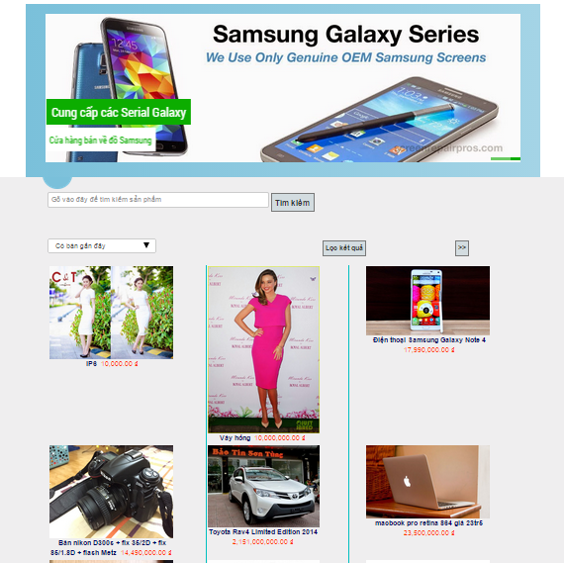
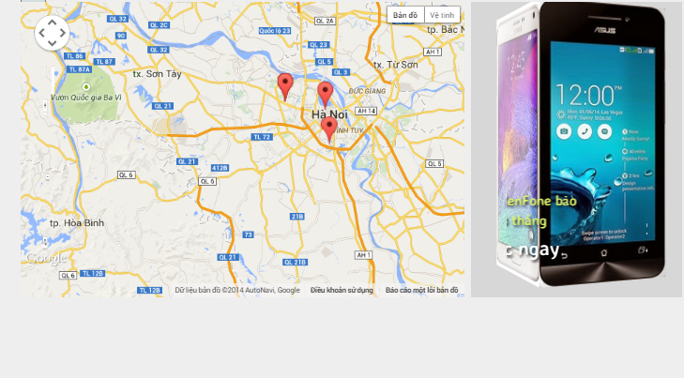
4
System Design Description
4.5 Interface Design
Home page http://shotandsell.com

Slide 29
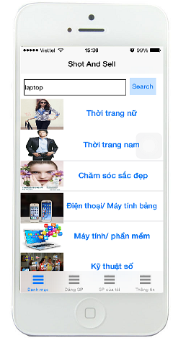
4
System Design Description
4.5 Interface Design
Icon Ios application
Main Screen

Slide 30
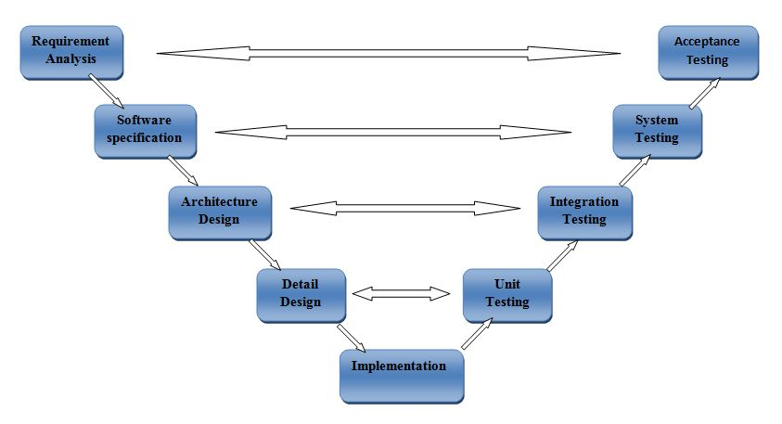
5
System Implementation & Test
5.1 V_model
V-model

Slide 31
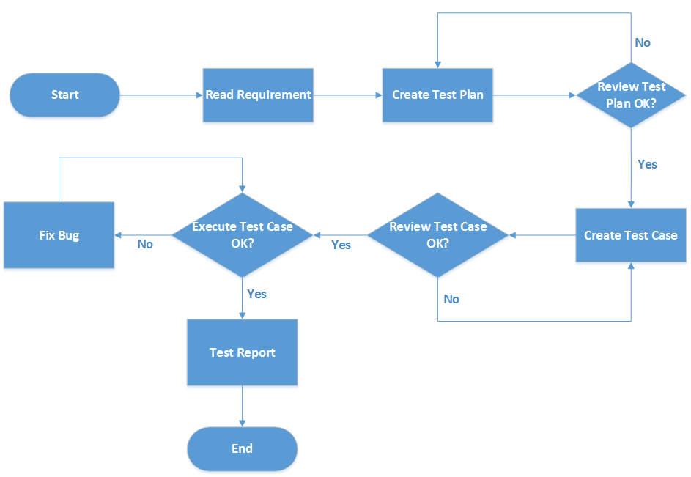
5
System Implementation & Test
5.2 Test process
Test process

Slide 32
5
System Implementation & Test
5.3 Test Plan
Iteration 1
Iteration 2

Slide 33
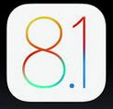
5
System Implementation & Test
5.4 Test environment

Slide 34
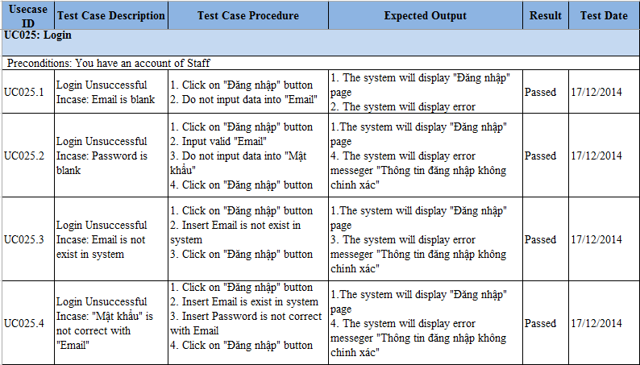

Slide 35
5
System Implementation & Test
5.4 Test Results
Test converage | 100%
Test successful converage | 97,7%

Slide 36
6
Demo & QA
6.1 Demo

Slide 37
6
Demo & QA
6.2 QA

Slide 38
Thank You !
http://shotandsell.com/

