Slide 1

Location Information Networking
Supervisor: Mr. Luong Trung Kien
Students:
  Le Tien Dung
  Tran Quang Ngoc
  Duong Duc Quyen
  Nguyen Bao Trung
  Hoang Khac Tien

Slide 2
Content
Introduction
Project Management Plan
Requirement Specifications
Design Description
Implementation
Testing
Maintenance & Future development
Demo – Q&A

Slide 3
1. Introduction
Human resources
Background
Existing system
Proposal

Slide 4
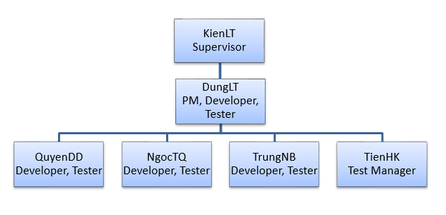
Human resources

Slide 5
Background
Malls, restaurants, coffee shops…are growing up.
Location information exigency increases.
Some website, applications helps dealing with this problem.

Slide 6

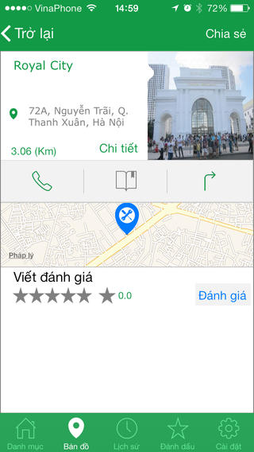
Existing System
A website helps users search places.
  Diverse
  Exactly
  Only website
NhaNha application provides location information on map.
  Diverse
  Good interaction
  Visually
  Not enough information

Slide 7
Proposal
Search location by criteria such as: cuisine, drinks, entertainment, bar-pub…
Provide nearest location around 3km.
Leave review, feedback to location.
Search nearest user, make friend.
Join chat room.

Slide 8
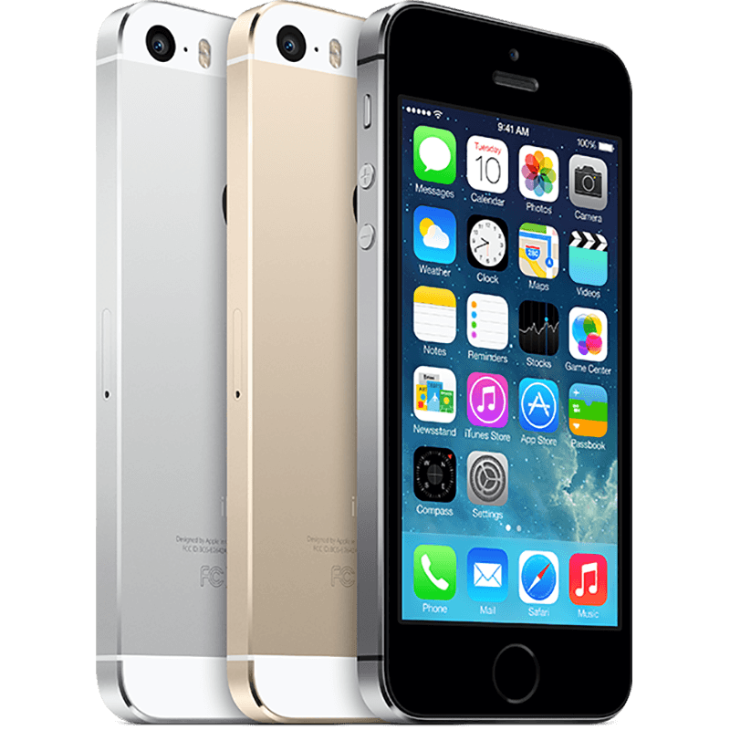
Proposal
iPhone Application
High stability.
Good security
Have experience developing on iOS flat-form

Slide 9

2. Project Management Plan
The proposed system & scope
Develop environment
Process
Project organization
Project planning

Slide 10
Proposed system & scope
Propose
      Everyone can search location easily, exactly.
      Connect users.
      Nearest locations, users.
Scope
      Vietnamese language.
      iOS Application & Admin Page.

Slide 11
Develop Environment
Hardware
  Macbook Pro 8GB Ram, Core i7.
  Vaio Laptop 4GB Ram, Core i7.
  iPhone 5S/4S, iPad Mini.

Slide 12










Develop Environment
Software & Tools
  Operating System:
  IDE:
  Create diagram:
  Source control:
  Other:

Slide 13
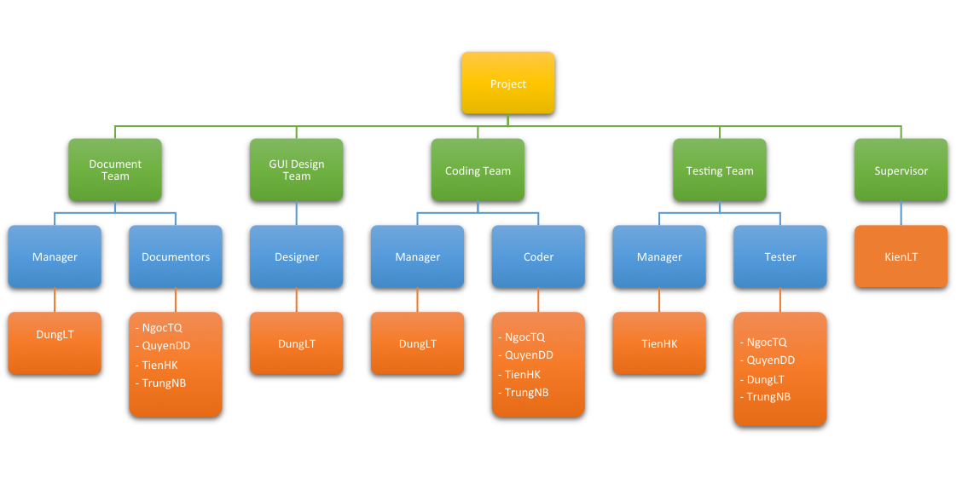
Project Organization

Slide 14
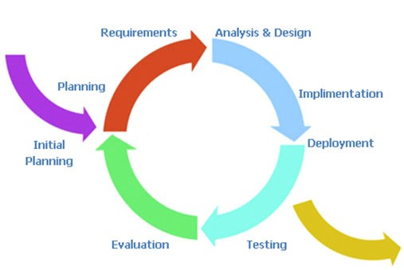
Iterative and Incremental

Slide 15
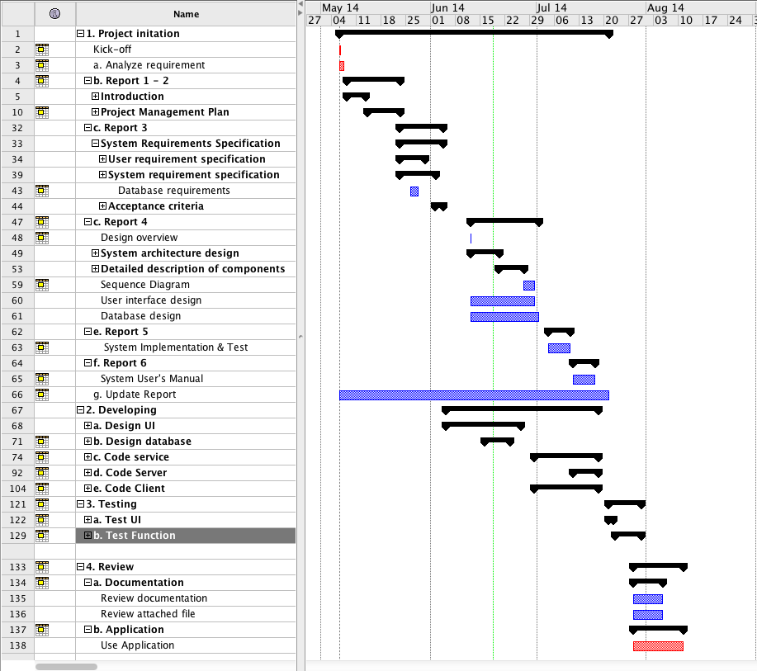
Project Planning

Slide 16

Risk Management
Predictable risks:
  Conflict between members.
  Members are sick.
  Waste time to study technical.
Unpredictable risks:
  Equipment is broken.
  Internet connection.

Slide 17
Team Management
Work 6 hours/day.
Meeting: Every Thursday & Sunday, from 9h00 – 18h00.
Meeting Place: Member’s house.
Communication: Skype, Gmail.

Slide 18
3. Requirement Specifications
The mandatory functions.
Functional Requirements
  Visitor
  Registered User
  Administrator
Non-Functional Requirements

Slide 19
The mandatory functions
List location by type.
Search location.
View detail location.
List nearest location on Apple Map.
Search user, make friend.
List nearest user.

Slide 20
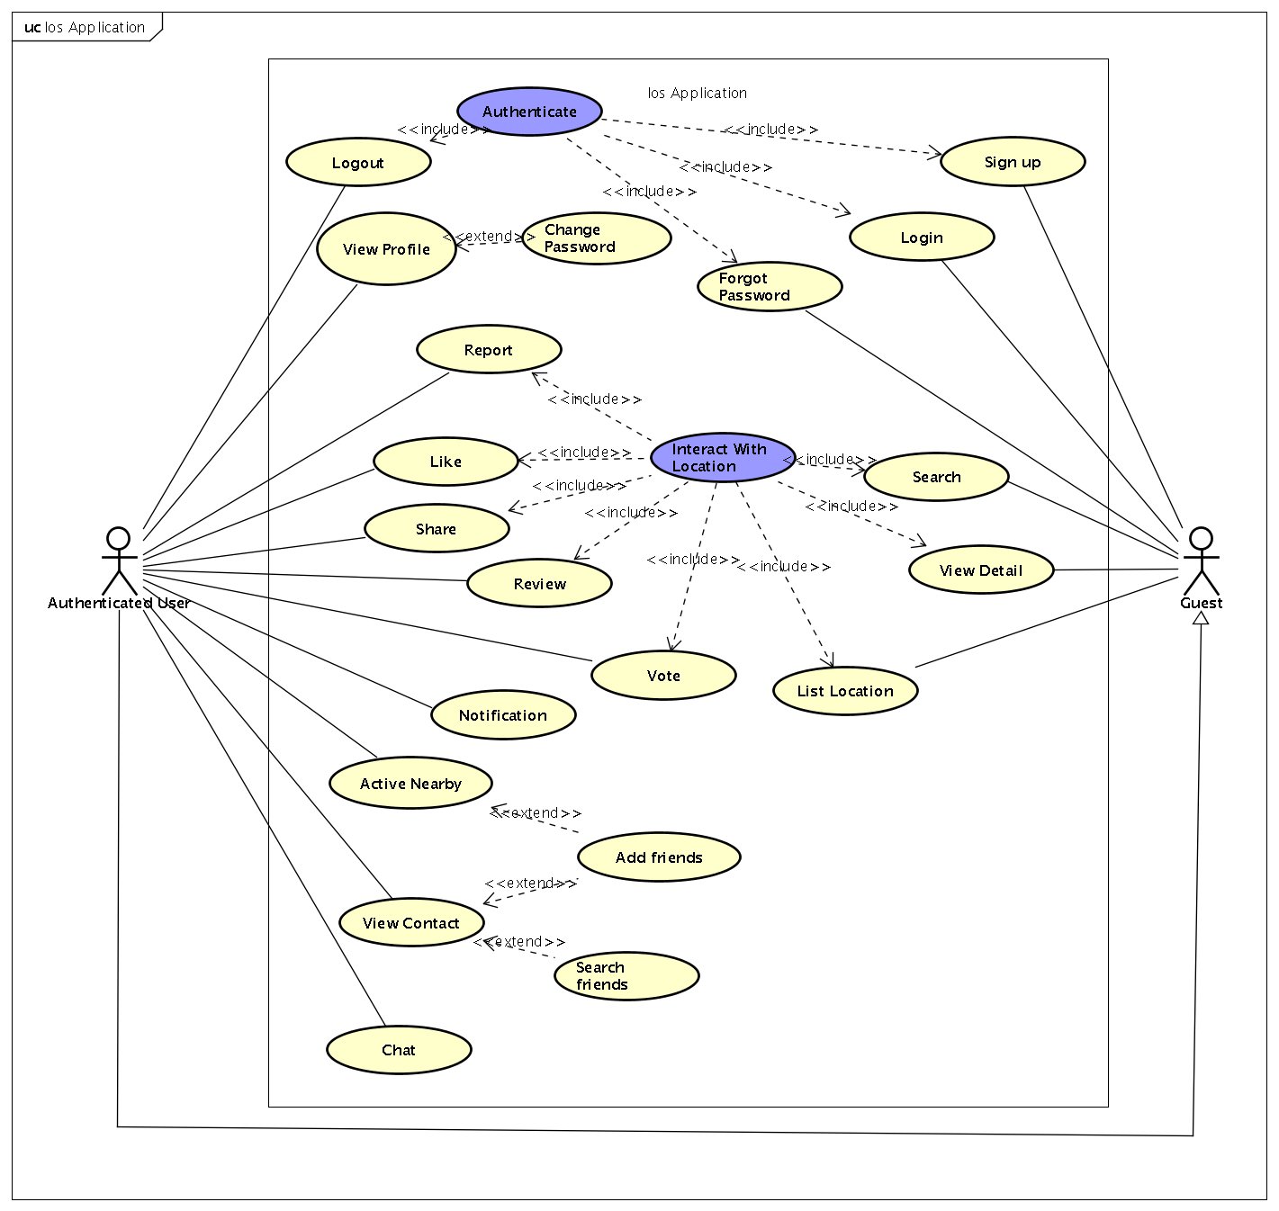
Functional Requirement

Slide 21
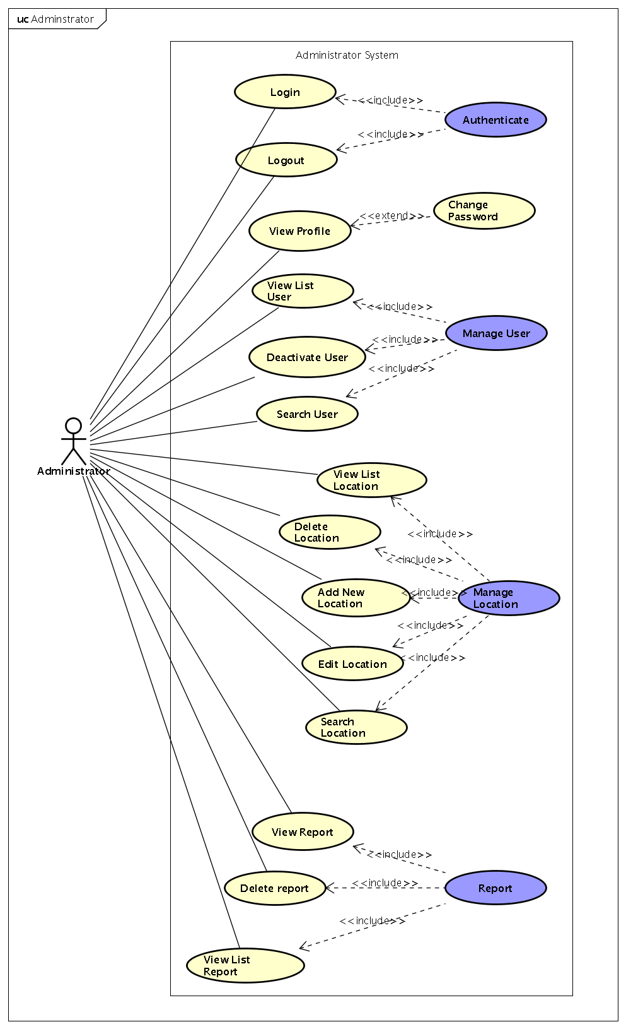
Functional Requirement

Slide 22
Non-functional Requirement
Performance requirement
  High speed, load data quickly.
  Smooth, not shock while scroll, transfer view.
Reliability
  Ensure information is newest & most exactly.
  Always receive feedback from user to update data.
Usability
  Ease to use, the UI is base on user experience.

Slide 23
Non-functional Requirement
Availability
  Run 24/7.
Portability
  Installation package size is small.
Security
  Use session & user token to ensure high secure.
Maintainability
  Can back-up data in case of data loss.
  Follow coding convention to easy maintain.

Slide 24
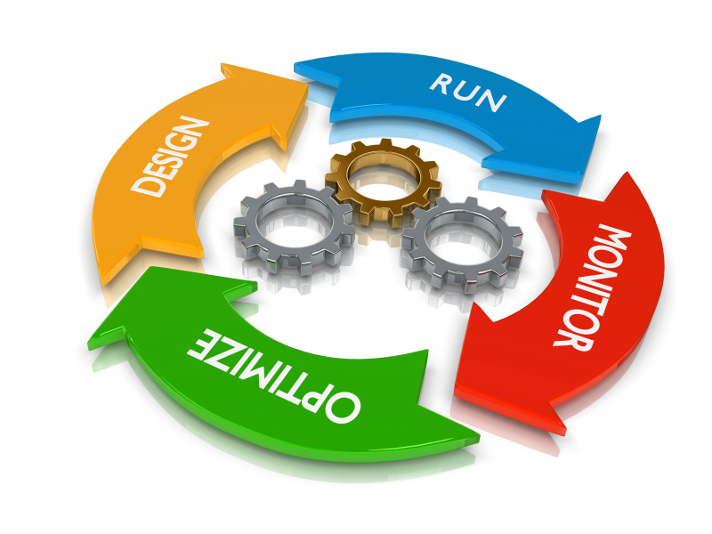
4. Design description
Architectural design
Detailed design
Database design

Slide 25
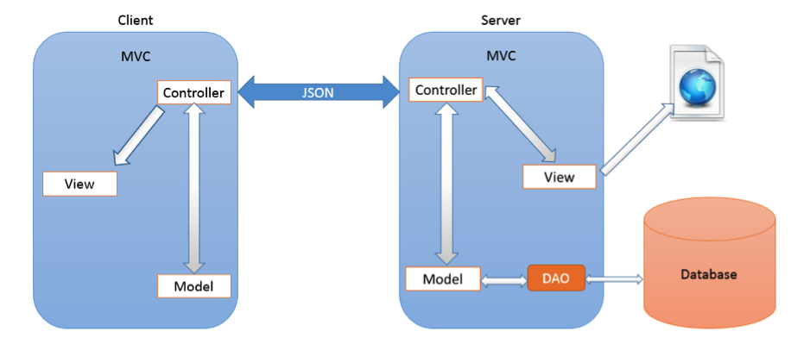
Architectural Design

Slide 26
Detailed Design
Design for each use case
Class diagram
Sequence diagram

Slide 27
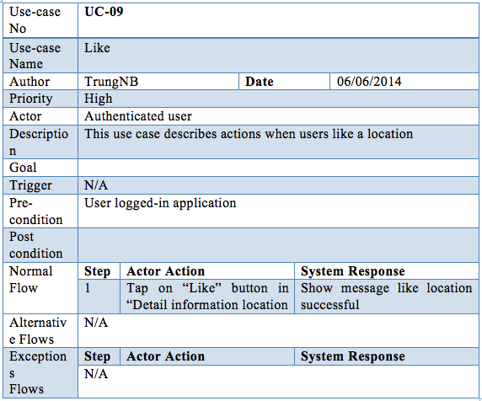
Use case example

Slide 28
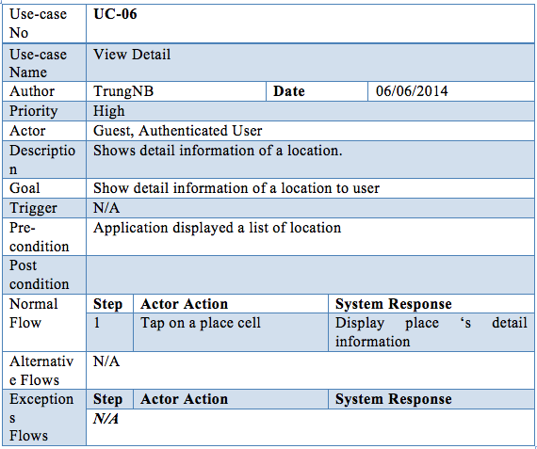
Use case example

Slide 29
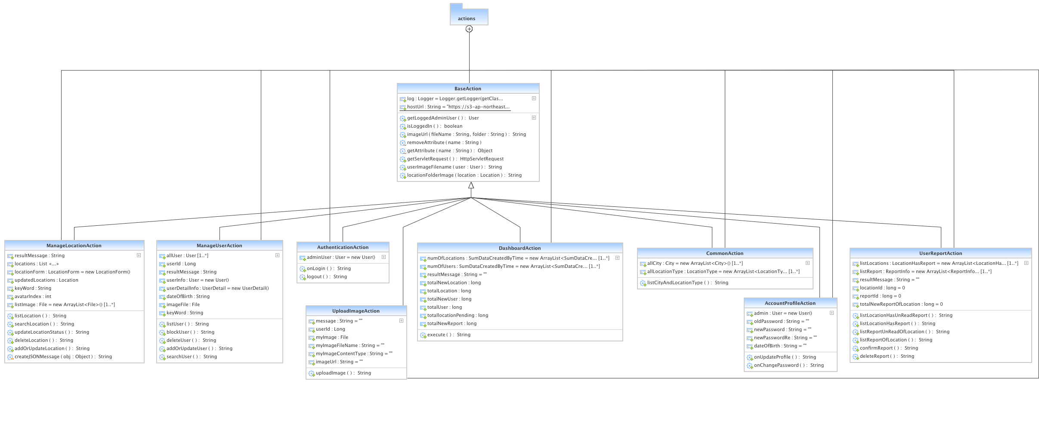
Class diagram

Slide 30
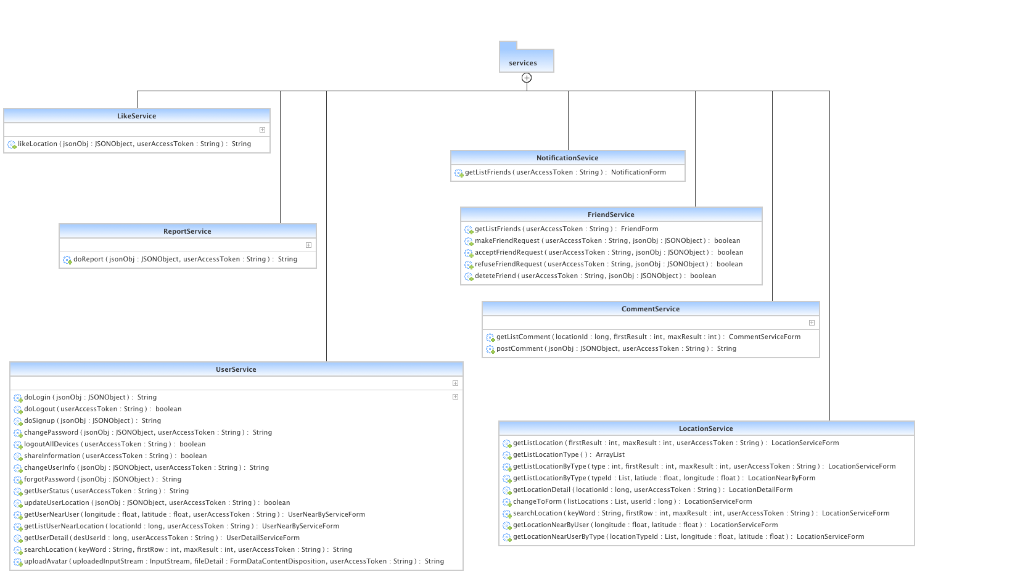
Class diagram

Slide 31
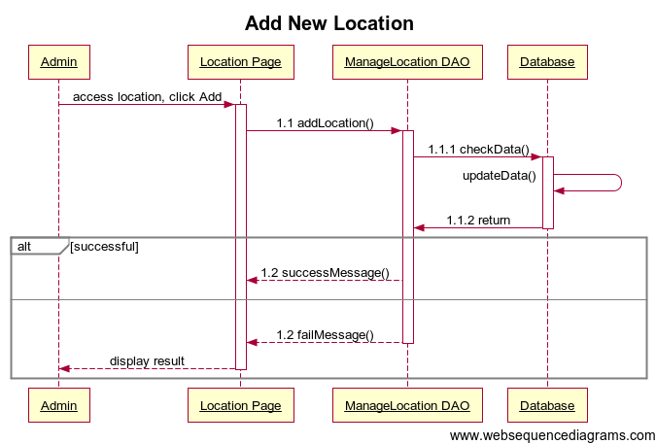
Sequence diagram

Slide 32
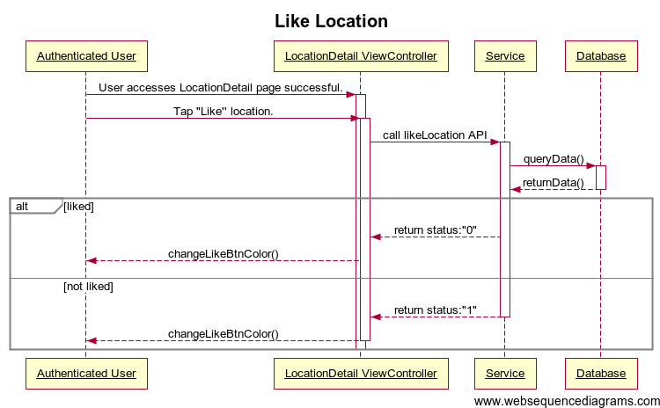
Sequence diagram

Slide 33
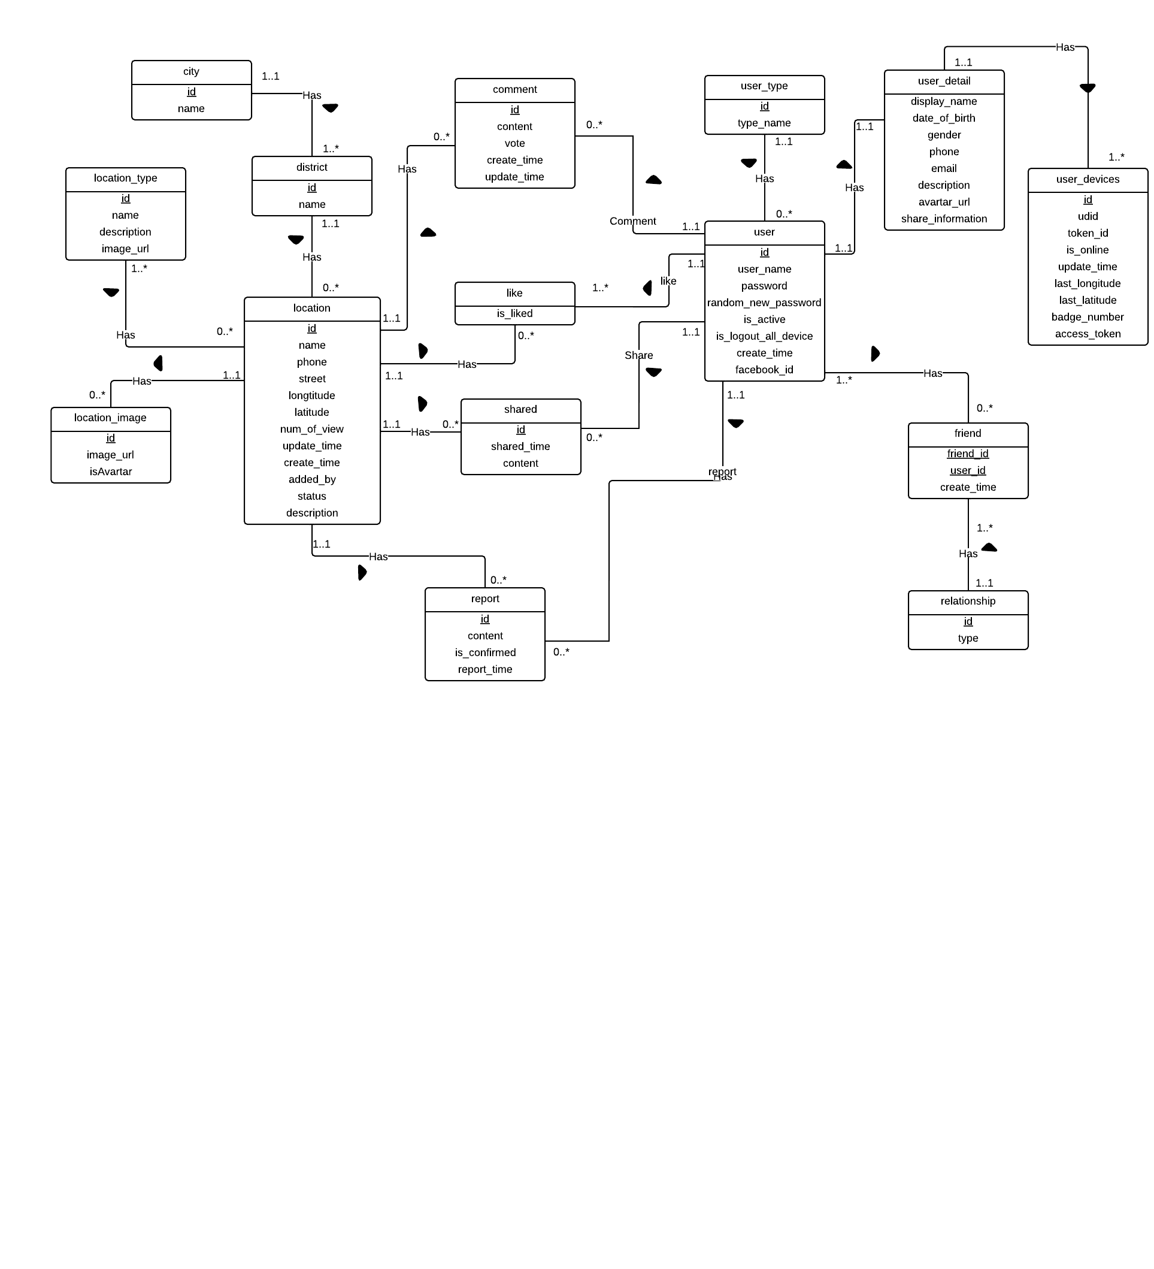
ER Diagram

Slide 34
5. Implementation
Source code
Coding convention
Class implementation
Sequence implementation

Slide 35
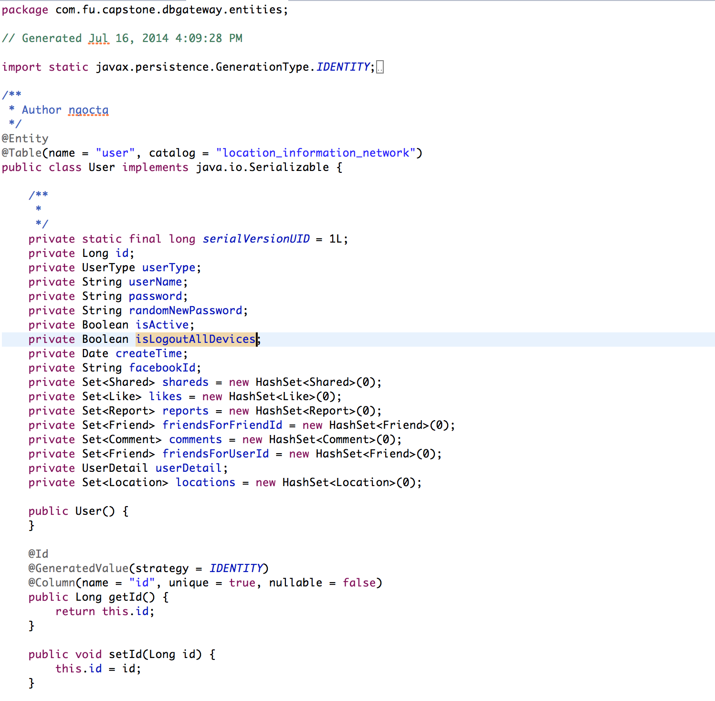
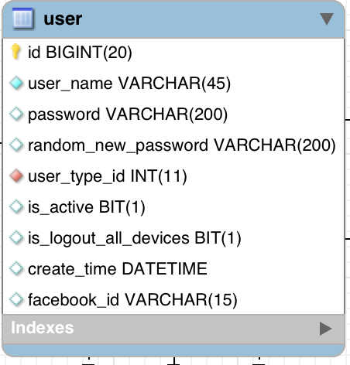
Class Implementation
Coding Convention:
  Package
  Variable
  Class
  Method

Slide 36
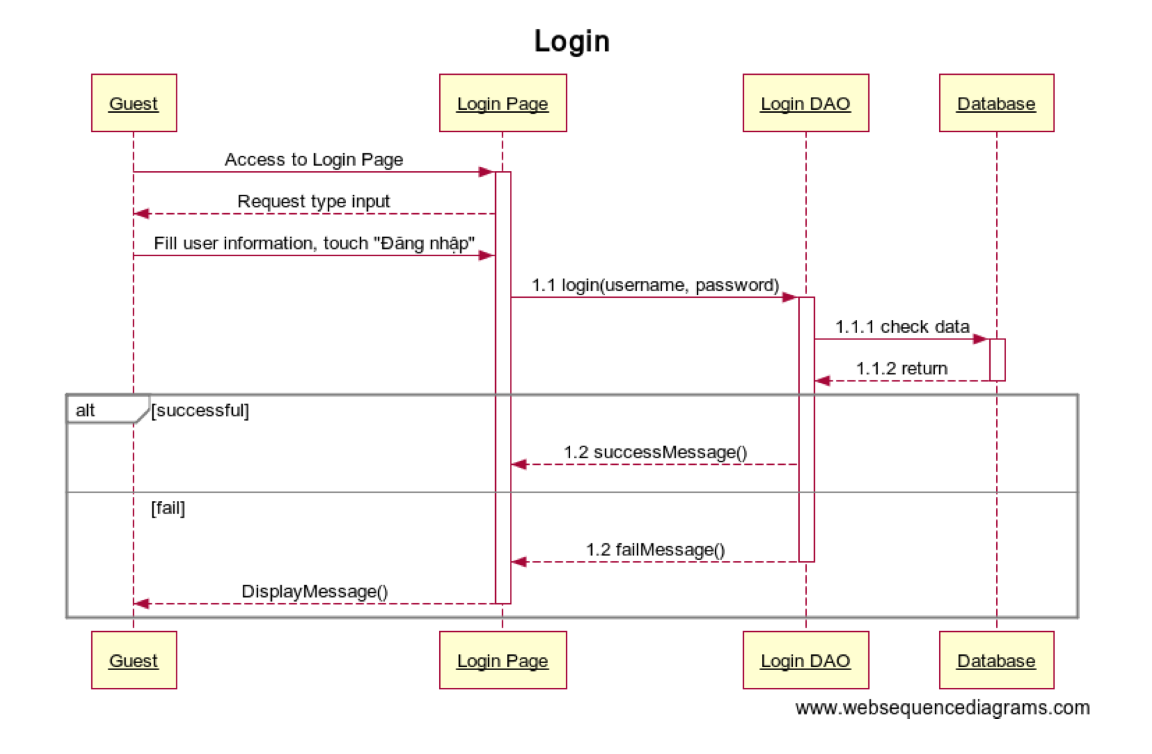
Sequence Implementation
Sequence diagram

Slide 37
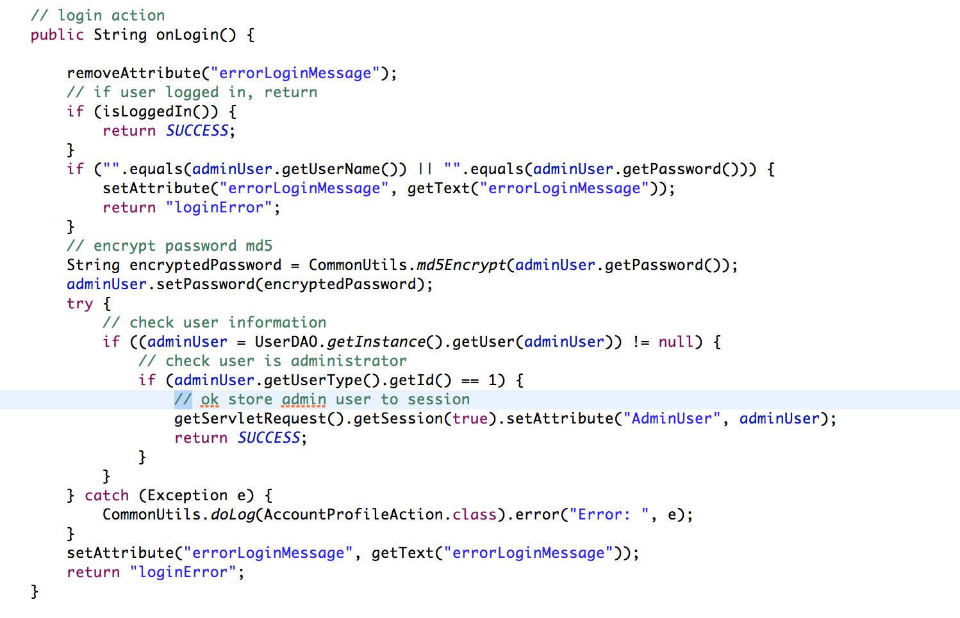
Source code

Slide 38
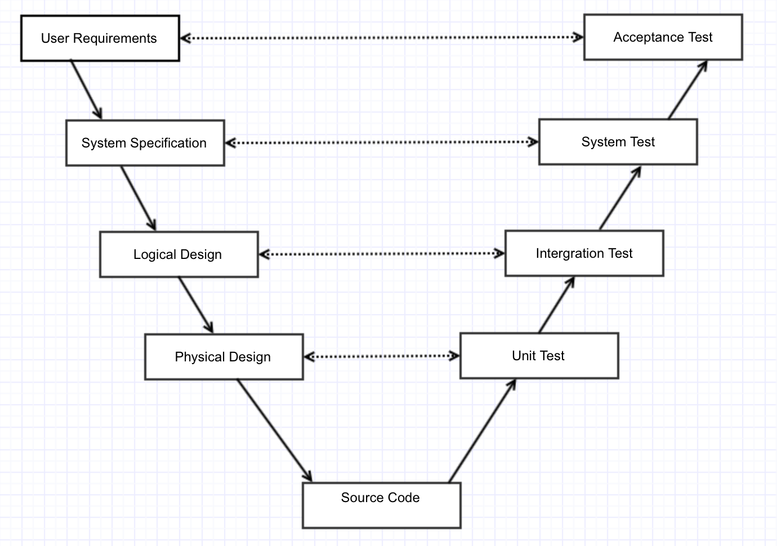
6. Testing

Slide 39
Testing process
Analyze requirements
Create test plan
Create test case
Test execution
Log bug
Fix bug
Re-test
Test report

Slide 40
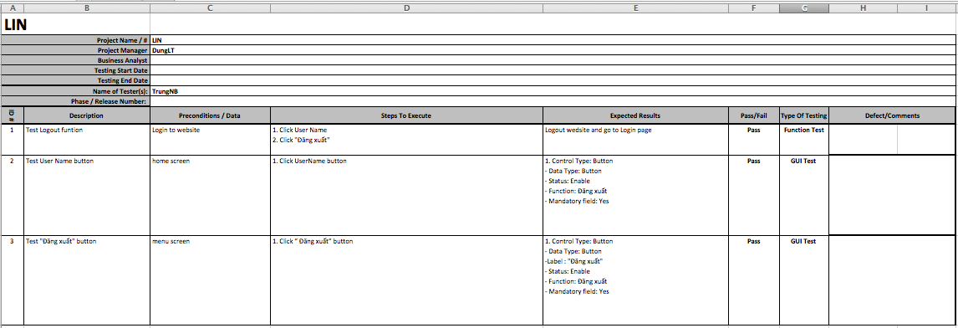
Test case

Slide 41
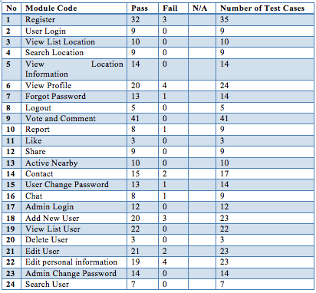
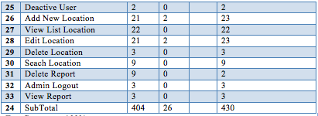
Test report
Test coverage: 100%
Test successful coverage: 93,96%

Slide 42
Testing tool & environment
Admin website
  Safari Version 7.0.5 (9537.77.4) / Chrome v 36.0.1985.143 / Firefox v.31
  Mac OSX 10.9.4
  CPU Core i7 16gb Ram
  512 GB SSD
Application
  iPhone 5s, iPhone 4, iPhone 4s, iPad Mini
  iOS 7.1.1

Slide 43
7. Maintenance & Future developments
Maintenance
  Review code
  Running test, debug & fix bug.
  Update missing functions
Future developments
  Inbox messages
  Invite to go.

Slide 44
Skill Achievement
Manage project.
Java/ Objective-C language.
Team-work.

Slide 45

8. Demo & QA

Slide 46
Q&A

Slide 47
Thank for your attention!

