Slide 1

MINISTRY OF EDUCATION AND TRAINING
DELIVERY MANAGEMENT SYSTEM
Group Members | Vũ Đình Đồng | 01680 | DongVD01680
 | Lê Khánh Toàn | 01887 | ToanLK01887
 | Nguyễn Minh Tú | 01392 | TuNM01392
 | Nguyễn Đức Hiếu | 01414 | HieuND01414
 | Lê Mạnh Quân | SE02250 | QuanLM02250
Supervisor | LamPT
Capstone Project code | DMS

Slide 2
Table of content
Introduction
Project Plan
  Development Environment
  Project organization
  Roles and Responsibilities
  Tools and Techniques
  Project management plan
  Coding convention
Software Requirement Specification
  Agent functions
  Seller functions
  Administrator functions
  ERD and database
  Architecture design
Testing
Project result
Demo
Q&A

Slide 3
I. Introduction
  Project Information
  1.1. Problem abstract
Vinamilk
Agent
Seller
Seller
Agent
Seller
Figure 1.1: Organizational chart

Slide 4
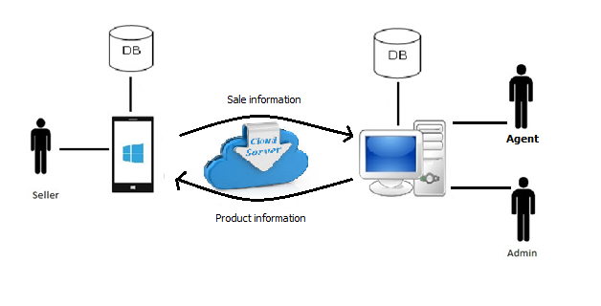
I. Introduction
  Project Information
  1.2. Our proposal
  Delivery Management System includes two separated applications.
  The first application runs on Windows phone smart devices (DMS-Phone). It supports the sale staff in managing orders, stores
  The second one is a website (DMS-Server). that helps agents controlling almost daily business activities such as manage store, sale staff, and product

Slide 5
I. Introduction
  Existing systems
  2.1. Overview existing application
  Ipharm delivery: A product of “CÔNG TY CỔ PHẦN GIẢI PHÁP CÔNG NGHỆ IPHARM”
  Main functions of this product:
  The system’s functions:
    User management: create new account, decentralization.
    Product management: enables customer to change information of enterprises
    Backup and restore database
  User management: Staff management, customer management.
  Order management: create order, update order information, delivery information, and debt.
  Report.

Slide 6
I. Introduction
  Existing systems
  2.1. Overview existing application
  DMS-Emobiz: A product of FPT Software
  Main functions of this product:
    A total solution for managing sales on handheld devices
    Order online
    Order management
    Product management
    Staff management
    Sales revenues
    GPS
    Warehouse management
    Report

Slide 7
I. Introduction
  Existing systems
  2.2. Limitation of existing system
  Not suitable with small enterprises.
  With IPharm Delivery: just only setup on PC, laptop, not support phone.
  With DMS-Emobiz: best solution for delivery business activities but it gets high cost.

Slide 8
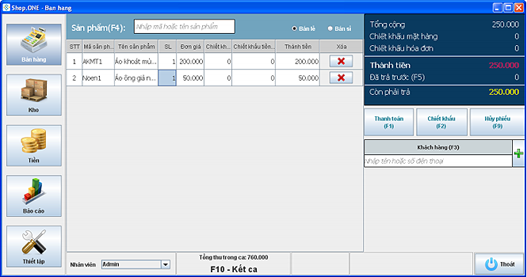
I. Introduction
  3. The Current System
  Vinamilk has using Shop One – a system of Viettel.
  Main features:
  Sale management
  Storage management
  Revenue and expenditure
  Report
  Customer management

Slide 9
I. Introduction
  4. Proposed system
  DMS includes two components: a website for agent users and a smart device application for sale staff.
    functionss for agent users:
      Products management
      Categories management
      Store management
      Request management
      Report
      Orders management
      Sale staff management
    functionss for sale staff:
      Store management
      Order management
    functionss for Administrator istrators
      Account management

Slide 10
I. Introduction
  5. Boundaries of the system
  Supporting only languages: Vietnamese.
  Supported only in Windows phone
  Host on windows azure
  Warehouse management, product’s information, sellers management, store management, order management and report

Slide 11
I. Introduction
  6. Business outline

Slide 12
I. Introduction
  7. Timeline
1 week
Study and define problem
2 weeks
Collect requirement
2 weeks
Design
4 weeks
Coding
2 weeks
Testing
2 weeks
Summary and finish

Slide 13
II. Project Plan
  Development Environment
  Hardware development requirement
    Personal computers for developing/testing with the minimum configuration: 2GB of RAM, 100 Gb of hard disk, Core 2 Duo 2.0 GHz.
    A server computer with the minimum configuration: 4GB of RAM, 100GB of hard disk, Core 2 Duo 2.0 GHz.
    Windows Phone and Wi-Fi powered for testing and deploying purposes.
    Internet connection and stability
  Software requirement for development environment
    Database server: Azure Cloud SQL Server .
    Web Server: IIS 7.
    Framework: .NET Framework 4.0, ASP .NET Web Services.
    Programming tool: Visual Studio 2012.
    Others: MS Office, MS Project, MS Visio, Astah Community.

Slide 14
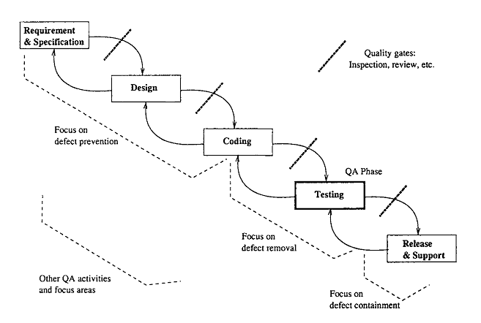
II. Project Plan
  Project organization
  We choose Waterfall model for our software process because of some features:
    Requirements are clearly
    and unambiguously.
    Complete project execution
    is divided in to well defined
    stages of initial, plan,
    software requirement specification,
    design description, implement,
    testing and user acceptance
    followed by maintenance support.
    A schedule is typically set with deadline for each stage of development at the start of the project.

Slide 15
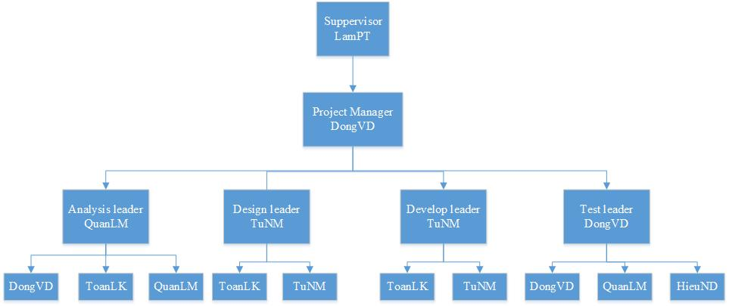
II. Project Plan
  3. Role and Responsibilities

Slide 16
II. Project Plan
  Tools and Techniques
  Tool for coding:
    Visual studio 2012.
  Database system:
    Windows Azure SQL Database.
  Programming language:
    C#
  Other:
    Microsoft Office 2007,2010,2013
    Astah Community
    Microsoft Visio 2013
    Microsoft Project 2013
    Adobe Photoshop CS5
  Techniques
    HTML, CSS, JavaScript, Visualization (Google Charts)

Slide 17
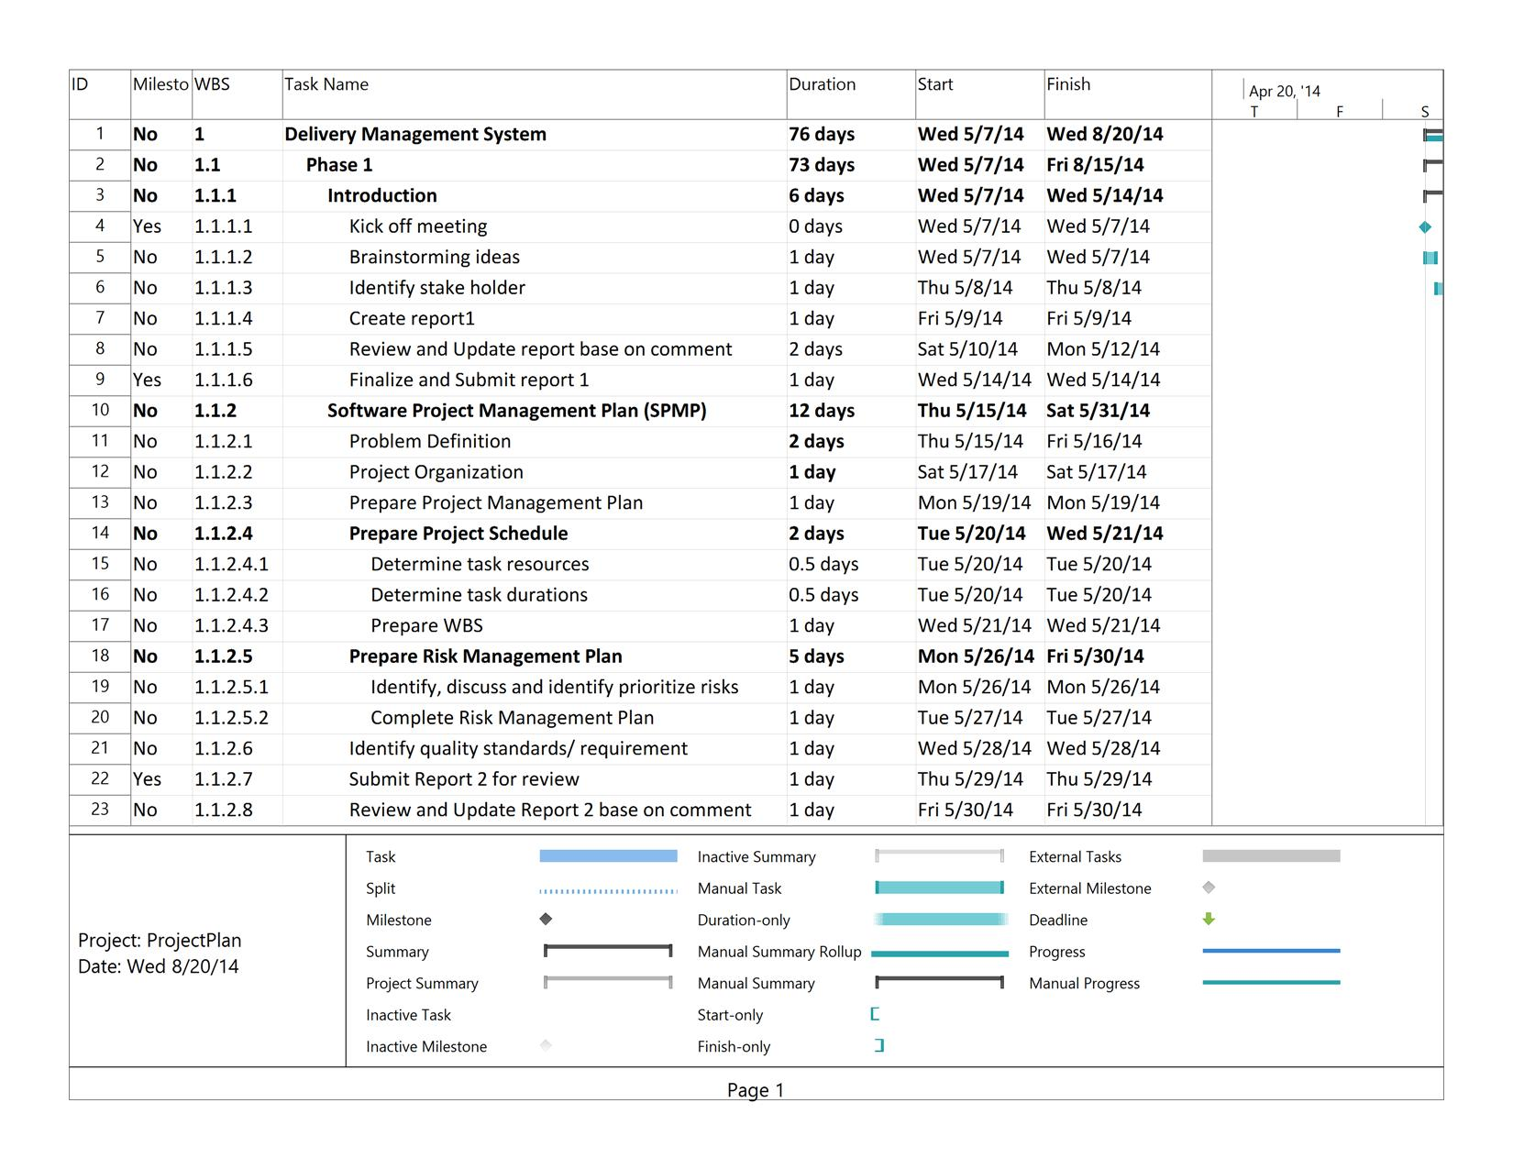
II. Project Plan
  Project management plan
  Refer attached master schedule document: DMS_WBS.mpp

Slide 18
III. Project Plan
  Coding convention
  The project team uses the following coding convention: http://msdn.microsoft.com/en-us/library/ff926074.aspx

Slide 19
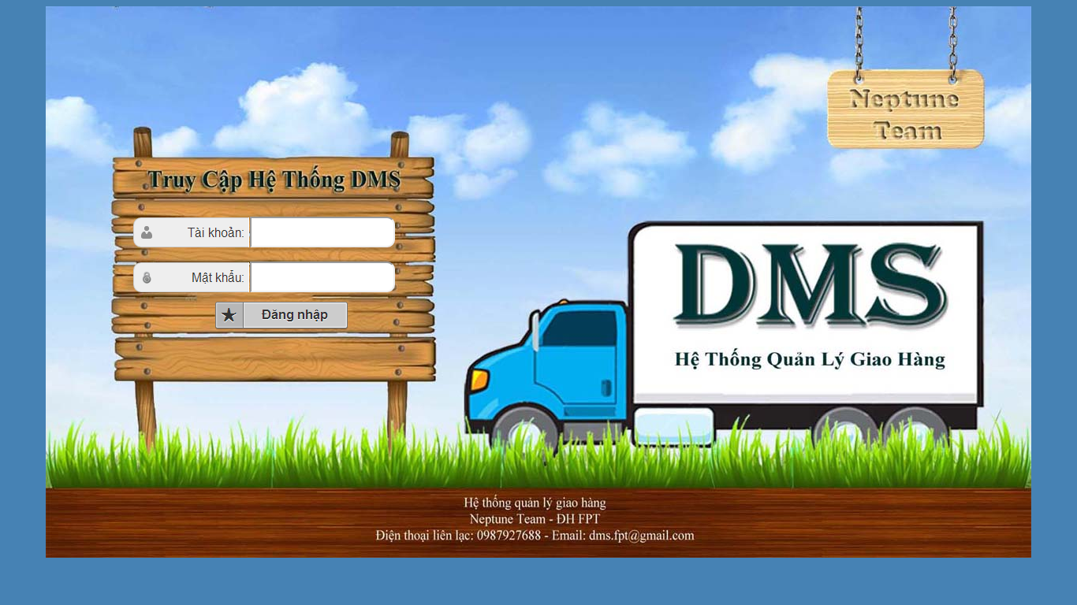
IIII. Software Requirement Specification
  Agent functions

Slide 20
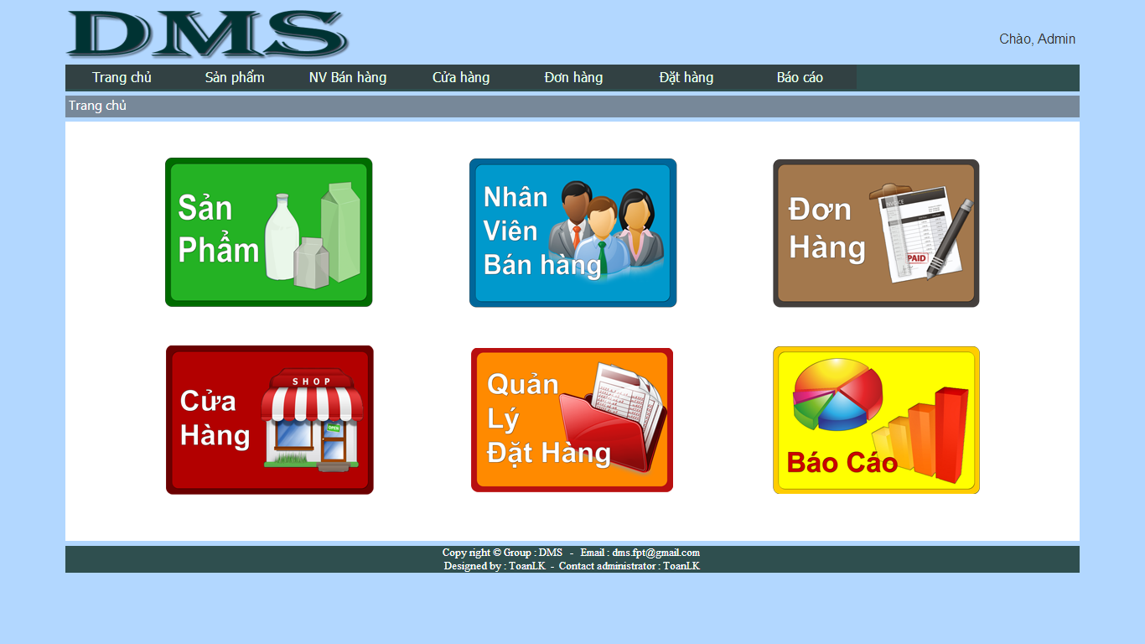
III. Software Requirement Specification
  Agent functions

Slide 21
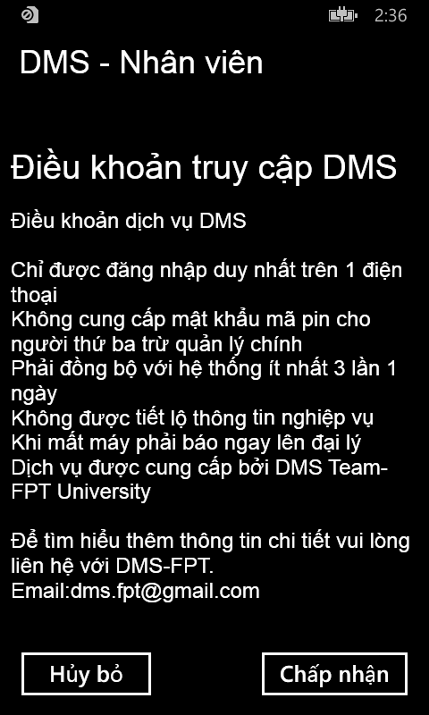
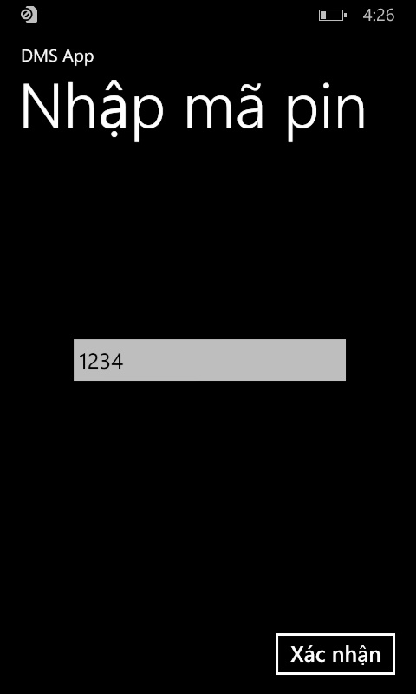
III. Software Requirement Specification
  2. Seller functions

Slide 22
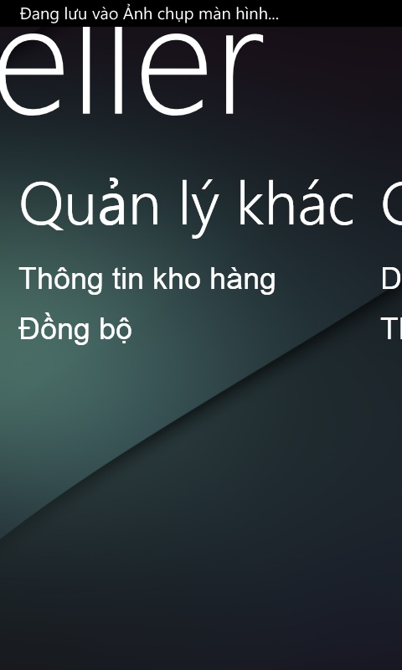
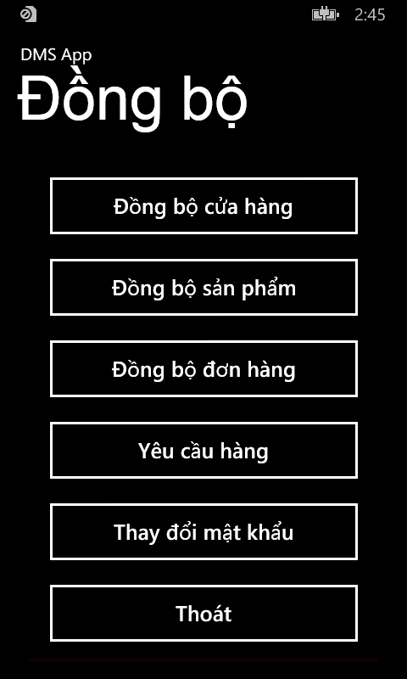
III. Software Requirement Specification
  2. Seller functions

Slide 23
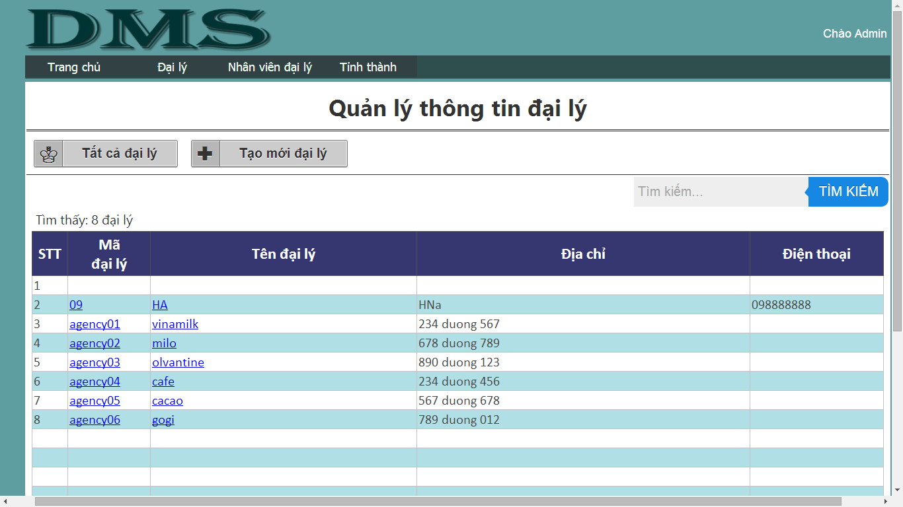
III. Software Requirement Specification
  Administrator functions

Slide 24
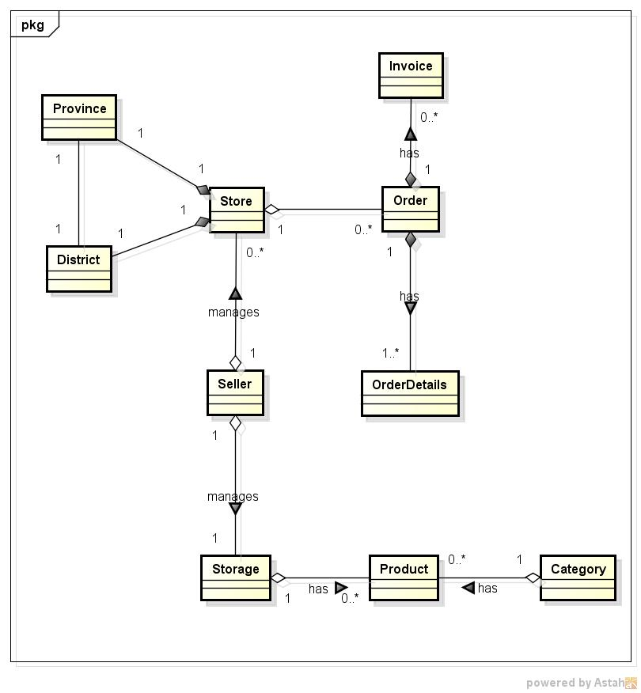
III. Software Requirement Specification
  4. ERD and Database
  4.1. ERD
  DMS-Phone

Slide 25
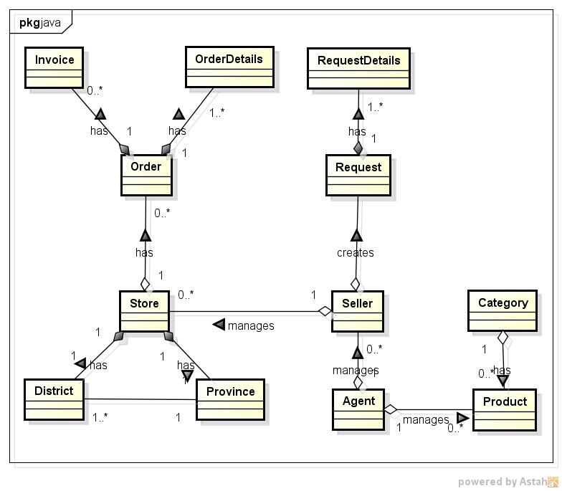
III. Software Requirement Specification
  4. ERD and Database
  4.1. ERD
  DMS-Server Service

Slide 26
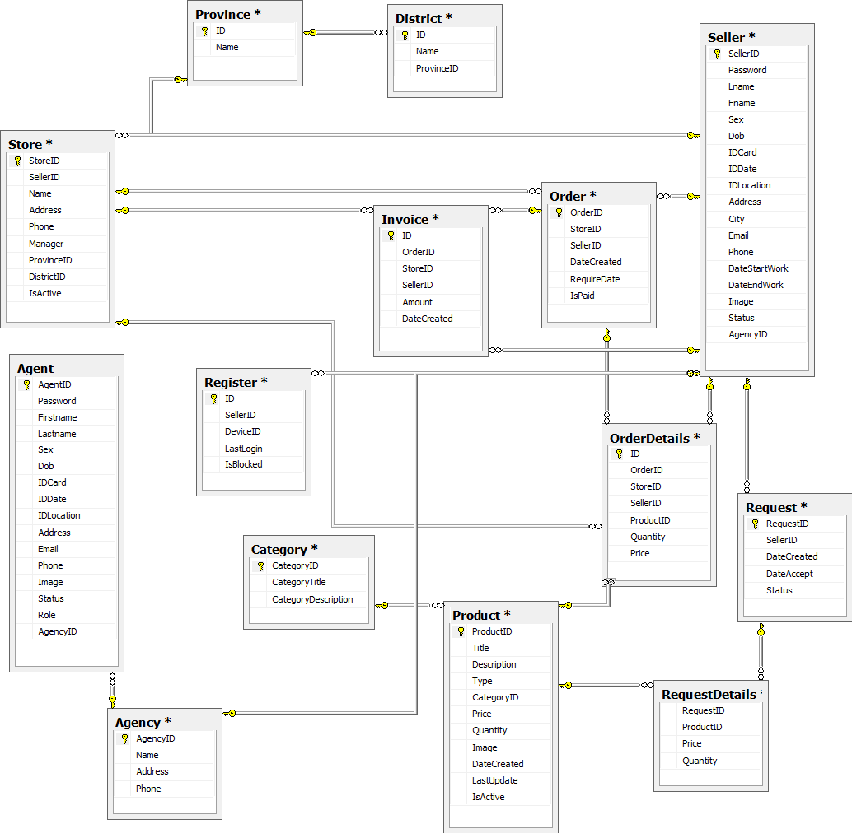
III. Software Requirement Specification
  4. ERD and Database
  4.2. DMS-Server Service database diagram

Slide 27
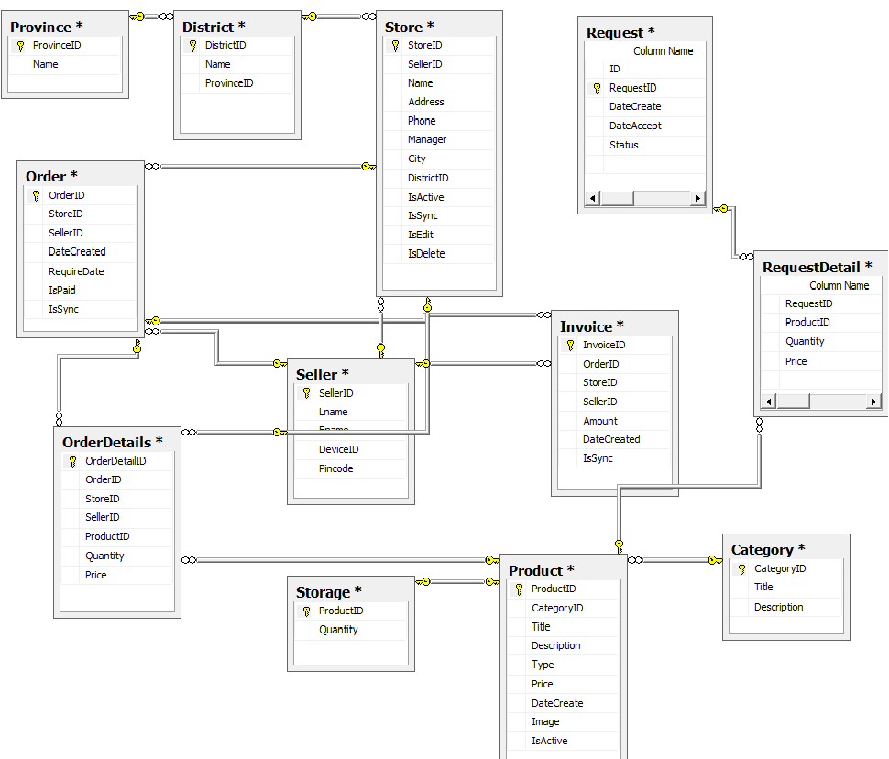
III. Software Requirement Specification
  4. ERD and Database
  4.2. DMS-Phone database diagram

Slide 28
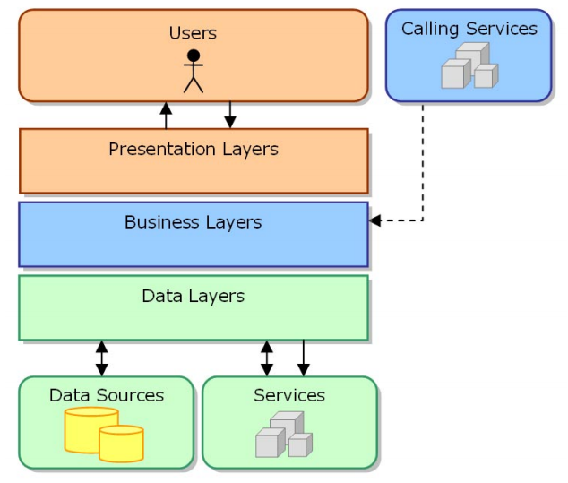
III. Software Requirement Specification
  Architecture design
  The database from mobile application and database from cloud must be independence.
  In DMS system have a connection among agent in two different devices (mobile and computer).
  Data was multi talking and multi viewing.
  Use WCF protocol to connect

Slide 29
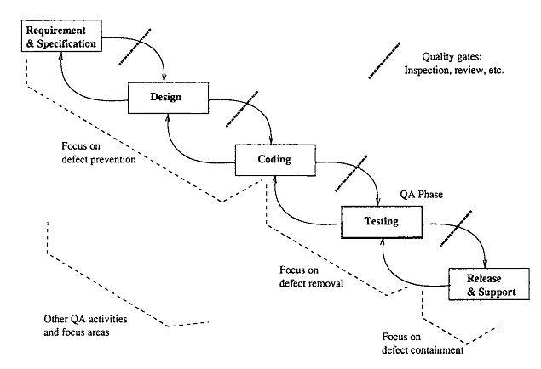
IV. Testing
  Test Model

Slide 30
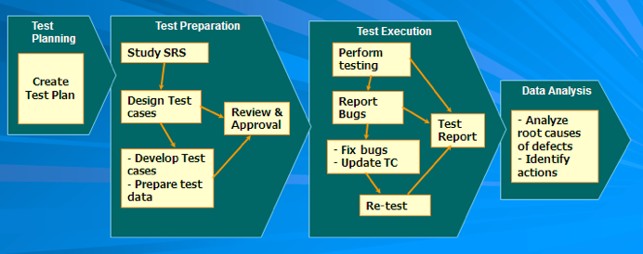
IV. Testing
  2. Test process

Slide 31
IV. Testing
  3. Test type
Unit test
Developer
System test
Tester
Acceptance
Our friends

Slide 32
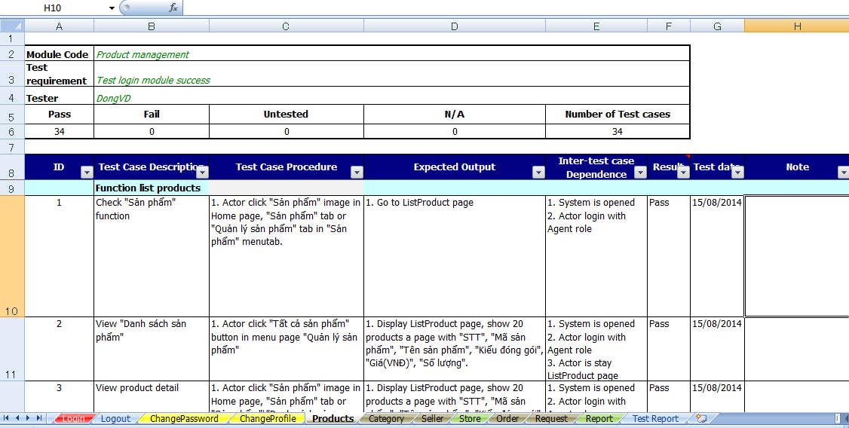
IV. Testing
  4. Test case
  Refer to TestCase.xsl

Slide 33
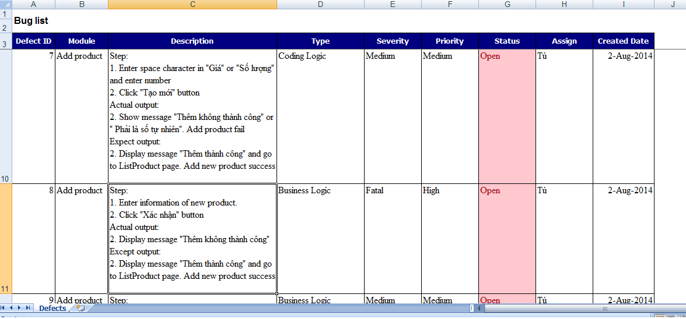
IV. Testing
  5. Defect log
  Refer to DefectLog.xsl

Slide 34
IV. Testing
  6. Test tools and environment
  6.1. Hardware
  At Seller: Handhelds running Windows Phone 8 OS
  At Agent: A configured PC workstation listed in the project’s Requirement specification.
  The product will NOT be tested in other devices.
  6.2. Software
  Microsoft Office Excel 2007
  NET Framework 4.0
  6.3. Operation System
  Windows Phone 8
  Windows 7 (32bit, 64 bit)
  Windows 8 (32bit, 64bit)

Slide 35
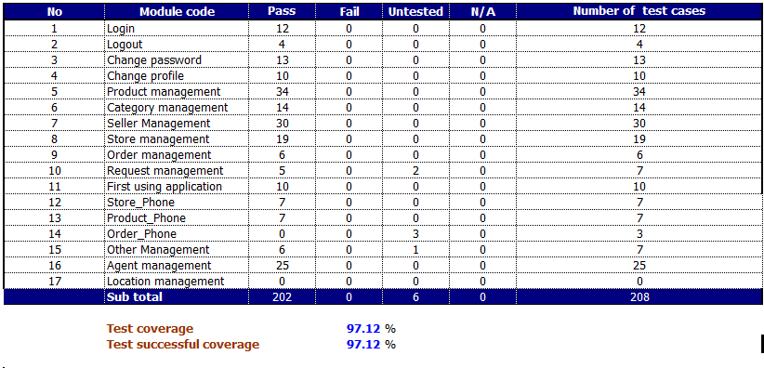
IV. Testing
  7. Test report

Slide 36
DEMO
Q&A

Slide 37
Thanks for listening

