Slide 1
GIMIS PROJECT

Slide 2
Member
Nguyễn Ngọc Phương - 01584
Nguyễn Đức Hùng - SE01987
Phạm Công Thành - SE02232
Trần Việt Tiệp - 01565
Nguyễn Ngọc Trường - SE02121

Slide 3
TABLE CONTENT
INTRODUCTION
SOFTWARE MANAGEMENT PLANT
REQUIRMENT SPECIFICATION
SOFTWARE DESIGN
TESTING
LESSON LEARNED
Q &A

Slide 4
1. INTRODUCTION

Slide 5
GIMIS
Optimize tracking the training progress and body indexes for trainees.
Use more functions of trainer by using their professional experiences.
Give advices and training courses from the trainee’s indexes that they gathered.
The changing of the indexes will be display as visual charts, easy and convenient to check.

Slide 6
GIMIS MAIN FUNTION
General
Staff account management
Customer management
Training process management

Slide 7
General Funtion
Register
Login/logout
Recover/Change password
Edit user’s own profile

Slide 8
Staff account management
Add/ Search & View Staff account
Edit Staff account information

Slide 9
Customer management
Add/Active/Search & View customer
Check-in/check-out customer
Stop service of customer
Edit customer information
Print member card
Assign trainer to customer
Search & View trainer information
Send SMS to customer

Slide 10
Training process management
Exercise:
Add/Edit/Delete exercise in training schedule
Print training schedule
Add/Edit/Delete comment
View training schedule & comment from trainer
View General Exercise List
Index:
Add index stat
View index chart & customer’s own training progress photo
Add/Delete customer training progress photo

Slide 11
2. SOFTWARE MANAGEMENT PLAN

Slide 12
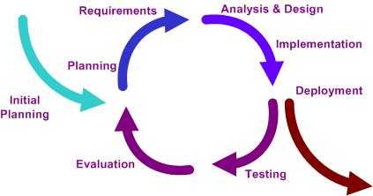
SOFTWARE PROJECT MODEL
Iterative model for managing and developing software project

Slide 13
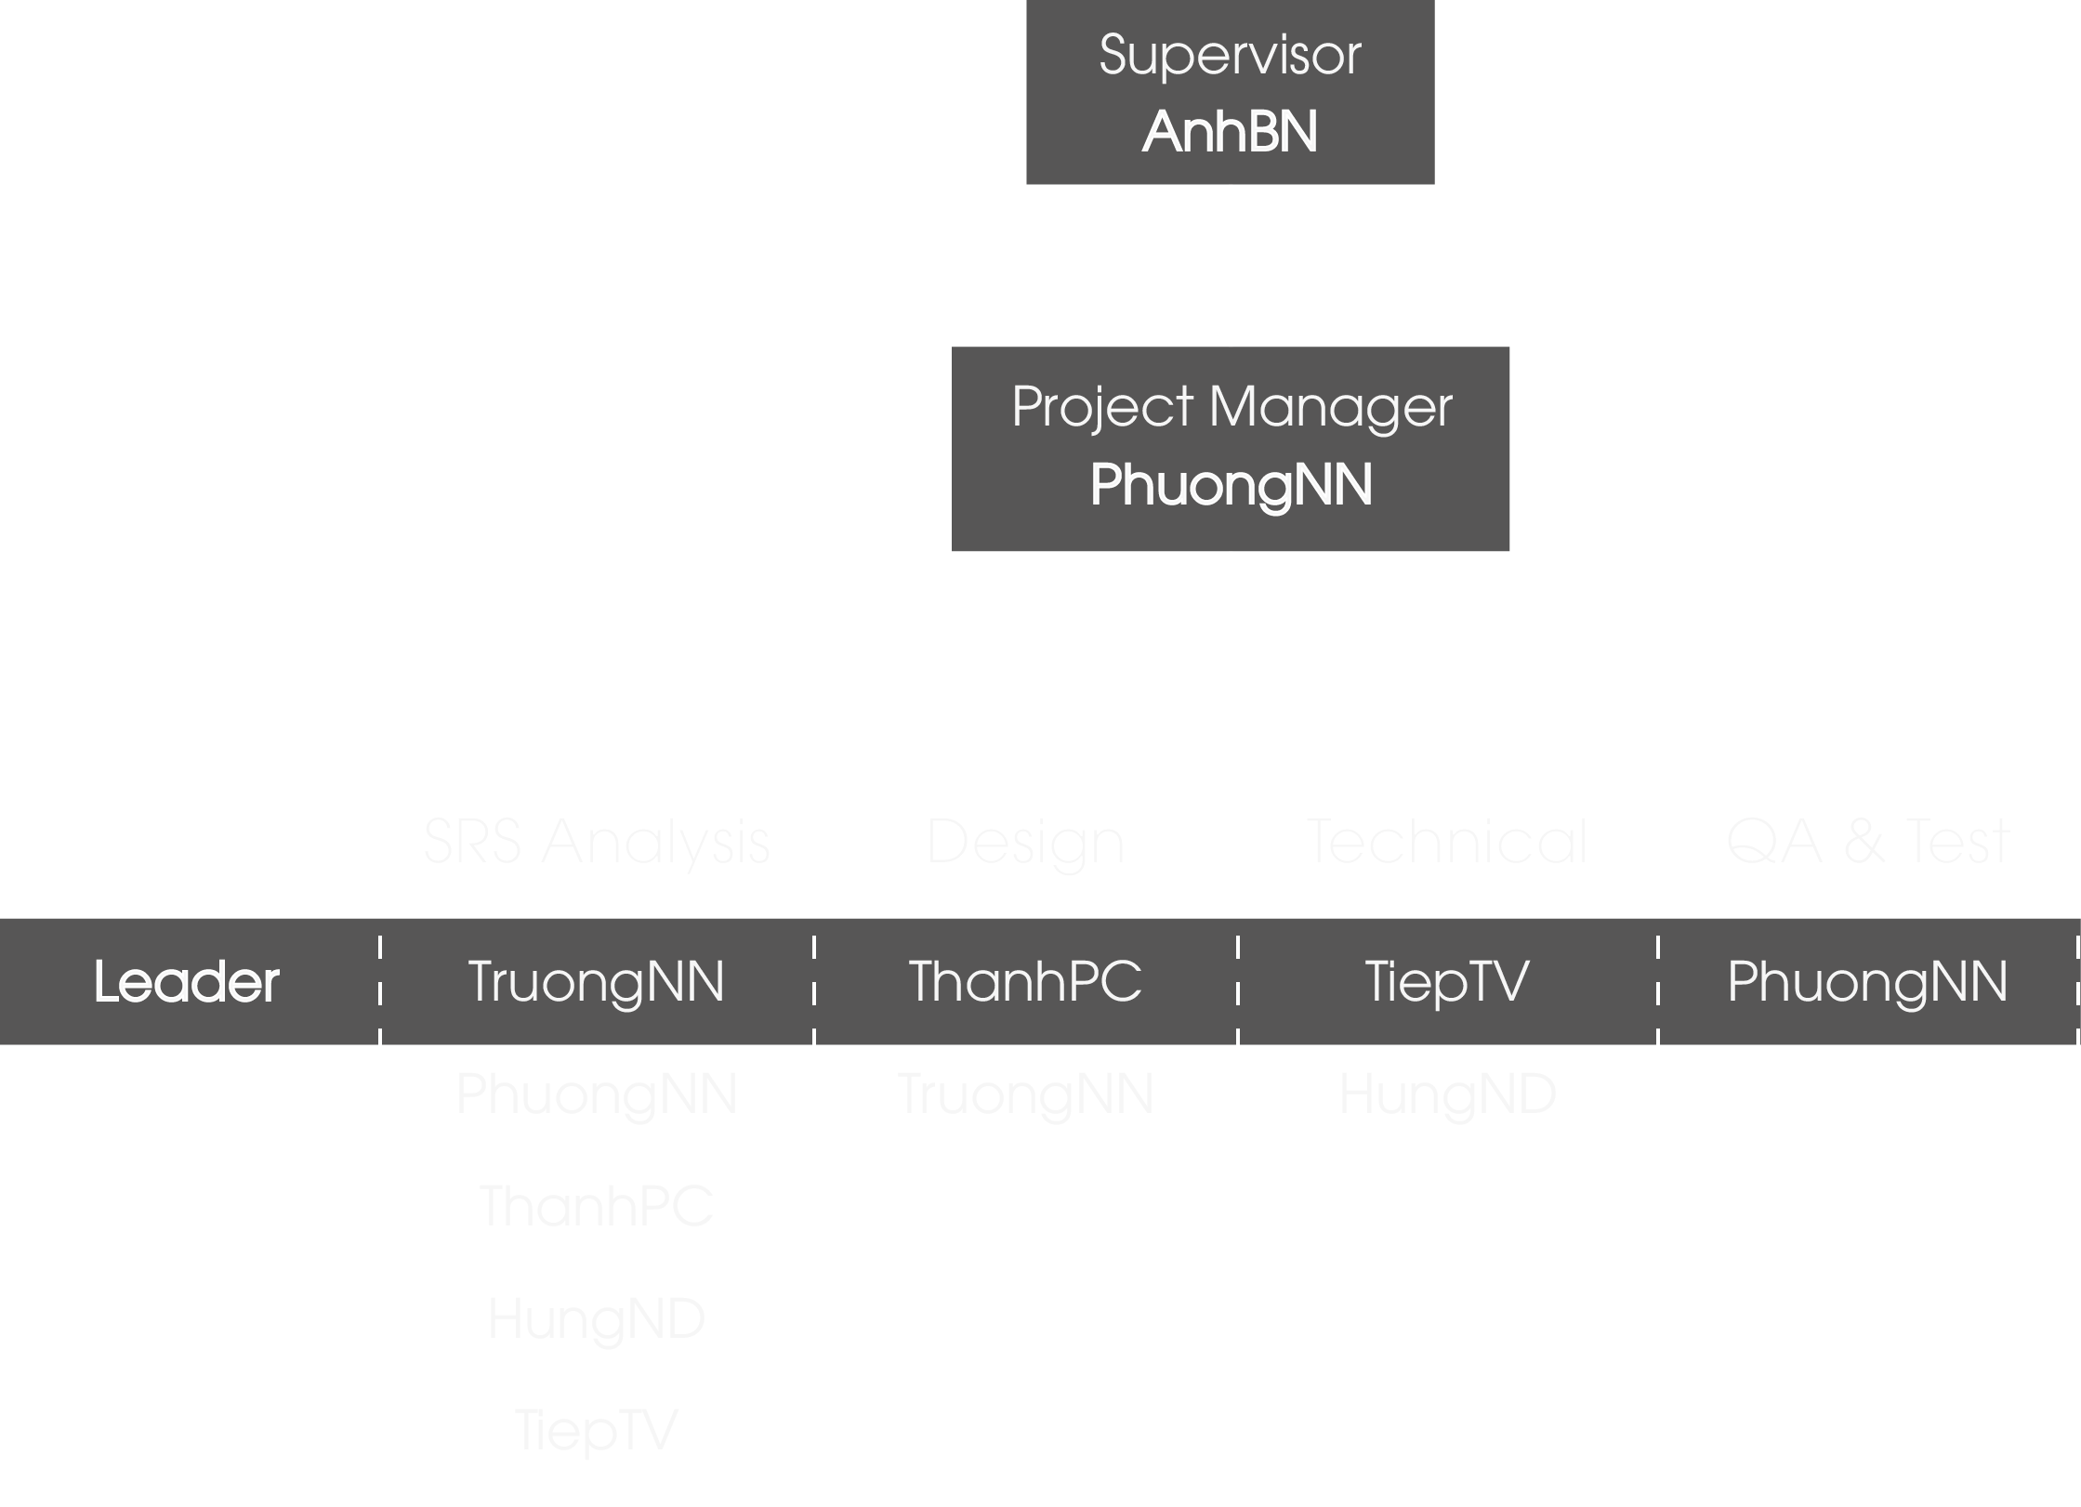
ORGANIZATION STRUCTURE

Slide 14
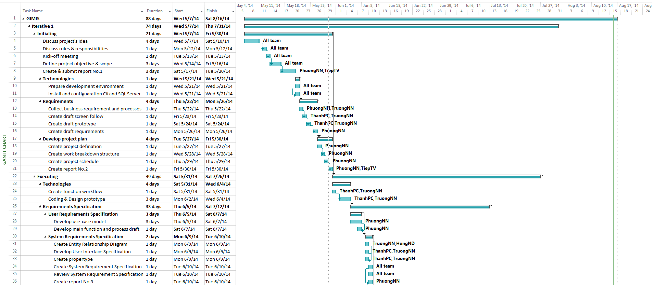
WBS AND GANTT CHART

Slide 15
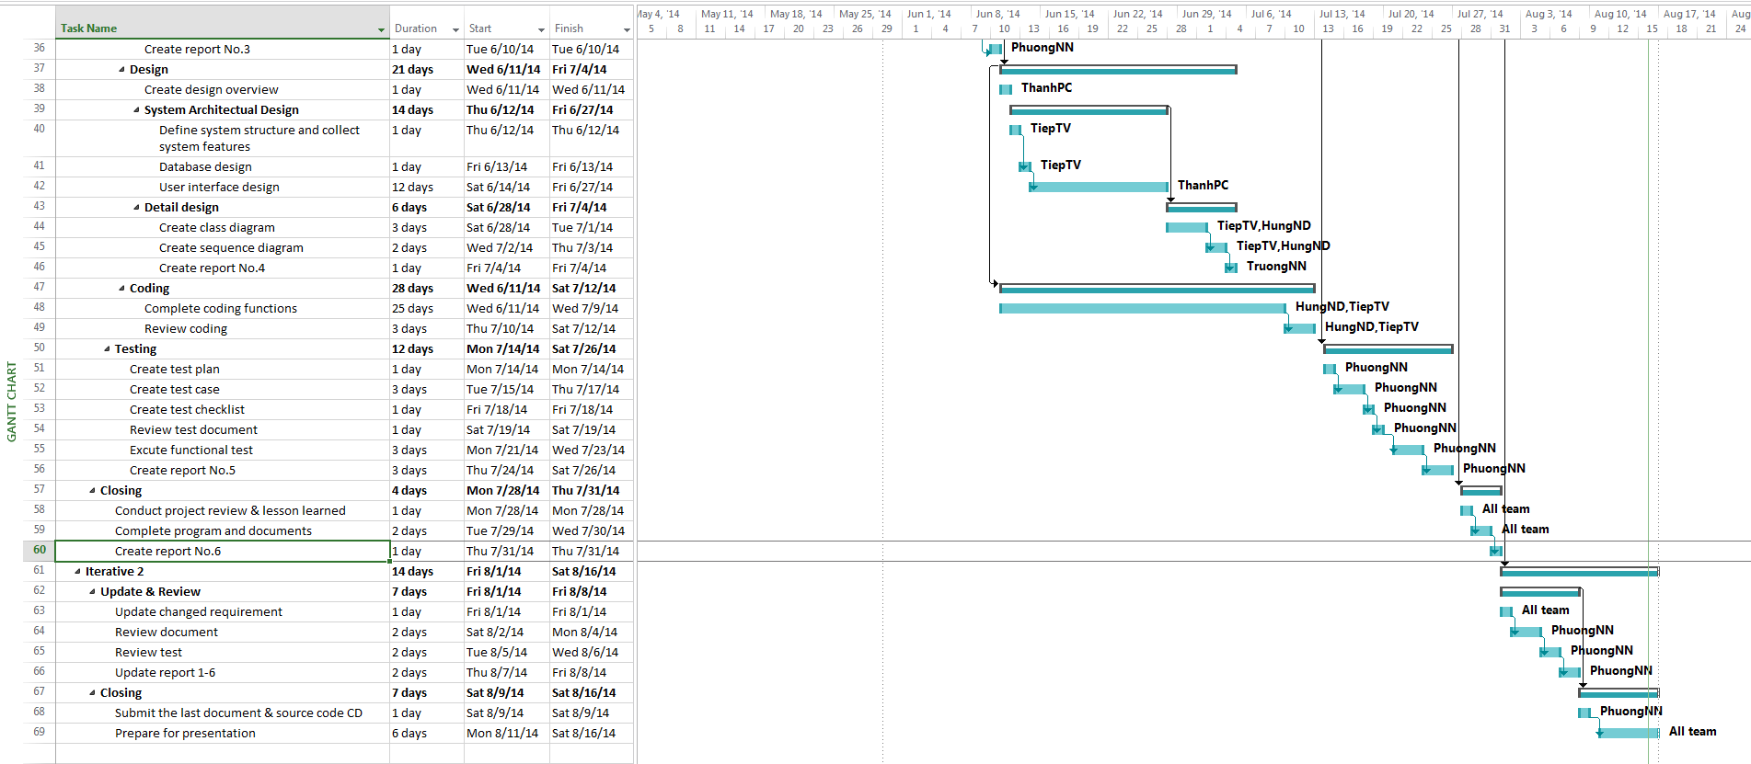
WBS AND GANTT CHART

Slide 16
3. REQUIREMENT SPECIFICATION

Slide 17
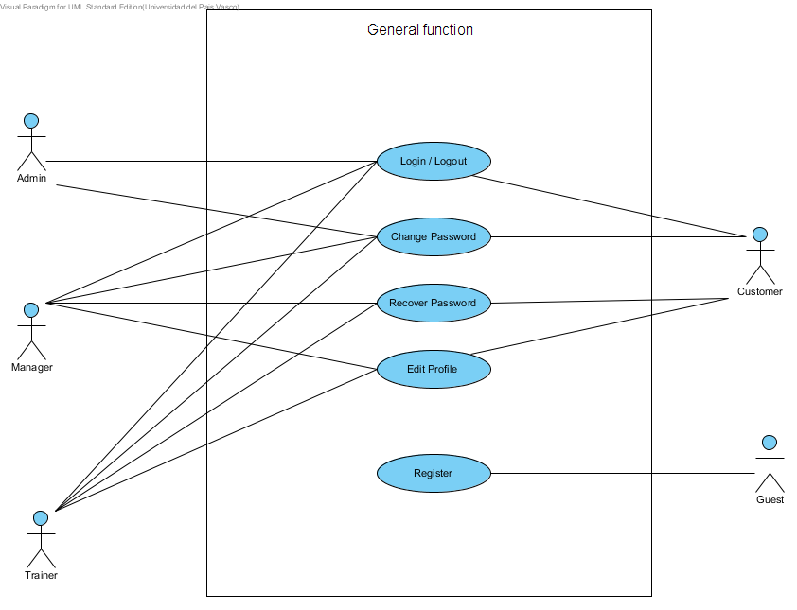
GENERAL

Slide 18
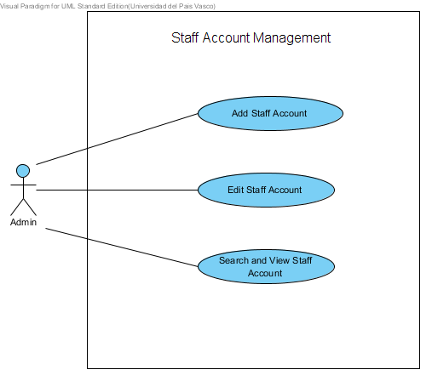
STAFF ACCOUNT MANAGEMENT

Slide 19
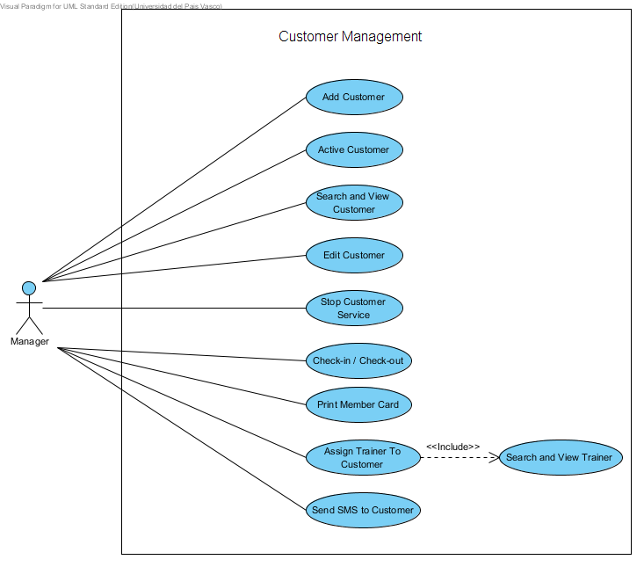
CUSTOMER MANAGEMENT

Slide 20
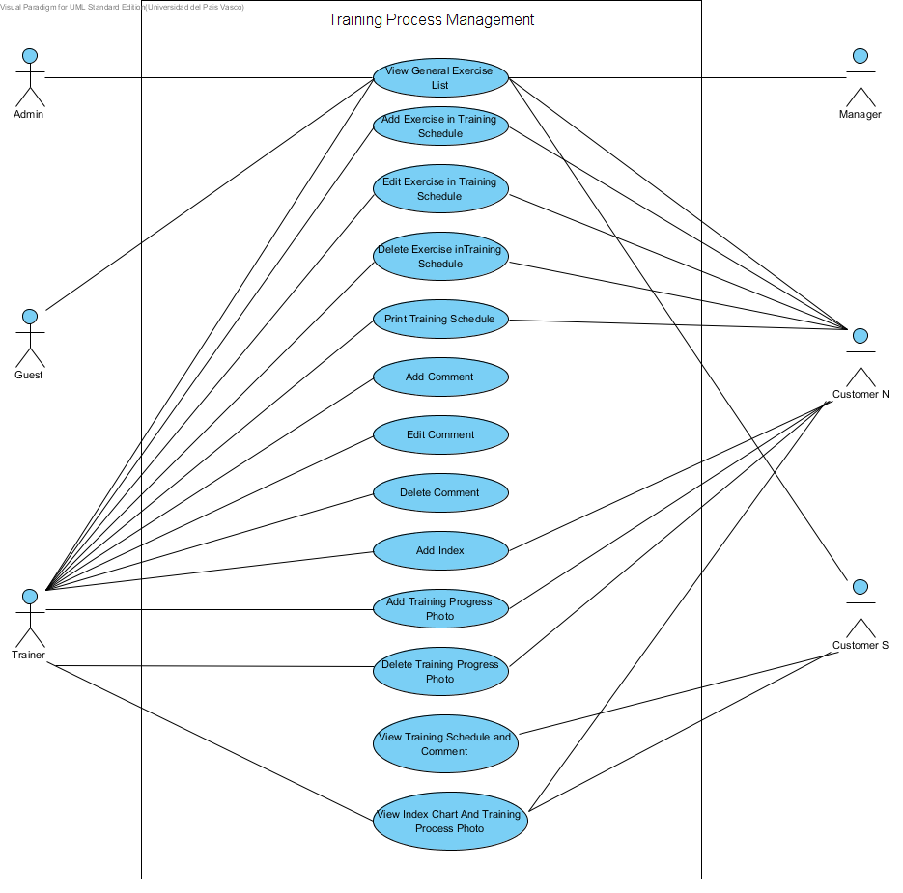
TRAINING PROCESS MANAGEMENT

Slide 21
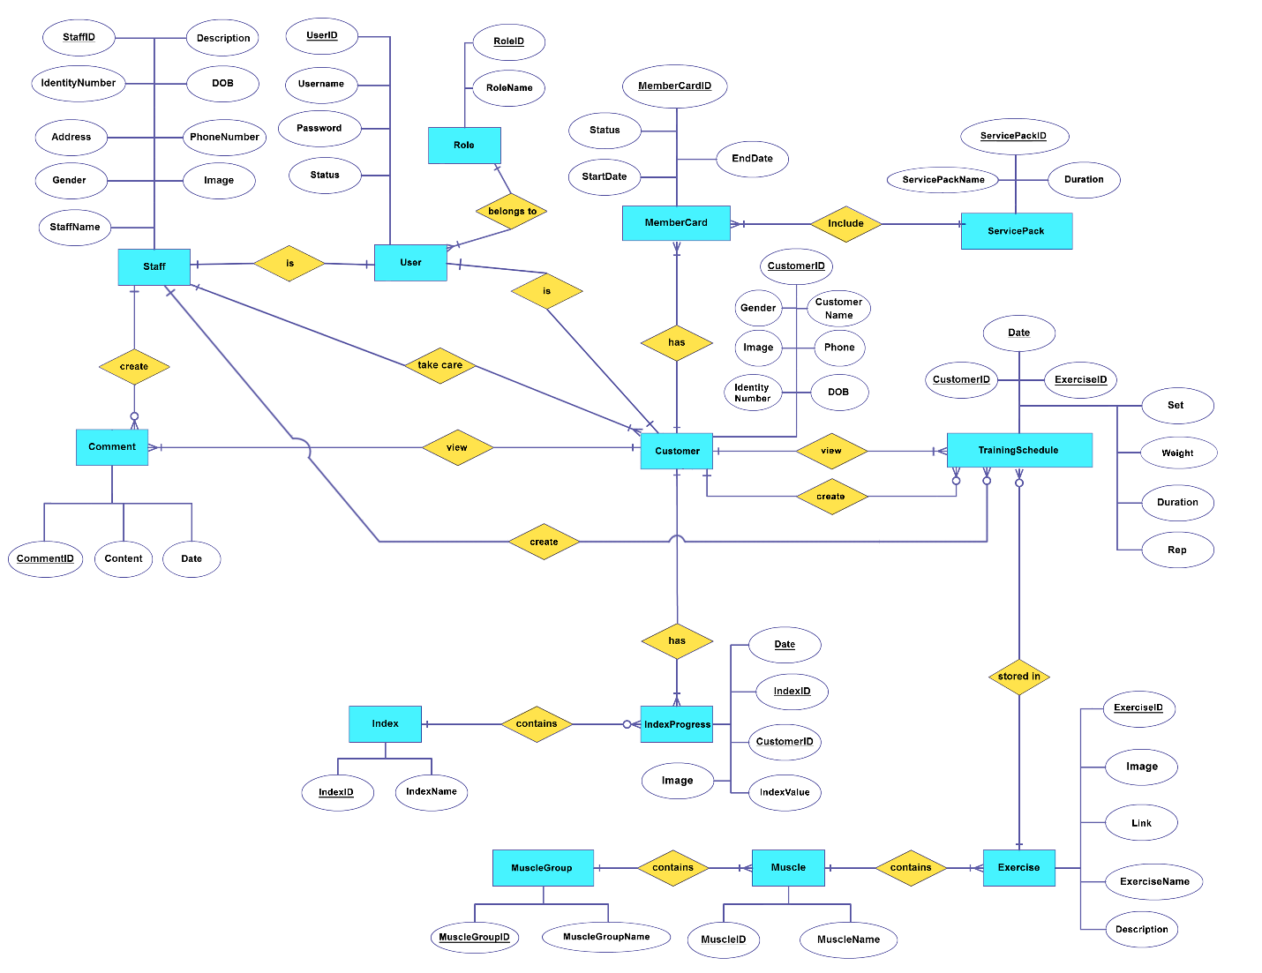
ENTITY RELATIONAL DIAGRAM

Slide 22
SCREEN FLOW

Slide 23
SCREEN FLOW

Slide 24
SCREEN FLOW

Slide 25
SCREEN FLOW

Slide 26
SCREEN FLOW

Slide 27
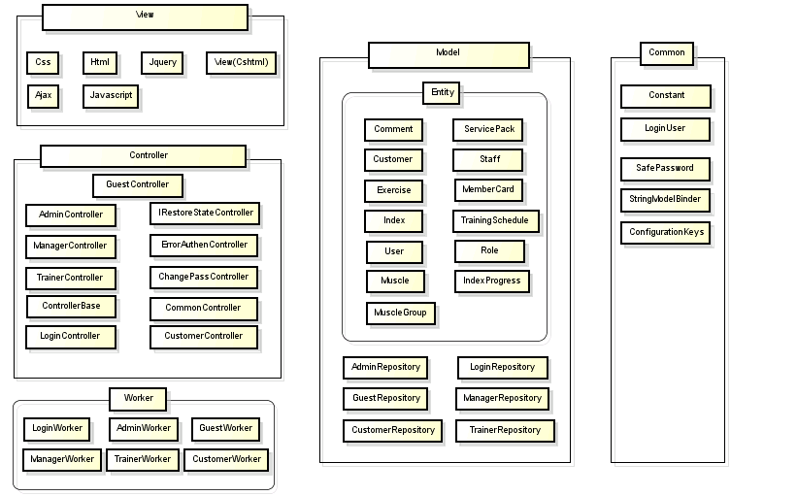
STRUCTURE DIAGRAM

Slide 28
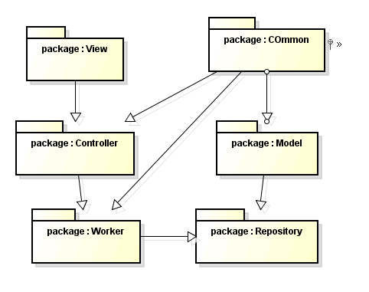
PACKAGE DIAGRAM

Slide 29
4. SOFWARE DESIGN

Slide 30
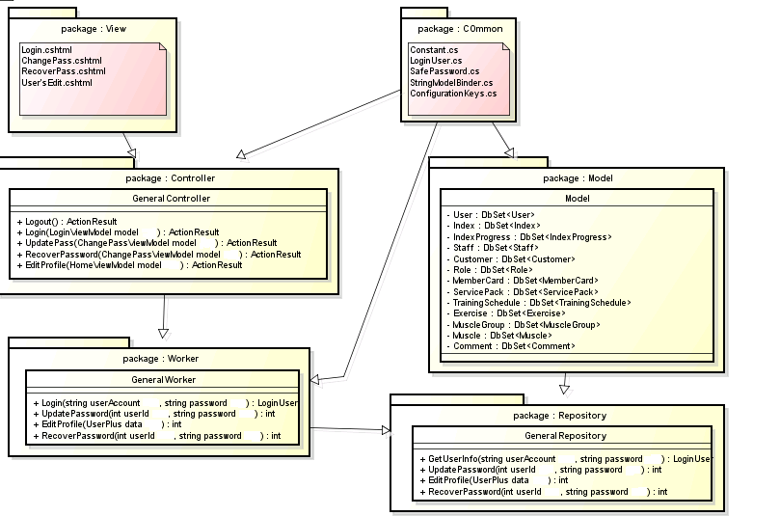
GENERAL GROUP

Slide 31
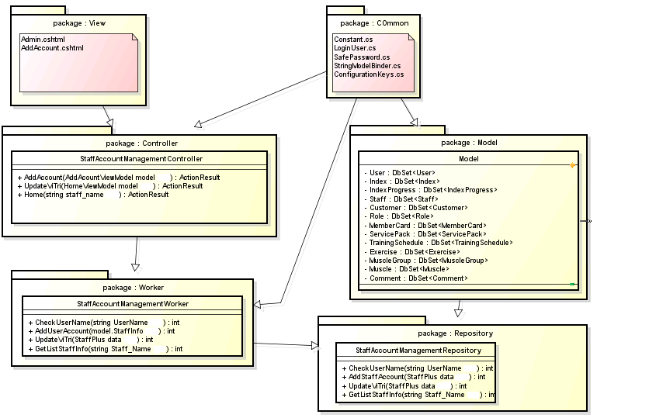
STAFF ACCOUNT MANAGEMENT

Slide 32
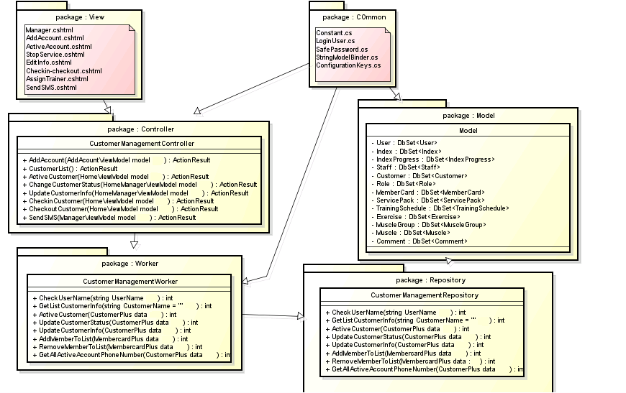
CUSTOMER MANAGEMENT

Slide 33
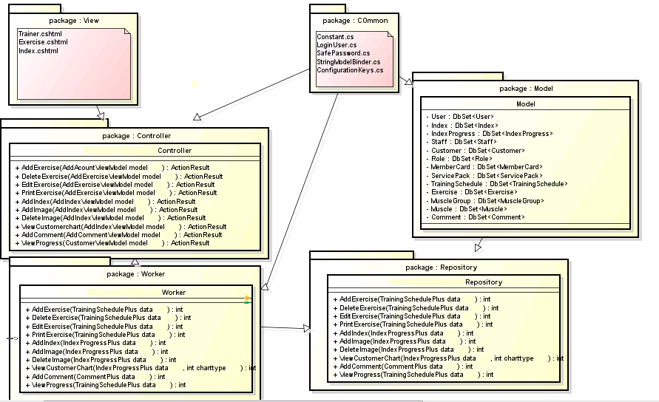
TRAINING PROGRESS MANAGEMENT

Slide 34
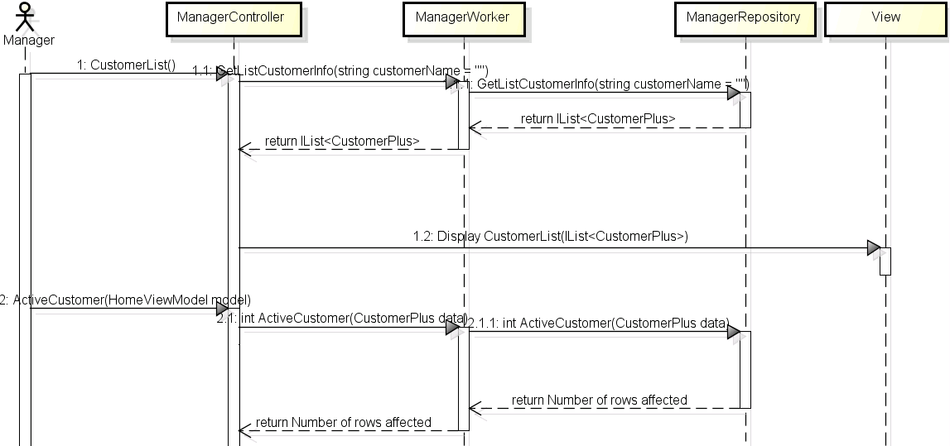
SEQUENCE DIAGRAM

Slide 35
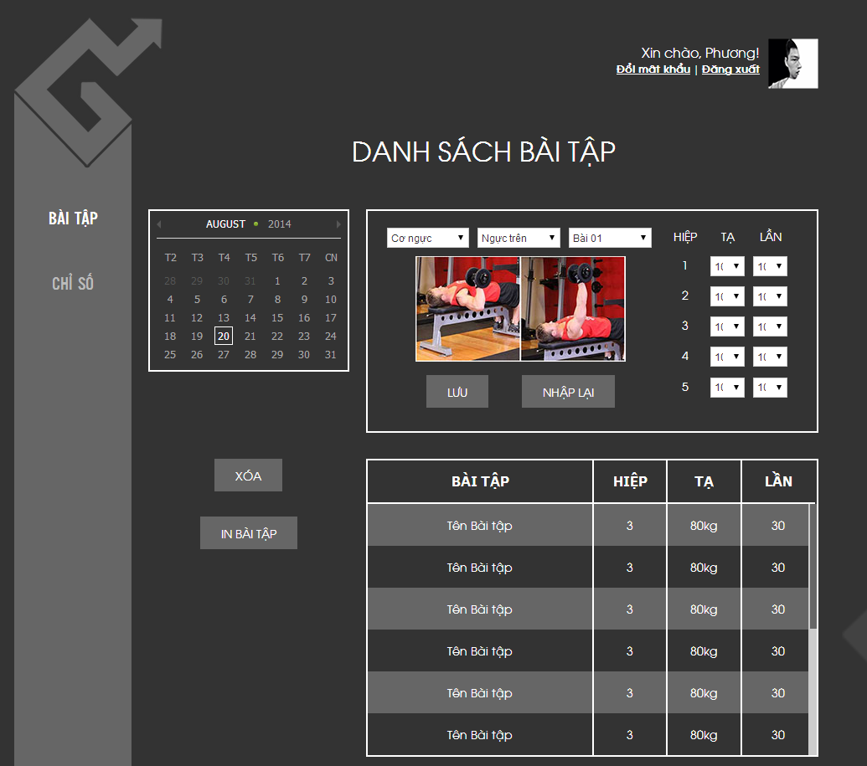
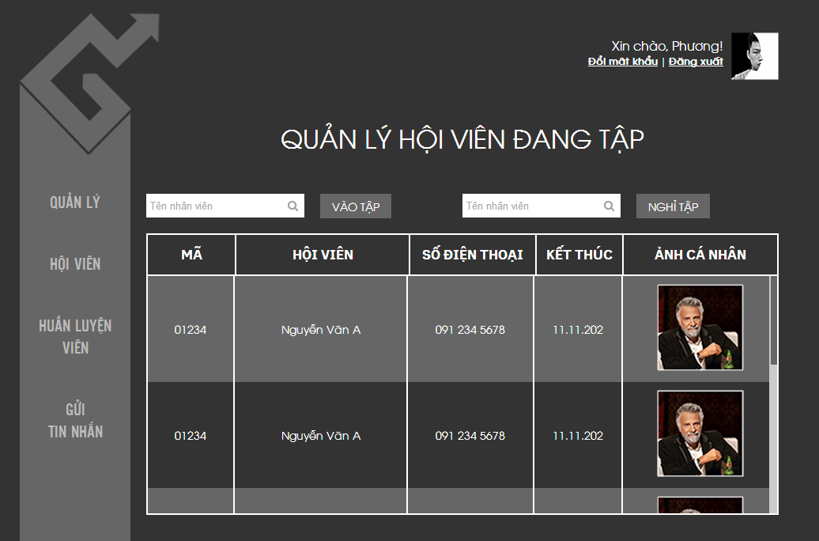
SCREEN DESIGN

Slide 36
5. TESTING

Slide 37
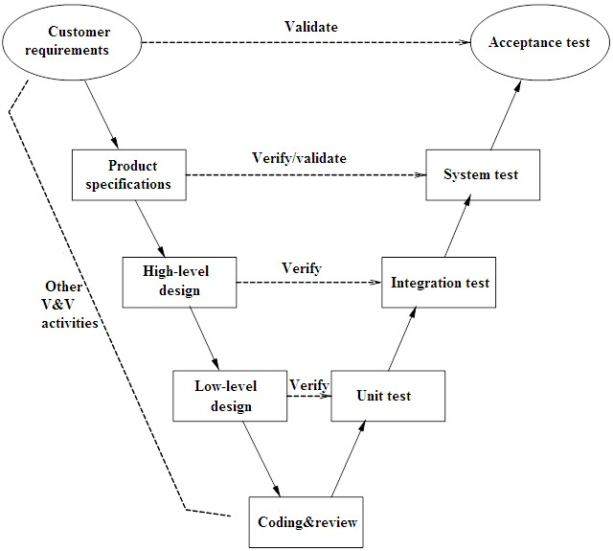
STAGE OF TESTING

Slide 38
TESTING TYPES
GUI TESTING
SYSTEM TESTING
TESTING

Slide 39
TOOLS AND ENVIRONMENT
PURPOSE | TOOLS / ENVIRONMENT | VERSION | SOURCE
Access to web for | Chrome | 33 | Google
 | Firefox | 28 | Mozilla
Test Report | Microsoft Word Office | 2013 | Microsoft
Test Plan | Microsoft Word Office | 2013 | Microsoft
Test Case | Microsoft Excel | 2013 | Microsoft
Test Log | Microsoft Excel | 2013 | Microsoft

Slide 40
6. LESSON LEARNED
Our first lesson we learned that scheduling is going to be a problem. It’s hard to solve problems immediately when we still have schedule in school, assignments, test and other obligations.
As a team we learned that assess the capability of each member in team is a key factor to do Project. At the beginning our project, we don’t understand our own capacity and that lead to our work is not effective as we expect but later we refocus and started pulling things together.

Slide 41
7. Q & A

