Slide 1



HANOI CITY GUIDE
Supervisor
Mr.Tran Binh Duong
Team member
Team member
Nguyen Anh Tuan
(Leader)
Nguyen The Hung
Team member
Team member
Vu Van Duoc
Tien Minh Tuan

Slide 2

CONTENT
Introduction
1
2
Project plan
Requirement
3
Project Design
4
Testing
5
Demo
6
Q & A
7

Slide 3
Introduction
01
Project Background
02
Existing system
03
Proposal & expected system

Slide 4
Project Background

Slide 5
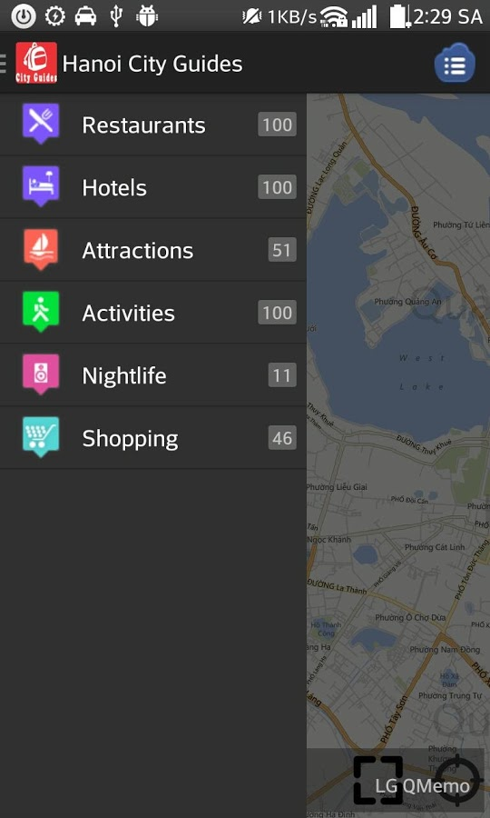
Existing System
1. Hanoi City Guides
Pros:
  A lot of places from Hanoi. Using database from TripAdvisor.com makes it easily updated continuously.
  Has itineraries picked by member of TripAdvisor.com
  Has availability for working offline
Cons:
  Doesn’t provide enough basic informations for travellers/tourists
  Not actually helpful in guiding travellers/tourists, only providing locations.

Slide 6
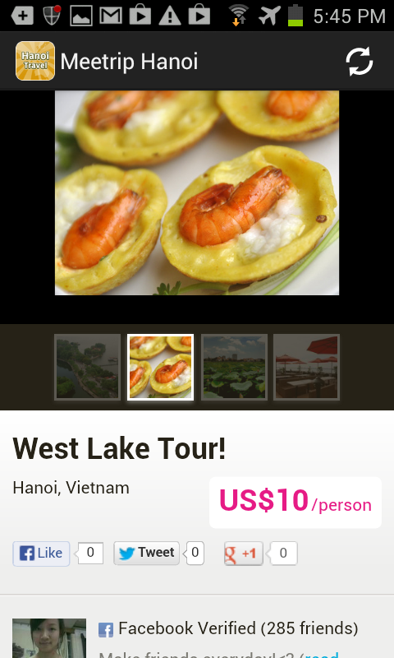
Existing System(2)
2. Hanoi Travel Guide, Local Tour
Pros:
  Has a quite good business idea. Users can directly contact locals and sign up for a low-price trip.
  Users also can ask other local people about weather, clothes, etc, using social interaction (Facebook)
  Booking directy from the app
Cons:
  Requires internet connection to use features. When users travel around city, users won’t always able to connect to internet.
  As the same one above, this app doesn’t provide basic informations for users, make it becomes none-guide at all, just an app for booking and contacting local tourism companies.

Slide 7
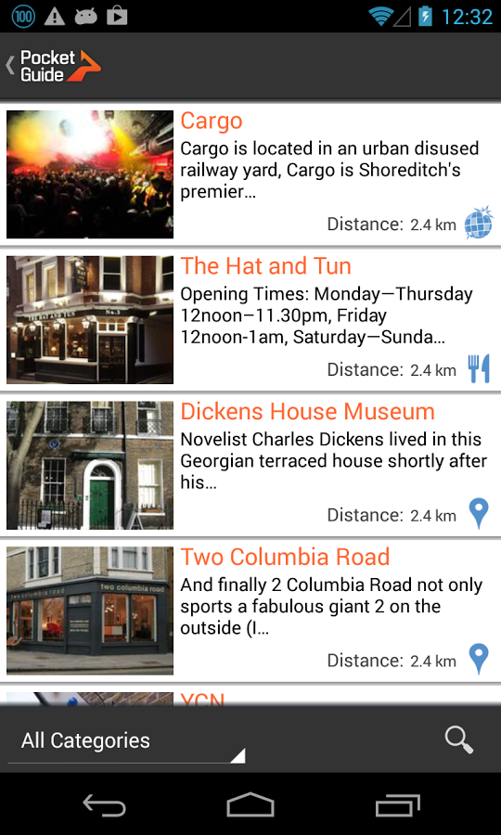
Existing System(3)
3. Pocket Guide
Pros:
  Well designed GUI.
  Suggested tours.
  Support multilingual: Over 10 languages are supported
  Voice guidance: It will guide user with clear audio cues and once user approach a sight it automatically start to tell user about it
  Take photos and comments about places then share to other people about it.
  Available offline
Cons:
  Doesn’t support Hanoi

Slide 8
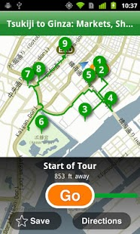
Existing System(4)
4. Tokyo City Guide
Pros:
  Huge database, a lot of restaurants, hotels and attractions.
  Good rating system: Thousands of reviews from users. An remarkable advantage since TripAdvisor is a big company with many users around the world
  Suggested itineraries
  Simple GUI, easy to use
Cons:
  Doesn’t have voice guidance
  Doesn’t have Hanoi guide version

Slide 9

Proposal
Realizing the need of intergrated application that can provide not only basic informations for travellers/tourists but also help them easier when travelling to Hanoi, we want to develop the “Hanoi City Guide” on mobile

Slide 10
Expected System
 | Hanoi City Guide | Hanoi Travel Guide | Pocket Guide | Tokyo City Guide | Our expected product
Provide locations | X |  | X | X | X
Suggested itineraries | X |  | X | X | X
Work offline | X |  | X | X | X
Directly booking |  | X
Routing |  |  | X | X | X
Voice Guidance |  |  | X |  | X
Rating and reviewing system |  |  |  | X
Interact with social network |  | X | X | X | X

Slide 11

Project management plan
01
Software Process Model
02
Work BreakDown Structure
03
Tool & Techniques
04
Risk Management Plan

Slide 12
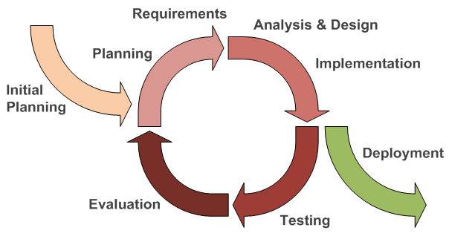
Software Process Model
Allows flexibility in accommodating new requirements or changes thereof
Can learn lessons and get experience from previous iterations to improve more in succeeding iterations
Each iteration is a V-model process, so that testers can take part in project earlier. Combining with IID make testers easier to test and debug during smaller iteration

Slide 13
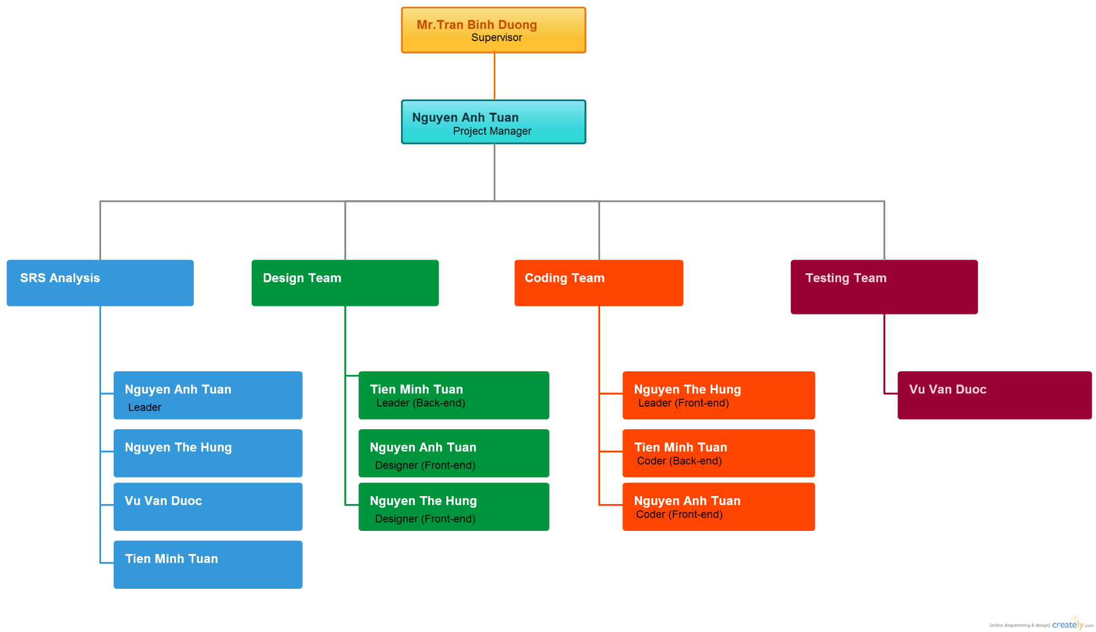
Roles and Responsibilities

Slide 14
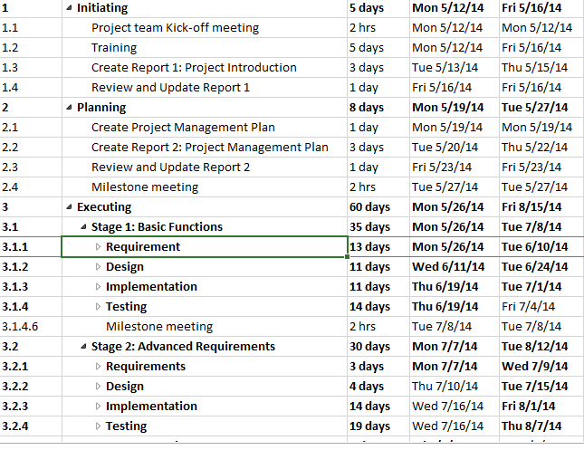
Work Breakdown Structure

Slide 15
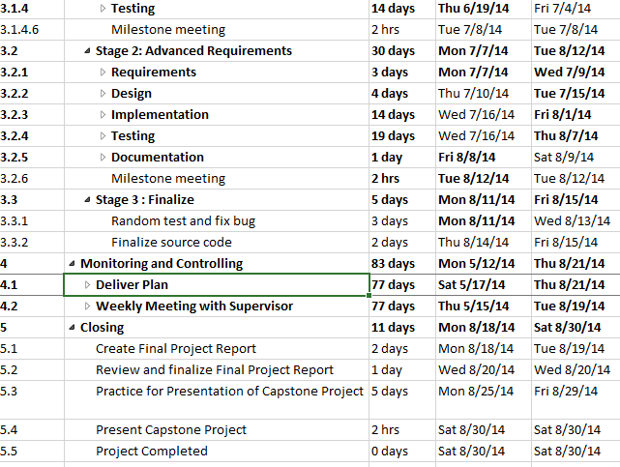
Work Breakdown Structure(2)

Slide 16
Tool & Techniques
Language: Java.
Architecture and design patterns: Multi-tiers.
Database: SQL Server.
Development tools: Eclipse ADT, Microsoft SQL Server 2008.
Design tools: Astah community, LucidChart, Creately
Communication tools: Facebook, Skype, Google mail, Phone.
Document tools: Microsoft Office 2010, Microsoft Project 2013

Slide 17
Risk Management Plan
ID | Description | Avoidance plan | Contingency plan | Status
1 | Overestimate or underestimate time of project | - Define detail plan in each working phase. - Major functions must be in high priority. - Ask supervisor for advices. | - Implement tasks concurrently. - Work overtime. | Closed
2 | Conflicts between team members | - Regularly organize team buildings to improve members’ spirit. | - Team members should make concession to each other. - All team should analyze and find a way to become reconciled. | Closed
3 | Requirement changing | - Carefully brainstorm among team members. - Regularly hold meetings to define and discuss all features in project. | -Team meetings with supervisor to determine whether features should be implemented or not. - Project manager creates implementation plan for implemented features and push progress quickly. | Closed
4 | Member is sick | - Define a suitable schedule to guarantee member’s health. | - Share work to other members to meet work deadline. | Closed
5 | Lack of executing skills | - Define what skills are needed, then have training or learning for those specific skills | - Ask for advice from supervisor or experimenced person | Closed
6 | Hardware unavailability | - Define a schedule to backup project’s data. | - Restore project’s data. | Closed

Slide 18

Requirement Specification
01
Functional Requirements
02
Non-Function Requirements

Slide 19
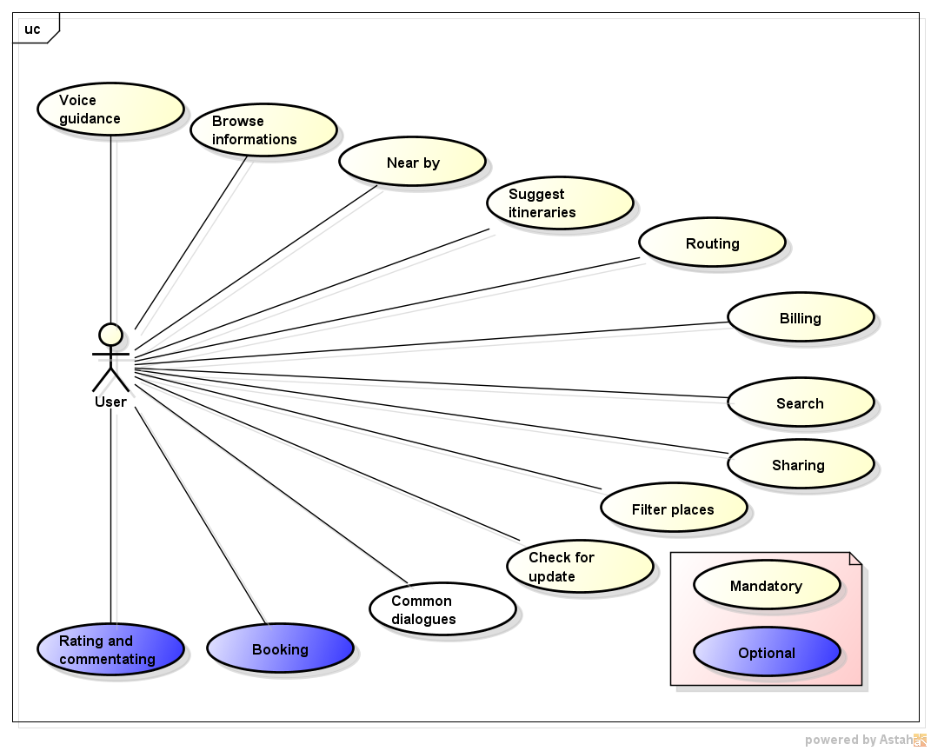
Functional Requirements
Use-case Diagram of User

Slide 20
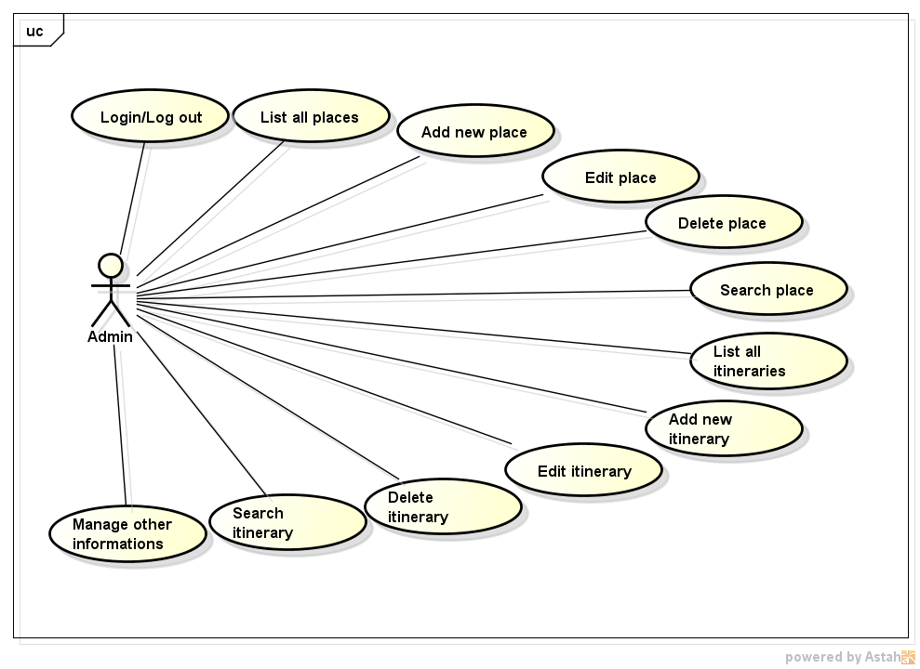
Functional Requirements(2)
Use-case Diagram of Admin

Slide 21
Non-Functional Requirements
Usability and Design constrains
Maintainability
UI is flexible and coherent,easily with all users
Images are in high quality 800x600(pixel)
Normal user can be familiar with application within 30 minutes
Product can be easily modified and extended
The places can be easily added, editted and also removed
Other additional informations can be added in future such as addresses of banks and ATMs, weather forecast, etc
Performance
Flexible
The data loading process must be running in a small amount of time less than 30 secs.
When adding places in back-end, accuracy of geographic coordinates is less than 50 metres
Product will be used regularly with a new set of initial data and can accommodate changes in database such as modifying the contents

Slide 22
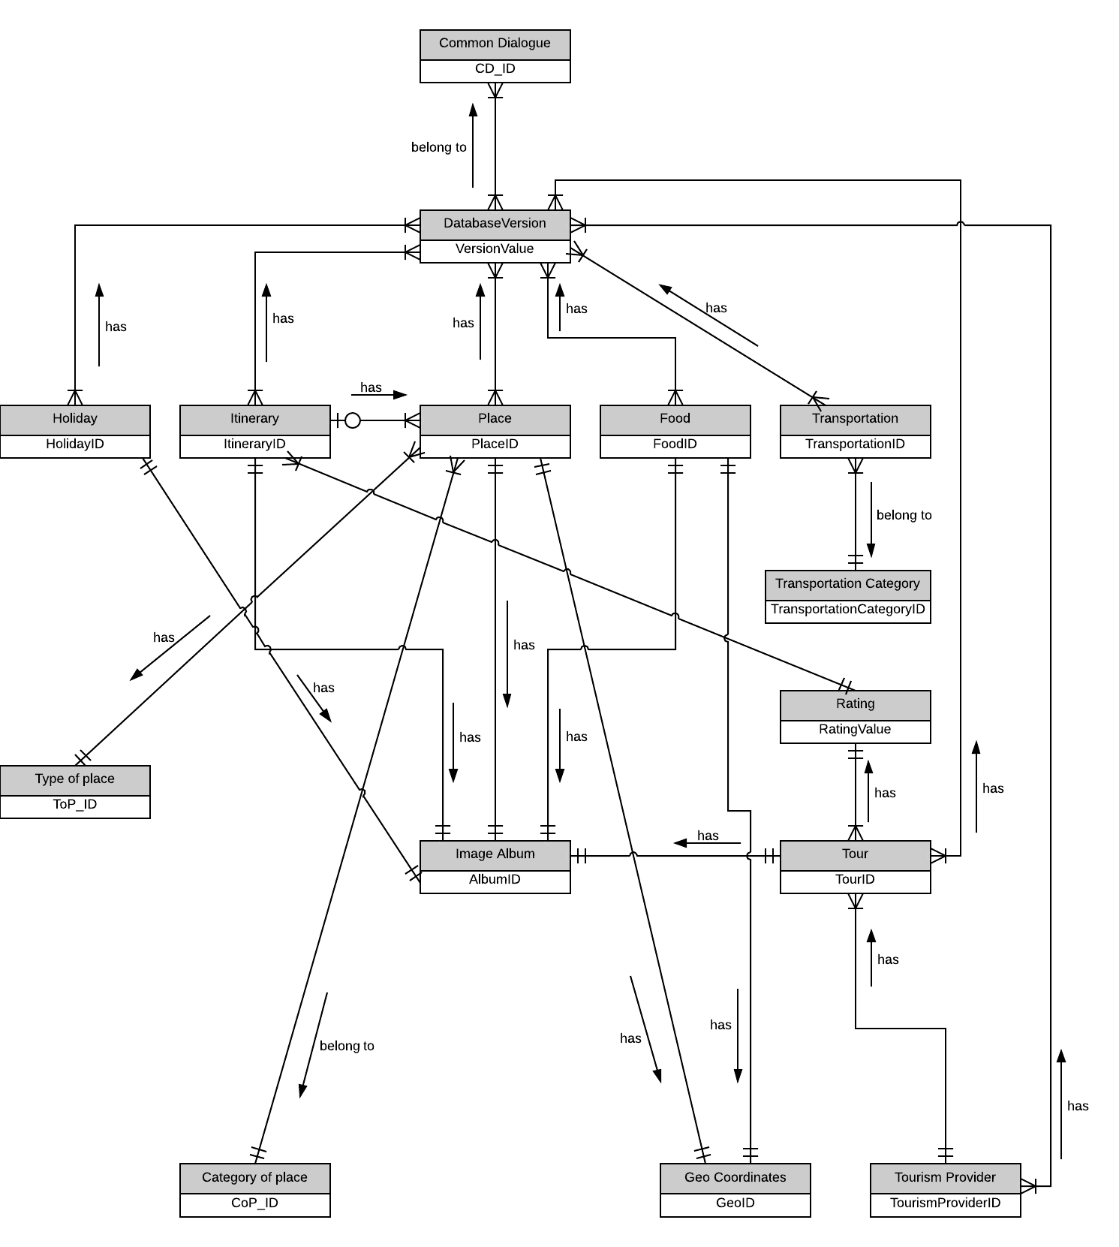
Entity-Relationship Diagram

Slide 23
Software Design
01
System Architecture Design
02
Component Diagram
03
Detailed Design
04
Database Design

Slide 24
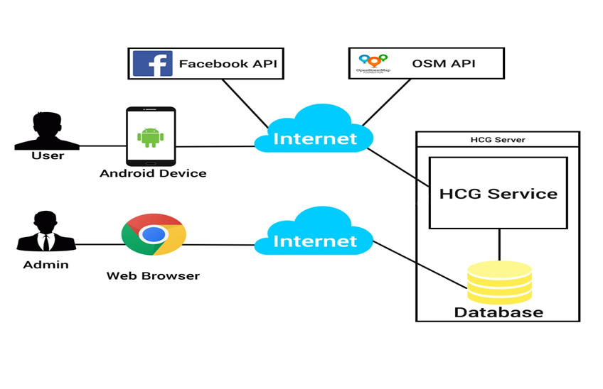
Overall System Architecture Design

Slide 25
Client Degisn

Slide 26
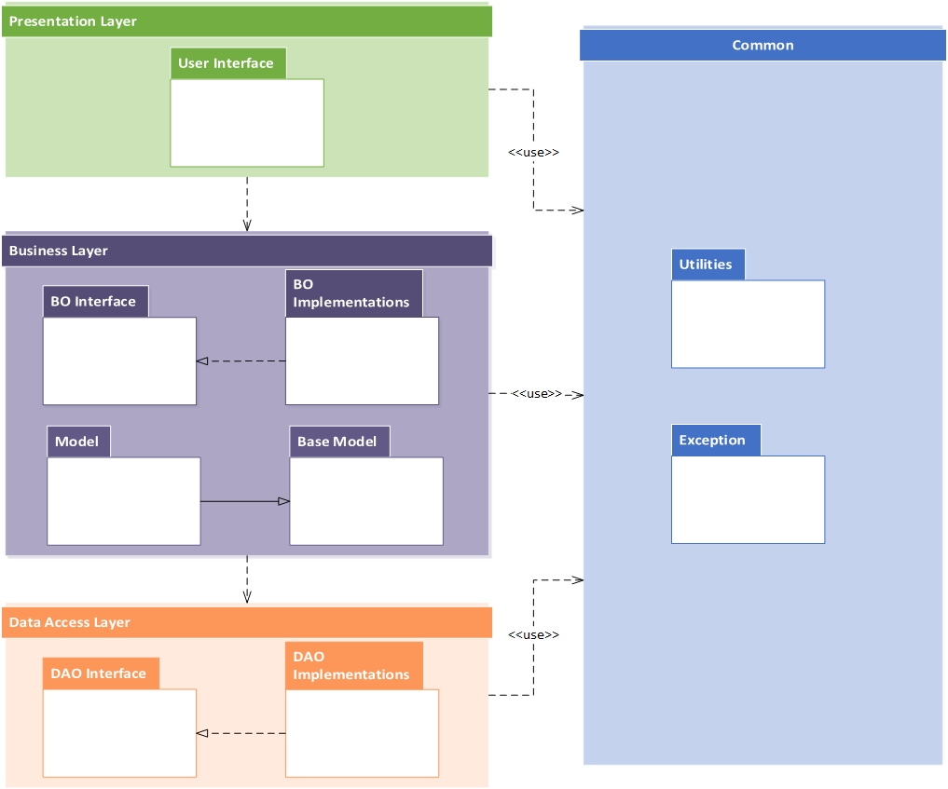
Logical View

Slide 27
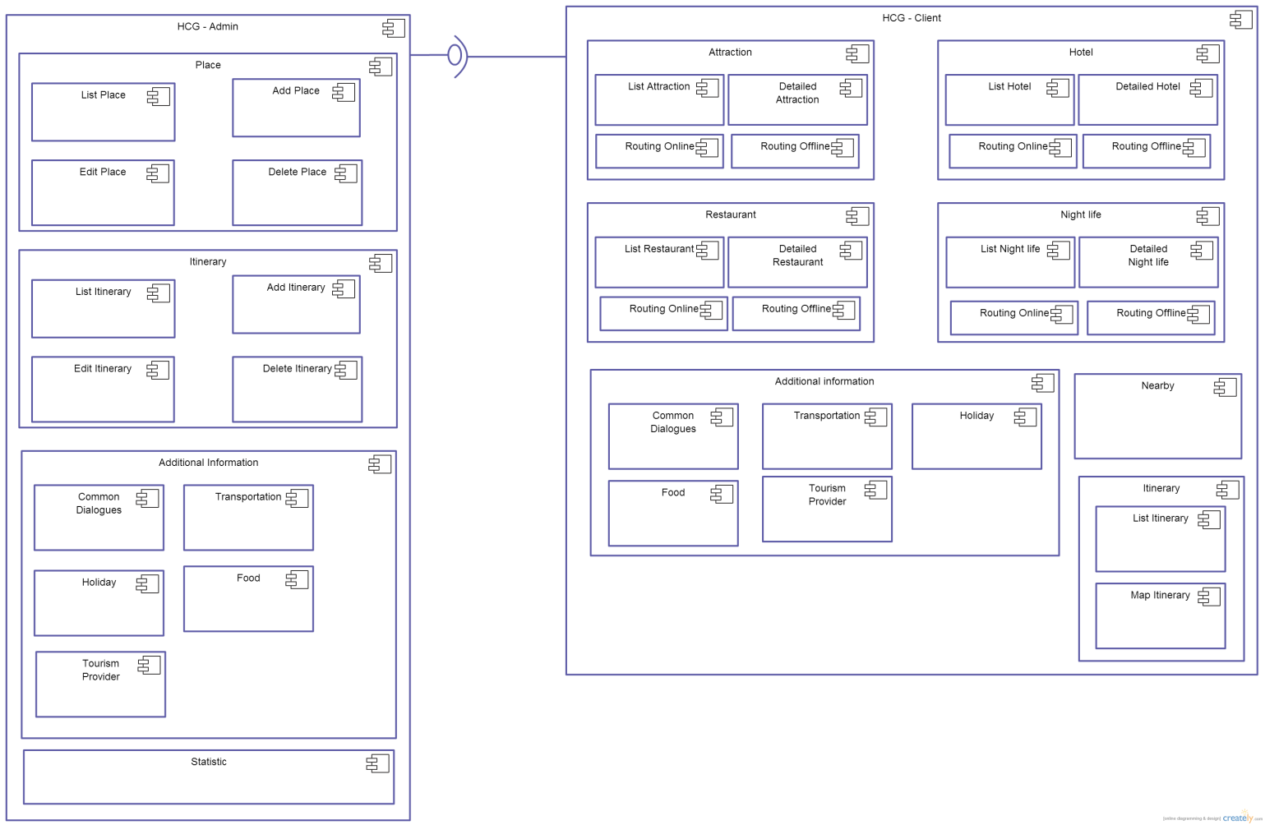
Component Diagram

Slide 28
Detailed Design - User
List Attraction Class diagram

Slide 29
Detailed Design - User(2)
List Attraction Sequence diagram

Slide 30
Admin Design

Slide 31
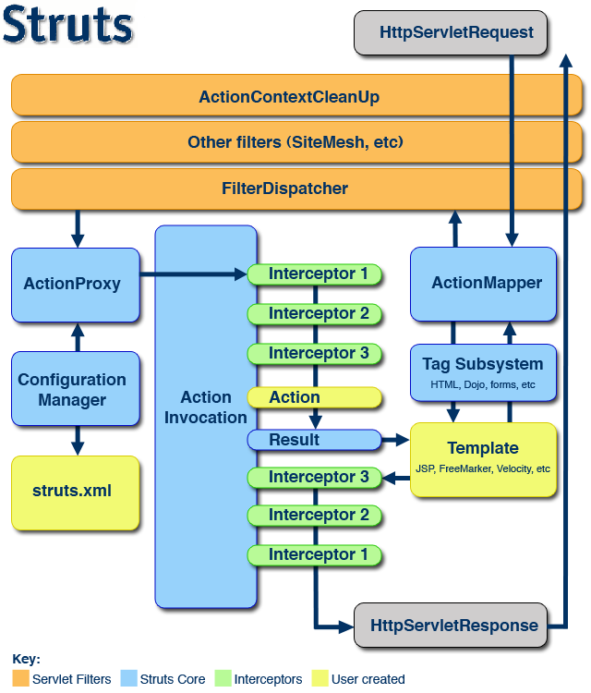
Framework

Slide 32
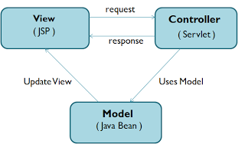
Design Pattern

Slide 33
Detailed Design - Admin
View All Places Class Diagram

Slide 34
Detailed Design – Admin(2)
View All Places Sequence Diagram

Slide 35
Database Design

Slide 36
Testing
Testing model
Test result
Testing Process
Test Environment
Test case
Test Milestones

Slide 37
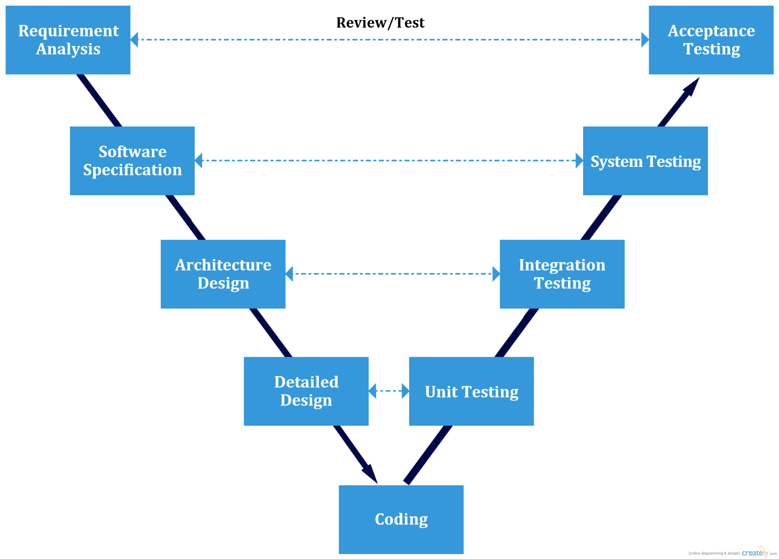
Testing Model

Slide 38
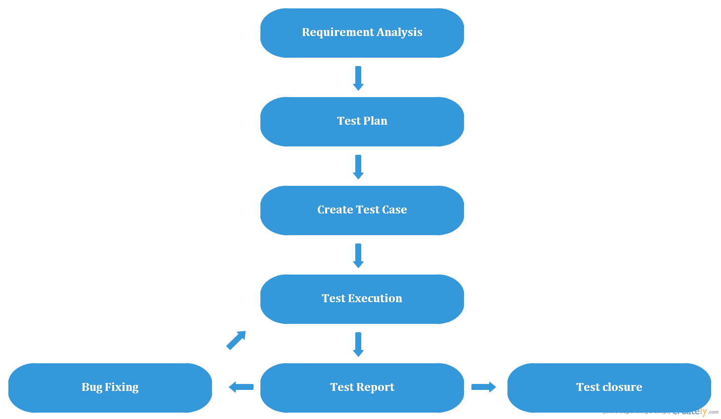
Testing Process

Slide 39
Test Environment
Hardware Requirements
  Android devices with OS 4.0 and above
Software Requirements
  Google Chrome 35.0.1916.153 m
  Sql Server 2008 R2 Enterprise
Connection
  3G or Wifi connection

Slide 40
Test Milestones
 | Milestones Task | Start Date | End Date
Phase 1 | Create test plan | 01/07/2014 | 08/07/2014
Phase 2 | Create test case for [Admin] | 13/07/2014 | 14/07/2014
Phase 3 | Create test case for [Browse information], [Search] and [Filter places] | 15/07/2014 | 20/07/2014
 | Create test case for [Near by] , [Routing] , [Suggested itineraries] and [Home screen] | 21/07/2014 | 23/07/2014
 | Create test case for [Voice guidance],[Check for update], [Billing] and [Common dialog] | 24/07/2014 | 25/07/2014
Phase 4 | Execute test for [Admin] | 26/07/2014 | 27/07/2014
Phase 5 | Execute test for [Browse information], [Search] and [Filter places] | 28/07/2014 | 04/08/2014
 | Execute test for [Display near by places],[Routing] and [Suggested itineraries],[Billing] | 05/08/2014 | 08/08/2014
 | Execute test for [Voice guidance],[Check for update] and [Common dialog] | 09/08/2014 | 11/08/2014
Phase 6 | System test for full functions | 12/08/2014 | 15/08/2014

Slide 41
Test case
Module Code | Suggested itineraries
Tester | DuocVV
Test date | 15-Aug
ID | Description | Procedure | Expected output | Type of testing | Status
[Search place-1] | Check search place field | 1.Look at search field in List all places screen | 1. - Control type : Textbox - Data type : Text - Default value : "Search" in blurred - Status : Editable - Function : input keyword to search | GUI | Pass
[Search place-2] | Validate input text field to search | 1.Input no keyword | 1.No action occurred | GUI | Pass
[Search place-3] |  | 1.Input one keyword 2.For example : - Input "Ho" - Input "an" | 1.Records of places that contain keyword will be displayed. 2. - All records that contain "Ho" will be displayed - All records that contain "an" will be displayed | GUI | Pass
[Search place-4] |  | 1.Input two keywords separated by a space 2.For example : - Input "Ho Guom" - Input "an mie" | 1.Records of places that contain keywords will be displayed. 2. - All records that contain "Ho Guom" will be displayed - All records that contain "an mie" (Van Mieu) will be displayed | GUI | Pass
[Search place-5] |  | 1.Input two keywords separated by many spaces 2.For example : - Input "Ho Guom" - Input "an mie" | 1.Records of places that contain keywords will be displayed. 2. - All records that contain "Ho Guom" will be displayed - All records that contain "an mie" (Van Mieu) will be displayed | Function | Pass
[Search place-6] |  | 1.Input invalid keyword | 1a.No record of place will be displayed 1b.Title "No matching records found" will appear 1c.Number of records will disappear.It's replaced by title "Showing 0 to 0 of 0 entries(filtered from (number of records) total entries)" 1d.Paging number will disappear | Function | Pass

Slide 42
Test Result

Slide 43
Lesson Learned
Technologies :
Java
Framework : Struts 2
API : Facebook API, OSM API..
Soft skills :
Teamwork
Team motivation

Slide 44
01
02
Demo
03
www.PowerPointDep.net

Slide 45
Q&A

