Slide 1
MUSIC IN ME
Supervisor : Trần Đình Trí

Slide 2
TEAM G5
Trần Hà Huy
Bùi Quốc Anh
Nguyễn Phúc Lộc
Trần Quang Tùng
Hoàng Anh Minh

Slide 3
Content outline
Introduction
Project Management Plan
Software Requirement Specification
Software Architecture Design
Testing
Q&A and Demo

Slide 4
Introduction
Content:
Background
Existing solutions
Our purpose

Slide 5
Introduction(cont)
Background
Nowadays, music is a basic need of human
Especially, demand for online music is driving the digital world
- The online music sites such as Spotify, Youtube grown 32% while CD sales fell 14% in the U.S market(*)
- A statistics from BritORA (The British Online Retailing Association) shows that online music grew 33.7%(**)
Online music is a very potential market not only in the world but also in Vietnam
(*): http://www.bbc.com/news/entertainment-arts-25650359
(**): http://www.bbc.com/news/entertainment-arts-25650359

Slide 6
Introduction(cont)
Background
Vietnam online music sites:
Pros: They have a rich resource of music and easy to find
Cons: Interaction with end-users and data synchronization are still poor

Slide 7
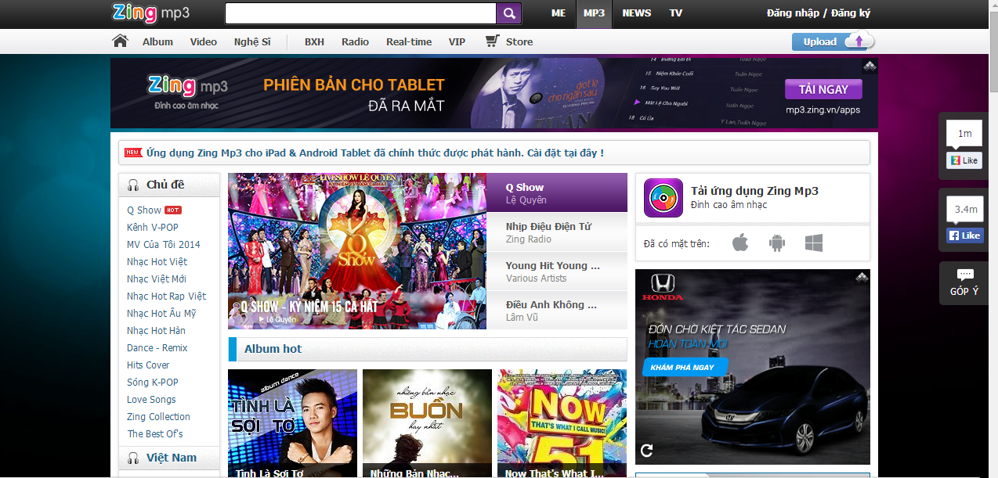
Introduction(cont)
Existing solutions
www.mp3.zing.vn

Slide 8
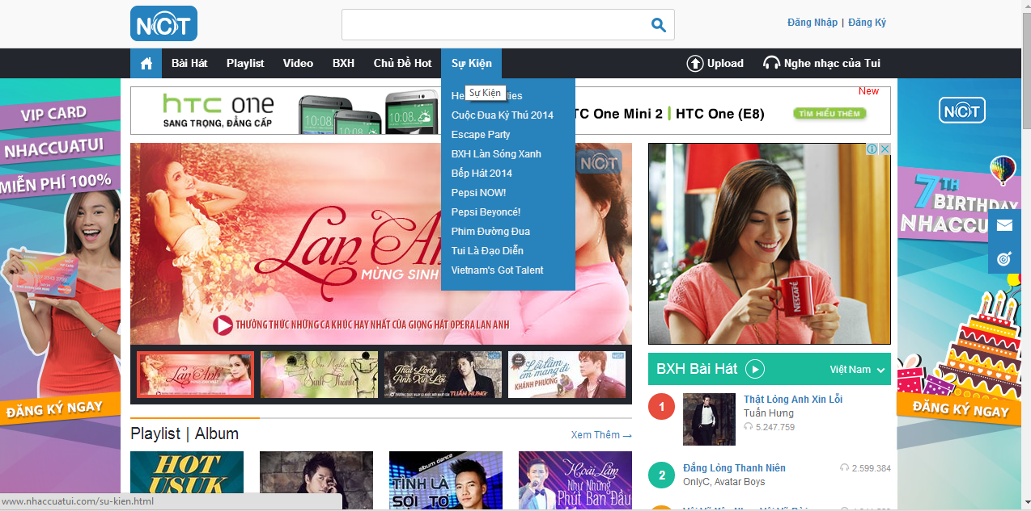
Introduction(cont)
Existing solutions
www.nhaccuatui.com

Slide 9
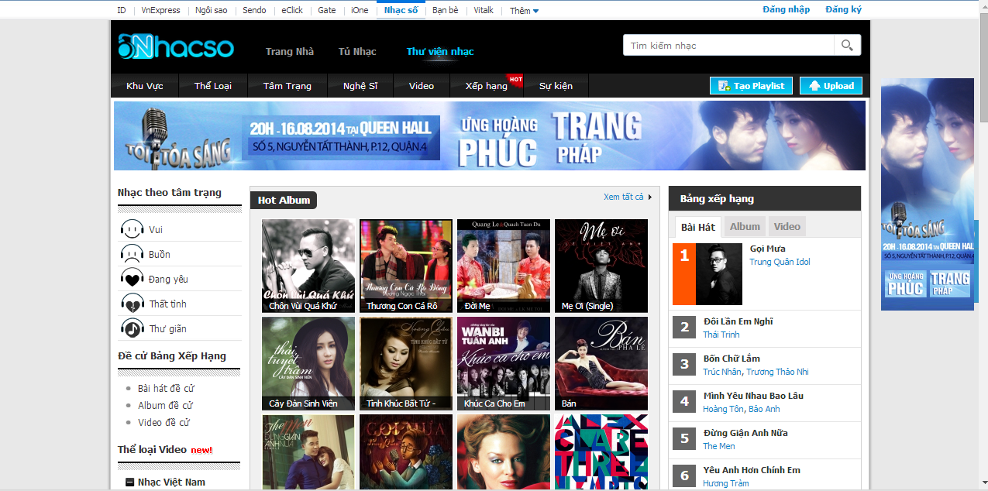
Introduction(cont)
Existing solutions
www.mp3.zing.vn

Slide 10
Introduction (cont)
Our purpose
We will create a online music website with name MIM(Music in Me)
End-users in Vietnam can experience music in a new way
Can access MIM anytime and anywhere with stable speed
Can enjoy in real-time from MIM

Slide 11
Introduction(cont)
Base on some new technologies:

Slide 12
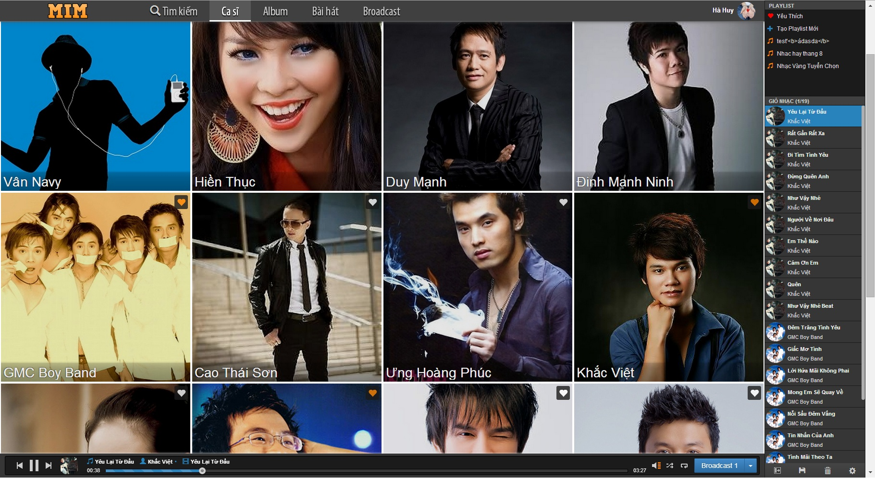
Introduction(cont)
MIM GUI

Slide 13
Project Management Plan(cont)
Content:
Software Process Model
Role & Responsibilities
Project Schedule
Developing Environment

Slide 14
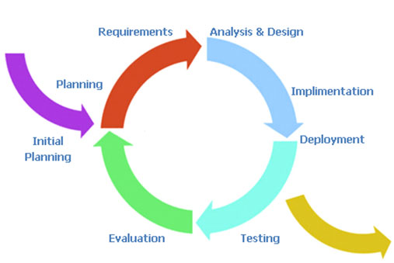
Project Management Plan(cont)
Software Process Model
Iterative Model

Slide 15
Plan(cont)
Role & Responsibilities
Superviser
TriTD
Documenter
Analyst
Project Manager HuyTH
Designer
Developer
Tester
Quality Assurance
TungTQ
AnhBQ
MinhHA
TungTQ
HuyTH
LocNP
AnhBQ
HuyTH
LocNP
TungTQ
HuyTH
LocNP
TungTQ
AnhBQ
MinhHA
AnhBQ
MinhHA
TungTQ
LocNP
MinhHA

Slide 16
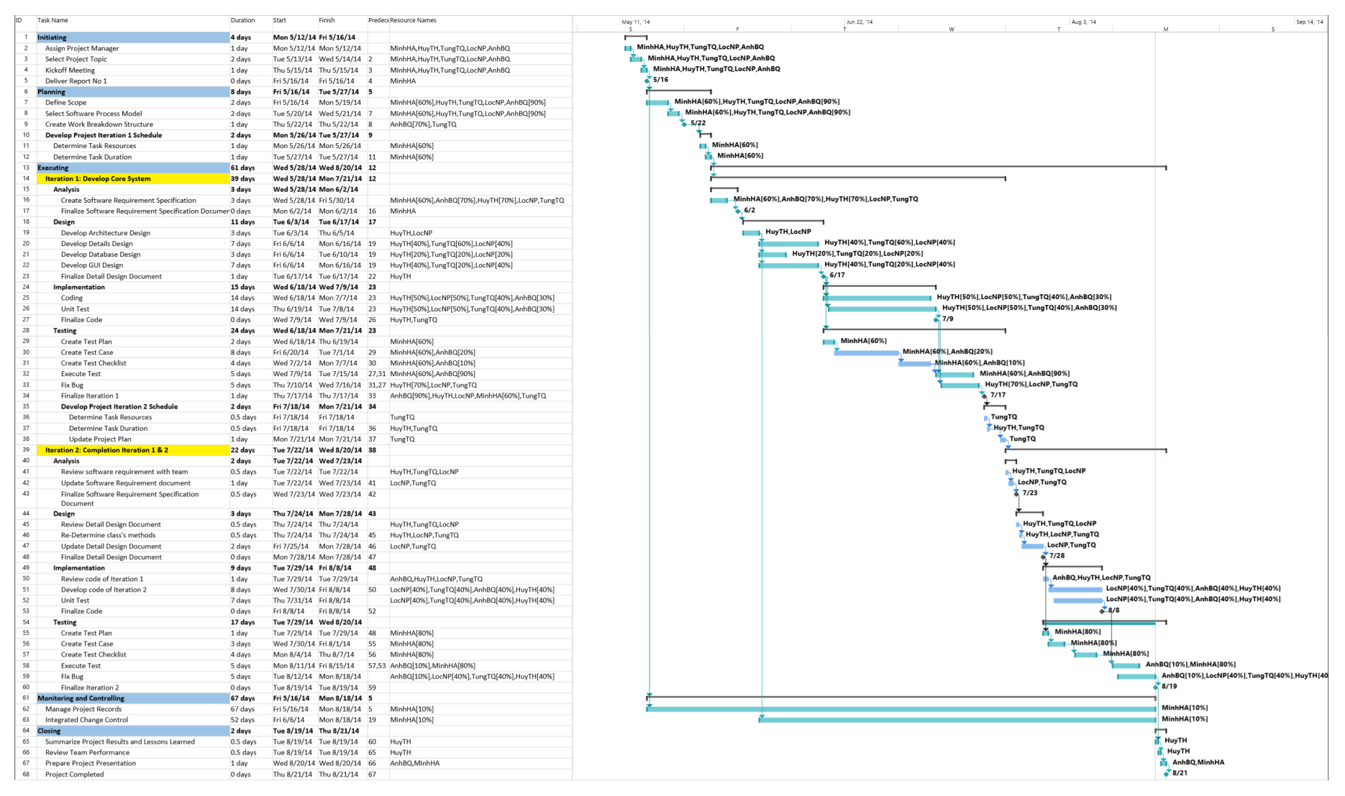
Plan(cont)
Project Schedule
Project Plan

Slide 17
Plan(cont)
Developing Environtment
Tools:
Microsoft® Office 2007, Microsoft® Project 2013, Microsoft® Visio 2010
Astah Professional 6.8.0
Debug: Chrome Developer Tools
IDE: Sublime 3, Notepad++ 6.6.8
Manage database: PHPMyAdmin v 5.6.1
Manage source: Tortoise SVN 1.8.7 for client and Subversion 1.6 on server svn.mim.vn
Browser: Chrome 34.0.1847.131 m, Firefox 23.0.1, Internet Explorer 8
Techniques:
Platform: Node.js v0.10.28
Framework: Sails.js 0.10
Database: Mysql v5.6 innoDB
Client: HTML5, CSS3 (bootstrap 3), JavaScript (jQuery 1.10, jPlayer 2.6)
Template Engine: Embedded JavaScript version 1.0 (EJS )

Slide 18
Software Requirement Specification
Content:
Functional Requirements
Non-functional Requirements

Slide 19
Software Requirement Specification(cont)
Functional
5 Usergroups in our system:
+ Guest
+ Member
+ Banned-member
+ Admin
+ Staff

Slide 20
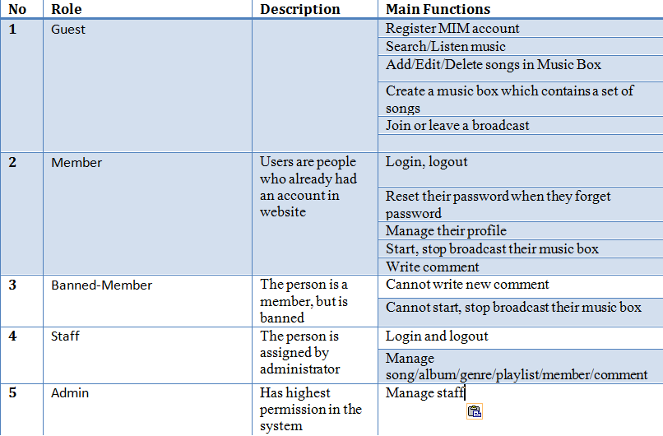
Software Requirement Specification(cont)
Functional

Slide 21
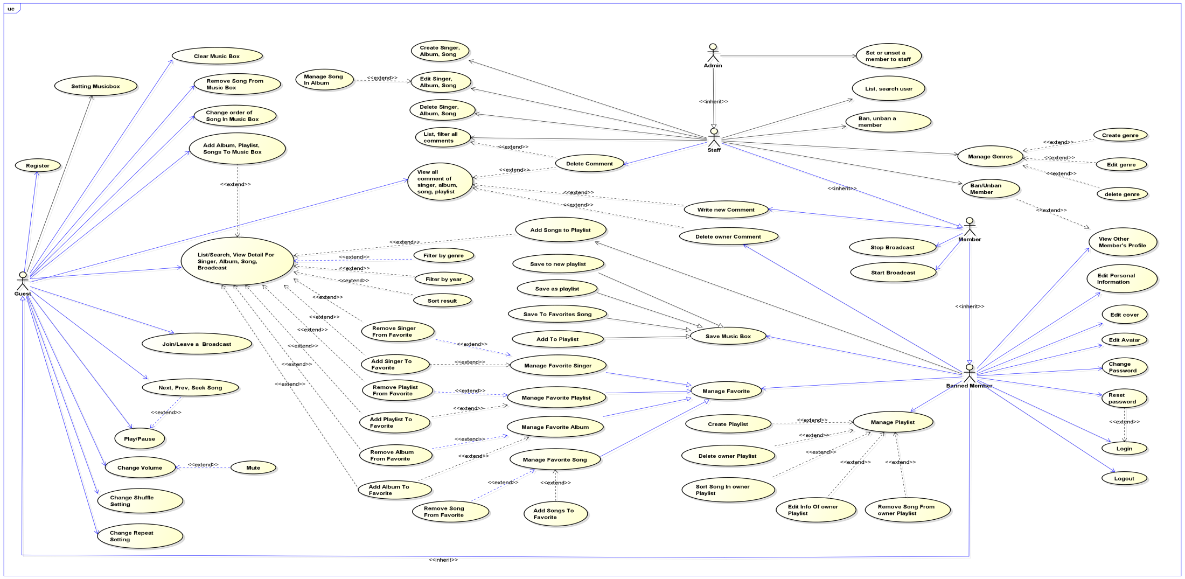
Software Requirement Specification(cont)
Usecase Diagram
Overall Use-case Diagram

Slide 22
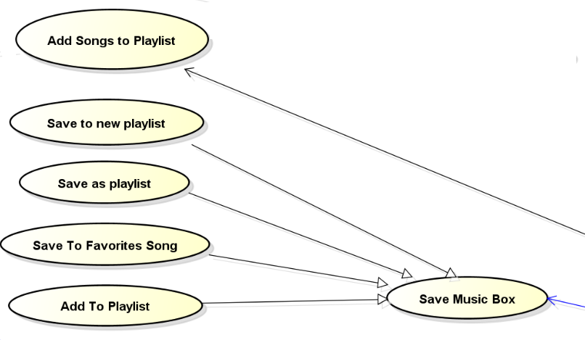
Software Requirement Specification(cont)
Usecase Diagram
UseCase Diagram for Music Box

Slide 23
Software Requirement Specification(cont)
Non-Functional
Security: Protect website from some attack as XSS, SQL injection. Must encrypt password of users in database.
Accessibility: Speed of website & songs stream is high. Time delay in real-time must very low.
Maintainability and Extensibility: Easily add new features or maintain the website.

Slide 24
Software Architecture Design
Content:
Overall Architecture
Component Diagram
Class Diagram
Sequence Diagram
Flowchart
Entity Relationship Diagram
Database Design

Slide 25
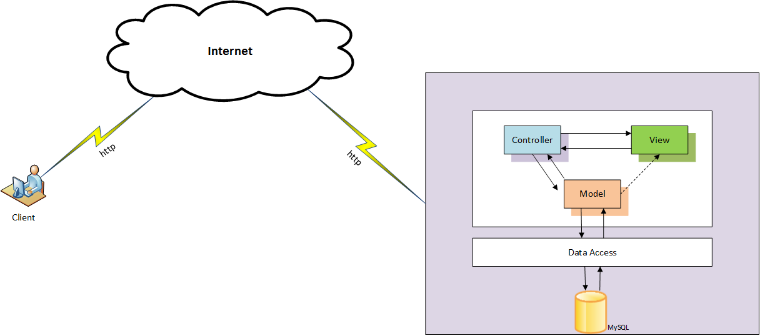
Software Architecture Design(cont)
Overall Architecture
MIM was built follow MVC pattern

Slide 26
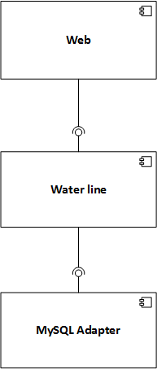
Software Architecture Design
Component Diagram

Slide 27
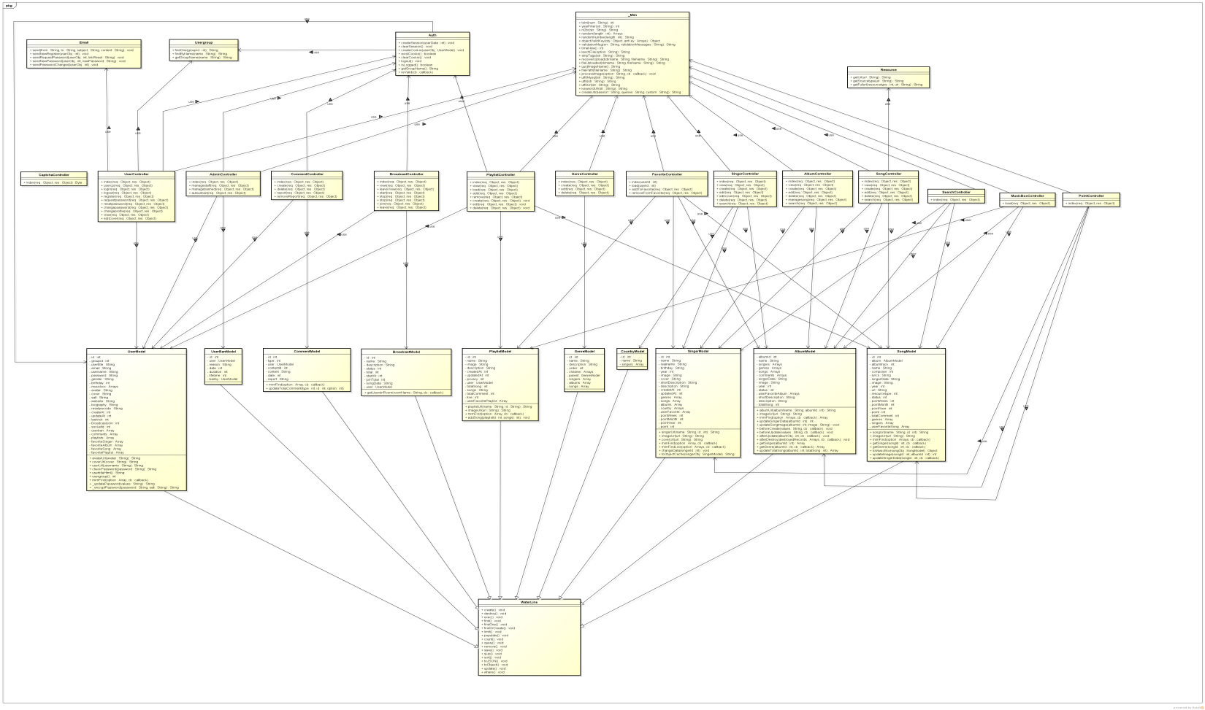
Software Architecture Design(cont)
Class Diagram
Overall Class Diagram of MIM

Slide 28
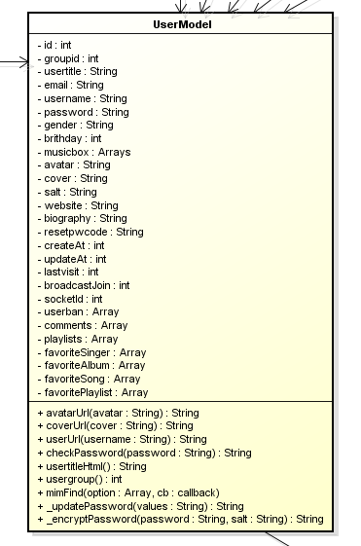
Software Architecture Design(cont)
Class Diagram
Example:
Class Diagram for UserModel

Slide 29
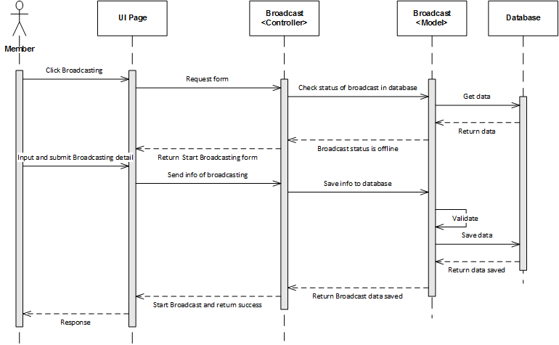
Software Architecture Design(cont)
Sequence Diagram
Sequence Diagram for starting Broadcast

Slide 30
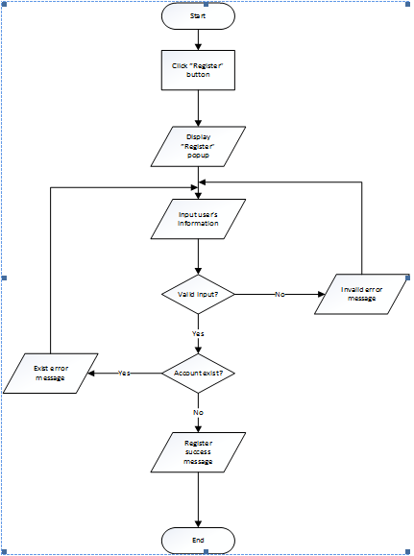
Software Architecture Design(cont)
Flowchart
Flowchart for Register method of User class

Slide 31
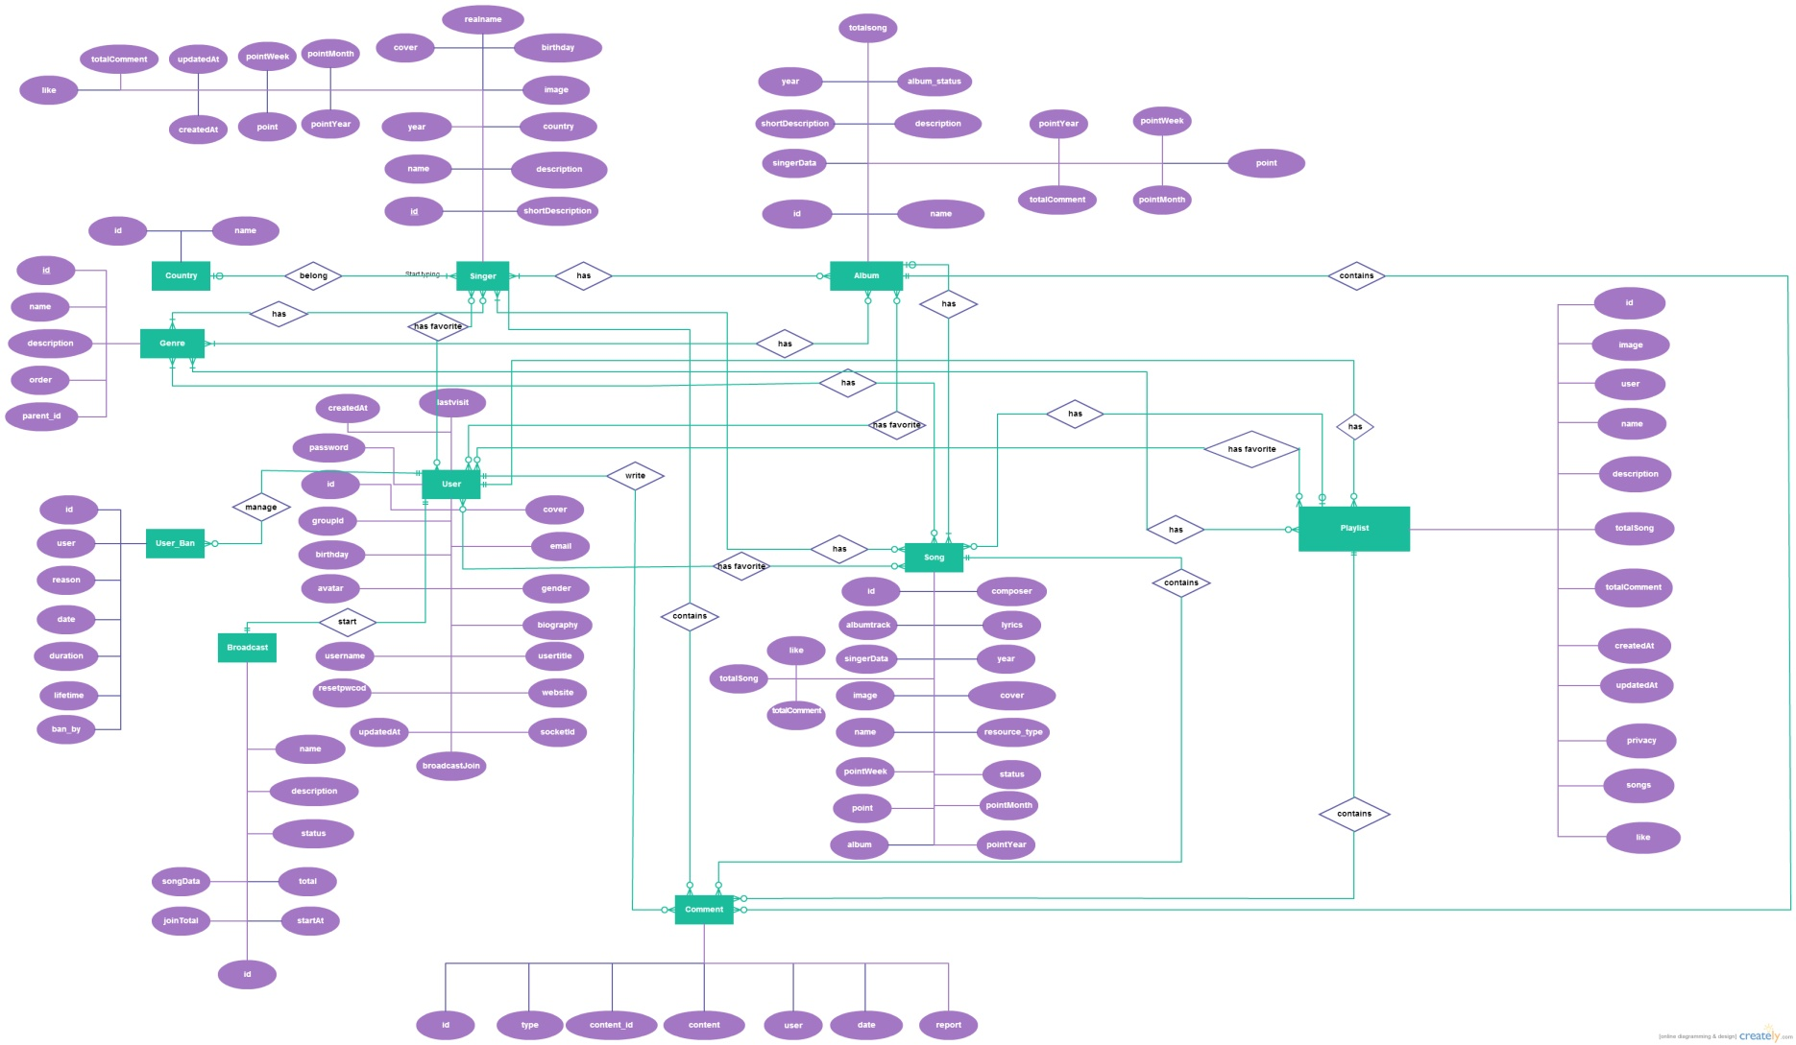
Software Architecture Design(cont)
Entity Relationship Diagram
Overall ERD

Slide 32
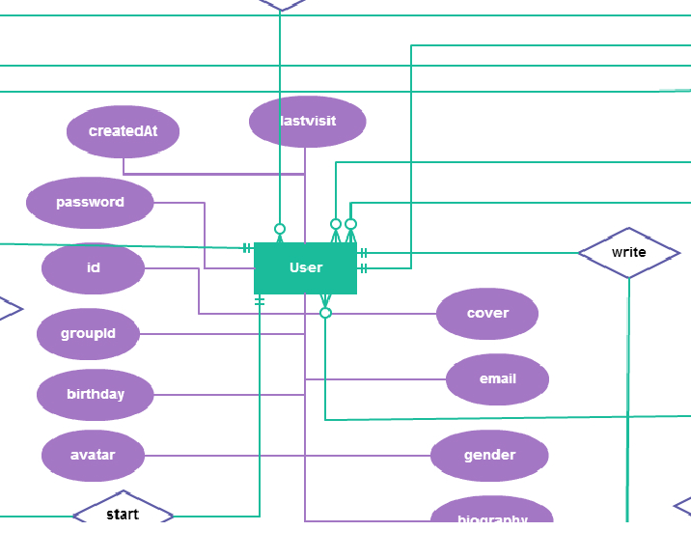
Software Architecture Design(cont)
Entity Relationship Diagram
ERD for entity User

Slide 33
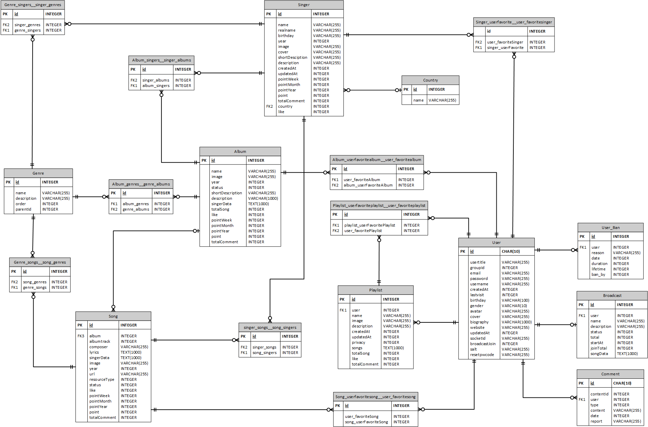
Software Architecture Design(cont)
Database Design
Overall database of MIM

Slide 34
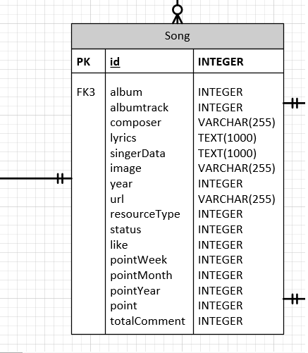
Software Architecture Design(cont)
Database Design
Example: Song Table

Slide 35
Testing
Content:
Testing Process
Testing Model
Testing Plan
Testing Environment
Sample Test Case
Test result

Slide 36
Testing(cont)
Testing Process

Slide 37
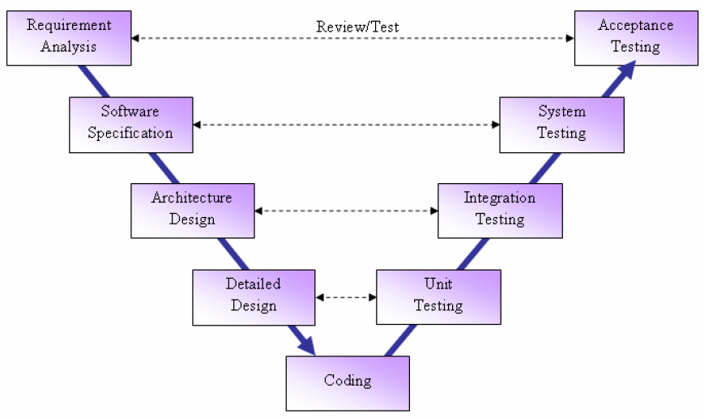
Testing(cont)
Testing Model

Slide 38
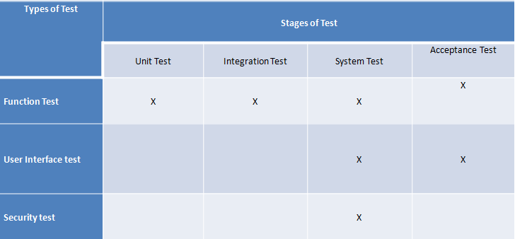
Testing(cont)
Testing Plan

Slide 39
Testing(cont)
Testing Environment
Website: Firefox, Google Chrome,Windows Explorer

Slide 40
Testing(cont)
Sample TestCase
GUI TestCase

Slide 41
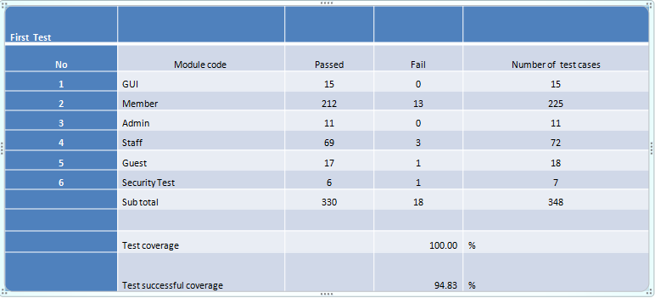
Testing(cont)
Test result

Slide 42
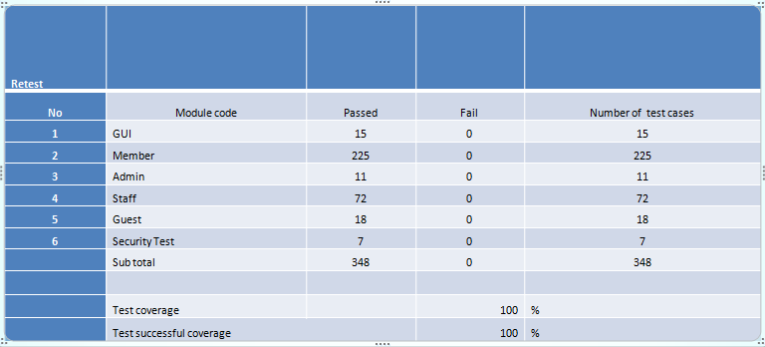
Testing(cont)
Test result

Slide 43
QA and Demo

