Slide 1
Vietnam’s Famous Location
Capstone Project Presentation
- by VFL Team
Hanoi, August 2014

Slide 2
OUTLINE OF CONTENTS
Introduction
Project Management
Software Requirement
System Design
Testing
Demonstration
Q&A
Vietnam’s Famous Location

Slide 3
INTRODUCTION
Current situation
The idea
Proposal
Vietnam’s Famous Location

Slide 4
INTRODUCTION
Current situation
Vietnam have lots of beautiful beaches resorts, well-known pagodas, and famous historical places.
Finding a place to go at weekend or holiday is an issue for many people!
Is the information suggested by search engine always correct?
Vietnam’s Famous Location

Slide 5
INTRODUCTION
The idea
Website
Organized the place data
Retrieve information quickly and correctly
Suitable for Vietnamese people
Vietnam’s Famous Location

Slide 6
INTRODUCTION
Proposal
Crawl data from multiple sources on the Internet.
Ensure the accuracy of the information.
Allows users to share locations information on social networks.
Provide users with information about the locations.
Vietnam’s Famous Location

Slide 7
PROJECT MANAGEMENT
Software Process Model
Organization
Structure
Project Plan
Technologies & Tools
Vietnam’s Famous Location

Slide 8
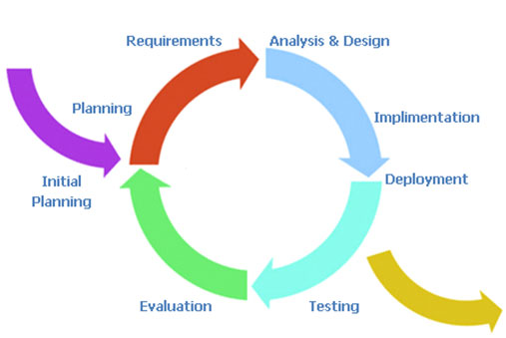
PROJECT MANAGEMENT
Software Process Model
Vietnam’s Famous Location

Slide 9
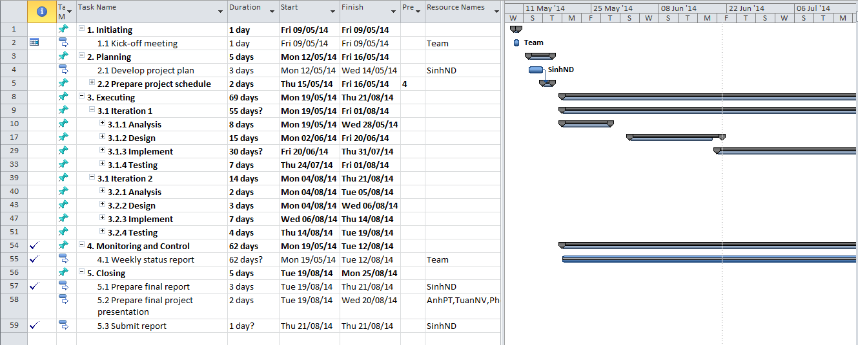
PROJECT MANAGEMENT
Project Plan
1st Iteration
19/05/2014
2nd Iteration
04/08/2014
Finish project
21/08/2014
Vietnam’s Famous Location

Slide 10
PROJECT MANAGEMENT
Organization Structure
Mr.Phan Trường Lâm
Supervisor
Nguyễn Đức Sinh
PM/Developer
Phạm Tiến Anh
Designer/Developer
Nguyễn Tiến Phong
Developer
Nguyễn Văn Tuấn
Tester/QA
Trần Thanh Hải Tester
Vietnam’s Famous Location

Slide 11
PROJECT MANAGEMENT
Risk Management
ID | Risk content | Probability | Effect | Solution
1 | Team member is not hard working, do not follow deadline. | HIGH | SERIOUS | Find out the reason why? Remind, give sanctions.
2 | Bad communication make team member not understanding idea, delay plan. | HIGH | SERIOUS | We need using words more clearly, talk with each other more, note and send email to confirm information.
3 | Computer is broken. | HIGH | SERIOUS | Backup team data frequently.
4 | Poor experience of management so that team makes plan unrealistically . | HIGH | SERIOUS | Team leader will tightly co-operate with team members when planning.
Vietnam’s Famous Location

Slide 12
PROJECT MANAGEMENT
Technologies & Tools
KEPLER
Vietnam’s Famous Location

Slide 13
SOFTWARE REQUIREMENT
User Groups
End-User
Content Editor
System Admin
Vietnam’s Famous Location

Slide 14
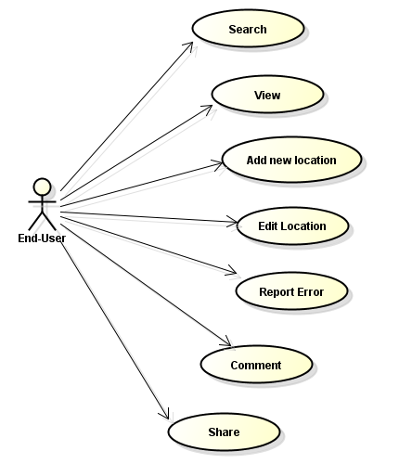
SOFTWARE REQUIREMENT
Use case for End-User
Vietnam’s Famous Location

Slide 15
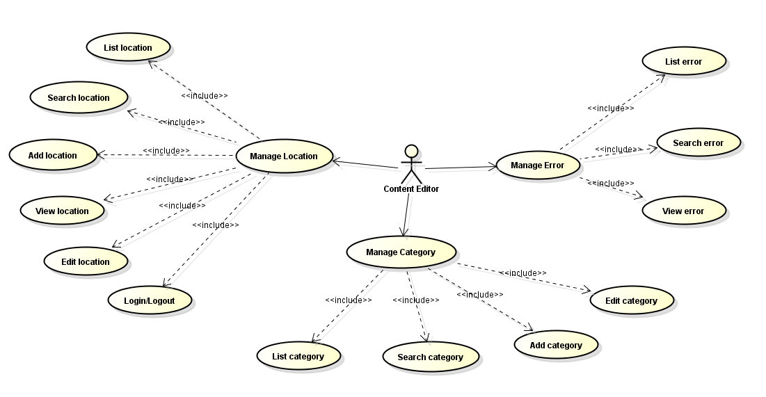
SOFTWARE REQUIREMENT
Use case for Content Editor
Vietnam’s Famous Location

Slide 16
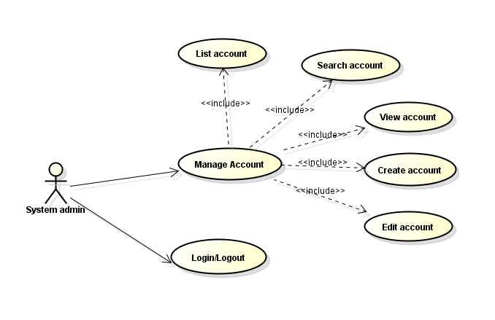
SOFTWARE REQUIREMENT
Use case for System Admin
Vietnam’s Famous Location

Slide 17
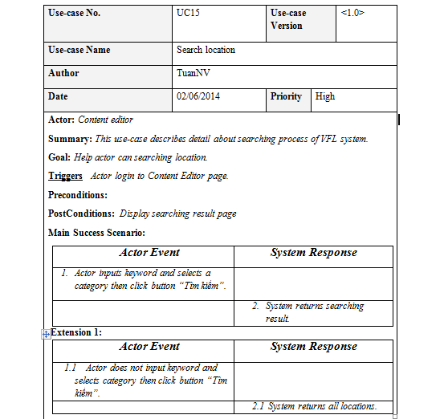
SOFTWARE REQUIREMENT
Use case writing
Vietnam’s Famous Location

Slide 18
SOFTWARE REQUIREMENT
Non-functional Requirement
Usability
The data is correct and up-to-date. These are done by semi-crawler tools and content-editor staff.
Availability
The website will be hosted in a reliable commerce web hosting Service Company.
Maintainability
The system designing and implementing follows Object Oriented Analysis and Design (OOAD), Object Oriented Paradigm (OOP) principles. All developers follow coding convention strictly. In addition, each component/module is well documented.
Vietnam’s Famous Location

Slide 19
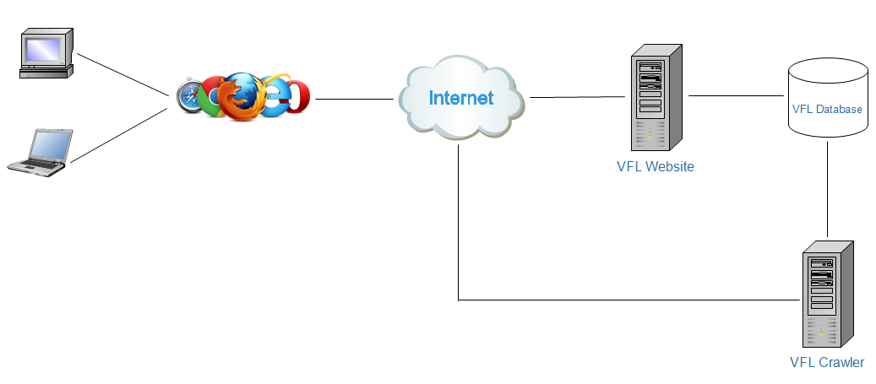
System Design
System Architecture Overview
Vietnam’s Famous Location

Slide 20
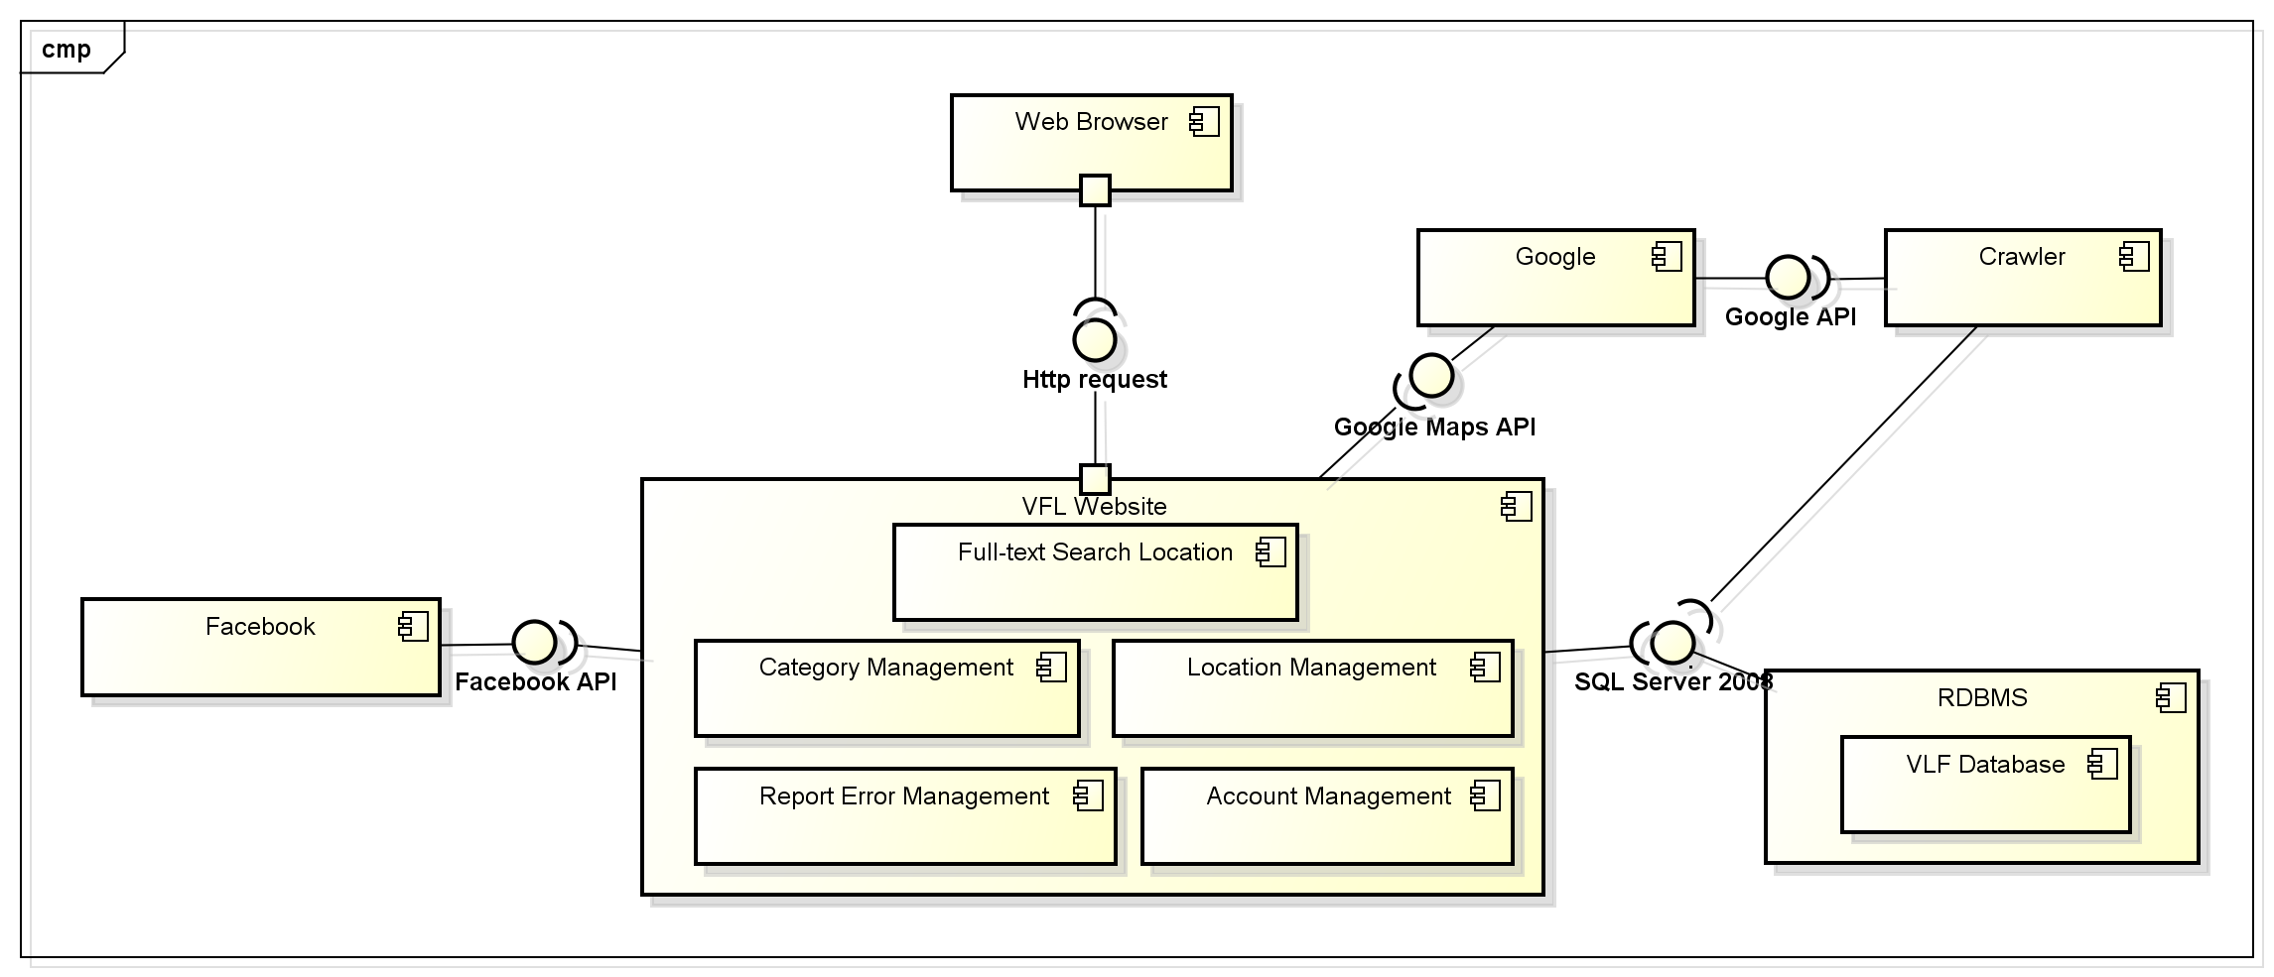
System Design
Component Diagram
Vietnam’s Famous Location

Slide 21
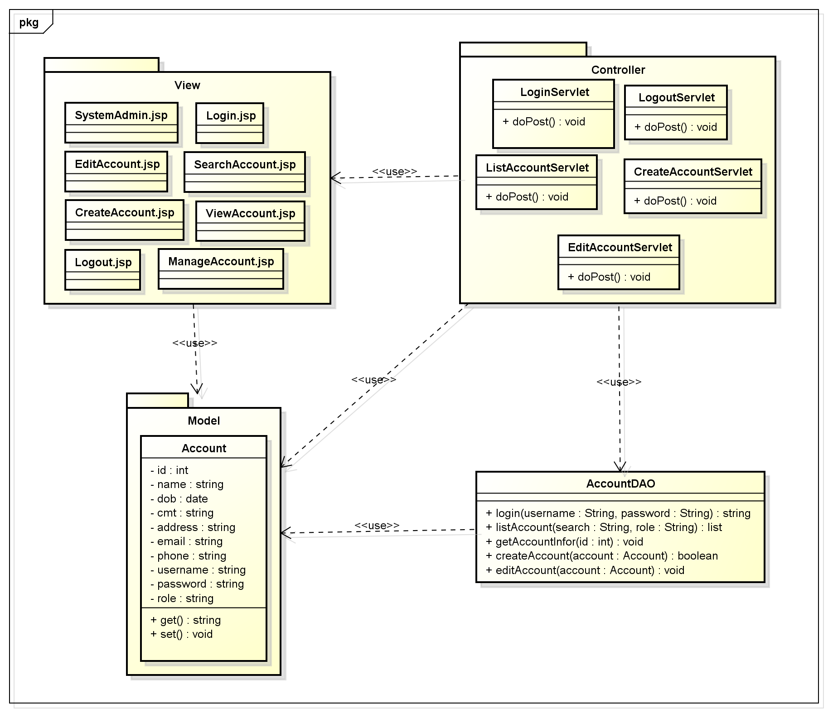
System Design
Account Management Class Diagram
Vietnam’s Famous Location

Slide 22
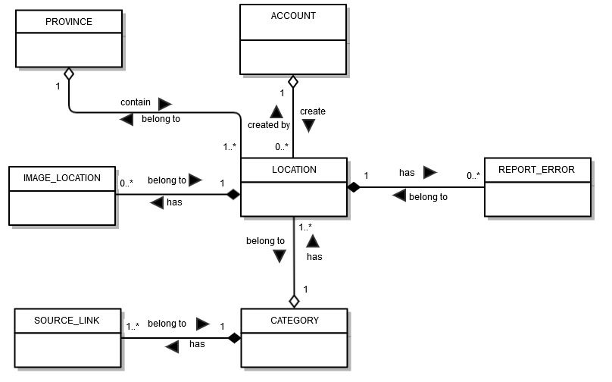
System Design
Conceptual Database Design
Vietnam’s Famous Location

Slide 23
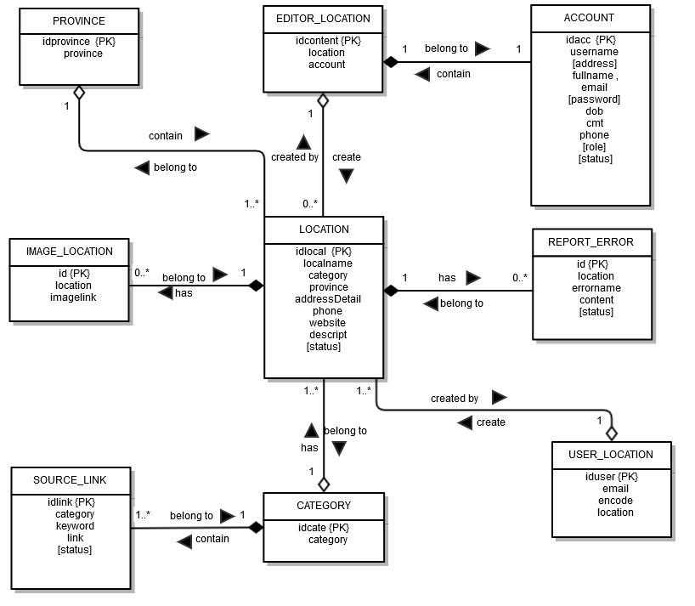
System Design
Logical Database Design
Vietnam’s Famous Location

Slide 24
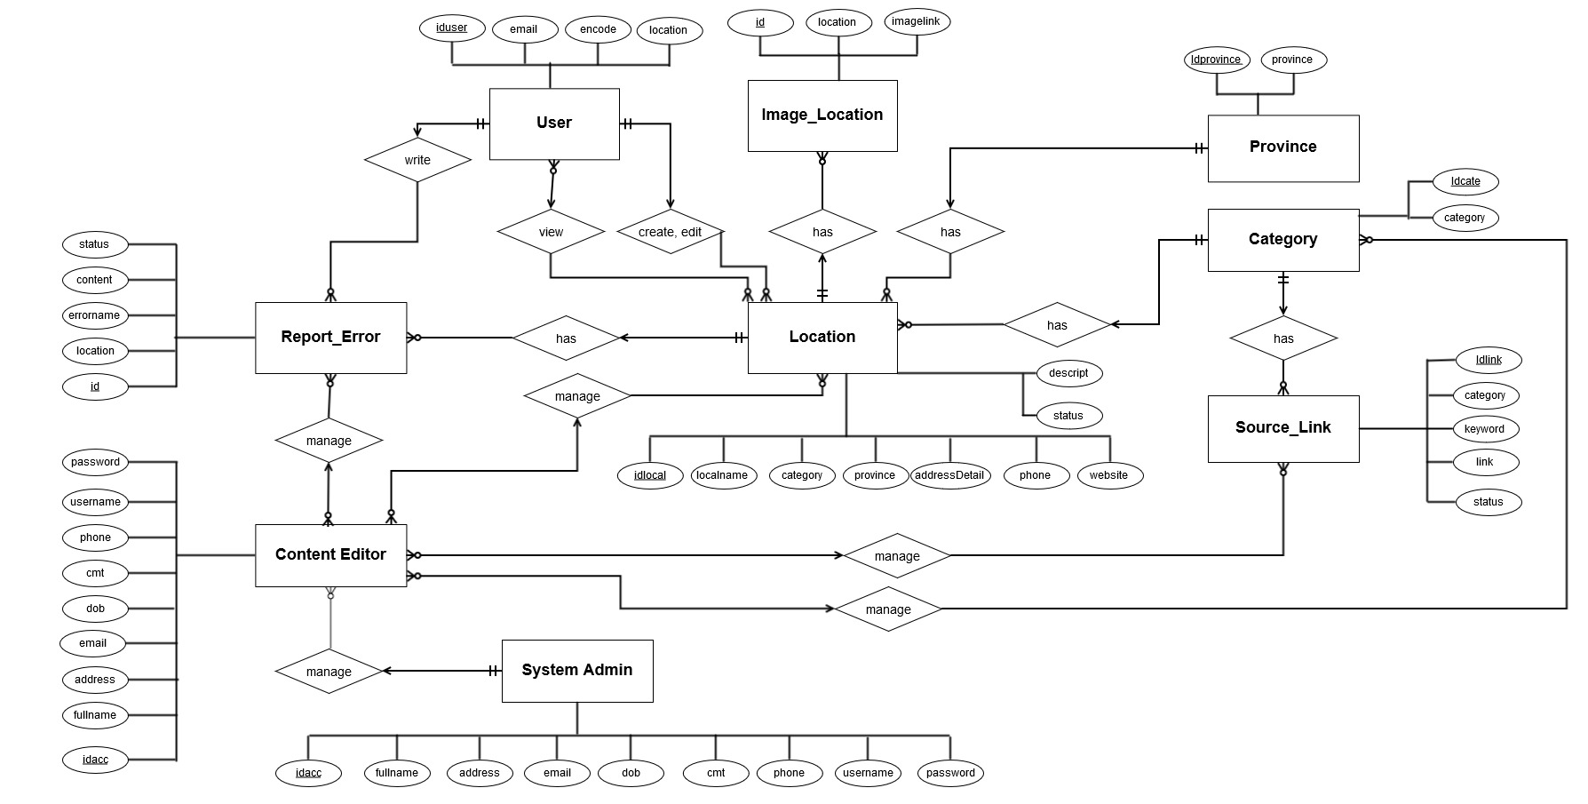
SOFTWARE REQUIREMENT
Entity Relationship Diagram
Vietnam’s Famous Location

Slide 25
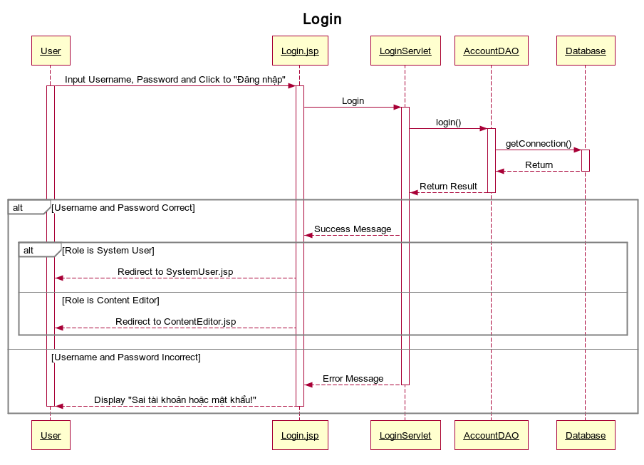
System Design
Sequence Diagram for Login function
Vietnam’s Famous Location

Slide 26
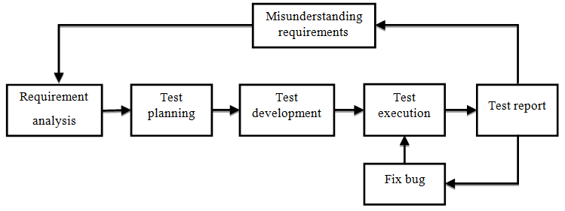
Testing
Testing process
Vietnam’s Famous Location

Slide 27
Testing
Testing types
Testing types
Unit testing
Integration testing
System testing
Acceptance testing
Vietnam’s Famous Location

Slide 28
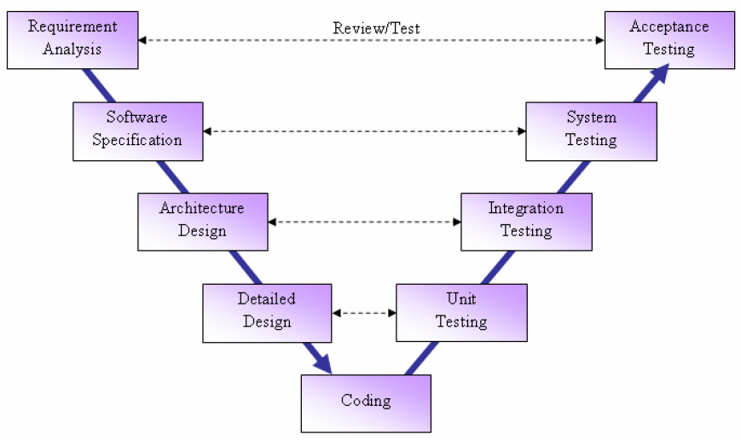
Testing
Testing model
Vietnam’s Famous Location

Slide 29
Testing
Testing approach
Unit testing: Developers
Testing environment
Website: Firefox, Google Chrome
System/Integration testing: Testers
Acceptance testing: Team members, friends
Crawler: Microsoft Windows 8.1
Vietnam’s Famous Location

Slide 30
Testing
Functions to be tested
End-User functions
Search location
Management functions
Manage account
Create location
Comment/Share
Report Error
Manage location/category/report error
Login/Logout
Vietnam’s Famous Location

Slide 31
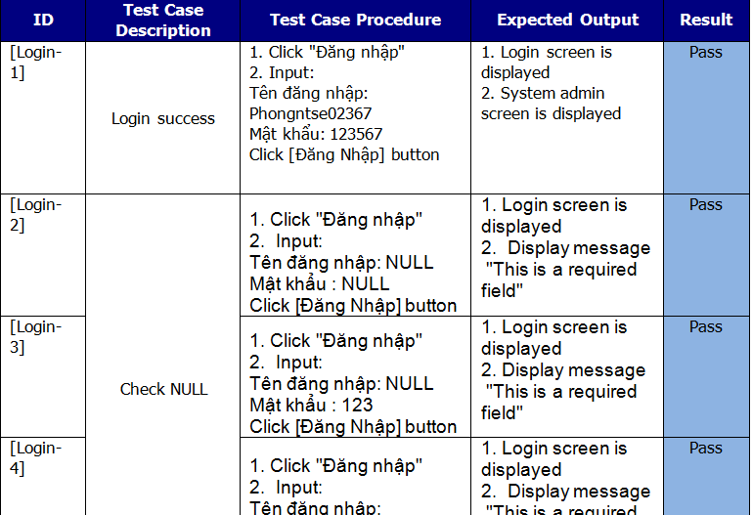
Testing
Sample test case
Vietnam’s Famous Location

Slide 32
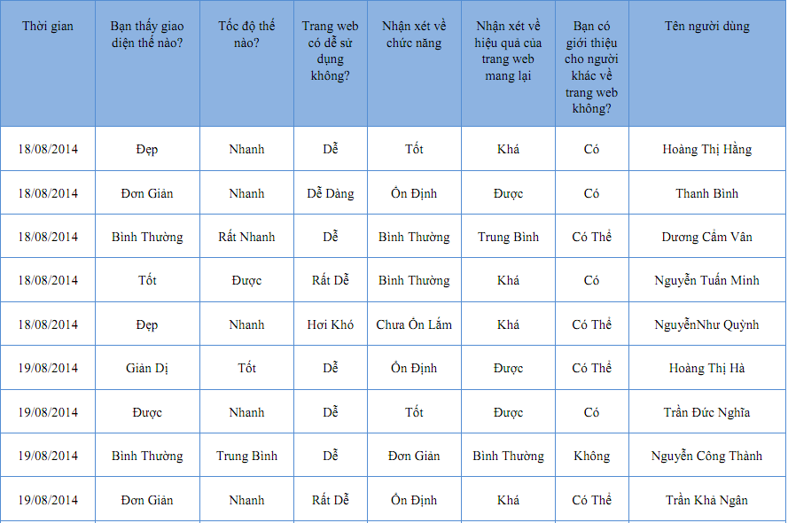
Testing
Acceptance test
Vietnam’s Famous Location

Slide 33
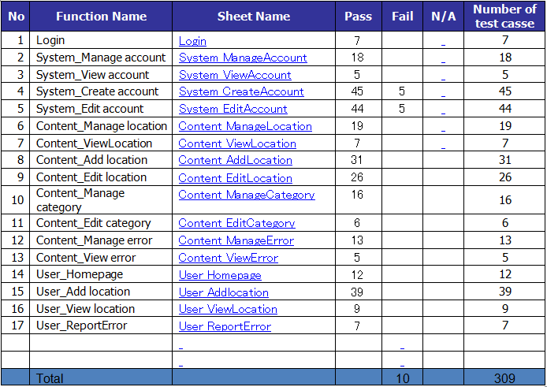
Testing
Test report
Vietnam’s Famous Location

Slide 34
Project Results
New technologies have been applied successfully
Has more experiences and skills
Management skill
Completed basic functions
Working in group skill
Technical
Vietnam’s Famous Location

Slide 35
Limitation & Expectation
Limitation | Exepectation
Less function Don’t have enough time to design more attractive UI | Develop more functions Efficiency improvements Broader development
Vietnam’s Famous Location

Slide 36
Time for Q&A

