Slide 1
Capstone Project: Recruitment Agency and Consultancy Process Management System
RA-Team
Supervisor: Tran Dinh Tri
Member: Nguyen Hoang Duc(PM)
Nguyen Van Cao
Tran Danh Hung
Ngo Manh Hung
Bui Quoc Huy

Slide 2
Table of Contents
Introduction
Project Management Plan
Software Requirement Specification
System Design
System Implementation & Test
Lesson Learned
Demo
Q&A

Slide 3
Introduction
Project Background
The idea
Expected System
The existing system
Purpose

Slide 4
Introduction
Background
A lot of companies take a lot of time to recruit employees who match their requirements.
And a lot of employees want to find a job that they want to work.
The Idea of Our System

Slide 5
Introduction
Existing System
Pros:
Mobile App
Personal Member Page
Cons:
Old-fashioned designed
Not verify information
Not pre-interview candidates

Slide 6
Introduction
Expected System
Our system is developed for an agency company.
Companies can post their jobs and Job Seekers will apply for the job they want.
Companies and Job information on our system is verified to improve the reliability of the information

Slide 7
Introduction
Purpose
Pass the Capstone Project with high value
Approach new Technology
Better in team work
All team member experience the software development process

Slide 8
Software Project Management Plan
Software process model
Work breakdown Structure
Technologies & Tools
Communication Plan
Risk Management Plan

Slide 9
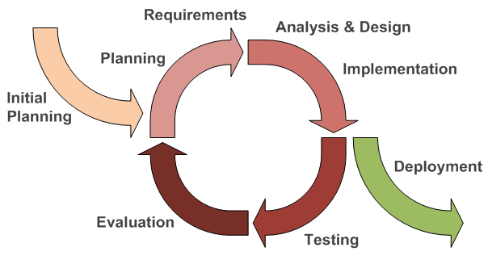
Software Process Model
The process model chosen for the project is Iterative and Incremental (IID).
Flexible to change requirements
Getting experience from previous iterations

Slide 10
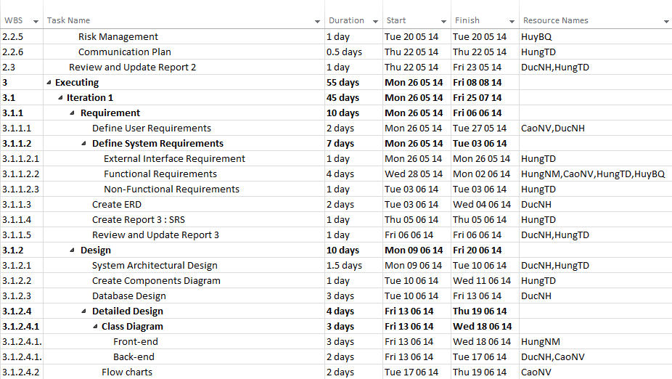
Work Breakdown Structure

Slide 11
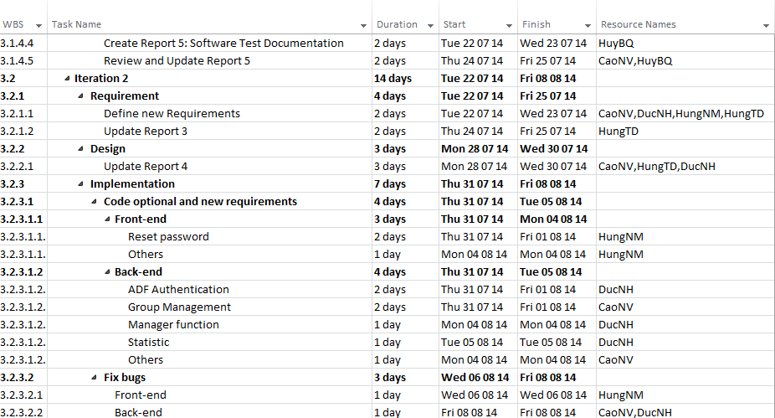
Work Breakdown Structure

Slide 12
Technologies

Slide 13
Tools
Development Tools
Design Tools
Document Tools
Communication Tools
Resource Control Tools

Slide 14
Communication Plan
8 hours/day
5 days/week
FPT University
Home
Coffee
Skype
Gmail
Face-to-face
Once/week
Time
Location
Communication
Meeting Supervisor

Slide 15
Risk Management Plan
Risk Description | Risk type | Probability | Impact | Risk strategy | Fallback plan
Members suffer Ebola and member unexpected out team | People | High | Serious | - Member Define a suitable schedule to guarantee member’s health. -Leader share work for team member remain | - Share work to other members to meet work deadline. -Announce for supervisor to seek to resolve
Conflicts between team members | People | High | Serious | -Regularly organize team buildings to improve members’ spirit. | - Team members should make concession to each other. - All team should analyze and find a way to become reconciled.
Overestimate or underestimate time for tasks, or many members are working in companies so they don’t have much time for project | People | High | Serious | - Define detail plan in each working phase. - redistribution of work - Organize meeting to remind to all members that project is the most important. | -Work overtime. - work Sunday and Saturday

Slide 16
3.System Requirements Specifications (SRS)
Functional Requirements
Non-Functional Requirements
Entity-Relationship Diagram

Slide 17
Functional Requirement
Use case diagram for Guest and Registered User

Slide 18
Functional Requirement
Use case diagram for Staff, Manager and Admin

Slide 19
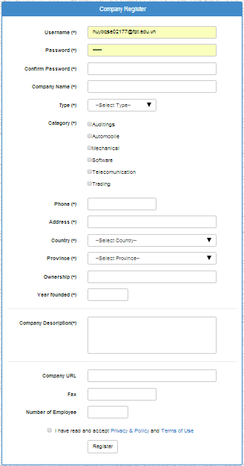
Guest
Register
View Information
Search Job

Slide 20
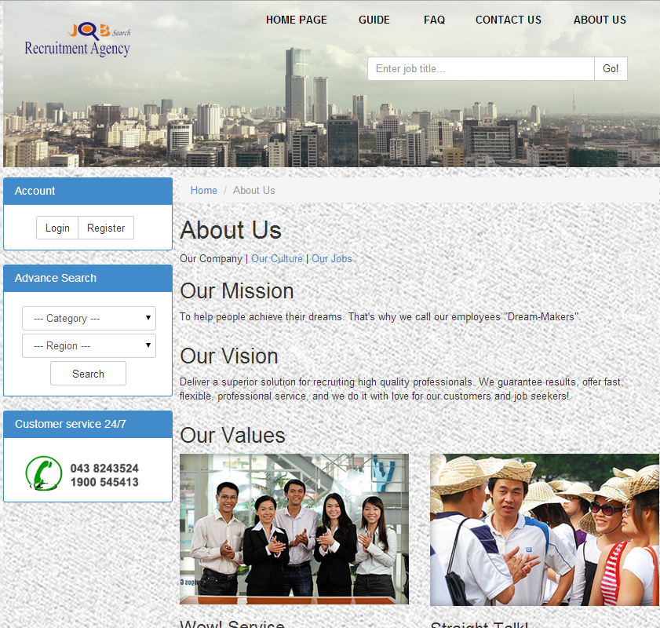
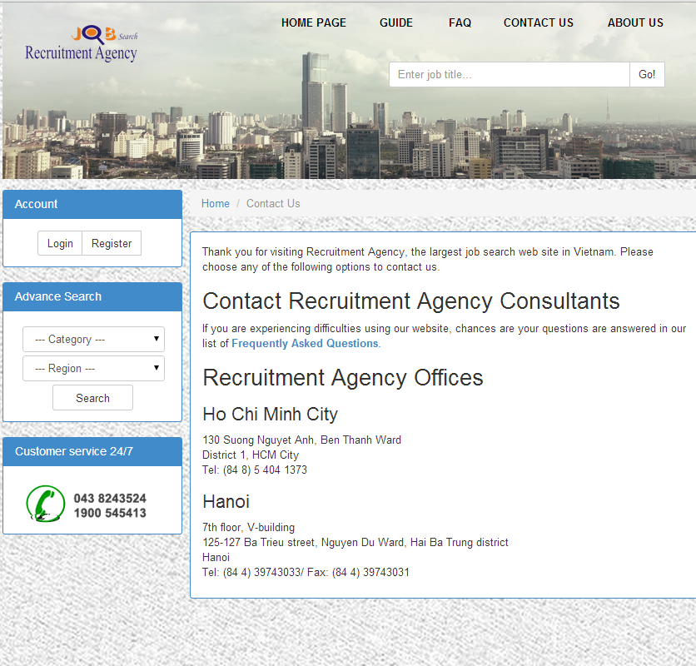
Guest
Register
View Information
Search Job

Slide 21
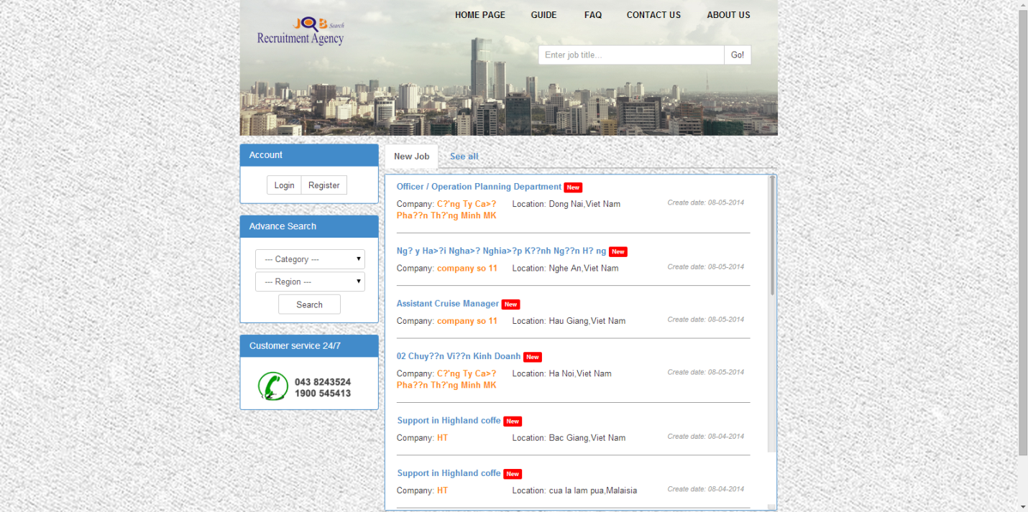
Guest
Register
View Information
Search Job

Slide 22
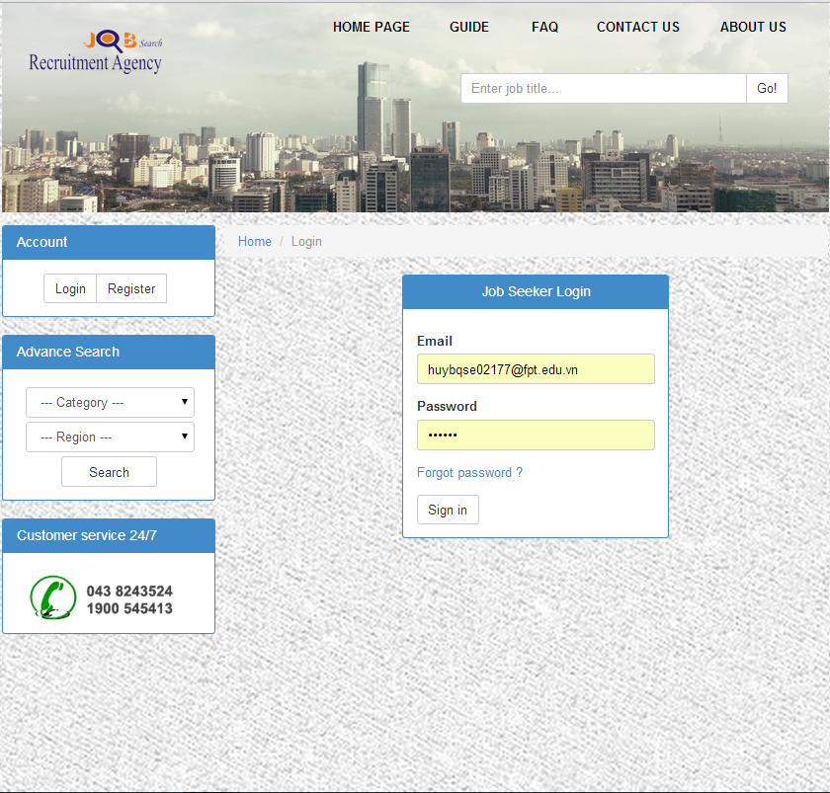
Registered User
Login
Apply Job
Edit Profile
Manage Education
Manage History

Slide 23
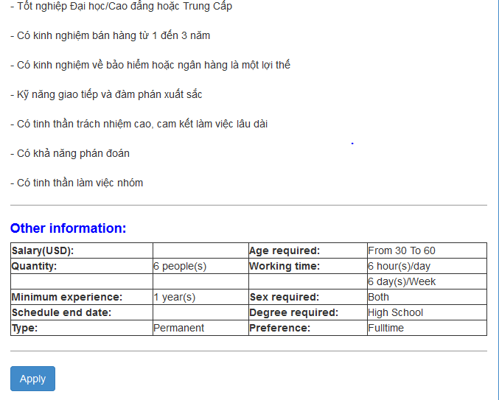
Registered User / Job Seeker
Login
Apply Job
Edit Profile
Manage Education
Manage History

Slide 24
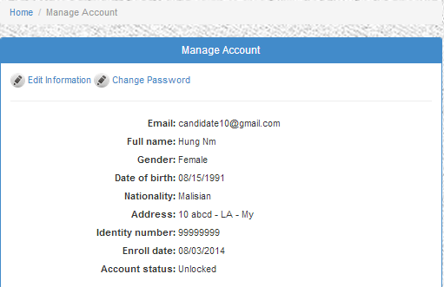
Registered User / Job Seeker
Login
Apply Job
Edit Profile
Manage Education
Manage History

Slide 25
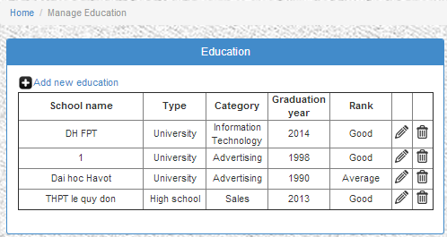
Registered User / Job Seeker
Login
Apply Job
Edit Profile
Manage Education
Manage History

Slide 26
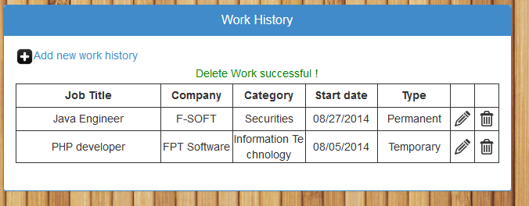
Registered User / Job Seeker
Login
Apply Job
Edit Profile
Manage Education
Manage History

Slide 27
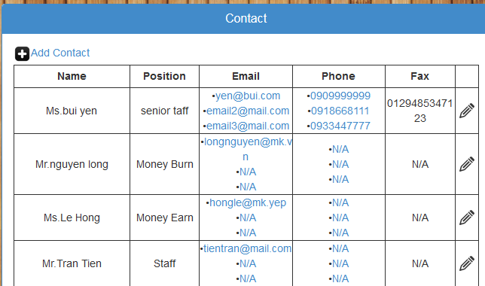
Registered User / Company
Manage Contact
Post Job
Edit Information
Edit Waiting Job

Slide 28
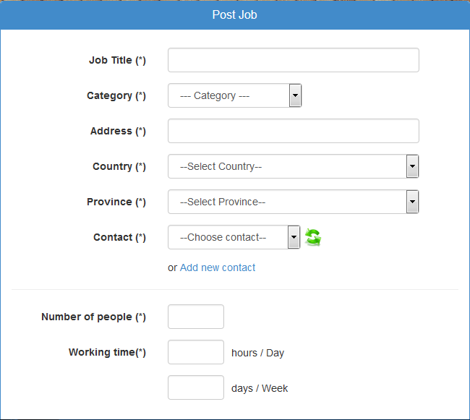
Registered User / Company
Manage Contact
Post Job
Edit Information
Edit Waiting Job

Slide 29
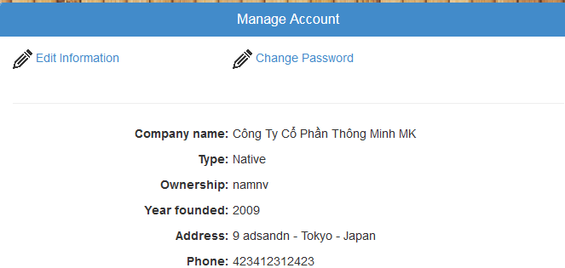
Registered User / Company
Manage Contact
Post Job
Edit Information
Edit Waiting Job

Slide 30
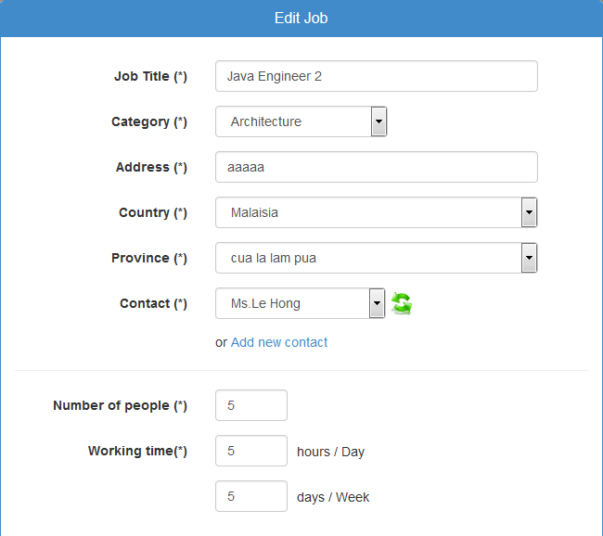
Registered User / Company
Manage Contact
Post Job
Edit Information
Edit Waiting Job

Slide 31
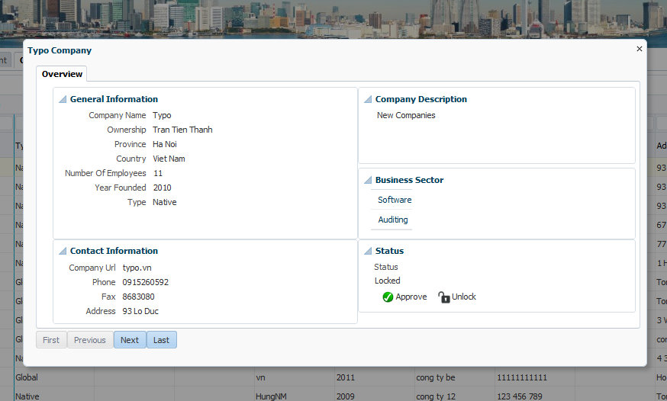
Agency User / Staff
Approve Company
Approve Job
Schedule Interview
Export Result

Slide 32
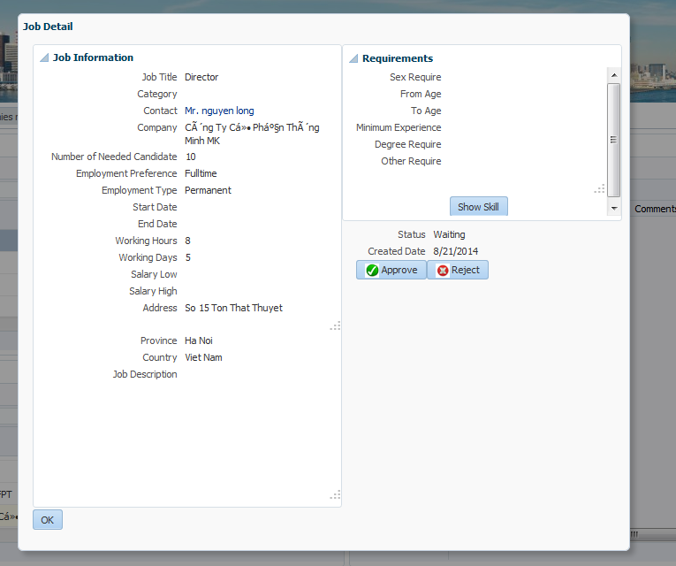
Agency User / Staff
Approve Company
Approve Job
Schedule Interview
Export Result

Slide 33
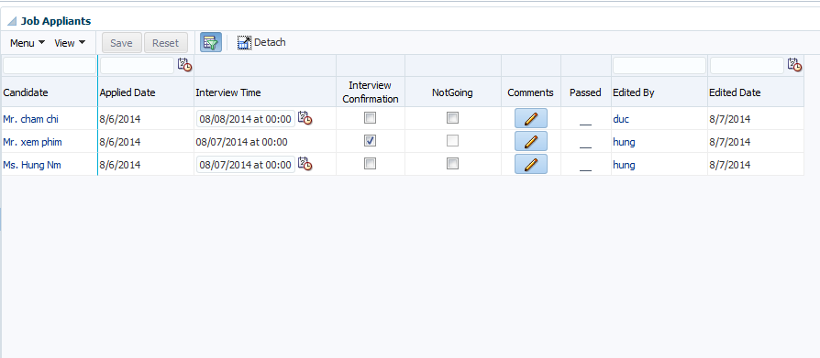
Agency User / Staff
Approve Company
Approve Job
Schedule Interview
Export Result

Slide 34
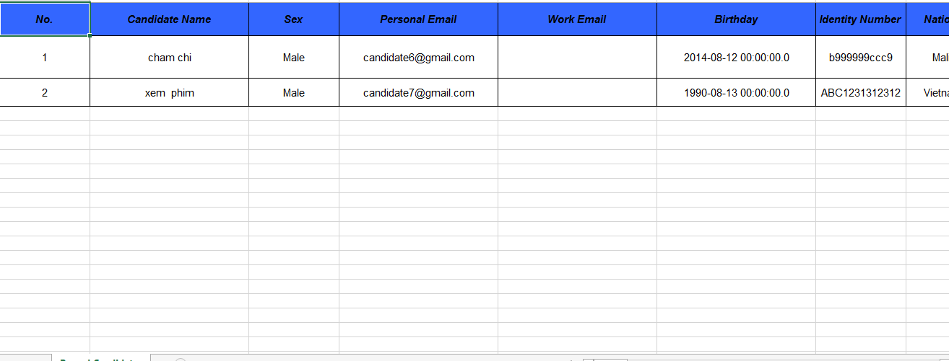
Agency User / Staff
Approve Company
Approve Job
Schedule Interview
Export Result

Slide 35
Non-Functional Requirements
Reliability
Maintainability
Data must be collected carefully and correctly
Code comments and naming convention.
The database must be backup regularly
OOP paradigm
Usability
Security
Meaningful error message.
Password encrypted
User manual guide

Slide 36
Entity-Relationship Diagram

Slide 37
4.Software Design
Overall Architecture
Component Diagram
Detailed Design
Database Design

Slide 38
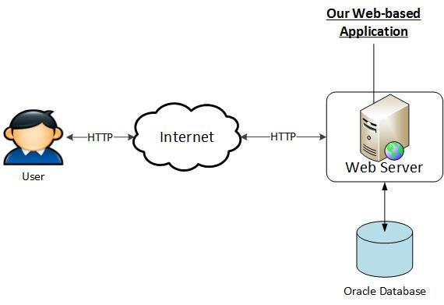
Overall Architecture

Slide 39
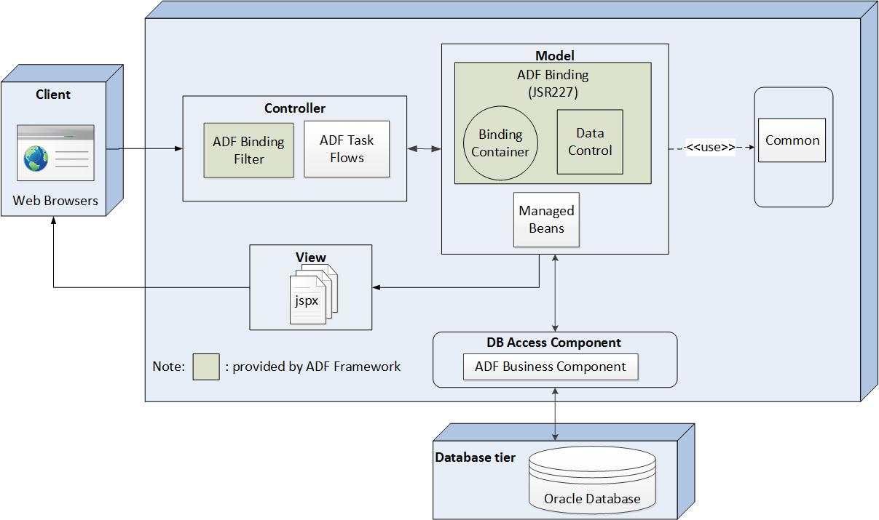
Overall Architecture (Back-end)

Slide 40
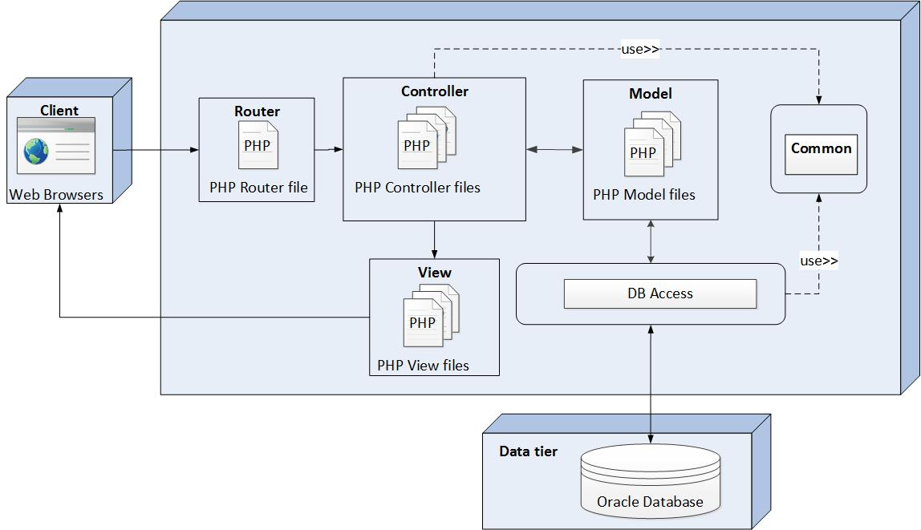
Overall Architecture (Front-end)

Slide 41
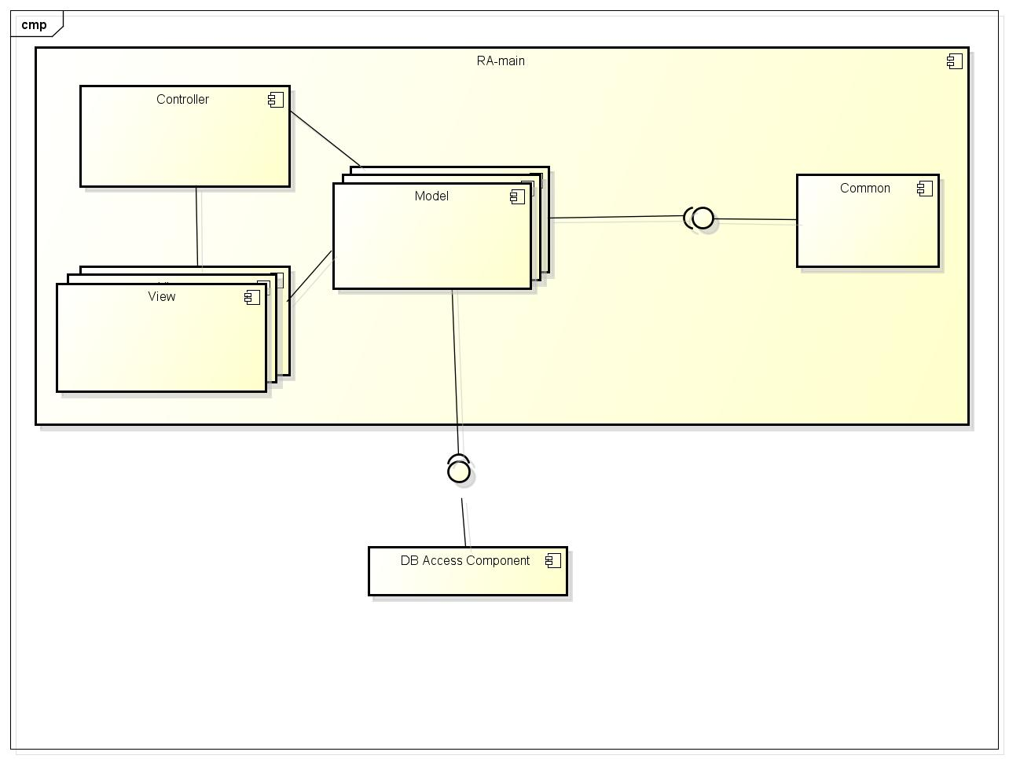
Component Diagram (Back-end)

Slide 42
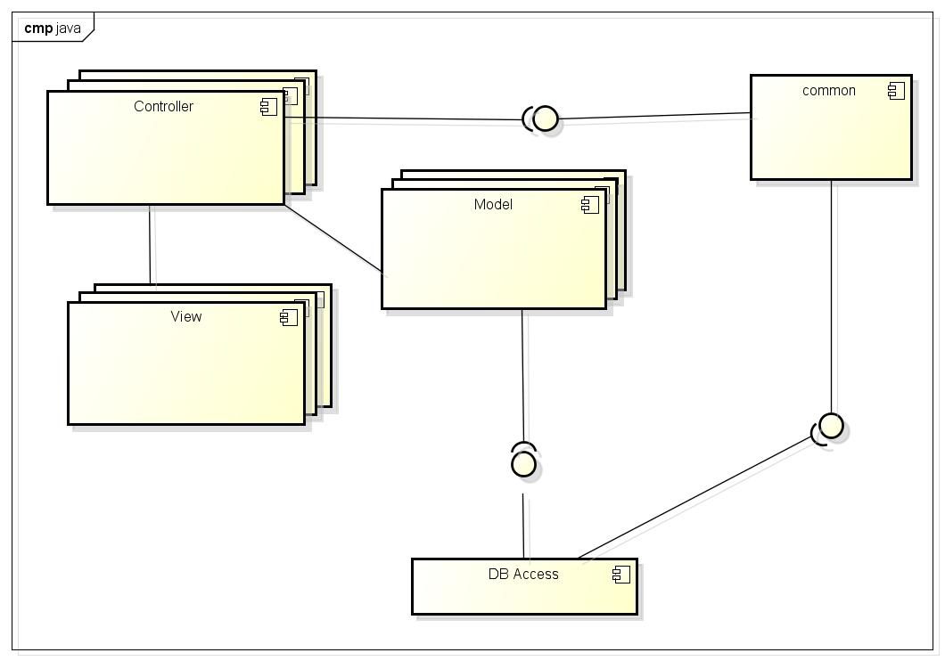
Component Diagram (Front-end)

Slide 43
Detailed Design
First cut Front-end
Class diagram

Slide 44
Detailed Design
Login (Back-end) Class diagram

Slide 45
Detailed Design
Login(Back-end) Sequence Diagram

Slide 46
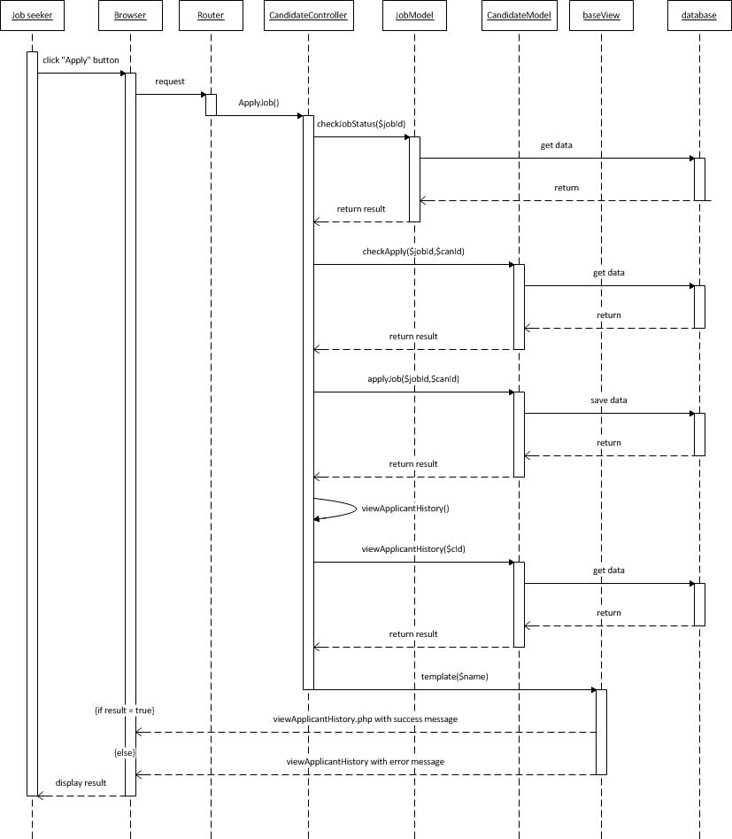
Detailed Design
Approve Job(Front-end) Sequence Diagram

Slide 47
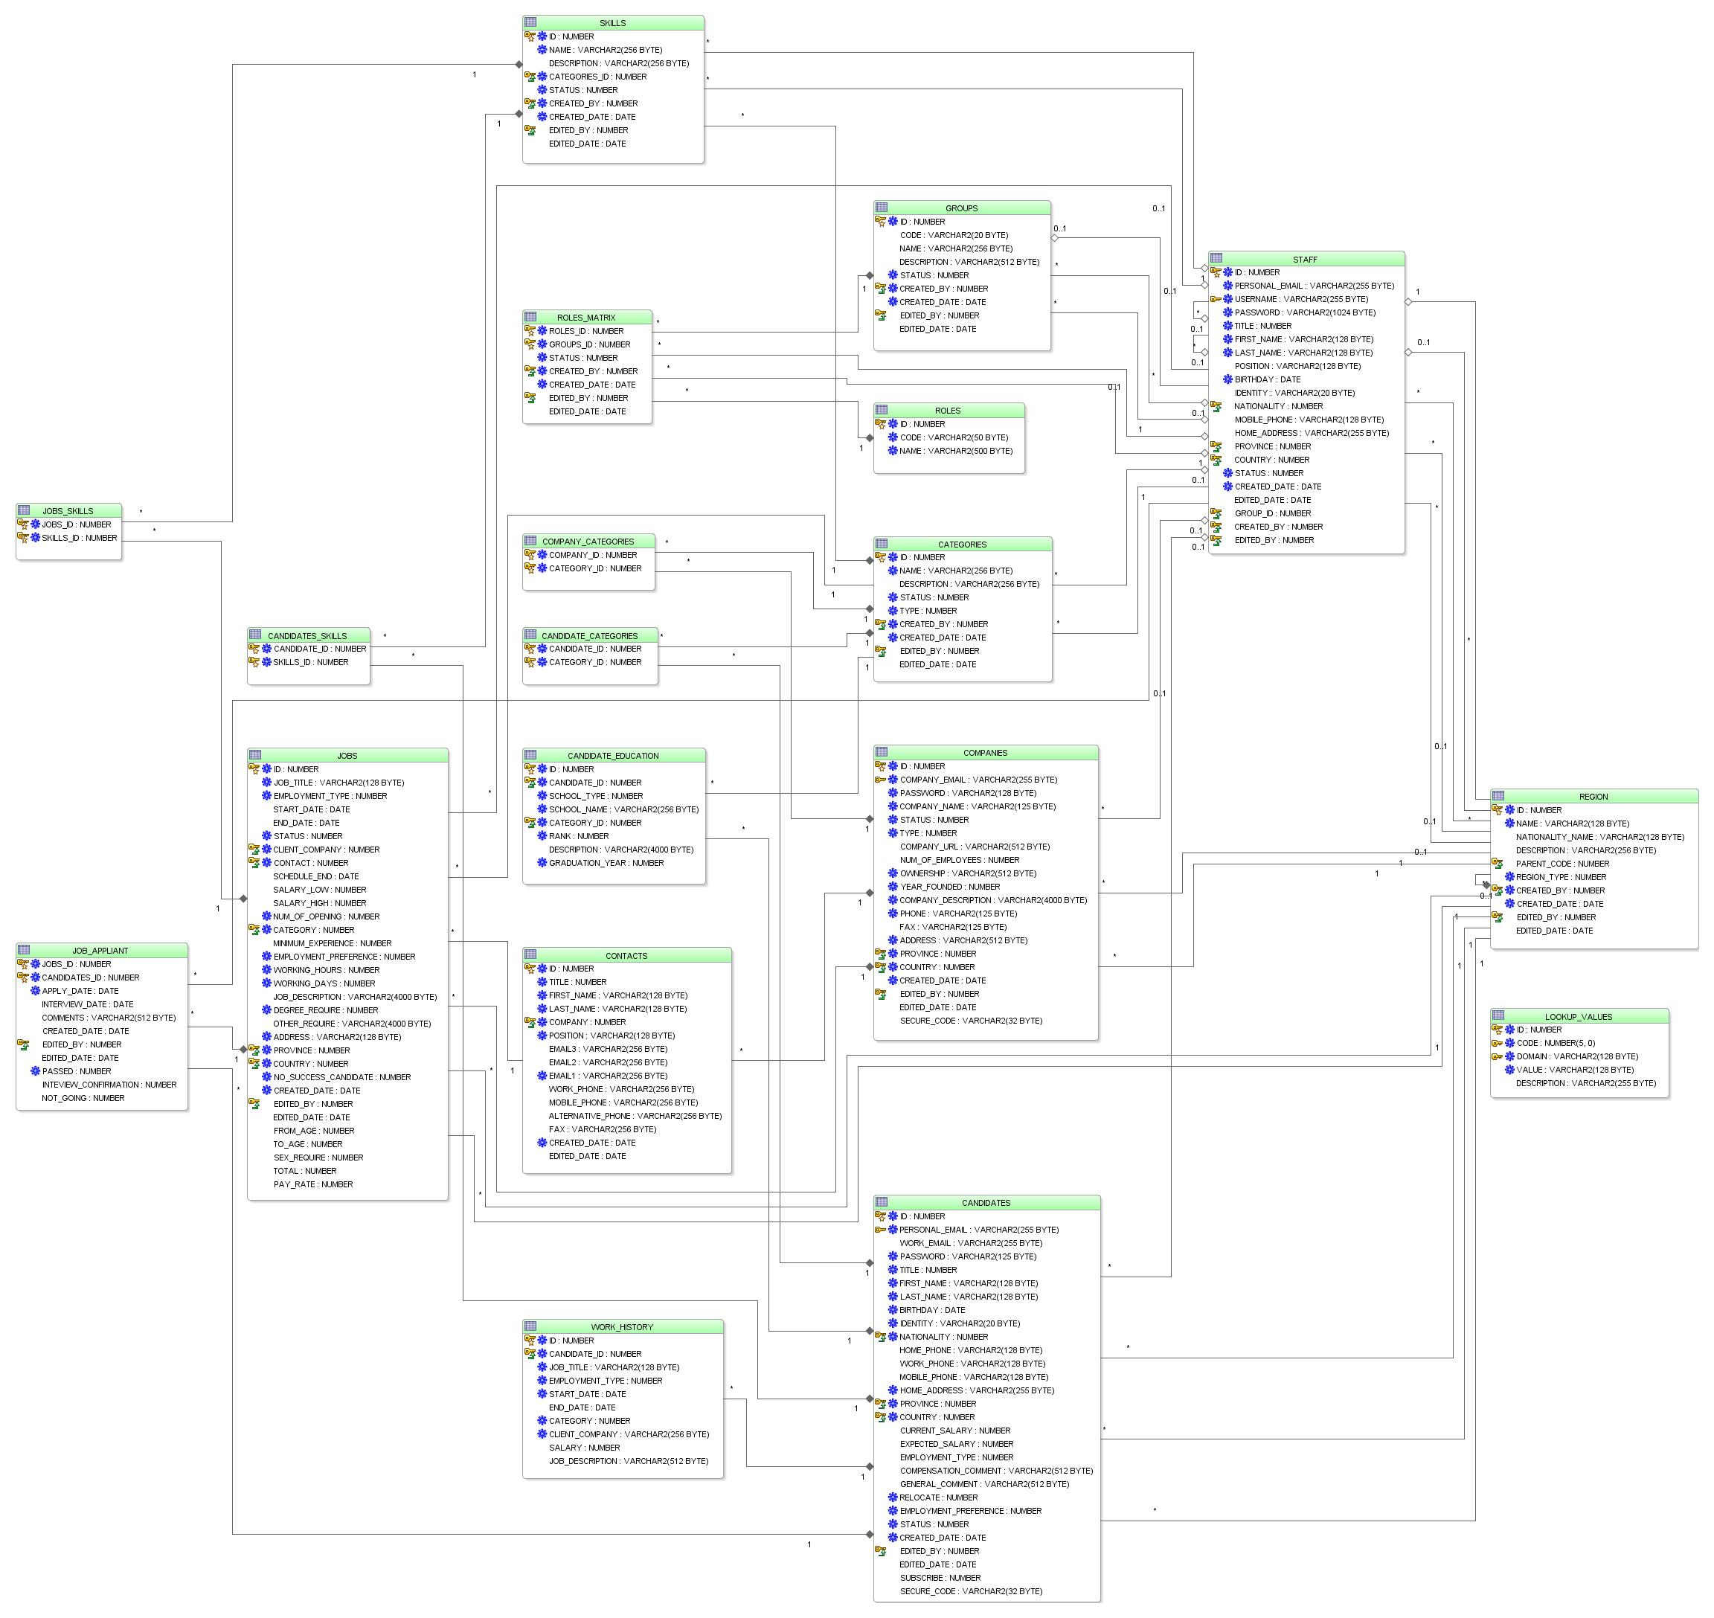
Database Design ( Table Diagram)

Slide 48
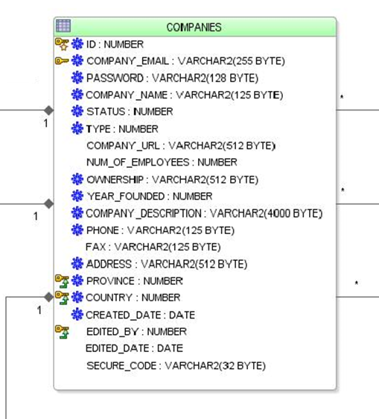
Database Design(Example Table: Companies)

Slide 49
5.System Implementation & Test
Testing Strategy
Testing Process
Testing Environment
Test Plan
Test Case
Test Result

Slide 50
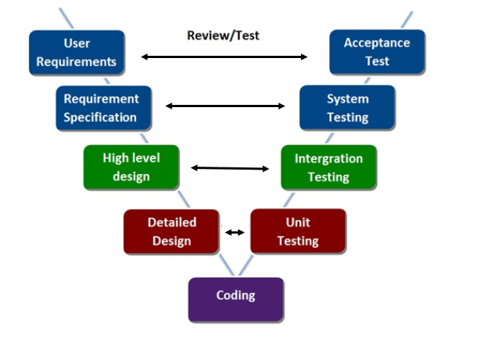
Testing Strategy
Using V-Model for testing

Slide 51
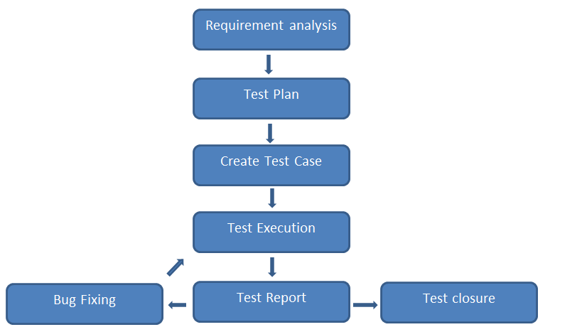
Testing Process

Slide 52
Testing Environment
Mozilla Firefox 31.0
Google Chrome Version 36.0.1985.143 m
RAM 4.0 GB | CPU i5 2.40GHz

Slide 53
Test Plan

Slide 54
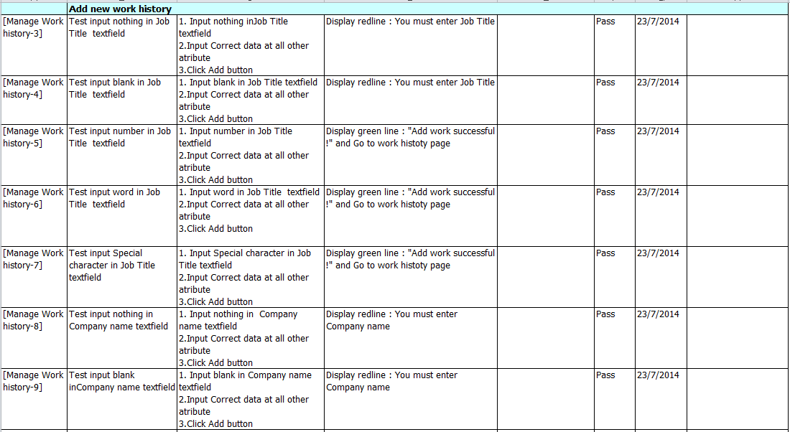
Test Cases(example)

Slide 55
Test Result
Module Code | Pass | Fail | Untested | N/A | Number of test cases
Integration test
Total | 548 |  |  |  | 548
Register | 111 |  |  |  | 111
Search Job | 6 |  |  |  | 6
Login | 11 |  |  |  | 11
Forgot password | 11 |  |  |  | 11
Change password – Front end | 11 |  |  |  | 11
Applied history | 8 |  |  |  | 8
Add new work history | 66 |  |  |  | 66
Add Education | 25 |  |  |  | 25
Post Job | 76 |  |  |  | 76
Lock & unlock job seeker | 2 |  |  |  | 2
Export Job seeker report | 2 |  |  |  | 2
Overview Job | 27 |  |  |  | 27
Manage Data | 48 |  |  |  | 48
Group | 33 |  |  |  | 33
Overview Company | 3 |  |  |  | 3
Change password –back end | 15 |  |  |  | 15
GUI – Front-end | 28 |  |  |  | 28
GUI – Back-end | 65 |  |  |  | 65
System test
Total | 574 |  |  |  | 574
Confirm moving –Front –end | 217 |  |  |  | 217
Confirm moving –Back –end | 39 |  |  |  | 39
Performance –Front –end | 217 |  |  |  | 217
Performance –Back –end | 39 |  |  |  | 39
Confirm Influence | 62 |  |  |  | 62
Total | 1122 |  |  |  | 1122

Slide 56
6.Lesson Learned
Soft skills:
Communication
Negotiation
Planning
Team motivation
Teamwork
Technologies:
Java
PHP
Framework: ADF Framework
Subversive SVN, Code Google
jQuery, CSS, HTML,…

Slide 57
7.Demo

Slide 59
Thank you!

