Slide 1
ViVu
SOCIAL NETWORK

Slide 2
Vivu Team
2

Slide 3
Contents
1
2
Project Management Plan
Project Introduction
3
Software Requirement Specification
4
Software Design
5
Testing
7
Q&A
6
Lesson Learned
8
Demo

Slide 4
Project Introduction
Background
Common information
Project name: ViVu
Project code: ViVu
Project type: Social Network
Project Lifetime: 31/5/2014 - 20/8/2014

Slide 5
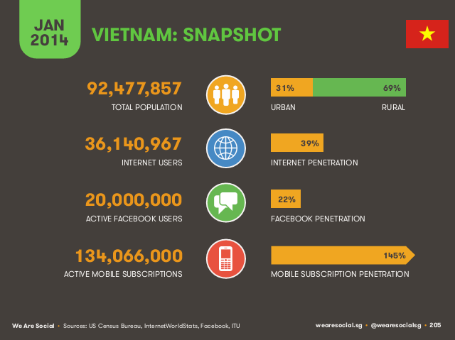
Project Introduction
Background
Source: We Are Social 2014 http://wearesocial.net/

Slide 6
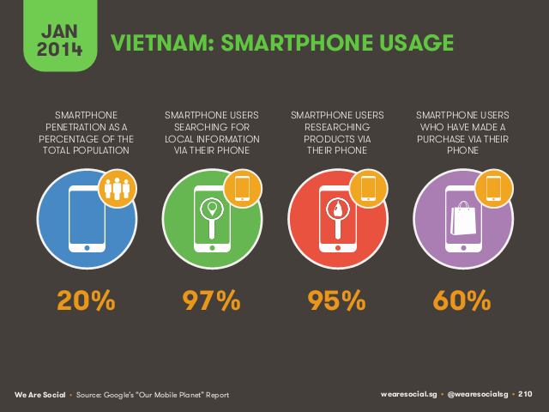
Project Introduction
Background
Source: We Are Social 2014 http://wearesocial.net/

Slide 7
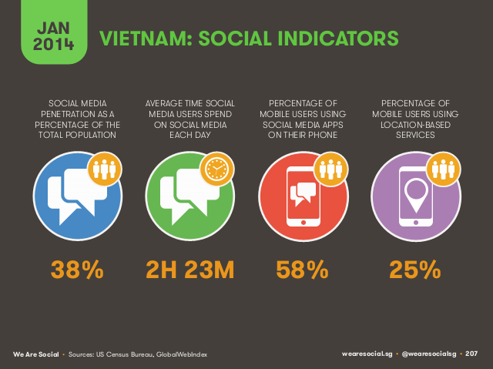
Project Introduction
Background
Source: We Are Social 2014 http://wearesocial.net/

Slide 8
Project Introduction
Evaluation & Change
Internet growing fast
Social network are becoming more popular in Vietnam
Change

Slide 9
Project Introduction
Idea
Vietnam has relatively young population, dynamically developing economy.
Demanding for entertainment, travel,…
Communication between people.
Where to go?
How to do?
Build a social network allow user can explore, manage and share places to their friend.
9

Slide 10
Project Introduction
Proposal System
Web Application:
View user’s position and friend’s on Map.
Search and suggest place for checking-in using DATA MINING.
Check-in and add new location, image and information about place.
Get direction from user’ current position to other place in system.
Share user’s current position to friends via Facebook, ViVu system.
Android Application:
View user’s position and friend’s on Map.
Search and suggest place for checking-in.
Share user’s current position to friends via SMS, Facebook, ViVu system.
Check-in and add new location, image and information about place.

Slide 11
Project Introduction
Main Objectives
Friend and notification
Search place using search processing
Get Direction
Main Objectives
Check-in and share place
View user’s location and friend’s

Slide 12
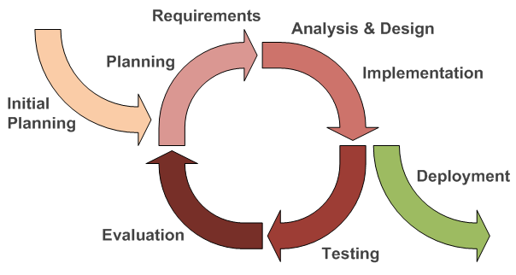
Project Management Plan
Software Process Model
Iterative Model

Slide 13
Project Management Plan
Team Work
Time: 6 hours/day, 5 days/week
Location: school, home
Communication:
Meeting supervisor: once a week
Team building: once a month

Slide 14
Project Management Plan
Development Tools
Hardware
Develop:
- Personal computers (Windows 8.1)
- Smartphone running Android 4.3 with 3G, Wi-Fi, GPS.
Deploy: Server on VPS
Test: Personal computers, Server
Software
File manage: TortoiseSVN 1.8.8
Code manage: TortoiseSVN 1.8.8
Document: Microsoft Office 2013 (Word, Excel, Project, PowerPoint).
Code: PHP 5.5, Notepad++ 5.9.8, Java JDK 1.7
Design: Microsoft Office Visio 2013, Enterprise Architect 7.1
Running and test:, chrome 36.0
Bug Tracker: Bugzilla 4.0.4

Slide 15
Project Management Plan
Techniques
v. 5.6
V 2.0
v. 1.7
v 1.8

Slide 16
Project Management Plan
Detail Plan
WBS & GANTT CHART

Slide 17
Project Management Plan
Risk Management
No. | Risk | Avoidance | Contingency Plan | Status
1 | Conflict between team members | - Team building to bond member together. - Team meeting. | - Talk with each member to find out the solutions. | Closed
2 | The project is not on time | Define clearly user, goal of project. Allocate reasonable time to research and code. | Work over time | Closed
3 | Team members do not have much knowledge in some algorithm/ technology | Orient project problem to suitable technology. Use popular technology to replace | Review all information about technology/ algorithm and tasks in the end of the meeting | Closed
4 | Requirement can be changed | Ensure possible cases of project are covered. Review requirement with stakeholders and PM. | Ask supervisor for a convenient change. Work over time. | Closed
5 | Data lost | Create backup data in other laptop or desktop. Use cloud such as: icloud, SkyDrive …etc… | Define a schedule for project’s backup and restore latest backup file. | Closed
6 | Misunderstanding on work assigned and deadline | Review requirement with all team members. Use clear word to communicate Assigned tasks in written format | Assign task again to suitable members. | Closed
7 | Team members have personal problem, they cannot complete deadline on time | Feedback problem to PM/ team leader early. | Find help from outside if team members have emergency situation | Closed

Slide 18
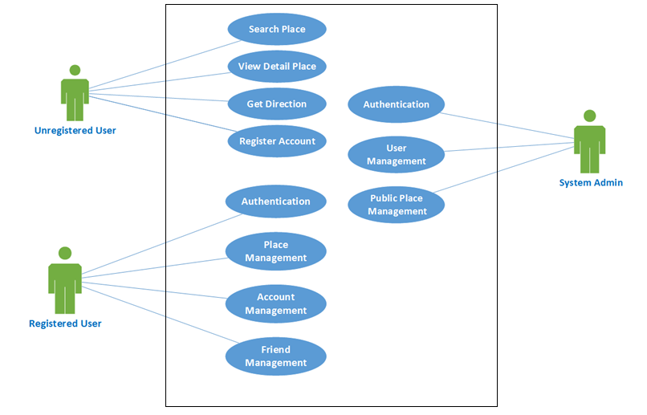
Software Requirement Specification
Use case diagram
Web application
Use case diagram-Web application

Slide 19
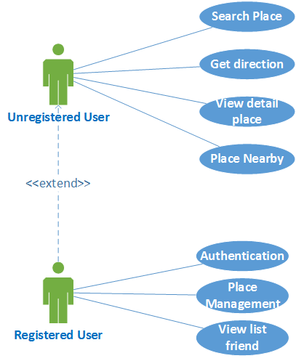
Software Requirement Specification
Use case diagram
Android application
Use case diagram-Android application

Slide 20
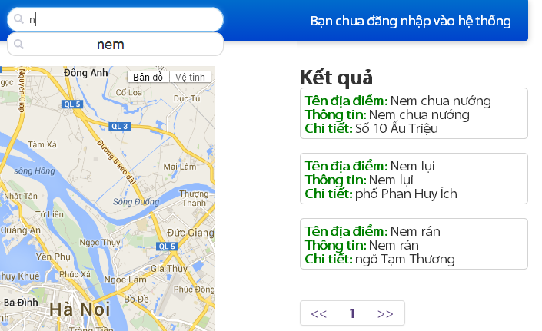
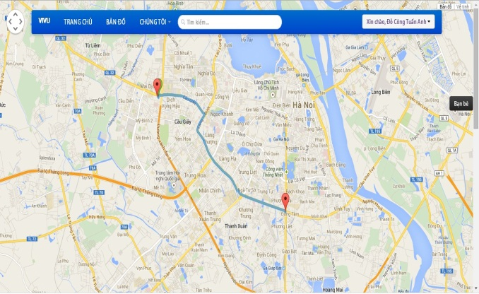
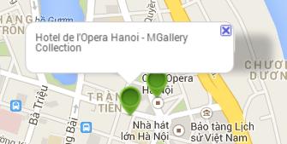
Software Requirement Specification
Functional Requirement
Web application
Unregistered User
Search Place
View Detail Place
Get Direction
Register Account

Slide 21
Software Requirement Specification
Functional Requirement
Web application
Unregistered user:
Search place
View place
Register account
Registered user:
Authentication
Account management
Places management
Friend management
Admin:
User management
Places management
Use case diagram-Android application

Slide 22
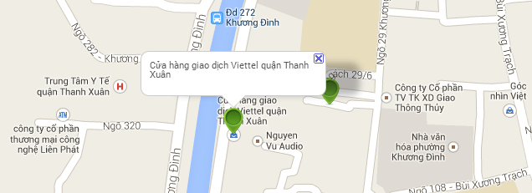
Project Management Plan
Software Requirement Specification
Web application
Unregistered User
View detail place

Slide 23
Project Management Plan
Software Requirement Specification
Web application
Unregistered User
View detail place

Slide 24
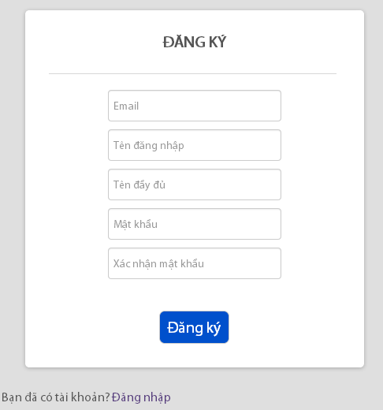
Project Management Plan
Software Requirement Specification
Register User

Slide 25
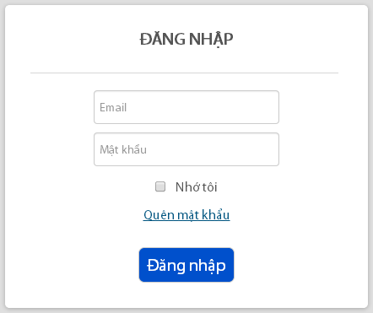
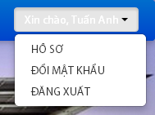
Project Management Plan
Software Requirement Specification
Registered User
Authentication

Slide 26
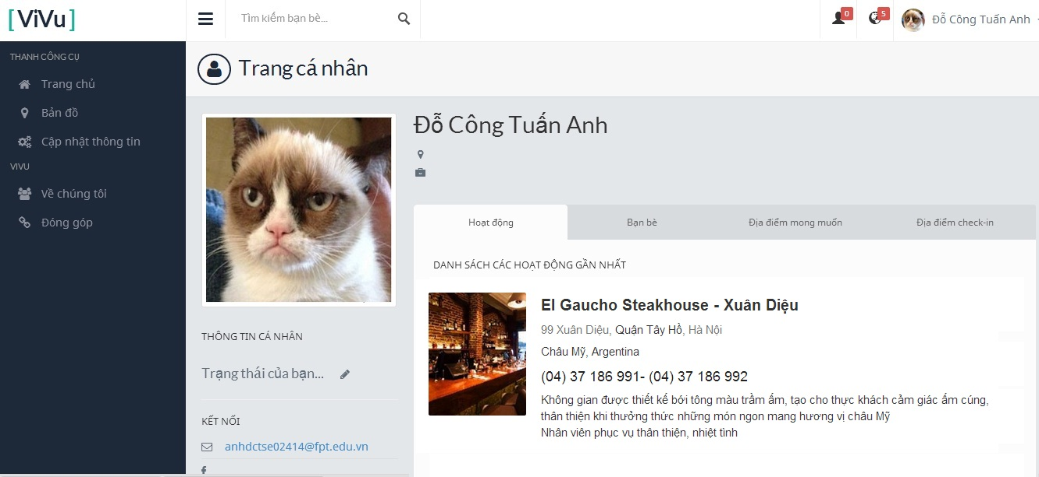
Project Management Plan
Software Requirement Specification
Registered User
Personal Page

Slide 27
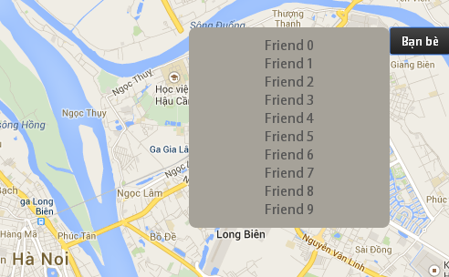
Project Management Plan
Software Requirement Specification
Registered User
Place Management
View Place

Slide 28
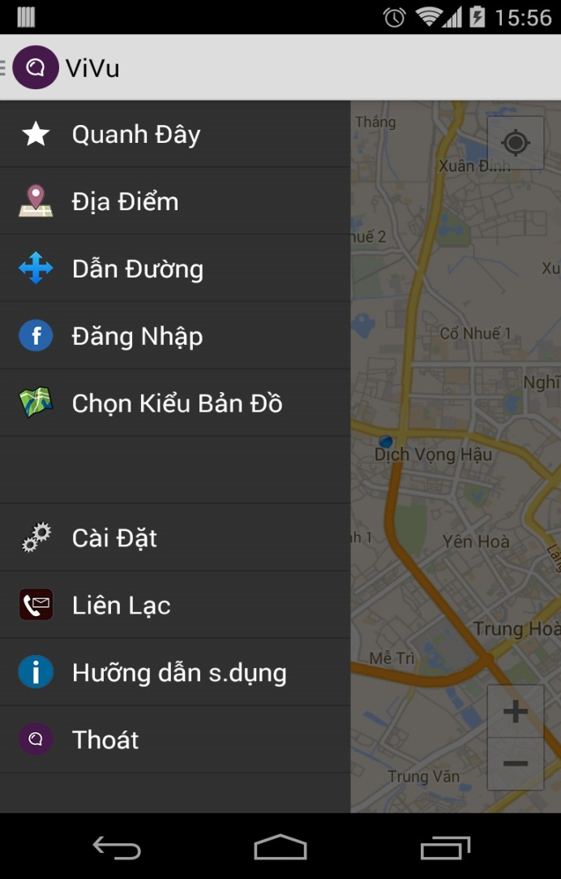
Project Management Plan
Software Requirement Specification
Android application
Menu

Slide 29
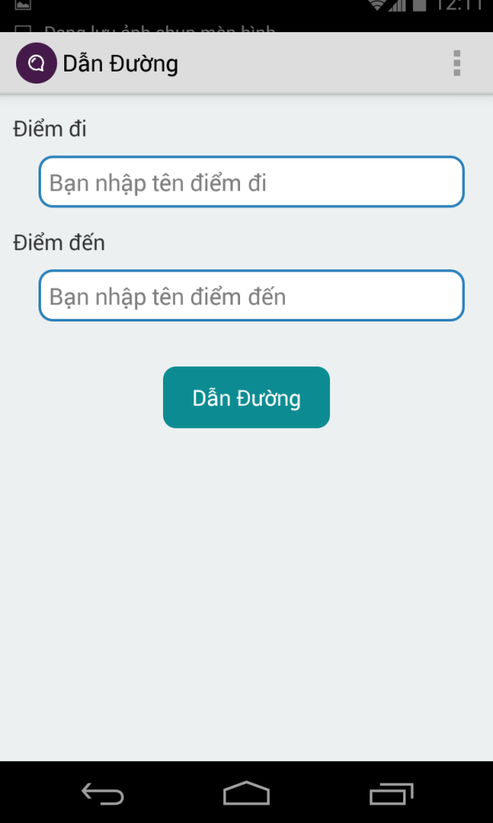
Project Management Plan
Software Requirement Specification
Android application
Get Direction

Slide 30
Project Management Plan
Non-function requirement
Usability | Security | Maintainability | Performance
Vietnamese GUI | Require authentication and authorization for admin access | Build system to separated parts | Response time is not higher than 3s
Full-text search | Access database need an account and password | Follow the Coding Convention
 | User email, password is encrypted by SHA1, MD5 before saving | Follow Object Oriented Programing paradigm

Slide 31
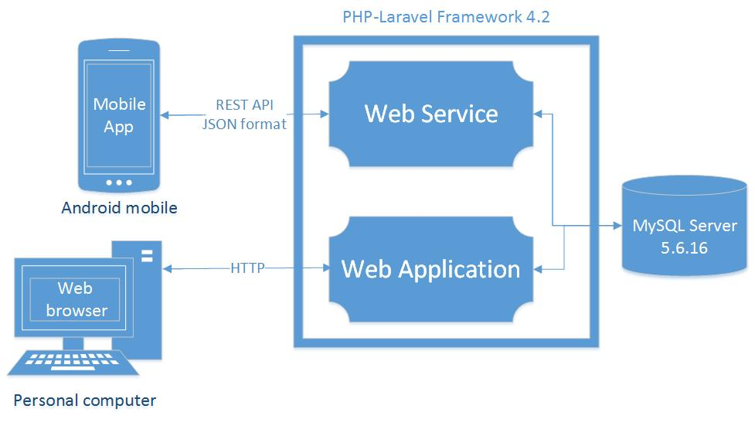
Software design
System Architecture overview

Slide 32
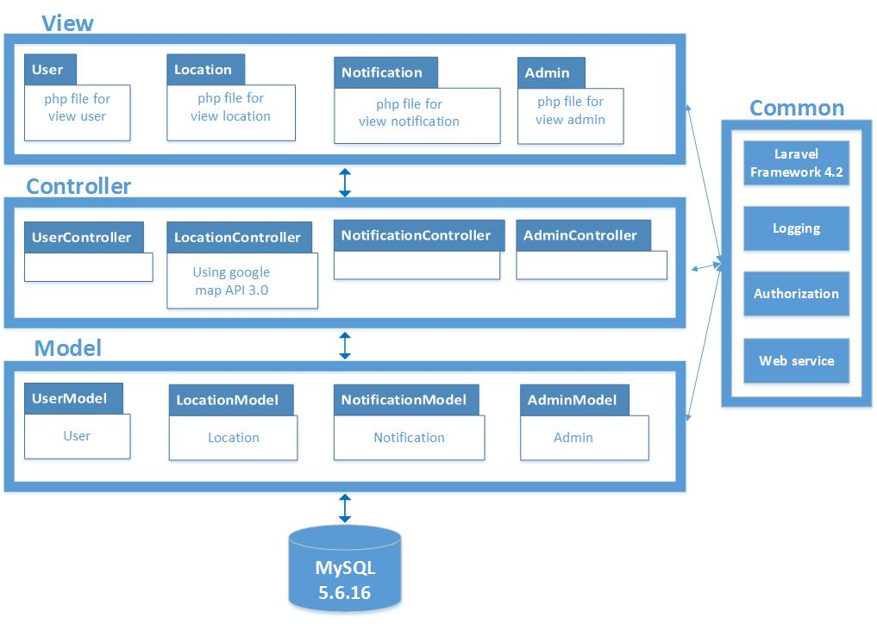
Software design
Web Application Architecture overview

Slide 33
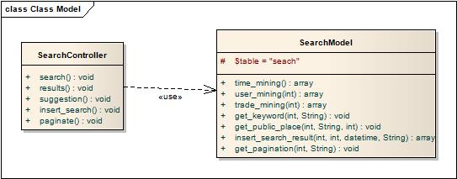
Software design
Search - Class diagram
Class diagram- Search place

Slide 34
Software design
Search - Sequence diagram
Sequence diagram- Search place

Slide 35
Software design
Searching - Flowchart diagram

Slide 36
Software design
Data processing

Slide 37
Software design
Image upload processing

Slide 38
Software design
Data processing
Simply, data mining could be understood that is a process: Using algorithms and methods to extract big data, to get useful information, trends, laws or relationships.
A common Data processing is:
Data source - Data cleansing - Using algorithms and methods

Slide 39
Software design
Data processing
Extract data according to time:
Use Sequenced Patterns to get the public place’s category that is the top 1 of searching in 7 day to become priority.
Example:
SELECT public_place_category, count (search_id) AS Number
FROM SEARCH, PUBLIC_PLACE
WHERE DATEDIFF (CURDATE (), search_time) < 7
AND public_place_id = search_public_place_id
GROUP BY public_place_category
ORDER BY Number DESC
LIMIT 1;

Slide 40
Software design
Data processing
Extract data according to user’s history
Use Frequent Pattern, Association rules to get the public place’s priority category of each trade
Example
SELECT public_place_category
FROM
(SELECT public_place_category, count (search_id) AS Number
FROM SEARCH, USER, PUBLIC_PLACE
WHERE search_user_id = user_id
AND public_place_id = search_public_place_id
AND user_id = ‘1’
GROUP BY public_place_category) AS Number,
(SELECT count (search_id) AS Total
FROM SEARCH
WHERE search_user_id = ‘1’) AS Total
WHERE Total/Number < 2;

Slide 41
Software design
Data processing
Extract data according to user’s job
Use Frequent Pattern, Association rules to get the public place’s priority category of each job
Example:
SELECT public_place_category
FROM
(SELECT public_place_category, COUNT(search_id) AS Number
FROM SEARCH, USER, PUBLIC_PLACE
WHERE search_user_id = user_id
AND public_place_id = search_public_place_id
AND user_trade = (SELECT trade FROM USER WHERE user_id = ‘1’)
GROUP BY public_place_category) AS Number,
(SELECT count (search_id) AS Total
FROM SEARCH, USER
WHERE search_user_id = user_id
AND user_trade = (SELECT trade FROM USER WHERE id = ‘1’)) AS Total
WHERE Total/Number < 2
.

Slide 42
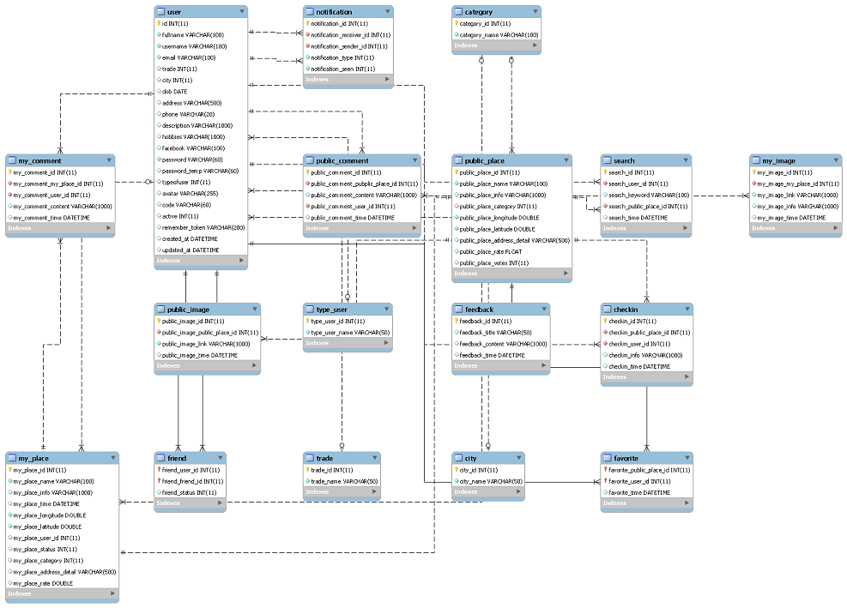
Software design
Database design

Slide 43
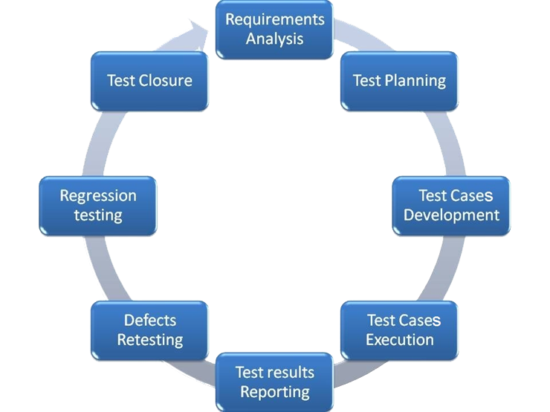
Testing
Testing life cycle

Slide 44
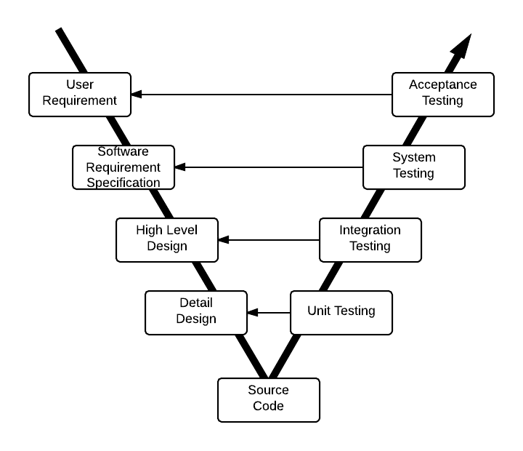
Testing
Test model

Slide 45
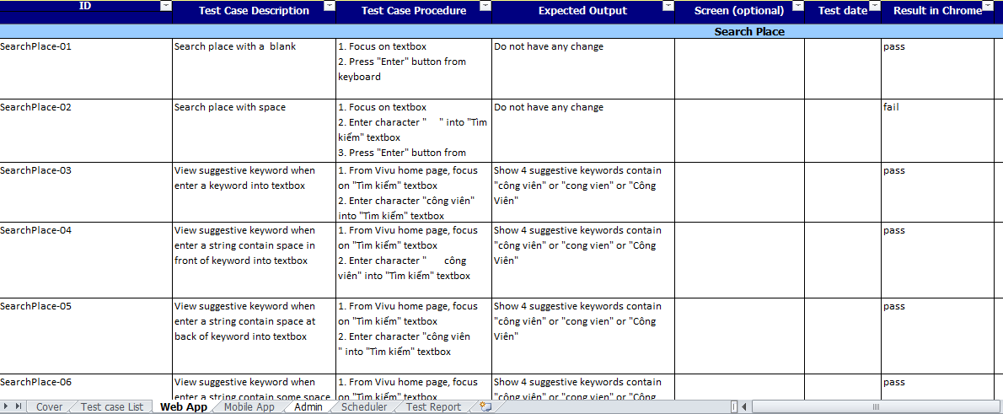
Testing
Test case

