Slide 1

Capstone Project DocumenT
Team collaboration - HAKI
  Nguyễn Văn Hiệp – SE01961
  Nguyễn Hoàng Anh – SE02151
  Đỗ Hữu Chiến – SE02258
  Lê Mạnh Linh – SE02352
  Nguyễn Văn Vũ – SE02130
Team Collaboration Application
HAKI

Slide 2

Contents
1. Introduction
2. Project Management Plan
7. Demo & Q&A
3. System Requirement Specifications
4. System Design Description
5. System Implementation & Test
6. Maintenance & Future developments

Slide 3
Part 1:
Introduction

Slide 4
The People
Mr. Lương Trung Kiên
Instructor
Nguyễn Văn Hiệp
Nguyễn Hoàng Anh
Project Manager
Developer
Developer
Designer
Nguyễn Văn Vũ
Đỗ Hữu Chiến
Developer
Technical
Technical
Tester
Lê Mạnh Linh
Test leader

Slide 5

Background
sharing website
  Many kinds of project:
    Charity
    Entertainment
    Event management
    Business
    Scientific research
    Personal
    etc

Slide 6


Background
sharing website
  Exchange information
  Team work
  Manage information
  Manage people in team

Slide 7

Problems
sharing website
  Many small tasks
  Members are different role
  Group members need to communicate
  Share and exchange information
  Information need to updated frequently
  Need to know working progress
  Assign works for members
  Manage many groups

Slide 8
Our proposal
Our proposal to increase work's effective:
  Brings better user experience.
  Comfortable.
  Professional to work.
  Professional to manage group and project when users work like a team or user want to manage their plan.

Slide 9


Our proposal
sharing website
  Haki is developed on Android and Web browser

Slide 10
Part 2:
Project Management Plan
sharing website

Slide 11

The proposed system and scope
Development Technologies
Process
Project organization
Project Planning

Slide 12
The Proposed System & Scope
  Proposed system
    Create boards (as projects)
    Create lists ( each list has many tasks)
    Track activities of all members
    Manage personal tasks
    Manage project and member ( for PM)
    Search group, project and user
    Synchronize
  Scope
    Android application
    Web application

Slide 13






Development Technologies
sharing website

Slide 14
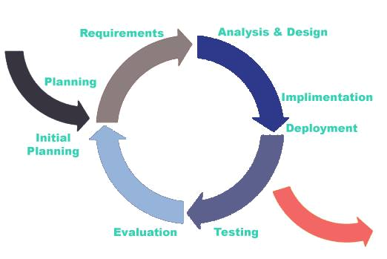
Process model
Iterative Development Model

Slide 15
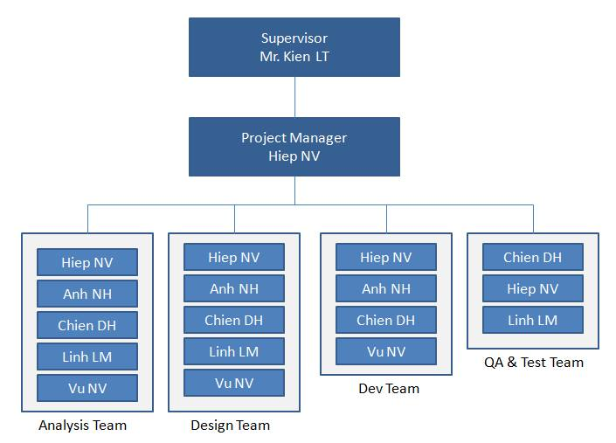
Project organization

Slide 16
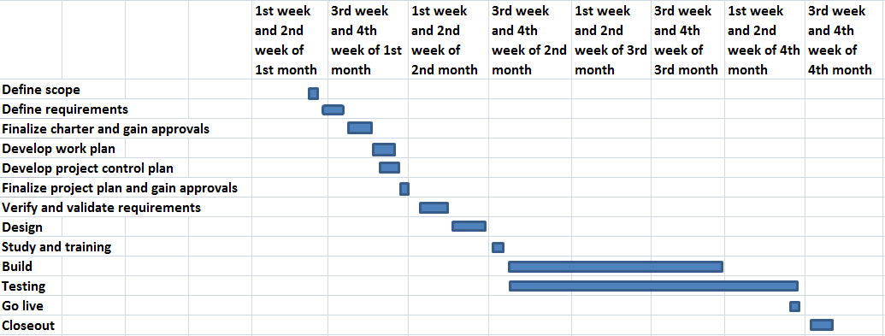
Project Planning

Slide 17





Team management
sharing website
  Work 5hs/day
  and 5 days/week
  Buffer: about 1 week
  Meeting: from Monday
    to Friday
  Online meeting

Slide 18
Risk Management
Risk Description | Avoidance plan | Contingency plan
Team member’s illness | Define the suitable schedule to ensure the health of members | Other members try to share and complete work to meet the deadline.
Conflicts between team members | Organize team buildings frequently to improve members spirit | Team members should make concession to each other. All of the members should analyze and find the way to become reconciled.
Changing requirement | Hold meeting frequently to define and discuss all features of project | Meet supervisor to determine whether features should be implemented or not. Project manager creates implementation plan and push progress quickly.

Slide 19
Quality Control
  Desired value
    Main features are completed
    Use coding convention
    User interface is good, friendly
    Functions are implemented quickly
    Synchronization is exactly, quickly and integrity
    Easy to maintain
    Good performance
    High security

Slide 20
Part 3:
System Requirement Specifications

Slide 21

System Requirement Specifications
Functional requirement
Non-Functional requirement

Slide 22
Functional Requirement
Guest user
Member user
Master user
Owner user

Slide 23
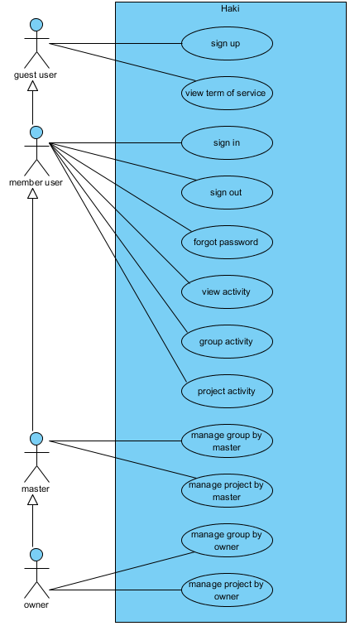
Functional requirement

Slide 24
Functional Requirement
Member user
    Sign in
    Sign out
    Change password
    Forgot password
    View activity
    Group activity
    Project activity

Slide 25
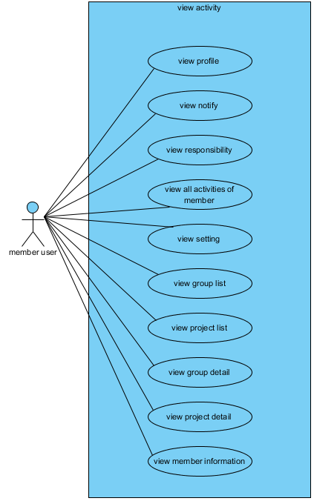
Functional requirement

Slide 26
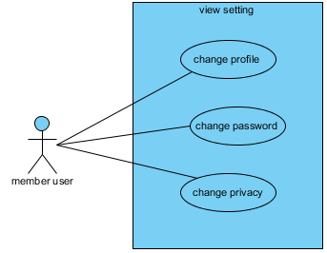
Functional requirement

Slide 27
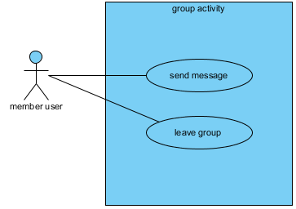
Functional requirement

Slide 28
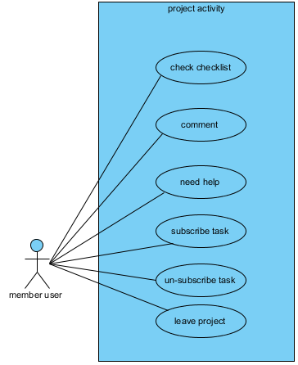
Functional requirement

Slide 29
Functional Requirement
Master user
    Mange group by master
        Add member to group
        Remove member of group
        Update information of group
    Manage project by master

Slide 30
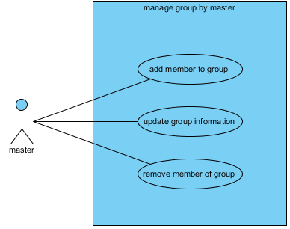
Functional requirement

Slide 31
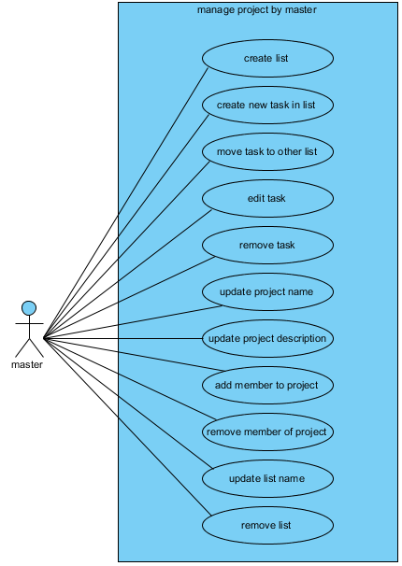
Functional requirement

Slide 32
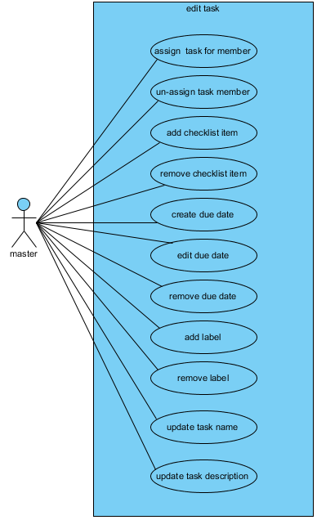
Functional requirement

Slide 33
Functional Requirement
Owner user
    Manage group by owner
        Create group
        Change permission in group
        Remove group
    Manage project by owner
        Create project
        Change permission in project
        Remove project

Slide 34
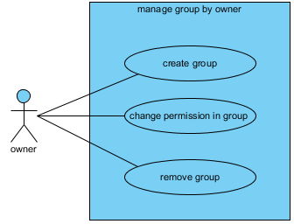
Functional requirement

Slide 35
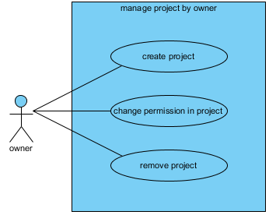
Functional requirement

Slide 36
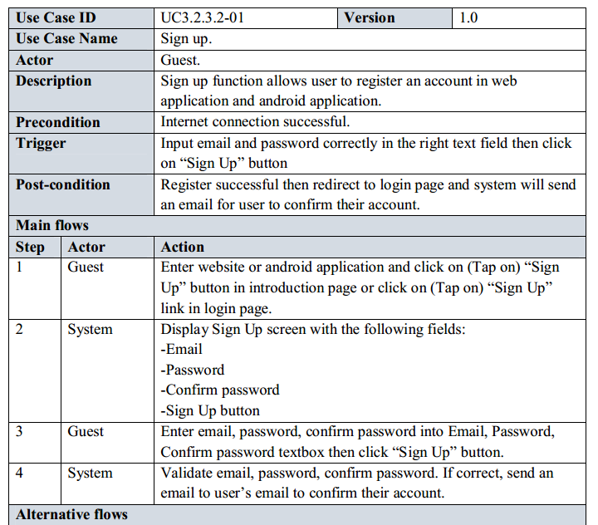
Use case specification

Slide 37
System Requirement Specifications
sharing website
Non-Function requirement
Usability
Availability
Reliability
Security
Security
Performance
Maintainability

Slide 38
Non-Functional requirement
Usability
    Front-end language: English
    Easy to use
    Clear and convenient user interface
      Availability
              Run 24/24
      Reliability
              Database and files: backed up regularly
              Easily to upgrade to expanded
      Security
              Implement secure session token for authentication.
              Validate form’s data input from user.
              Use token to prevent CSRF attack.
              Sanitizing user’s input to prevent XSS attack.
              Use Reliable and safety configuration for server.

Slide 39
Non-Functional requirement
      Maintainability
          Source code must be commented clearly for maintenance and expansion in future.
          Errors must be logged, easy to maintenance and fixing.
          Apply coding standards and naming conventions.
          When project completed, documents related to standards and conventions must be included.
      Portability
          User can access to the system from anywhere with Internet connection.
          Installation package size must be small enough to be suitable for Android phone.
          Haki is developed on Android and web application.
Performance
  The system and server are able to serve for the numbers of concurrent connection to be 200 users. We will consider upgrading if necessary.
  The access numbers per day is about 1000 accesses, concentrate on from 9:00 to 11:00 and from 14:00 to 16:00.
  Screen transition is less than 5 seconds.

Slide 40
Part 4:
System Design Description

Slide 41
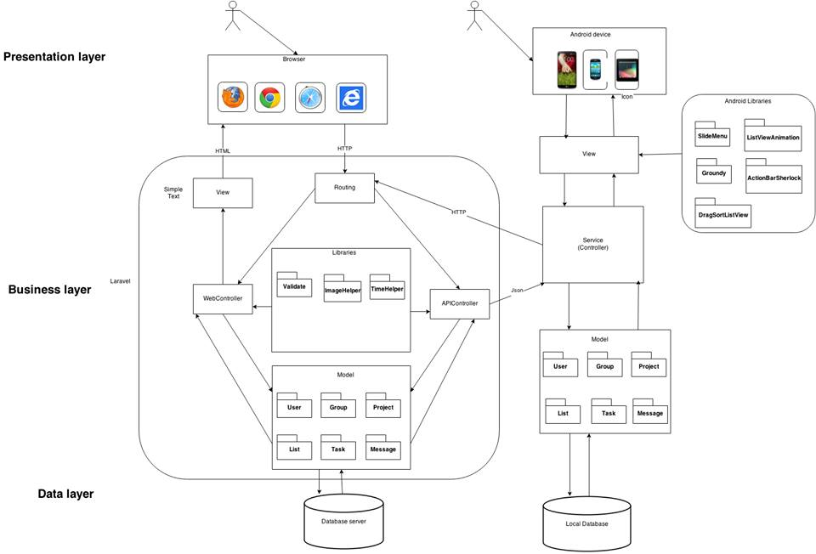
System Logical Architecture

Slide 42
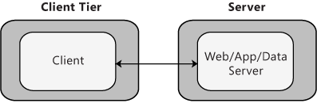
System Physical Architecture
Client-server

Slide 43
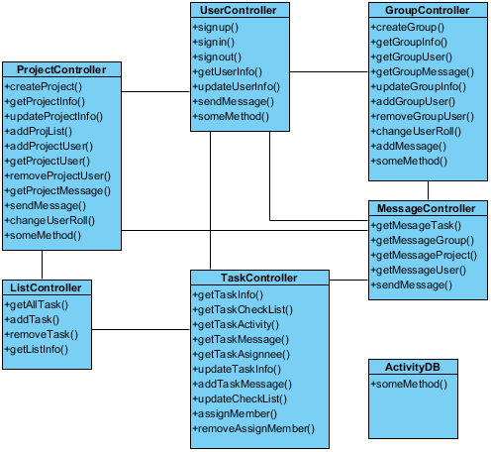
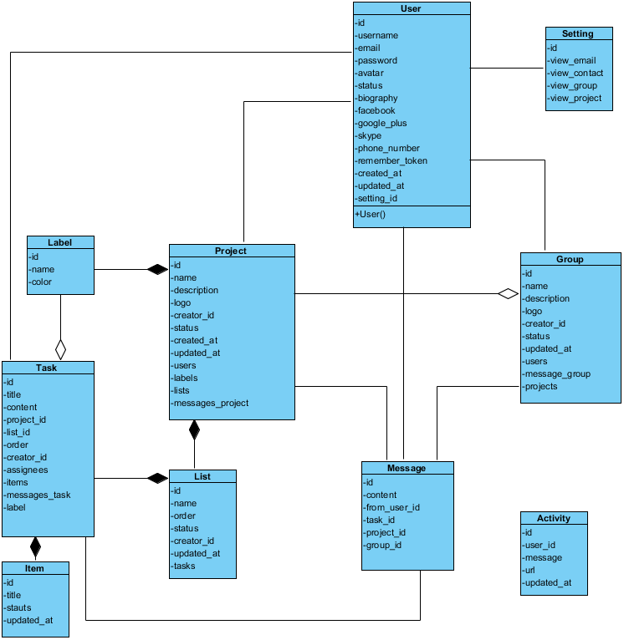
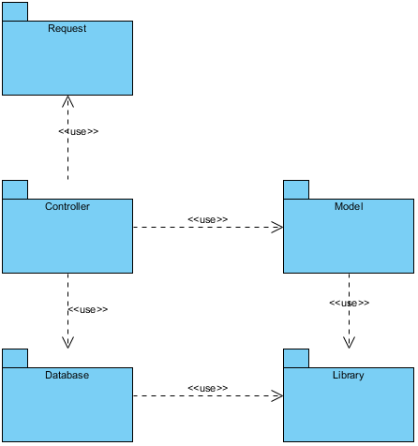
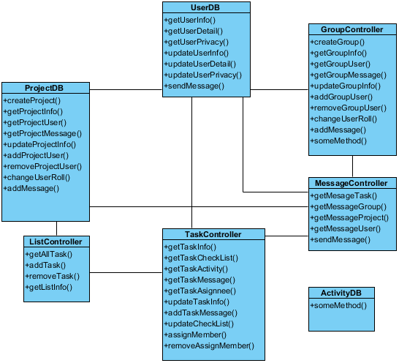
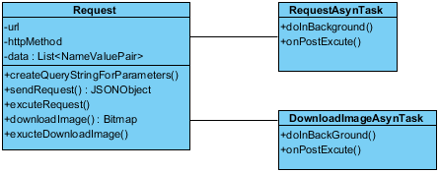

Class diagram
Package
Model
Controller
Library
Request
Database

Slide 44
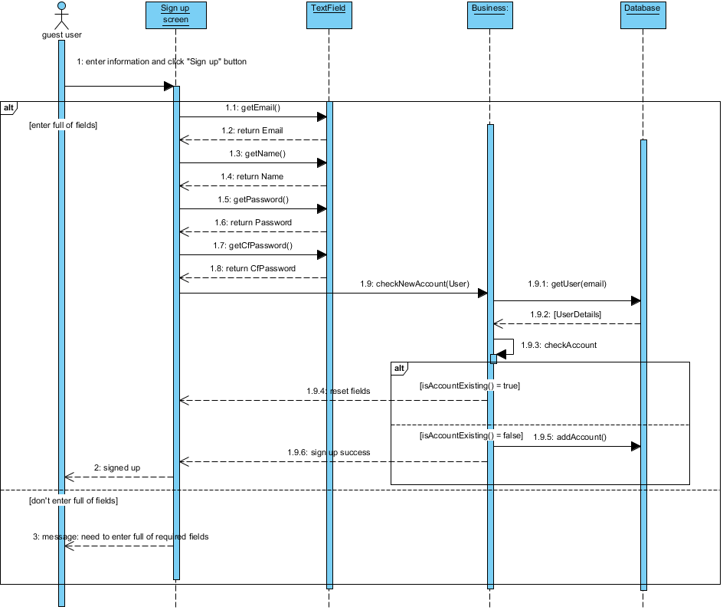
Sequence diagram

Slide 45
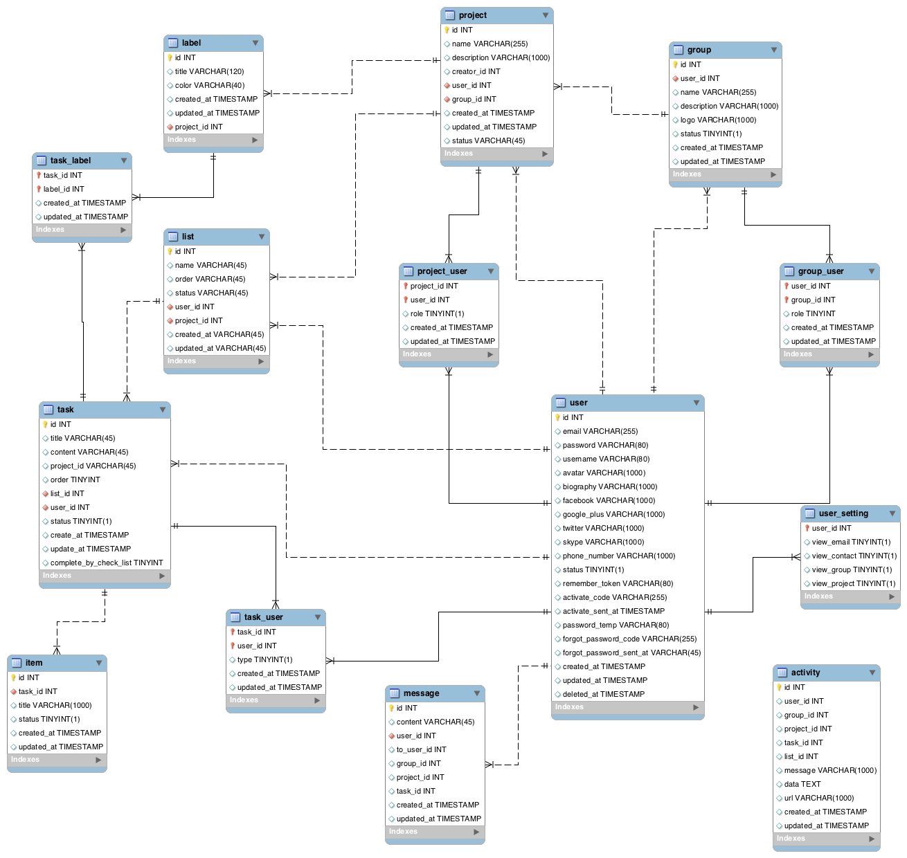
Database

Slide 46
Part 5:
System Implementation & Test

Slide 47
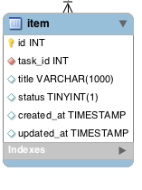
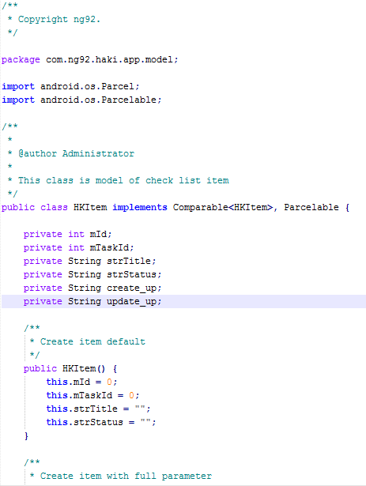
System Implementation
Coding convention

Slide 48
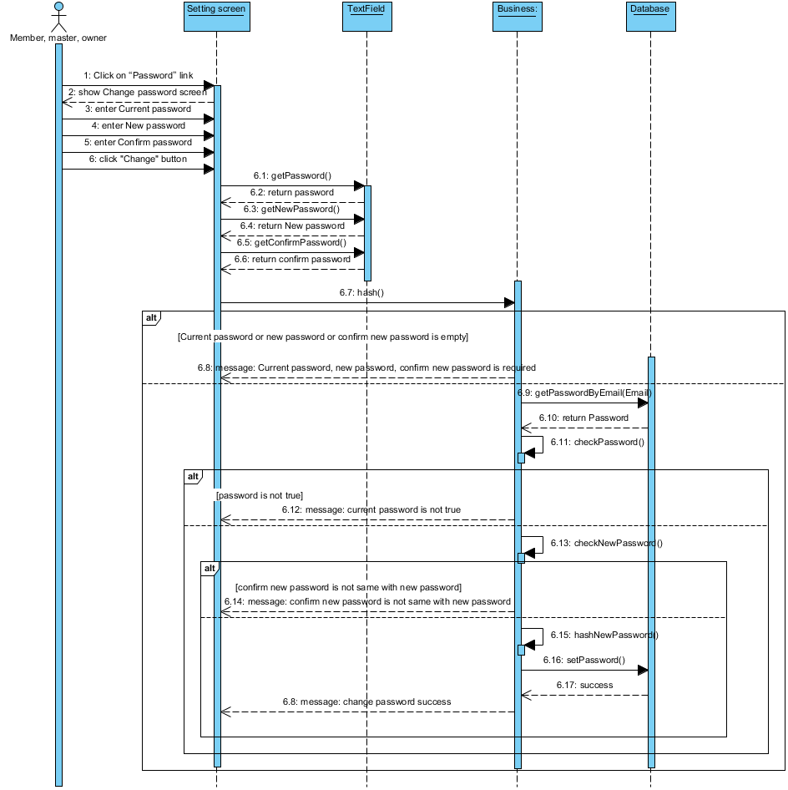
Sequence diagram
Sequence diagram
Sign in

Slide 49
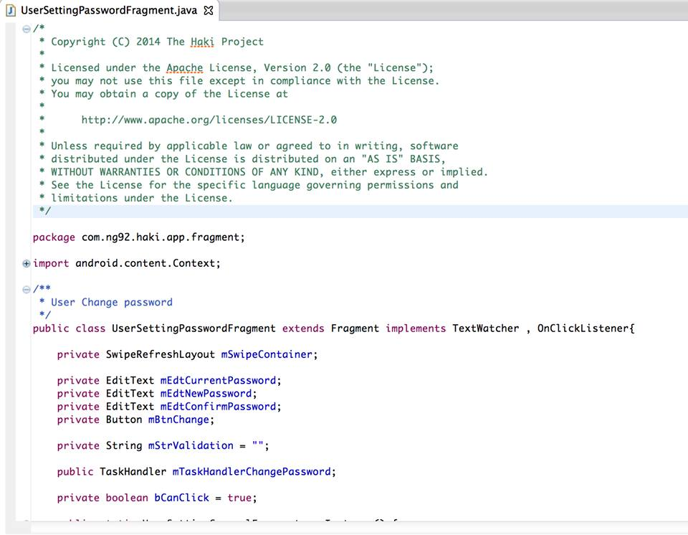
Source code

Slide 50
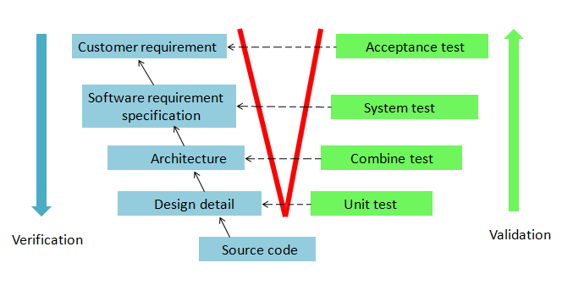
Test
Testing model
Verification & Validation Model

Slide 51

Test
sharing website
The efficiency of V&V model:
  Can detect defects, resolve defects and find the cause of defects in early stage of life cycle.
  Reduce risks of project.
  Improve quality and reliability of application.
  Reduce the affect to costs and schedule

Slide 52




Testing environment
Chrome 36
IE 9
Firefox 31
Android 4.1

Slide 53

Testing tools
sharing website
  Robolectric
  Junit

Slide 54
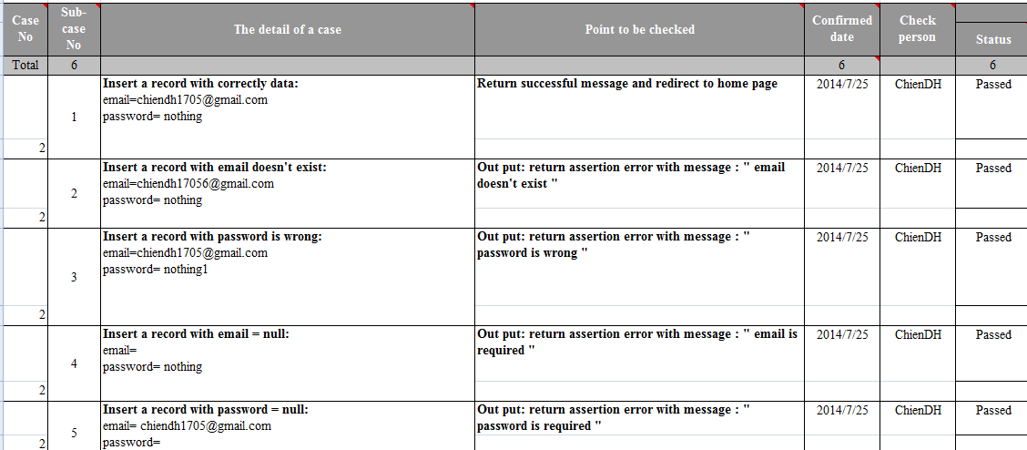
Test cases

Slide 55
Testing results v1
File | Number of test case | Passed | Failed | Skip | Coverage (%)
Android-app | 125 | 90 | 35 | 0 | 72%
Web-app | 125 | 100 | 25 | 0 | 80%
Server | 100 | 83 | 17 | 0 | 83%
Integration test | 10 | 10 | 0 | 0 | 100%
GUI | 144 | 94 | 50 | 0 | 65%
TOTAL | 504 | 377 | 127 | 0 | 74.8%

Slide 56
Testing results v2
File | Number of test case | Passed | Failed | Skip | Coverage (%)
Android-app | 125 | 125 | 0 | 0 | 100%
Web-app | 125 | 125 | 0 | 0 | 100%
Server | 100 | 100 | 0 | 0 | 100%
Integration test | 10 | 10 | 0 | 0 | 100%
GUI | 144 | 144 | 0 | 0 | 100%
TOTAL | 504 | 504 | 0 | 0 | 100%
Test successful coverage: 100%

Slide 57
Part 6: Maintenance & Future developments

Slide 58
Maintenance
Review code
Running the test, debug and fix errors
Update the missing functions.

Slide 59
Approach to development
Develop app on iOS
Development full function for our application
Improve the function of convenience, flexibility and easier for users on android application.
Development chat function become real-time
Development real-time notification
Development to integrate with google drive & dropbox for attachment feature and file sharing

Slide 60

Lesson learned
sharing website
  Team work:
            Working in group
            Communication
            Resolve conflicts
  Technologies
  Software development processes
  Management skill
            Organize
            Negotiate
            Planning

Slide 61

sharing website

Slide 62

sharing website

Slide 63
Thanks for attending!

