Slide 1
CV Builder for Jobs
CVO Team
FPT University
August 29, 2014

Slide 2
Team Member
Supervisor
Nguyen Tat Trung
Team Leader
Tran Trung Hieu
Technical Leader
Vu Nhat Anh
Tran Duc Tam
Developer
Phan Ngoc Huan
Developer
Pham Thi Ngoc Anh
Tester

Slide 3
Table Content
1. Project Background
2. Project Management Plan
3. Requirement Specification
4. Software Design
5. Testing
6. Lesson Learned
7. Demo and Q&A

Slide 4

Project Background
In first quarter of 2014
162.400
bachelors & masters are unemployed

Slide 5

Project Background
Why you are rejected?
Notes:
Tại sao bạn bị nhà tuyển dụng từ chối khi xin việc?

Slide 6


Project Background
How?
Notes:
Đi tìm nguyên nhân tại sao?
Khi số lương sinh viên ra trường ngày càng tăng -> sự cạnh tranh càng lớn
- Làm thế nào để không bị từ chối khi xin việc.

Slide 7

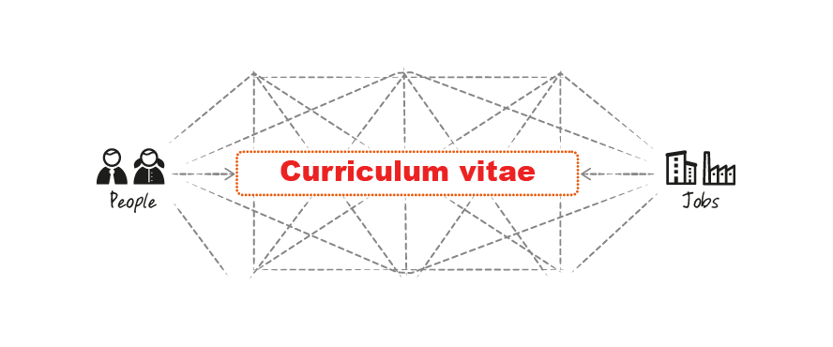

Project Background
Notes:
-> cần phải gây ấn tượng với nhà tuyển dụng
-> 2 bên hiểu nhau qua CV

Slide 8
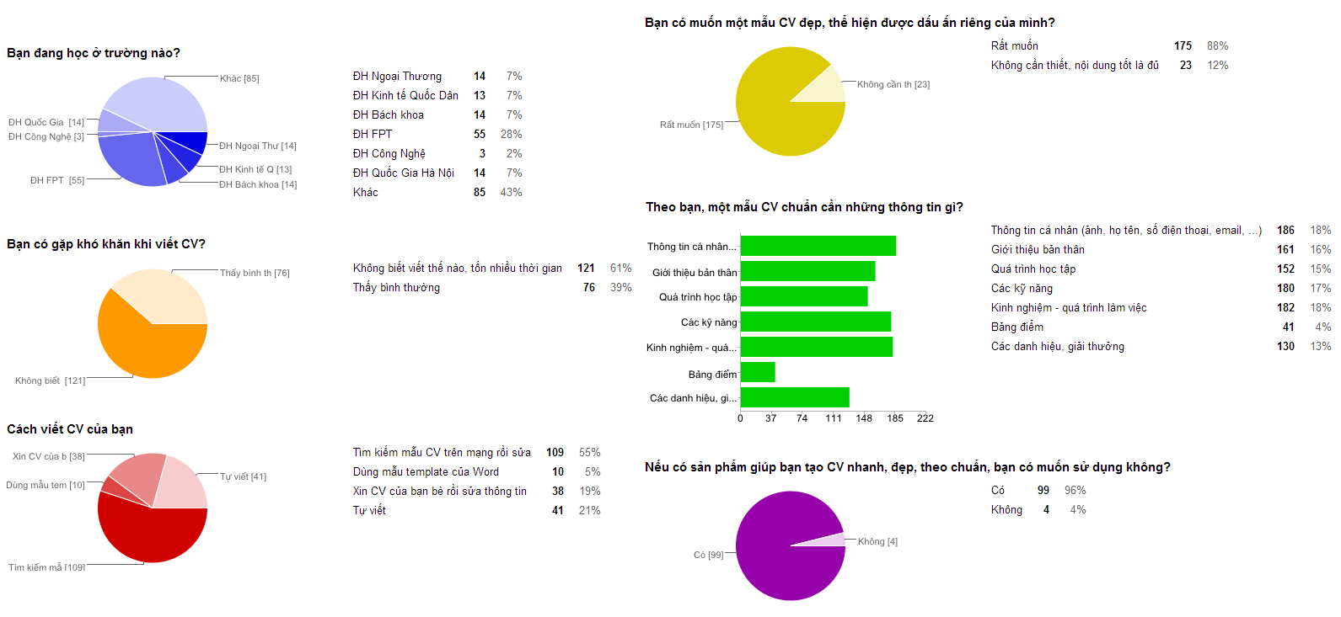
Project Background
Survey how to write CV
Notes:
- Theo khảo sát, > 61% gặp khó khăn khi viết CV
- Các bạn sv thuộc các trường top ít gặp khó khăn hơn khi viết CV

Slide 9
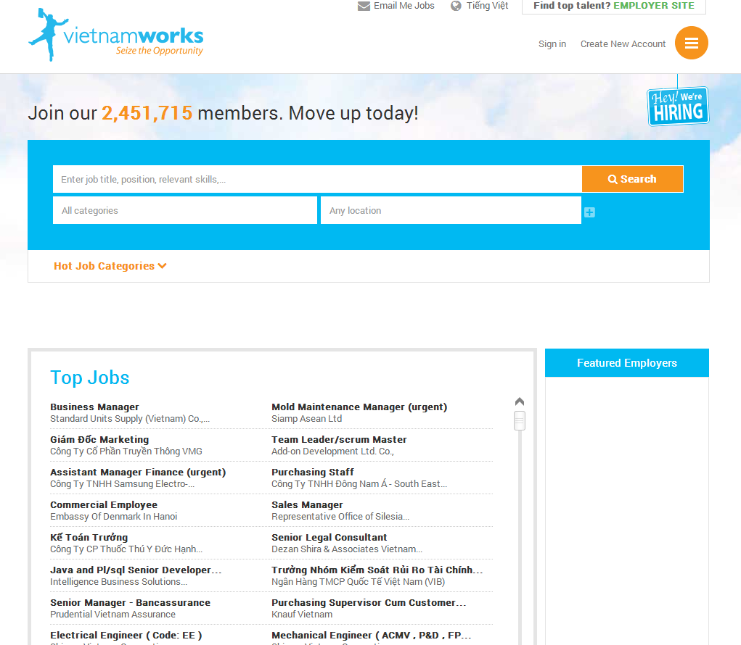
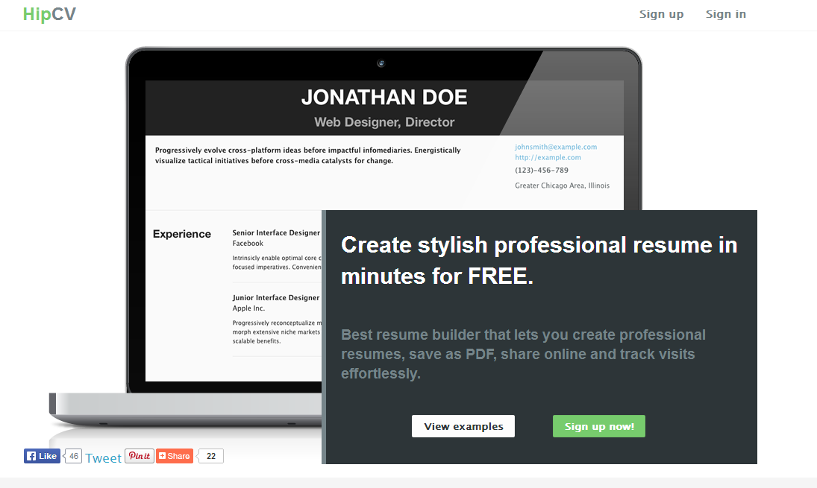
Existing System
Vietnamworks.com
HipCV.com
Notes:
Tại sao các hệ thống hiện tại chưa giải quyết được vấn đề này?

Slide 10
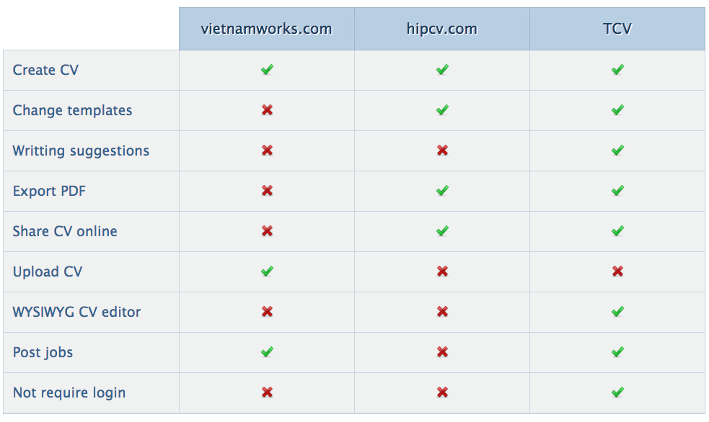
Existing System
Features comparing

Slide 11
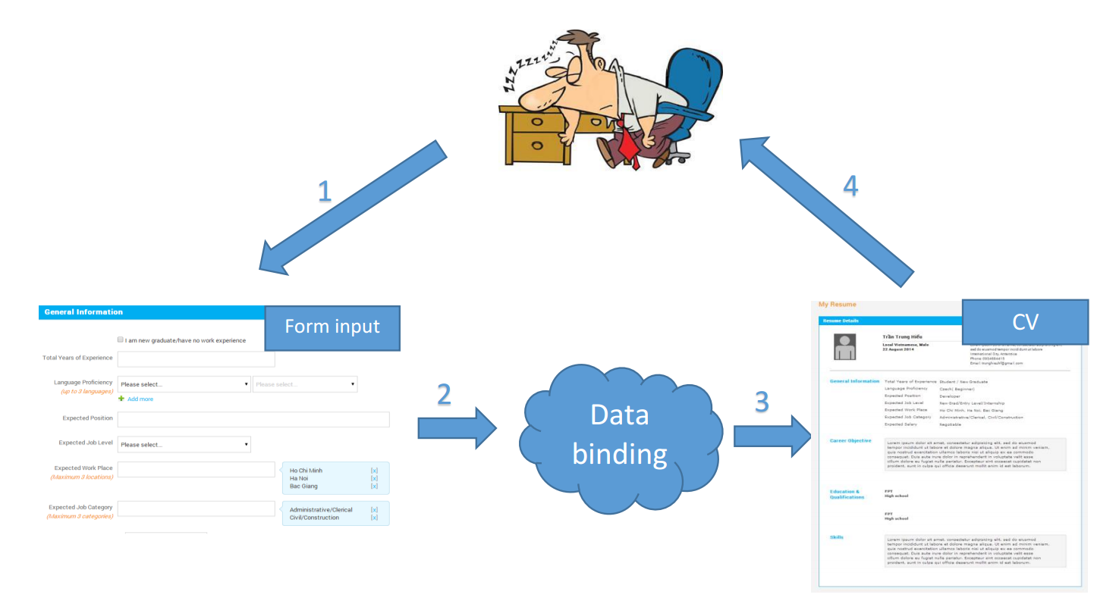

Project Background
Traditional
Notes:
Nhập quá nhiều thông tin, nhiều bước -> cảm thấy mệt mỏi, và chán
Mọi người thường muốn được nhìn ngay kết quả của quá trình

Slide 12
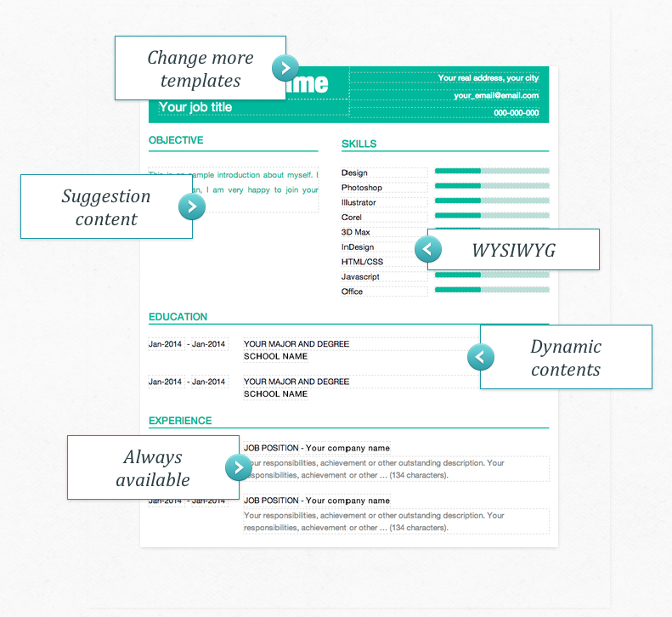

Project Idea
CV Builder

Slide 13
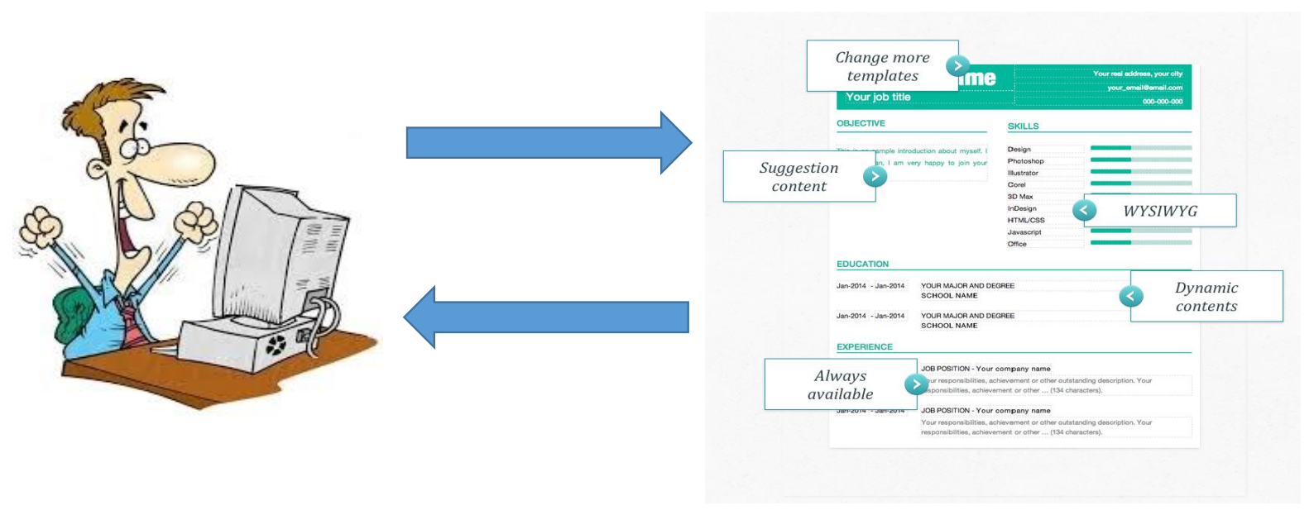

Project Idea
WYGIWYS

Slide 14

Main Objectives
Create fast and effective CV Builder.
System support posting and applying job.
Extensible system support developing template easily.

Slide 15
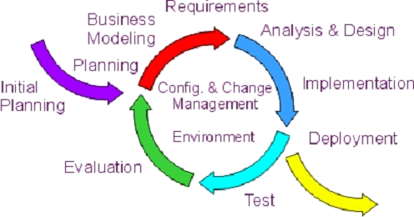
Iterative Process Model

Slide 16
Team Work
Working time
Meeting
Working space
Meeting with Supervisor
Communications Tool
Team Building
6 hours per day
Group meeting 2 times per week
FPT University Library
Home’s member
2 times per week
Facebook
Google Mail
Skype
Mobile Phone
1 times per month

Slide 17
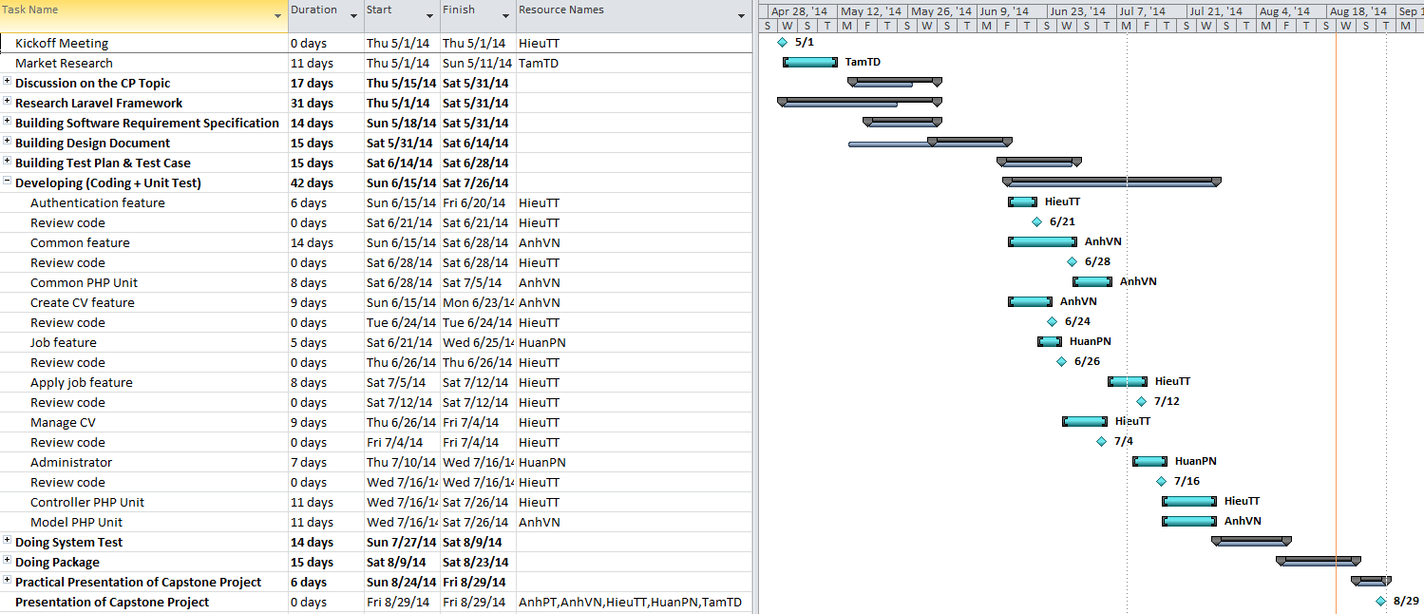
WBS and Gantt Chart

Slide 18







Project Tool: Software
Notes:
Document Tool: Microsoft Office 2013
File Manager: Google Drive
Coding Tool: Sublime Text
Source Management: Git-hub
Design Tool: Enterprise Architecture
Test Tool: Google Chrome
Defect Management: Hosted Red-mine

Slide 19




Technologies

Slide 20
Project Risk Management
No | Description | Root Cause | Avoidance plan | Contingency plan | Status
1 | Team members can miss some important information. | - Don’t use common tool to communicate. - Members are too busy to check notifications or messages. | - Come to agreement of which is the main communication tool all members use. - Use phone call in case of important situations. - Use reminder web service to assign task and tracking work schedule. | - Review all information and tasks in the end of the wrap-up meeting. | Close
2 | The project is not on time. | - Underestimate time of project. - The scope of project is too big for team. - Spend too much time to research and study but don’t start coding. | - Keep track with capstone’s deadline. - Ask supervisor for advice to define suitable scope. - Put high priority on main functions. - Start coding as early as possible. | - Work together for tracking schedule. | Close
3 | Poor experience of evaluation make miss scope. | - This project to need some new technique to meet scope. - Some team members do not work in web development function. - Team member do not have experience about this domain knowledge. | - List tasks and check continuously. - Evaluate quality and progress weekly. | - Training some new technique like: Github and how to use, Ubuntu Linux, web remind… - Assign one member to research about domain knowledge and create business annalistic. | Close
4 | Conflict between team members | - Opinion disagreements - Some team members don’t get along with others. | - Organize some team buildings to bond members together. | - Talk with each member to find the solution. | Close
5 | Productivity is low | - Some members spend too little time to do project. - New technique required a lot of time to research and study. | - Set rule with money penalty for who doesn’t finish job on time. - Set minimum working time for every team members. | - Tell team members to rearrange their working time. - Work overtime to study new technique. | Close
6 | Data lost | - Lost data because do not backup the data. - Someone merge code make lost another one code. | - Define a schedule to back up project’s data | - Restore project’s data. - Using Github repository to back- up data. | Close

Slide 21
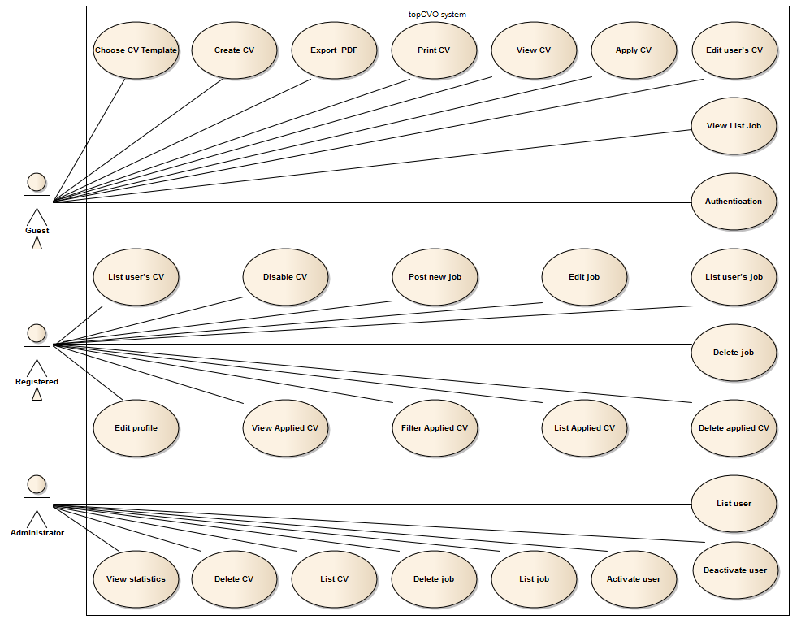
User-Case Diagram

Slide 22
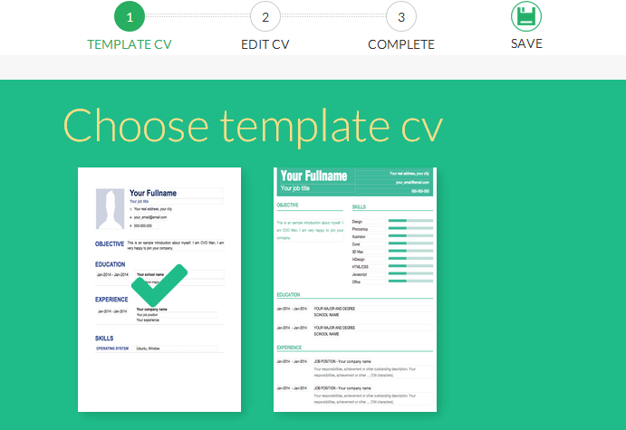
Role: Guest
Choose CV template
Create CV
Print – Export CV
Apply Job

Slide 23
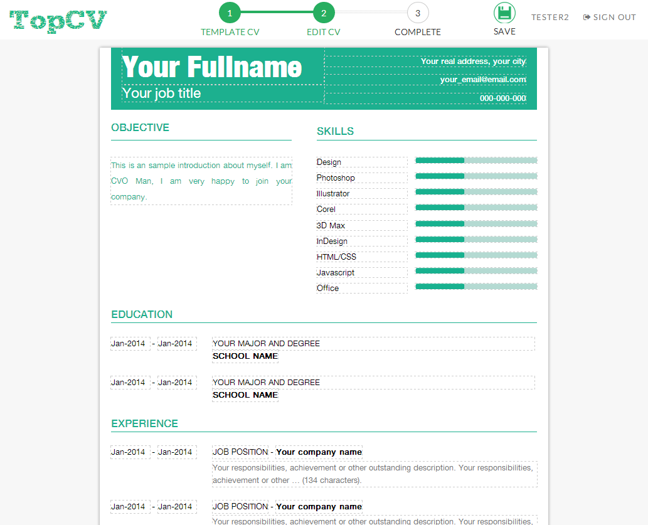
Role: Guest
Choose CV template
Choose CV template
Create CV
Create CV
Print – Export CV
Apply Job

Slide 24
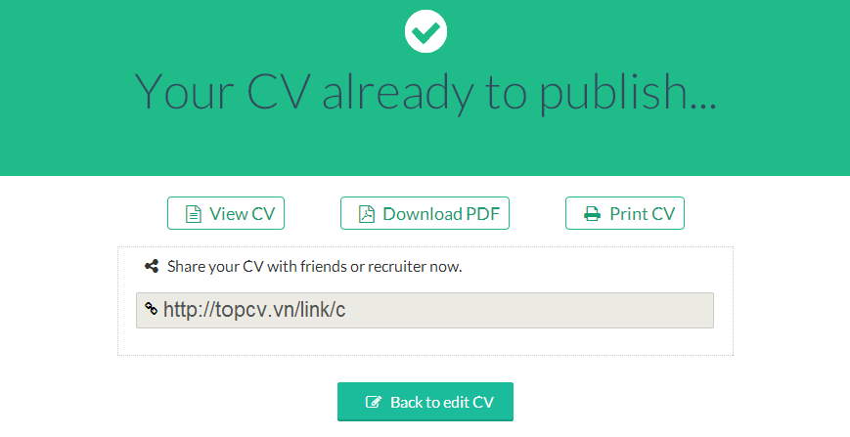
Role: Guest
Choose CV template
Create CV
Create CV
Print – Export CV
Export – Print CV
Apply Job

Slide 25
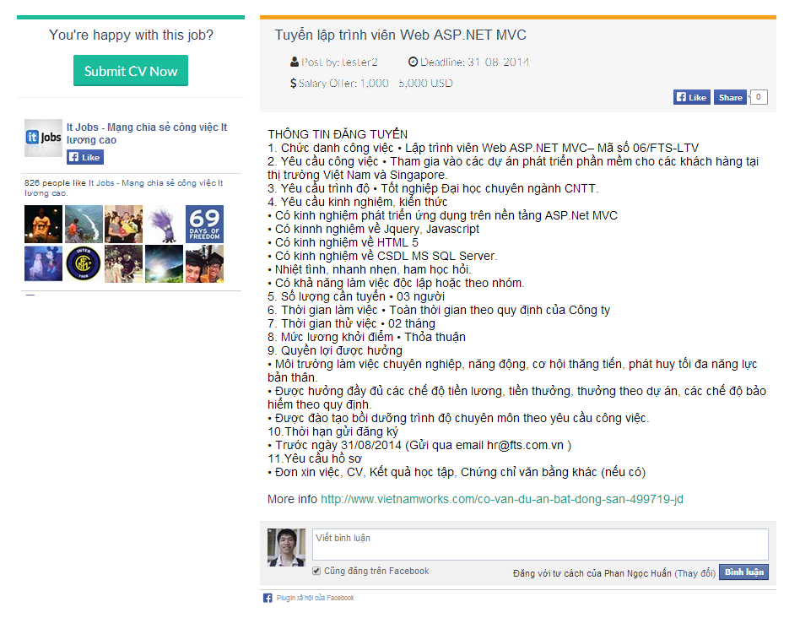
Role: Guest
Choose CV template
Create CV
Export – Print CV
Export – Print CV
Apply Job
Apply Job

Slide 26
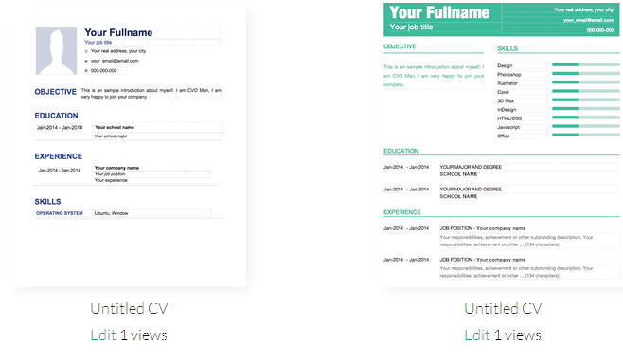
Role: Registered User
List user’s CV
Post Job
List Applied CV
Edit Profile
Deactivate account
Portfolio Page

Slide 27
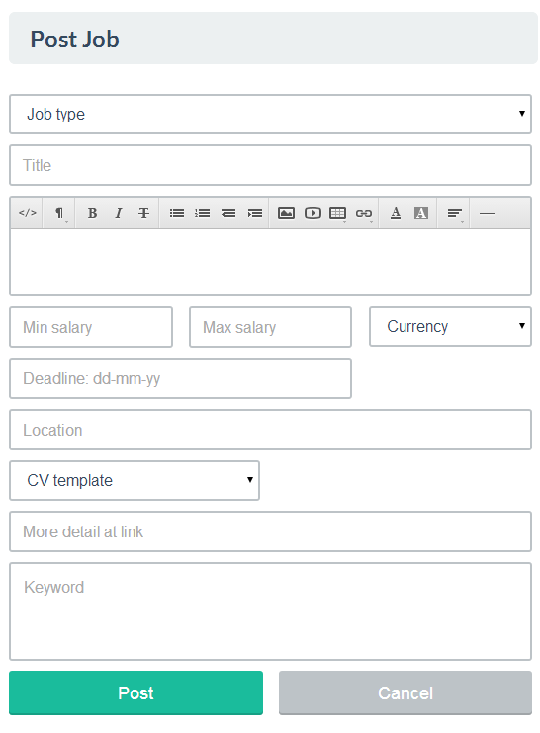
Role: Registered User
List user’s CV
List user’s CV
Post Job
Post Job
List Applied CV
Edit Profile
Deactivate account
Portfolio Page

Slide 28
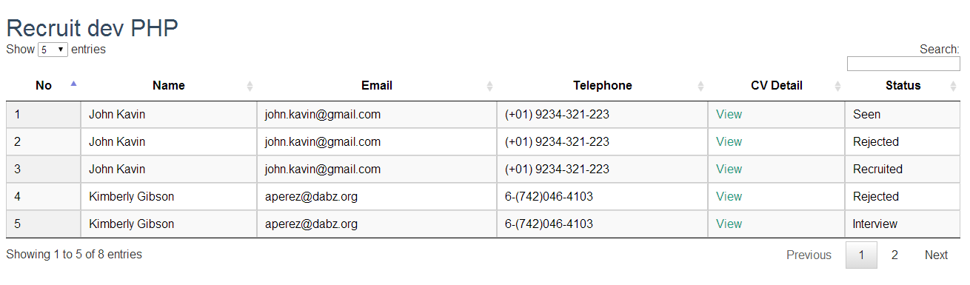
Role: Registered User
List user’s CV
Post Job
Post Job
List Applied CV
List Applied CV
Edit Profile
Deactivate account
Portfolio Page

Slide 29
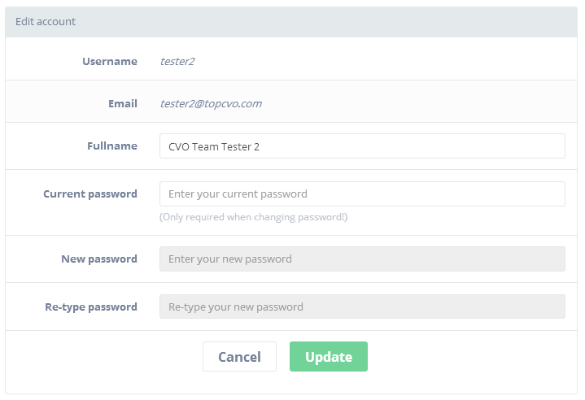
Role: Registered User
List user’s CV
Post Job
List Applied CV
List Applied CV
Edit Profile
Edit Profile
Deactivate account
Portfolio Page

Slide 30
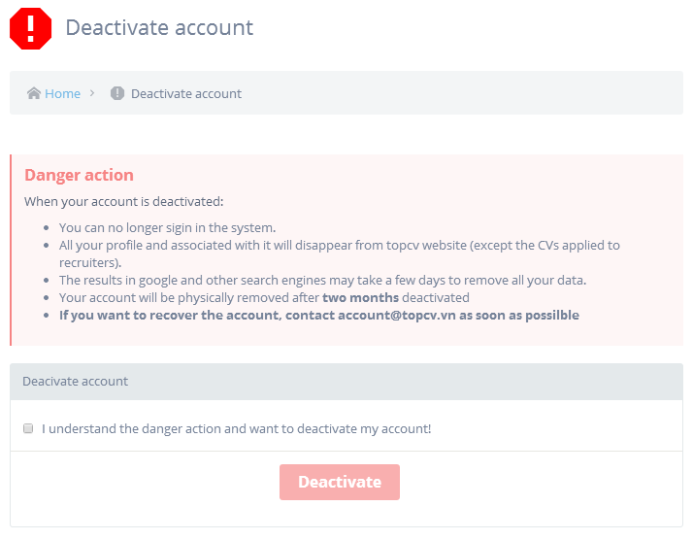
Role: Registered User
List user’s CV
Post Job
List Applied CV
Edit Profile
Edit Profile
Deactivate account
Deactivate account
Portfolio Page

Slide 31
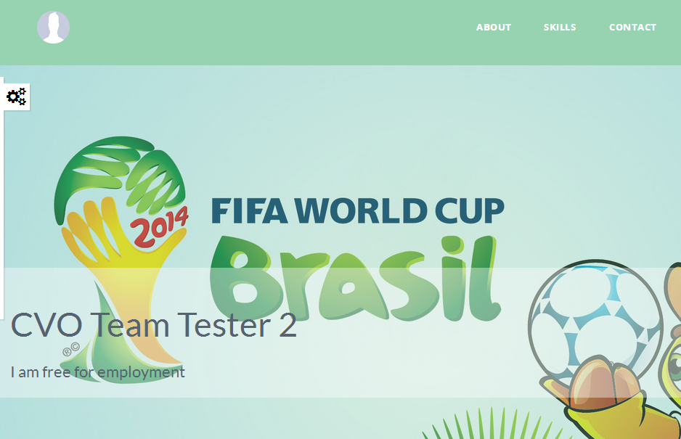
Role: Registered User
List user’s CV
Post Job
List Applied CV
Edit Profile
Deactivate account
Deactivate account
Portfolio Page
Portfolio Page

Slide 32
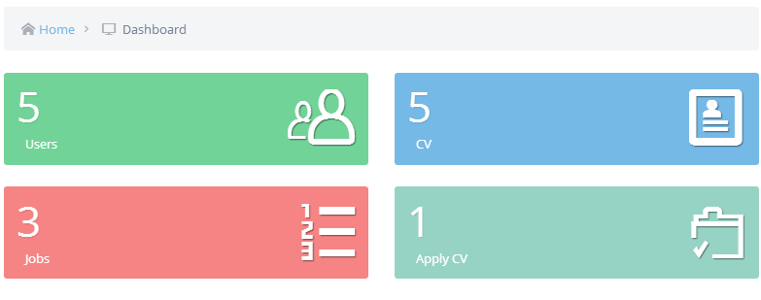
Role: Administrator
View Statistic
Manage users
Manage jobs
Manage CV

Slide 33
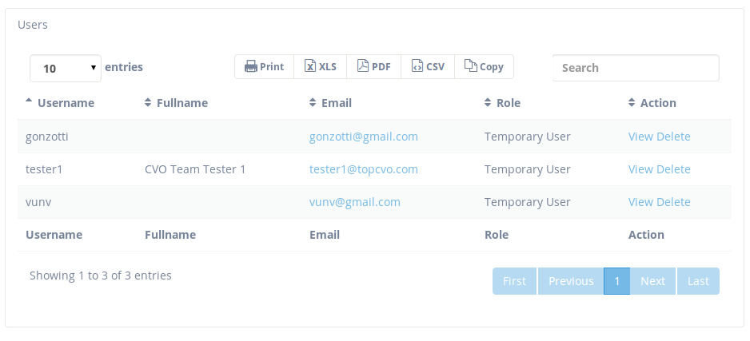
Role: Administrator
View Statistic
View Statistic
Manage users
Manage users
Manage jobs
Manage CV

Slide 34
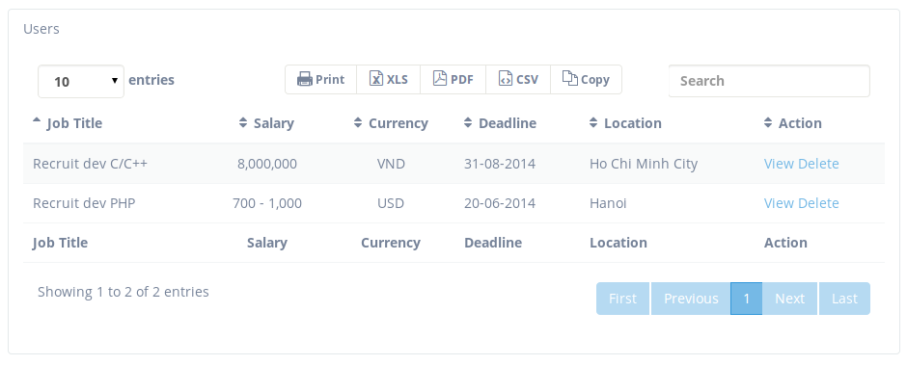
Role: Administrator
View Statistic
Manage users
Manage users
Manage jobs
Manage jobs
Manage CV

Slide 35
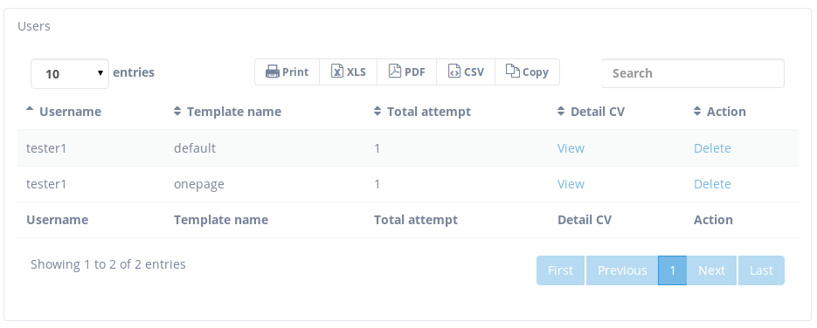
Role: Administrator
View Statistic
Manage users
Manage jobs
Manage jobs
Manage CV
Manage CV

Slide 36
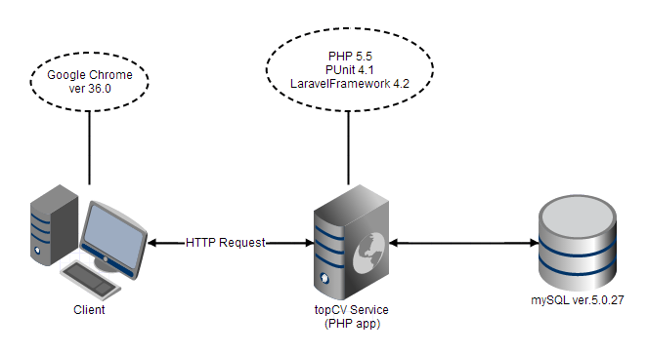
System Overview

Slide 37
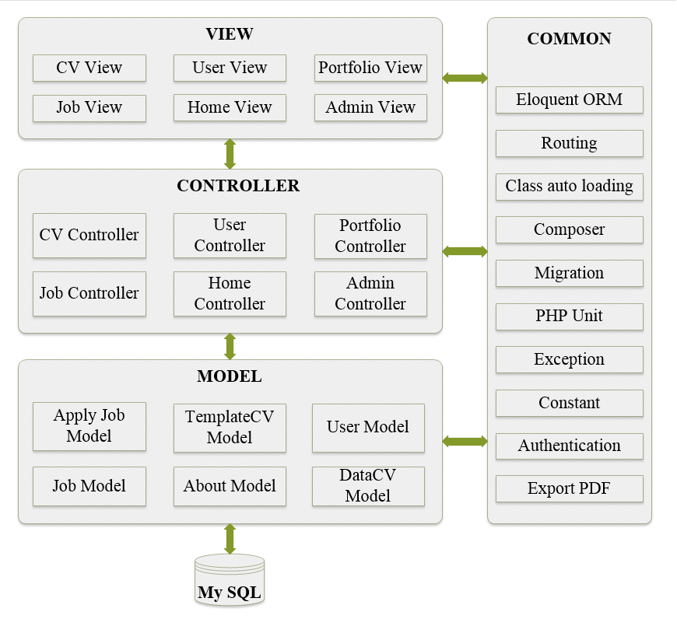
Architecture Design

Slide 38
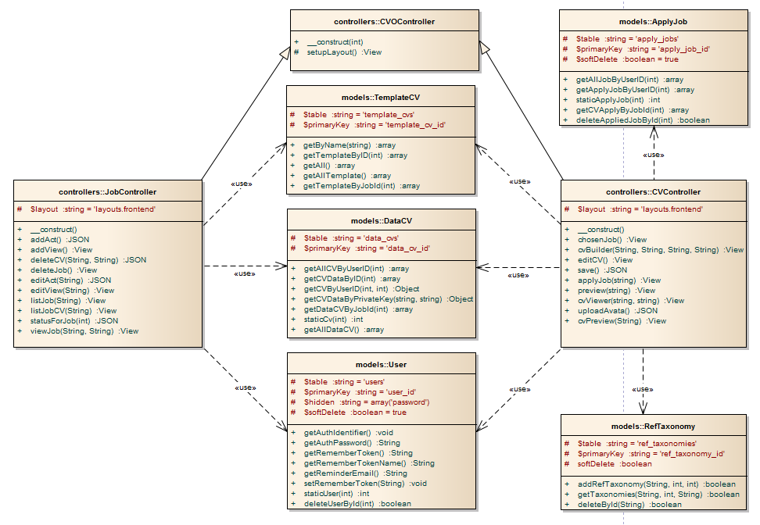
Class Diagram
Apply CV

Slide 39
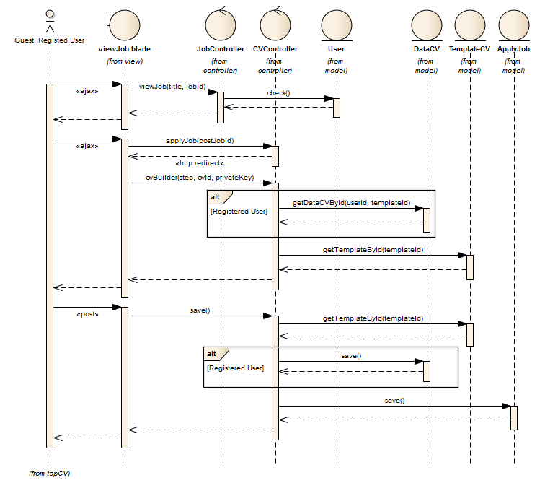
Sequence Diagram
Apply CV

Slide 40
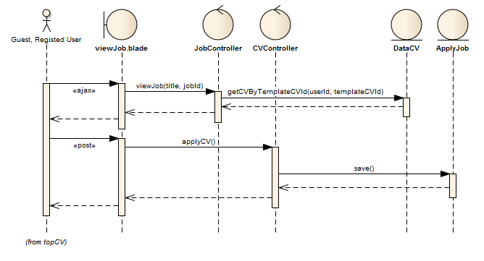
Sequence Diagram
Apply CV by select exist CV

Slide 41
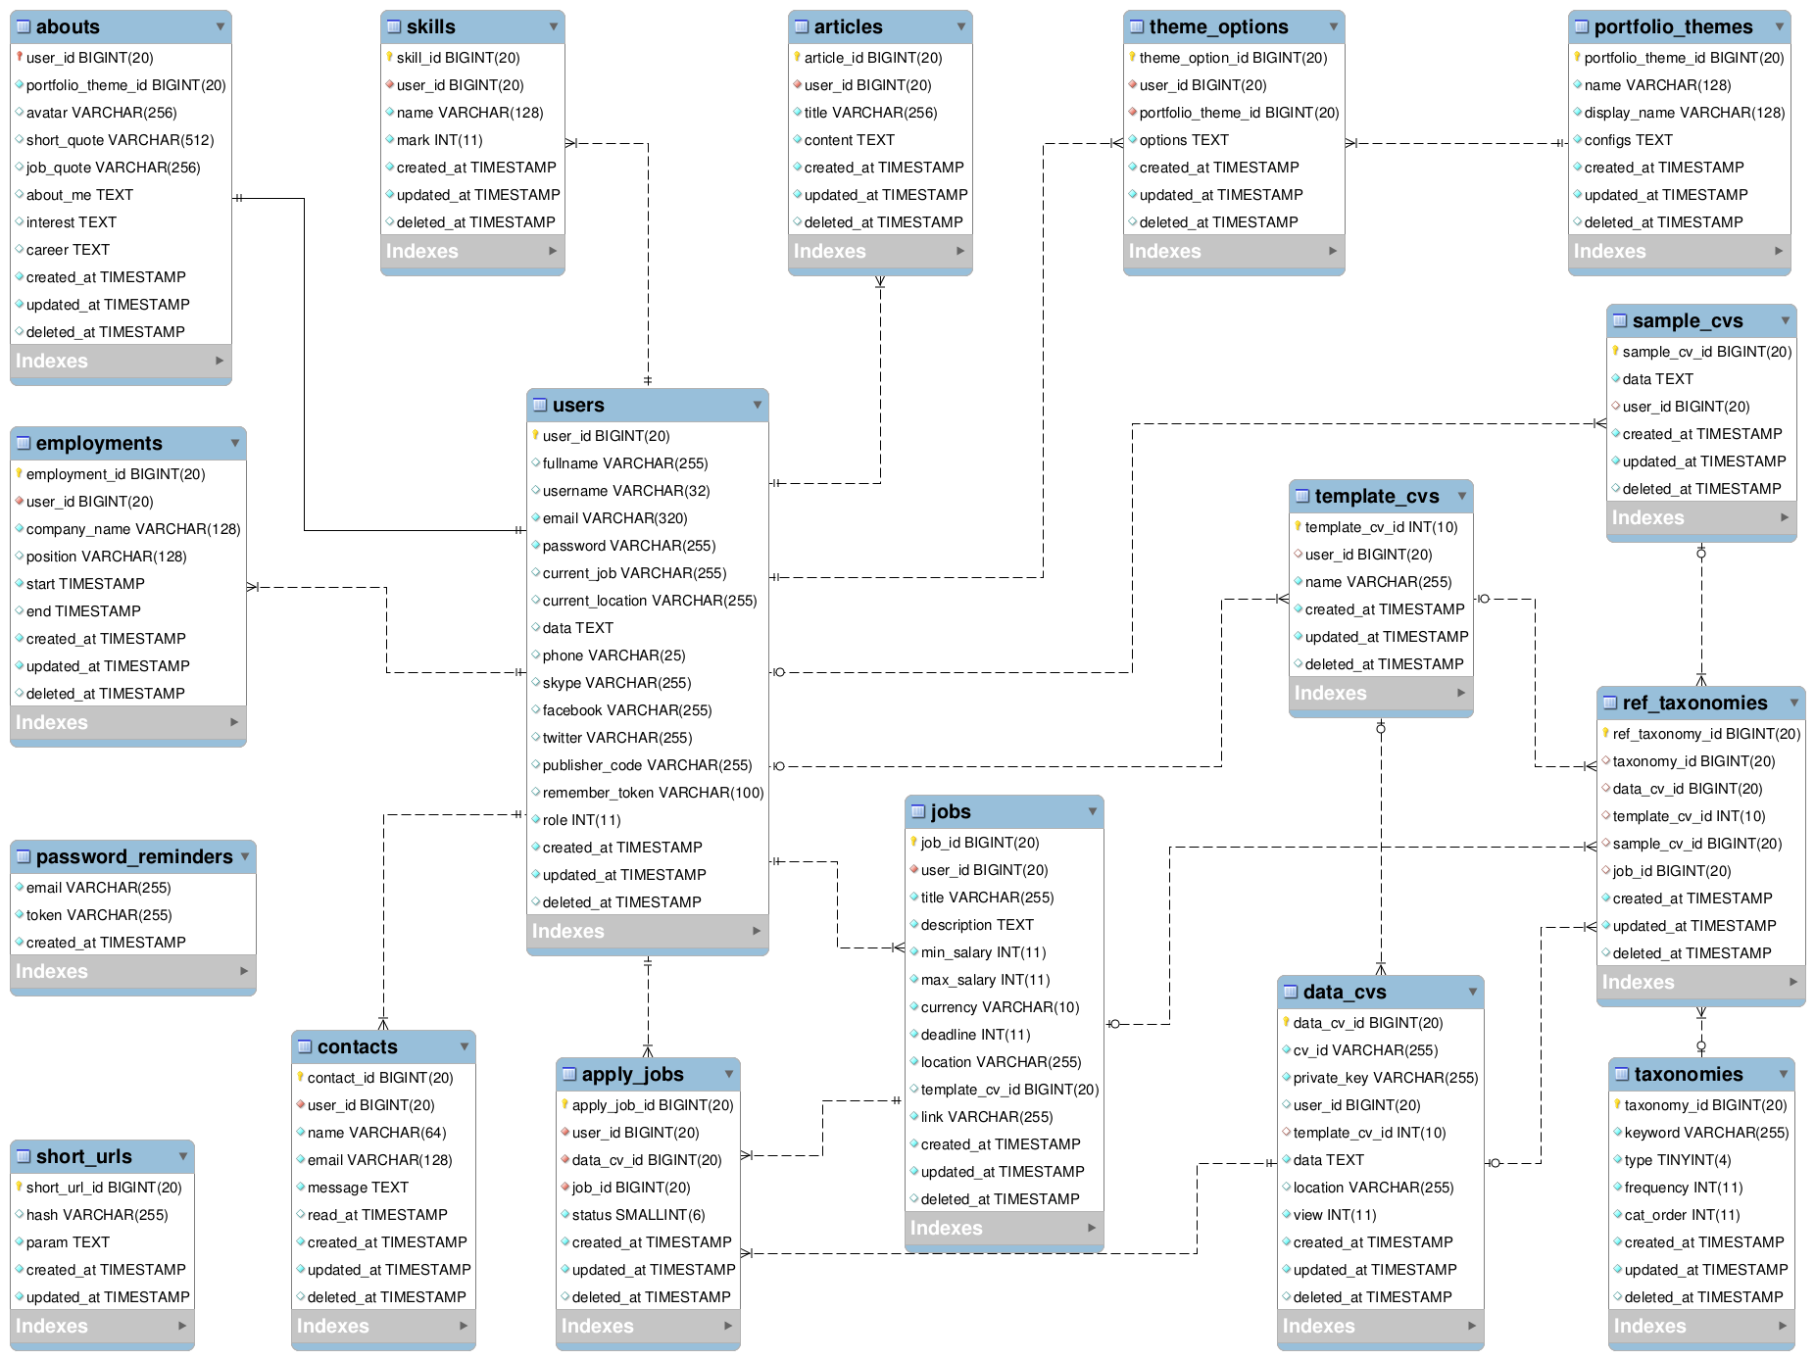
Database Design

Slide 42
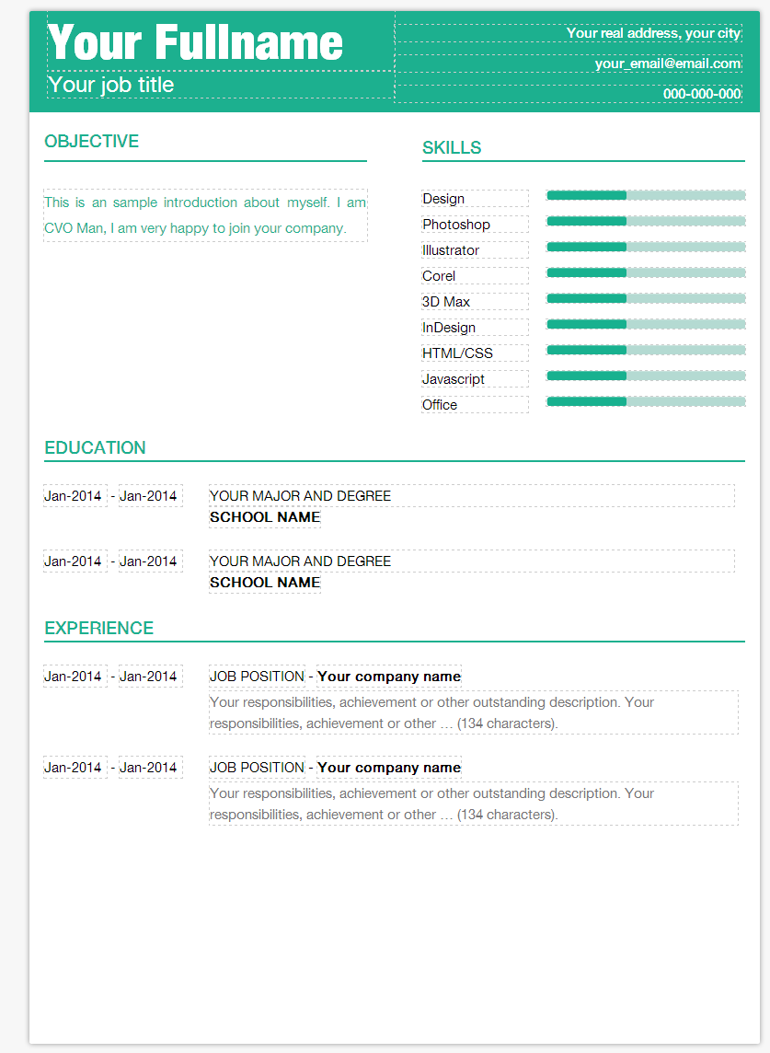
CV-Builder technique idea
HTML CV Template
JSON Mapping
CVFormUtils
WYSIWYG
Editable CV

Slide 43
CV-Builder life cycle
Load Template & CV Data
Initialize WYSIWYG Editable CV
User modify CV Data
User save data
Extract CV form data and submit
Store saved data to database

Slide 44
CV Templates organization
All template folders located at /public/packages/cvo/cv
The name of the template folder is also the template name
Template_1
template.blade.php
cv.json
cv.css
print.json
images/
fonts/
Template_2
Template_3

Slide 45
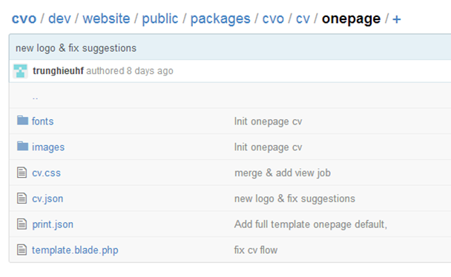
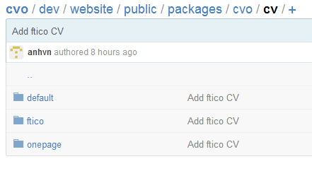
CV Template folders example
Example of folder “cv” and template “onepage” folder structure

Slide 46
CV Template folder explanations
template.blade.php (required)
HTML template for the CV, written with Balde-template.
cv.json (required)
The template mapping file, used to define template metadata, data mapping and data validation rules.
print.json(required)
Print configurations for exporting template to PDF.
cv.css (required)
Main stylesheet file of the template
Other asset files and folders
Includes images, fonts and any assets for the template.
These files and folders are not required.

Slide 47
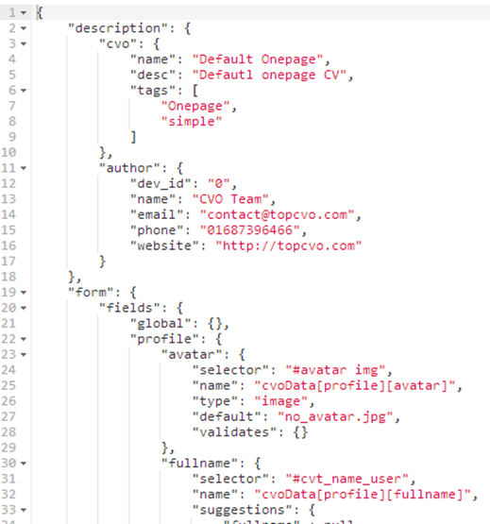
Understand the JSON-Mapping object
HTML CV Template
JSON Mapping
CVFormUtils
WYSIWYG
Editable CV
cv.json (required)
  The template mapping file, used to define template metadata, data mapping and data validation rules.

Slide 48
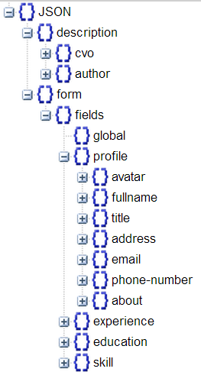
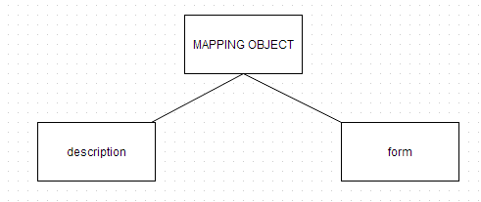
The mapping object
The template mapping object, used to define template metadata, data mapping and data validation rules.
The mapping object contains two properties: “description” for description part and “form” for the data part.

Slide 49
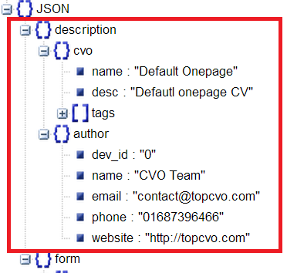
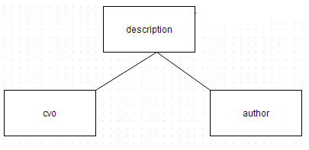
Mapping object->description
Contains the description about the name, description, tags of the CV template and profile of the author.

Slide 50
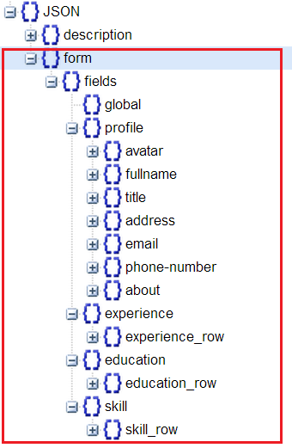
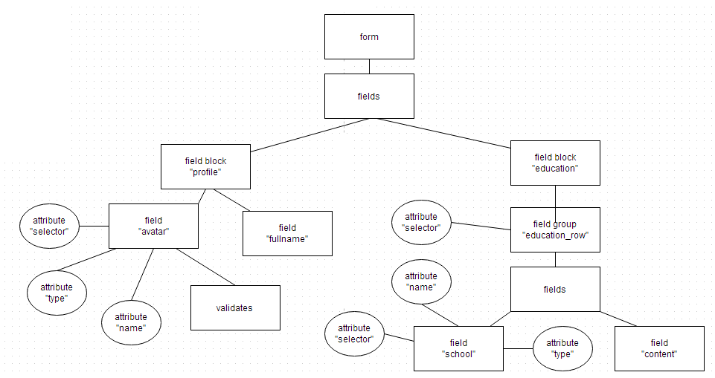
Mapping object->form
The most important property of the mapping object.
Contains all about form metadata, mapping, and validation rules

Slide 51
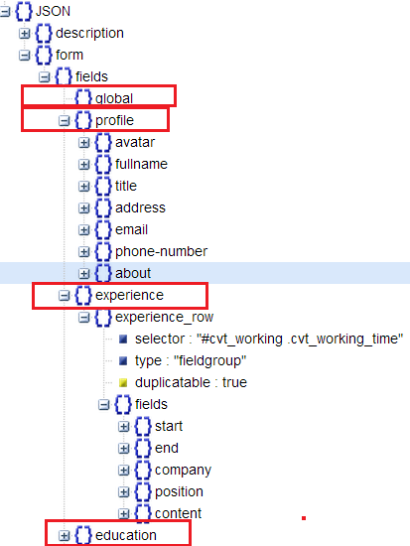
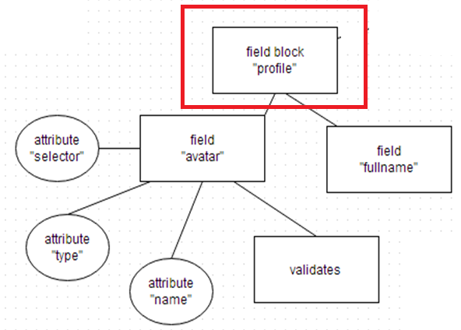
Mapping object->form->field block
A field block object contains a set of data fields, ex: “avatar”, “fullname”..etc, or a fieldgroup like “ education_row”.

Slide 52
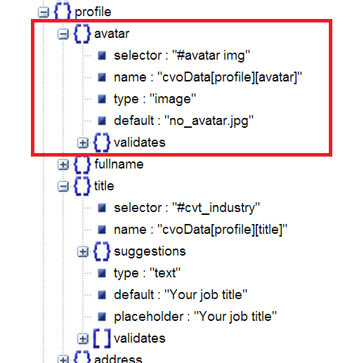
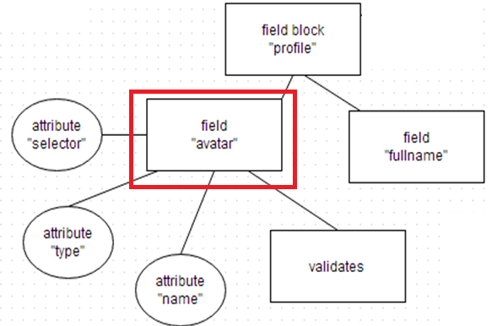
Mapping object->form->field block->field
A field object is a object use to describe a data field in the CV Form

Slide 53
Field properties explanations
No | Name | Data type | Description | Required
1 | selector | String | Similar to CSS Selector, use to select a set of HTML Element that map to the definition of the field. | Yes
2 | type | String | The data type of the field. Ex: text, image, rate | Yes
3 | Name | String | The form name of the field. Similar to the name attribute of HTML input | Yes
4 | Placeholder | String | Placeholder for the field. Similar to HTML placeholder | No
5 | default | String | Default value of the field | No
6 | suggestion | Object | The suggestion definition for this field | No
7 | validate | Object | The validation definition for this field | No
8 | index | Boolean | Is the field required indexing or not? | Only in fieldgroup
9 | display_attr | String | The attribute that the display value of the field will bind o. | Only in field type rate
10 | rate_data | Object | The rate data definition for the rate field | Only in field type rate

Slide 54
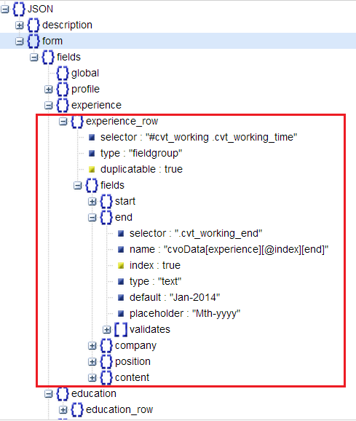
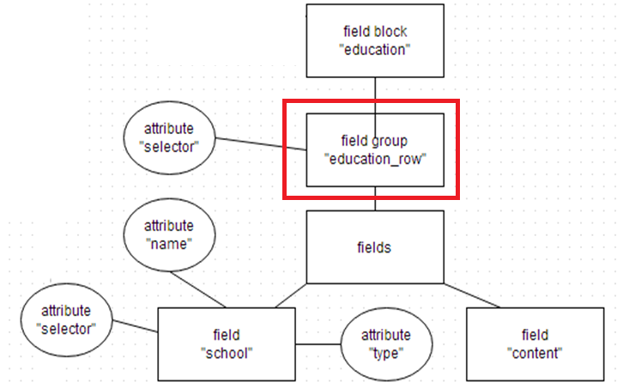
Mapping object->form->field block->fieldgroup
Is a special kind of field object.
Has the same parent as the field object, have no attribute of field object but contains a set of field objects.

Slide 55
Fieldgroup properties explanations
No | Name | Data type | Description | Required
1 | selector | String | Similar to CSS Selector, use to select a set of HTML Element that map to the definition of the fieldgroup. | Yes
2 | type | String | Always be “fieldgroup”. | Yes
3 | duplicateable | Boolean | Can the fieldgroup be duplicate or not. | Yes
4 | Fields | Object | An object contains a set of field objects that belong to the fieldgroup. | Yes

Slide 56
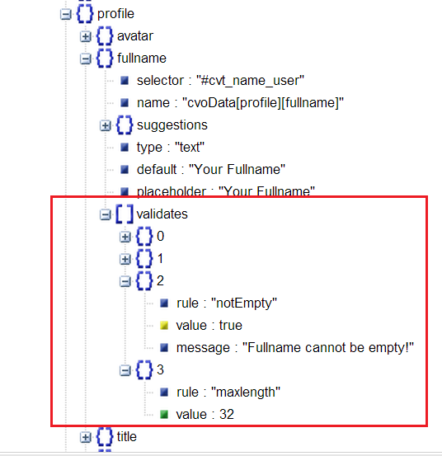
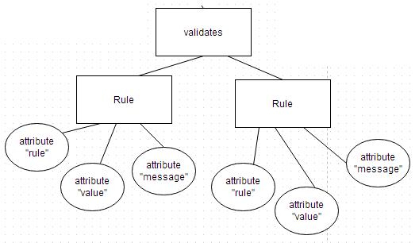
Mapping object->form->field block->field->validates
Used to define validation rules for field object.

Slide 57
Validations properties explanations
Rule: The name of the rule.
Value: The value that input to the rule validator, for example, the number input to the rule maxlength.
Message: The message when the rule be violated.
No | Name | Value type | Description
1 | inline | Boolean | If value is “true” the data of the field cannot contain newline character.
2 | textonly | Boolean | If the value is “true” the data of the field cannot change its style. (In this version, it always true).
3 | notEmpty | Boolean | If the value is “true” the dat of the field cannot be empty.
4 | maxLength | Integer | The length of the field cannot be over the value.
5 | email | N/A | The data of the field must be valid email format (Define in CVFormValidator.js)
6 | Phone | N/A | The data of the field must be valid phone numberformat (Define in CVFormValidator.js)

Slide 58
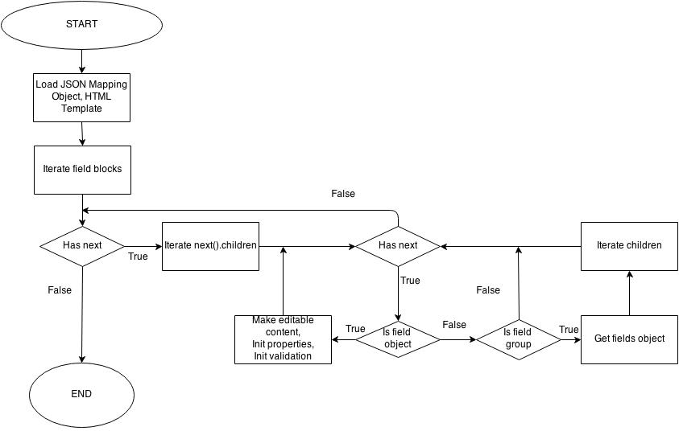
The process of initializing editable CV Form

Slide 59
ID Encryption process
ID_ENCRYPT_KEY = ‘CvObIzA#zP123’
Id = 1
getIntegerFixedLength
(000000000000001 )
safe_b64encode
(c0Z_UnlKcRNKYAECA3NH)
cvoMagicEncrypt
(VwdqZmxXCC8GY3t4a3EmcQA3NH)
xorEncrypt with ID_ENCRYPT_KEY
(\x73\x46\x7f\x52\x79\x4a\x71\x13\x4a\x60\x01\x02\x03\x73\x47)

Slide 60
ID Decryption process
ID_ENCRYPT_KEY = ‘CvObIzA#zP123’
Encrypted Id = “VwdqZmxXCC8GY3t4a3EmcQA3NH”
cvoMagicDecrypt
(c0Z_UnlKcRNKYAECA3NH)
safe_b64decode (x73\x46\x7f\x52\x79\x4a\x71\x13\x4a\x60\x01\x02\x03\x73\x47)
xorEncrypt with ID_ENCRYPT_KEY
(000000000000001 )
intval
(Id = 1)

Slide 61

XorEncryption algorithm

Slide 62

Testing phase

Slide 63
Testing Environment
Client:
  Window 8.1
  4CPUs 1.8MHz
  RAM 8GB
  Google Chrome 36.0
Server:
  Ubuntu (x64) 14.04LTS
  CPU 3.6MHz
  RAM 512MB
  PHP 5.5
  MySQL 5.0.27

Slide 64

Test guideline
No data: Run your test cases on blank or default data. See if proper error messages are generated.
Valid data set: Create it to check if application is functioning as per requirements and valid input data is properly saved in database or files.
Invalid data set: Prepare invalid data set to check application behavior for negative values, alphanumeric string inputs.
Illegal data format: Make one data set of illegal data format. System should not accept data in invalid or illegal format. Also check proper error messages are generated.
Boundary Condition data set: Data set containing out of range data. Identify application boundary cases and prepare data set that will cover lower as well as upper boundary conditions.
Data set for performance, load and stress testing: This data set should be large in volume.

Slide 65

Test-case

Slide 66

Test Report

Slide 67

PHPUnit
$ phpunit
$ OK (9 test, 9 assertions)

Slide 68

Test Result

Slide 69





Lessons Learned

Slide 70
7. Project Demo

Slide 71
8. Questions and Answers

Slide 72
Thank you for your listening!

