Slide 1



AutoCarParking
Capstone Project

Slide 2







Project Role
Toannv
Technical leader
Huynb
Project Manager,
Developer
Truongpx
Developer
Linhnv
Test leader
HungPD
Supervisor
Tuanhh
Developer,
tester
Linhnh
Tester

Slide 3
Contents
1
Introduction
2
Project Management
3
Introduction of the system
4
Introduction of Algorithm
5
Implementation
6
Testing
7
Conclusion & Demo
8
Q & A

Slide 4
1. Introduction
Project Background
Existed System
Idea
Definition & Scope

Slide 5



1. Introduction
Project background
Overview:
6.8 m
4.0 m
0.5 m

Slide 6
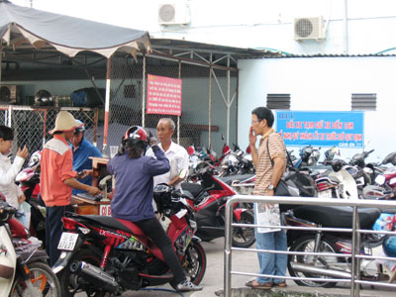
1. Introduction
Existed system
Traditional Parking:
Need a lot of work force and not scientific.
Causes many troubles for drivers.
Not safe.

Slide 7
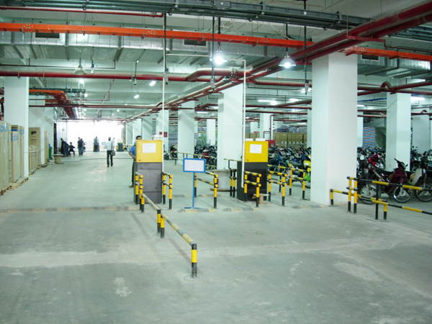
1. Introduction
Existed system
Car parking in junior buildings:
Control cars in and out with tickets issued by own company.
Equipped with automatic barriers.

Slide 8
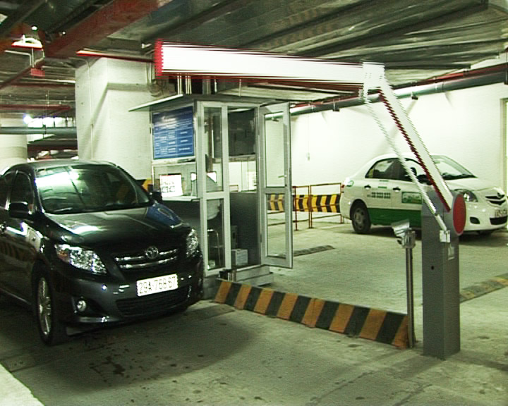
1. Introduction
Existed system
Car parking in senior buildings:
Semi – automatic system.
Need employee to control system.

Slide 9
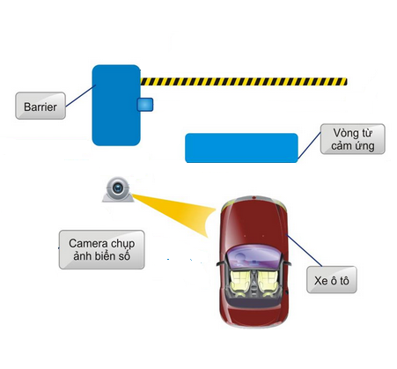
1. Introduction
Ideal
Totally automatic car parking system.
Scientific, smart and convenient solution.
Efficient enough to solve problems for parking.

Slide 10
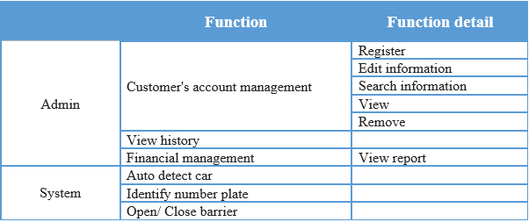
1. Introduction
Definition & Scope

Slide 11
2. Project Management
Software Process Model.
Team Work.
Tools.
Project Plan.
Project Risk Management.

Slide 12
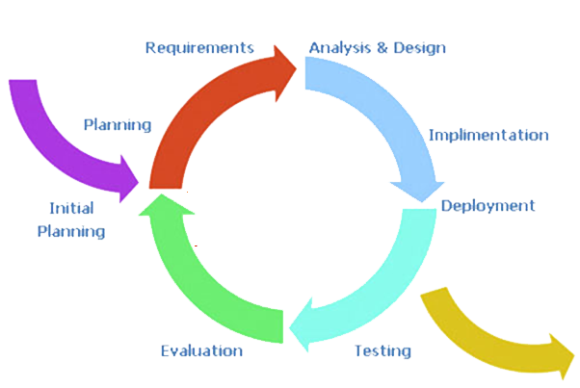
2. Project Management
Software Process Model.
Easy for team members who don’t have much experience.
Easily identify the source of last error.
Less time for corrections.

Slide 13





2. Project Management
Teamwork.
Time: 6 hours/day, 6 days/week.
Location: school, home.
Communication:
Meeting supervisor: once a week.
Team building: when necessary.

Slide 14
2. Project Management
Tools.
Hardware
Develop: Personal computers (Windows 7), soldering machine.
Software
Framework: DotNet 4.0
SVN tortoise: 1.7
Design: Microsoft Office Visio 2013, Altium Designer Summer 09, ISIS Professional .
Document: Microsoft Office 2013
Code: Visual Studio 2010 Professional
Arduino (1.0.5)
Database: SQL Server 2008.

Slide 15
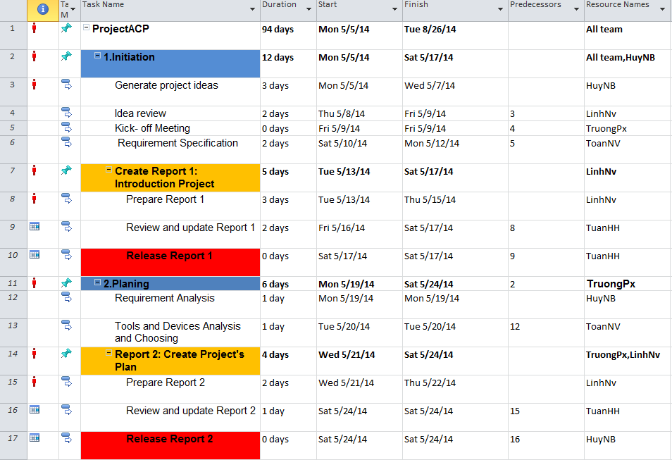
2. Project Management
Project Plan.

Slide 16
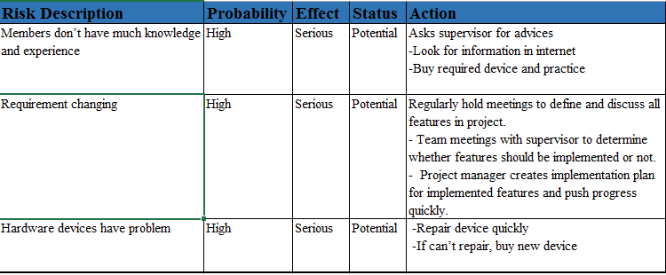
2. Project Management
Project Risk Management.
Example:

Slide 17
3. Introduction of the system
System Architecture
System Descriptions

Slide 18
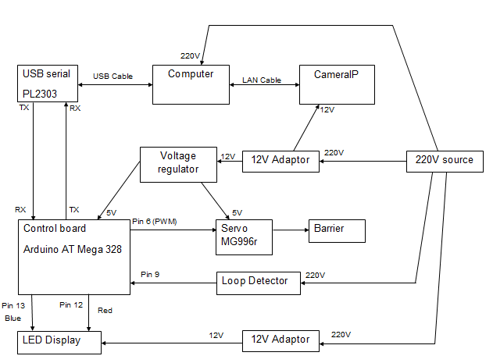
3. Introduction of the system
System Architecture

Slide 19
3. Introduction of the system
System Descriptions
Barrier Module
Camera
Loop Detector
LED

Slide 20
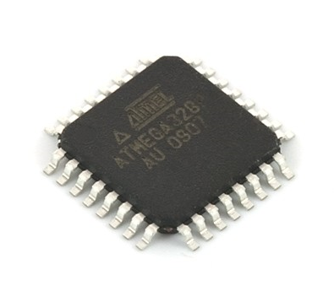
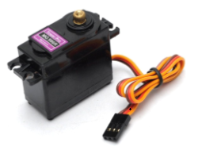
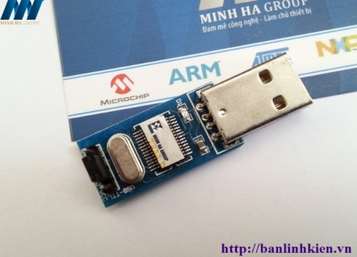
3. Introduction of the system
Barrier Module
ATMEGA328 microcontroller
Servo MG996r
USB Serial P2303

Slide 21
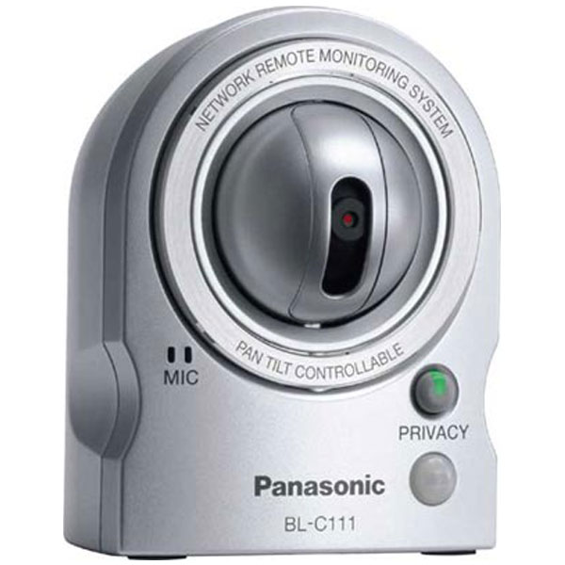
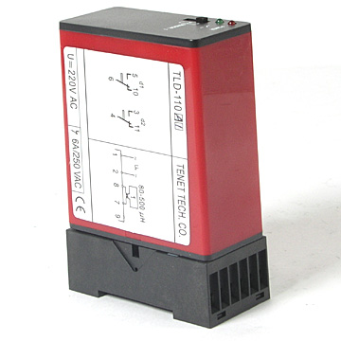
3. Introduction of the system
Camera & Loop Detector
PANASONIC BL-C111
Loop Detector

Slide 22
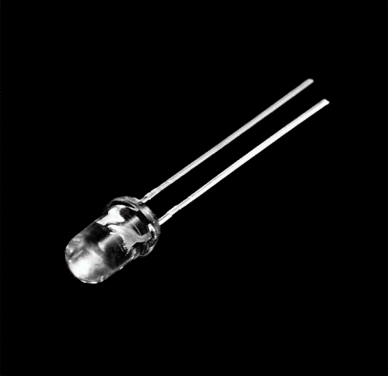
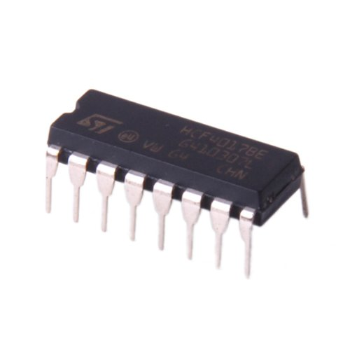
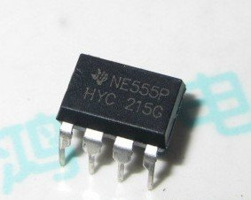
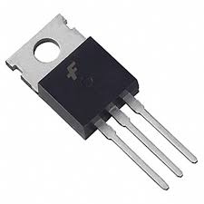
3. Introduction of the system
LED Module
LED
IC 4017
ne555p
TIP122

Slide 23
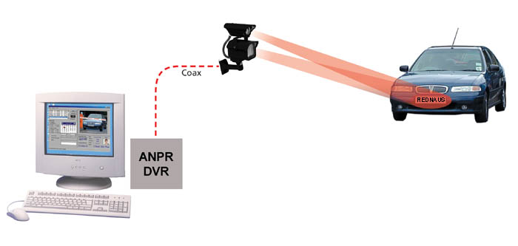
4. Introduction of Algorithm
Overview of License Plate Recognition

Slide 24
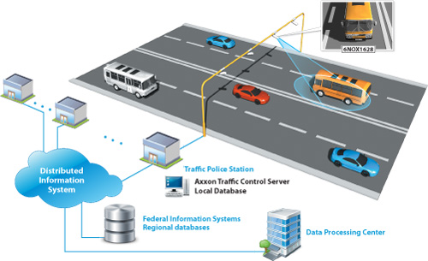
4. Introduction of Algorithm

Slide 25
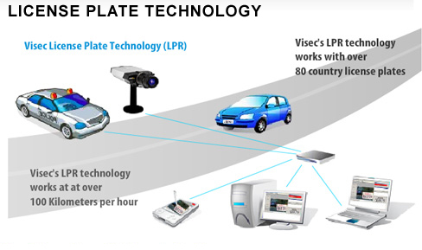
4. Introduction of Algorithm

Slide 26
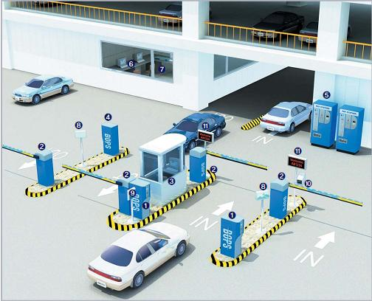
4. Introduction of Algorithm

Slide 27
4. Introduction of Algorithm
Input image camera
License Plate extraction
Character Segmentation
Optical Character Recognition
Output Text
Figure 4‑1:Components of Proposed License Plate

Slide 28
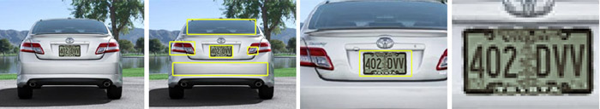
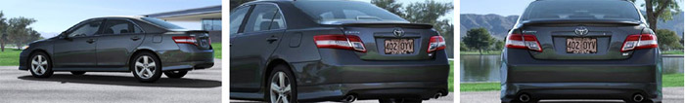
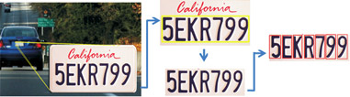
4. Introduction of Algorithm

Slide 29


4. Introduction of Algorithm
5EKR799

Slide 30


4. Introduction of Algorithm
Tessract-OCR

Slide 31
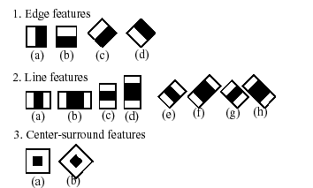
4. Introduction of Algorithm
Haar Feature-based Cascade Classifier for Object Detection

Slide 32
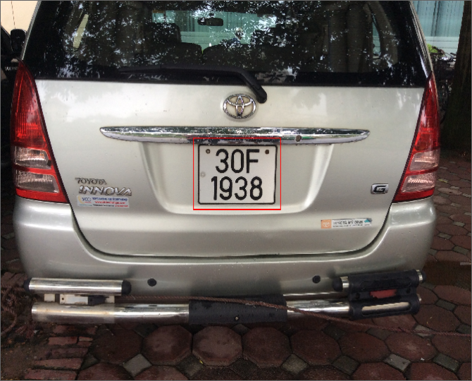
4. Introduction of Algorithm

Slide 33
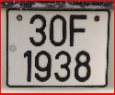
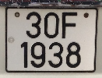




4. Introduction of Algorithm
Standardization
Convert to gray
Histogram Equalization
Threshold binary
Smoothing
Tessract-OCR
30F1938

Slide 34
5. Implementation
  Hardware Design.
  Mechanical Design.
  Circuit Design.
  Software Design.

Slide 35
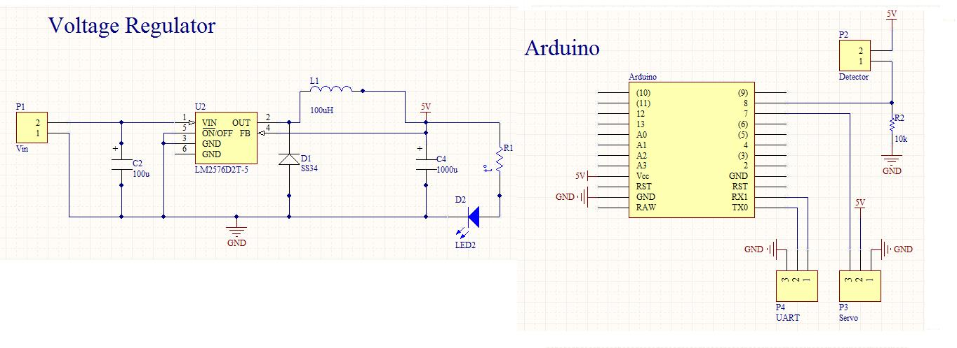
Hardware Design
Control Box Schematic

Slide 36
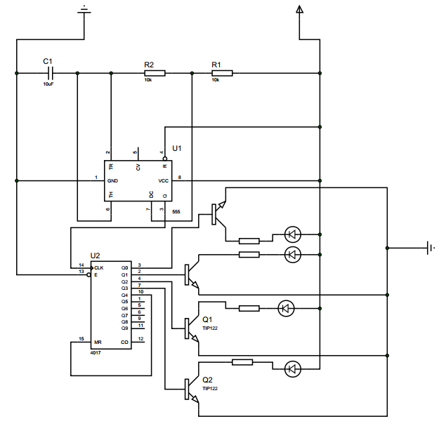
5. Implementation
  Hardware Design.
LED Display Schematic

Slide 37
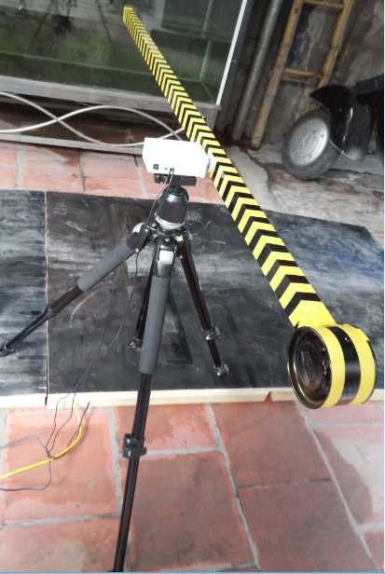
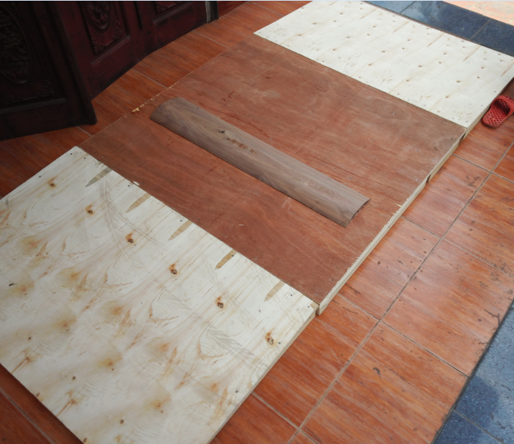
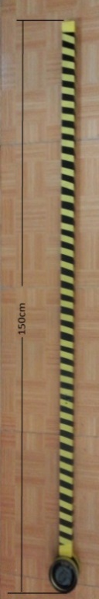
5. Implementation
  Mechanical Design.
Barrier
Floor

Slide 38
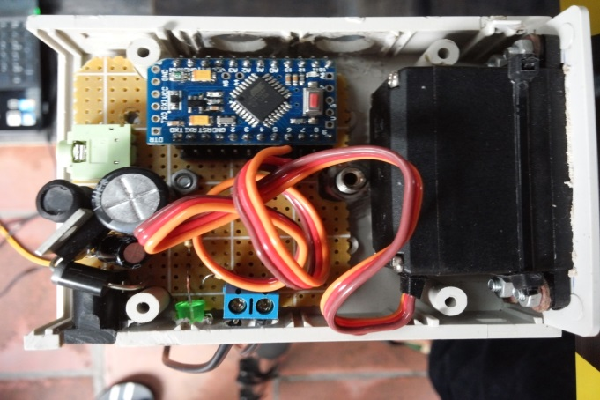
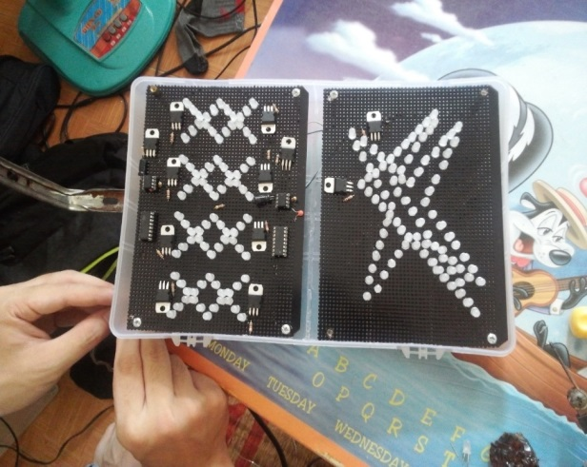
5. Implementation
  Circuit Design.
Control Box
LED Panel

Slide 39
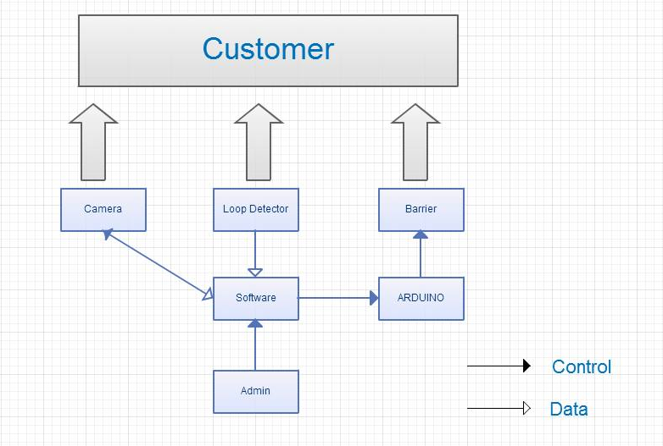
5. Implementation
  Software Design.
System architecture design

Slide 40
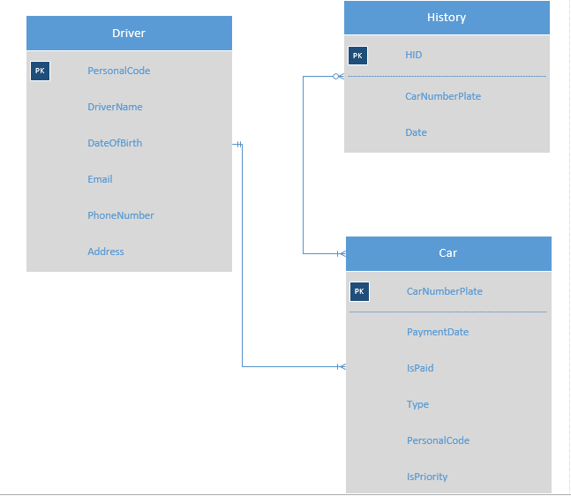
5. Implementation
  Software Design.
Entity Relationship diagram

Slide 41
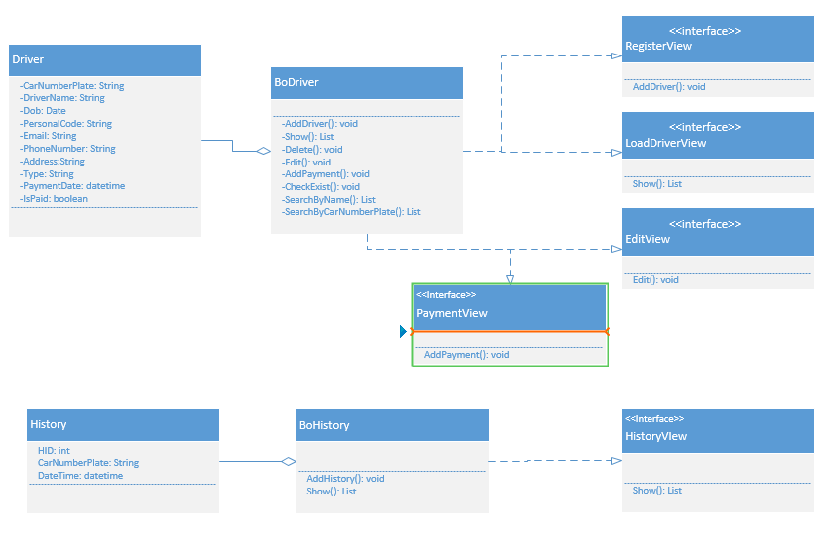
5. Implementation
  Software Design.
Class Diagram

Slide 42
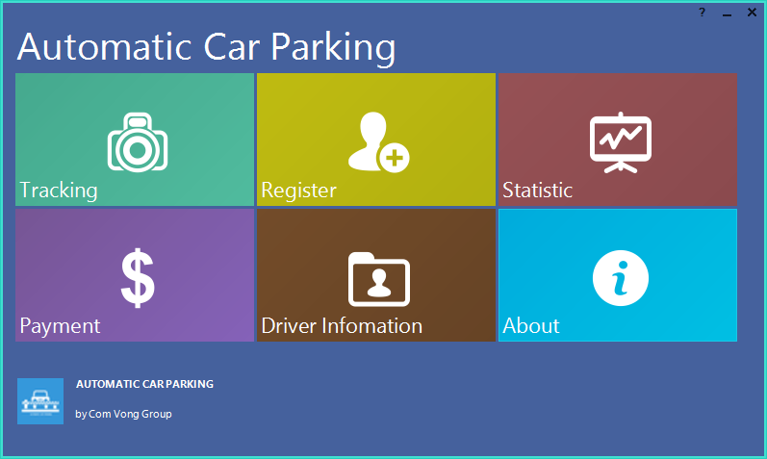
5. Implementation
  User Interface.
  Home Screen.

Slide 43
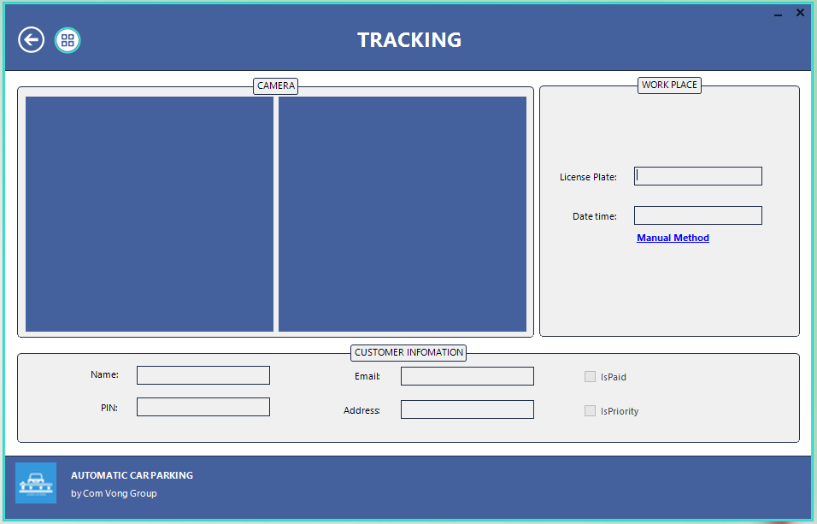
5. Implementation
  User Interface.
  Tracking.

Slide 44
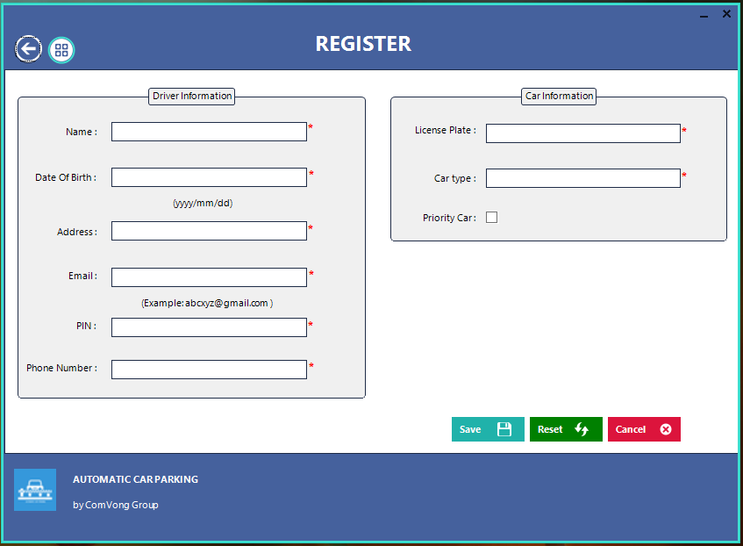
5. Implementation
  User Interface.
  Register.

Slide 45
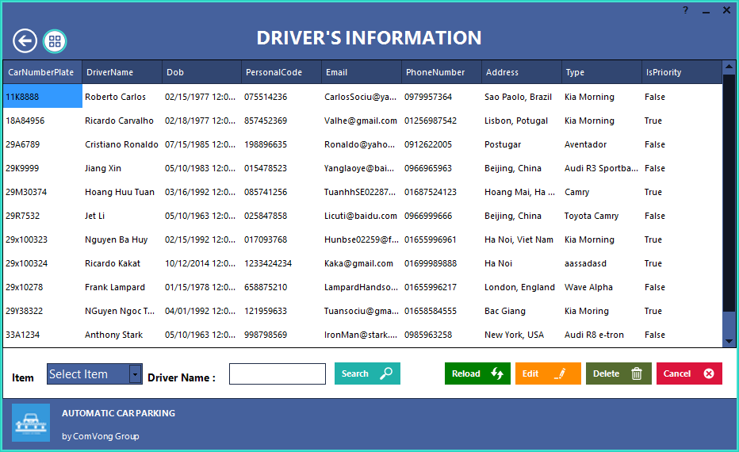
5. Implementation
  User Interface.
  List information.

Slide 46
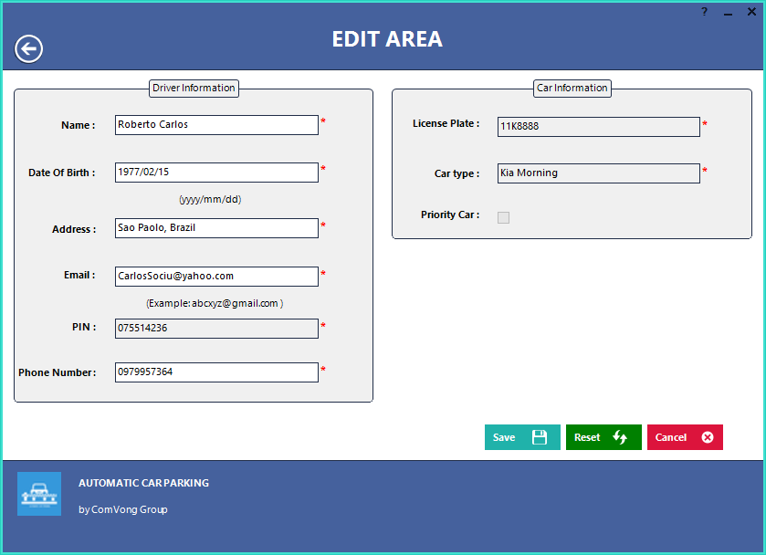
5. Implementation
  User Interface.
  Edit.

Slide 47
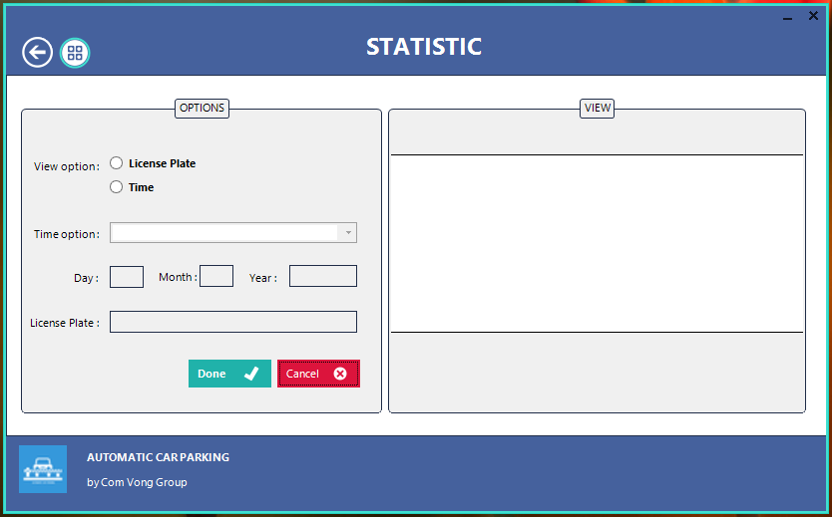
5. Implementation
  User Interface.
  Statistic.

Slide 48
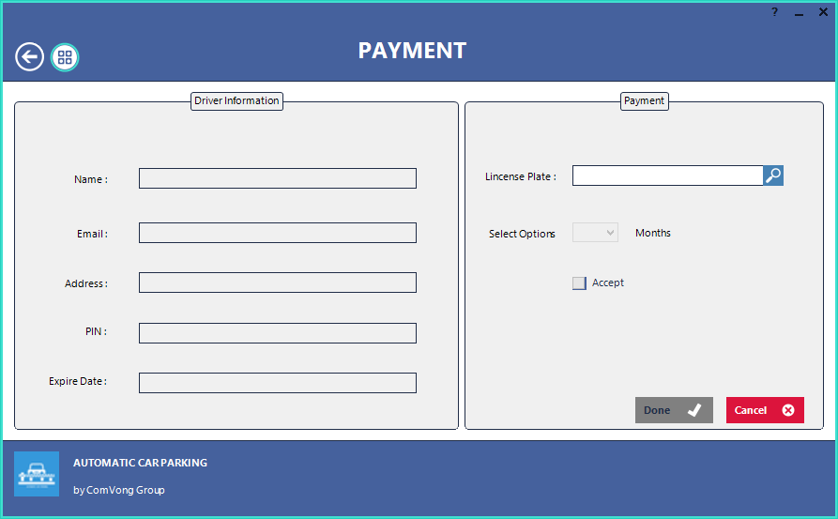
5. Implementation
  User Interface.
  Payment.

Slide 49
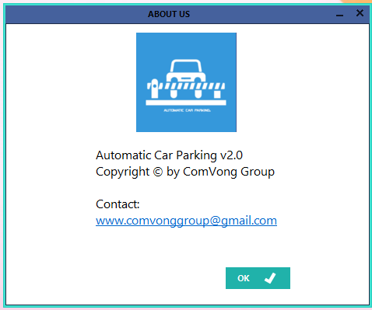
5. Implementation
  User Interface.
  About.

Slide 50
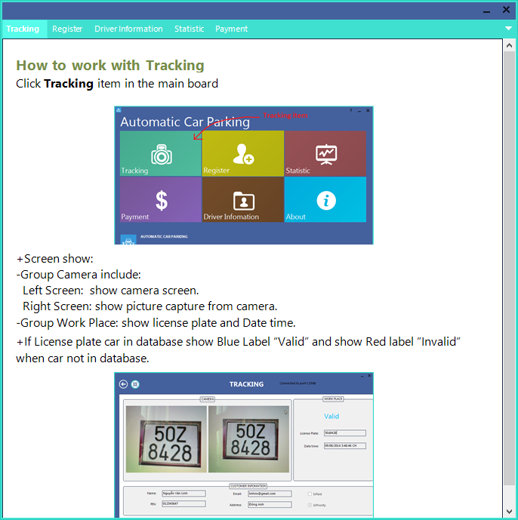
5. Implementation
  User Interface.
  Help.

Slide 51
6. Testing
  Introduction
  Solution for Issues
  Experiments results and analysis

Slide 52
6. Testing
Introduction
For testing in ACP project, testing activities are carried out in parallel with development so we can have a closely view about the project. From this, the project can be tested more carefully and effectively with high coverage.

Slide 53
6. Testing
  Solution for Issues
    None-Technical Problems
    Technical Problems

Slide 54
6. Testing
  Experiments results and analysis.
    Test Hardware.
      Test case for first loop detector and second completed.
      Display errors of Led in case of in or out cars.
      Testing and balancing of the strong barrier.
    Test Software.
Test Home Form.
Test Tracking Form.
Test Edit Form.
Test Statistic From.
Test Load Drivers Information Form.
Test Register Form.
Test Payment Form.

Slide 55
7. Conclusion & Demo
Result
Future Development
Demo

Slide 56
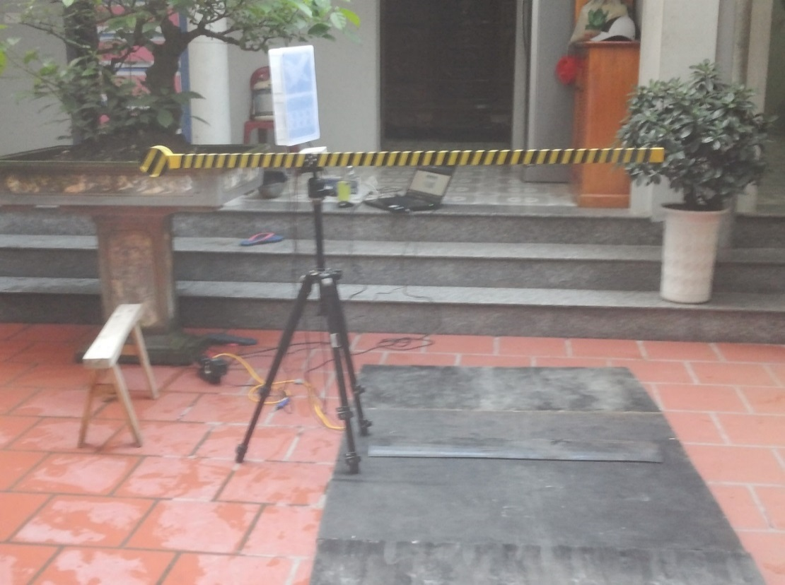
7. Conclusion & Demo
Result

Slide 57
7. Conclusion & Demo
Future Development
Enhance the accuracy of the algorithm.
Implement all the system’s specialties
Proceed car’s outcomes.
Smart guide system in car parks.
Develop daily ticket service for customers.
Facial recognition system consolidates security.

Slide 58
7. Conclusion & Demo
Demo

Slide 59

8. Q & A

Slide 60
Thank You
for listenning !

