Slide 1
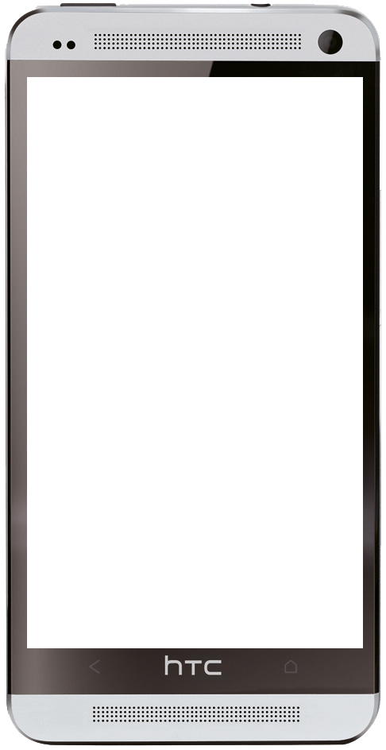
Smart Navigator Application
Supervisor: Mr. Phan Truong Lam

Slide 2


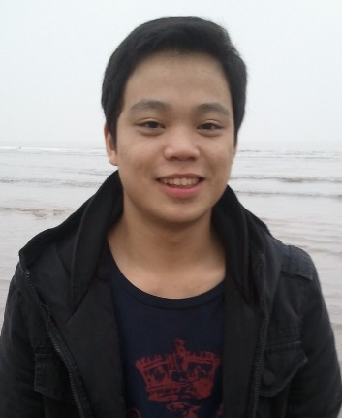


Team member
Hoa Xuan Bach
Nguyen Dai Duong
Nguyen Xuan Toan
Le Ngoc Cong
Vu The Anh

Slide 3

Content
Introduction
Project management Plan
Requirement Specification
Design Description
Implementation
Testing
Lesson Learned
Demo and Q&A

Slide 4
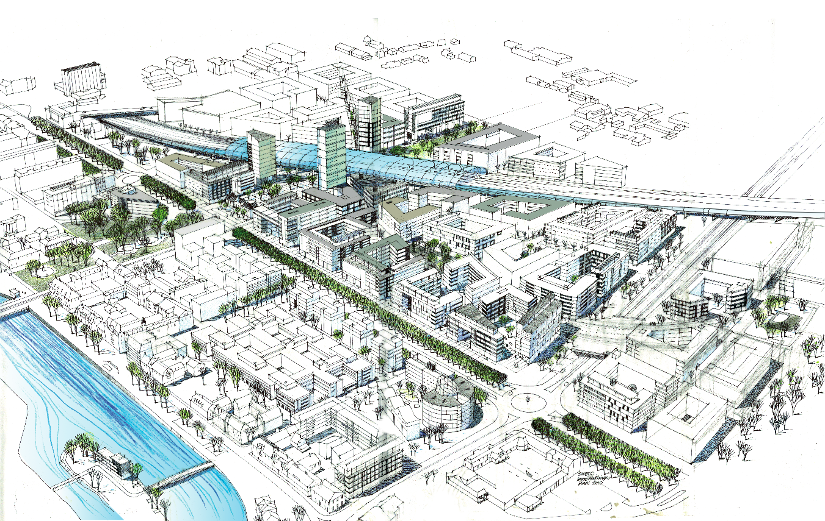
Introduction
Increase new cities

Slide 5

Introduction
New ways

Slide 6
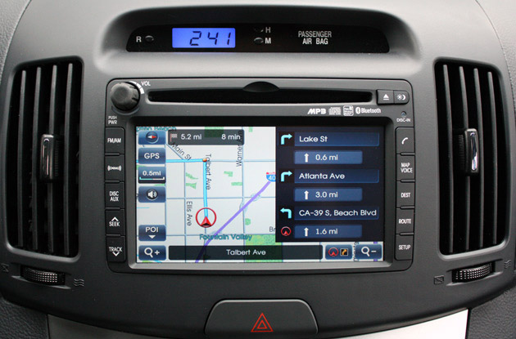
Introduction
Increase navigation devices

Slide 7
Introduction
Disadvantage
Expensive
Not up-to-date
None voice-guided

Slide 8

Introduction
Solution
An android application that help to find route easily and quickly

Slide 9

Introduction

Slide 10
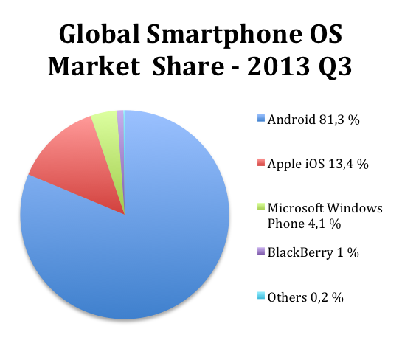
Introduction
Why android?
https://blog.surfnet.nl/?p=2918
Big market share
Java technique

Slide 11
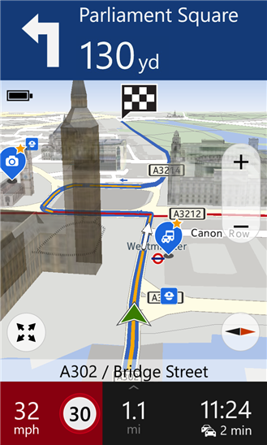
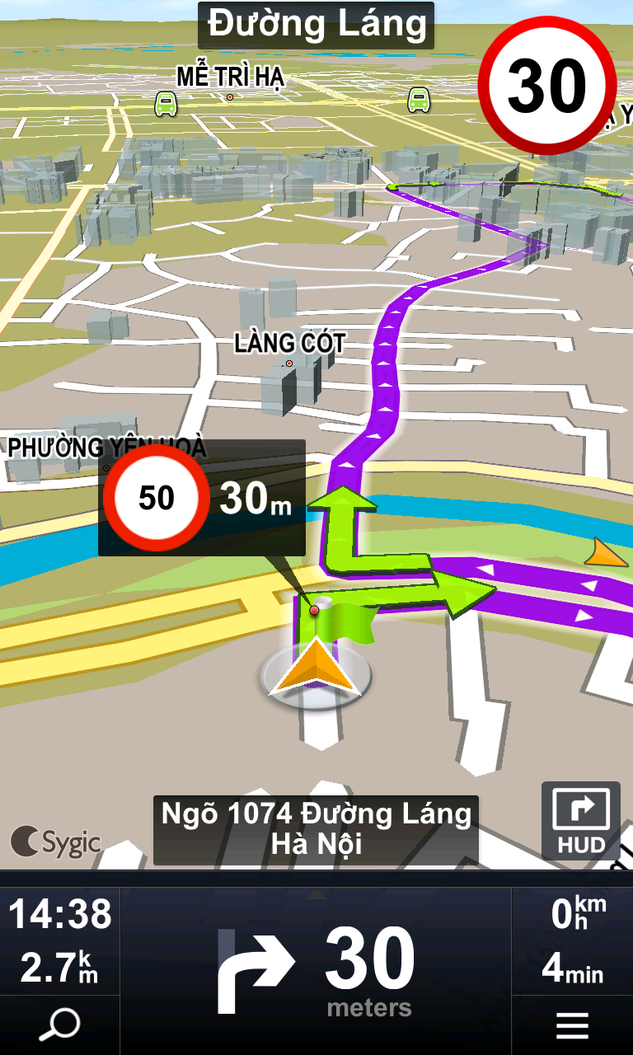
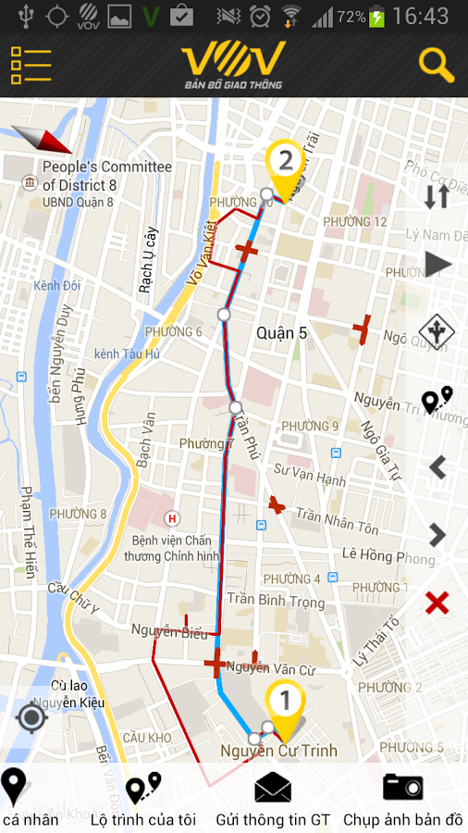
Introduction
Existing systems
Nokia drive
Sygic
VOV Bản đồ giao thông

Slide 12
  Proposed System
A navigator with voice-guide application that runs on smartphones
Run on an Android smartphone
Save device cost
Always up-to-date

Slide 13
Project management Plan
Development Environment
Hardware
Laptop
RAM: 4 GB
HTC One
Display: 4.7 inch
HDSPA, Wifi, GPS
RAM: 2 GB
HDD: 100 GB
Core i5 2.4 GHz

Slide 14
Project management Plan
Development Environment
Software
Category | Name | Version
Operating System | Windows 7 | Professional
 | Android | 4.3
IDE | Netbean | 7.4
 | Eclipse | 4.3.1.v20130911-1000
UML Tool | http://creately.com

Slide 15
Project management Plan
Process Model
Requirement
Design
Implementation
Verification
Maintenance

Slide 16
Project management Plan
Mr. Phan Truong Lam (Supervisor)
Nguyen Xuan Toan (Project Manager)
Le Ngoc Cong (Technical Leader)
Vu The Anh (Developer)
Nguyen Xuan Toan (Developer)
Nguyen Dai Duong (DBA, Test Leader)
Hoa Xuan Bach (QA, Tester)
Project Organization

Slide 17




Project management Plan
Project Communication
Works 8h per day, 6 days per week
Meeting with project’s supervisor every week

Slide 18
Project management Plan
Project Risk Management
ID | Risk Description | Solutions
1 | Conflicting between team members | - PM has responsibility to find the root cause and help to solve conflict between individuals. - Team-building is also an essential activity.
2 | Project duration is too short so it is difficult to complete all tasks on time | - Works over time to meet the deadline.
3 | Project Manager lacks of project management skill | - Ask for help from project’s supervisor when needed.
4 | Team members do not have experience with new technologies (Android, Google API…) | Take time to study new technologies before project start.

Slide 19
Requirement Specification

Slide 20
Requirement Specification
Functional requirement – Android Application
Download the latest data from server
Search location
Find the routes
Voice-guided navigation

Slide 21
Requirement Specification
Functional requirement – Desktop application
City management
Street management
Voice management
Build data for Android application

Slide 22


Requirement Specification
Non-functional requirement
Usability
  Simple
  Easy to use
Reliability
  Accuracy
Performance
  Response time
Maintainability
  Coding standards and naming conventions

Slide 23
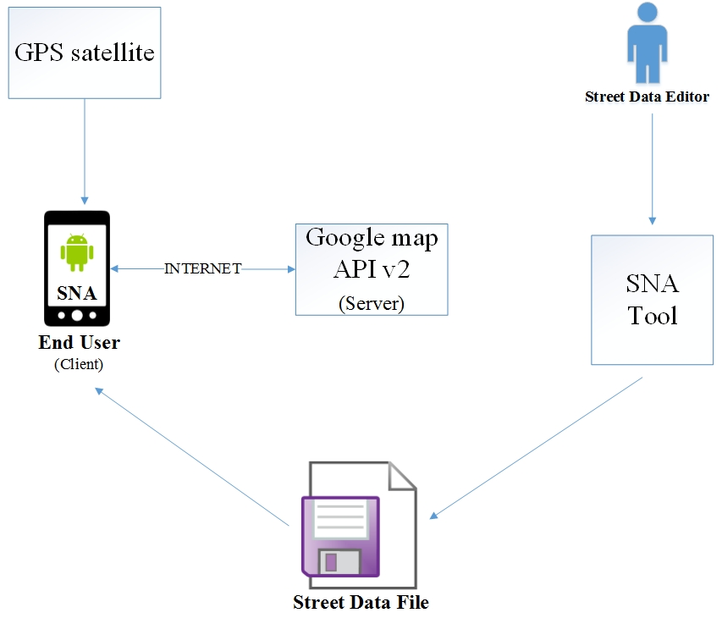
Software Design Description
Design overview

Slide 24
Software Design Description
System architecture design
View
Controller
Model
MVC architecture

Slide 25
Software Design Description
System architecture design
Model
  Model objects are the part of the application that implement the logic for the application’s data domain.
View
  Are the components that display the application’s user interface.
Controller
  Are the components that handle user interaction, work with the model, and ultimately select a view to render that displays UI.

Slide 26
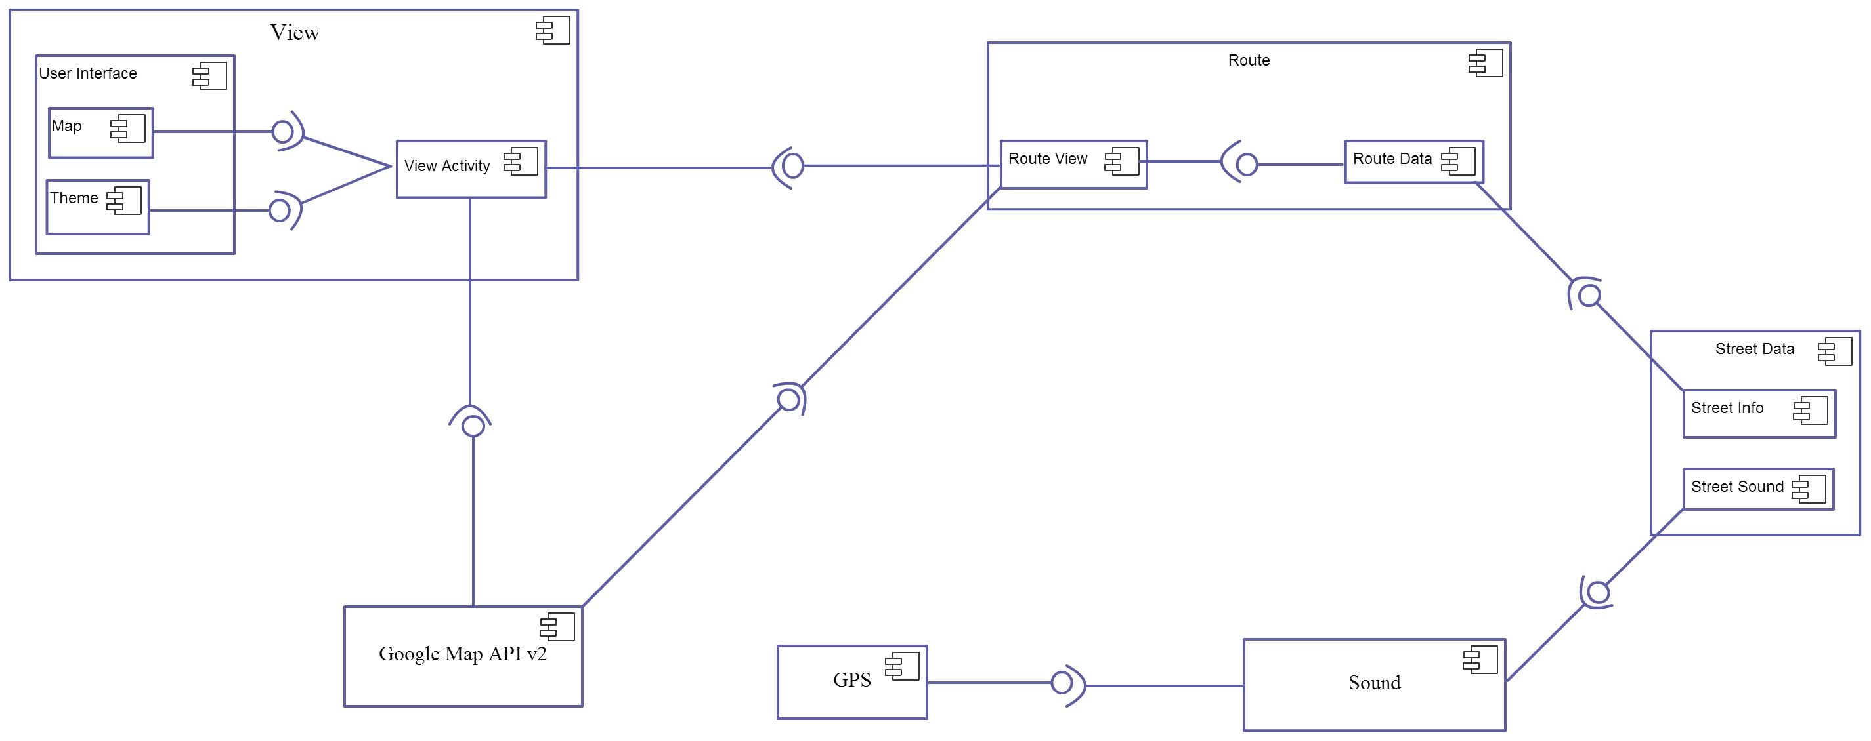
Software Design Description
Component Diagram

Slide 27
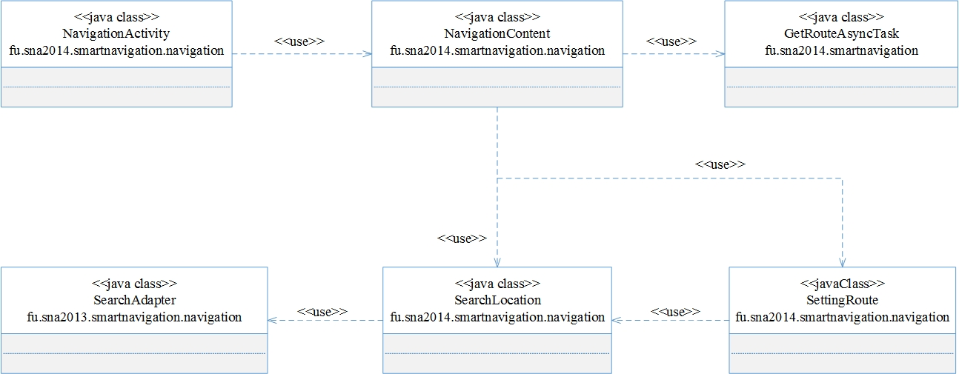
Software Design Description
Class diagram for search route

Slide 28
Implementation

Slide 29
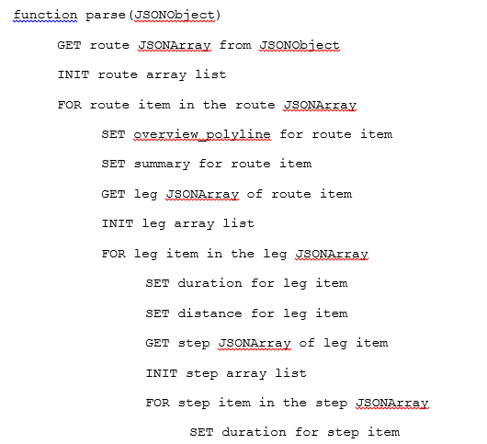
Implementation
Pseudo-code

Slide 30
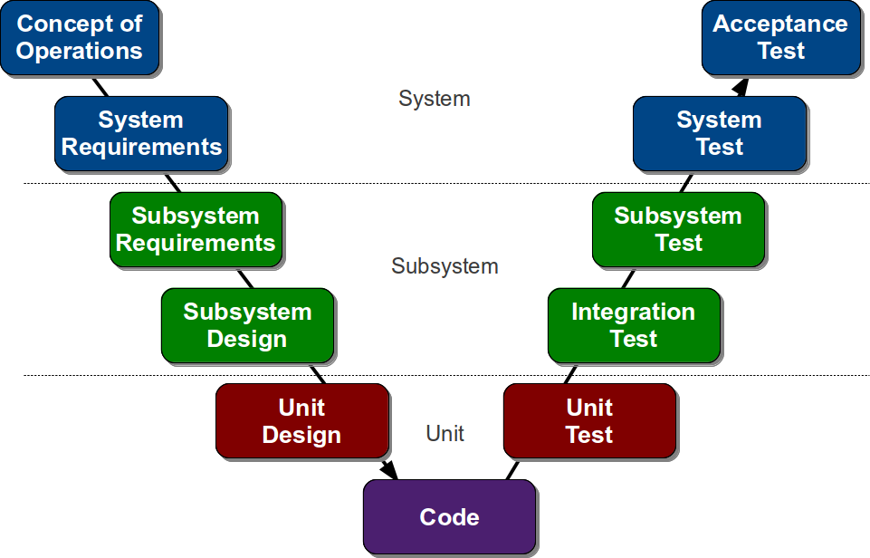
Testing
V model

Slide 31
Testing
Testing process
Requirement Analysis
Test Planning
Test Case Development
Test Execution
Test Circle Closure

Slide 32
Software Design Description
Features to be tested

Slide 33
Software Design Description
Testing Environment
Android application
  HTC One
    OS: Android JellyBean 4.3
    RAM: 2 GB
    Processor: Snapdragon 600 1.7 GHz
    Screen: 4.7 inch
Desktop application
  Asus K53SV Notebook
    OS: Windows 7 Professional x64
    RAM: 4 GB
    Processor: Intel Core i5 2.4 GHz

Slide 34
Demo and Q&A

Slide 35
Thank you

