Slide 1
F-Flashcard
Dream of Innovation
Supervisor: Ms. Pham Thi Minh Tam
Members: Dao Duc Manh
Pham Minh Hieu
Nguyen Trong Hieu
Vu Thi Huong

Slide 2
Contents
Introduction
Project Management Plan
Requirement Specifications
Design Description
Testing
Demo and Q&A

Slide 3
I) Introduction
About us:
Project name: F-FlashCard
Form FPT University
Want to make a product with high practical value.
Supervisor: Ms. Pham Thi Minh Tam
Member:
  Dao Duc Manh
  Pham Minh Hieu
  Nguyen Trong Hieu
  Vu Thi Huong

Slide 4


Background
People want to learn everything from the life.
They want to take note everything they know…

Slide 5
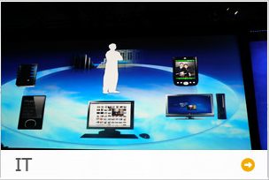
Background
Solution: Build a F-Flashcard learning language system
Provide standard function: login, logout, add, delete, edit, search words.
Provide extra-function: Manage website and control site member.
Sample in 2 available languages: English and Japanese
Easy to use in Window and Android system.

Slide 6

II). Project Management Plan

Slide 7


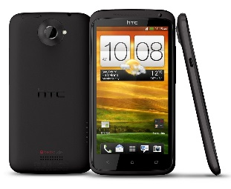
Development Environment
Hardware:
2 Gb of RAM
100Gb of hard disk
Core 2 Duo 2.0 GHz
4 Gb of RAM
100Gb of hard disk
Core 2 Duo 2.0 GHz
1Gb RAM
4.7 Inch
GPRS, WIFI, GPS

Slide 8
Development Environment
Software:
Category | Name | Version
Operating System | Window 7 | Ultimate
 | Android | 4.0
Web server | IIS | 7.5
Framework | Struts 2 | 2.3.16
 | ASP.NET Web Service | 4.0
IDE | Eclipse | 4.2
 | Jdk | 1.7.0.25
Source Control | Tortoise SVN | 1.7.9
Tool | Visual Paradigm for UML | 10.2
 | Astah | 6.2
DBMS | Mysql (phpMyAdmin) | 4.1.6

Slide 9
Project Organization
Ms. Pham Thi Minh Tam Supervisor
Pham Minh Hieu Project Manager
Dao Duc Manh Technique Leader
Vu Thi Huong Tester
Pham Minh Hieu BA Leader
Vu Thi Huong BA
Nguyen Trong Hieu Developer

Slide 10



Project Communication
Works 8h per day, 5 days per week
Meeting with project’s supervisor every week

Slide 11

III). Requirement Specifications

Slide 12
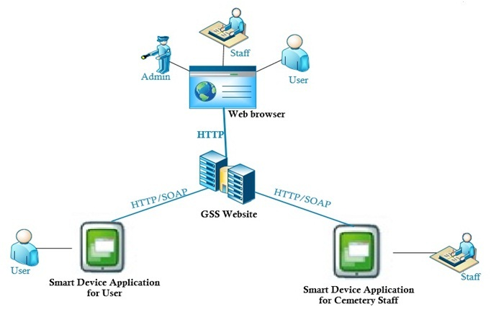
System Overview

Slide 13
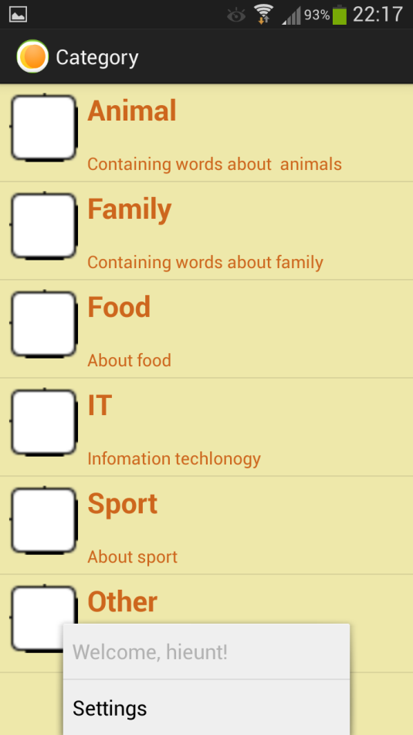
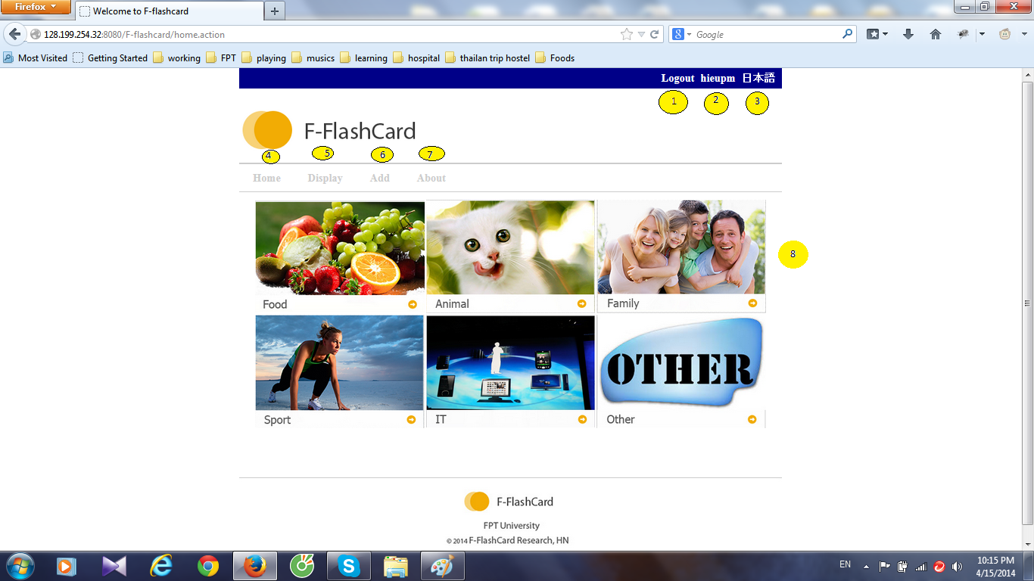
Functional Requirements
Android Application
Web application

Slide 14

Functional Requirements(cont)
User
Code | Description | Web | Mobile
Account Manager | Login | x | x
 | Logout | x | x
 | Change password | x | x
 | Register | x | x
 | Edit Profile | x | x

Slide 15
Functional Requirements(cont)
Code | Description | Web | Android
Category
 | Display all Category | x | x
Vocabulary | Display all words | x | x
 | Add New Vocabulary | x | x
 | Search Vocabulary | x | x
 | Edit Vocabulary | x | x
 | Delete Vocabulary | x | x

Slide 16
Functional Requirements(cont)
Vocabulary Management
1
Search Vocabulary
2
Add New Vocabulary
3
Edit Vocabulary
4
Delete Vocabulary

Slide 17
Usability
  Simple
  Minimum surprise
  Easy to use
Reliability
  Accuracy
Performance
  Response time
Data Integrity
Usability
Non-functional
Data Integrity
Reliability
Performance

Slide 18
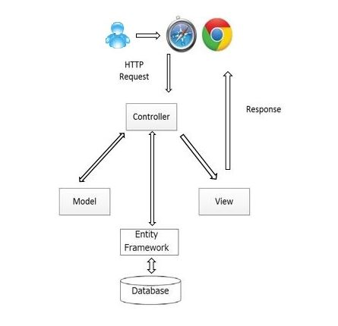
IV). Design Description
Architectural overview using MVC

Slide 19
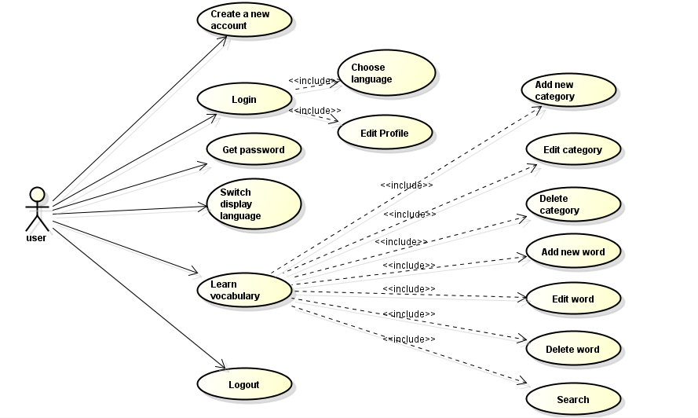
IV). Design Description(cont)
Class Diagram

Slide 20
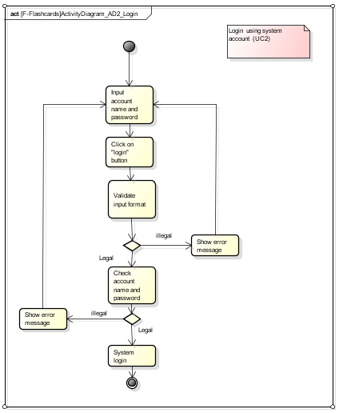
IV). Design Description(cont)
Activity Diagram

Slide 21
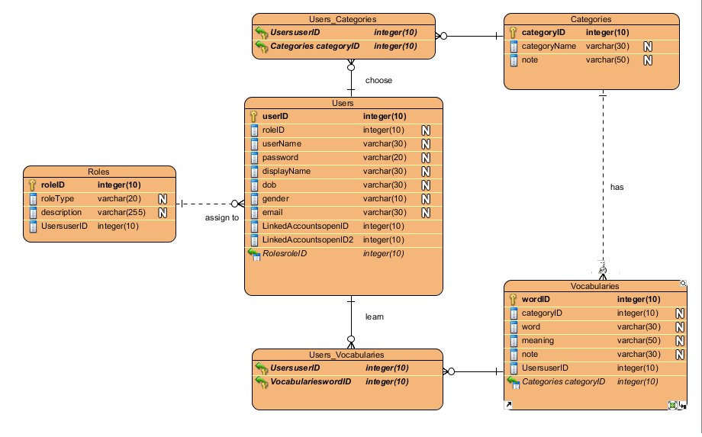
IV). Design Description(cont)
Entity Relationship Diagram

Slide 22
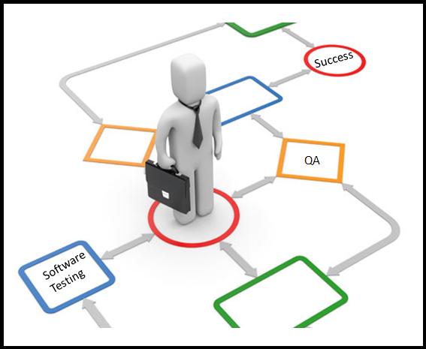
V). Testing

Slide 23
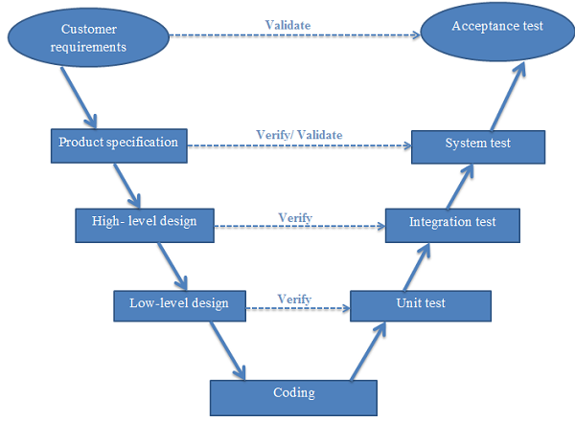
Test Model
V- Model

Slide 24
Testing Process
Estimation Document
Test Strategy Document
Requirement Analysis
Test Planning
Test Case Development
Test Execution
Test Cycle Closure
Test Cases
Test Data
Test Results
Defect Report
Test Closure Report

Slide 25
Test Plan
Base on Specification, create test plan:
  Features to be tested
  Environment
  Schedules
  Responsibilities
  Risks and contingencies
  …

Slide 26
Testing Process
Base on requirement, write test case about all functions
Create Test Case (TC)
Test Case
Review TC
Execute
Test
Track Bug
Retest
Report

Slide 27
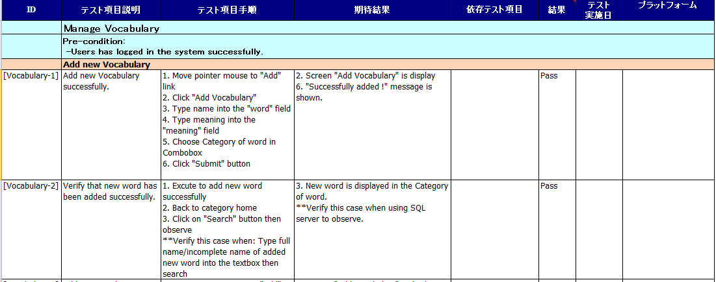
Test Case

Slide 28
Testing Process
Add corrections or suggestions
Review Test Case
By Test Leader
Review TC
Test Case
Execute
Test
Track Bug
Retest
Report

Slide 29
Testing Process
Find Bug
Execute Test
All Function
Execute
Test
Test Case
Review TC
Track Bug
Retest
Report

Slide 30
Testing Process
These bugs must fixed before these related relese is shipped
Find, Log bug and assign
Bug to appropriate developer to fix
Track bug
Test Case
Review TC
Execute
Test
Retest
Report

Slide 31
Testing Process
For keeping track bug until it is fixed
Testers has responsibility
To retest.
Retest
Test Case
Review TC
Execute
Test
Track Bug
Report

Slide 32
Testing Process
To Summary test progress and test result
Testers has responsibility
To write Test report
Report
Test Case
Review TC
Execute
Test
Track Bug
Retest

Slide 33
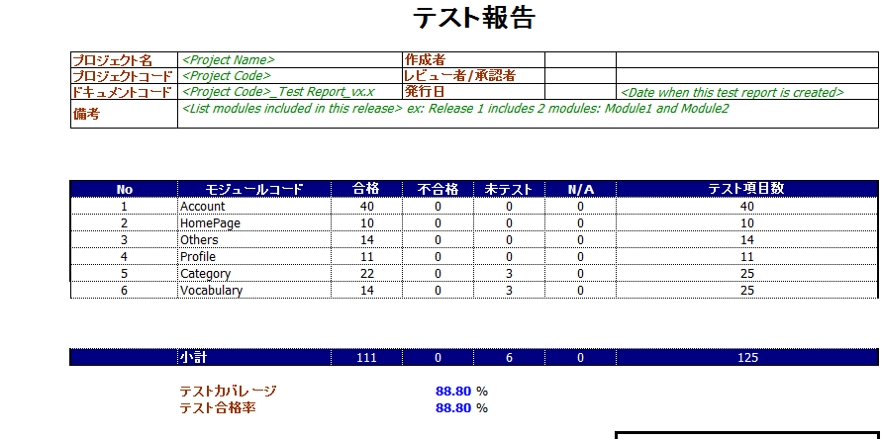
Testing Report

Slide 34




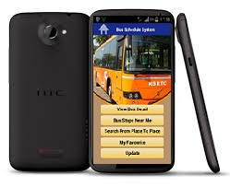
Testing Environment
Web application
  OS: Windows 7
  Browser: Internet Explorer 10
  Mozilla Firefox 22
Client
  OS: Android
  Mobile name: SAMSUNG LTE2

Slide 35

VI). DEMO AND Q&A

Slide 36
Dream of Innovation
Thank You !

