Slide 1
Capstone Project Delivering Food Online
Supervisor: Tran Dinh Tri
Group Members: Duong Ngoc Nhat-NhatDN01687
Nguyen Quang Minh-MinhNQ01717
Duong Hoang Nam-NamDH01552
Tan Van Son-SonTV01379
Pham Duc Anh-AnhPD01806

Slide 2
Contents
Background
Professional Competence of Project
Proposal
Software Process Model
Role and responsibilities
Technology and tools
Project plan
Requirement
System Architecture
System Implementation & Test (SIT)

Slide 3
Background
Society has developed quickly, and people now have become busy with work and other purposes, so sometime they don’t have enough time to go out and buy their favourite food. With now technology, a lot of people have at least one laptop, so a lot of websites has appeared to serve high demand of people. For this reason, we decided to create a webiste to bring the best food and the best services to customers.

Slide 4
Professional Competence of Project
Bring Food to the final customers
Customers can go to the website of the restaurant, have not to sign in, can view, search and order Food
Customers order product by enter their information: Name, Phone, Address
Order of customers will be saved in database, and be checked by manager.
Manager create schedules for staffs who deliver products to customers
Staffs sign in and see their schedules, deliver food to the customers and transfer back to the restaurant

Slide 5
Proposal
Create a website for a specific restaurant with delivering food service: this website will serve one specific restaurant. It will classify clearly 2 products: food and drink.With multiform contacts (phone, email...) and delivery, it will make people feel satisfaction.

Slide 6
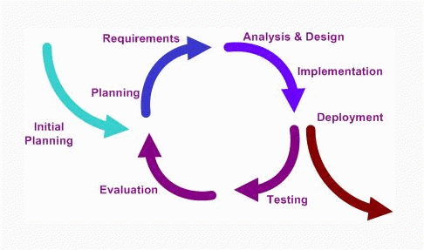
Software Process Model
For the development process, we choose the Iterative and Incremental model. The software will be developed and updated continuously in the circle model

Slide 7
Role and responsibilities
No | Full name | Role in Group | Responsibilities
1 | Dương Ngọc Nhật | Team leader | - Manage project plan -Training technique for other members. - Design database. - Software developer
2 | Phạm Đức Anh | Team member | - Resolve technique problems. - Software developer - Provide coding assistance to other members
3 | Dương Hoàng Nam | Team member | - QA and tester - Managing documents - Control project process. - Control product‘s quality after leader-reviewing. - Create and execute system test case. - Write test report.
4 | Nguyễn Quang Minh | Team member | - Identify and make team members aware project issues. - Create and execute integration test case - Create and execute system test case. - Write test report. - Design database
5 | Tân Văn Sơn | Team member | - Software developer - Designer - Provide coding assistance to other members

Slide 8
Technology and tools
Language: .Net
Architecture and design patterns: MVC4.
Database: SQL Server.
Development tools: Microsoft Visual Studio 2012, SQL Server 2008, 2012
Design tools: CSS, HTML
Communication tools: Skype, Google mail, Facebook
Document tools: Microsoft Office 2010, Microsoft Project 2010, Microsoft Visio 2010
Source Control : Tortoise SVN 1.8.4

Slide 9
Project plan

Slide 10
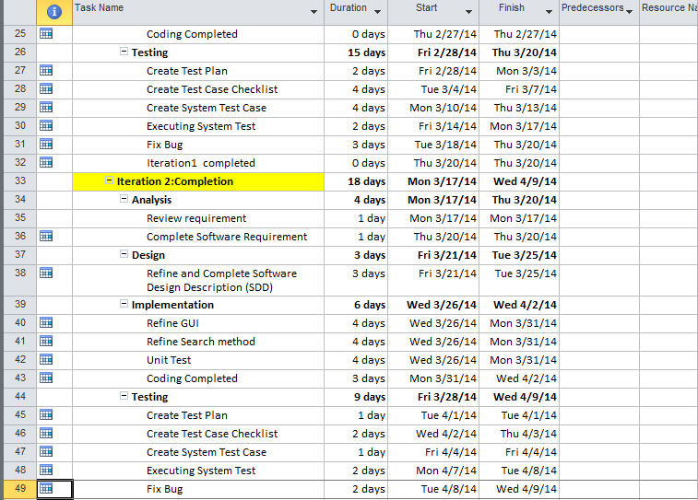
Project plan

Slide 11
Risk Management
No | Risk | Category | Probability (1-5) | Affection (1-5) | Reduction Strategy | Resolve Solution
1 | Project Plan is not effective, the processes does not meet their deadlines | Management Risk | 3 | 4 | leader should build a reasonable plan | Check and re-schedule the plan. The team members can work over-time.
2 | When each member give different opinions about project | Communicate Rick | 3 | 3 | Team have one member with responsibility control member ideal | List all opinions and make a day for all member discussing about them

Slide 12
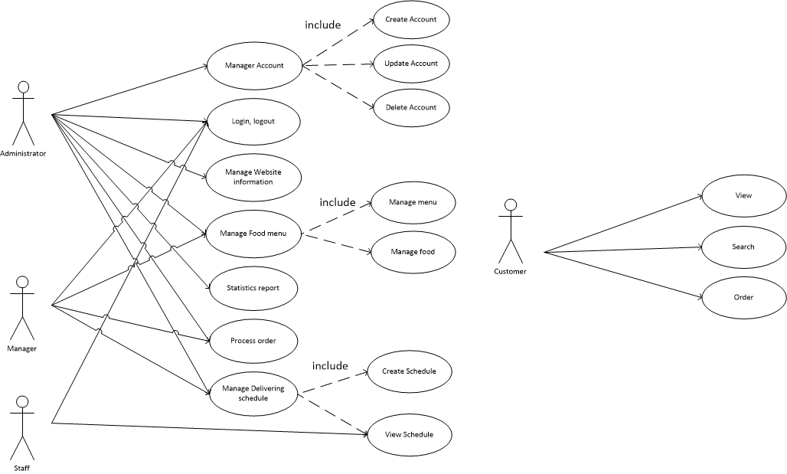
Use case diagram

Slide 13
Requirement
This system is designed for 4 main objects:
Normal user (Customer)
Administrator
Manager
Staff (deliver product)

Slide 14
Requirement
For normal user (customer)
Customers have not to register because it is not necessary. Customer just want to order food so if they don’t have to register, they can order faster, so they will feel more comfortable
Customer can use this function without creating an account and signing in.
View: View menu
Search: Customer can request the system to search for Food with some information by keyword
Order: Customer can add product to cart, after that, customer can process to order that food by filling order form with his/her personal information.

Slide 15
Requirement
For administrator
At login page, function Log in, user can log in with Admin role .
After logging in, Admin can perform following actions:
Manage (add, update, delete) account
Manage (add, update, delete) Delivering food online system information
Manage Food menu
Manage Delivering schedule
Process Orders
Statistics report (Financial Report)

Slide 16
Requirement
For manager
At Management page, function Log in, user with Manager rule can sign in
After logging in, Manager can perform following actions:
Manage Food menu
Manage Delivering schedule
Process Orders

Slide 17
Requirement
For staff (deliver product)
At Staff page, function Log in, only user with staff role can sign in
View: They will see their schedule, the product that they have to deliver, places that they have to deliver to.

Slide 18
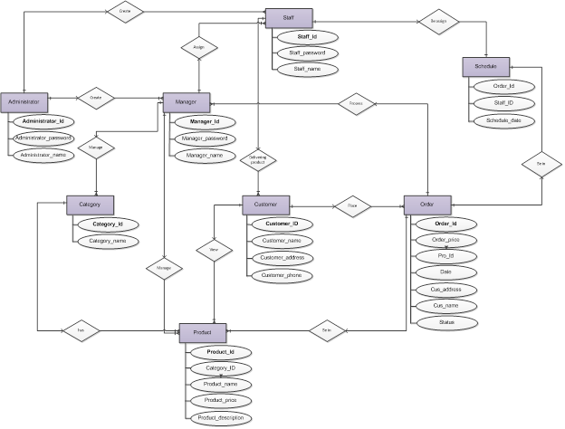
Entity Relationship Diagram

Slide 19
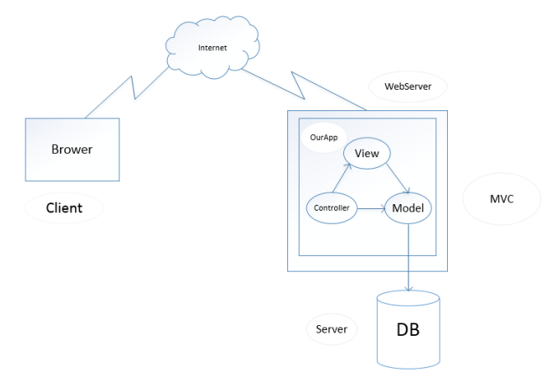
System Architecture
System architectural design

Slide 20
Component diagram

Slide 21
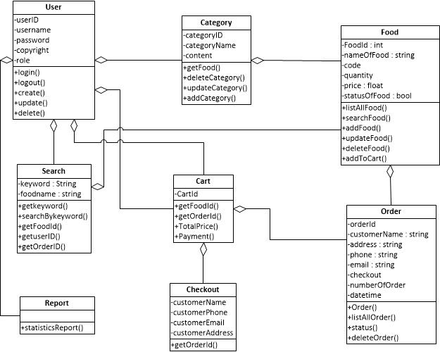
Class diagram

Slide 22
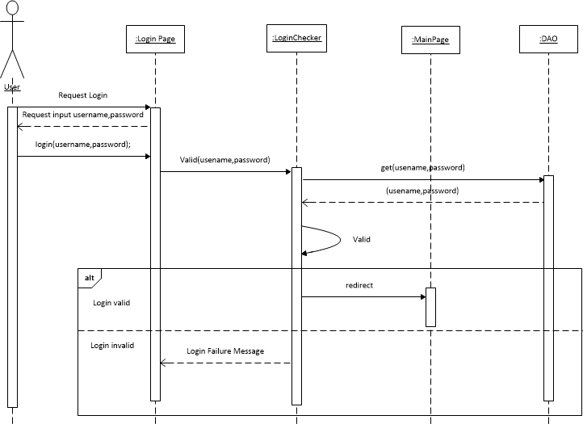
Sequence diagram
Sequence diagram for functionality Login

Slide 23
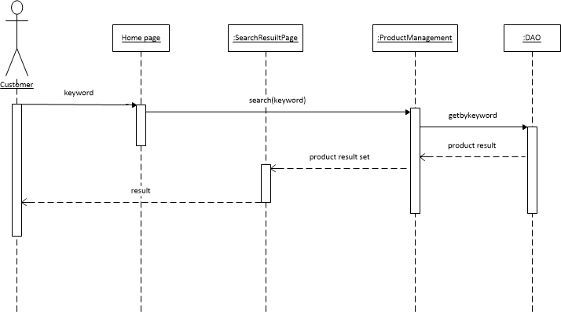
Sequence diagram
Sequence diagram for functionality Search

Slide 24
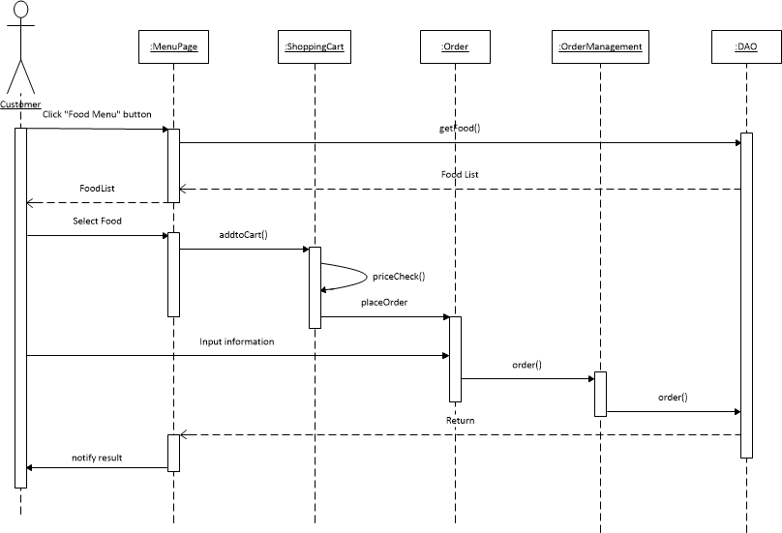
Sequence diagram
Sequence diagram for functionality Add to cart and order

Slide 25
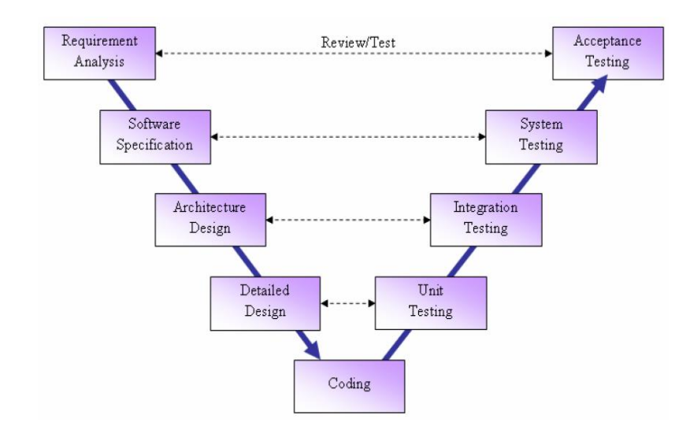
System Implementation & Test (SIT)
“Delivery Food Online” project follows a customized V-Model process. The types of testing that will be carry out throughout this project are: Unit test, Integration test, System test and Acceptance test

Slide 26
Test plan
Features to be tested
Login
Manage account
Searching
Add to cart
Order
Manage Based Information of Delivering Food Online System
Manage Service of Delivering Food Online System
Manage Menu of Food of Delivering Food Online System
Manage Delivering Schedule
Statistics report
View Schedule
Features not to be tested
The following items will not to be tested by test team:
The stable of website when do not connect internet.
Too much users connect on system.
Test on too much web browser tools

Slide 27
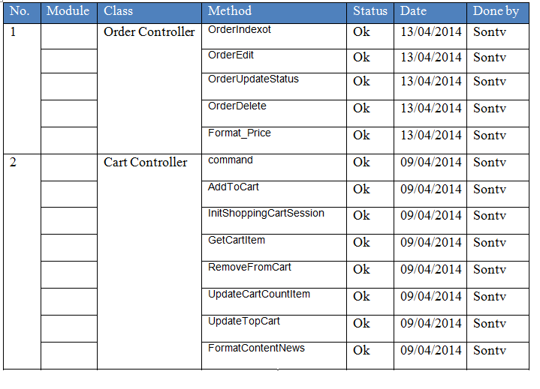
Unit test

Slide 28
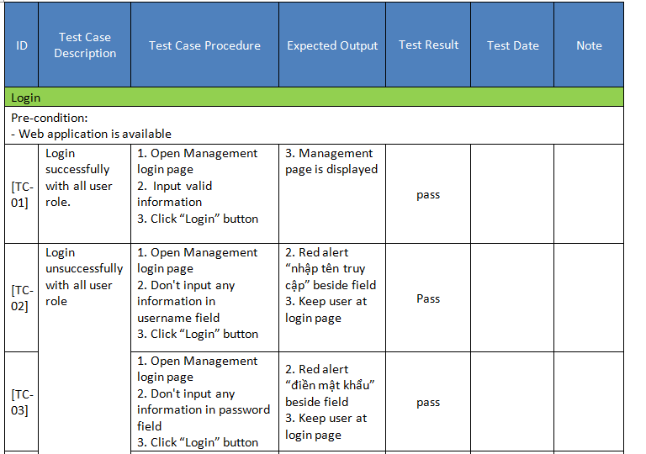
Test Case

Slide 29
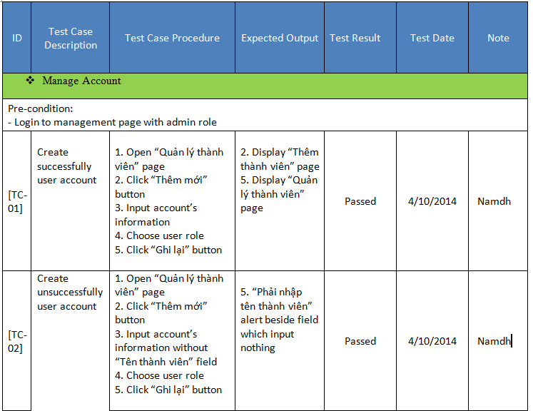
Test Case

Slide 30
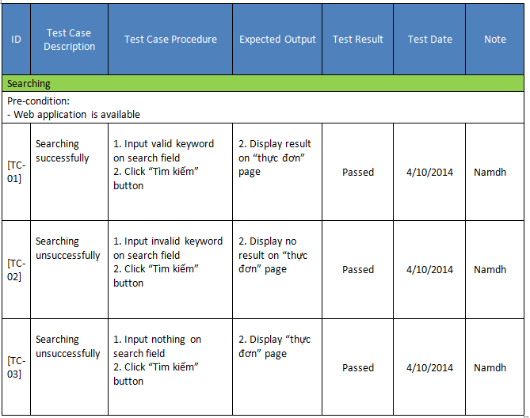
Test Case

Slide 31
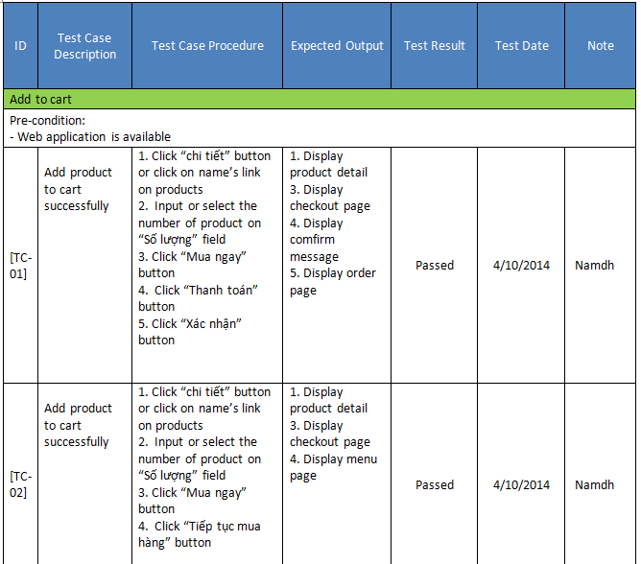
Test Case

