Slide 1
My Furniture Store Project
Supervisor: Nguyễn Văn Sang
Đỗ Giang Long
Nguyễn Mạnh Hùng
Nguyễn Duy Anh
Phạm Tuấn Hoàng

Slide 2
Presentation outline
Project overview
Project management
Software specification
Software design
Testing
Project result
Demo

Slide 3
Project overview
Business needs
Current Application Limitations
Technology Trends

Slide 4
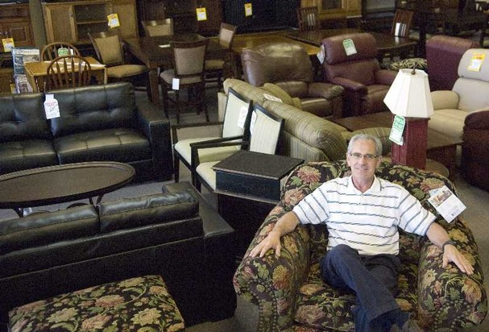
Current situation
The Store owner
Or the Administrator of the store
Not only should have a real store but also an online store
Want to help customers buying thing more convenient and faster
Can remotely manage without staying at the store

Slide 5
Current situation
Normal user – Customers
Want to shopping but cannot go to the store
Want to shopping anytime, anywhere
Want to save time
Can avoiding crowd
Easier comparison shopping
Want fast order

Slide 6
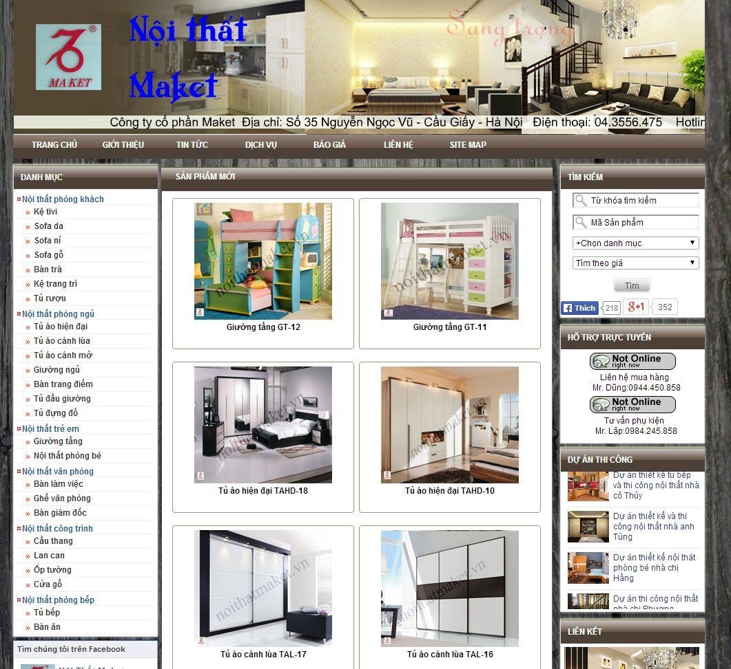
Current situation
Current Application Limitation
Vietnamese website - noithatmaket.vn
Look easy to use
Simple interface
BUT
Customer can only see
the product
No price, no cart
Cannot give order

Slide 7
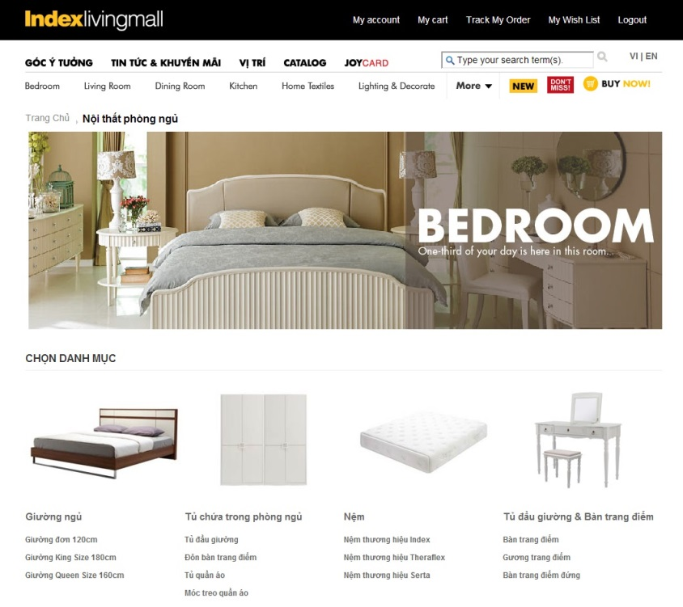
Current situation
Current Application Limitation
Vietnamese website - Indexlivingmall.vn
Friendly look
Good filter and search
Have cart and order online
BUT
Not fully support Vietnamese

Slide 8
Current situation
Technology Trends
Internet is fast growing
Shopping online and e-commerce is expanding wide
ASP.net is a good programming language
Famous and useful for web developing
Got support good from Microsoft

Slide 9
THE IDEAS
We want to build a Furniture Store that:
Support the administrator in managing their online store
Support the store’s customer has better shopping experience
Inherits the advantages and learn from the limitations of similar product
Try to improve the limitation
Bring a product which fully supported and suitable for Vietnamese

Slide 10
Objectives
Fulfill requirements to graduate from FPT University studying program
Get familiar with doing real project
Learn the process of doing real project
Get experience in working in group
Study new technology
Practice what we have learnt
Create a good website
Improve Skill:
Communication
Management
Information collection
Technical

Slide 11
PROJECT MANAGEMENT
Project Model
Organization Structure
Master Schedule
Deliverables
Tools & Environment

Slide 12
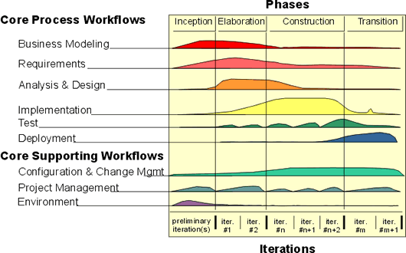
PROJECT MODEL

Slide 13
PROJECT MODEL
Why Choosing RUP?
Develop iteratively
Supports an iterative approach to development that addresses the highest risk items at every stage in the lifecycle, significantly reducing a project’s risk.
Manage Requirements
Managing requirements during the whole development process ensures project team develops the right system with right requirements.
Software quality
Testing process is implemented in all the cycles of application development time
-> Suitable for a inexperience team and can significantly reduce risks

Slide 14
ORGANIZATION STRUCTURE

Slide 15
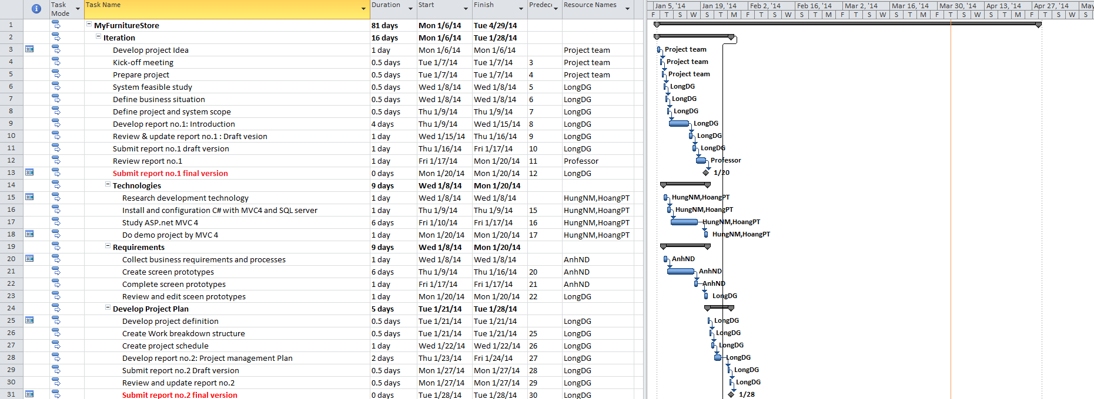
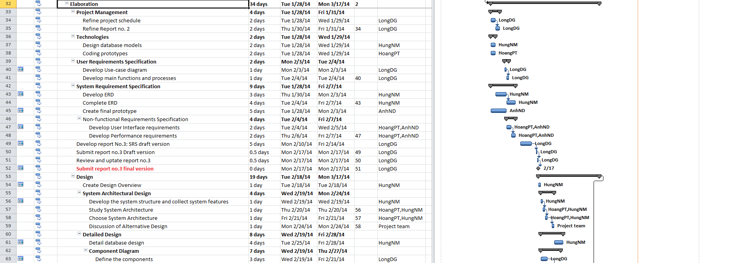
SCHEDULE

Slide 16
SCHEDULE

Slide 17
Objectives
Metrics | Unit | Committed | Actual | Deviation
Start Date | dd-mmm-yy | 6-Jan-14 | 6-Jan-14 | 0 days
End Date | dd-mmm-yy | 29-Apr-14 | 24-Apr-14 | 5 days
Duration | elapsed days | 96 days | 91 days | 5 days
Maximum Team Size | Person | 4 | 4 | 0

Slide 18
Deliverables
No | Stage | Deliverable/ Milestone | Delivery Date | Inspect | Final | Delivery Location
1 | Inception | Deliver report 1 | 20-Jan-2014 |  |  | Supervisor
2 | Inception | Project plan | 23-Jan-2014 |  |  | Supervisor
3 | Inception | Deliver report 2 | 28-Jan-2014 |  |  | Supervisor
4 | Elaboration | Complete ERD | 5-Feb-2014 |  |  | Supervisor
5 | Elaboration | Final prototypes | 7-Feb-2014 |  |  | Supervisor
6 | Elaboration | Requirements specification | 7-Feb-2014 |  |  | Supervisor
7 | Elaboration | Deliver report 3 | 17-Feb-2014 |  |  | Supervisor
8 | Design | System architecture design | 24-Feb-2014 |  |  | Supervisor
9 | Design | Deliver report 4 | 17-Mar-2014 |  |  | Supervisor
10 | Construction | Complete coding | 2-Apr-2014 |  |  | Supervisor
11 | Construction | Complete test documents | 4-Apr-2014 |  |  | Supervisor
12 | Construction | Deliver report 5 | 9-Apr-2014 |  |  | Supervisor
13 | Construction | Deliver report 6 | 14-Apr-2014 |  |  | Supervisor
14 | Transition | Deliver documents and CD source code | 16-Apr-2014 |  |  | FPT university
15 | Transition | Project complete | 29-Apr-2014

Slide 19
TOOL AND ENVIRONMENTS

Slide 20
Software specification
System Overview
Functional Requirement
Non Functional Requirement

Slide 21
SYSTEM OVERVIEW

Slide 22
FUNCTIONAL
Group of functions | Function’s name
General functions | Register
 | Login
 | Logout
 | Change password
 | Forgot password
Customer’s functions | Browse products by categories
 | Search product (simple)
 | Search product (advance)
 | View product’s information
 | Add product to shopping cart
 | Remove product from shopping cart
 | Change product’s quantity in shopping cart
 | Place order
 | View order’s history
 | View order’s details
 | Cancel order

Slide 23
FUnctional
Group of functions | Functions
User management | Search user
 | View user’s details
 | Delete user
 | Reset password
Product management | Search Product
 | Add new product
 | Delete Product
 | Edit product’s information
 | View product’s details
Order management | Search order
 | View order’s details
 | Change order’s status
 | Delete order
Supplier management | Search supplier
 | View provided products of a supplier
 | Add new supplier
 | Edit supplier information
 | Remove supplier
Report | Sales report

Slide 24
NON-FUNCTIONAL
Non-Functional | Description
Reliability | Data backed up daily and can be recovered if necessary Mean time between failures (MTBF): The mean time between each failure is expected to be about 480 hours (20 days) of using. Mean time to repair (MTTR): Immediately when Administrator finds out problem or website is attacked by someone. Average 1 day. Try reduce bug per function
Avaiability | Approximately 99%
Response time | Processing time will be 3 to 4 second
Usability | Site Load-time Is Reasonable Efficiency of use Intuitiveness
User interface | Easy to use, Friendly

Slide 25
Software design
Architecture Presentation
Package Design
Entity Relationship

Slide 26
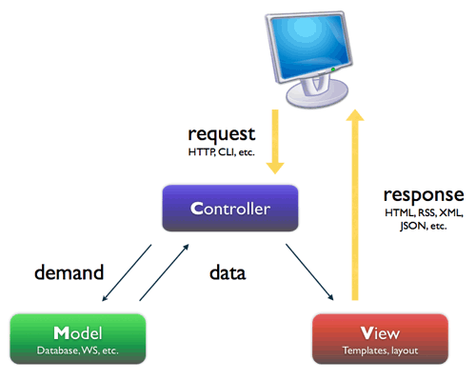
Architecture Overview

Slide 27
Why MVC?
It makes it easier to manage complexity.
It does not use view state or server-based forms.
It uses a Front Controller pattern that processes Web application requests through a single controller.
It provides better support for test-driven development (TDD).

Slide 28
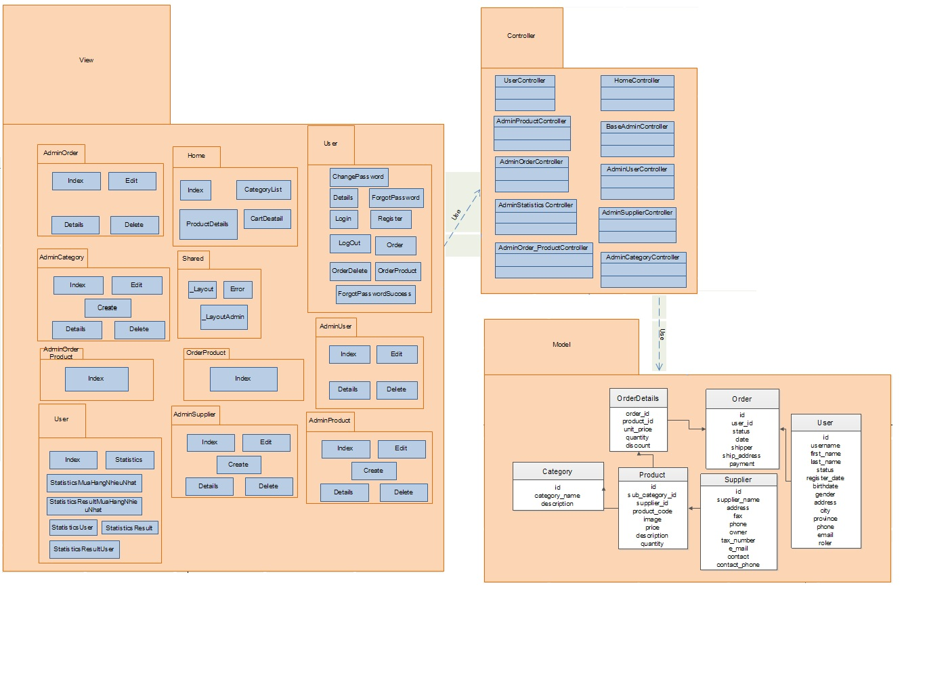
Package Design

Slide 29
Entity Relationship Diagram

Slide 30
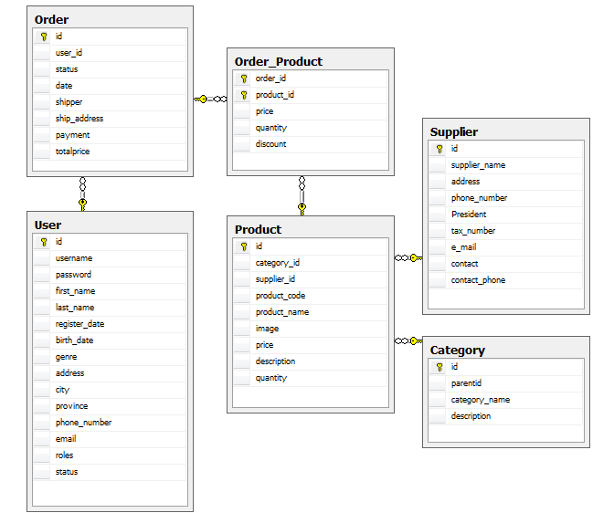
Database Design

Slide 31
TESTing
Test Model
Test Processes
Test Approach & Environment
Test Result

Slide 32
TEST MODEL

Slide 33
TEST PROCESS
Test Plan
Review TC
Execute test
Defect log
Create TC
Retest
Test report

Slide 34
TEST PROCESS - Test plan -
Based on Specification, create test plan:
Features to be tested
Environment
Schedules
Responsibilities
Risks and contingencies
...
Test Plan
Create TC
Review TC
Execute test
Defect log
Retest
Test report

Slide 35
TEST PROCESS - Test case -
Based on requirement, write test case about all functions.
Test Plan
Create TC
Review TC
Execute test
Defect log
Retest
Test report

Slide 36
TEST PROCESS - Review test case -
Test leader & developer.
Add corrections or suggestions.
Test Plan
Create TC
Review TC
Execute test
Defect log
Retest
Test report

Slide 37
TESTING PROCESS - Execute test -
Execute test all function.
Find bug.
Test Plan
Create TC
Review TC
Execute test
Defect log
Retest
Test report

Slide 38
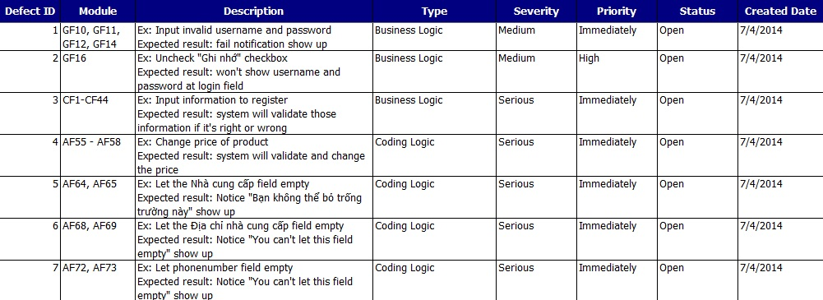
TESTING PROCESS - Defect log -
Test Plan
Create TC
Review TC
Execute test
Defect log
Retest
Test report

Slide 39
TESTING PROCESS - Defect log -
Find, log bug into defect log document and assign bug to appropriate developer to fix.
These bugs must be fixed before these related release is shipped.
Test Plan
Create TC
Review TC
Execute test
Defect log
Retest
Test report

Slide 40
TESTING PROCESS - Retest -
Tester has responsibility to keep track bug until it is fixed.
Test Plan
Create TC
Review TC
Execute test
Defect log
Retest
Test report

Slide 41
TESTING PROCESS - Test report -
Test leader has responsibility to write test report to summary test progress and test result.
Test Plan
Create TC
Review TC
Execute test
Defect log
Retest
Test report

Slide 42
TESTING PROCESS - Test report -
Test Plan
Create TC
Review TC
Execute test
Defect log
Retest
Test report

Slide 43
TESTING PROCESS - Test approach & environment -
Test Approach:
Unit testing: developers.
System/Integration testing: testers.
Acceptance testing: not have actual customer.
Manual testing by hand.
Test environment:
Web: Chrome 34, Firefox 28

Slide 44
PROJECT SUMMARY
Project Result
Comparison Result
Lessons Learned

Slide 45
PROJECT RESULT
New technologies have been applied successfully.
Completed basic functions.
Has more experiences and skills:
Soft skill.
Management.
Technical.

Slide 46
COMPARISON RESULT
Items | Plan | Actual
Main objective | Develop an website that help user to purchase furniture stuff online and help admin of the store manage the online store.
Releases Date | 04/24/2014 | 04/24/2014
Releases version | 1.0 | 1.0
Days | 96 | 96
Test case + check list | 350 | 240
Defects | 10 | 13
Document pages | 200
Lines of code | 15000 | Approximately 15000

Slide 47
LIMITATION AND EXPECTATION
Limitation
Cannot do online payment
Cannot decentralize user to other role rather than one administrator and customers
GUI, Test case and Report is still in upgrading
Expectation
Develop more functions
Put the system in real life
Improve the GUI

Slide 48
Situation | Problem | Lesson learnt
Laziness of some member | Miss the deadline | remind each other focus on the project since the start
Illness of some member | cannot go for weekly meeting or do works | should keep our health good while doing projects
Conflicts | Stress Miss Deadline | Be chill Analysis the problem
Not understanding about technical | Coding language is new with us | researching internet, asking for supporting from community.

Slide 49
DEMO

Slide 50
THANKS FOR Listening!

