Slide 1
Capstone Project
Disease Early Warning website
Hanoi 4-2014

Slide 2
Introduction
Project Information
  Project name: Diseases Early Warning Website
  Project code: DEWW2014
  Project type: Website
  Timeline: From 07 Jan 2014 to17 Apr 2014
Members
  Hoàng Xuân Hiếu
  Nguyễn Tiến Hạnh
  Lê Đình Duy
  Bùi Bảo Việt
  Phạm Phan Ngọc Mai
Supervisor
  Phan Trường Lâm

Slide 3
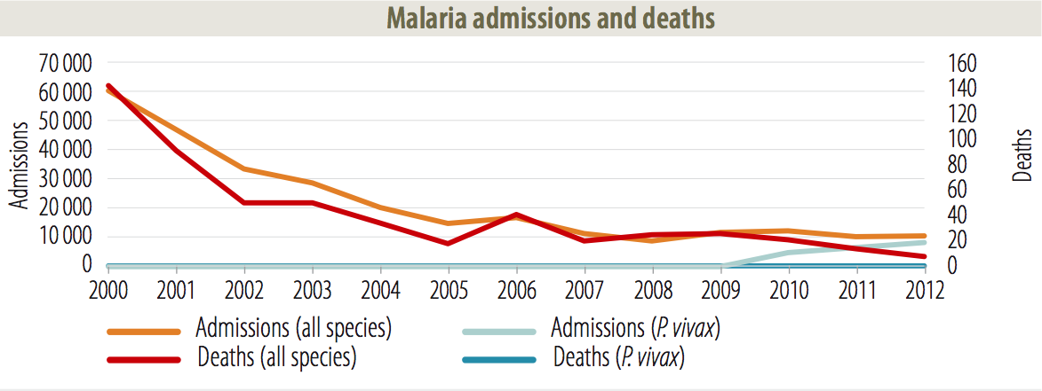
Problem
Vietnam is a tropical country with high temperatures, high humidity and a monsoon climate so there are a lot of dangerous diseases.

Slide 4
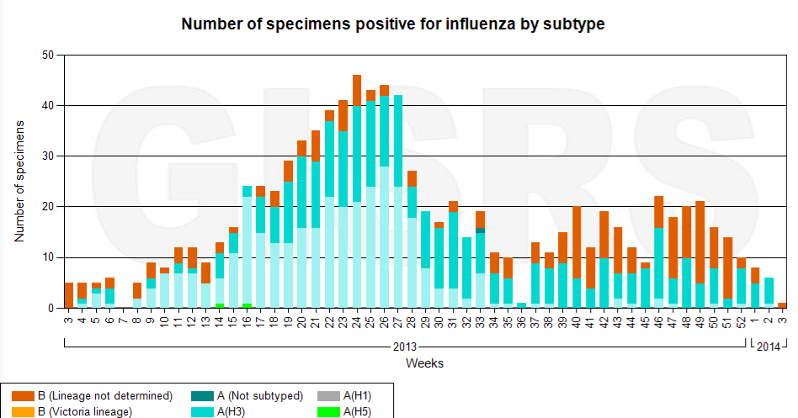
Problem

Slide 5
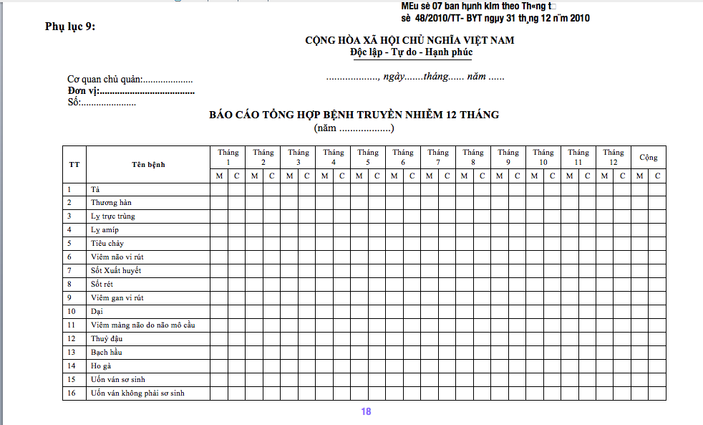
Problem
Following Circular 48 of the Ministry of Health about reporting infectious disease, there are lots disadvantage of collection paper report about disease

Slide 6
Problem Solve?
From theses problem, we decide to make a website to:
  collect information about diseases in community daily.
  information about diseases in community daily.

Slide 7
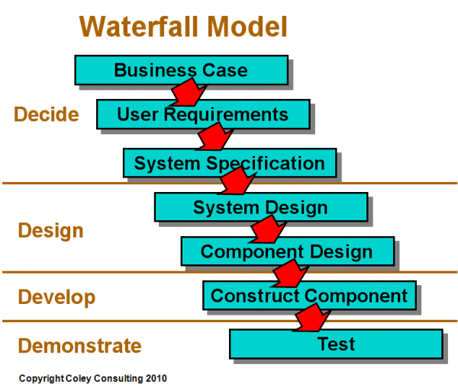
Software Development
Using waterfall model to develop
  Team member is familiar with waterfall model
  Clear requirement with Circular 48

Slide 8
Software Development
Folder project via Drop box
Using Redmine project management tool hosted in azure cloud to manage task, bug…
Using Apache Subversion to manage source code
Member communicate via skype, email, meeting

Slide 9
User Requirement
User need an authenticate system to login, logout, recovery password
Commune user manage report
Center, City, District user view report’s statistics by list, by graph
Center, City, District can export report by week, month, year to excel file
Center, City, District manage user account

Slide 10
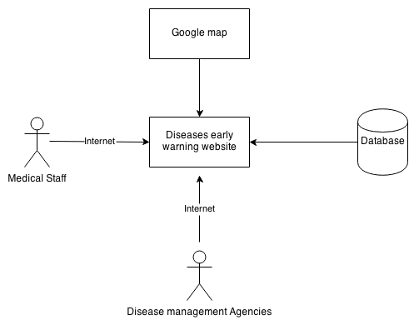
System overview

Slide 11
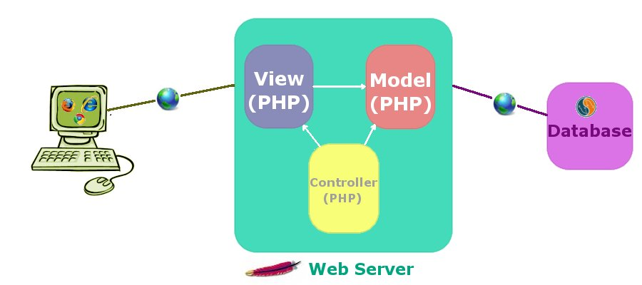
Architectural design
MVC model design pattern.

Slide 12
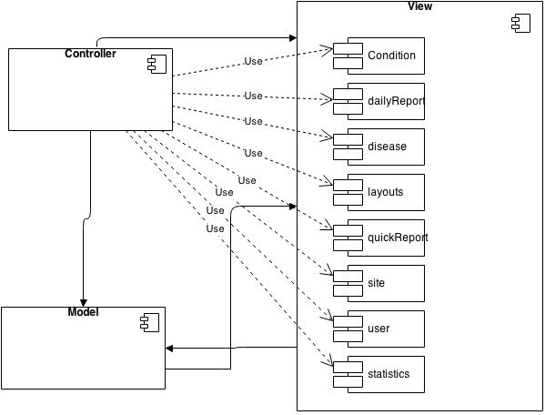
Component diagram
Component Diagram

Slide 13
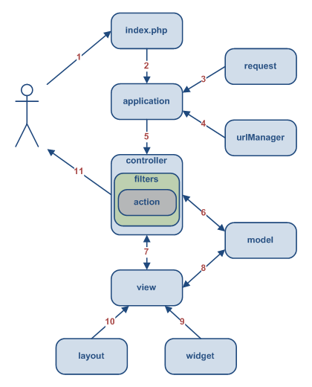
Main flow
Yii framework main flow

Slide 14
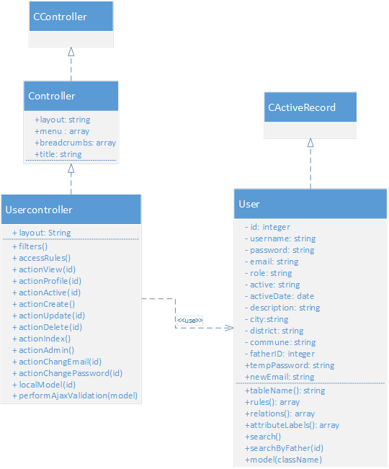
Details design
Create User class diagram

Slide 15
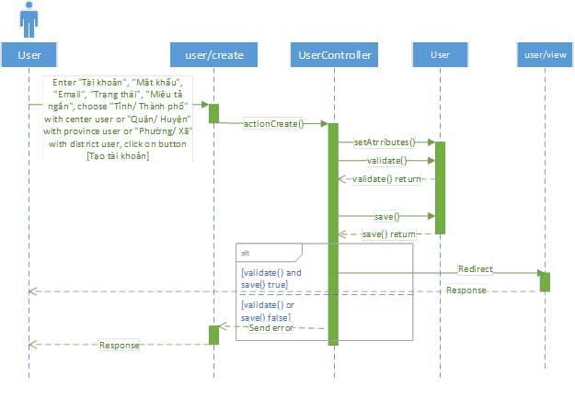
Details design
Create user sequence diagram

Slide 16
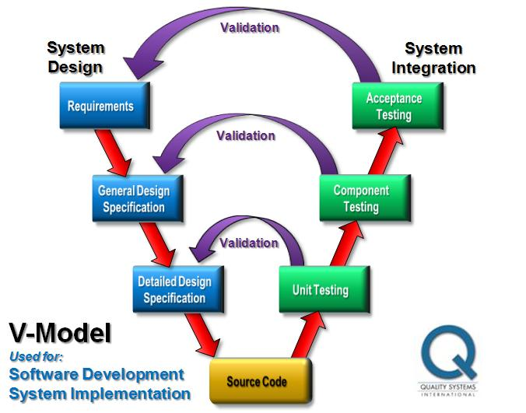
Testing
Follow V-Model process

Slide 17
Testing
Process
  Create test plan
  Create test case
  Execute test case
  Log bug to Redmine tool
  Retest until it is corrected

Slide 18
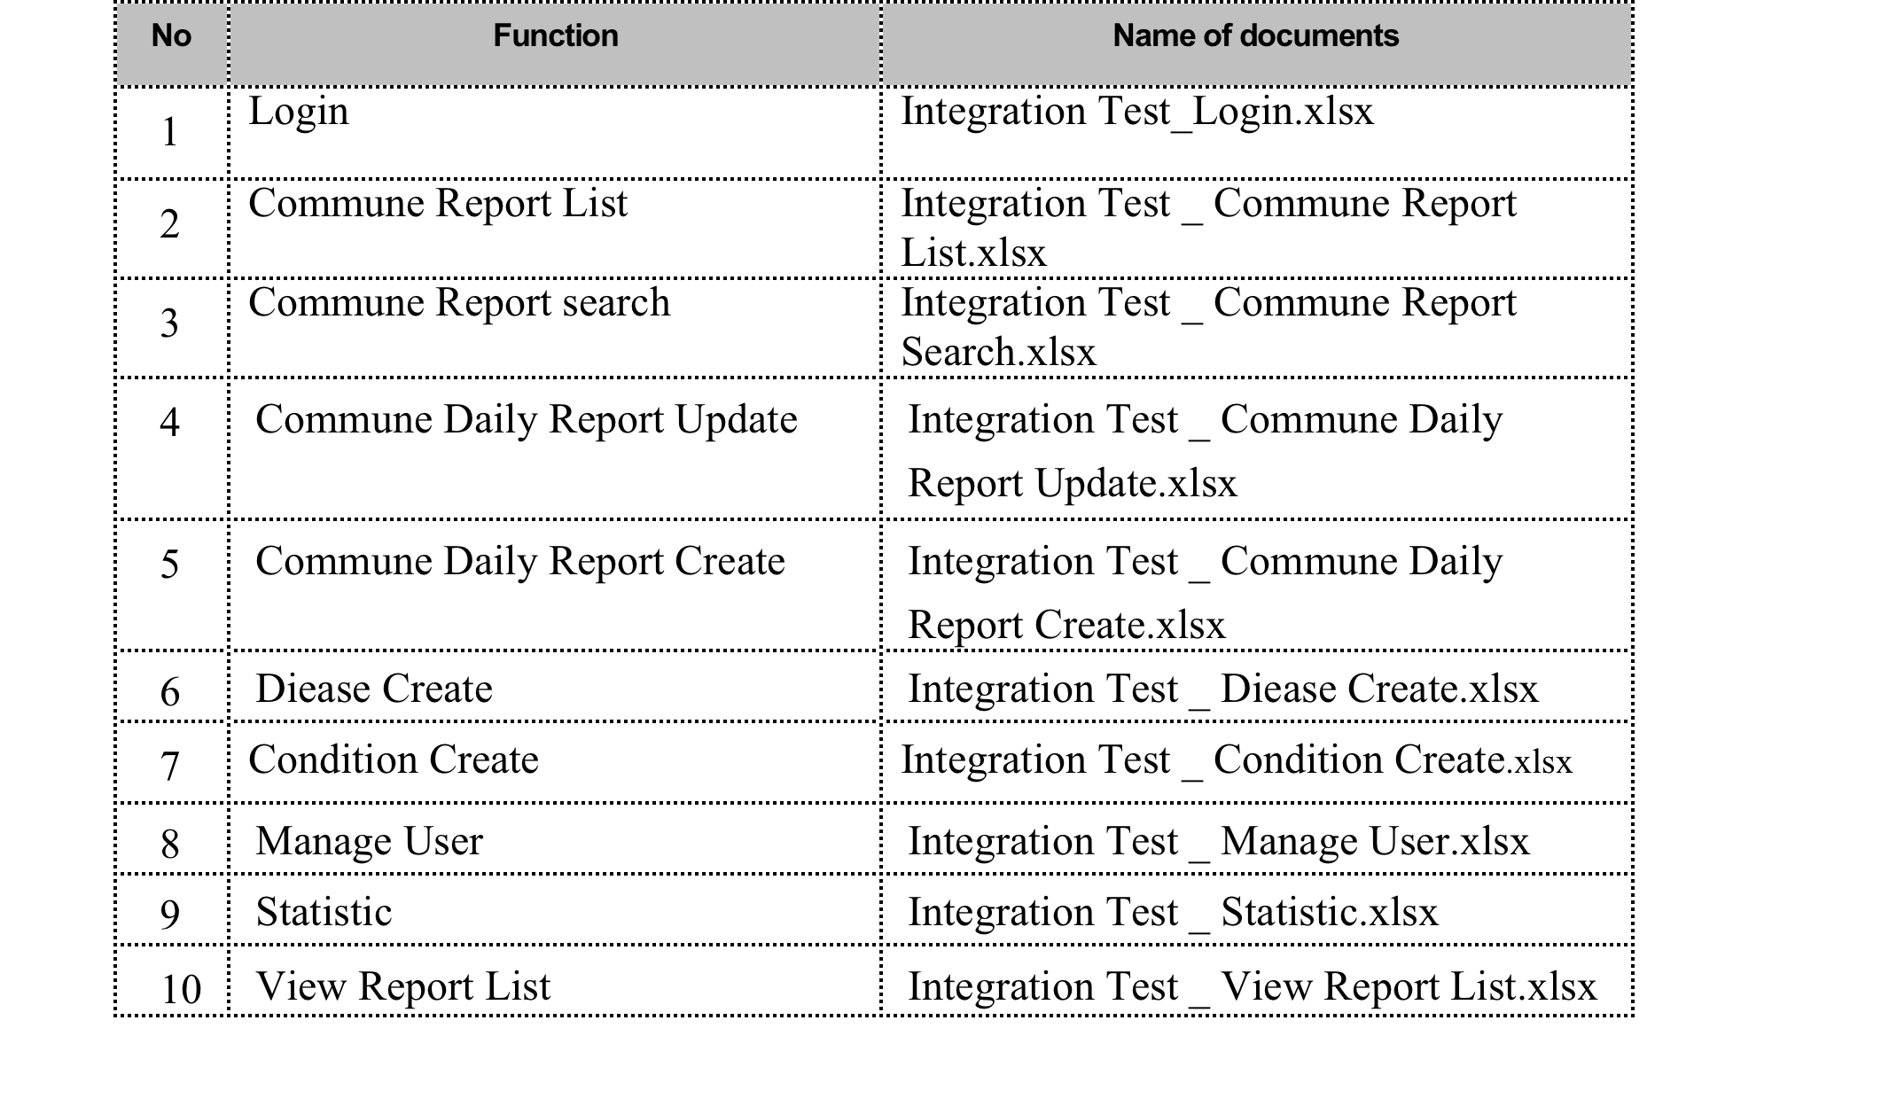
Testing
Sample of Integration test

Slide 19
Testing
Sample of System Test

Slide 20
Testing
Test summary
  Total Integration Test case: 274 case
  Total System Test case: 28 case
  Total Bug: 58 bug

Slide 21
Q/A
Question ?

