Slide 1
Smart Tendering System
Supervisor: Mr. Bùi Ngọc Anh
Team members:
Trần Trọng Thức
Lưu Tiến Sơn
Đỗ Quyết Thắng
Phạm Tiến Mạnh
Nguyễn Thế Phụng Long

Slide 2
Project Organization

Slide 3
Contents
Introduction
Project Management Plan
Requirement Specifications
Design Description
Test Documentation
Demo & Q&A

Slide 4
Part I : Introduction

Slide 5
Introduction
What is auction?
Types of e-auction
Benefits of e-auction

Slide 6
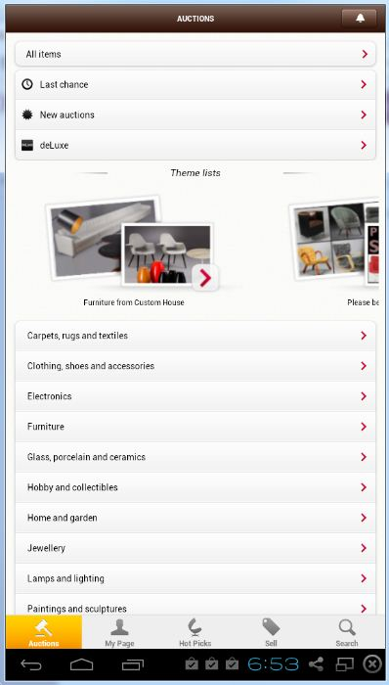
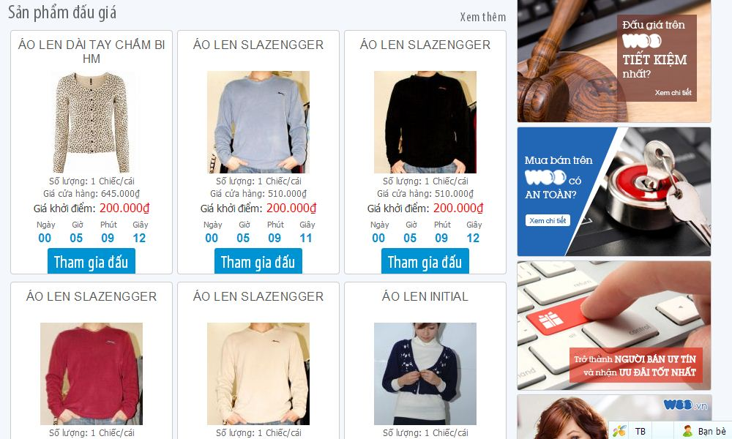
Introduction
Existing System and Limitation :
+ Domestic auction system : woo.vn
+ Foreign auction system: Lauritz.com

Slide 7
Introduction

Slide 8
Introduction
Potential risks :

Slide 9
Part II : Project Management Plan

Slide 10
Project Management Plan
The Proposed System
No | Group of functions | Function
1 | Guest module | Register account
 |  | Login
 |  | View detail products
2 | User module | Login
 |  | Logout
 |  | Edit information of account
 |  | Reset password
 |  | Bid
 |  | Set payment
 |  | View detail products
 |  | Edit information of account or products that supplier posted
 |  | Post product and set bid
 |  | Set payment
 |  | Search information about product
3 | Administrator module | Login
 |  | Logout
 |  | Change password
 |  | Manage user , auctions, payment, category, system history
 |  | Approve auction
 |  | Add, edit and delete category system.

Slide 11
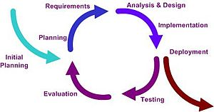
Project Management Plan
Software Process Model
Iterative model

Slide 12
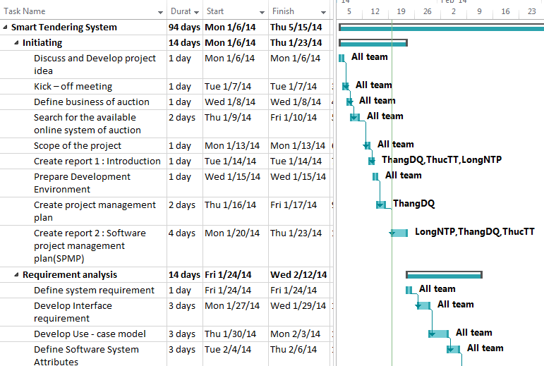
Project Management Plan
Project planning

Slide 13
Part III : Requirement Specifications

Slide 14
System Requirement Specifications (SRS)
Functional Requirement :
+ Guest
+ User
+ Administration

Slide 15
System Requirement Specifications (SRS)
Guest :
+ Register
+ Search auction
+ View all auction by category
+ View detail auction

Slide 16
System Requirement Specifications (SRS)
User:
+ Create , edit and cancel auction
+ Bid , auto bid
+ Feedback , Payment

Slide 17
System Requirement Specifications (SRS)
Administration :
+ Management user
+ Management category
+ Management bid
+ Management payment
+ Management history
+ Approve auction
+ Management feedback

Slide 18
System Requirement Specifications (SRS)
Non-functional Requirements
Usability
Availability
Reliability
Security
Security
Performance
Maintainability

Slide 19
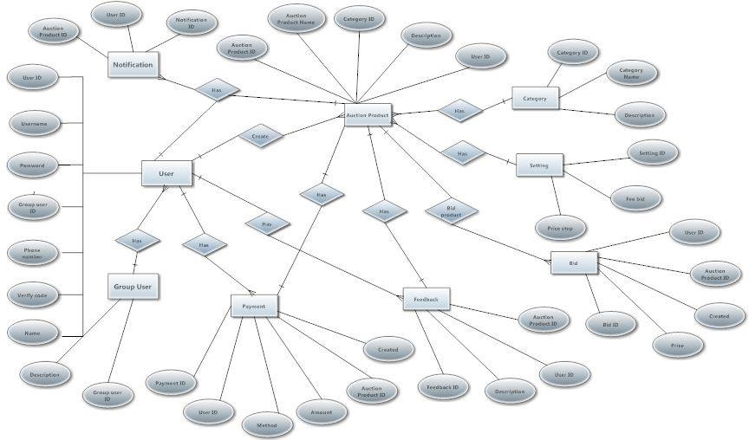
System Requirement Specifications (SRS)
Entity Relationship Diagram

Slide 20
Part IV: Design Description

Slide 21
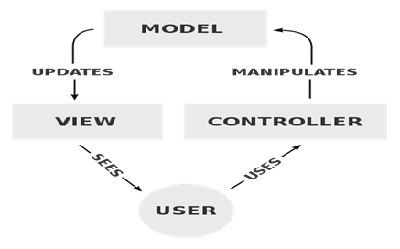
Software Design Description (SDD)
Choice of System Architecture
On Android application and Web application : MVC model

Slide 22
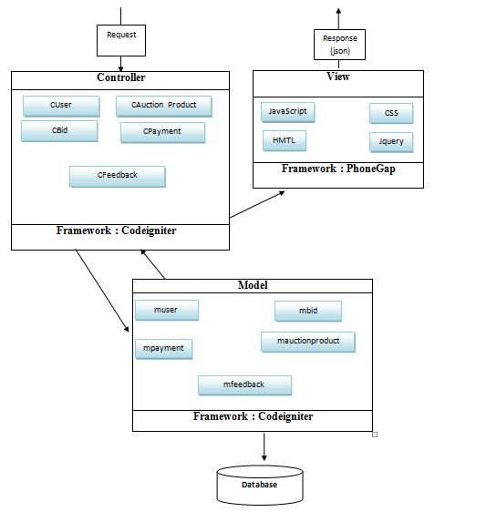
Software Design Description (SDD)
Structure diagram android application

Slide 23
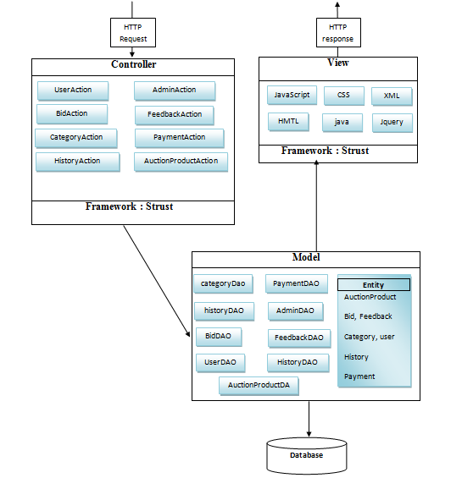
Software Design Description (SDD)
Structure diagram web application

Slide 24
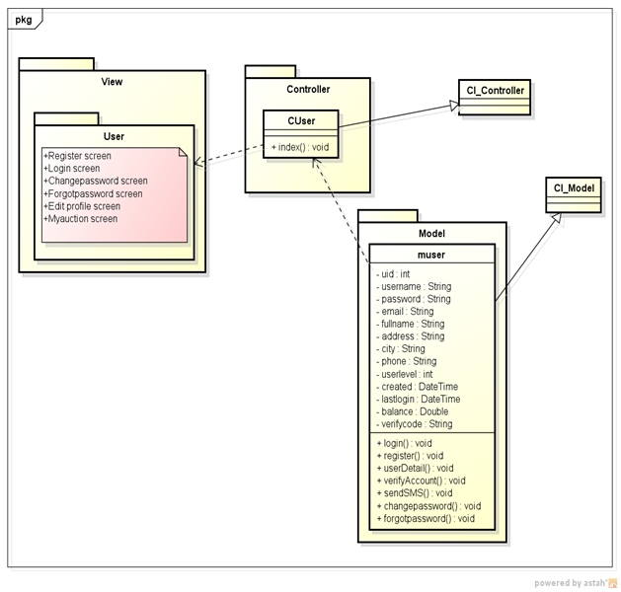
Software Design Description (SDD)
Android application class diagram have five class :
+ User
+ Auction product
+ Bid
+ Feedback
+ Payment
User class diagram

Slide 25
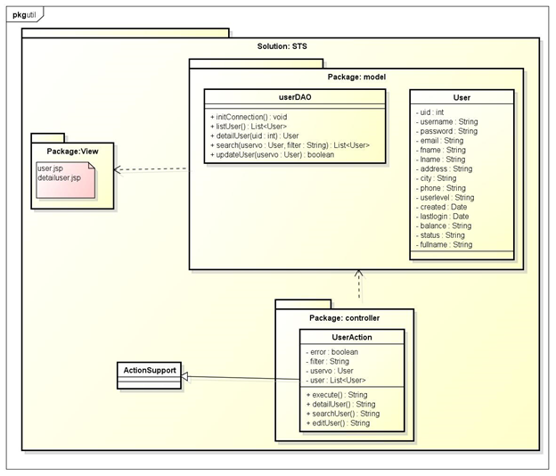
Software Design Description (SDD)
Web application class diagram have eight class :
+Management account
+Management user
+Management Category
+Management history
+Management Feedback
+ Management bid
+Management payment
+ Management auction product
Management user class diagram

Slide 26
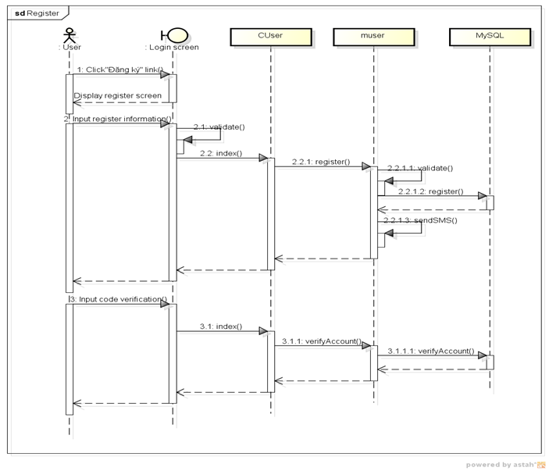
Software Design Description (SDD)
Sequence diagram: Android application
Register sequence diagram

Slide 27
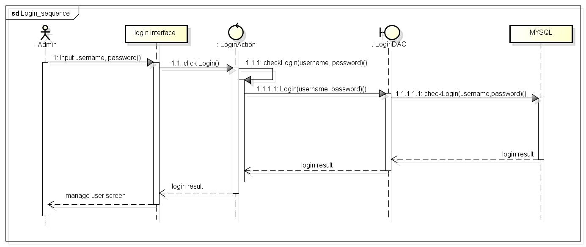
Software Design Description (SDD)
Sequence diagram: Web application
Login sequence diagram

Slide 28
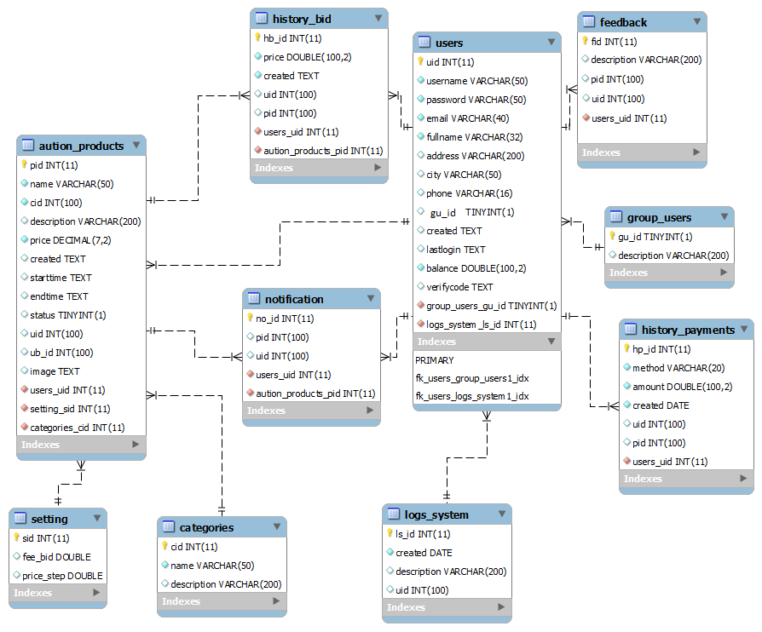
Software Design Description (SDD)
Database design:

Slide 29
Part V : Test Documentation

Slide 30
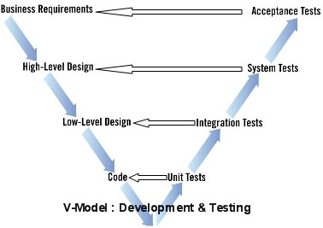
Software Test Document
Test Model:

Slide 31
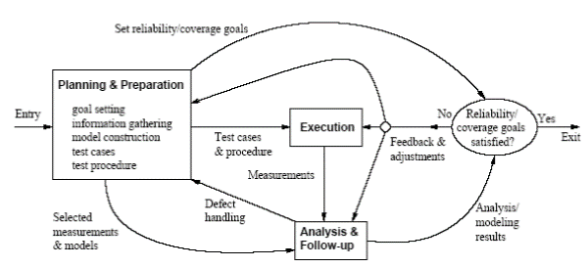
Software Test Document
Test process :

Slide 32
Software Test Document
Test :
+ Unit Test
+ Integration Testing
+System Testing
Not test:
+ Acceptance Test

Slide 33
Part VI : Demo & Q&A

Slide 34
Demo

Slide 35
Q & A

Slide 36
Thanks for attending !

