Slide 1
12SQ
Clash of 12 clans
Supervisor: Phan Trường Lâm
Team member : - Lê Mạnh Tùng - Lê Cảnh Nghị
- Nguyễn Lâm Hùng - Đào Đức Trình
- Nguyễn Trường Giang

Slide 3
Outline of content
1
Introduction
2
Project Management
3
Software Requirement Specification
4
Software Design Description
5
Testing
6
Summary
7
Demo, Q&A

Slide 4
I- Introduction
Background
Nowadays, in Vietnam, there are many problems of learning and teaching history subject in schools.

Slide 5
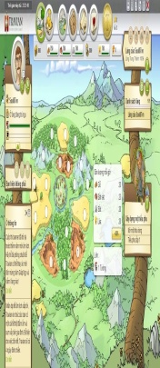
I- Introduction (cont.)
Literature Review of Existing System
Travian
Ikariam
“Bát Quái Trận Đồ”

Slide 6
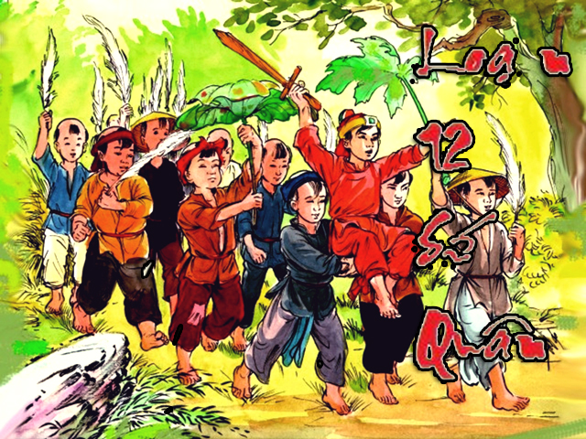
I- Introduction (cont.)
Our Proposal
Build “12 Sứ Quân” game, a strategy game, which has historical contents in period of chaos - 12 lords. The player acts as one part of history, they can participate in the battles with the historic characters, context and learn more about the historic

Slide 7
II- Project Manager
1. Development Environment
Hardware
Software
Category | Software name | Version
Operating System | Windows 7 Professional
 | Windows 8 Pro
Data Management System | Microsoft SQL Server 2008
IDE | NetBean | 8.0
Web Server | Apache Tomcat | 7.0.2
UML Tool | Microsoft Visio Professional
Document Tool | Microsoft Office Enterprise 2007
 | Microsoft Office Project Professional 2007 or 2013
Browsers | Mozilla Firefox | 9
 | Google Chrome | 11
- Monitor with resolution 1366x768 or higher.
- Intel Core 2 Duo 2.0 GHz or higher.
- 2 GB DDR2 or larger.
- 120 GB HDD or larger.

Slide 8
II- Project Manager(Cont.)
2. Project organization
* Role member
Full name | Roll no.
Lê Mạnh Tùng | 00393 | PM, SD, Dev, Writer, QA, ID
Nguyễn Lâm Hùng | 00923 | TL, Dev, Tester, Collector
Nguyễn Trường Giang | 01046 | Collector, ID
Lê Cảnh Nghị | 01871 | Dev, Tester, Collector, ID
Đào Đức Trình | 00922 | Dev, Tester, Collector
* Role member
- Language: Java, CSS, HTML, JavaScript.
- Front-end technologies: jQuery, AJAX.
- Architecture and design patterns: MVC.
- Database: SQL Server.
- Framework: JSF.
- Development tools: NetBeans IDE 8.0, SQL Server 2008.
- Design tools: Astah, Lucidchart.
- Communication tools: Skype, Google mail, Facebook
- Document tools: Microsoft Office 2007, Microsoft Project 2013.

Slide 9
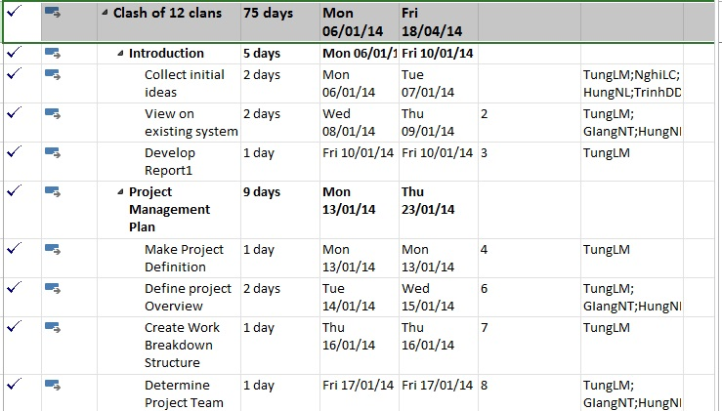
II- Project Manager(Cont.)
3. Project management plan

Slide 10
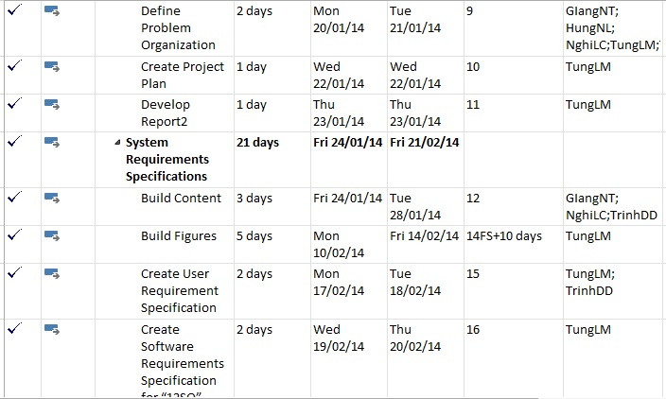
II- Project Manager(Cont.)
3. Project management plan

Slide 11
II- Project Manager(Cont.)
3. Work breakdown structure
1
Programming game “12SQ” on the web
1.1
Introduction
1.1.1
Collect initial ideas
1.1.2
View on existing system
1.1.3
Develop Report1
1.2
Project Management Plan
1.2.1
Make Project Definition
1.2.2
Define project Overview
1.2.3
Create Work Breakdown Structure
1.2.4
Determine Project Team
1.2.5
Define Problem Organization
1.2.7
Develop Report2
1.3
System Requirements Specifications
1.3.1
Build Content
1.3.2
Build Figures
1.3.3
Create User Requirement Specification
1.3.4
Create Software Requirements Specification
1.4
Design Interface
1.4.1
Design Web
1.4.2
Design Map
1.4.3
Design Object
1.5
Coding
1.5.1
Web Function
1.5.2
Game Function
1.3.5
Develop Report3
1.6
Software Test Documentation
1.2.6
Create Project Plan
1.6.1
Create Test Plan
1.6.4
Develop Report5
1.6.2
Create Test Case
1.6.3
Check List
1.5.3
Develop Report4
1.6.5
Develop Report6
1.7
Software User's Manual
1.7.1
Installation Guide
1.7.2
User's Guide
1.7.3
Develop Report6

Slide 12
III- Software requirement specification
1. Type of Users
Admin
Player
Guest

Slide 13
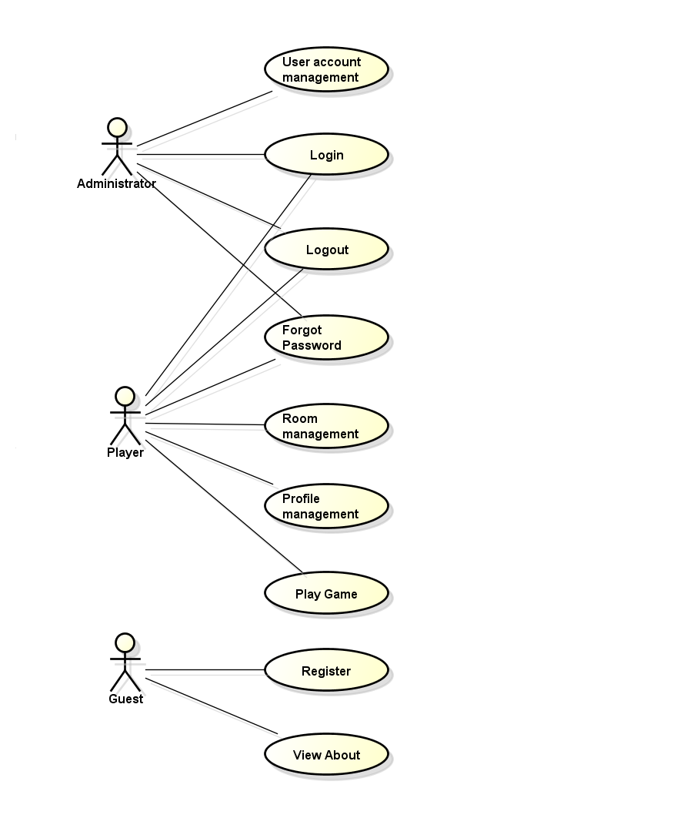
III- Software requirement specification
2. User requirement specification
2.1 Function requirements

Slide 14
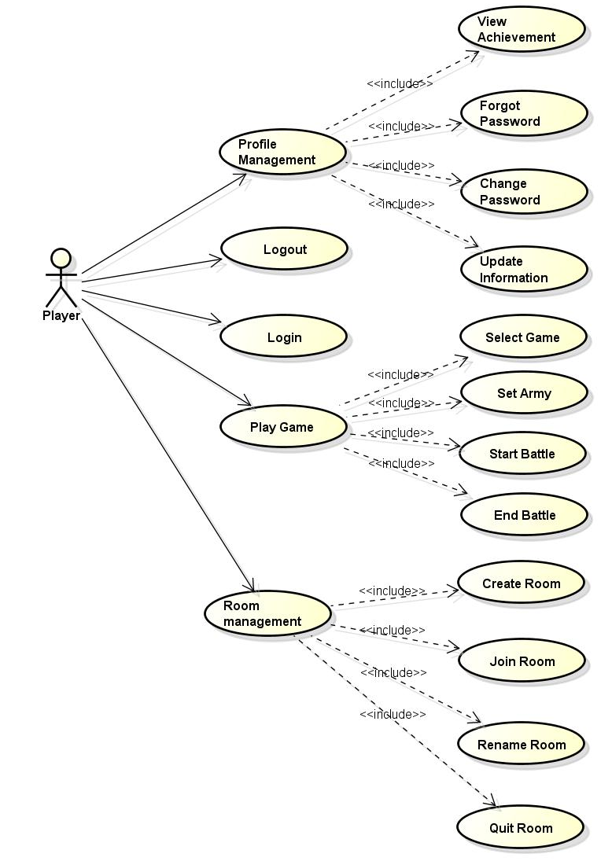
III- Software requirement specification
Use Case Diagram for Player

Slide 15
III- Software requirement specification
2. User requirement specification (cont.)
2.2 Figures
In the battle have two forces:
Attack force:
- Forces conquered the stronghold.
- Fix number of group and limit units in group.
* Example game “12 Sứ Quân” attack forces have 4 groups and each group have limit 10000 units.
Defend force:
- Forces defend stronghold.
- Receive benefits from the stronghold.
- Fix number of group and limit units in each type group.
 | Number groups | Limit unit each group (Unit) | Coefficient defense (*)
Stronghold level 1 | 4 | 3000 | 300%
Stronghold level 2 | 2 | 5000 | 350%
Stronghold level 3 (Capital) | 1 | 8000 | 400%
(*) Coefficient defense increases for attack-value, defend-value of defend forces.

Slide 16
III- Software requirement specification
2. User requirement specification (cont.)
2.2 Figures
Army:
Use both attack forces, defend forces
Each game has different army systems but have common characteristics
Example game “12 Sứ Quân”:
Army type and characteristics table:
 | Attack-value (SM) | Defend-value (SM) | Coefficient lives (C) | Quantities of attack forces (Unit) | Quantities of defend forces (Unit)
Spearman (SP) | 1750 | 1200 | 1 | 7000 | 7500
Archer (AR) | 1800 | 1000 | 1 | 13000 | 12000
Swordman (SW) | 1600 | 1250 | 1 | 10000 | 6000
Cavalry (CL) | 1800 | 1100 | 2 | 4000 | 0
Catapult (CT) | 2000 | 100 | 7 | 1000 | 500

Slide 17
III- Software requirement specification
2. User requirement specification (cont.)
2.2 Figures
Formula
- Attack:
EAA = ASPA * USPA * (1 + TSPA) + AARA * UARA * (1 + TARA) + ASWA * USWA *
(1 + TSWA) + ACL * UCLA * (1 + TCLA) + ACT * UCTA * (1 + TCTA)
EDA = DSPA * USPA * (1 + TSPA) + DARA * UARA * (1 + TARA) + DSWA * USWA *
(1 + TSWA) + DCLA * UCLA * (1 + TCLA) + DCTA * UCTA * (1 + TCTA)
ECA = CSPA * USPA + CARA * UARA + CSWA * USWA + CCLA * UCLA + CCTA * UCTA
- Defend:
EAD = ASPD * USPD * (1 + TSPD) + AARD * UARD * (1 + TARD) + ASWD* USWD *
(1 + TSWD) + ACLD * UCLD * (1 + TCLD) + ACTD * UCTD * (1 + TCTD)
EDD = DSPD * USPD * (1 + TSPD) + DARD * UARD * (1 + TARD) + DSWD * USWD *
(1 + TSWD) + DCLD * UCLD * (1 + TCLD) + DCTD* UCTD * (1 + TCTD)
ECD = CSPD * USPD + CARD * UARD + CSWD * USWD + CCLD * UCLD + CCTD * UCTD

Slide 18
III- Software requirement specification
2. User requirement specification (cont.)
2.2 Figures
Determining win or lose:
Determine the rate of damage on each force (R):
Determine the results battle:
 | Results
RA >= RD | Attack lost defend win
RA >=1 | Attack lost defend win
RA < RD && RA < 1 | Attack win defend lost

Slide 19
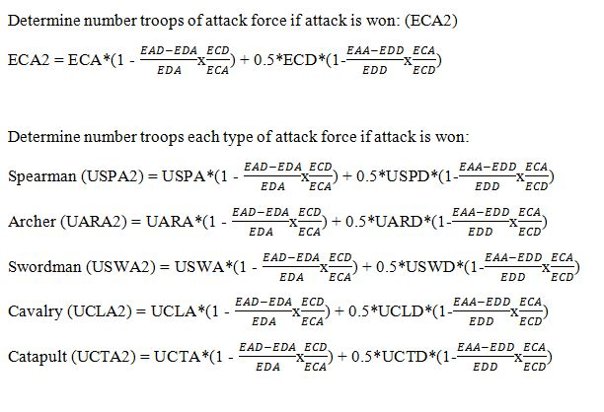
III-Software requirement specification
2. User requirement specification (cont.)
2.2 Figures

Slide 20
III- Software requirement specification
3.Non-functional requirements
Usability
Interface should be simple and friendly, users can learn to use easily without any demos or instructions.
Security
System should protect user information from outside or other users. All the information of users must not be available for anyone or software that is not part of the system.

Slide 21
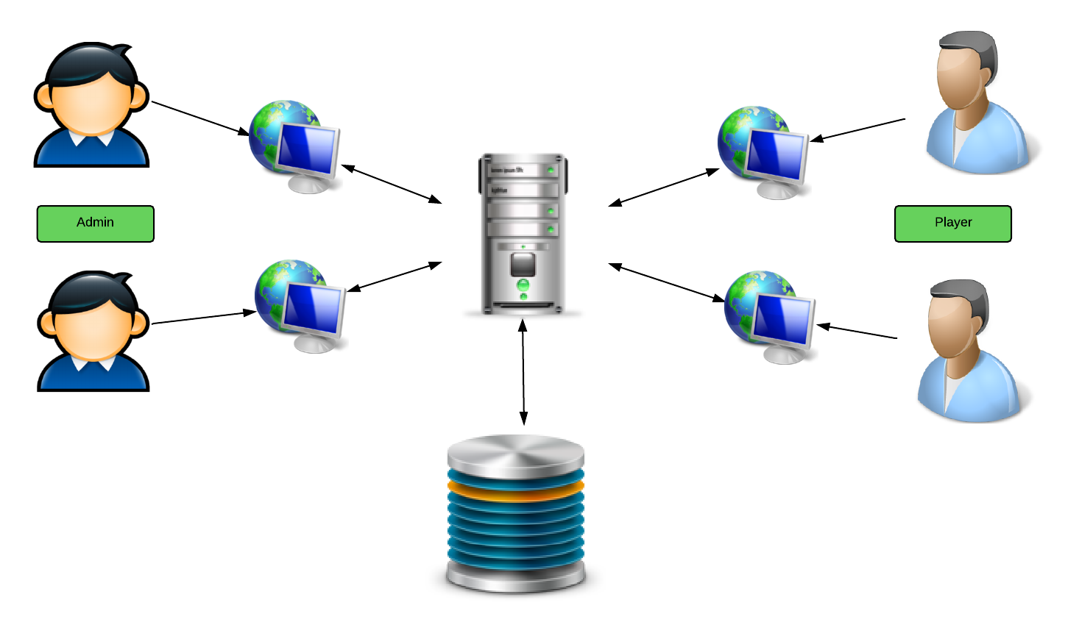
IV- Software Design Description
Overall System architecture

Slide 22
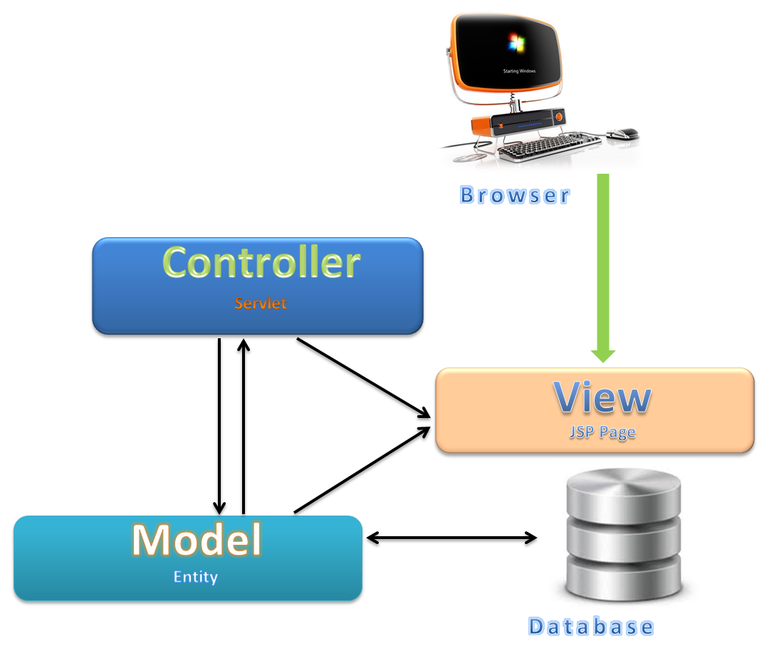
IV- Software Design Description(cont.)
MVC Architecture

Slide 23
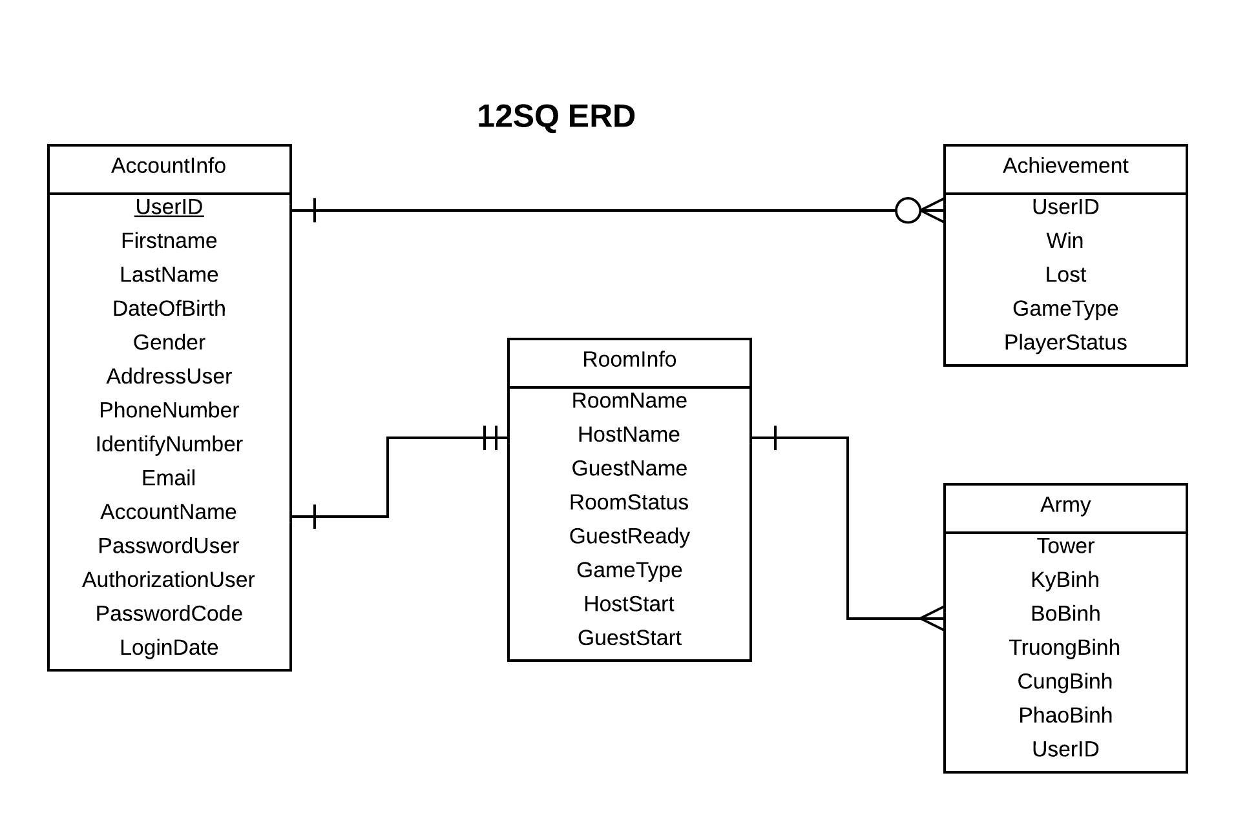
IV- Software Design Description(cont.)
Database Design

Slide 24
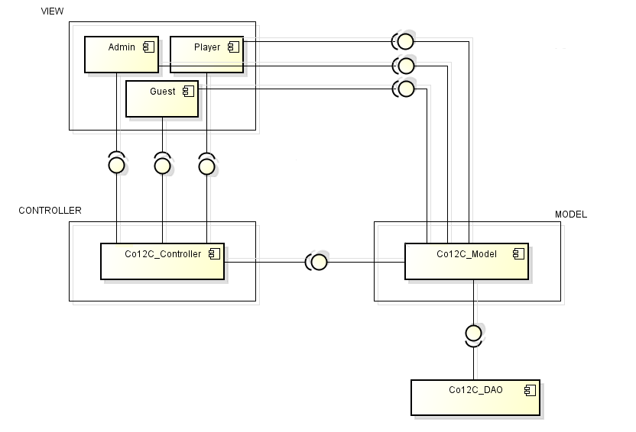
IV- Software Design Description(cont.)
Component Diagram

Slide 25
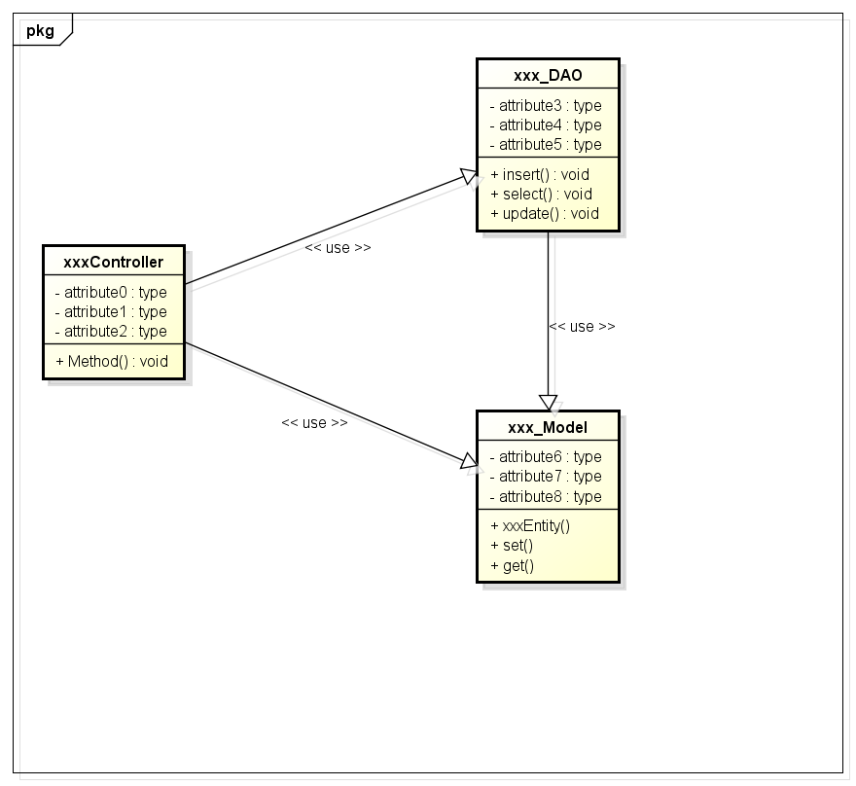
IV- Software Design Description(cont.)
First cut of class diagram

Slide 26
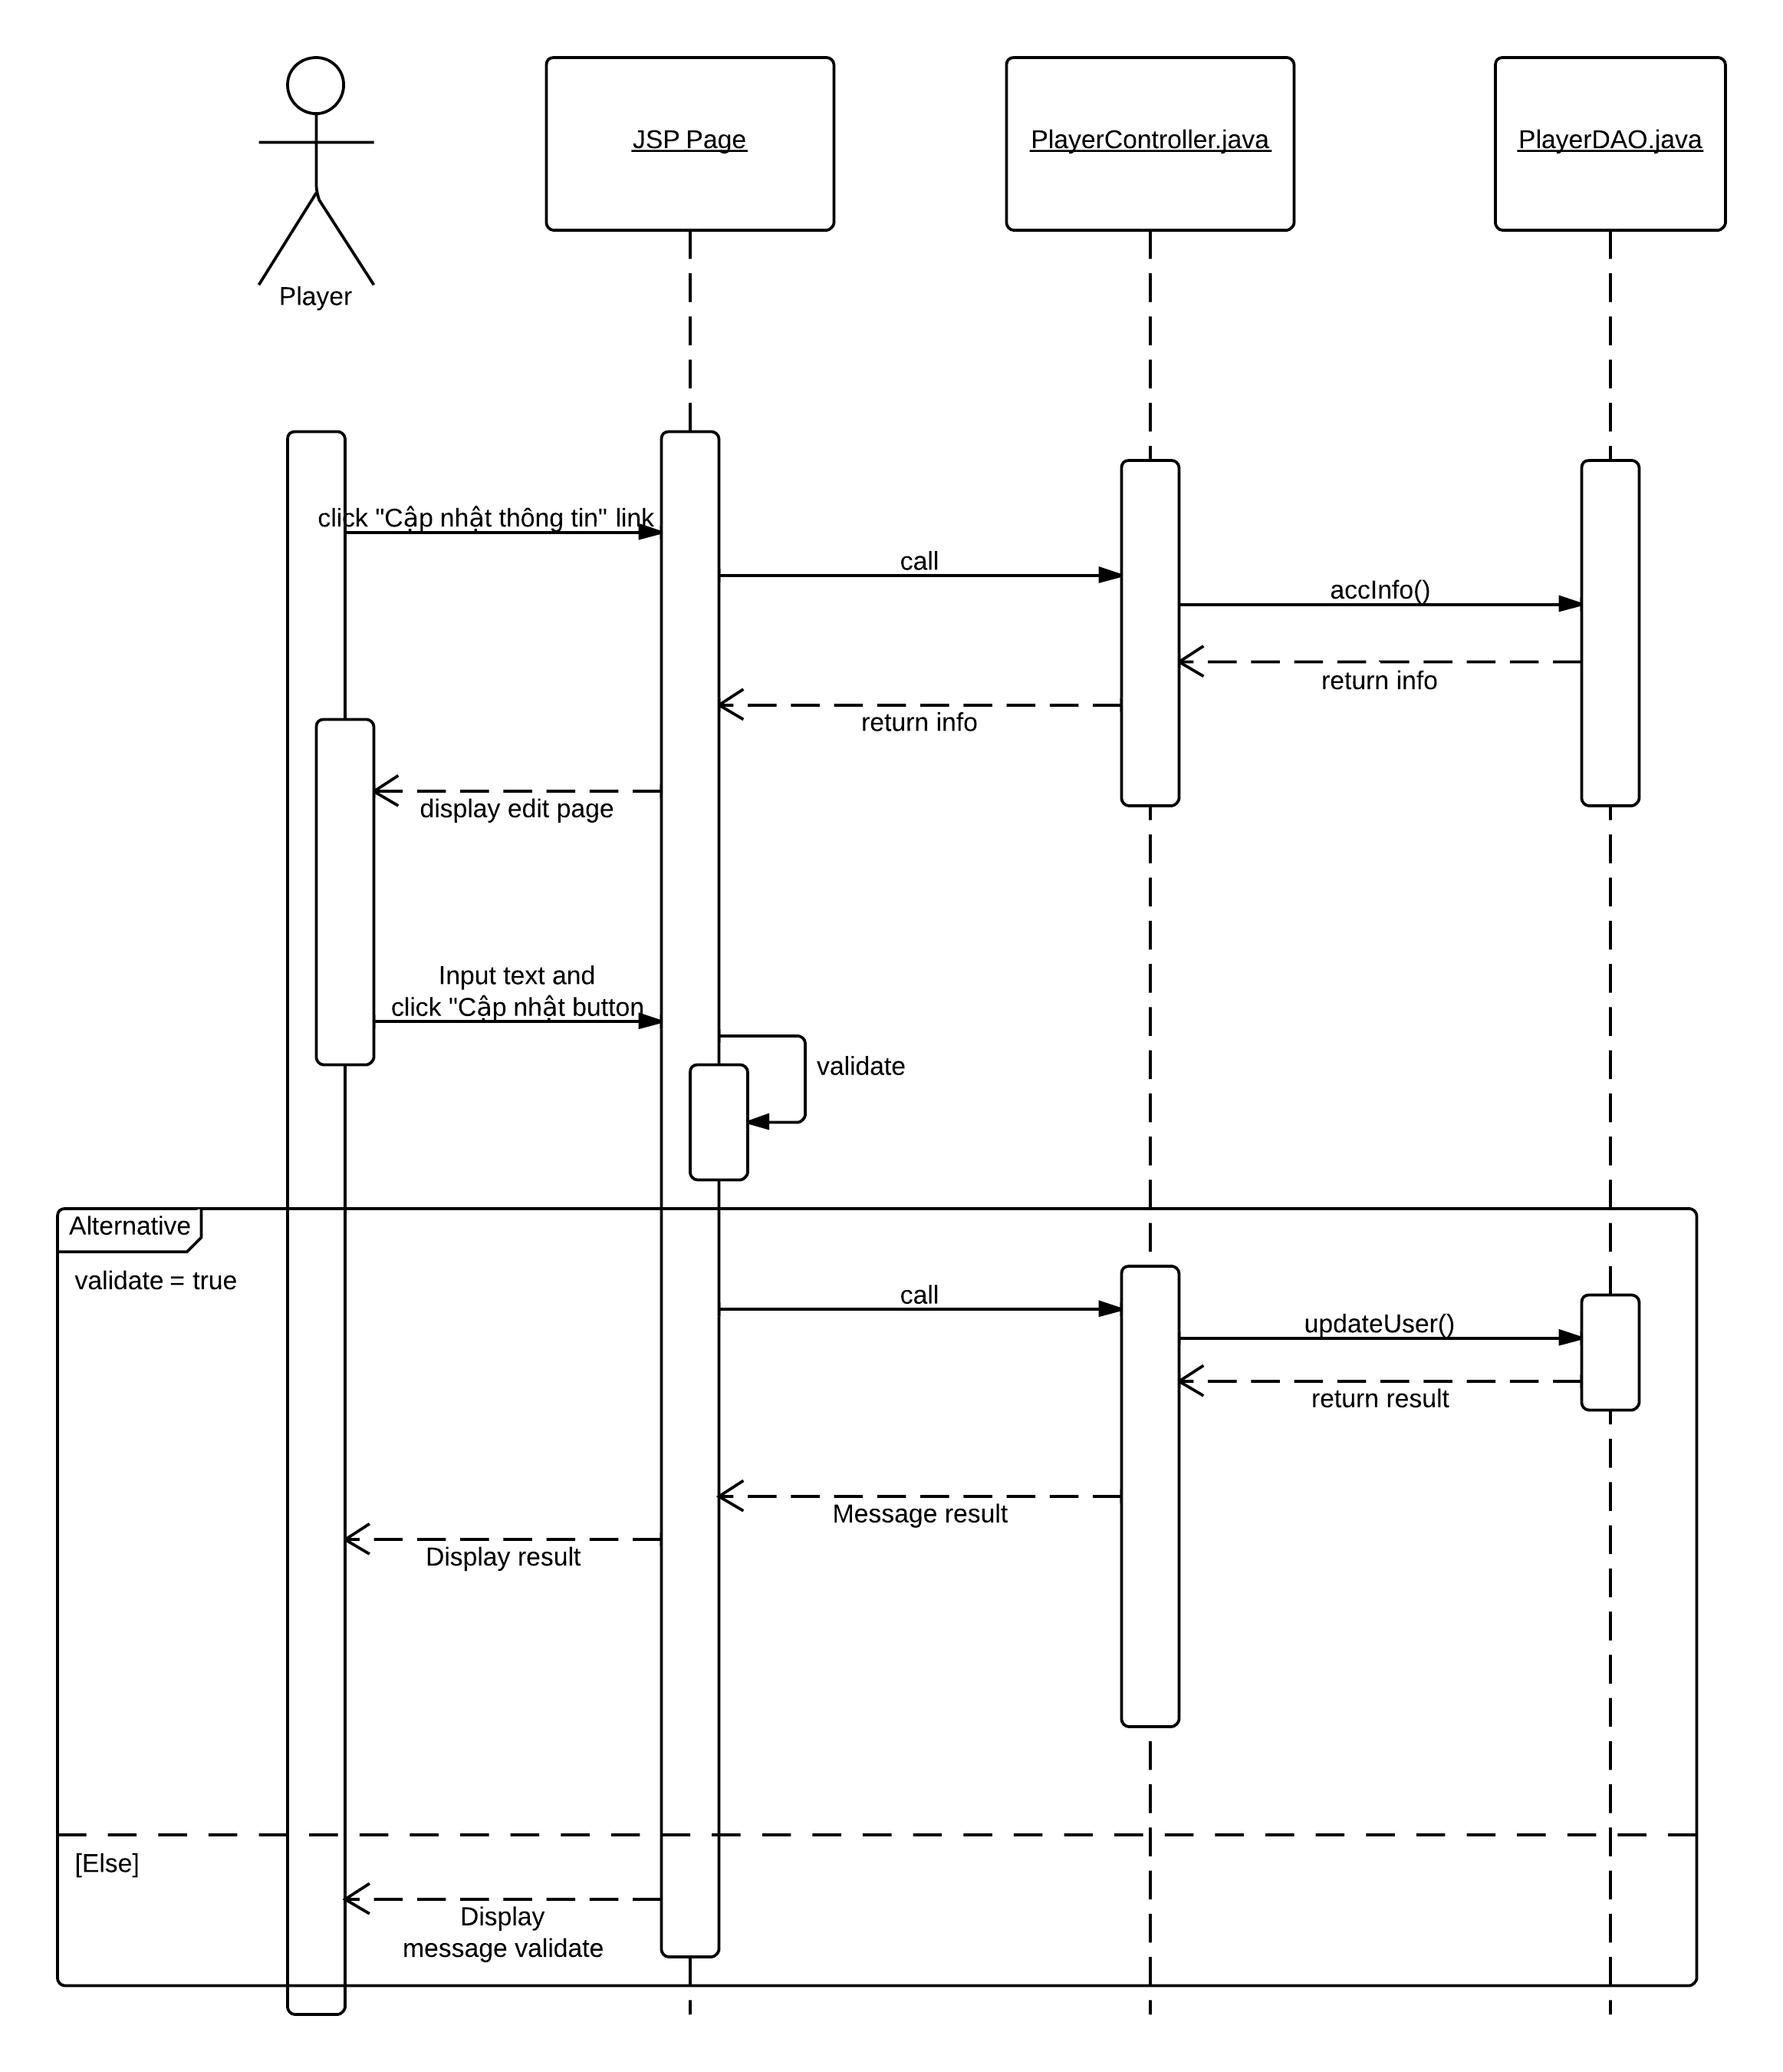
IV- Software Design Description(cont.)
Sequence diagram

Slide 27
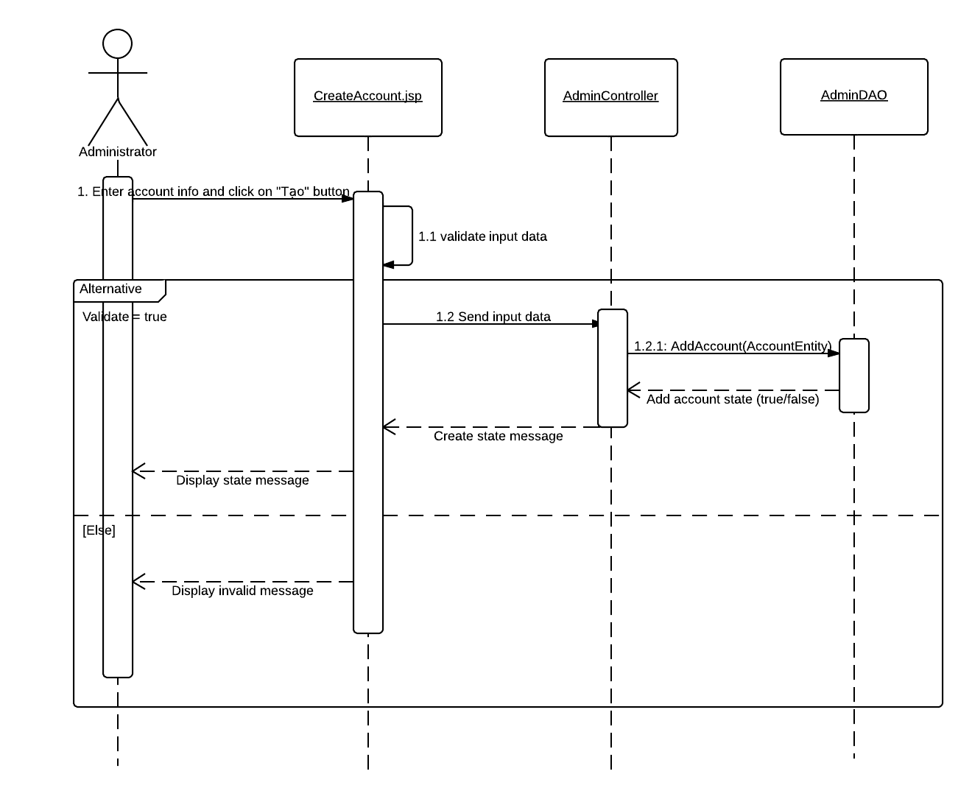
IV- Software Design Description(cont.)

Slide 28
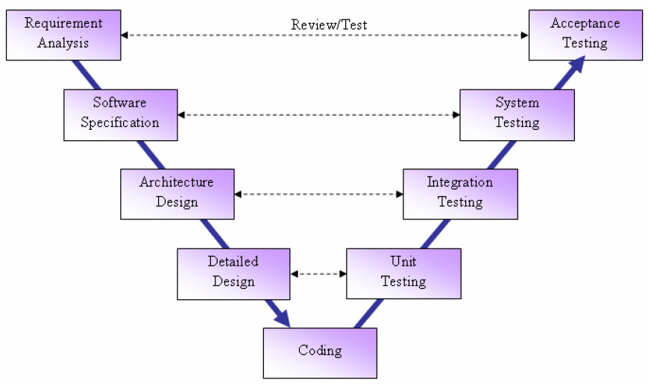
Testing
1. Introduction
Test Model

Slide 29
V- Testing (cont.)
1. Introduction (cont.)
Test Approach
Unit testing
Integration testing
System testing
Acceptance testing

Slide 30
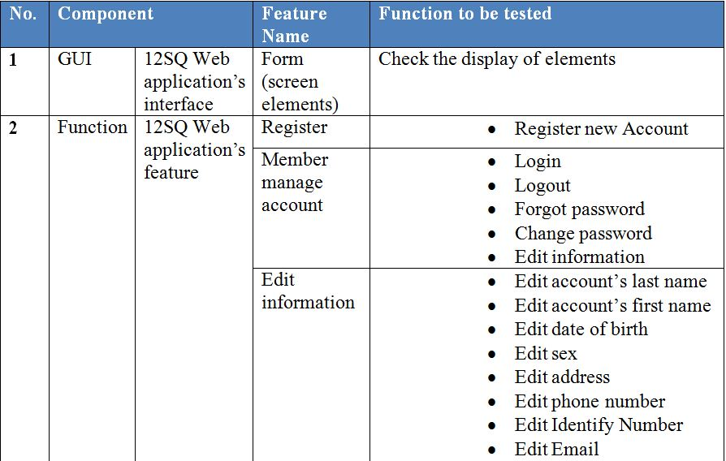
V- Testing (cont.)
2. Test Plan
Features to be tested

Slide 31
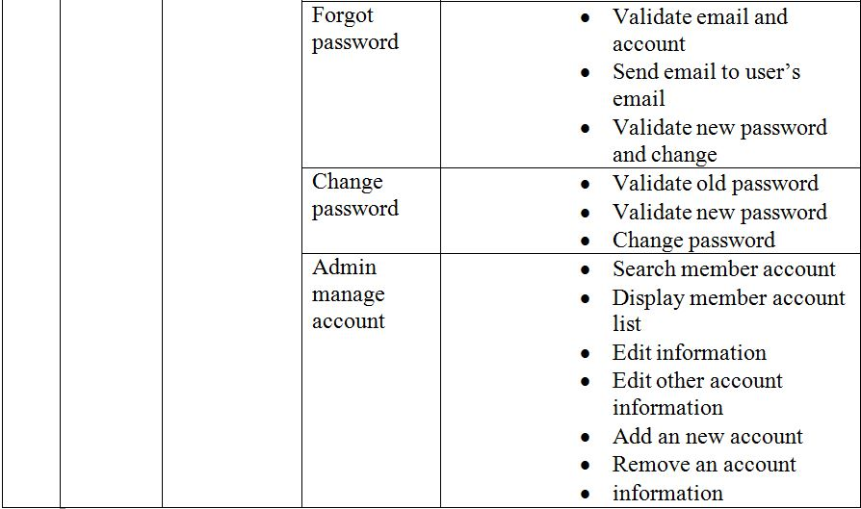
V- Testing (cont.)
2. Test Plan(cont.)
Features to be tested

Slide 32
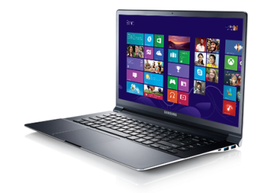
V- Testing (cont.)
2. Test Plan (cont.)
Test Environment
PC1:
- Windows 8 – 64bit
Inter® Core™ i7 - 3630QM CPU @ 2.40 GHz
Installed Memory (RAM) : 8.00 GB
PC2:
Windows 8 – 64bit
Inter® Core™ 2Duo–T6000 CPU @ 2.0 GHz
Installed Memory (RAM) : 4.00 GB
Browser:
Firefox 28.0
Google Chrome 34.0.1847.116

Slide 33
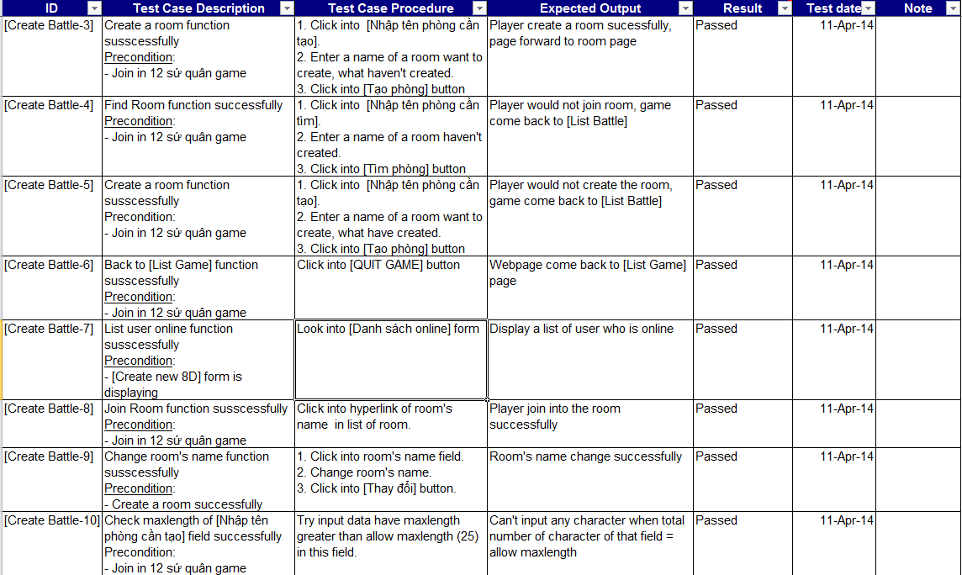
V- Testing (cont.)
3. Function Test
Create Battle test case

Slide 34
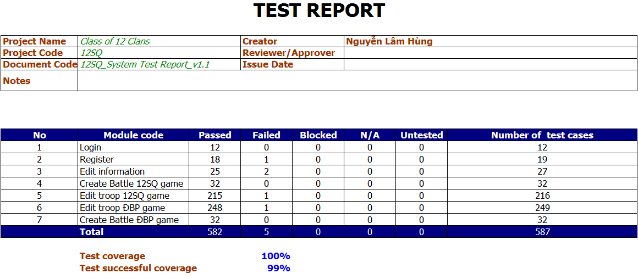
V- Testing (cont.)
3. Test Summary Report
Test Result

Slide 35
VI- Summary
Lesson Learned
Technique
Soft-skill
Design user’s interface
Software Requirement
work pressure
Management
Team work

Slide 36
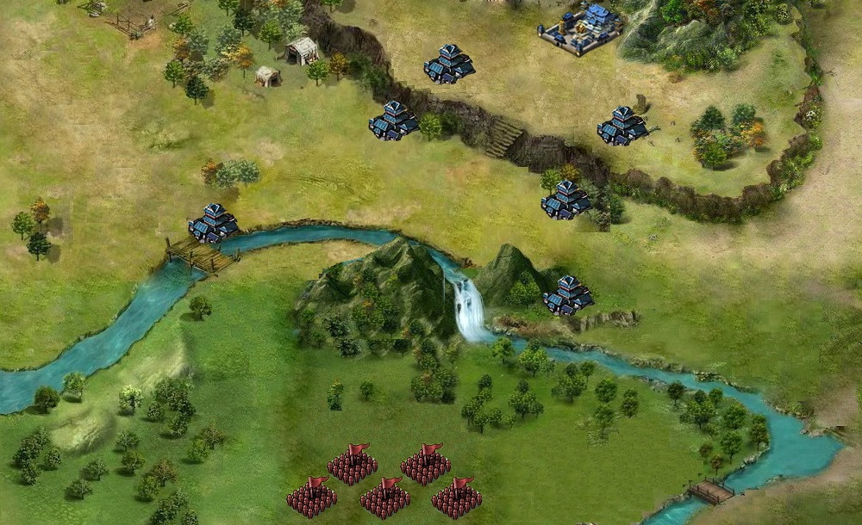
VII- Demo, Q&A

Slide 37
Thank You !

