Slide 1
CEMETERY INFORMATION MANAGEMENT SYSTEM
Supervisor: Mr.Trần Bình Dương
    Team Members:
      Phạm Văn Bình 01911
      Ngô Việt Anh 01749
      Đoàn Anh Tuấn 01720
      Chử Hùng Vương 01791
      Nguyễn Việt Anh 00895
Cemetery Information Management System
FPT University

Slide 2


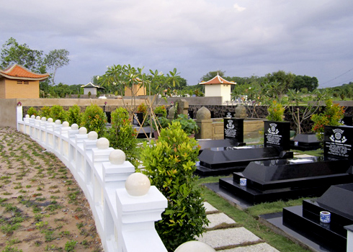

Contents
Introduction
Project Management Plan
Requirement Specifications
Design Description
System Implementation & Test
Lesson Learned
Demo and Q&A
Cemetery Information Management System
Notes:
Căn chỉnh lại

Slide 3
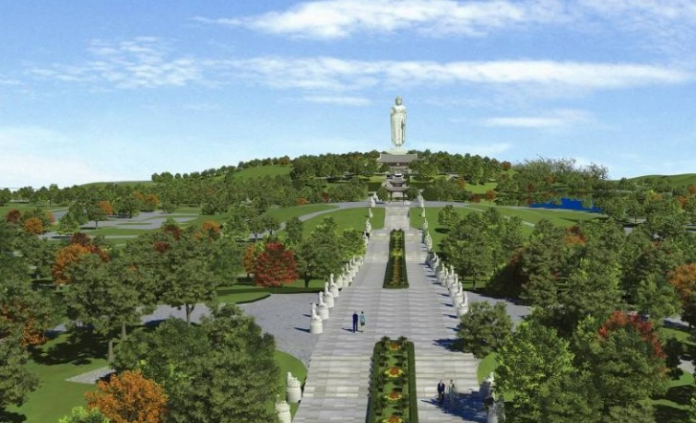

I - Introduction (cont.)
Background
  Cemetery
  Difficult to find information
Cemetery Information Management System

Slide 4

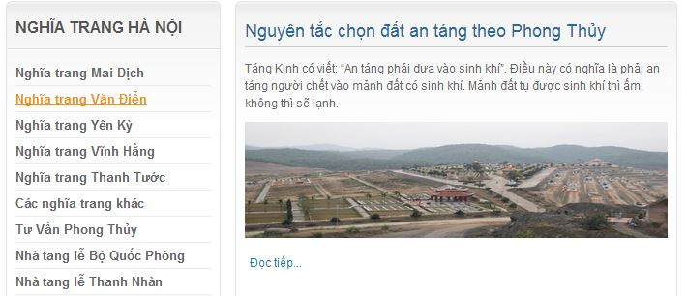
I - Introduction (cont.)
Background (cont.)
  Main causes:
    Almost cemetery site does not provide a full overview of the planning of the cemetery as a model to map the full interface.
Cemetery Information Management System
Notes:
-Hầu hết trang web nghĩa trang không cung cấp một cái nhìn tổng quan đầy đủ các quy hoạch nghĩa trang như một mô hình để lập bản đồ giao diện đầy đủ

Slide 5
I - Introduction (cont.)
    A major of customers who believe in spirituality, they will need more as the direction, location and number of grave.
    Some people want to buy before the graves for relatives like grandparents or father, their mother. Even buy a grave for themselves.
    Or distant relatives, they do not have facility for care grave on holidays, festival, or anniversary... but nowhere provides grave care services.
Cemetery Information Management System
Notes:
-Một số khách hàng tin vào tâm linh, họ sẽ cần nhiều hơn chỉ dẫn, vị trí và số lượng ngôi mộ.
-Một số người muốn mua trước các ngôi mộ cho người thân như ông bà hoặc cha, mẹ của họ. Thậm chí mua một ngôi mộ cho mình.
-Hoặc người thân ở xa, họ không có điều kiện dễ dàng để chăm sóc mộ vào các ngày lễ, lễ hội, hoặc ngày giỗ ,kỵ ... nhưng không nơi nào cung cấp dịch vụ chăm sóc mộ.

Slide 6
I - Introduction (cont.)
Background (cont.)
  Solution:
    Project online management cemetery will overcome all the disadvantages mentioned above.
    Helping to build one the easiest way to manage for the manager, while creating the most detailed information page for the burial service.
Cemetery Information Management System
Notes:
-Nghĩa trang trực tuyến quản lý dự án sẽ vượt qua tất cả các khó khăn nêu trên
- Giúp xây dựng một trong những cách dễ nhất để quản lý cho người quản lý, khi tạo ra các trang thông tin chi tiết nhất cho các dịch vụ mai táng.

Slide 7

I - Introduction (cont.)
Solution
  An web application that help manager easily manage Cemetery
Help customer order and manage service easily.
Cemetery Information Management System
Notes:
Xây dựng ứng dụng web, giúp việc quản lý nghĩa trang trở nên dễ dàng cũng như trong việc tìm kiếm thông tin

Slide 8

I - Introduction (cont.)
Why web application?
Cemetery Information Management System

Slide 9


I - Introduction (cont.)
Most of people use internet for find information everytime and everywhere
Technique:
  Java language.
Cemetery Information Management System
Notes:
Lí do xây dựng ứng dụng web là vì ngày nay thì internet phát triển, mọi người dân đều quen với việc lướt web tìm kiếm thông tin
- lựa chọn công nghệ Java vì các thành viên trong nhóm làm việc với nó trong thời gian dài → mất ít thời gian trong việc tìm hiểu về công nghệ, đây cũng là công cụ hỗ trợ nhiều trong việc xây dựng website

Slide 10
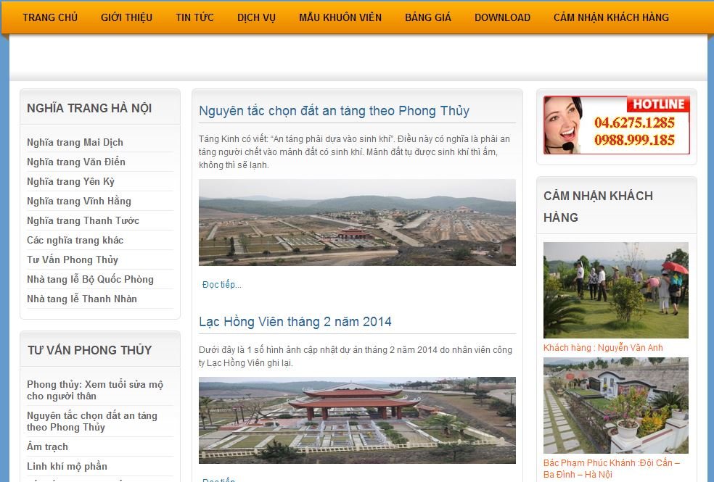
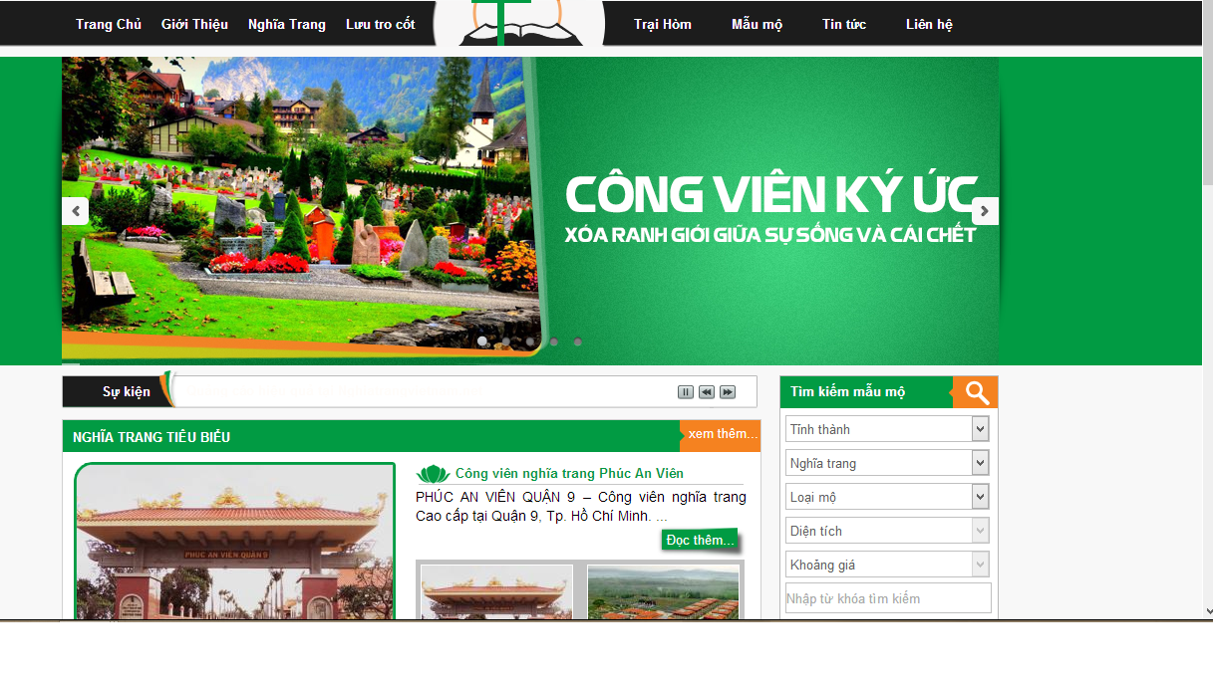
I - Introduction (cont.)
Existing systems
Nghiatranghanoi.vn
Nghiatrangvietnam.net
Cemetery Information Management System
Notes:
Một số website nghĩa trang

Slide 11
II – Project Management Plan
Cemetery Information Management System

Slide 12
Development Environment
Hardware
Intel Core 2 Dual 2.0 GHz
2 Gb of RAM
250Gb of hard disk
Intel Core 2 Dual 2.0 GHz
4 Gb of RAM
250Gb of hard disk
Cemetery Information Management System

Slide 13
Development Environment
Software
Category | Name | Version
Operating System | Microsoft Windows 8 | Pro
Web Server | Windows Server | 2008
Framework | Struts | 2
IDE | Eclipse | Indigo
Source control | TortoiseSVN | 1.8.5
UML Tool | Astah | 6.8.0
 | Microsoft Visio 2010 | Pro
Cemetery Information Management System

Slide 14
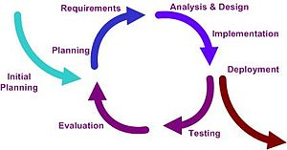
Process Model
Follow interative process model
Cemetery Information Management System
Notes:
-Nhóm lựa chọn mô hình phát triển là mô hình interative vì các thành viên trong nhóm chưa có kinh nghiệm làm việc.
-Thêm nữa nhóm làm đồ án này theo hướng là cho nghiatranghanoi , bản thân họ là cũng chưa nắm rõ được yêu cầu chức năng là gì, trong quá trình làm mới phát sinh thêm. Nên mô hình như vậy là hợp lí nhất
-Model First

Slide 15
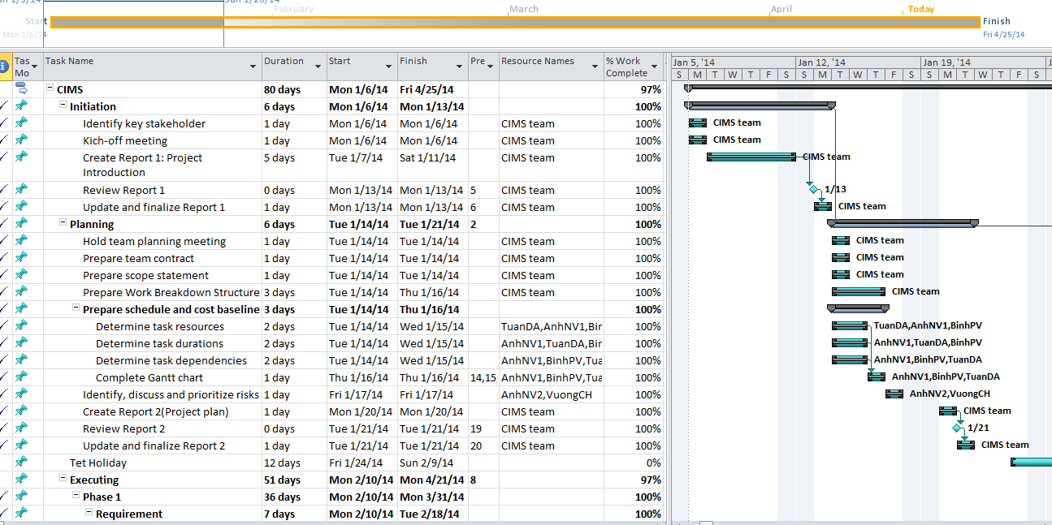
Task sheet
Cemetery Information Management System

Slide 16
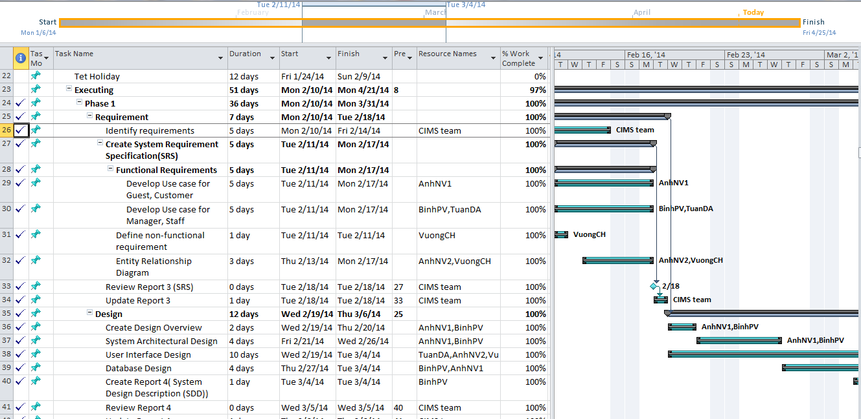
Task sheet(Cont.)
Cemetery Information Management System

Slide 17
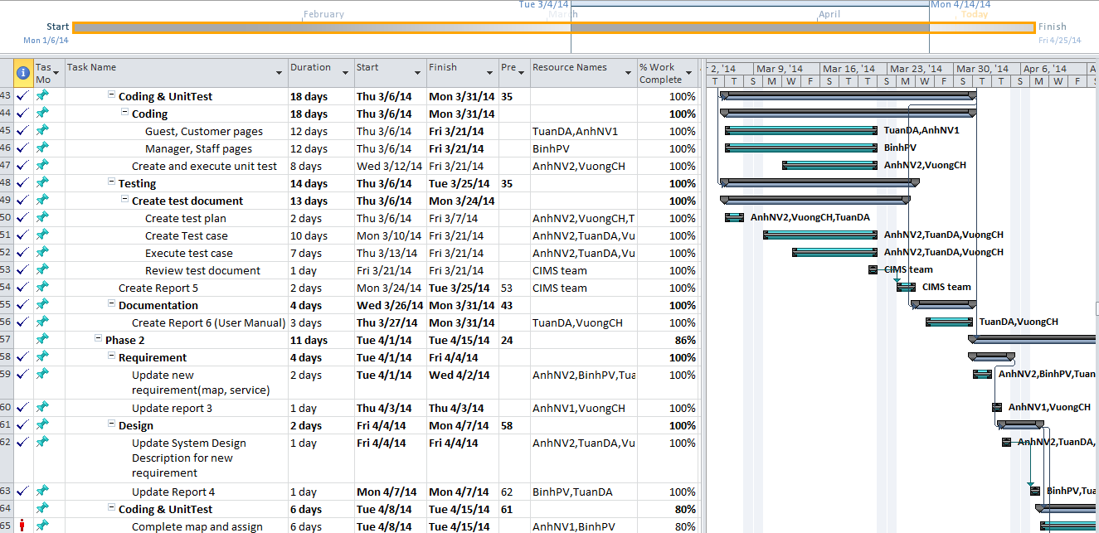
Task sheet(Cont.)
Cemetery Information Management System

Slide 18
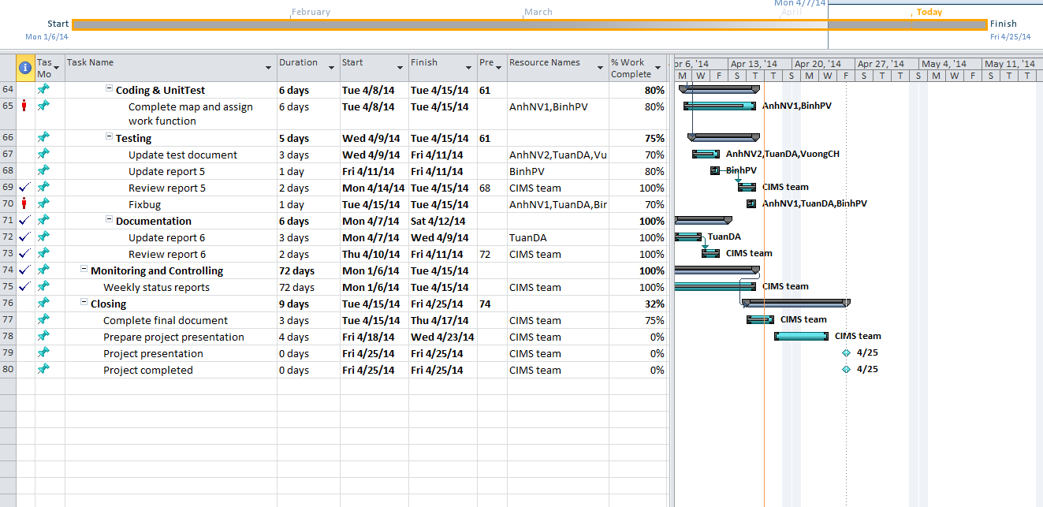
Task sheet(Cont.)
Cemetery Information Management System

Slide 19




Project Communication
Works 7h per day, 5 days per week in school.
Works at home. And sometimes in the weekend
Meeting with project’s supervisor every week
Cemetery Information Management System

Slide 20
Project Risk Management
No. | Risk Description | Probability | Effect | Status | Solutions
1 | The members do not have much experient to research the important informations and apply it to the project situations. | High | Tolerable | Occurred | Plan schedule detailed the works of team and member's responsibilities. Discuss and connected With each other in usually. Find more supports from supervisor or other sources - Summarize, training for members about what knowledges are used
2 | New technology: Google API, encoding-decoding algorithm | High | Serious | Potential | - Prepare knowledge for new technologies by materials and internet. Request support from friends or someone that is expert of that new technology
3 | Design difficulty: unclear how to design, or interfaces not well defined or controlled | Moderate | Serious | Potential | - All members in team need to discuss and decide one solution for design. Finding support from experience people

Slide 21
III - Requirement Specifications
The web applications designed for:
Guest
Customer
Staff
Manager
Cemetery Information Management System

Slide 22


III - Requirement Specifications
GUEST
View
Registration
Cemetery Information Management System

Slide 23
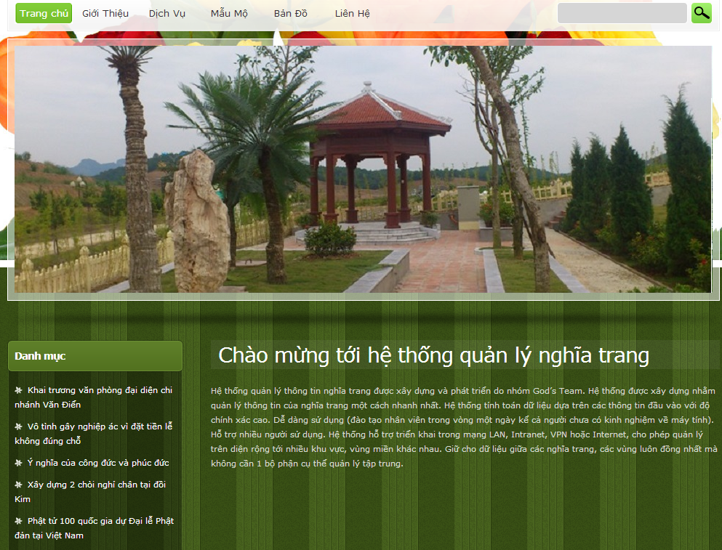
III - Requirement Specifications
Cemetery Information Management System

Slide 24
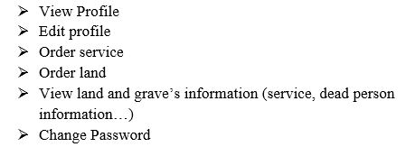
III - Requirement Specifications
CUSTOMER
Cemetery Information Management System

Slide 25
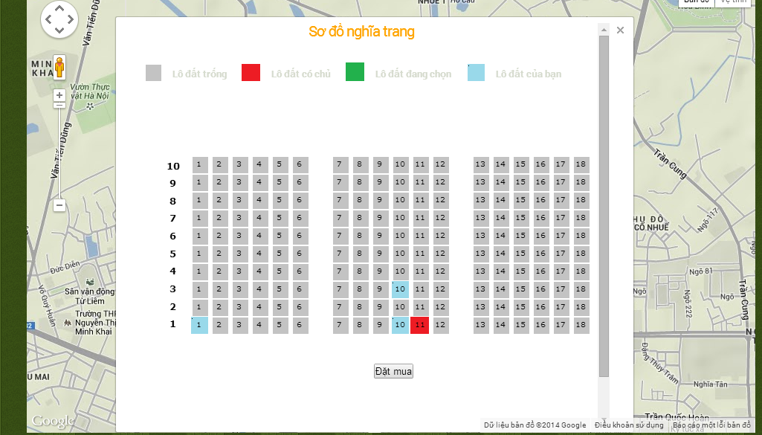
III - Requirement Specifications
Cemetery Information Management System

Slide 26
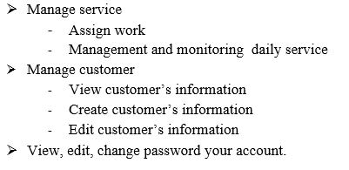
III - Requirement Specifications
STAFF
Cemetery Information Management System

Slide 27
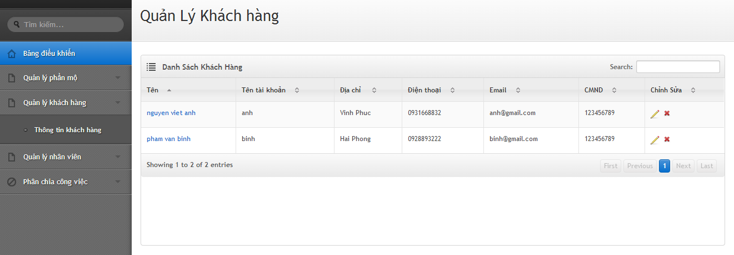
III - Requirement Specifications
Cemetery Information Management System

Slide 28
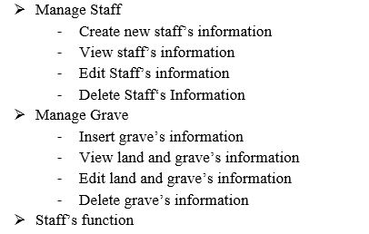
III - Requirement Specifications
Manager
Cemetery Information Management System

Slide 29
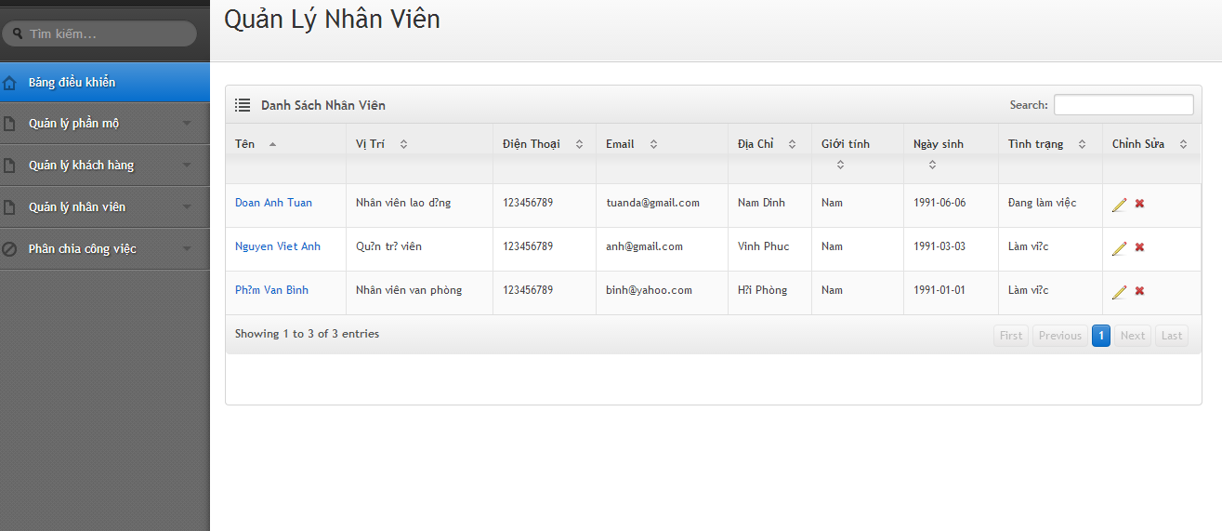
III - Requirement Specifications
Cemetery Information Management System

Slide 30
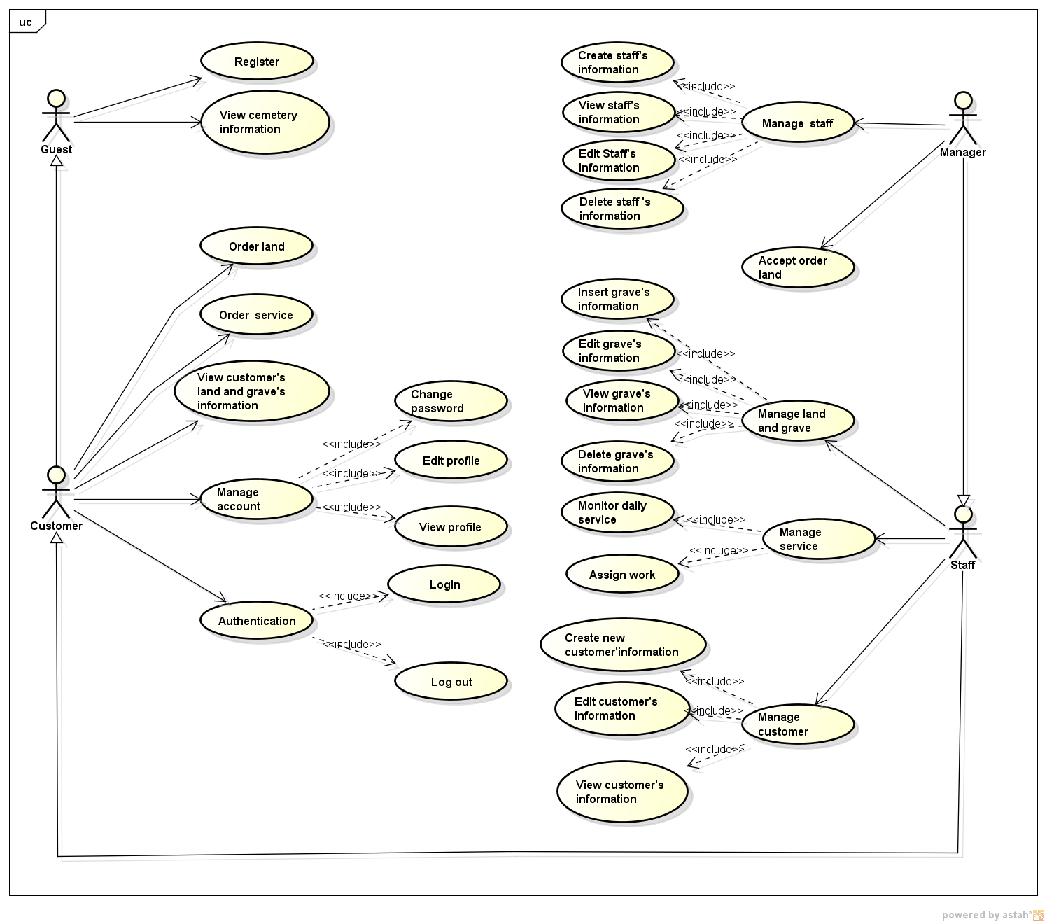

Slide 31
Non-functional Requirements
Availability
Reliability
Maintainability
Non-functional
Performance
Security
Cemetery Information Management System

Slide 32
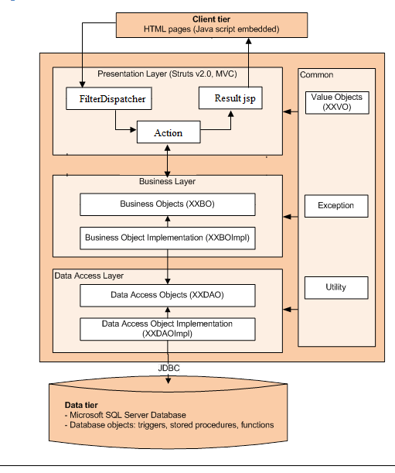
IV - Software Design Description
System architecture design
MVC architecture
Cemetery Information Management System

Slide 33
IV - Software Design Description (cont.)
System architecture design
  Presentation Layer:
    This layer controls the display to the end user.
  Business Layer:
    This layer manages the business processing rules and logic. It consists of a set of Business Objects to support business logic implementation of the system.
  Data Access Layer:
    This layer manages access to persistent storage via JDBC. It manages reading, writing, updating, and deleting stored data.
Cemetery Information Management System

Slide 34
IV - Software Design Description
(cont.)
System architecture design
  Common classes:
    Contain lightweight structures for related business information.
Cemetery Information Management System

Slide 35
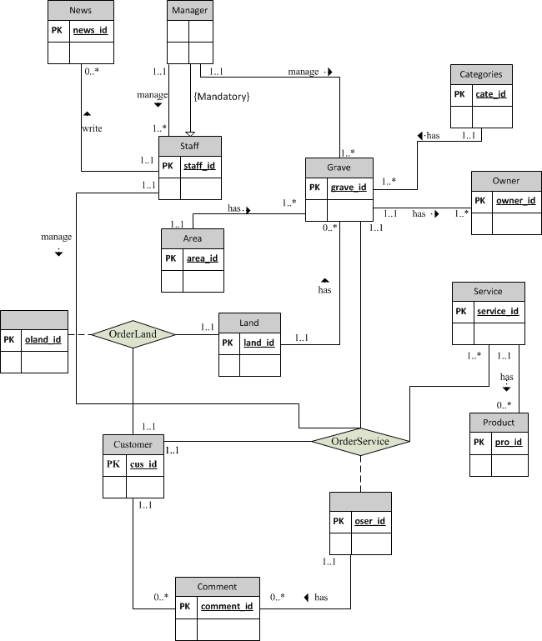
IV - Software Design Description (cont.)
Entity
Relationship
Diagram
Cemetery Information Management System

Slide 36
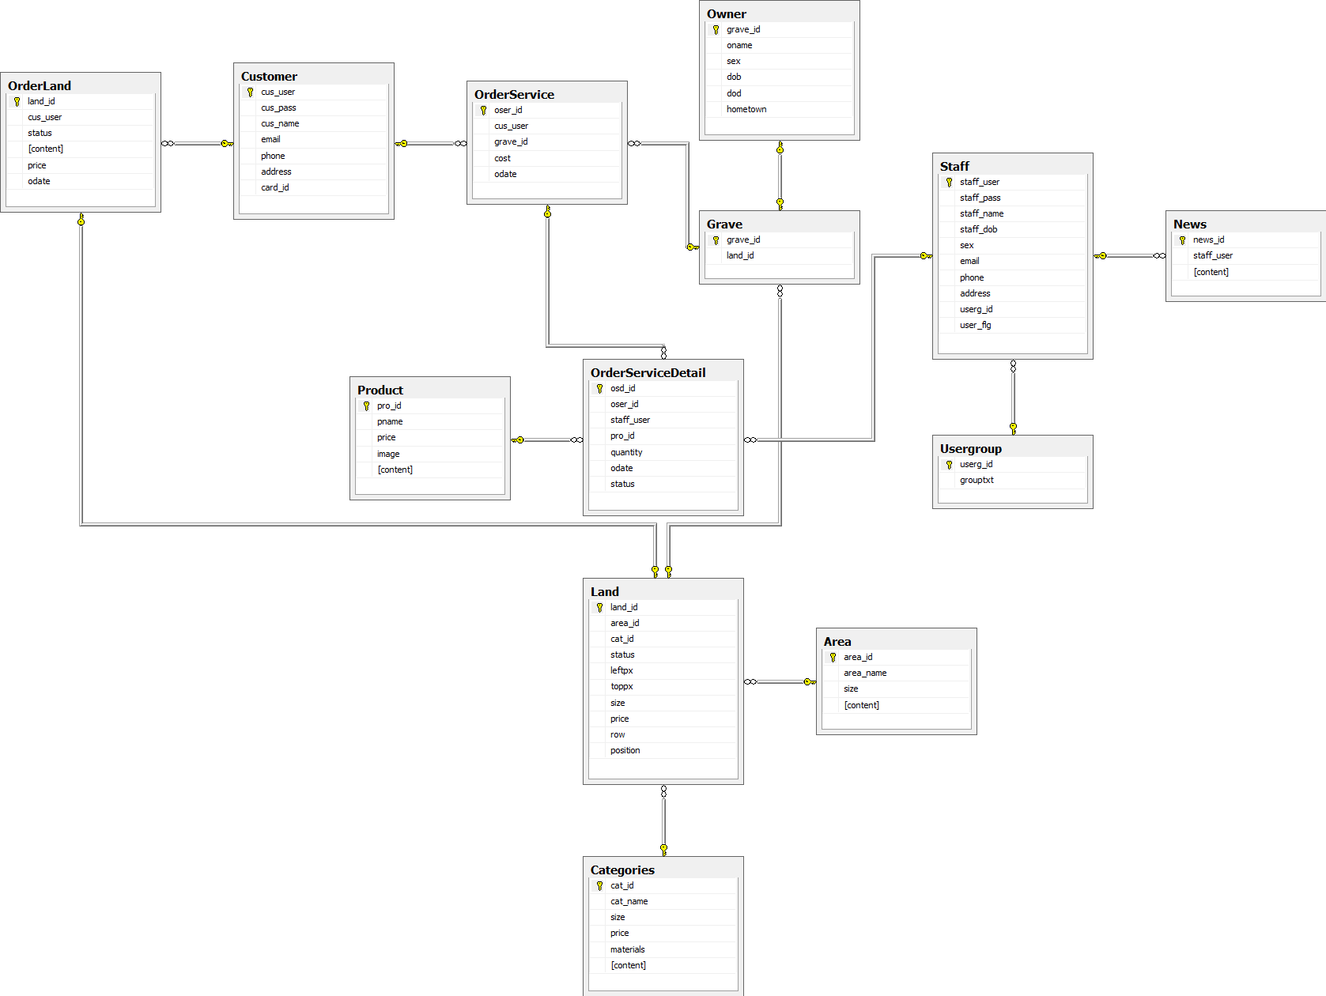
IV - Software Design Description
(cont.)
Database
design
Cemetery Information Management System

Slide 37
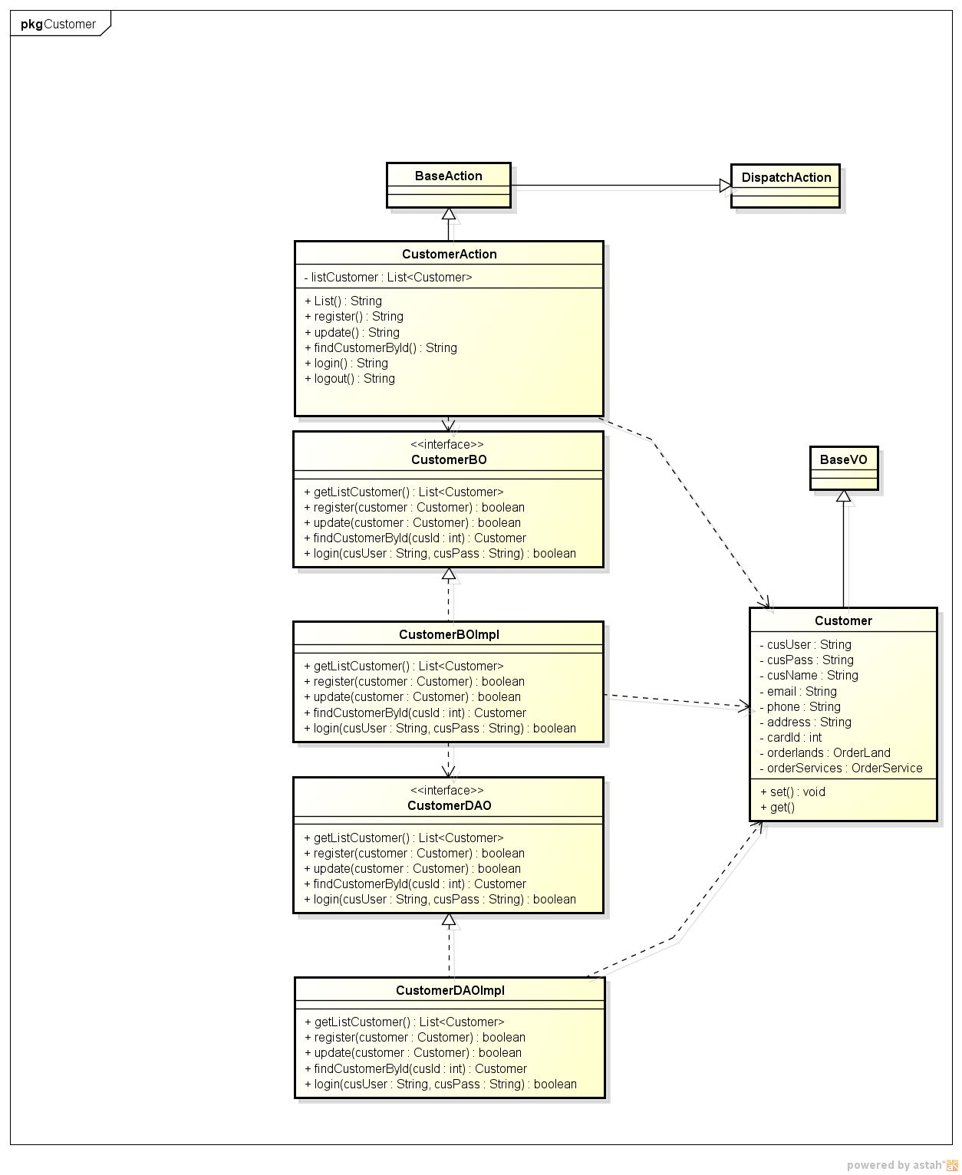
IV - Software Design Description (cont.)
Class diagram
for customer
module.
Cemetery Information Management System

Slide 38
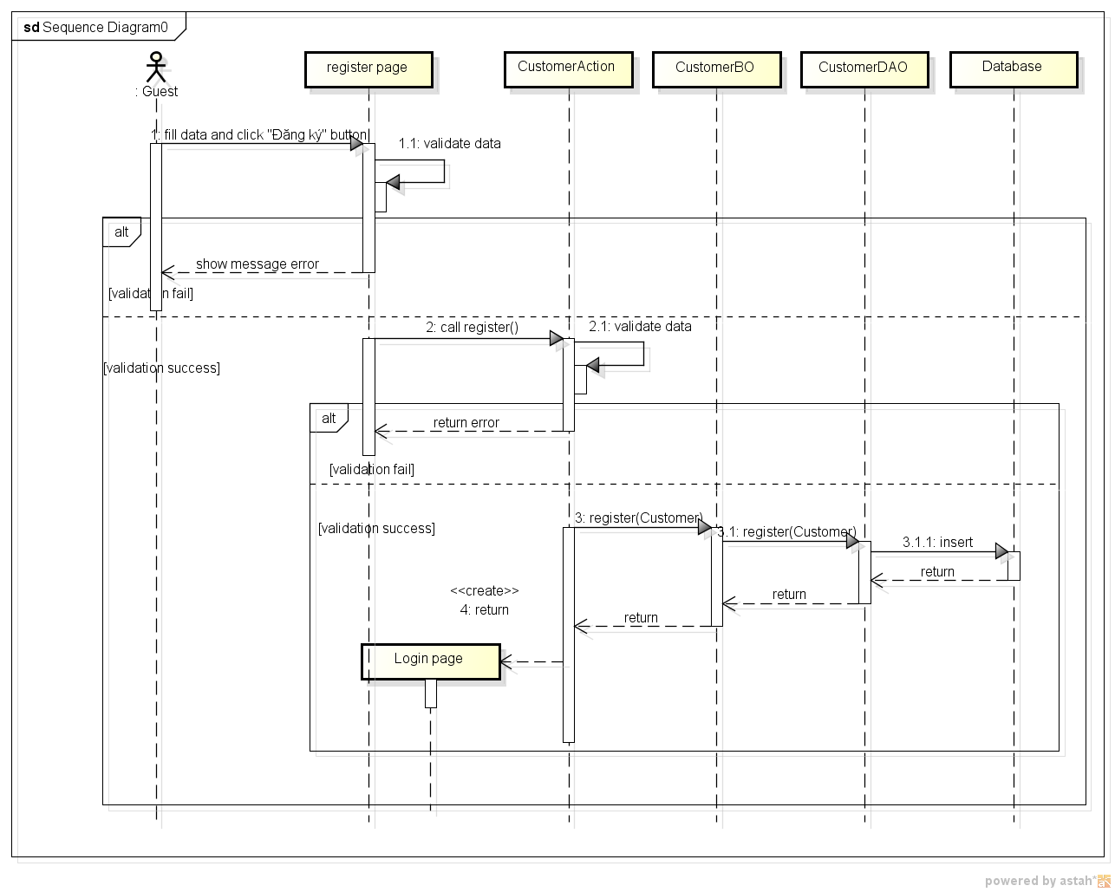
IV - Software Design Description
(cont.)
Sequence
Diagram for
register new
customer.
Cemetery Information Management System

Slide 39






IV - Software Design Description
(cont.)
Technology used in project:
Cemetery Information Management System

Slide 40
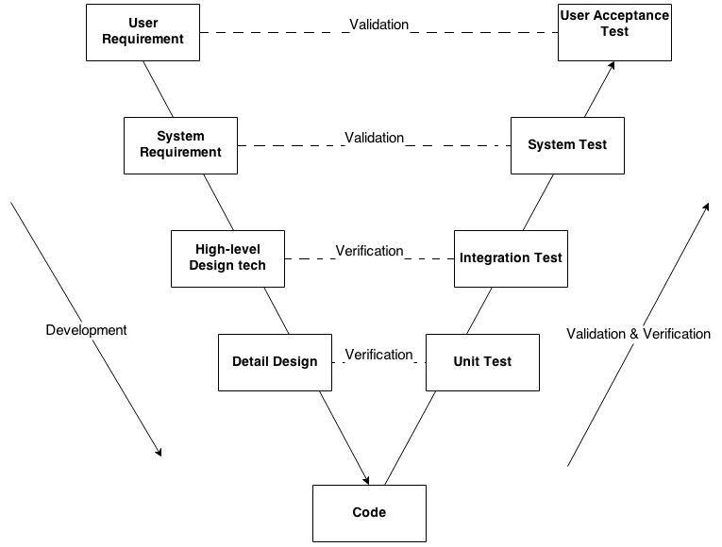
V - System Implementation & Test
V-Model
Cemetery Information Management System

Slide 41


V - System Implementation & Test (cont.)
Testing Environment
Web application
  OS: Windows 8
  Browser: Chrome 33.0.1750.159
Cemetery Information Management System
Notes:
Xem lại cách trình bày, chưa ổn
Nêu rõ các môi trường Windows XP, 7, 8 và các trình duyệt Web đã dùng để test thử

Slide 42
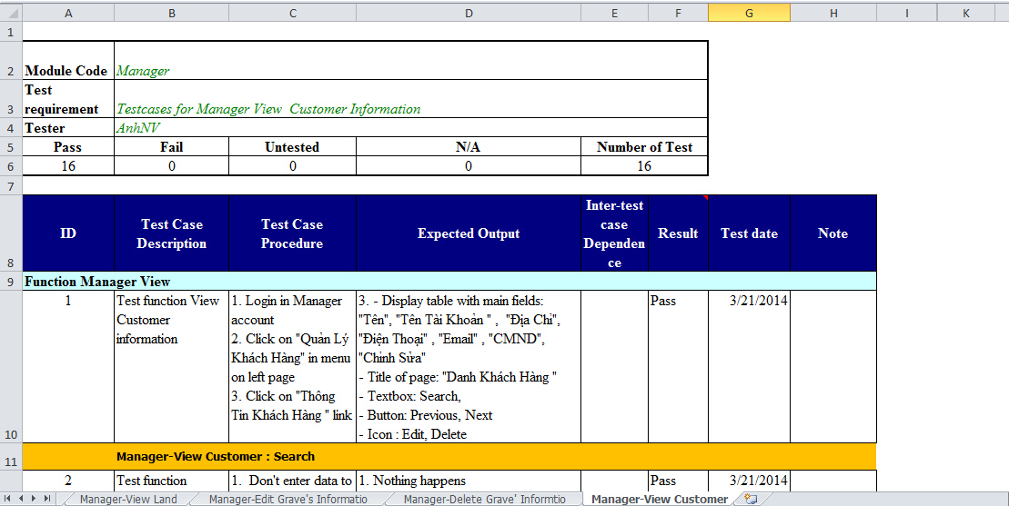
V - System Implementation & Test (cont.)
Test case
Cemetery Information Management System

Slide 43
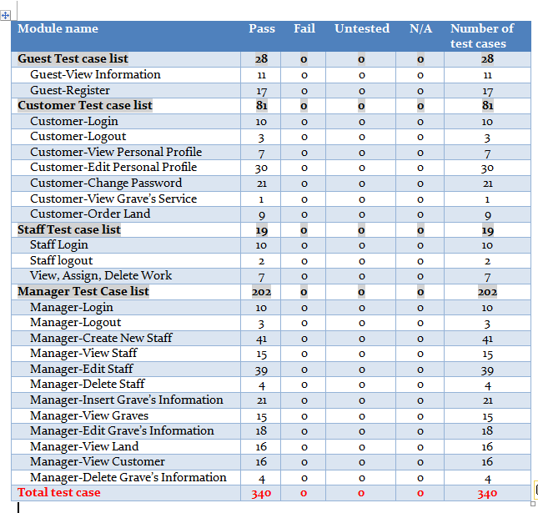
V - System Implementation & Test (cont.)
Cemetery Information Management System

Slide 44



VI - Lesson Learned
Communication
  Team work skill
  Resolve conflict skill
Management
  Organization
  Make plan
Technical
  Java Strust2
  SQL server
  Jquery, CSS, javascript
Cemetery Information Management System

Slide 45
VIII - Demo and Q&A
Cemetery Information Management System

Slide 46
Thank You!
FPT University
Capstone Project

