Slide 1
CAPSTONE PROJECT
MEKART- Online Flea MARKET
TanNN, HuyPV, HaDV, NhatDH, TuLA

Slide 2
I, Project Introduction

Slide 3
REason
Difficult to buy/sell old item in internet
High demand

Slide 4
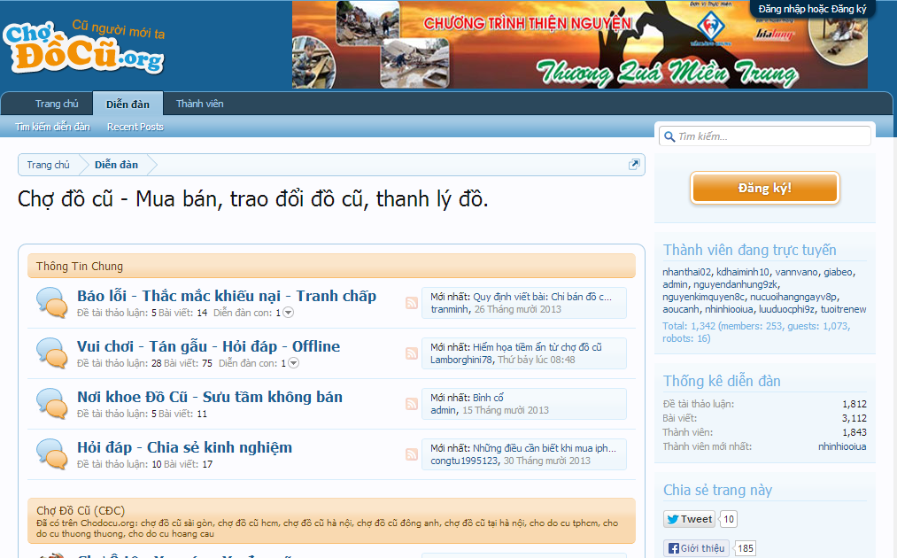
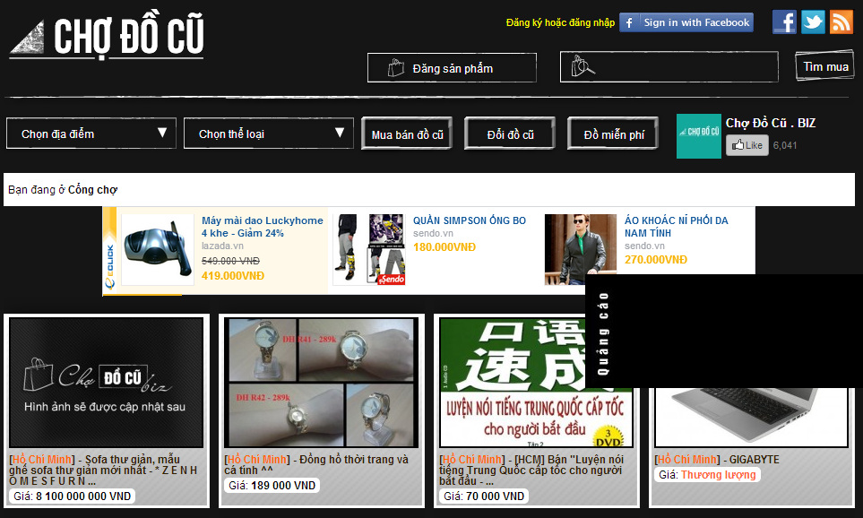
DIRECT Competitor
Notes:
Custom animation effects: widescreen picture fades
(Basic)
To reproduce the picture effects on this slide, do the following:
On the Home tab, in the Slides group, click Layout, and then click Blank.
On the Home tab, in the Drawing group, click Shapes, and then under Rectangles click Rectangle (first option from the left). On the slide, drag to draw a rectangle.
Select the rectangle. Under Drawing Tools, on the Format tab, in the Size group, do the following:
In the Shape Height box, enter 4.55”.
In the Shape Width box, enter 8”.
On the Home tab, in the bottom right corner of the Drawing group, click the Format Shape dialog box launcher. In the Format Shape dialog box, in the left pane, click Fill. In the Fill pane, click Solid fill, click the button next to Color, and then under Theme Colors click Black, Text 1 (first row, second option from the left).
Also in the Format Shape dialog box, in the left pane, click Line Color. In the Line Color pane, click Solid line, click the button next to Color, and then under Theme Colors click Black, Text 1, Lighter 35% (third row, second option from the left).
Also in the Format Shape dialog box, in the left pane, click Line Style, and then do the following in the Line Style pane:
In the Width box, enter 20 pt.
In the Cap type list, select Flat.
In the Join type list, select Miter.
Also in the Format Shape dialog box, in the left pane, click Shadow. In the Shadow pane, click the button next to Presets, and then under Perspective click Perspective Diagonal Upper Right (first row, second option from the left).
Also in the Format Shape dialog box, in the left pane, click 3-D Format, and then do the following in the 3-D Format pane:
Under Bevel, click the button next to Top, and then under Bevel click Hard Edge (third row, third option from the left). Next to Top, in the Width box, enter 27 pt, and in the Height box, enter 5.5 pt.
Under Depth, click the button next to Color, and then under Theme Colors click Black, Text 1, Lighter 35% (third row, second option from the left). In the Depth box, enter 40 pt.
Also in the Format Shape dialog box, in the left pane, click 3-D Rotation. In the 3-D Rotation pane, click the button next to Presets, under Perspective click Perspective Contrasting Left (second row, fourth option from the left), and then do the following:
In the X box, enter 20⁰.
In the Y box, enter 9.3⁰.
In the Z box, enter 358⁰.
In the Perspective box, enter 45⁰.
On the slide, drag the rectangle slightly to the left to position it in the middle of the slide.
On the Insert tab, in the Illustrations group, click Picture. In the Insert Picture dialog box, select a picture, and then click Insert.
On the slide, select the picture. Under Picture Tools, on the Format tab, in the bottom right corner of the Size group, click the Size and Position dialog box launcher. In the Size and Position dialog box, on the Size tab, resize or crop the picture as needed so that under Size and rotate, the Height box is set to 4.11” and the Width box is set to 7.3”. Resize the picture under Size and rotate by entering values into the Height and Width boxes. Crop the picture under Crop from by entering values into the Left, Right, Top, and Bottom boxes.
Under Drawing Tools, on the Format tab, in the Picture Styles group, click the arrow next to Picture Border, and then do the following:
Under Theme Colors click Black, Text 1 (first row, second option from the left).
Point to Weight, and then click 3 pt.
Under Picture Tools, on the Format tab, in the bottom right corner of the Picture Styles group, click the Format Shape dialog box launcher. In the Format Picture dialog box, in the left pane, click 3-D Rotation. In the 3-D Rotation pane, click the button next to Presets, under Perspective click Perspective Contrasting Left (second row, fourth option from the left), and then do the following:
In the X box, enter 20⁰.
In the Y box, enter 9.3⁰.
In the Z box, enter 358⁰.
In the Perspective box, enter 45⁰.
Select the picture. On the Home tab, in the Clipboard group, click the arrow under Paste, and then click Duplicate. Repeat this process one more time for a total of three pictures.
Select the second picture. Under Picture Tools, on the Format tab, in the Adjust group, click Change Picture. In the Insert Picture dialog box, select a picture, and then click Insert.
On the slide, select the second picture. Under Picture Tools, on the Format tab, in the bottom right corner of the Size group, click the Size and Position dialog box launcher. In the Size and Position dialog box, on the Size tab, resize or crop the picture as needed so that under Size and rotate, the Height box is set to 4.11” and the Width box is set to 7.3”. Resize the picture under Size and rotate by entering values into the Height and Width boxes. Crop the picture under Crop from by entering values into the Left, Right, Top, and Bottom boxes.
Select the third picture. Under Picture Tools, on the Format tab, in the Adjust group, click Change Picture. In the Insert Picture dialog box, select a picture, and then click Insert.
On the slide, select the third picture. Under Picture Tools, on the Format tab, in the bottom right corner of the Size group, click the Size and Position dialog box launcher. In the Size and Position dialog box, on the Size tab, resize or crop the picture as needed so that under Size and rotate, the Height box is set to 4.11” and the Width box is set to 7.3”. Resize the picture under Size and rotate by entering values into the Height and Width boxes. Crop the picture under Crop from by entering values into the Left, Right, Top, and Bottom boxes.
Press and hold CTRL, and then select all three pictures on the slide. On the Home tab, in the Drawing group, click Arrange, point to Align, and then do the following:
Click Align to Slide.
Click Align Middle.
Click Align Center.
Drag the group of three pictures into the middle of the rectangle (picture frame).
To reproduce the animation effects on this slide, do the following:
On the Home tab, in the Editing group, click Select, and then click Selection Pane.
On the Animations tab, in the Animations group, click Custom Animation.
In the Selection and Visibility pane, select the first picture. In the Custom Animation task pane, do the following:
Click Add Effect, point to Exit, and then click More Effects. In the Add Exit Effect dialog box, under Subtle, click Fade, and then click OK.
Under Modify: Fade, in the Start list, select After Previous.
Under Modify: Fade, in the Speed list, select Medium.
Also in the Custom Animation task pane, click the arrow to the right of the animation effect, and then click Timing. In the Fade dialog box, on the Timing tab, in the Delay box, enter 0.5.
In the Selection and Visibility pane, select the second picture. In the Custom Animation task pane, do the following:
Click Add Effect, point to Exit, and then click More Effects. In the Add Exit Effect dialog box, under Subtle, click Fade, and then click OK.
Under Modify: Fade, in the Start list, select After Previous.
Under Modify: Fade, in the Speed list, select Medium.
Also in the Custom Animation task pane, click the arrow to the right of the second animation effect, and then click Timing. In the Fade dialog box, on the Timing tab, in the Delay box, enter 0.5.
In the Selection and Visibility pane, select the third picture. In the Custom Animation task pane, do the following:
Click Add Effect, point to Exit, and then click More Effects. In the Add Exit Effect dialog box, under Subtle, click Fade, and then click OK.
Under Modify: Fade, in the Start list, select After Previous.
Under Modify: Fade, in the Speed list, select Medium.
Also in the Custom Animation task pane, click the arrow to the right of the third animation effect, and then click Timing. In the Fade dialog box, on the Timing tab, in the Delay box, enter 0.5.
To reproduce the background effects on this slide, do the following:
Right-click the slide background area, and then click Format Background. In the Format Background dialog box, click Fill in the left pane, select Gradient fill in the Fill pane, and then do the following:
In the Type list, select Linear.
Click the button next to Direction, and then click Linear Up (second row, second option from the left).
Under Gradient stops, click Add or Remove until two stops appear in the drop-down list.
Also under Gradient stops, customize the gradient stops as follows:
Select Stop 1 from the list, and then do the following:
In the Stop position box, enter 0%.
Click the button next to Color, and then under Theme Colors click White, Background 1, Darker 35% (fifth row, first option from the left).
Select Stop 2 from the list, and then do the following:
In the Stop position box, enter 54%.
Click the button next to Color, and then under Theme Colors click Black, Text 1, Lighter 15% (fifth row, second option from the left).

Slide 5
DIRECT Competitor
Notes:
Custom animation effects: widescreen picture fades
(Basic)
To reproduce the picture effects on this slide, do the following:
On the Home tab, in the Slides group, click Layout, and then click Blank.
On the Home tab, in the Drawing group, click Shapes, and then under Rectangles click Rectangle (first option from the left). On the slide, drag to draw a rectangle.
Select the rectangle. Under Drawing Tools, on the Format tab, in the Size group, do the following:
In the Shape Height box, enter 4.55”.
In the Shape Width box, enter 8”.
On the Home tab, in the bottom right corner of the Drawing group, click the Format Shape dialog box launcher. In the Format Shape dialog box, in the left pane, click Fill. In the Fill pane, click Solid fill, click the button next to Color, and then under Theme Colors click Black, Text 1 (first row, second option from the left).
Also in the Format Shape dialog box, in the left pane, click Line Color. In the Line Color pane, click Solid line, click the button next to Color, and then under Theme Colors click Black, Text 1, Lighter 35% (third row, second option from the left).
Also in the Format Shape dialog box, in the left pane, click Line Style, and then do the following in the Line Style pane:
In the Width box, enter 20 pt.
In the Cap type list, select Flat.
In the Join type list, select Miter.
Also in the Format Shape dialog box, in the left pane, click Shadow. In the Shadow pane, click the button next to Presets, and then under Perspective click Perspective Diagonal Upper Right (first row, second option from the left).
Also in the Format Shape dialog box, in the left pane, click 3-D Format, and then do the following in the 3-D Format pane:
Under Bevel, click the button next to Top, and then under Bevel click Hard Edge (third row, third option from the left). Next to Top, in the Width box, enter 27 pt, and in the Height box, enter 5.5 pt.
Under Depth, click the button next to Color, and then under Theme Colors click Black, Text 1, Lighter 35% (third row, second option from the left). In the Depth box, enter 40 pt.
Also in the Format Shape dialog box, in the left pane, click 3-D Rotation. In the 3-D Rotation pane, click the button next to Presets, under Perspective click Perspective Contrasting Left (second row, fourth option from the left), and then do the following:
In the X box, enter 20⁰.
In the Y box, enter 9.3⁰.
In the Z box, enter 358⁰.
In the Perspective box, enter 45⁰.
On the slide, drag the rectangle slightly to the left to position it in the middle of the slide.
On the Insert tab, in the Illustrations group, click Picture. In the Insert Picture dialog box, select a picture, and then click Insert.
On the slide, select the picture. Under Picture Tools, on the Format tab, in the bottom right corner of the Size group, click the Size and Position dialog box launcher. In the Size and Position dialog box, on the Size tab, resize or crop the picture as needed so that under Size and rotate, the Height box is set to 4.11” and the Width box is set to 7.3”. Resize the picture under Size and rotate by entering values into the Height and Width boxes. Crop the picture under Crop from by entering values into the Left, Right, Top, and Bottom boxes.
Under Drawing Tools, on the Format tab, in the Picture Styles group, click the arrow next to Picture Border, and then do the following:
Under Theme Colors click Black, Text 1 (first row, second option from the left).
Point to Weight, and then click 3 pt.
Under Picture Tools, on the Format tab, in the bottom right corner of the Picture Styles group, click the Format Shape dialog box launcher. In the Format Picture dialog box, in the left pane, click 3-D Rotation. In the 3-D Rotation pane, click the button next to Presets, under Perspective click Perspective Contrasting Left (second row, fourth option from the left), and then do the following:
In the X box, enter 20⁰.
In the Y box, enter 9.3⁰.
In the Z box, enter 358⁰.
In the Perspective box, enter 45⁰.
Select the picture. On the Home tab, in the Clipboard group, click the arrow under Paste, and then click Duplicate. Repeat this process one more time for a total of three pictures.
Select the second picture. Under Picture Tools, on the Format tab, in the Adjust group, click Change Picture. In the Insert Picture dialog box, select a picture, and then click Insert.
On the slide, select the second picture. Under Picture Tools, on the Format tab, in the bottom right corner of the Size group, click the Size and Position dialog box launcher. In the Size and Position dialog box, on the Size tab, resize or crop the picture as needed so that under Size and rotate, the Height box is set to 4.11” and the Width box is set to 7.3”. Resize the picture under Size and rotate by entering values into the Height and Width boxes. Crop the picture under Crop from by entering values into the Left, Right, Top, and Bottom boxes.
Select the third picture. Under Picture Tools, on the Format tab, in the Adjust group, click Change Picture. In the Insert Picture dialog box, select a picture, and then click Insert.
On the slide, select the third picture. Under Picture Tools, on the Format tab, in the bottom right corner of the Size group, click the Size and Position dialog box launcher. In the Size and Position dialog box, on the Size tab, resize or crop the picture as needed so that under Size and rotate, the Height box is set to 4.11” and the Width box is set to 7.3”. Resize the picture under Size and rotate by entering values into the Height and Width boxes. Crop the picture under Crop from by entering values into the Left, Right, Top, and Bottom boxes.
Press and hold CTRL, and then select all three pictures on the slide. On the Home tab, in the Drawing group, click Arrange, point to Align, and then do the following:
Click Align to Slide.
Click Align Middle.
Click Align Center.
Drag the group of three pictures into the middle of the rectangle (picture frame).
To reproduce the animation effects on this slide, do the following:
On the Home tab, in the Editing group, click Select, and then click Selection Pane.
On the Animations tab, in the Animations group, click Custom Animation.
In the Selection and Visibility pane, select the first picture. In the Custom Animation task pane, do the following:
Click Add Effect, point to Exit, and then click More Effects. In the Add Exit Effect dialog box, under Subtle, click Fade, and then click OK.
Under Modify: Fade, in the Start list, select After Previous.
Under Modify: Fade, in the Speed list, select Medium.
Also in the Custom Animation task pane, click the arrow to the right of the animation effect, and then click Timing. In the Fade dialog box, on the Timing tab, in the Delay box, enter 0.5.
In the Selection and Visibility pane, select the second picture. In the Custom Animation task pane, do the following:
Click Add Effect, point to Exit, and then click More Effects. In the Add Exit Effect dialog box, under Subtle, click Fade, and then click OK.
Under Modify: Fade, in the Start list, select After Previous.
Under Modify: Fade, in the Speed list, select Medium.
Also in the Custom Animation task pane, click the arrow to the right of the second animation effect, and then click Timing. In the Fade dialog box, on the Timing tab, in the Delay box, enter 0.5.
In the Selection and Visibility pane, select the third picture. In the Custom Animation task pane, do the following:
Click Add Effect, point to Exit, and then click More Effects. In the Add Exit Effect dialog box, under Subtle, click Fade, and then click OK.
Under Modify: Fade, in the Start list, select After Previous.
Under Modify: Fade, in the Speed list, select Medium.
Also in the Custom Animation task pane, click the arrow to the right of the third animation effect, and then click Timing. In the Fade dialog box, on the Timing tab, in the Delay box, enter 0.5.
To reproduce the background effects on this slide, do the following:
Right-click the slide background area, and then click Format Background. In the Format Background dialog box, click Fill in the left pane, select Gradient fill in the Fill pane, and then do the following:
In the Type list, select Linear.
Click the button next to Direction, and then click Linear Up (second row, second option from the left).
Under Gradient stops, click Add or Remove until two stops appear in the drop-down list.
Also under Gradient stops, customize the gradient stops as follows:
Select Stop 1 from the list, and then do the following:
In the Stop position box, enter 0%.
Click the button next to Color, and then under Theme Colors click White, Background 1, Darker 35% (fifth row, first option from the left).
Select Stop 2 from the list, and then do the following:
In the Stop position box, enter 54%.
Click the button next to Color, and then under Theme Colors click Black, Text 1, Lighter 15% (fifth row, second option from the left).

Slide 6
DIRECT Competitor
Notes:
Custom animation effects: widescreen picture fades
(Basic)
To reproduce the picture effects on this slide, do the following:
On the Home tab, in the Slides group, click Layout, and then click Blank.
On the Home tab, in the Drawing group, click Shapes, and then under Rectangles click Rectangle (first option from the left). On the slide, drag to draw a rectangle.
Select the rectangle. Under Drawing Tools, on the Format tab, in the Size group, do the following:
In the Shape Height box, enter 4.55”.
In the Shape Width box, enter 8”.
On the Home tab, in the bottom right corner of the Drawing group, click the Format Shape dialog box launcher. In the Format Shape dialog box, in the left pane, click Fill. In the Fill pane, click Solid fill, click the button next to Color, and then under Theme Colors click Black, Text 1 (first row, second option from the left).
Also in the Format Shape dialog box, in the left pane, click Line Color. In the Line Color pane, click Solid line, click the button next to Color, and then under Theme Colors click Black, Text 1, Lighter 35% (third row, second option from the left).
Also in the Format Shape dialog box, in the left pane, click Line Style, and then do the following in the Line Style pane:
In the Width box, enter 20 pt.
In the Cap type list, select Flat.
In the Join type list, select Miter.
Also in the Format Shape dialog box, in the left pane, click Shadow. In the Shadow pane, click the button next to Presets, and then under Perspective click Perspective Diagonal Upper Right (first row, second option from the left).
Also in the Format Shape dialog box, in the left pane, click 3-D Format, and then do the following in the 3-D Format pane:
Under Bevel, click the button next to Top, and then under Bevel click Hard Edge (third row, third option from the left). Next to Top, in the Width box, enter 27 pt, and in the Height box, enter 5.5 pt.
Under Depth, click the button next to Color, and then under Theme Colors click Black, Text 1, Lighter 35% (third row, second option from the left). In the Depth box, enter 40 pt.
Also in the Format Shape dialog box, in the left pane, click 3-D Rotation. In the 3-D Rotation pane, click the button next to Presets, under Perspective click Perspective Contrasting Left (second row, fourth option from the left), and then do the following:
In the X box, enter 20⁰.
In the Y box, enter 9.3⁰.
In the Z box, enter 358⁰.
In the Perspective box, enter 45⁰.
On the slide, drag the rectangle slightly to the left to position it in the middle of the slide.
On the Insert tab, in the Illustrations group, click Picture. In the Insert Picture dialog box, select a picture, and then click Insert.
On the slide, select the picture. Under Picture Tools, on the Format tab, in the bottom right corner of the Size group, click the Size and Position dialog box launcher. In the Size and Position dialog box, on the Size tab, resize or crop the picture as needed so that under Size and rotate, the Height box is set to 4.11” and the Width box is set to 7.3”. Resize the picture under Size and rotate by entering values into the Height and Width boxes. Crop the picture under Crop from by entering values into the Left, Right, Top, and Bottom boxes.
Under Drawing Tools, on the Format tab, in the Picture Styles group, click the arrow next to Picture Border, and then do the following:
Under Theme Colors click Black, Text 1 (first row, second option from the left).
Point to Weight, and then click 3 pt.
Under Picture Tools, on the Format tab, in the bottom right corner of the Picture Styles group, click the Format Shape dialog box launcher. In the Format Picture dialog box, in the left pane, click 3-D Rotation. In the 3-D Rotation pane, click the button next to Presets, under Perspective click Perspective Contrasting Left (second row, fourth option from the left), and then do the following:
In the X box, enter 20⁰.
In the Y box, enter 9.3⁰.
In the Z box, enter 358⁰.
In the Perspective box, enter 45⁰.
Select the picture. On the Home tab, in the Clipboard group, click the arrow under Paste, and then click Duplicate. Repeat this process one more time for a total of three pictures.
Select the second picture. Under Picture Tools, on the Format tab, in the Adjust group, click Change Picture. In the Insert Picture dialog box, select a picture, and then click Insert.
On the slide, select the second picture. Under Picture Tools, on the Format tab, in the bottom right corner of the Size group, click the Size and Position dialog box launcher. In the Size and Position dialog box, on the Size tab, resize or crop the picture as needed so that under Size and rotate, the Height box is set to 4.11” and the Width box is set to 7.3”. Resize the picture under Size and rotate by entering values into the Height and Width boxes. Crop the picture under Crop from by entering values into the Left, Right, Top, and Bottom boxes.
Select the third picture. Under Picture Tools, on the Format tab, in the Adjust group, click Change Picture. In the Insert Picture dialog box, select a picture, and then click Insert.
On the slide, select the third picture. Under Picture Tools, on the Format tab, in the bottom right corner of the Size group, click the Size and Position dialog box launcher. In the Size and Position dialog box, on the Size tab, resize or crop the picture as needed so that under Size and rotate, the Height box is set to 4.11” and the Width box is set to 7.3”. Resize the picture under Size and rotate by entering values into the Height and Width boxes. Crop the picture under Crop from by entering values into the Left, Right, Top, and Bottom boxes.
Press and hold CTRL, and then select all three pictures on the slide. On the Home tab, in the Drawing group, click Arrange, point to Align, and then do the following:
Click Align to Slide.
Click Align Middle.
Click Align Center.
Drag the group of three pictures into the middle of the rectangle (picture frame).
To reproduce the animation effects on this slide, do the following:
On the Home tab, in the Editing group, click Select, and then click Selection Pane.
On the Animations tab, in the Animations group, click Custom Animation.
In the Selection and Visibility pane, select the first picture. In the Custom Animation task pane, do the following:
Click Add Effect, point to Exit, and then click More Effects. In the Add Exit Effect dialog box, under Subtle, click Fade, and then click OK.
Under Modify: Fade, in the Start list, select After Previous.
Under Modify: Fade, in the Speed list, select Medium.
Also in the Custom Animation task pane, click the arrow to the right of the animation effect, and then click Timing. In the Fade dialog box, on the Timing tab, in the Delay box, enter 0.5.
In the Selection and Visibility pane, select the second picture. In the Custom Animation task pane, do the following:
Click Add Effect, point to Exit, and then click More Effects. In the Add Exit Effect dialog box, under Subtle, click Fade, and then click OK.
Under Modify: Fade, in the Start list, select After Previous.
Under Modify: Fade, in the Speed list, select Medium.
Also in the Custom Animation task pane, click the arrow to the right of the second animation effect, and then click Timing. In the Fade dialog box, on the Timing tab, in the Delay box, enter 0.5.
In the Selection and Visibility pane, select the third picture. In the Custom Animation task pane, do the following:
Click Add Effect, point to Exit, and then click More Effects. In the Add Exit Effect dialog box, under Subtle, click Fade, and then click OK.
Under Modify: Fade, in the Start list, select After Previous.
Under Modify: Fade, in the Speed list, select Medium.
Also in the Custom Animation task pane, click the arrow to the right of the third animation effect, and then click Timing. In the Fade dialog box, on the Timing tab, in the Delay box, enter 0.5.
To reproduce the background effects on this slide, do the following:
Right-click the slide background area, and then click Format Background. In the Format Background dialog box, click Fill in the left pane, select Gradient fill in the Fill pane, and then do the following:
In the Type list, select Linear.
Click the button next to Direction, and then click Linear Up (second row, second option from the left).
Under Gradient stops, click Add or Remove until two stops appear in the drop-down list.
Also under Gradient stops, customize the gradient stops as follows:
Select Stop 1 from the list, and then do the following:
In the Stop position box, enter 0%.
Click the button next to Color, and then under Theme Colors click White, Background 1, Darker 35% (fifth row, first option from the left).
Select Stop 2 from the list, and then do the following:
In the Stop position box, enter 54%.
Click the button next to Color, and then under Theme Colors click Black, Text 1, Lighter 15% (fifth row, second option from the left).

Slide 7
INDIRECT Competitor
vatgia
muare
rongbay
tinhte
voz
Notes:
Custom animation effects: widescreen picture fades
(Basic)
To reproduce the picture effects on this slide, do the following:
On the Home tab, in the Slides group, click Layout, and then click Blank.
On the Home tab, in the Drawing group, click Shapes, and then under Rectangles click Rectangle (first option from the left). On the slide, drag to draw a rectangle.
Select the rectangle. Under Drawing Tools, on the Format tab, in the Size group, do the following:
In the Shape Height box, enter 4.55”.
In the Shape Width box, enter 8”.
On the Home tab, in the bottom right corner of the Drawing group, click the Format Shape dialog box launcher. In the Format Shape dialog box, in the left pane, click Fill. In the Fill pane, click Solid fill, click the button next to Color, and then under Theme Colors click Black, Text 1 (first row, second option from the left).
Also in the Format Shape dialog box, in the left pane, click Line Color. In the Line Color pane, click Solid line, click the button next to Color, and then under Theme Colors click Black, Text 1, Lighter 35% (third row, second option from the left).
Also in the Format Shape dialog box, in the left pane, click Line Style, and then do the following in the Line Style pane:
In the Width box, enter 20 pt.
In the Cap type list, select Flat.
In the Join type list, select Miter.
Also in the Format Shape dialog box, in the left pane, click Shadow. In the Shadow pane, click the button next to Presets, and then under Perspective click Perspective Diagonal Upper Right (first row, second option from the left).
Also in the Format Shape dialog box, in the left pane, click 3-D Format, and then do the following in the 3-D Format pane:
Under Bevel, click the button next to Top, and then under Bevel click Hard Edge (third row, third option from the left). Next to Top, in the Width box, enter 27 pt, and in the Height box, enter 5.5 pt.
Under Depth, click the button next to Color, and then under Theme Colors click Black, Text 1, Lighter 35% (third row, second option from the left). In the Depth box, enter 40 pt.
Also in the Format Shape dialog box, in the left pane, click 3-D Rotation. In the 3-D Rotation pane, click the button next to Presets, under Perspective click Perspective Contrasting Left (second row, fourth option from the left), and then do the following:
In the X box, enter 20⁰.
In the Y box, enter 9.3⁰.
In the Z box, enter 358⁰.
In the Perspective box, enter 45⁰.
On the slide, drag the rectangle slightly to the left to position it in the middle of the slide.
On the Insert tab, in the Illustrations group, click Picture. In the Insert Picture dialog box, select a picture, and then click Insert.
On the slide, select the picture. Under Picture Tools, on the Format tab, in the bottom right corner of the Size group, click the Size and Position dialog box launcher. In the Size and Position dialog box, on the Size tab, resize or crop the picture as needed so that under Size and rotate, the Height box is set to 4.11” and the Width box is set to 7.3”. Resize the picture under Size and rotate by entering values into the Height and Width boxes. Crop the picture under Crop from by entering values into the Left, Right, Top, and Bottom boxes.
Under Drawing Tools, on the Format tab, in the Picture Styles group, click the arrow next to Picture Border, and then do the following:
Under Theme Colors click Black, Text 1 (first row, second option from the left).
Point to Weight, and then click 3 pt.
Under Picture Tools, on the Format tab, in the bottom right corner of the Picture Styles group, click the Format Shape dialog box launcher. In the Format Picture dialog box, in the left pane, click 3-D Rotation. In the 3-D Rotation pane, click the button next to Presets, under Perspective click Perspective Contrasting Left (second row, fourth option from the left), and then do the following:
In the X box, enter 20⁰.
In the Y box, enter 9.3⁰.
In the Z box, enter 358⁰.
In the Perspective box, enter 45⁰.
Select the picture. On the Home tab, in the Clipboard group, click the arrow under Paste, and then click Duplicate. Repeat this process one more time for a total of three pictures.
Select the second picture. Under Picture Tools, on the Format tab, in the Adjust group, click Change Picture. In the Insert Picture dialog box, select a picture, and then click Insert.
On the slide, select the second picture. Under Picture Tools, on the Format tab, in the bottom right corner of the Size group, click the Size and Position dialog box launcher. In the Size and Position dialog box, on the Size tab, resize or crop the picture as needed so that under Size and rotate, the Height box is set to 4.11” and the Width box is set to 7.3”. Resize the picture under Size and rotate by entering values into the Height and Width boxes. Crop the picture under Crop from by entering values into the Left, Right, Top, and Bottom boxes.
Select the third picture. Under Picture Tools, on the Format tab, in the Adjust group, click Change Picture. In the Insert Picture dialog box, select a picture, and then click Insert.
On the slide, select the third picture. Under Picture Tools, on the Format tab, in the bottom right corner of the Size group, click the Size and Position dialog box launcher. In the Size and Position dialog box, on the Size tab, resize or crop the picture as needed so that under Size and rotate, the Height box is set to 4.11” and the Width box is set to 7.3”. Resize the picture under Size and rotate by entering values into the Height and Width boxes. Crop the picture under Crop from by entering values into the Left, Right, Top, and Bottom boxes.
Press and hold CTRL, and then select all three pictures on the slide. On the Home tab, in the Drawing group, click Arrange, point to Align, and then do the following:
Click Align to Slide.
Click Align Middle.
Click Align Center.
Drag the group of three pictures into the middle of the rectangle (picture frame).
To reproduce the animation effects on this slide, do the following:
On the Home tab, in the Editing group, click Select, and then click Selection Pane.
On the Animations tab, in the Animations group, click Custom Animation.
In the Selection and Visibility pane, select the first picture. In the Custom Animation task pane, do the following:
Click Add Effect, point to Exit, and then click More Effects. In the Add Exit Effect dialog box, under Subtle, click Fade, and then click OK.
Under Modify: Fade, in the Start list, select After Previous.
Under Modify: Fade, in the Speed list, select Medium.
Also in the Custom Animation task pane, click the arrow to the right of the animation effect, and then click Timing. In the Fade dialog box, on the Timing tab, in the Delay box, enter 0.5.
In the Selection and Visibility pane, select the second picture. In the Custom Animation task pane, do the following:
Click Add Effect, point to Exit, and then click More Effects. In the Add Exit Effect dialog box, under Subtle, click Fade, and then click OK.
Under Modify: Fade, in the Start list, select After Previous.
Under Modify: Fade, in the Speed list, select Medium.
Also in the Custom Animation task pane, click the arrow to the right of the second animation effect, and then click Timing. In the Fade dialog box, on the Timing tab, in the Delay box, enter 0.5.
In the Selection and Visibility pane, select the third picture. In the Custom Animation task pane, do the following:
Click Add Effect, point to Exit, and then click More Effects. In the Add Exit Effect dialog box, under Subtle, click Fade, and then click OK.
Under Modify: Fade, in the Start list, select After Previous.
Under Modify: Fade, in the Speed list, select Medium.
Also in the Custom Animation task pane, click the arrow to the right of the third animation effect, and then click Timing. In the Fade dialog box, on the Timing tab, in the Delay box, enter 0.5.
To reproduce the background effects on this slide, do the following:
Right-click the slide background area, and then click Format Background. In the Format Background dialog box, click Fill in the left pane, select Gradient fill in the Fill pane, and then do the following:
In the Type list, select Linear.
Click the button next to Direction, and then click Linear Up (second row, second option from the left).
Under Gradient stops, click Add or Remove until two stops appear in the drop-down list.
Also under Gradient stops, customize the gradient stops as follows:
Select Stop 1 from the list, and then do the following:
In the Stop position box, enter 0%.
Click the button next to Color, and then under Theme Colors click White, Background 1, Darker 35% (fifth row, first option from the left).
Select Stop 2 from the list, and then do the following:
In the Stop position box, enter 54%.
Click the button next to Color, and then under Theme Colors click Black, Text 1, Lighter 15% (fifth row, second option from the left).

Slide 8
Difficulty
Create the good reputation, professional, convenience
Evaluate quality of old item
Don’t make website become the waste dump

Slide 9
Proposal idea
Have a right legal -> establish a company.
Evaluate quality of old item service:
Seller
buyer

Slide 10
TERMINOLOGY

Slide 11
II, Project Management Plan

Slide 12
Supervisor
TriTD Lecturer
Project Manager TanNN
Design Team
Coding Team
TanNN(L)
HaDV
HaDV(L)
HuyPV
SRS Analysis Team
Testing Team
NhatDH
HuyPV
HuyPV(L)
HaDV
TuLA(L)
QA Team
TanNN(L)
NhatDH
TuLA
TanNN
NhatDH

Slide 13
Process model
Iterative
Analysis & design
Requirements
Initial
planning
Implementation
Planning
Deployment
Evaluation
Testing

Slide 14
Project Schedule
Start Date
End Date
Iteration 1
27th Jan
13th Mar
Iteration 2
14th Mar
09th April

Slide 16
TECHNOLOGY
Struts 2
Tomcat
Hibernate
HTML
jQuery
Javascript
Css
Ajax

Slide 17
TOOLS
Eclipse Kepler
Notepad ++
SQL Server 2008
Sublime Text 3
SVN
Office 2013

Slide 18
Project Risk management
ID | Risk | Description | Category | Avoidance | Contingency | Status
1 | Behind schedule | Project tasks cannot meet the milestones and complete lately. | Planning | Create a good schedule right from the beginning. Carefully monitor the project progress. Follow other member statuses | Using these following methods to shortening schedule: reduce scope, fast tracking activities. Working overtime. | Response known
2 | Conflicts between team members | Conflict is pretty much inevitable when you work with others. People having different viewpoints easily conflict. | Team | Clear communication Being open, if people have issues, they need to be expressed immediately. Meeting regularly for team motivation | Dealing with conflict immediately: voting, referencing expert’s advices. | Issue

Slide 19
Project Risk management (CONT)
ID | Risk | Description | Category | Avoidance | Contingency | Status
3 | Late changes to the requirement | Right after second iteration of the development process has been started, the requirement is changed. | Requirement | Add buffer time when creating SRS Expand time of second iteration. | Update SRS, design, code… Fast tracking activities and working overtime. | Response known
4 | Inexperience team members | Member does not have enough knowledge or skill to deal with the project. | Team | Carefully choosing members when building team. Training members. | Training members. Reassign suitable task to those members. Change scope of project to appropriate to team skills. | Issue

Slide 20
Project Risk management (CONT)
ID | Risk | Description | Category | Avoidance | Contingency | Status
5 | Project involves the use of new technology that has not been used prior project | In this project we use some new technologies (Struts 2, Jquery and AJAX). There are two members have not used these technologies yet. | Requirement | We should choose the popular technologies that almost members know or easy to study. | Team member who has good technical skill should support or training other members. | Issue

Slide 21
RISK PROBABILITY AND IMPACT MATRIX
 | 2,4
 | 1,3 | 5
High
Probability
Medium
Low
Low
Medium
High
Impact

Slide 22
III, Software Requirement Specification

Slide 23
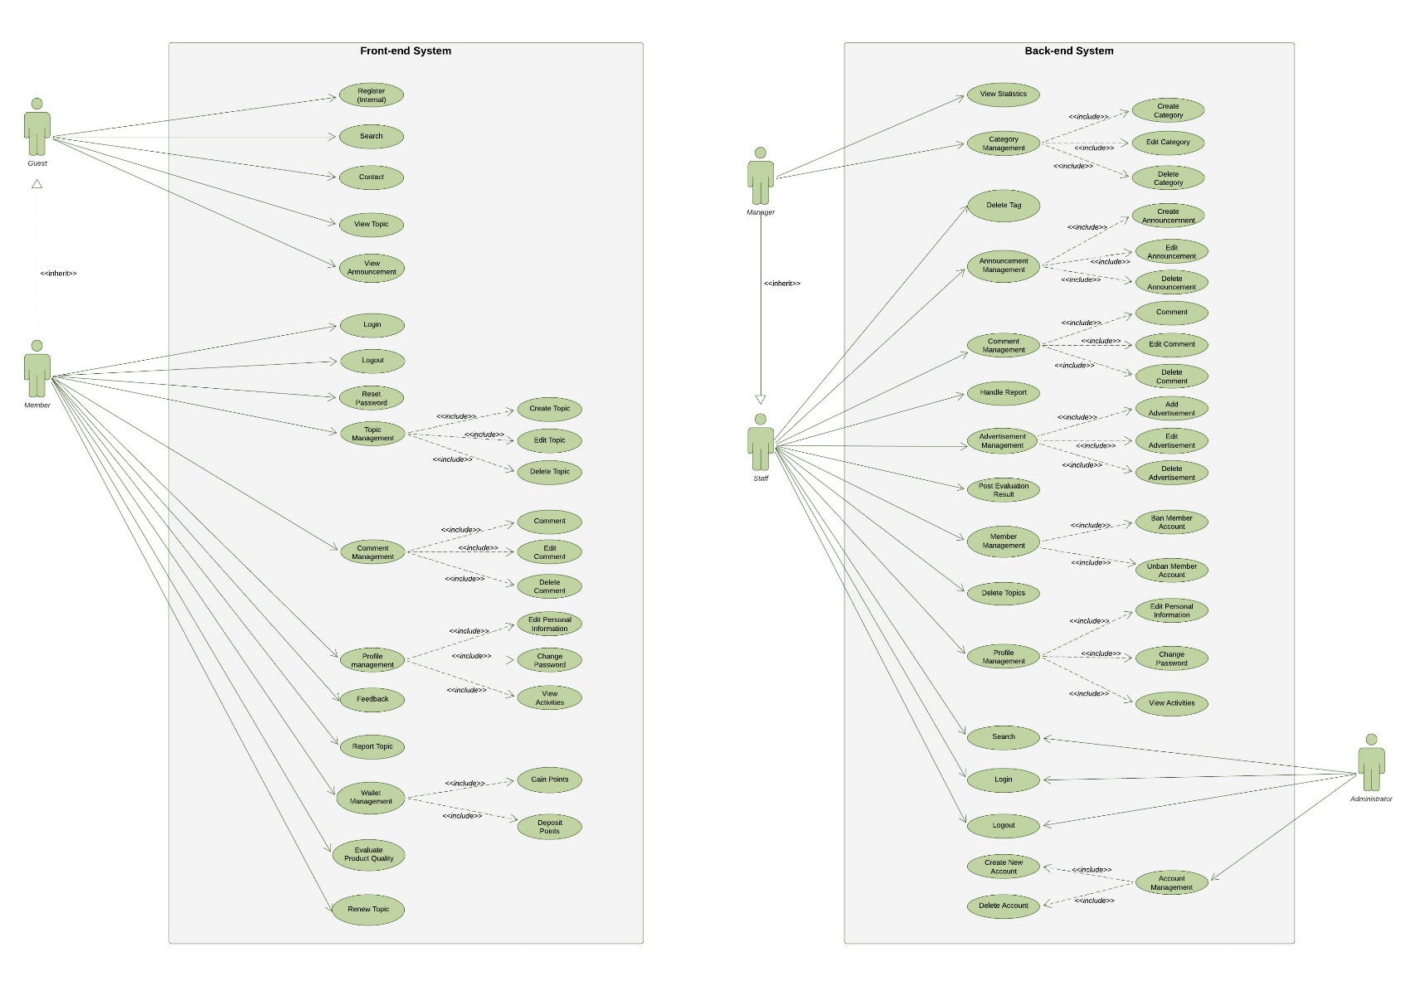
FUNCTIONAL REQUIREMENT

Slide 24
NONFUNCTIONAL REQUIREMENT
Reliability
* Restrict error in system. If error occurred, have methods to notify users.
* Database must be back up frequently and can restore when system have crash.

Slide 25
NONFUNCTIONAL REQUIREMENT
Security
* The system should provide methods to prevent common attacks (XSS, SQL injection...).
* Using SSL to encrypt transferred sensitive information.
* System must validate all user’s input data before sending to server to process.
* Administrator cannot change user’s information such as (password, username, email...), they can only create or delete account.
* Staff cannot change topic, comment of the others, they only can delete topics, comments.

Slide 26
NONFUNCTIONAL REQUIREMENT
Security(continues)
* All activities of system are invisible to external users.
* Sensitive information must process through user’s email (register, reset password…)

Slide 27
NONFUNCTIONAL REQUIREMENT
Maintainability
* All errors or activities will be logged.
* Easy change and not affected to other components
Portability
* Support multiple screen resolution such as 1024 * 768, 1366 * 788

Slide 28
SPECIAL FEATURES
Introduce about Xu
How to deposit Xu
Service of system:
* Renew topic
* Evaluate product

Slide 29
IV, Software Design

Slide 30
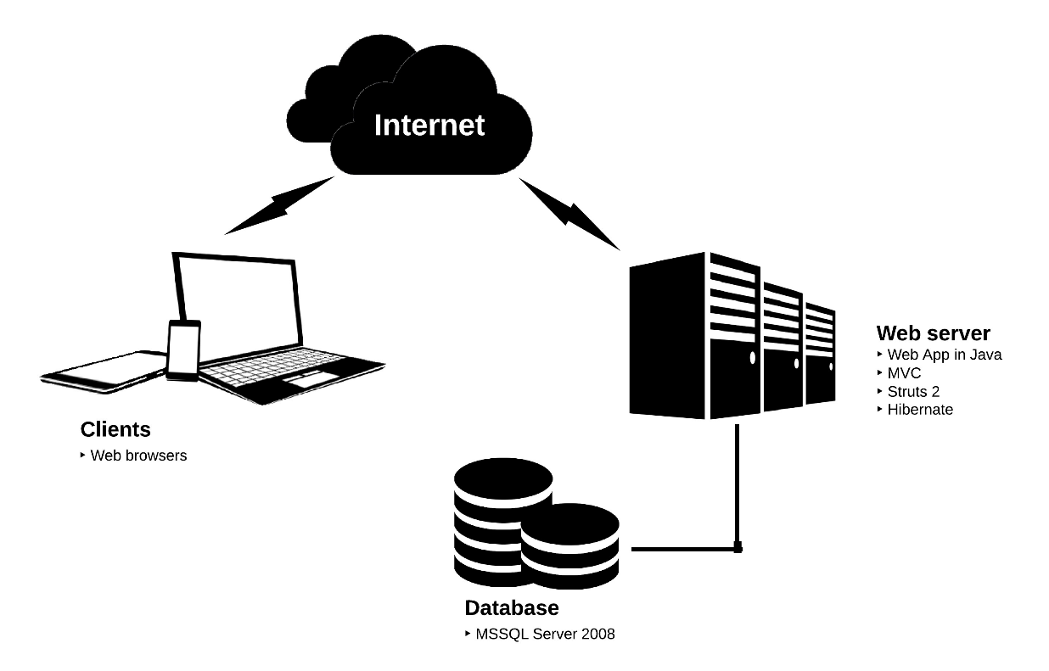
SOFTWARE ARCHITECTURE

Slide 31
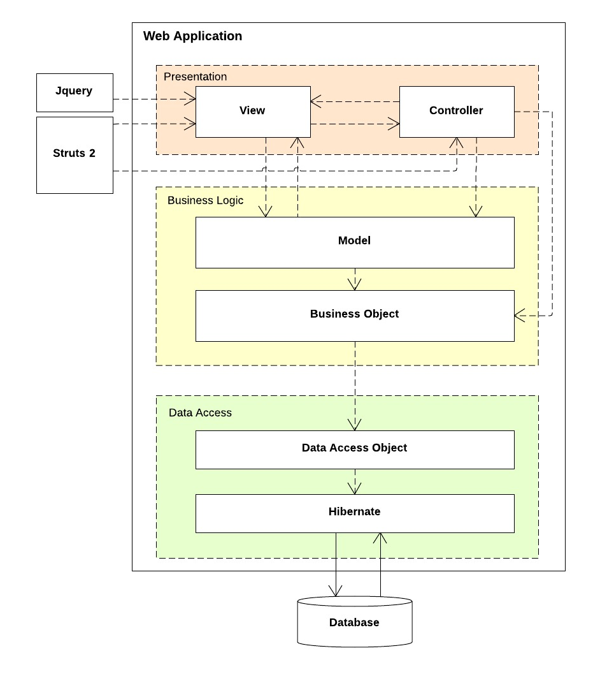
COMPONENT DIAGRAM

Slide 32
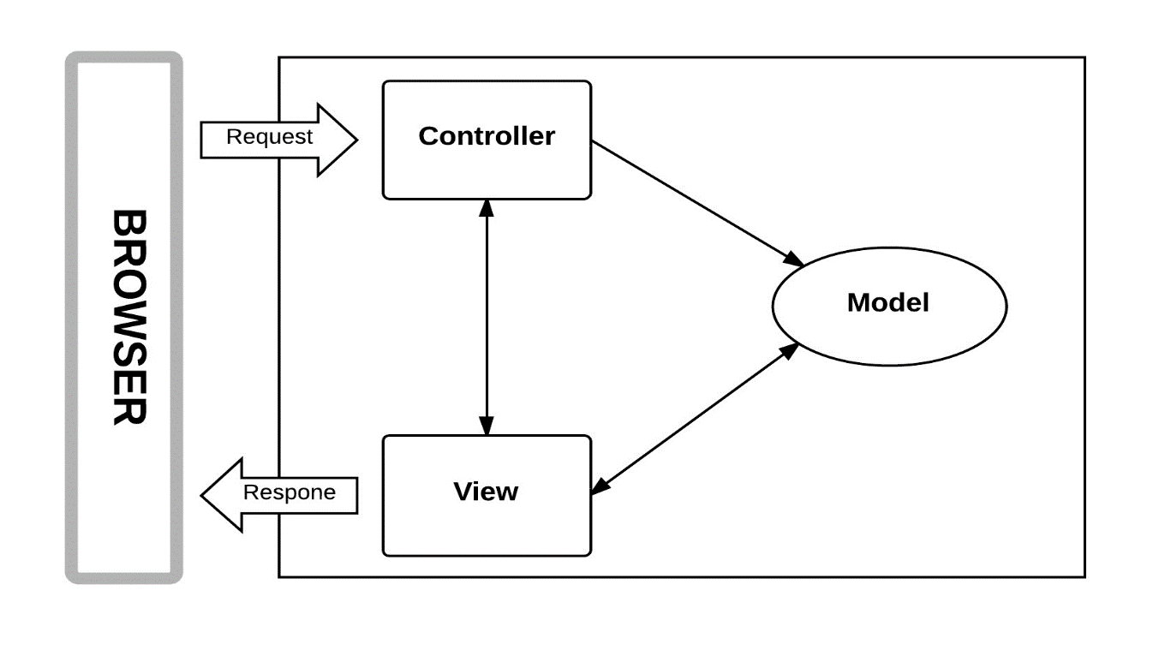
MVC MODEL

Slide 33
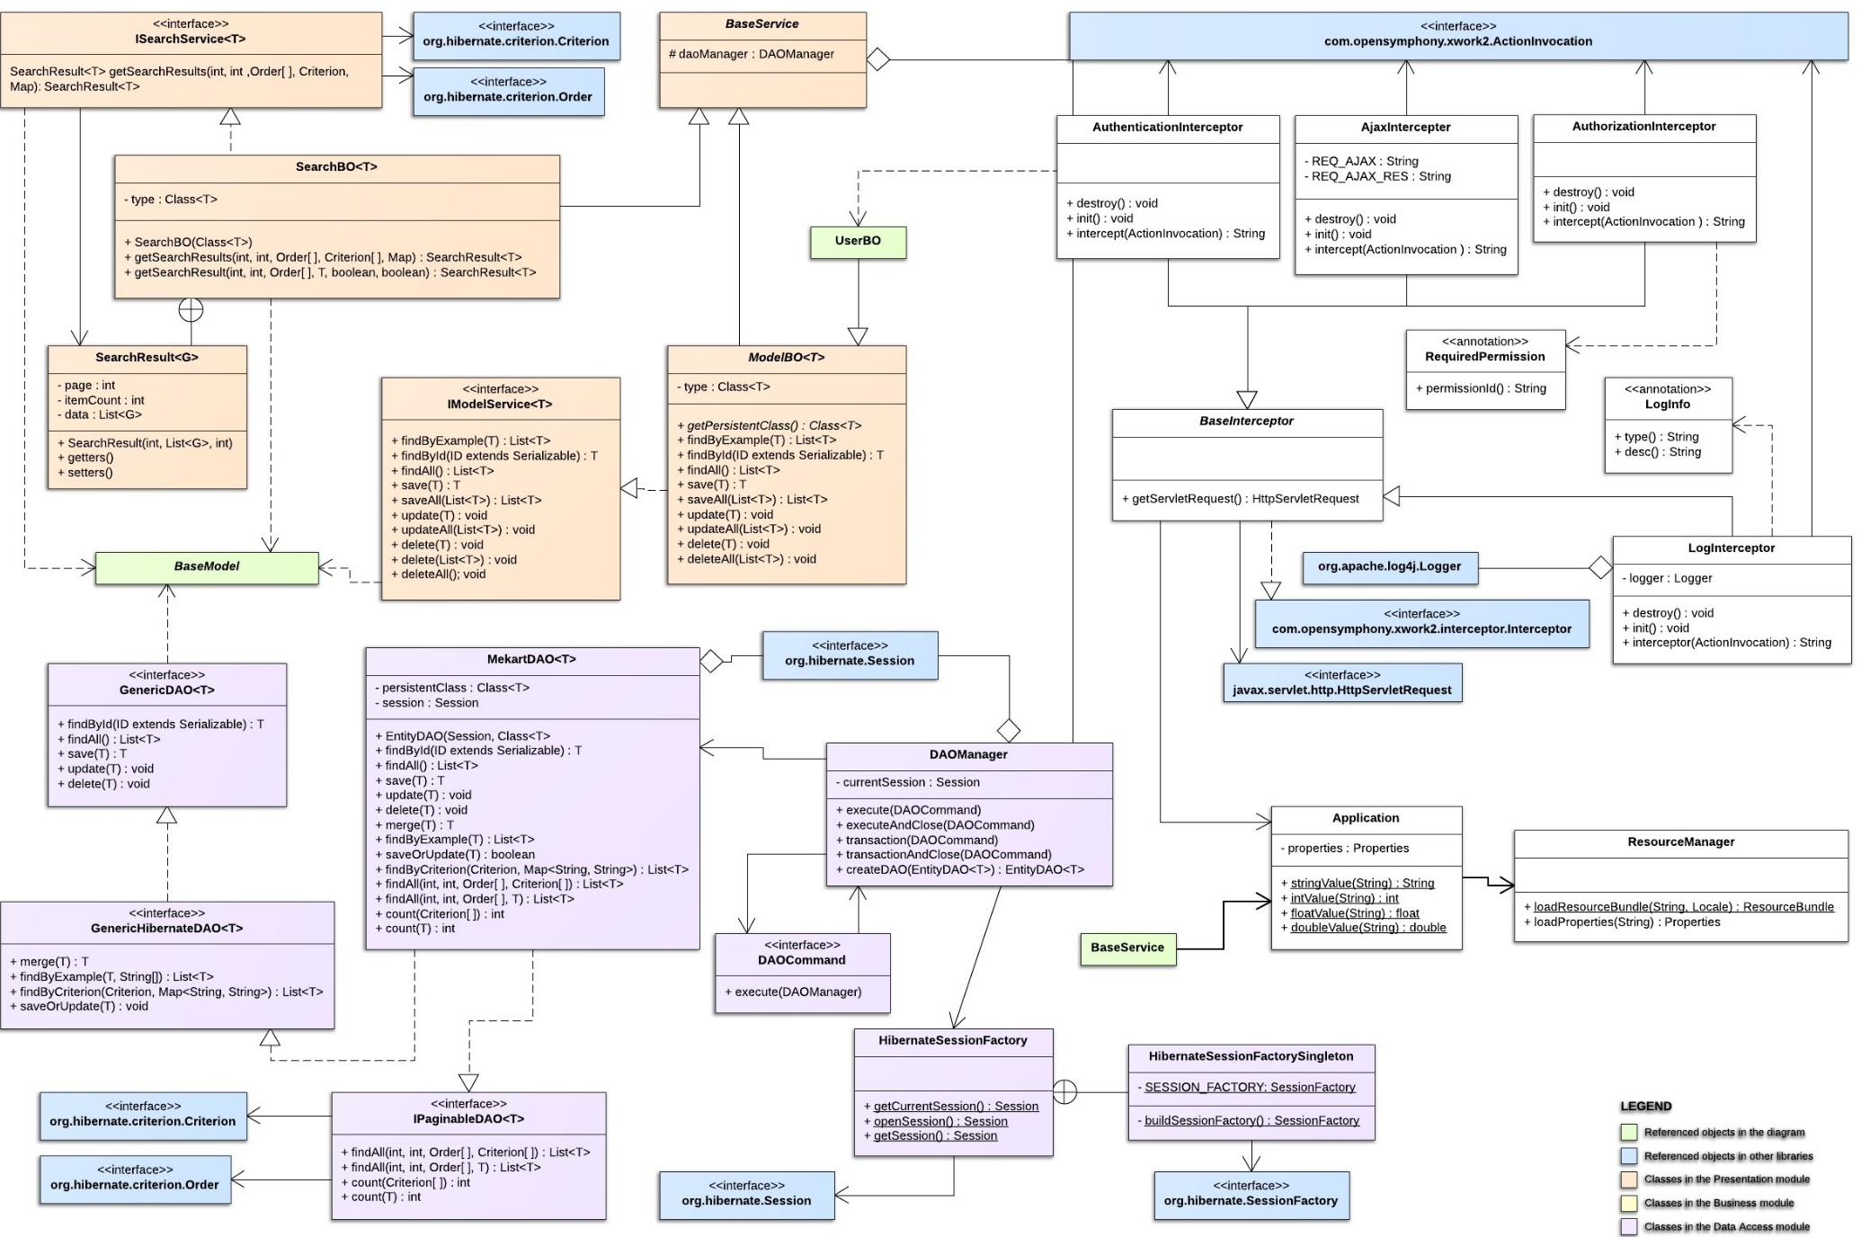
CLASS DIAGRAM (page-1)

Slide 34
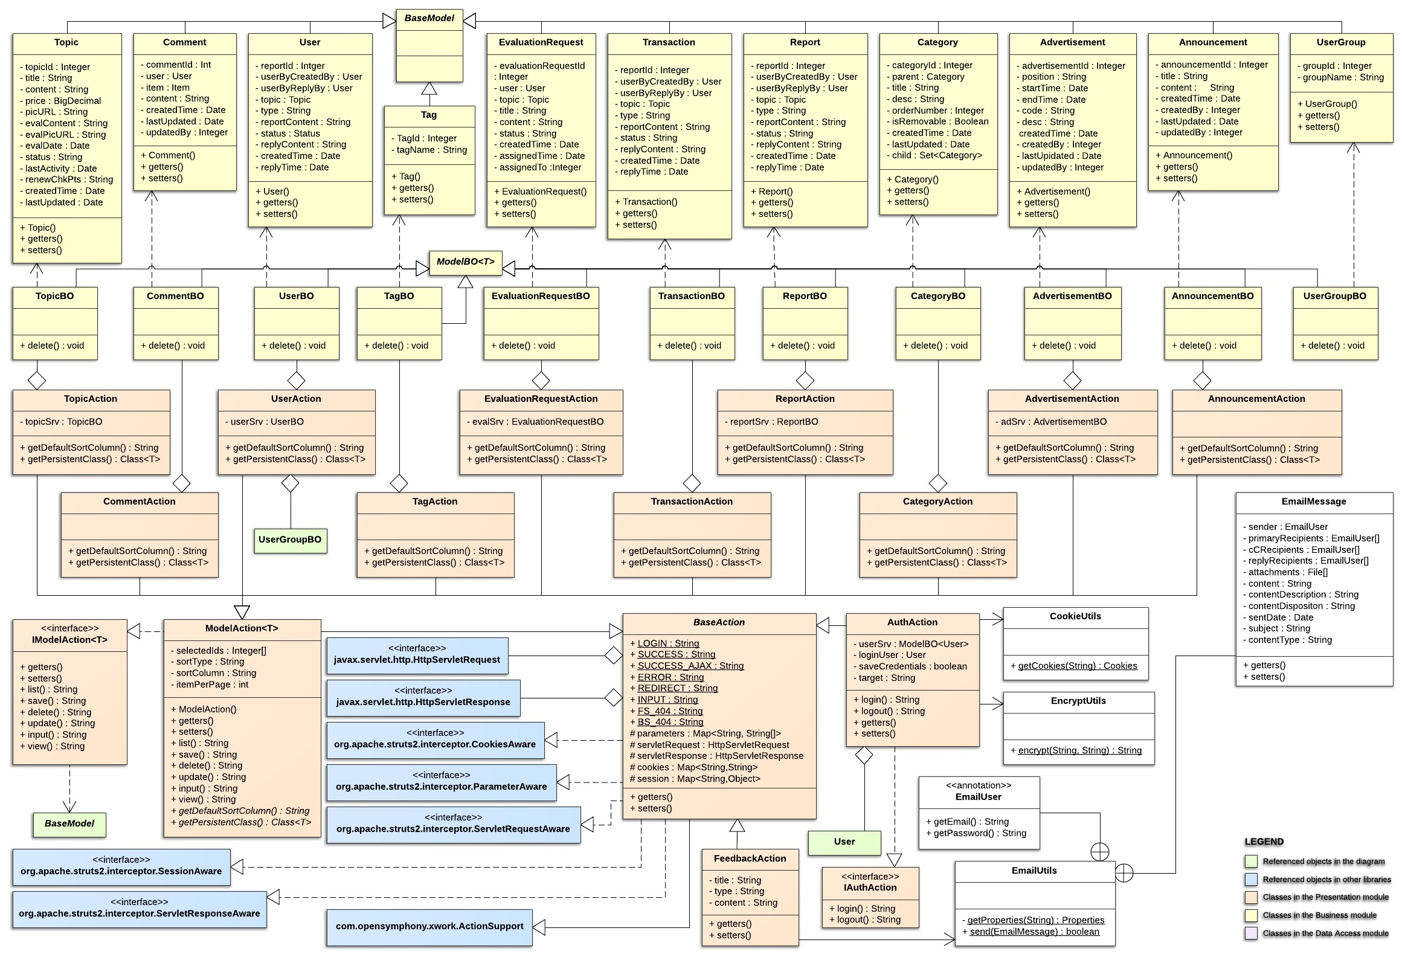
CLASS DIAGRAM (Page-2)

Slide 35
SEQUENCE DIAGRAM For LOGIN FUNCTION (SCENARIO-1)

Slide 36
SEQUENCE DIAGRAM For LOGIN FUNCTION (SCENARIO-2)

Slide 37
SEQUENCE DIAGRAM For Comment FUNCTION

Slide 38
SEQUENCE DIAGRAM For add advertisement FUNCTION

Slide 39
DATABASE DESIGN

Slide 40
V, Software Test

Slide 41
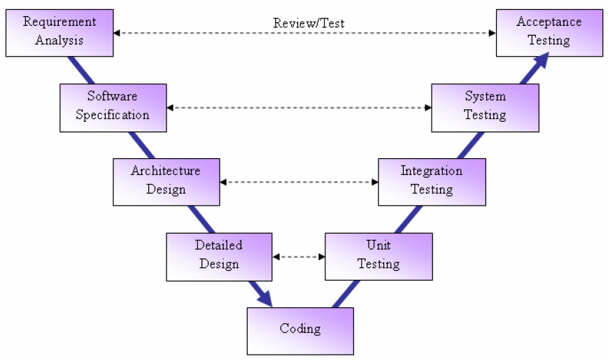
TEST MODEL
Notes:
Thay high level = architecture design

Slide 42
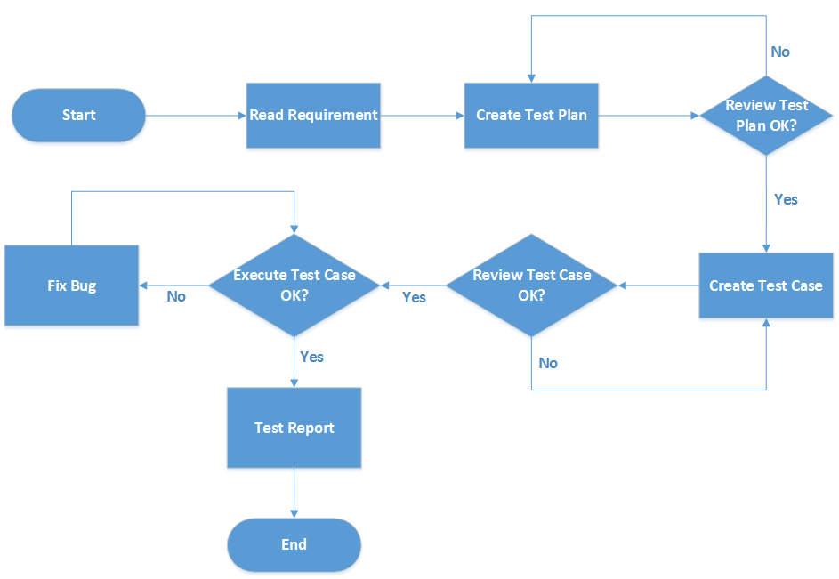
TEST PROCESS

Slide 43
TEST TYPES
Functional Test
User Interface Test
Security Test

Slide 44
UNIT test case
ID | Method | Return Type | Parameters | Expected Result | Result | Test date
 | AdvertisementBO Class
[Business Module-1] | SearchResult<Advertisement> list(List<Advertisement>, Date , Date , Date , Date , Date , Date , Date , Date , Order[] , Integer , Integer) | SearchResult<Advertisement> | Advertisement[advertisementId= 1,advertisementId = 2, advertisementId = 3]), '2-3-2014', '3-3-2014', '4-3-2014', '4-4-2014', '29-2-2014', '29-2-2014', '29-2-2014', null, 2, 10 | SearchResult[itemCount=15,page=0,pageCount=2] | Pass | 14/3/2014
[Business Module-2] | void addAvertisement( Advertisement,User) | void | Advertisement[position="H001", startTime="10/10/2014", endTime="8/10/2014", code="Test ads"], User[userid=1] | throw exception | Fail | 14/3/2014

Slide 45
INTEGRATION test case
ID | Test Case Description | Test Case Procedure |  | Expected Output | Actual Result | Inter-test case Dependence | Result | Test date
 | Register Function
[Integration Test-1] | Test Register new user function |  | 1. Click on "Register" button 2. Input Username ("leanhtu27") 3. Input Email ("leanhtu27@gmail.com") 4. Input Password ("12345678") 5. Input Re-Password ("12345678") 6. Click on "Register" button | The system will display "You have registered successfully" message New Succesful register log is written in [mekart.log] New record is created in [user] table | "UserBO -Called from: UserAction", "MekartDAO -Called from: UserBO", "[Action Name] : register", "[Desc] : Create user" and "[RESULT] : success_save" is displayed in file [mekart.log] New record "leanhtu27" is created in [user] table | 1. Register page is load successful 2. Connected to database | Pass | 4/3/2014

Slide 46
SYSTEM test case
ID | Test Case Description | Test Case Procedure | Expected Output | Inter-test case Dependence | Result | Test date
 | Login Function
[Member Function-1] | Test Login function (Successful) | 1. Click on "Đăng nhập" button 2. Insert "Tài khoản" ("leanhtu27") 3.. Insert "Mật khẩu" ("12345678") 4. Click on "Đăng nhập" button | 1. The system will redirect to “Đăng nhập" page 4. Logged in user’s account then redirect to “Trang chủ” |  | Pass | 4/3/2014

Slide 47
CHECKLISTS
No | Questions | Yes | No | N/A
1 | The system will show error message when users does not input any data in mandatory fields? | TuLA,TanNN, NhatDH,HaDV, HuyPV
2 | Is user interface is implemented as design document? | TuLA,NhatDH, TanNN | HaDV,HuyPV
3 | All mandatory fields require user input? | TuLA,TanNN, NhatDH,HaDV, HuyPV
4 | For all character/alphanumeric fields check the field to ensure that there is a character limit specified and that this limit is exactly correct for the specified database size? | TanNN | TuLA,HaDV, HuyPV | NhatDH
5 | For all numeric fields check the minimum and maximum values and also some mid-range values allowable? | TuLA,TanNN, HuyPV | HaDV | NhatDH

Slide 48
DEFECT LOG
Defect ID | Module | Description | Created Date | Status
1 | Register (Guest) | 1. Click on "Đăng ký" button 2. Insert "Tài khoản" ("abcd#&@dj") 3. Insert Email ("leanhtu27@gmail.com") 4. Insert "Mật khẩu" ("12345678") 5. Insert "Nhập lại mật khẩu" ("12345678") 6. Click on "Đăng ký" button Expect: Ở Username, các kí tự đặc biệt như @,#,$ cần được check. Chỉ chấp nhận chữ, số, ".", "_". Actual: Vẫn Register bình thường. | 4-Mar-14 | Assigned
2 | Search (Guest) | 1. Insert 101 keywords into the search box ("abcdefhjgldjsadqwesa…ab") 2. Select the category of the product ("Camera") 3. Click on "Tìm" button Expect: Thanh Search box không chấp nhận quá 100 kí tự Actual: Vẫn Search được hơn 100 kí tự | 4-Mar-14 | Assigned

Slide 49
TEST RESULTs
No | Module code | Pass | Fail | Untested | N/A | Number of test cases
1 | Guest Function | 27 | 4 | 0 | 0 | 31
2 | Member Function | 81 | 15 | 0 | 0 | 96
3 | Staff Function | 80 | 10 | 0 | 0 | 90
4 | Manager Function | 90 | 11 | 0 | 0 | 101
5 | Administrator Function | 26 | 3 | 0 | 0 | 29
6 | User Interface | 34 | 0 | 0 | 0 | 34
7 | Security Test | 13 | 0 | 0 | 0 | 13
 | Total | 351 | 43 | 0 | 0 | 394

Slide 50
VI, LESSON LEARNED

Slide 51
Lesson Learned
Team communication
Project management skills
Project scope management

Slide 52
Future development
IMPROVE ENGLISH VERSION
CONTINUE TO DEVELOP PROJECT IN REAL

Slide 53
VII, DEMONSTRATION

Slide 54
Thank You For Listening !!!
••••••••••••••••••••••••••••••••••••••••

