Slide 1
Interesting Fact
Group Members | Cù Hữu Hoàng Đặng Ngọc Dũng Đặng Việt Hùng Phạm Đức Vũ | SE01966 SE02251 SE02063 SE02129
Supervisor | Bùi Ngọc Anh MSc.

Slide 2
Summary
Idea
Plan
Risk
Member Usecase
Admin Usecase
Architecture design
ERD & Database
Newsfeed & Simulator
Testing
Project Result
Demo

Slide 3
Idea

Slide 4

Close Network
Facebook, Zing me
Get news from their friends, following.

Slide 5

Open Network
You tube, Pinterest
Get news from any node in network

Slide 6
Interesting fact social network
News Feed – where posts all over the network are collected.
Lifetime – To determine the value of a post
Ranking – To determine users’ reputation
Simulator – To emulate a system with virtual users

Slide 7
Software Project Management Plan

Slide 8
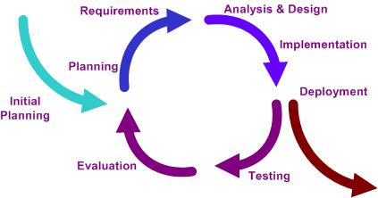
Iterative Model

Slide 9
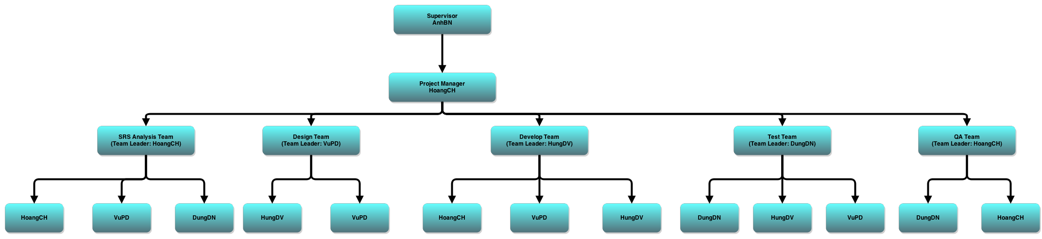
Roles and Responsibilities

Slide 10
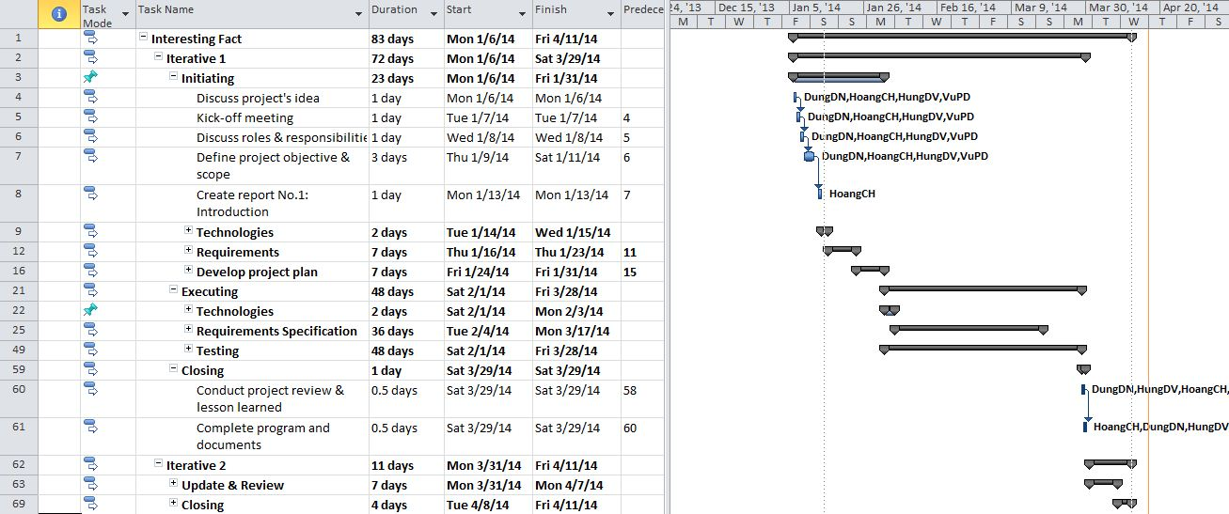
Schedule

Slide 11
Objective
Metrics | Committed | Actual
Start Date | 6-Jan-2014 | 6-Jan-2014
End Date | 11-Apr-2014 | 16-Apr-2014
Duration | 83 days | 88 days
Team member | 4 | 4

Slide 12
Risks
Not complete tasks on time
Project’s scope too large to manage
Conflict between team member
Project is behind schedule
Failure to manage user expectations
Misunderstanding requirements
Scope changes
Poor communications
Impossible deadlines

Slide 13
Member Usecase

Slide 14
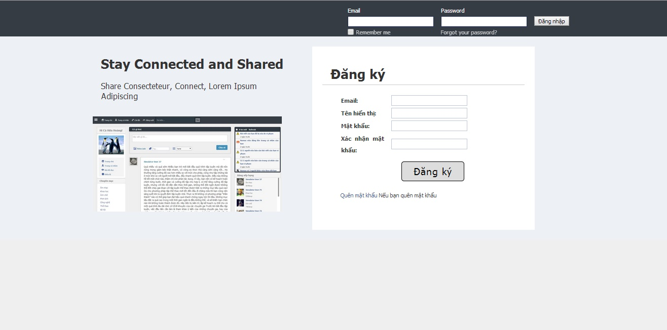
Login
Register
Recover password

Slide 15
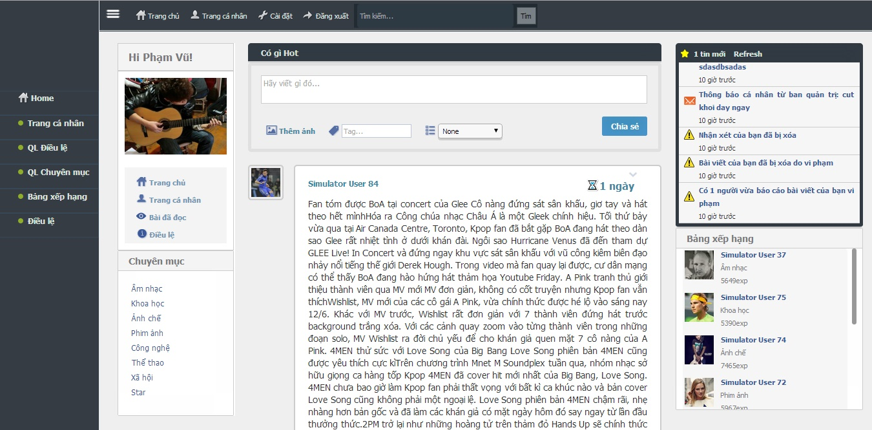
Log out
Display notification
-Display newsfeed
-Load more post

Slide 16
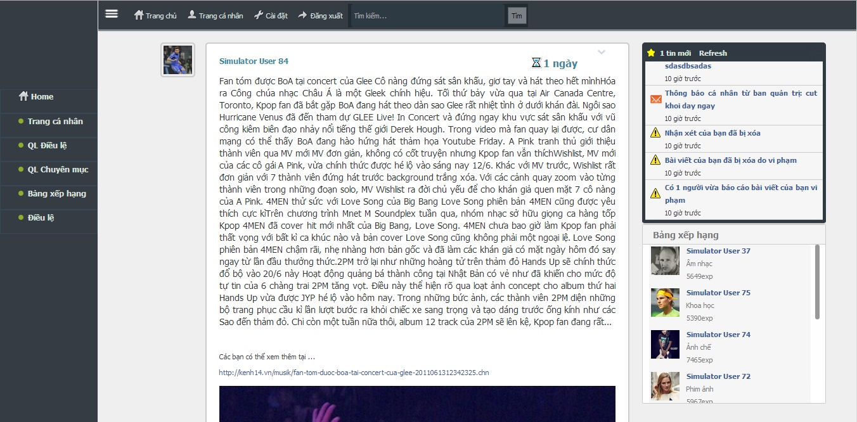
Display post

Slide 17
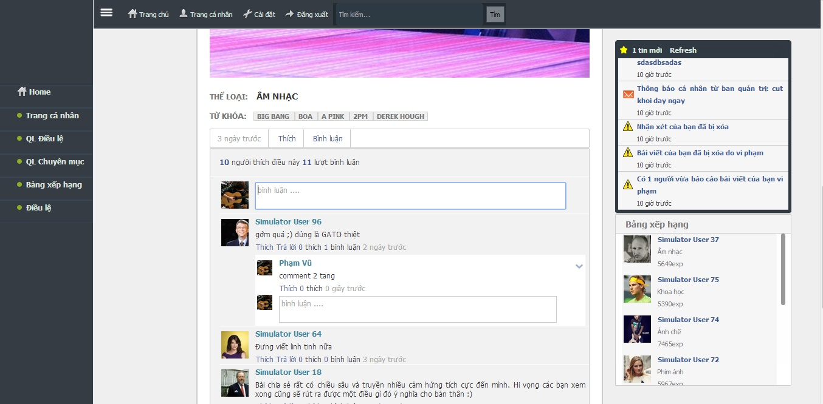
View post by tag/category
Like and comment post
Like and reply comment

Slide 18
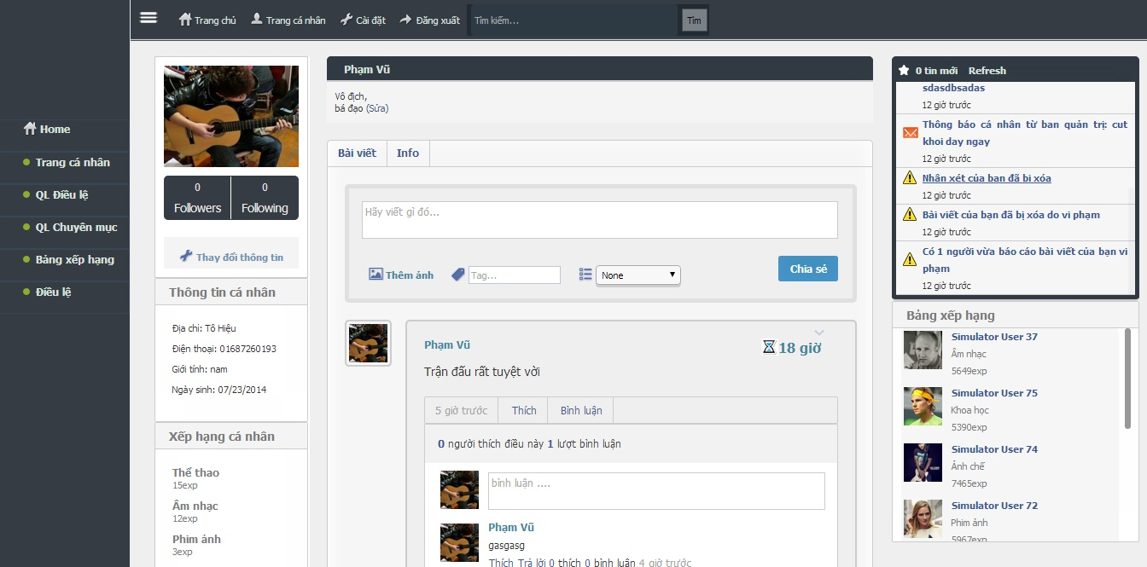
Search another person
Change profile
Post on own wall
Edit post/delete post
Display user profile
Edit post/delete comment

Slide 19
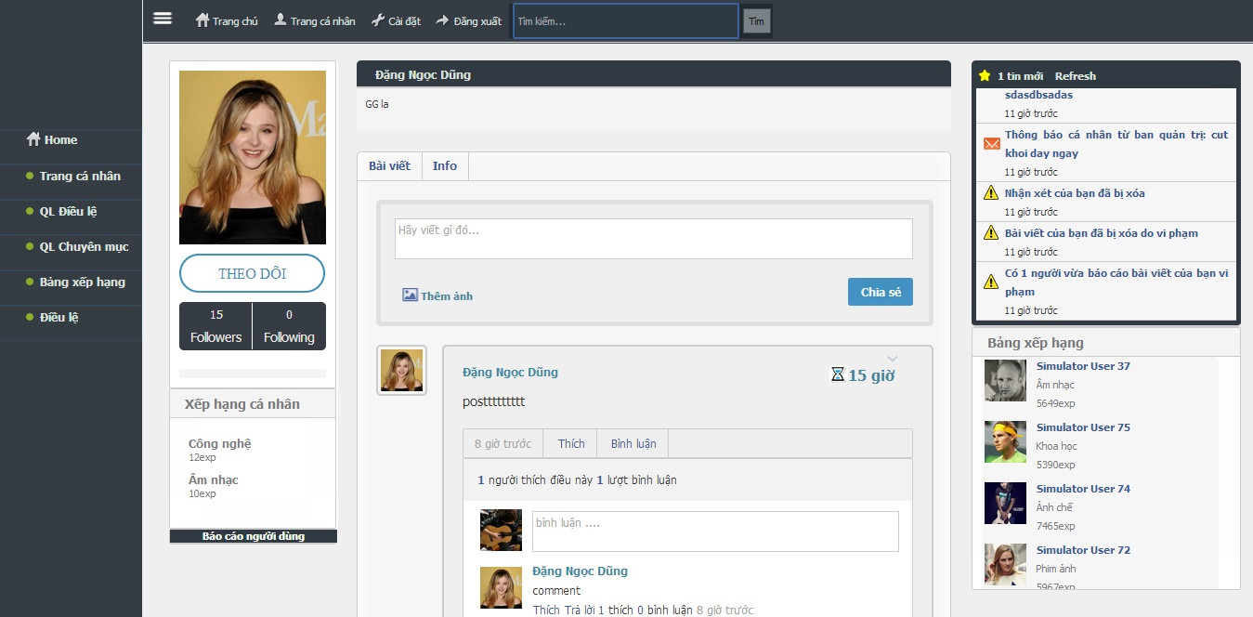
Post on another person’s wall
Follow/unfollow
Report post
Report user
Display one’s page

Slide 20
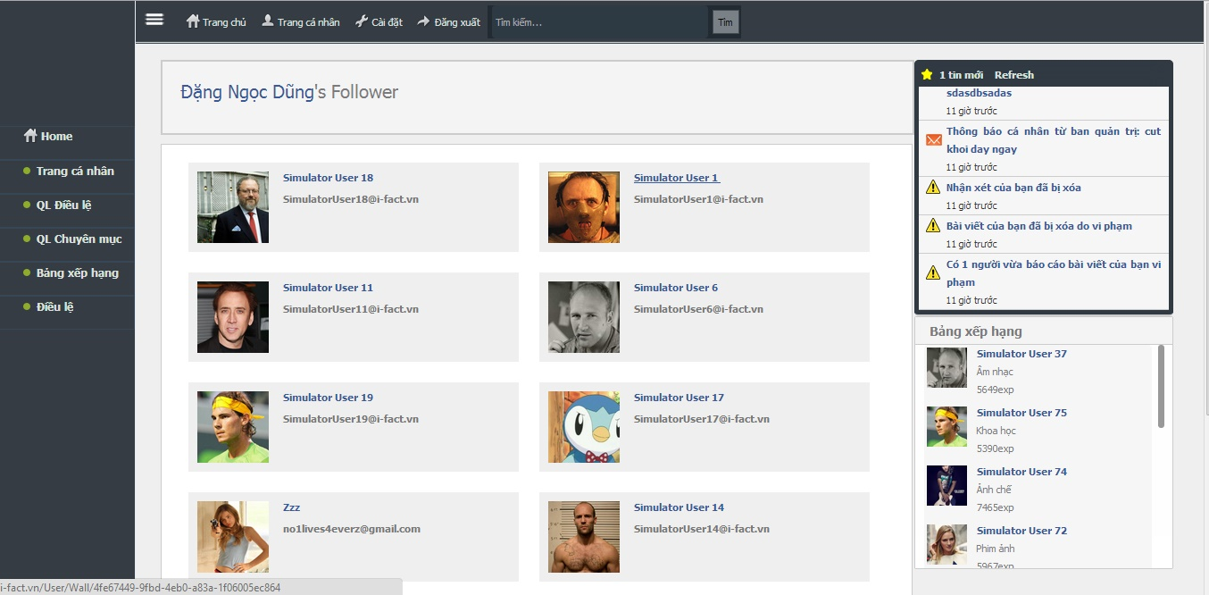
Display follower/following

Slide 21
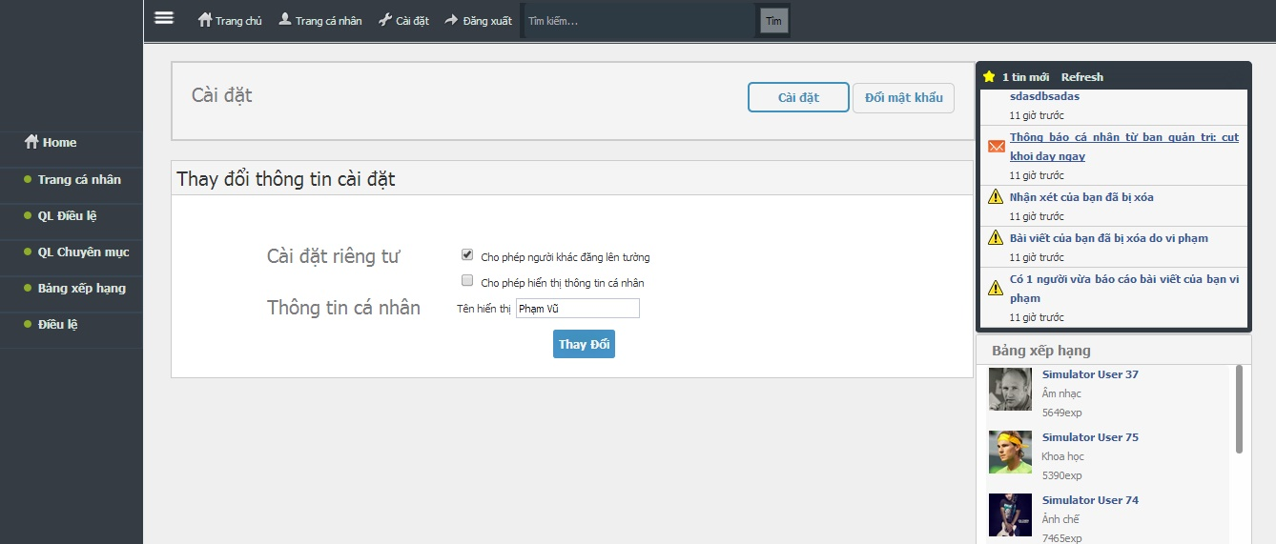
Display and change setting

Slide 22
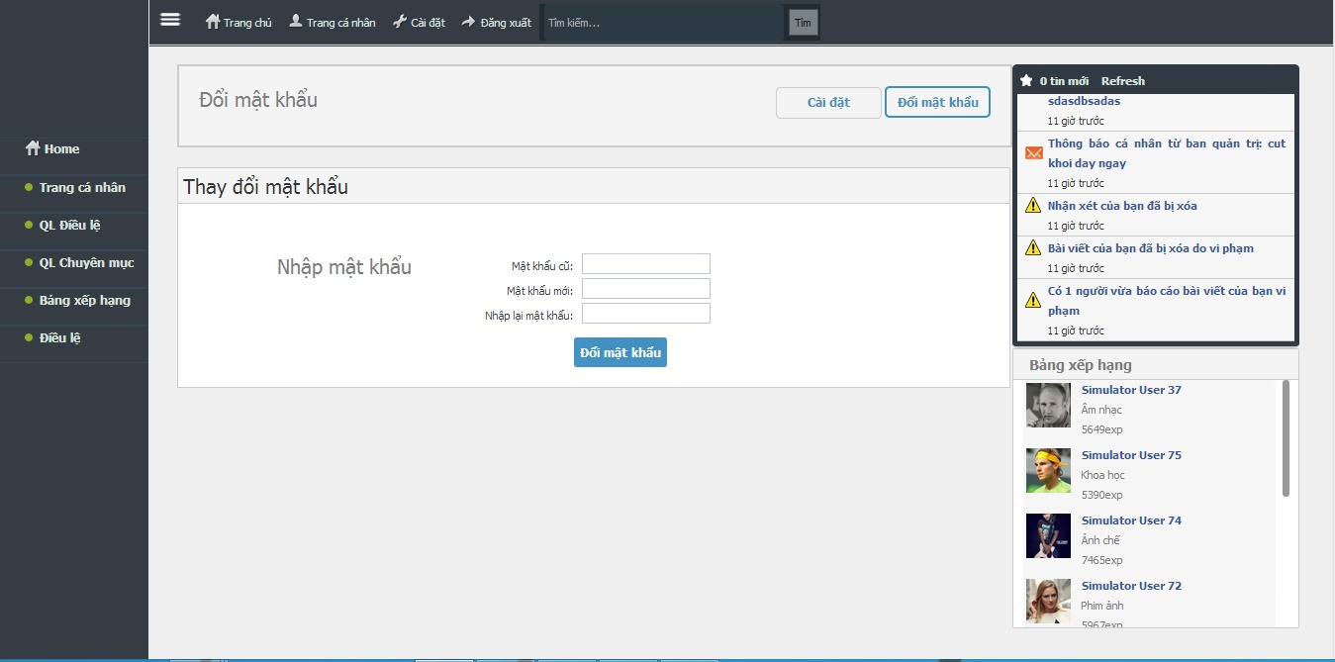
Change password

Slide 23
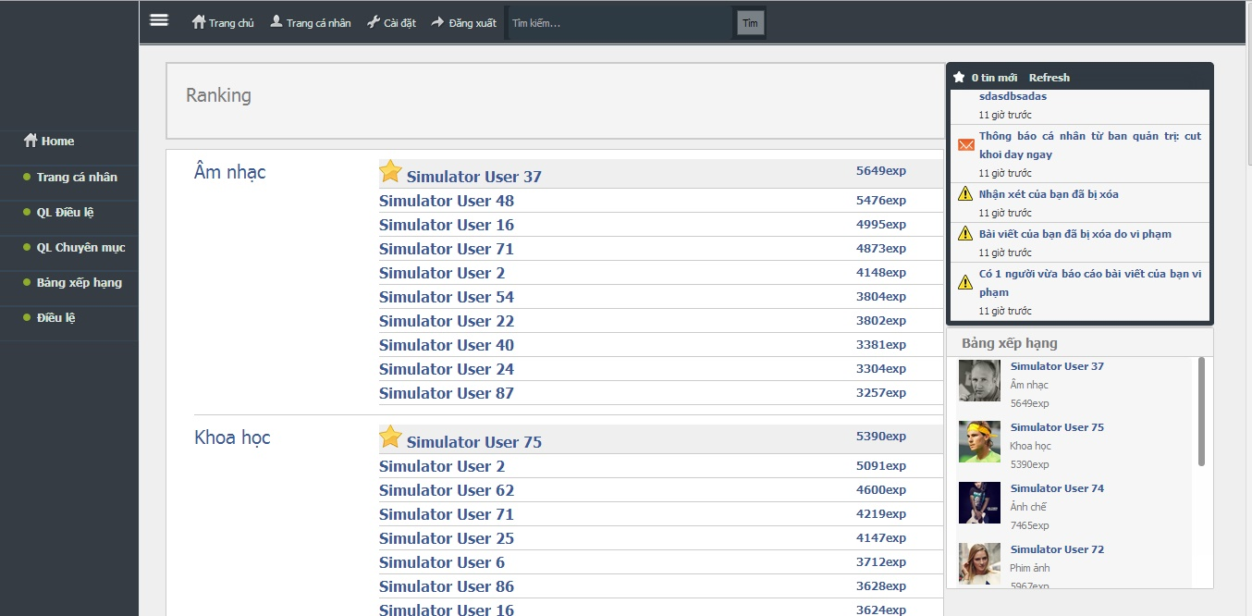
Display rank

Slide 24
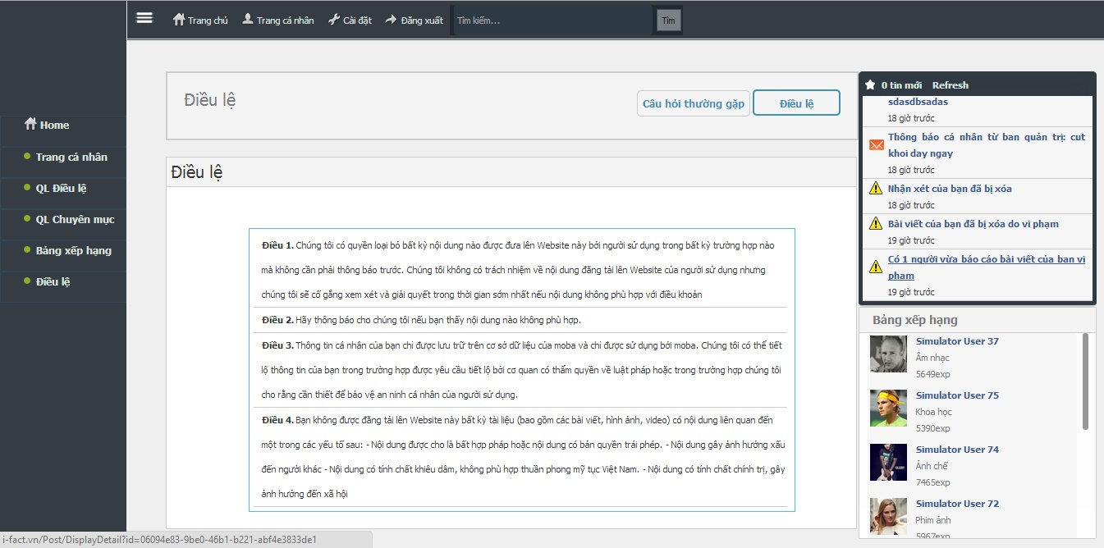
View FAQs and Rules

Slide 25
Administrator & Manager Usecase

Slide 26
Administrator & Manager Role
Post Manager
User Manager
Role Manager
Category Manager
Tag Manager
Report Manager
Configuration Manager
Announce Manager
Simulator Manager

Slide 27
 | Create | Search | Details | Edit | Block / Inactivate | Unblock / Activate | Other
Post Manager |  | x | x | x | x
User Manager |  | x | x |  | x | x | Send private message to user
Role Manager |  | x | x | x
Category Manager | x | x | x | x | x | x
Tag Manager |  | x | x | x | x
Report Manager | x | x | x | x | x | x
Configuration Manager |  |  |  | x
Announce Manager | x | x | x | x | x | x
Simulator Manager |  |  |  |  |  |  | Run / Stop / Pause simulator Delete simulate data

Slide 28
Post Manager View

Slide 29
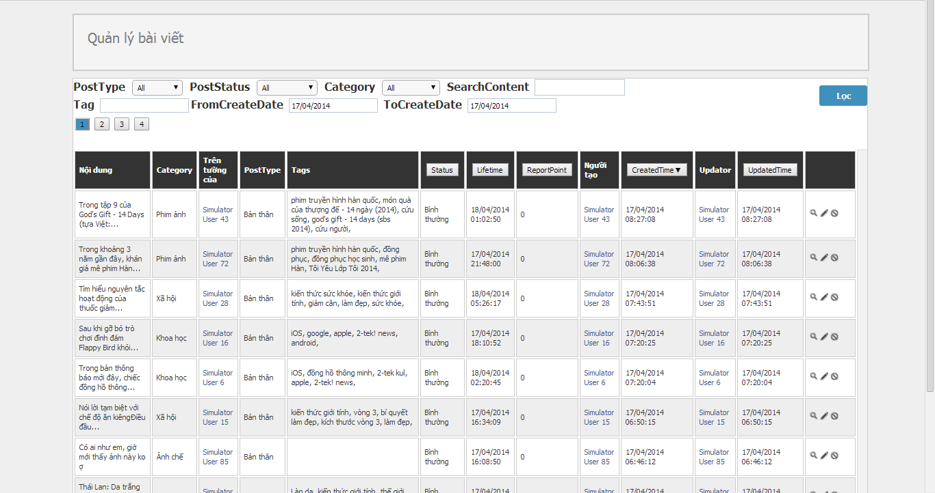
Filter box
Action box
Post table

Slide 30
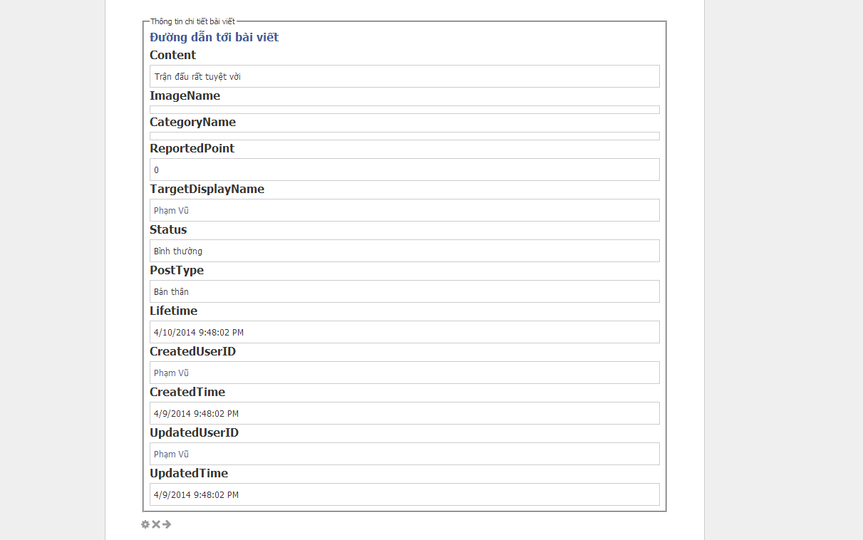

Slide 31
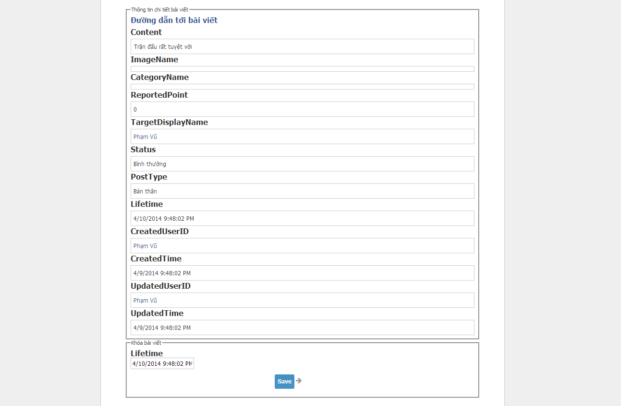
Edit lifetime

Slide 32
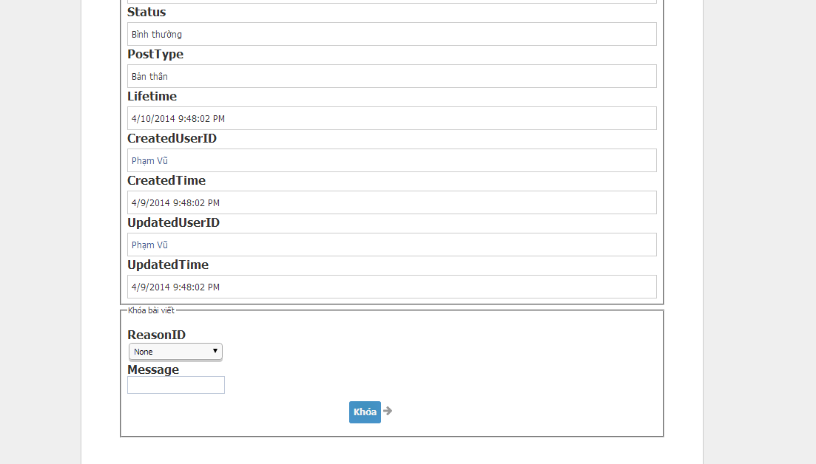
Block box

Slide 33
Role Manager View

Slide 34
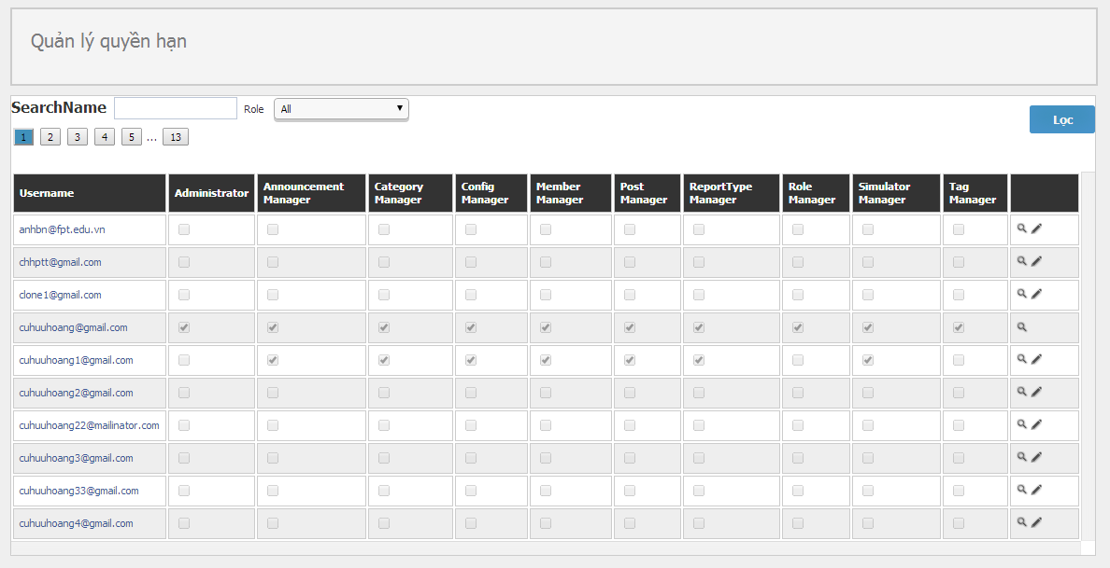
Filter box
Role table
Action box

Slide 35
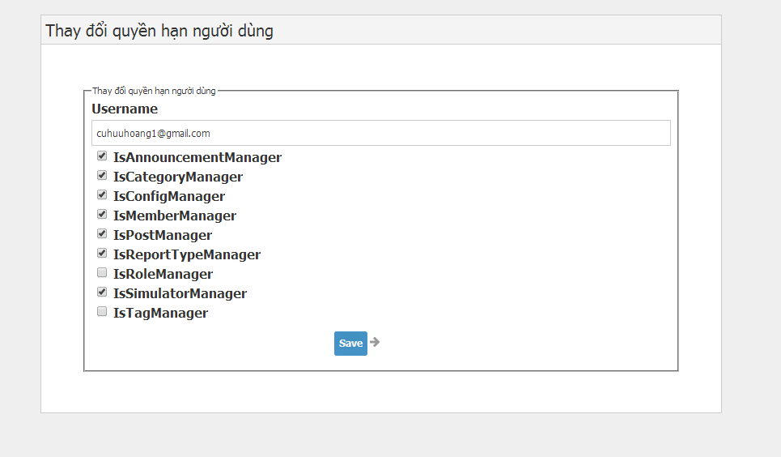
List role

Slide 36
Architecture design

Slide 37
Package Diagram
MVC 4 – Dot Net 4.0
Entity Framework
Asp .Net

Slide 38
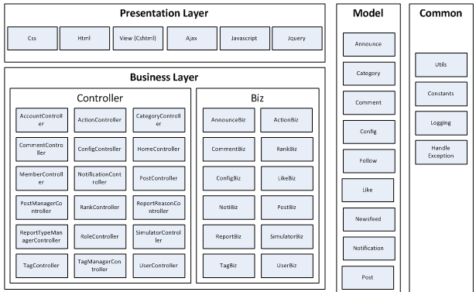

Slide 39
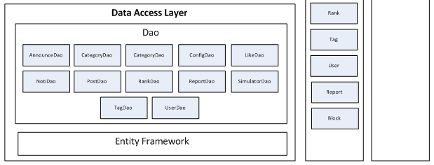

Slide 40
ERD

Slide 41
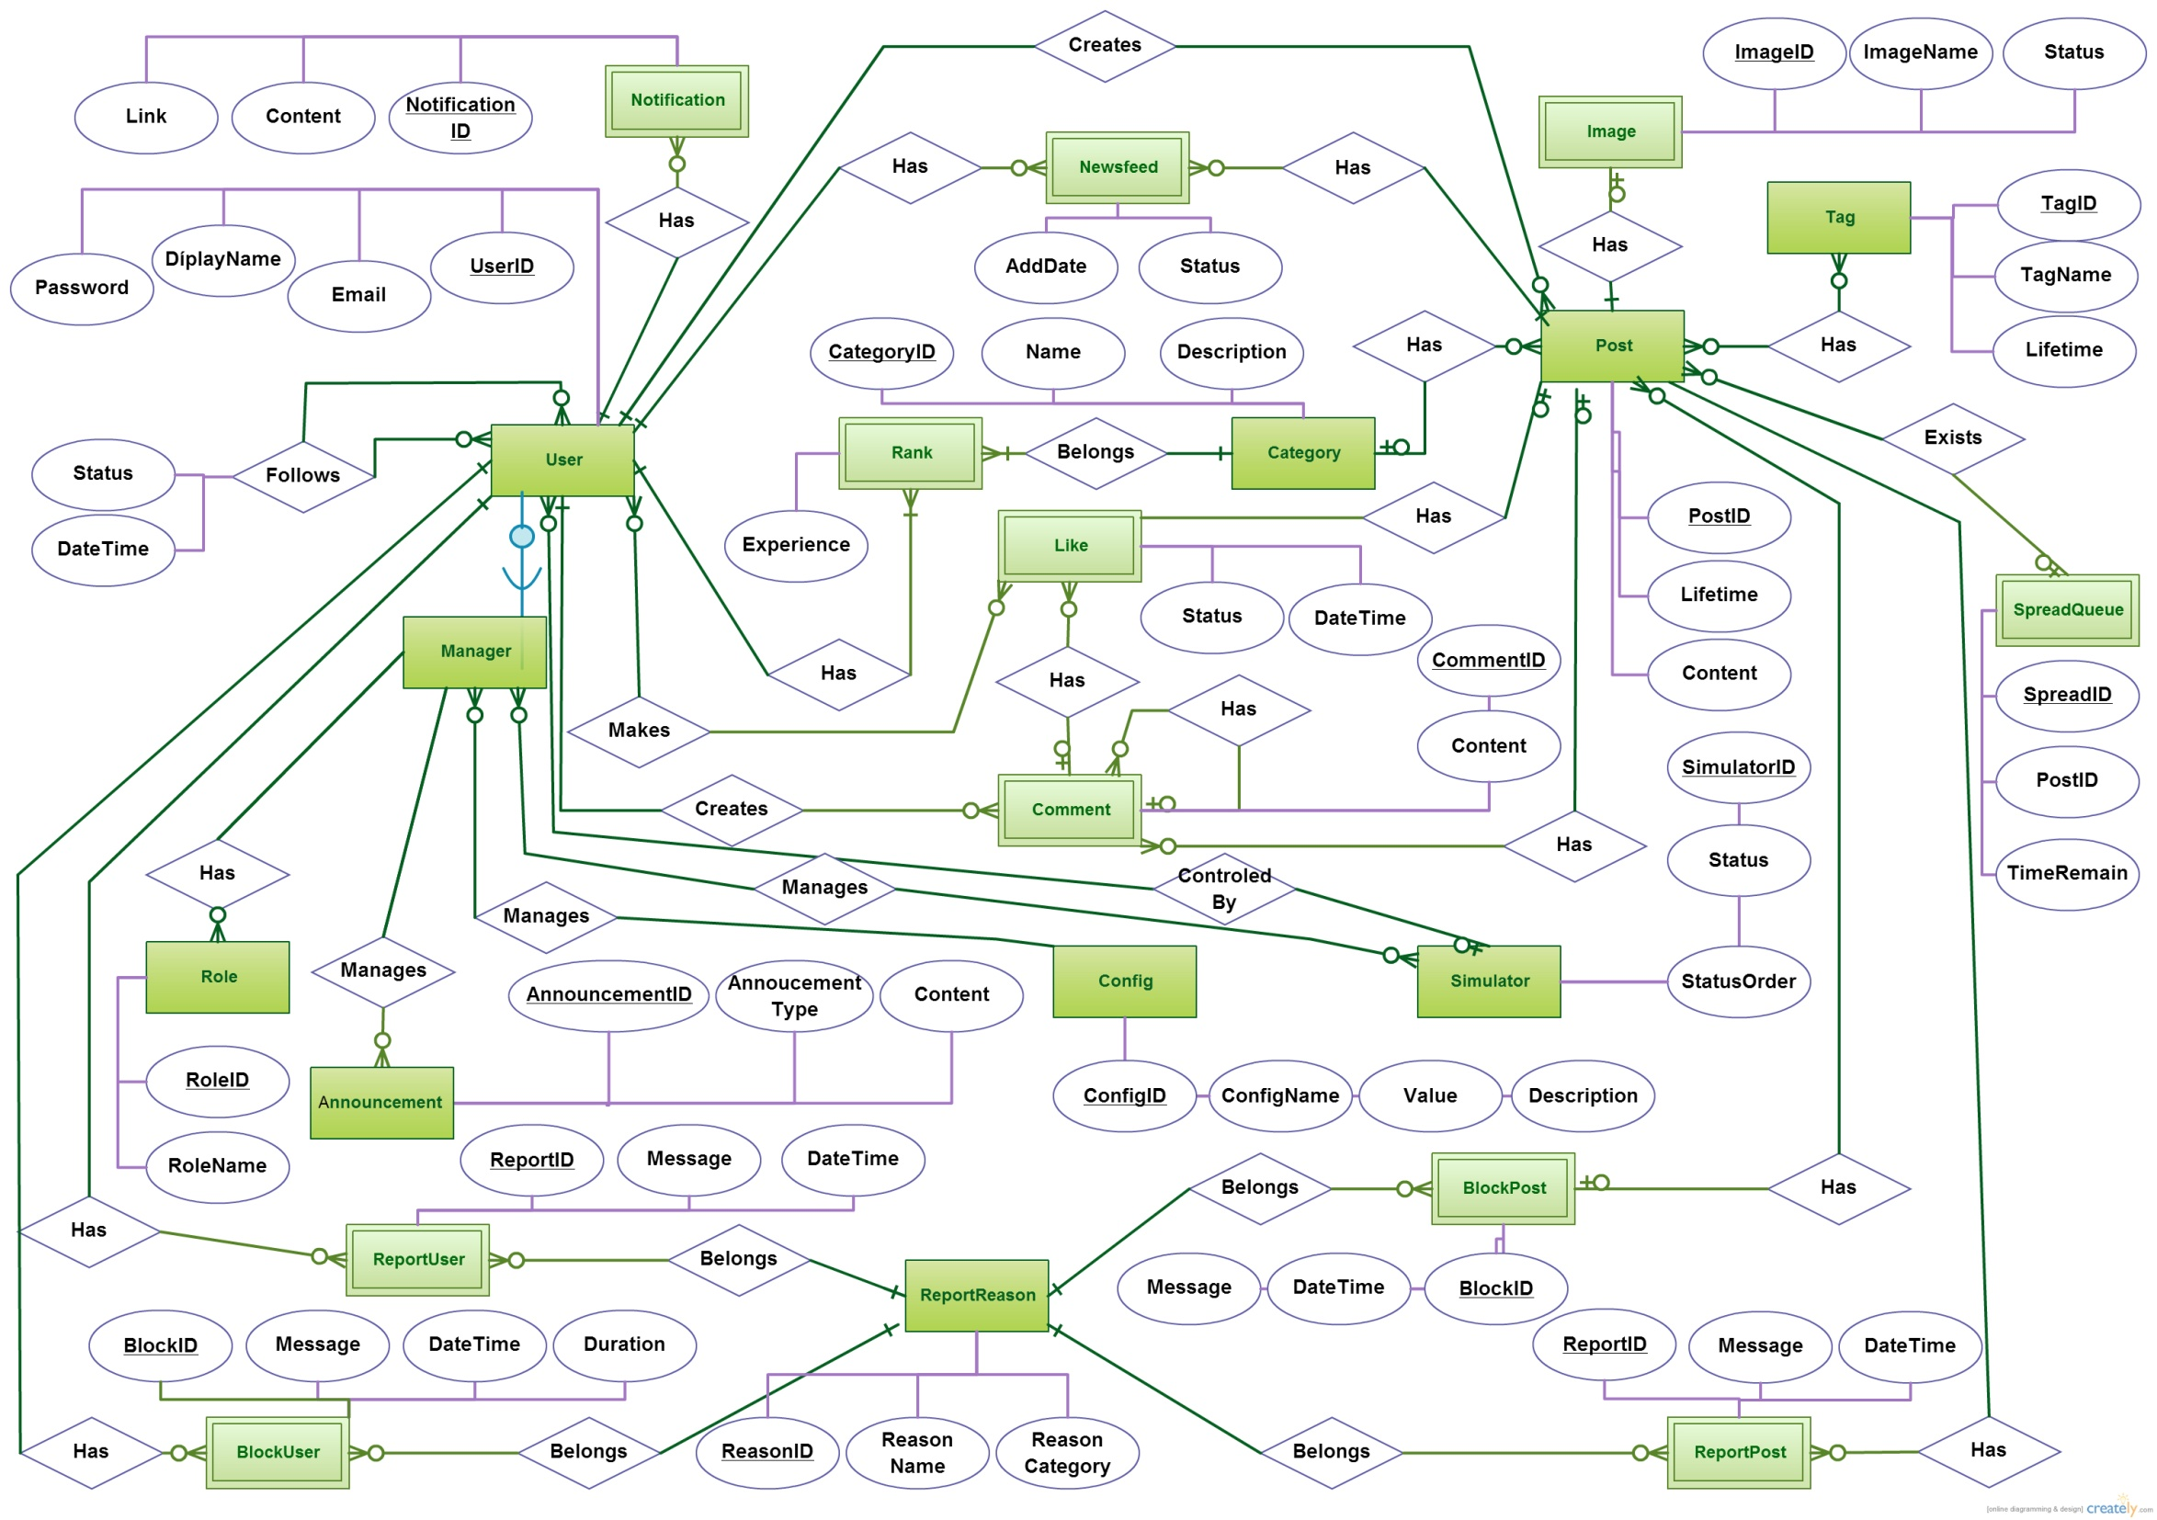

Slide 42
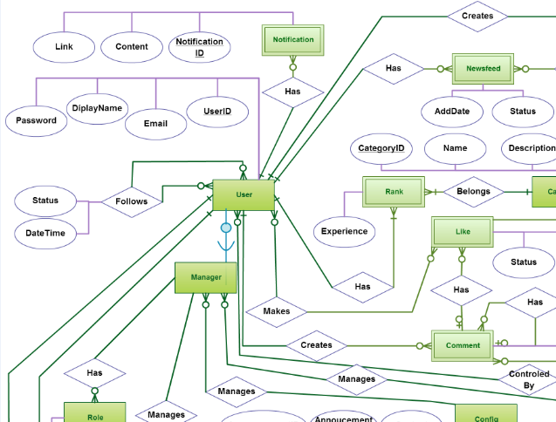
User
Rank
Manager
Like
Comment
Newsfeed
Notification

Slide 43
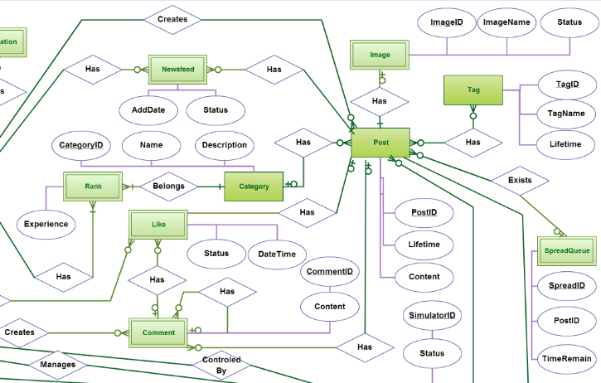
Post
Tag
Image
Category
Like
Comment

Slide 44
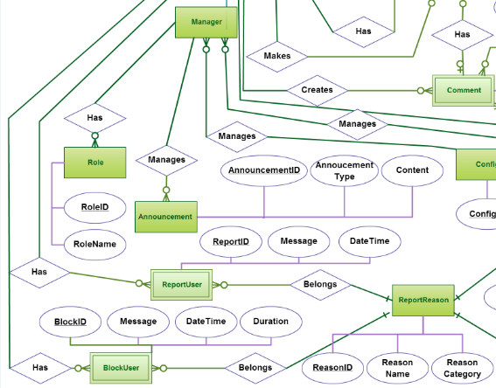
Report
Report User
Block User
Role
Announcement

Slide 45
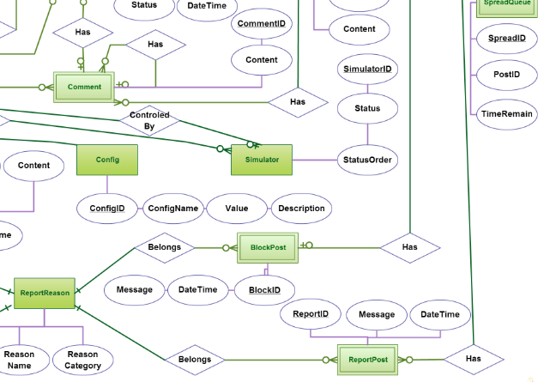
Configuration
Simulator
Report Post
Block Post

Slide 46
Database

Slide 47
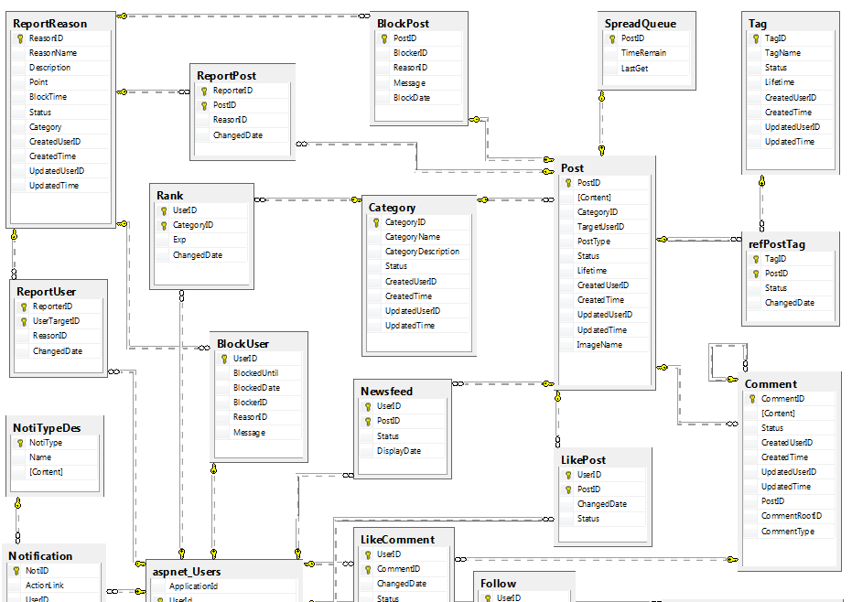
Post
Category
Tag
Rank
Users
Comment

Slide 48
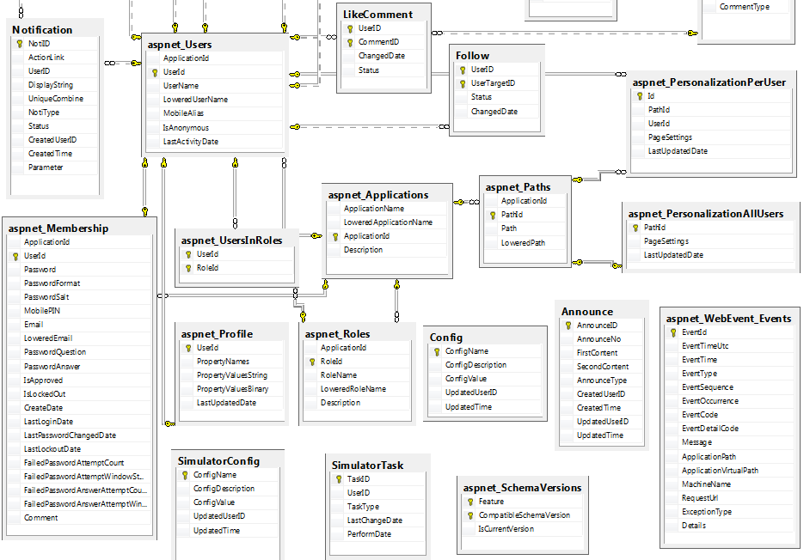
User
Role
Profile
Membership

Slide 49
Newsfeed formula

Slide 50

Out Rate Formula
GetQueue<GetTime: DateTime>
PushQueue<GetTime: DateTime, PushNumber: int>
OutRate: Post Out Rate
Count: Total number of item in queue

Slide 51

Like Rate Formula
LikeRate: Reflect user feedback speed.
LikeNumber: Total like made in concerning time.

Slide 52
Time Remain Formula
TimeRemain: Number of time that a post can be get to read
RankingRate: Depend on user’s ranking
ActionRate: Depend on action type (create, like, comment)

Slide 53

Get Time Per Post Formula
GetTimePerPost: Average time for each post to get in spreadqueue

Slide 54

Get Time Per Post Formula
TakeOutQueueNumber: How many times need to get from spreadqueue before a post is taken out
Spreadqueue: A queue that store new post and those posts which have high positive feedback

Slide 55

Life Time Gain Formula
LifeTimeGain: Lifetime that a post can gain after being put to spreadqueue
NewTimeRemain: TimeRemain of a post when it put to spread queue
OldTimeRemain: Number of time remain which a post already has in spread queue

Slide 56
Simulator formula

Slide 57
Simulator Formula (1)
NextReadDate += BaseReadTime * ReadActiveStatistic | NextReadDate: The next time a certain simulator user will load newsfeed BaseReadTime : TimeSpan ReadActiveStatistic= (r and BaseReadTime can be edit by configuration, 0 < r< 1)
NextWriteDate += BaseWriteTime * WriteActiveStatistic | NextWriteDate: The next time a certain simulator user will create a post BaseWriteTime : TimeSpan WriteActiveStatistic= (w and BaseReadTime can be edit by configuration, 0 < w < 1)
LikeChance = LikeActiveStatistic * LikeStatistic * CategoryConcern | LikeActiveStatistic = k LikeStatistic CategoryConcern = v (0 < k, l, v < 1)

Slide 58




Simulator Formula (2)
CommentChance = LikeActiveStatistic * CommentStatistic * CategoryConcern | LikeActiveStatistic = k CommentStatistic CategoryConcern = v (0 < k, c, v < 1)
ReadPostNum= WritePostNum = BalanceRatio= = | N: Number of active simulator users T: A random duration BalanceRatio: Ratio of total system’s post and total post read by single user

Slide 59
Testing

Slide 60
Testing
Test Model
Test Types
Tools and Environments
Test Report

Slide 61
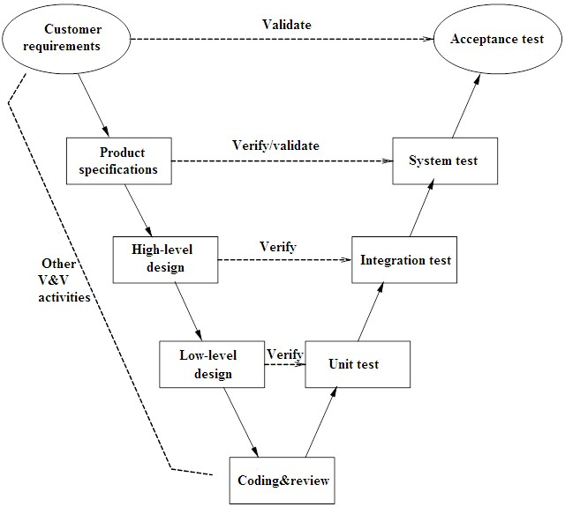
Test Model

Slide 62
Test Type
Unit Testing: Developers
Integration Testing: Testers
System Testing: Testers
Acceptance Testing: our friends

Slide 63
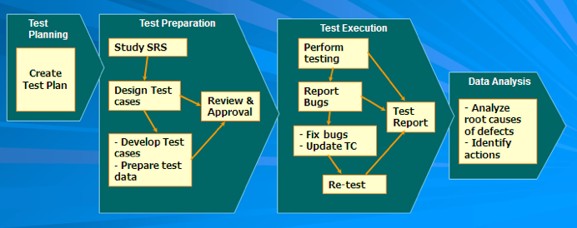
Test Process

Slide 64
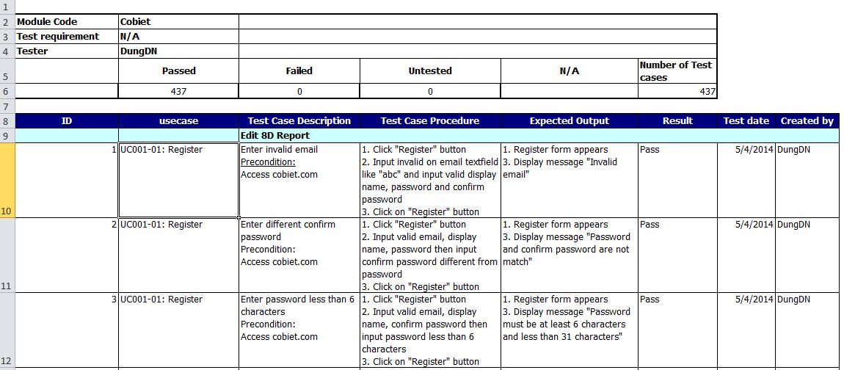
Test Case

Slide 65
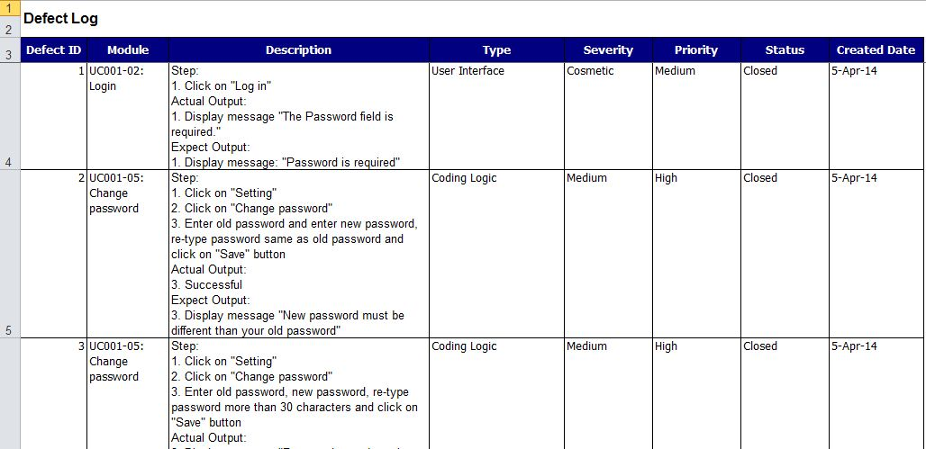
Defect Log

Slide 66
Tools and Environments
Purpose | Tools/Environment | Version | Source
Access to web for user | Chrome | 33 | Google
 | Firefox | 28 | Mozilla
Test Report | Microsoft Word Office | 2010 | Microsoft
Test Plan | Microsoft Word Office | 2010 | Microsoft
Test Case | Microsoft Excel | 2010 | Microsoft
Test Log | Microsoft Excel | 2010 | Microsoft

Slide 67
Test Report
Module | Pass | Fail | Untested | Test Case
System Testing | 402 | 41 | 0 | 443
GUI Testing | 128 | 0 | 0 | 128
Total | 530 | 41 | 0 | 571

Slide 68
Project Result

Slide 69
Project Result
New technologies have been applied successfully
Completed objective as plan
Have more experiences and skill:
  Team work
  Solve conflict
  Technical

Slide 70
Comparison
Main objective | Develop interesting fact – a social network that can share information that people want to read. Create an mechanism that could rank a post.
Purpose | Provide both admin and member function in website
 | Plan | Actual
Releases Date | 11/04/2014 | 16/04/2014
Releases version | 1.0 | 1.0
Days | 83 | 88
Test cases | 400 | 571
Defects | 30 | 41
Document pages | 250 | 343
Lines of code | 5000 | 10000

Slide 71
Limitation & Expectation
Limit
  Do not have GUI for smart phone
  Reduced system speed due to a large number of calculation
Expectation
  Continue improving lifetime mechanism
  Add more function to website as video, sound, location…

Slide 72
Demo

Slide 73
Thank you for your listening

